Slide 1









Simulation of Compound Flooding using River-Ocean Two-way Coupled E3SM Ensemble on Variable-resolution Meshes
Integrated Coastal Modeling
Dongyu Feng (PNNL)
Zeli Tan, Donghui Xu, Chang Liao,
Gautam Bisht, Tian Zhou, Ruby Leung (PNNL)
Darren Engwirda , Jon Wolfe, Jim Benedict (LANL)
Hong-Yi Li (University of Houston)
ESMD group
ICoM is funded by multiple programs in the Earth and Environmental Systems Sciences Division of DOE’s Office of Science

Slide 2
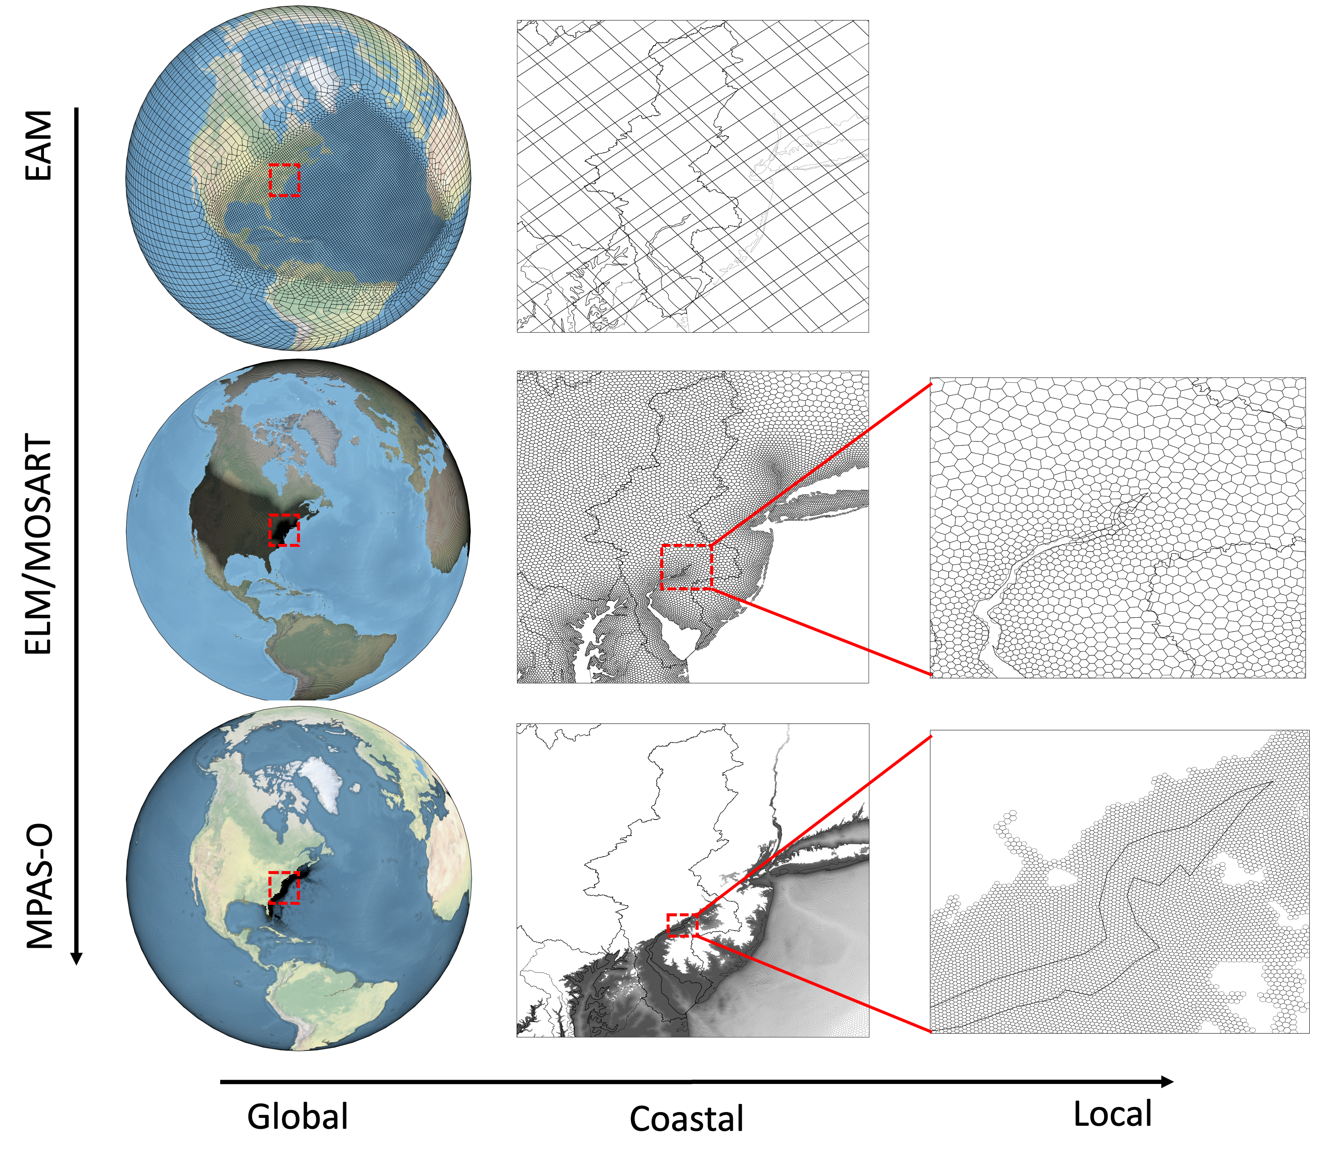
Coupled E3SM framework for coastal extremes
O(25km)
O(5km)
variable-resolution meshes
land-river-ocean two-way coupling
O(250m)
wetting and drying
barotropic tides
Notes:
Develop a fully-coupled E3SM configuration that integrates new physics capabilities, fundamental model formulation and numerical methods
multi-scale trigrid configuration

Slide 3
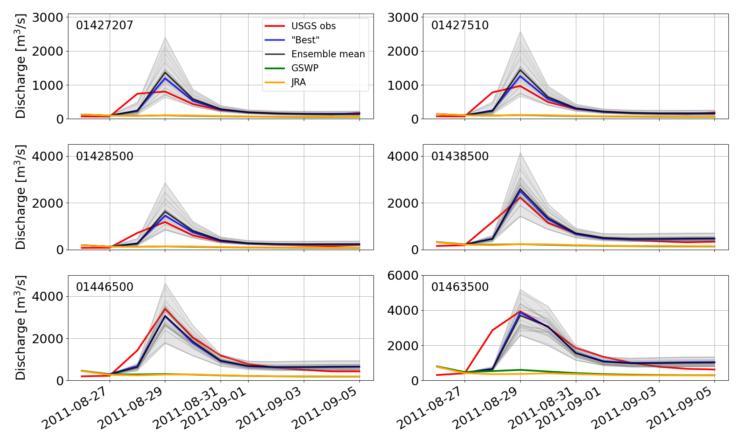
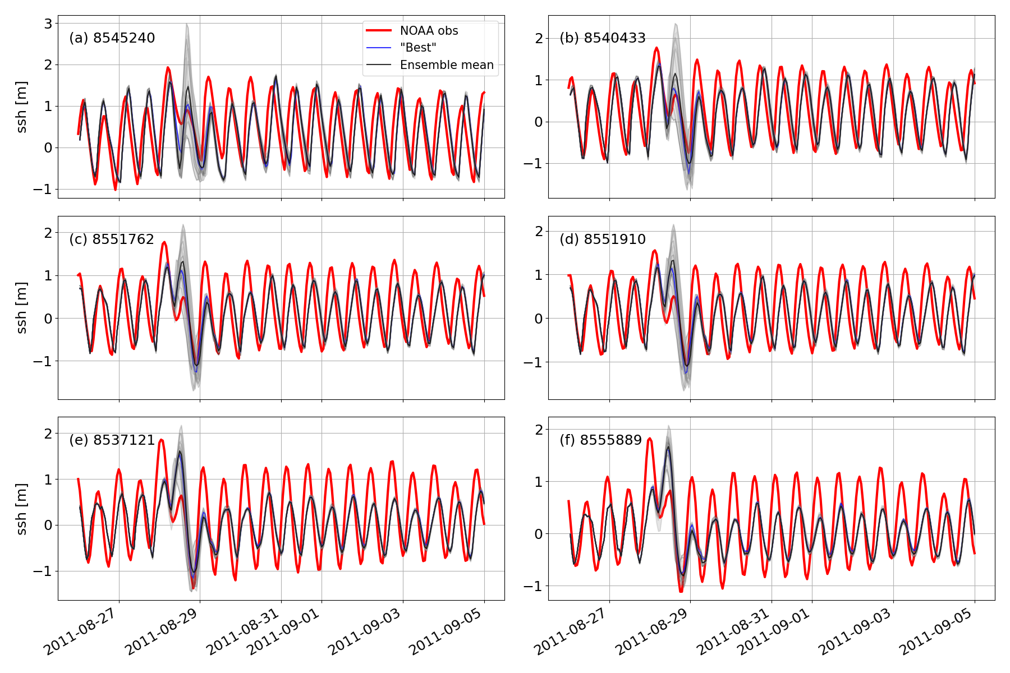
Resolved river‐estuary-ocean dynamics in TCs
Perform multi-ensemble E3SM simulations to assess an extreme TC in the Mid-Atlantic region
  The novel E3SM configuration improves the simulation of river discharge and SSH.
  The two‐way river‐ocean coupling improves the representation of coastal backwater effects at the river-ocean interface.

Slide 4
Reference
Feng, D., Tan, Z., Engwirda, D., Wolfe, J.D., Xu, D., Liao, C., Bisht, G., Benedict, J.J., Zhou, T., Li, H.Y. and Leung, L.R., 2024. Simulation of compound flooding using river‐ocean two‐way coupled E3SM ensemble on variable‐resolution meshes. Journal of Advances in Modeling Earth Systems, 16(6), p.e2023MS004054.
Feng, D., Tan, Z., Engwirda, D., Wolfe, J.D., Xu, D., Liao, C., Bisht, G., Benedict, J.J., Zhou, T., Deb, M., Li, H.Y. and Leung, L.R., 2024. Disentangling Atmospheric, Hydrological, and Coupling Uncertainties in Compound Flooding Modeling within a Coupled Earth System Model. In prep.
Xu, D., Bisht, G., Feng, D., Tan, Z., Li, L., Qiu, H., and Leung, L.R., 2024. Impacts of Sea-Level Rise on Coastal Groundwater Table Simulated by an Earth System Model With a Land-Ocean Coupling Scheme. Earth’s Future. Accepted.
Feng, D., Tan, Z., Engwirda, D., Liao, C., Xu, D., Bisht, G., Zhou, T., Li, H.Y. and Leung, L.R., 2022. Investigating coastal backwater effects and flooding in the coastal zone using a global river transport model on an unstructured mesh. Hydrology and Earth System Sciences, 26(21), pp.5473-5491.
Deb, M., Benedict, J.J., Sun, N., Yang, Z., Hetland, R.D., Judi, D. and Wang, T., 2024. Estuarine hurricane wind can intensify surge-dominated extreme water level in shallow and converging coastal systems. Natural Hazards and Earth System Sciences, 24(7), pp.2461-2479.
Pal, N., Barton, K.N., Petersen, M.R., Brus, S.R., Engwirda, D., Arbic, B.K., Roberts, A.F., Westerink, J.J. and Wirasaet, D., 2023. Barotropic tides in MPAS-Ocean (E3SM V2): impact of ice shelf cavities. Geoscientific Model Development, 16(4), pp.1297-1314.
Barton, K.N., Pal, N., Brus, S.R., Petersen, M.R., Arbic, B.K., Engwirda, D., Roberts, A.F., Westerink, J.J., Wirasaet, D. and Schindelegger, M., 2022. Global barotropic tide modeling using inline self‐attraction and loading in MPAS‐Ocean. Journal of Advances in Modeling Earth Systems, 14(11), p.e2022MS003207.
Liao, C., Zhou, T., Xu, D., Cooper, M.G., Engwirda, D., Li, H.Y. and Leung, L.R., 2023. Topological relationship‐based flow direction modeling: Mesh‐independent river networks representation. Journal of Advances in Modeling Earth Systems, 15(2), p.e2022MS003089.
Liao, C., Zhou, T., Xu, D., Tan, Z., Bisht, G., Cooper, M.G., Engwirda, D., Li, H.Y. and Leung, L.R., 2023. Topological relationship‐based flow direction modeling: Stream burning and depression filling. Journal of Advances in Modeling Earth Systems, 15(11), p.e2022MS003487.
Xu, D., Bisht, G., Zhou, T., Leung, L.R. and Pan, M., 2022. Development of land‐river two‐way hydrologic coupling for floodplain inundation in the energy exascale Earth system model. Journal of Advances in Modeling Earth Systems, 14(8), p.e2021MS002772.

