Slide 1
Reproducible Integrated Multisectoral, Multi-model Frameworks – Lessons Learned from IM3
(It Takes a Village…and a Mayor)
Jennie S. Rice, Casey D. Burleyson, Casey McGrath, Kendall Mongird, Em Rexer, Travis Thurber, Chris R. Vernon (all PNNL)

Slide 2
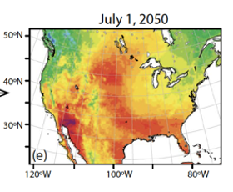
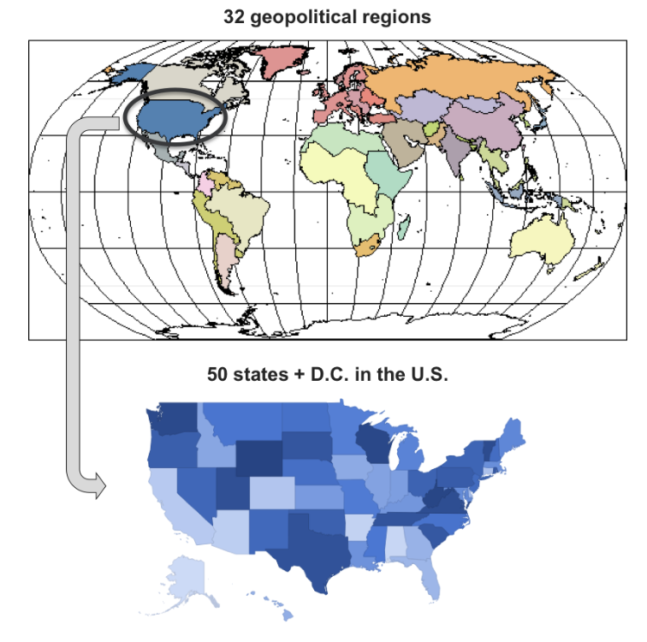
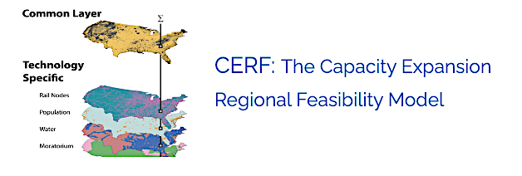
Integrated Multisector, Multiscale Modeling Example
How will the price of electricity, power outages, and the infrastructure landscape be affected by future climate, energy system transitions, multisectoral energy-water-land-economy interactions, and socioeconomics?
Thermodynamic Global
Warming Scenarios
GCAM-USA
Global/
National
Socioeconomic
Projections
(SSP3 and SSP5)
Infrastructure Siting
Mongird et al. in prep; Akdemir et al. in prep;
Wild et al. in prep
Local

Slide 3
The Real Work of Integrated Modeling is in the Arrows
How will the price of electricity, power outages, and the infrastructure landscape be affected by future climate, energy system transitions, multisectoral energy-water-land-economy interactions, and socioeconomics?
(SSP3 and SSP5)

Slide 4
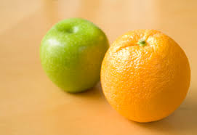
Key Challenges For Multi-Model Integration and Reproducibility
Many best-in-class models used in the project were designed originally for standalone use by a specific community of users
Differences in spatial, temporal, and process resolution between models
A large team across eleven collaborating institutions
Varying levels of software engineering expertise across collaborators
Terminology/jargon differences across subject matter areas; You don’t know what you don’t know
Disparate experiences with open science
Transitioning from desktop to HPC environment
Time and resources to manage QA/QC and integration
Documenting the complexity
Structural: management, funding, staffing, resources
“But I always use MATLAB!”

Slide 5
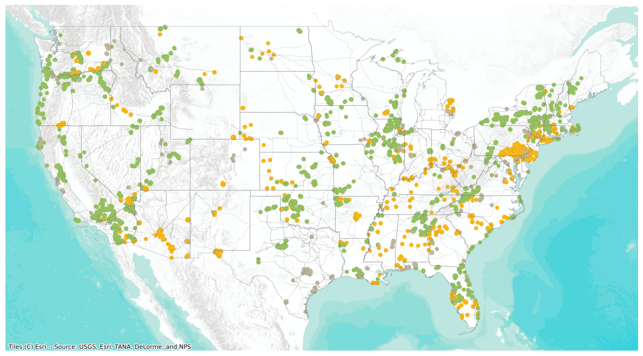
Data Extraction/Transformation Example: GCAM-USA to CERF (State-level Capacity Expansion Plan to On-the-ground Power Plant Sitings)
GCAM-USA
Convert
New Vintage Annual Energy Generation to Capacity by tech and state
New Vintage Capacity to # of power plants by technology and state
Account for solar and wind resource availability
Retirement Schedule to individual power plant retirements by state
Extract
Variable costs by tech
Plant lifetime
Fuel costs and fuel cost escalation
Carbon prices (if RCP4.5)
Emissions content of fuels
CCS efficiency
Key Challenges
GCAM-USA extraction tools and data structures not designed for these needs
Terminology and variable name misunderstandings between teams
Harmonizing assumptions implicit in GCAM input data (e.g., unit size)

Slide 6
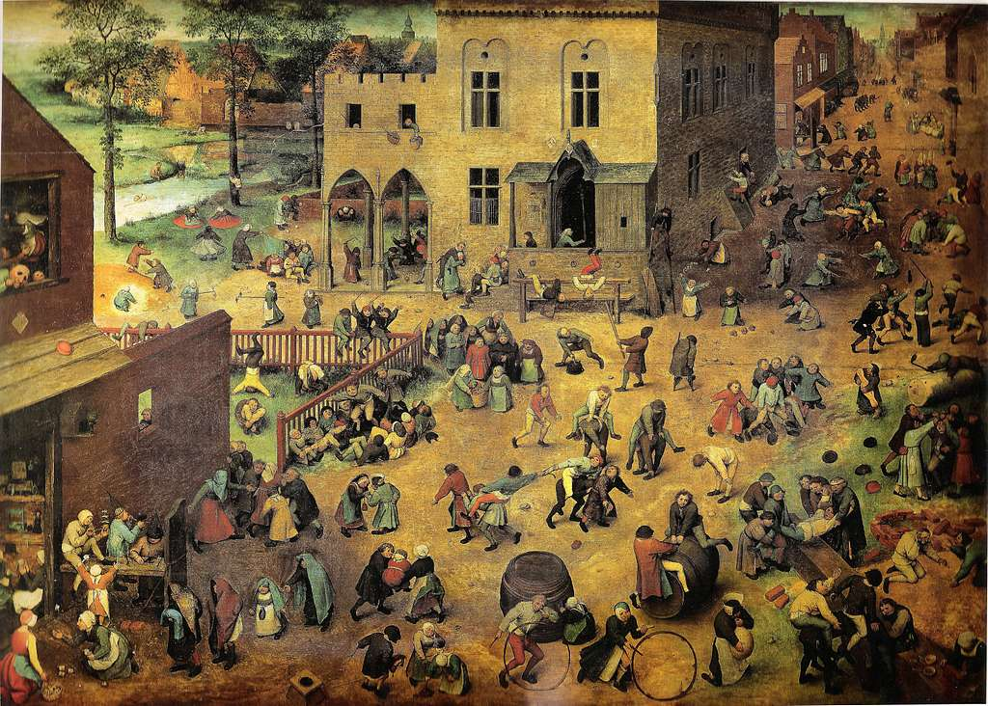
Lesson Learned #1: It Takes a Village
Multisectoral “translators” needed to converge the jargon
Scientists from each model willing to work together and co-develop the transformation scripts
All: Defining the variables needed in sufficient detail so that data transformation scripts can be written
Software engineers to support the data transformations and sometimes optimize/refactor code
Experts to design QA/QC for model outputs and for outputs of data transformation scripts—especially for first time coupling
Multisectoral review panels to bring different perspectives in QA/QC
Data management experts to mint the datasets and code versions; detailed metadata; MSD-LIVE
Collaboration experts (e.g., Slack channels devoted to each arrow

Slide 7
Lesson Learned #2: …and a “Mayor”
PI/Experiment Lead Role:
Require open source – all data, models, tools, solvers, etc.
Require workflow documentation – the meta-repository
Work with the team to translate the science question into the necessary multi-model workflow
Be accountable for the entire modeling chain – or delegate this
Be hands-on: go into “the weeds” to help team identify and resolve issues while keeping an eye on the larger picture

Slide 8
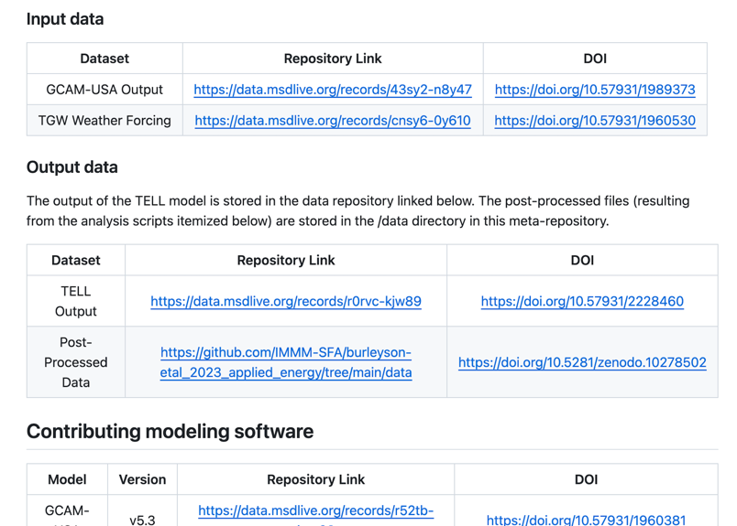
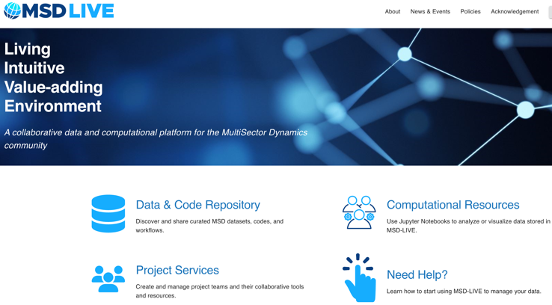
Leading Open Source and Fair Data Approaches for MSD Community
IM3 developed the concept of a “meta-repository” to accompany each submitted manuscript (Vernon, C.R. 2023) https://immm-sfa.github.io/metarepo/
IM3 requires all open-source code, data, and tools – no exceptions
IM3 ideas and data management objectives led to MSD-LIVE project led by Casey Burleyson
Reviewer feedback: "I agree that this paper should be deemed fully reproducible and given the highest rating for reproducibility."

Slide 9
Thank you jennie.rice@pnnl.gov

