Slide 1
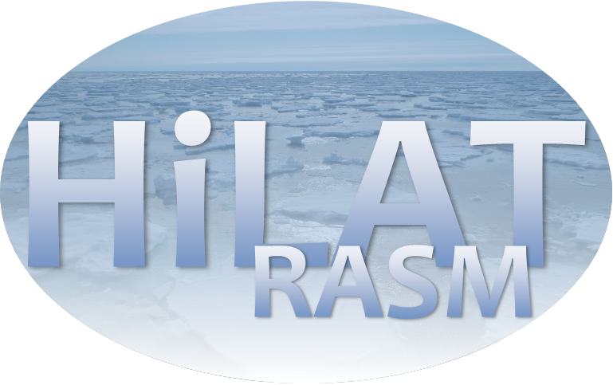
Benchmarking simulated sea-ice in ESMs: objective assessment of sector scale sea ice – Thu #117
Ana Ordonez¹, Jiwoo Lee¹, Paul J. Durack¹, Peter J. Gleckler¹, Karl E. Taylor¹, Kristin Y. Chang¹, Katherine M. Smith²
¹Lawrence Livermore National Laboratory, ²Los Alamos National Laboratory
DOE EESM PI Meeting North Bethesda, Washington DC
August 2024
LLNL-POST-867365
This work was performed under the auspices of the U.S. Department of Energy by Lawrence Livermore National Laboratory under contract DE-AC52-07NA27344. Lawrence Livermore National Security, LLC

Slide 2
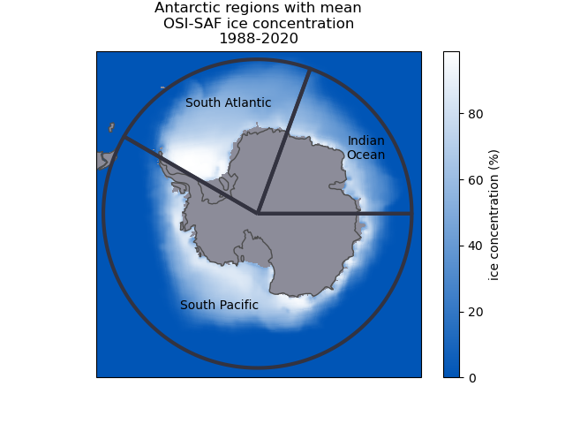
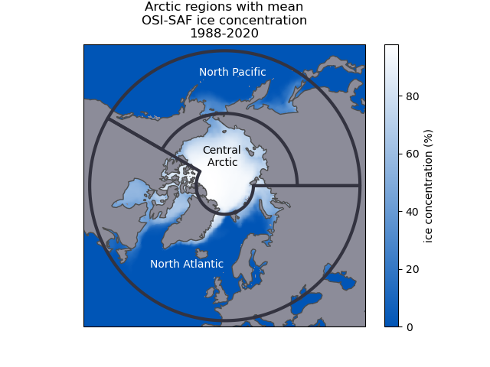
Moving beyond hemispheric sea ice extent
Developed for the HiLAT/RASM CAMAS workshop PCMDI Metrics Package (PMP) tutorial, Santa Fe, February 2024
Total hemispheric sea ice area is a routine way of large scale evaluation
Hemisphere-scale assessments hide important compensating errors across basins
Sector-based approach alleviates deficiencies in hemispheric analysis
Analysis aligns sea ice behavior to basins, elucidating ocean bias relationships with sea ice

Slide 3
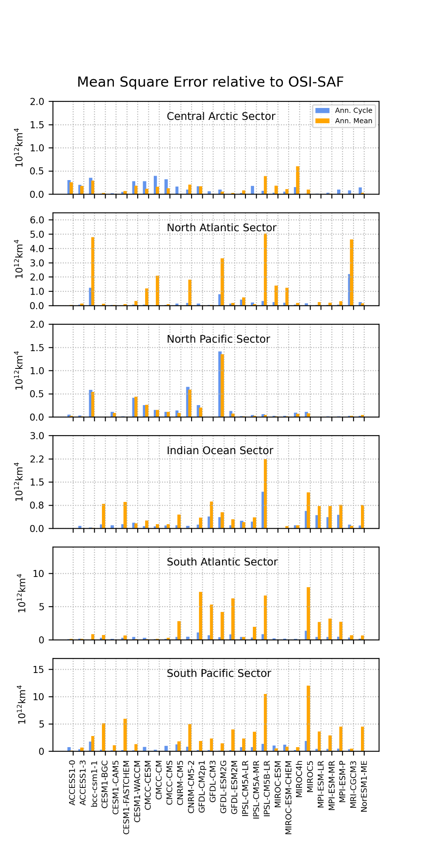
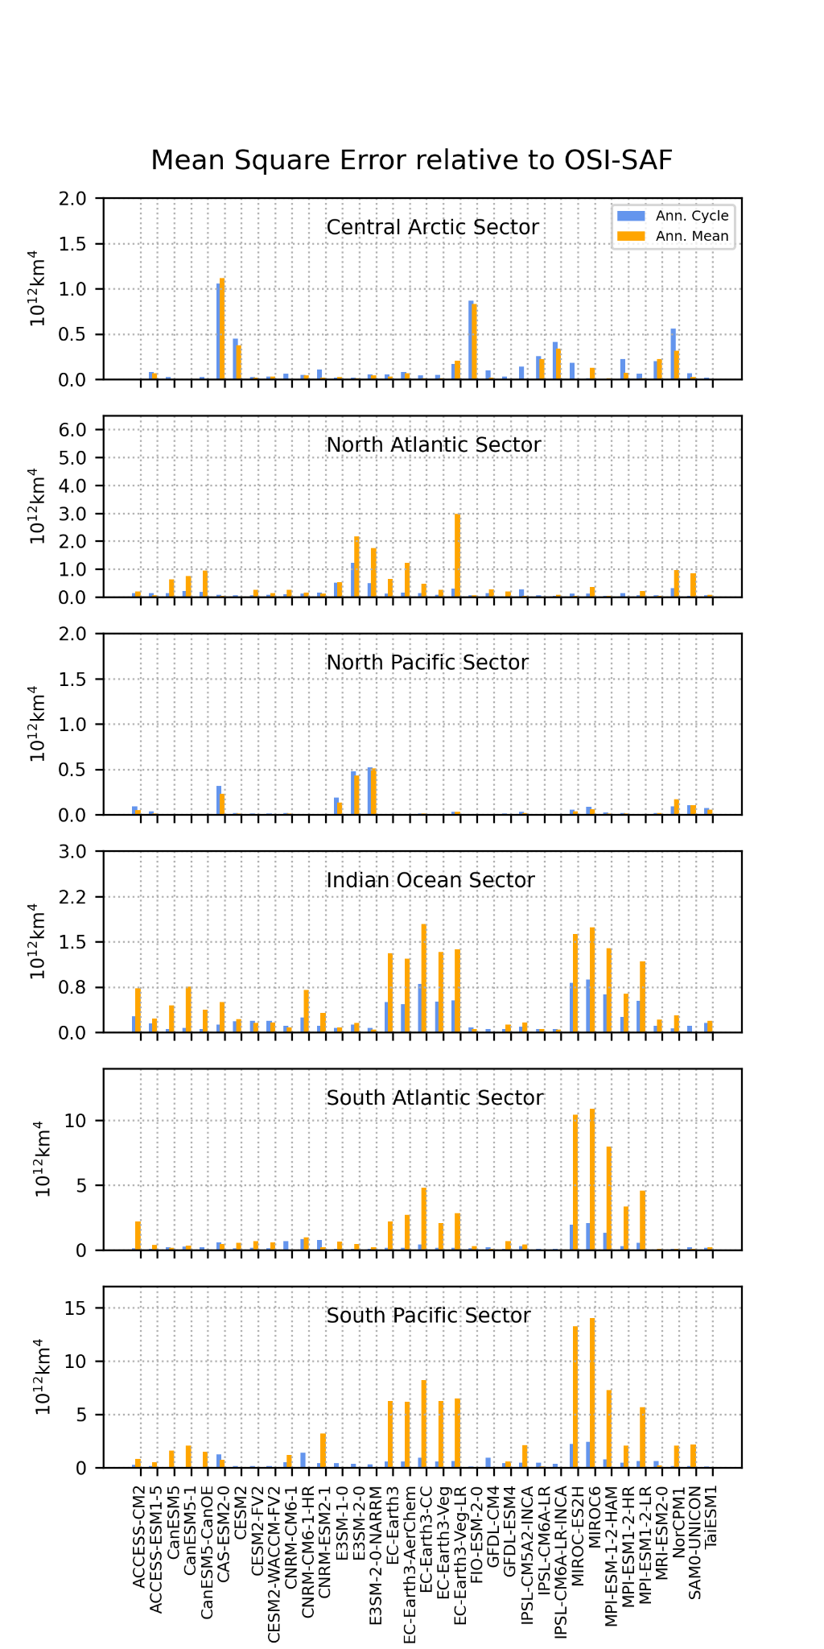
Behaviors across CMIP5 and CMIP6 models
CMIP5
CMIP6
Target well observed 1988-2005 period, with temporal coverage across CMIP5 and CMIP6 historical
Little evidence of systematic improvement CMIP5 -> CMIP6 – but true for multi-model mean
Qualitative improvement in Arctic sea ice – smaller magnitude errors
Some qualitative improvement in Antarctic sea ice – select models
Implemented in PMP, in preparation for CMIP7 – Rapid Evaluation Framework (REF)

Slide 4
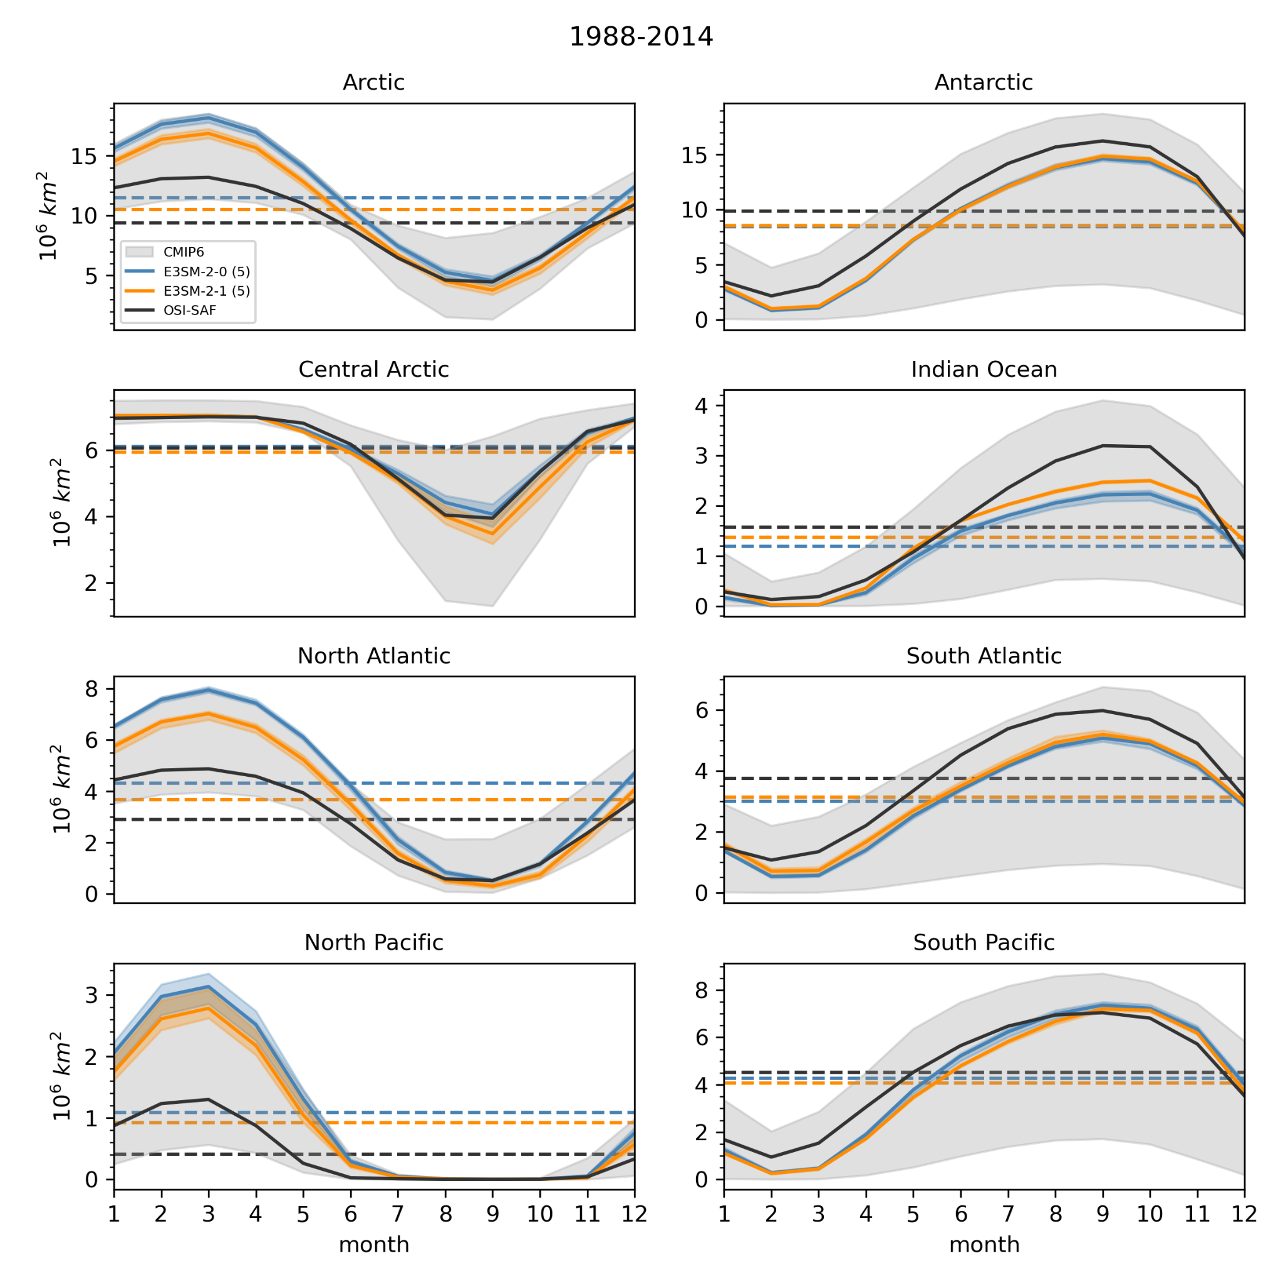
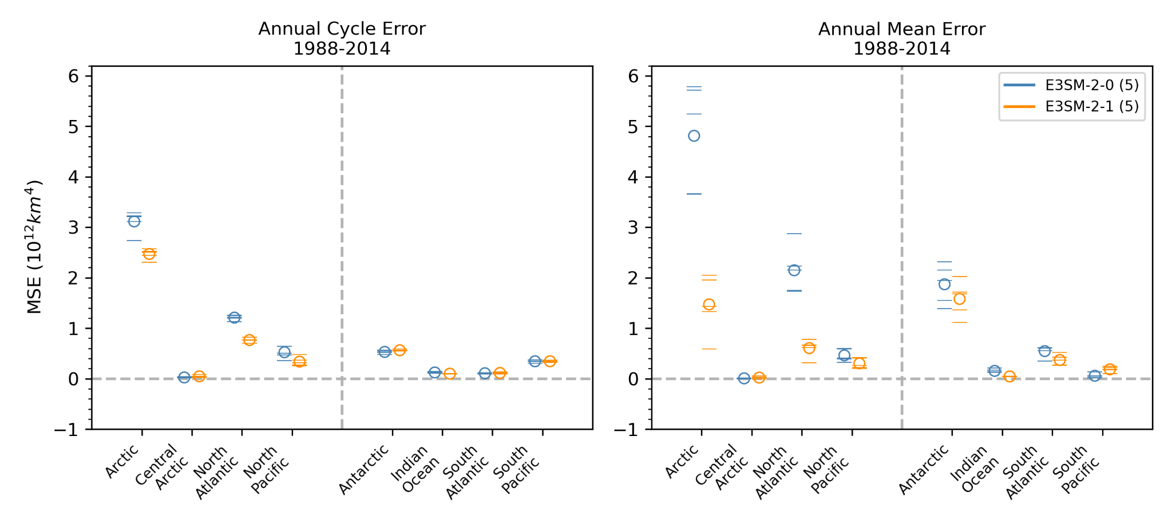
Improvements E3SMv2 vs E3SMv2.1
Ocean eddy parameterization amongst other updates E3SM2.0 -> 2.1
Significant multi-ensemble climatological seasonal improvements toward observed state in both hemispheres (left)
Reduced absolute errors compared to observations, all sectors (below)
Better

Slide 5
Paul J. Durack
PCMDI, LLNL
durack1@llnl.gov
Jiwoo Lee
PCMDI, LLNL
lee1043@llnl.gov
Disclaimer
This document was prepared as an account of work sponsored by an agency of the United States government. Neither the United States government nor Lawrence Livermore National Security, LLC, nor any of their employees makes any warranty, expressed or implied, or assumes any legal liability or responsibility for the accuracy, completeness, or usefulness of any information, apparatus, product, or process disclosed, or represents that its use would not infringe privately owned rights. Reference herein to any specific commercial product, process, or service by trade name, trademark, manufacturer, or otherwise does not necessarily constitute or imply its endorsement, recommendation, or favoring by the United States government or Lawrence Livermore National Security, LLC. The views and opinions of authors expressed herein do not necessarily state or reflect those of the United States government or Lawrence Livermore National Security, LLC, and shall not be used for advertising or product endorsement purposes.

Slide 6
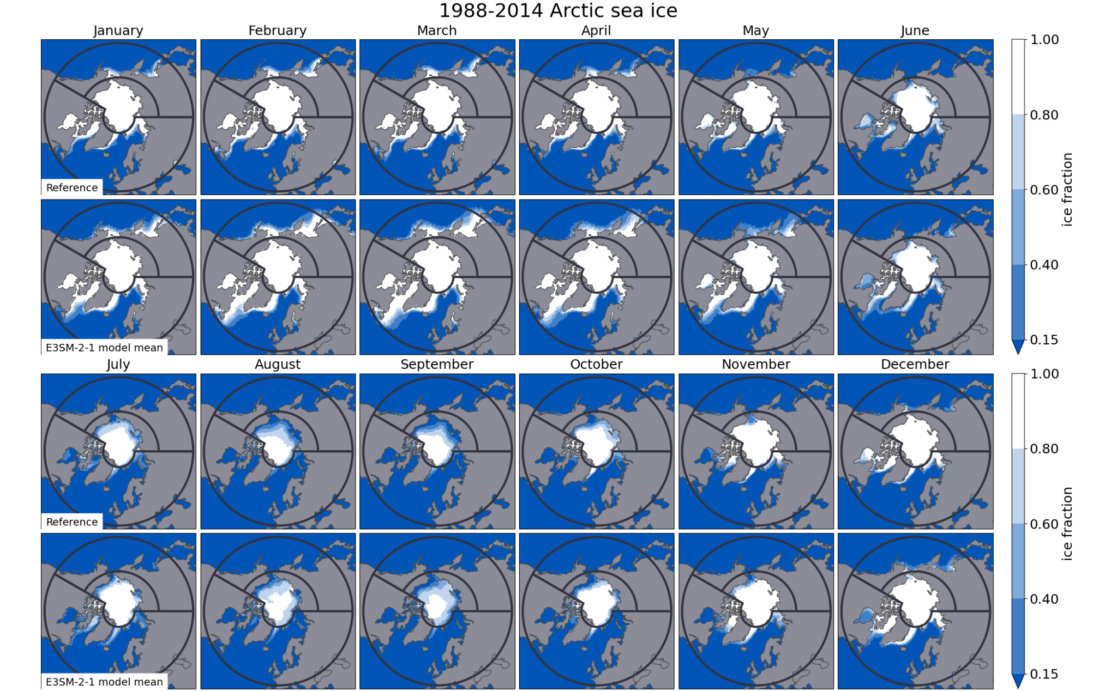
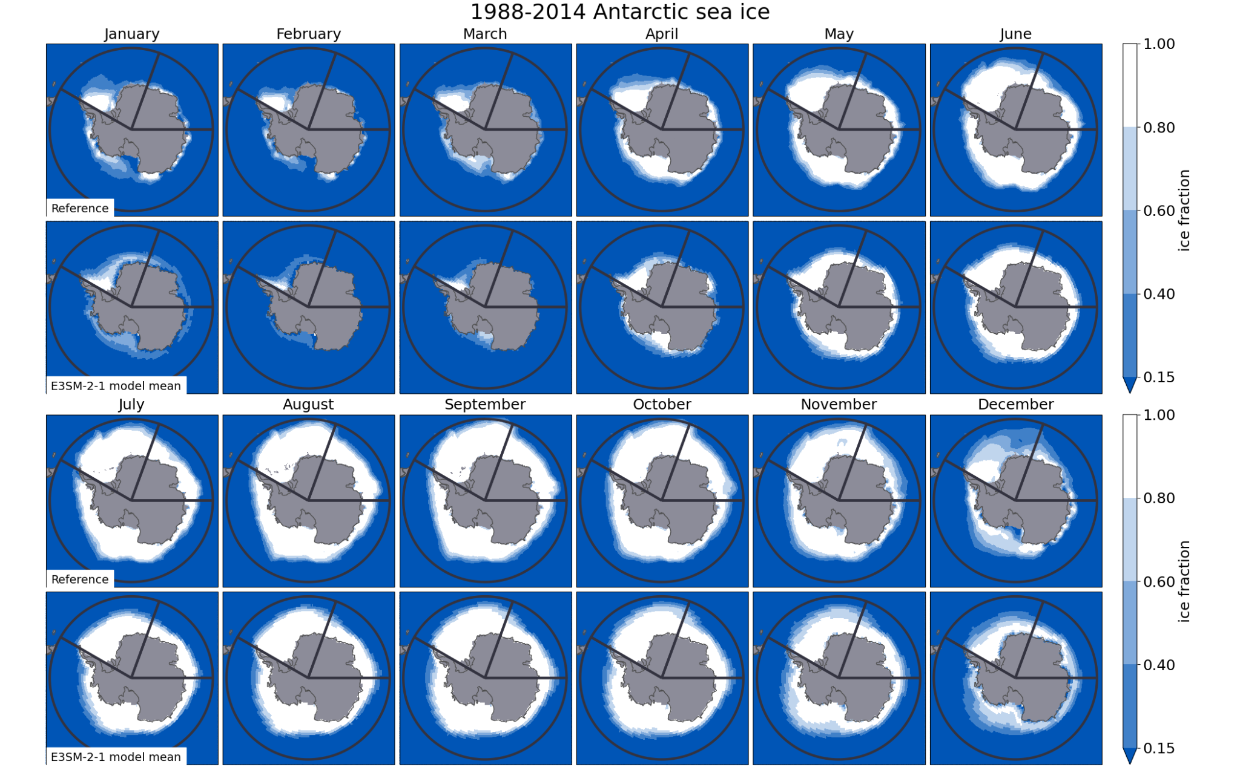
Improvements E3SMv2 vs E3SMv2.1
Total sea ice area

