Slide 1
CMIP7 the next phase: ongoing status and planning – Thu #116
Paul J. Durack¹, Karl E. Taylor¹, Jiwoo Lee¹, Sasha K. Ames^{1,2}, Chris C. Mauzey¹, Peter J. Gleckler¹ and Forrest Hoffman^{2,3} WIP and CMIP Panels and Task Teams
¹Program for Climate Model Diagnosis and Intercomparison,
²Earth System Grid Federation 2 – US, ³Oak Ridge National Laboratory/RUBISCO
LLNL-POST-867485
This work was performed under the auspices of the U.S. Department of Energy by Lawrence Livermore National Laboratory under contract DE-AC52-07NA27344. Lawrence Livermore National Security, LLC
DOE EESM PI Meeting North Bethesda, Washington DC
August 2024

Slide 2
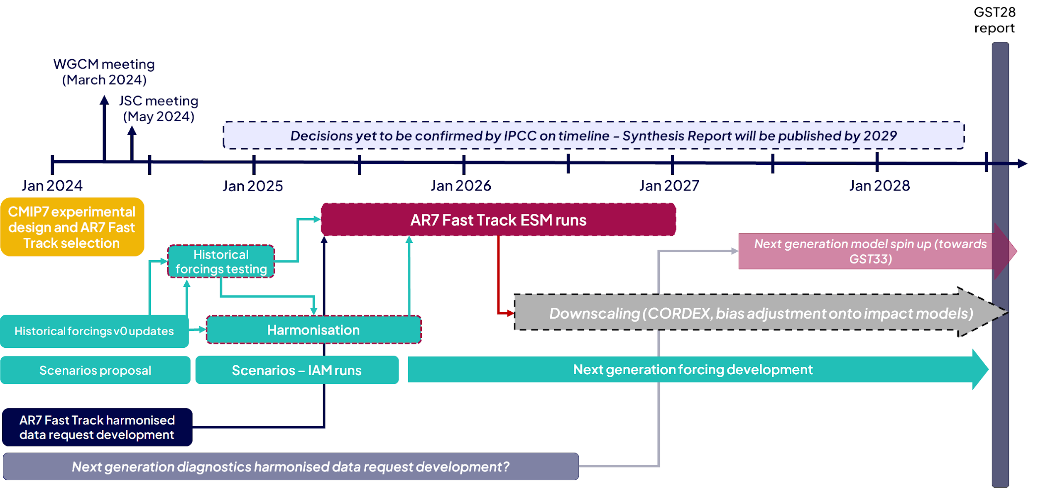
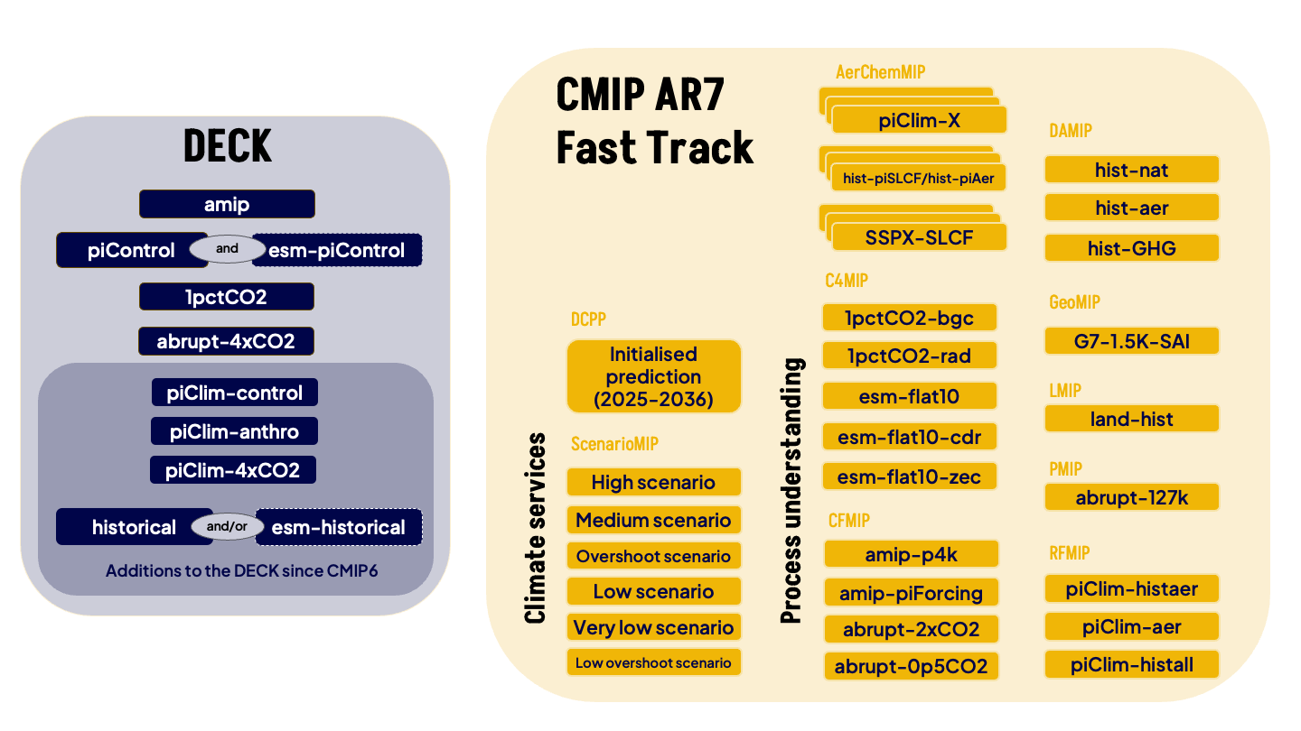
CMIP7 take home points
CMIP7 - starts with AR7 Fast Track ~2025-26
CMIP DECK, 8 experiments - model evaluation
+MIPs plus ~50 experiments - model sensitivity (AerChemMIP, C4MIP, CFMIP, LMIP, GeoMIP, PMIP, RFMIP) - model forcing responses (C4MIP, DAMIP, ScenarioMIP)
~5 PB of simulation data
Science: forcing responses, extremes, carbon cycle, tipping points
+33 additional MIPs identified for broader CMIP7 phase, broadening science focus
Engagement opportunities - many

Slide 3
DECK: expanding core model evaluation experiments
CMIP DECK provides key experiments to evaluate simulation fidelity, linking model performance and improvement across CMIP phases
Added historical – key evaluation experiment
Added RFMIP piClim-* atmospheric-only experiments to quantify radiative impacts and feedbacks to forcing
Added esm-* emissions-driven experiment variants

Slide 4
CMIP7: engagement opportunities
CMIP7 model documentation – community feedback – 12 August 2024 - https://wcrp-cmip.org/essential-model-documentation-feedback-wanted/
CMIP7 data request – what model data will be collected for what MIPs/experiments – 8 September 2024 - https://wcrp-cmip.org/have-your-say-on-the-cmip7-variables/
CMIP7 model benchmarking – See Forrest/Jiwoo
Forcings workshop – 28-31 October 2024 - evaluating next-generation forcing and working toward “sustained” regular updates ~annually https://wcrp-cmip.org/event/forcings-workshop/

Slide 5
Climate forcing and observations for evaluation
CMIP7 will benefit from comprehensive climate forcing approach
CMIP Climate Forcing Task Team working on next-generation data addressing CMIP6 known issues
Quantify forcing uncertainty through forcing intercomparison, and identification of missing forcing agents
obs4MIPs working to serve coordinated model evaluation efforts of the CMIP Model Benchmarking Task Team
Engage observing communities across NASA, ESA, MetOffice, DLR, RSS … connecting observationalists to modelers

Slide 6
Better CMIP data access and availability
See Forrest!
ESGF2-US consortium will replicate CMIP7 data across multiple US-nodes (CMIP6, 5, 3 already copied)
ORNL
ANL
LLNL
Discussions underway at
NERSC (CESMAC data lake exists already)
NIMBUS-LLNL – prototype jupyterhub cluster at LLNL direct access to LLNL ESGF data

Slide 7
Paul J. Durack
PCMDI, LLNL
durack1@llnl.gov
Latest CMIP info at
https://bit.ly/CMIP-mailinglists
Disclaimer
This document was prepared as an account of work sponsored by an agency of the United States government. Neither the United States government nor Lawrence Livermore National Security, LLC, nor any of their employees makes any warranty, expressed or implied, or assumes any legal liability or responsibility for the accuracy, completeness, or usefulness of any information, apparatus, product, or process disclosed, or represents that its use would not infringe privately owned rights. Reference herein to any specific commercial product, process, or service by trade name, trademark, manufacturer, or otherwise does not necessarily constitute or imply its endorsement, recommendation, or favoring by the United States government or Lawrence Livermore National Security, LLC. The views and opinions of authors expressed herein do not necessarily state or reflect those of the United States government or Lawrence Livermore National Security, LLC, and shall not be used for advertising or product endorsement purposes.

