Slide 1
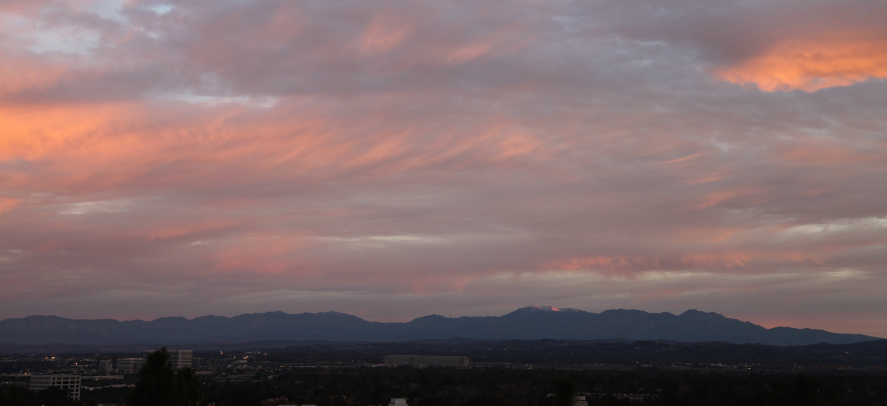

UCI 4 Jan 2010 0754h
Developing an efficient & accurate model of sunlight for use in all ACME components
Michael J. Prather, Juno Hsu,
Philip Cameron-Smith, Alex Nicolau, Alex Veidenbaum

Slide 2

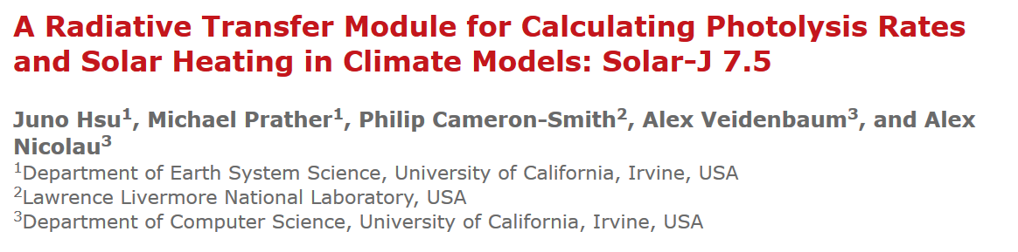
Subject: gmd-2017-27 (author) - manuscript accepted for final publication Date: Tue, 30 May 2017 15:50:56 +0200 (CEST) From: editorial@copernicus.org

Slide 3
Solar-J bins
RRTM-SW solar bins
Wavelength range # (nm) |  |  | Solar (W/m²)
28 | 200 | 263 | 3.12
27 | 263 | 345 | 50.15
26 | 345 | 441 | 129.5
25 | 441 | 625 | 347.2
24 | 625 | 778 | 218.1
23 | 778 | 1242 | 345.7
22 | 1242 | 1299 | 24.29
21 | 1299 | 1626 | 102.9
20 | 1626 | 1942 | 55.63
19 | 1942 | 2151 | 22.43
18 | 2151 | 2500 | 23.73
17 | 2500 | 3077 | 20.36
16 | 3077 | 3846 | 12.11
29 | 3846 | 12195 | 12.79
fast-J solar bins
# | Wavelength (nm) | Solar (W/m²) | PAR (µE)
1 | 187 | 0.01
2 | 191 | 0.02
3 | 193 | 0.02
4 | 196 | 0.01
5 | 202 | 0.08
6 | 208 | 0.04
7 | 211 | 0.09
8 | 214 | 0.11
9 | 261 | 4.84
10 | 267 | 2.97
11 | 277 | 2.23
12 | 295 | 3.97
13 | 303 | 5.03
14 | 310 | 3.23
15 | 316 | 5.59
16 | 333 | 22.98 | 3
17 | 380 | 80.45 | 125
18 | 412-850 | 696.40 | 2026
Fast-J would need to add 9 super-bins
which amounts to ~40 added calculations
Overlap bin #18 vs 24-25 (14 bins) will become Fast-J bins 18a,b,c,d,e.
Change Fast-J bin #18 to be 412-778 nm to assist overlap.

Slide 4
Solar-J disagrees with RRTMG-SW at 10% level in stratosphere:
we think this is their problem.
Solar-J disagrees with RRTMG-SW at 4% level in troposphere:
we know this is our problem.

Slide 5
STRATUS Cloud – pretty good, but bias

Slide 6
Solar-J disagrees with RRTMG-SW at 3-4% level in stratus radiative effect we think this is their problem (2-stream vs. 8 stream).
Solar-J vs. RRTMG. Radiative Effect of a Marine Stratus (W m⁻²) relative to Clear Sky.
SZA | 0° |  | 21° |  | 62° |  | 84°
Incid. Flux (Wm⁻²) | 1361 |  | 1268 |  | 634 |  | 139
 | Solar-J | RRTMG | Solar-J | RRTMG | Solar-J | RRTMG | Solar-J | RRTMG
TOA | +469 | +455 | +448 | +437 | +259 | +252 | +51 | +49
Atmosphere | +91 | +92 | +81 | +82 | +24 | +22 | -2 | -2
Surface | -560 | -546 | -529 | -518 | -283 | -274 | -49 | -47
Net TOA (W m⁻²) -14 -11 -7 -2

Slide 7
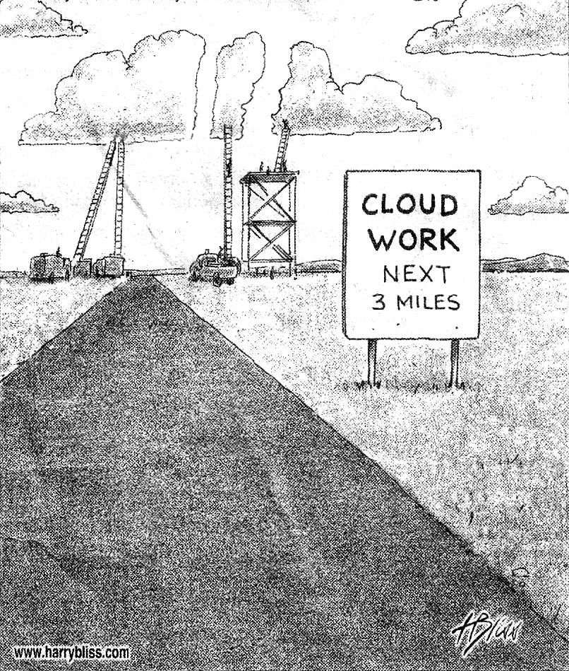

Slide 8
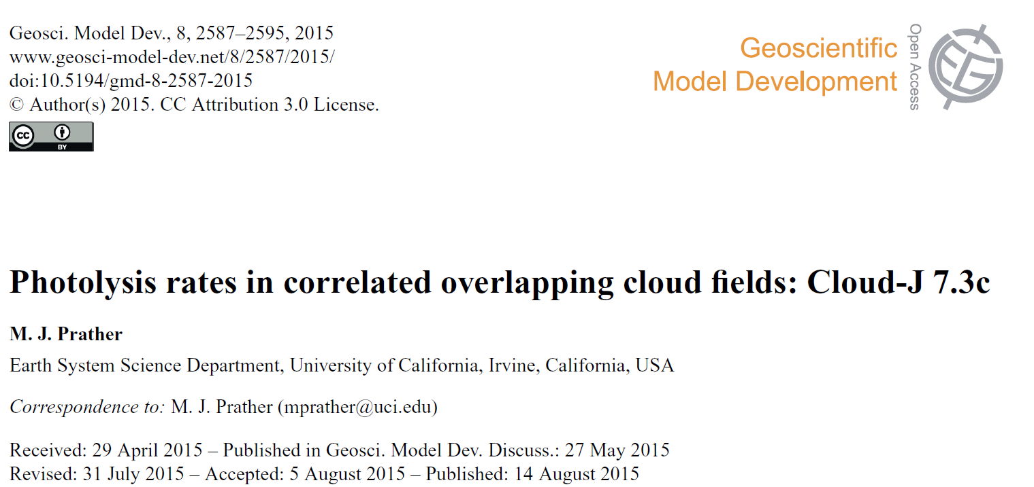
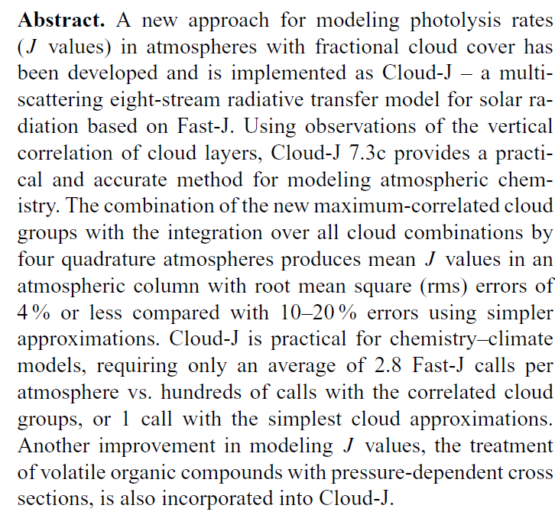
Fast-J & Cloud-J -- an update
Michael Prather

Slide 9

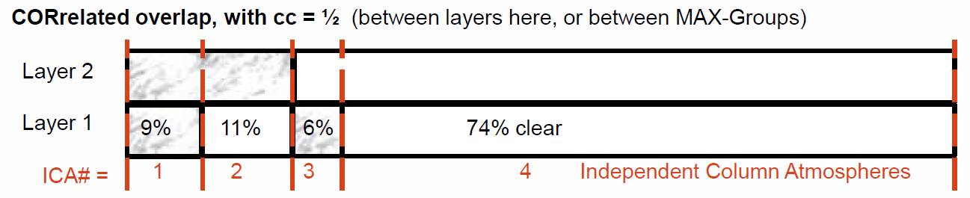

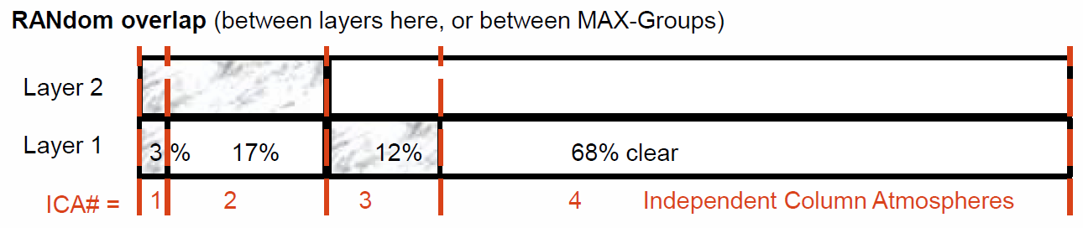

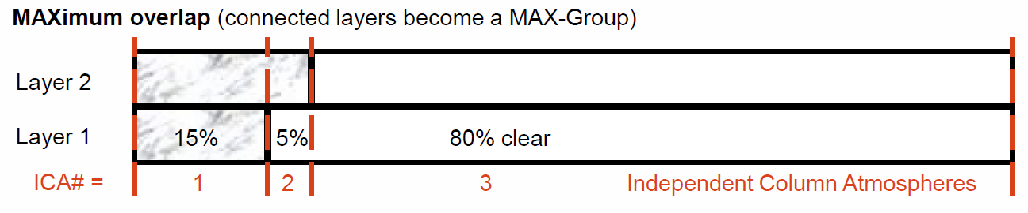
ICAs depend on overlap algorithm

Slide 10
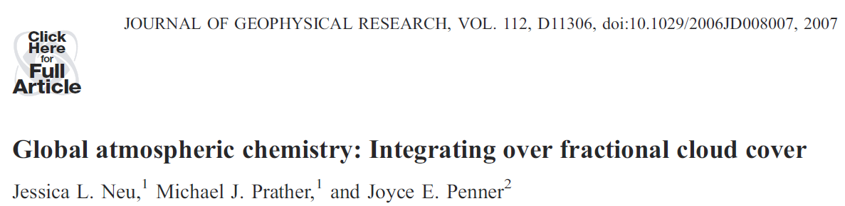
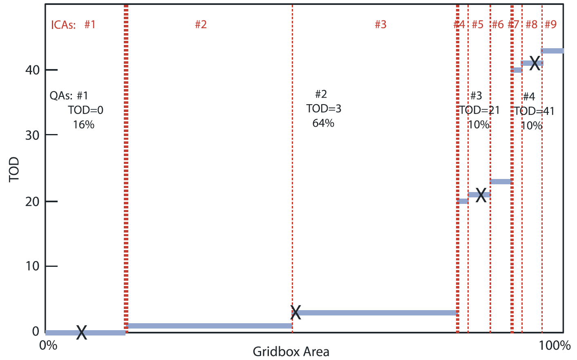
Cloud-JX
Cloud Quadrature picks 4 cloudy types
nearly clear cirrus stratus cumulus

Slide 11
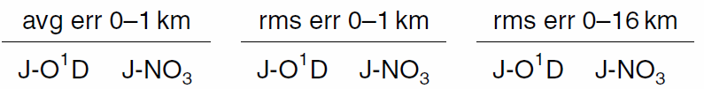
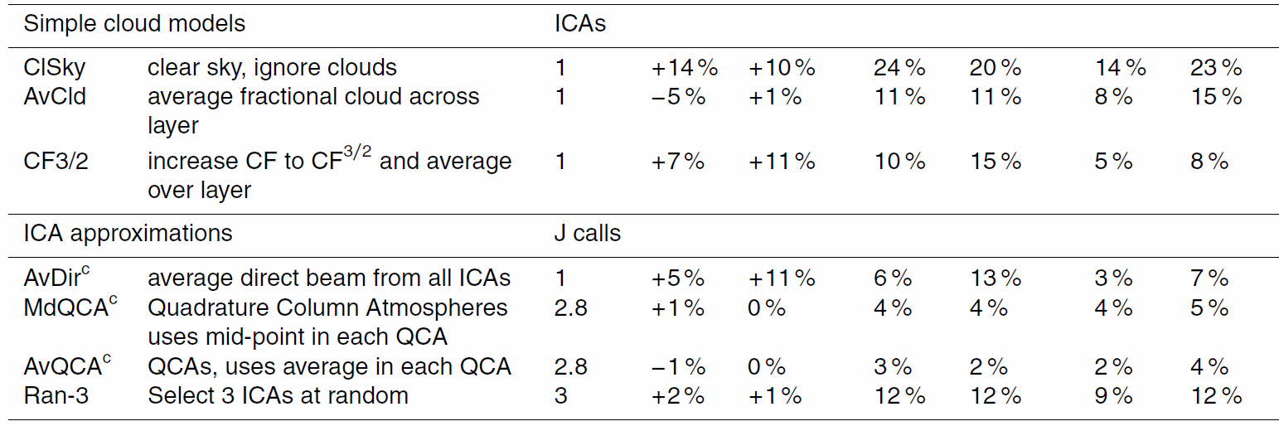
Solar-J. J-value average and root-mean-square error for approximating all ICAs
Simple cloud models all have large errors.
Either QCA models are best.
Averaging the direct beam over all ICAs did not work as well as expected.
Picking random ICAs (instead of the QCAs) is poor choice for rms error.

Slide 12
Error with ‘flat-Earth’ models start at SZA > 84º
Ozone photolysis rates (J_{O3}) from Solar-J (left) and atmospheric heating rates under clear sky (right) from both Solar-J (solid lines) and RRTMG (dashed lines, Hs ony) at large SZA and 4 different altitudes.
Current version(?) of RRTMG has heating rates reduce to zero at SZA= 90º due to the lack of spherical correction. Sphericity on the direct solar beam path is included in Solar-J.

Slide 13
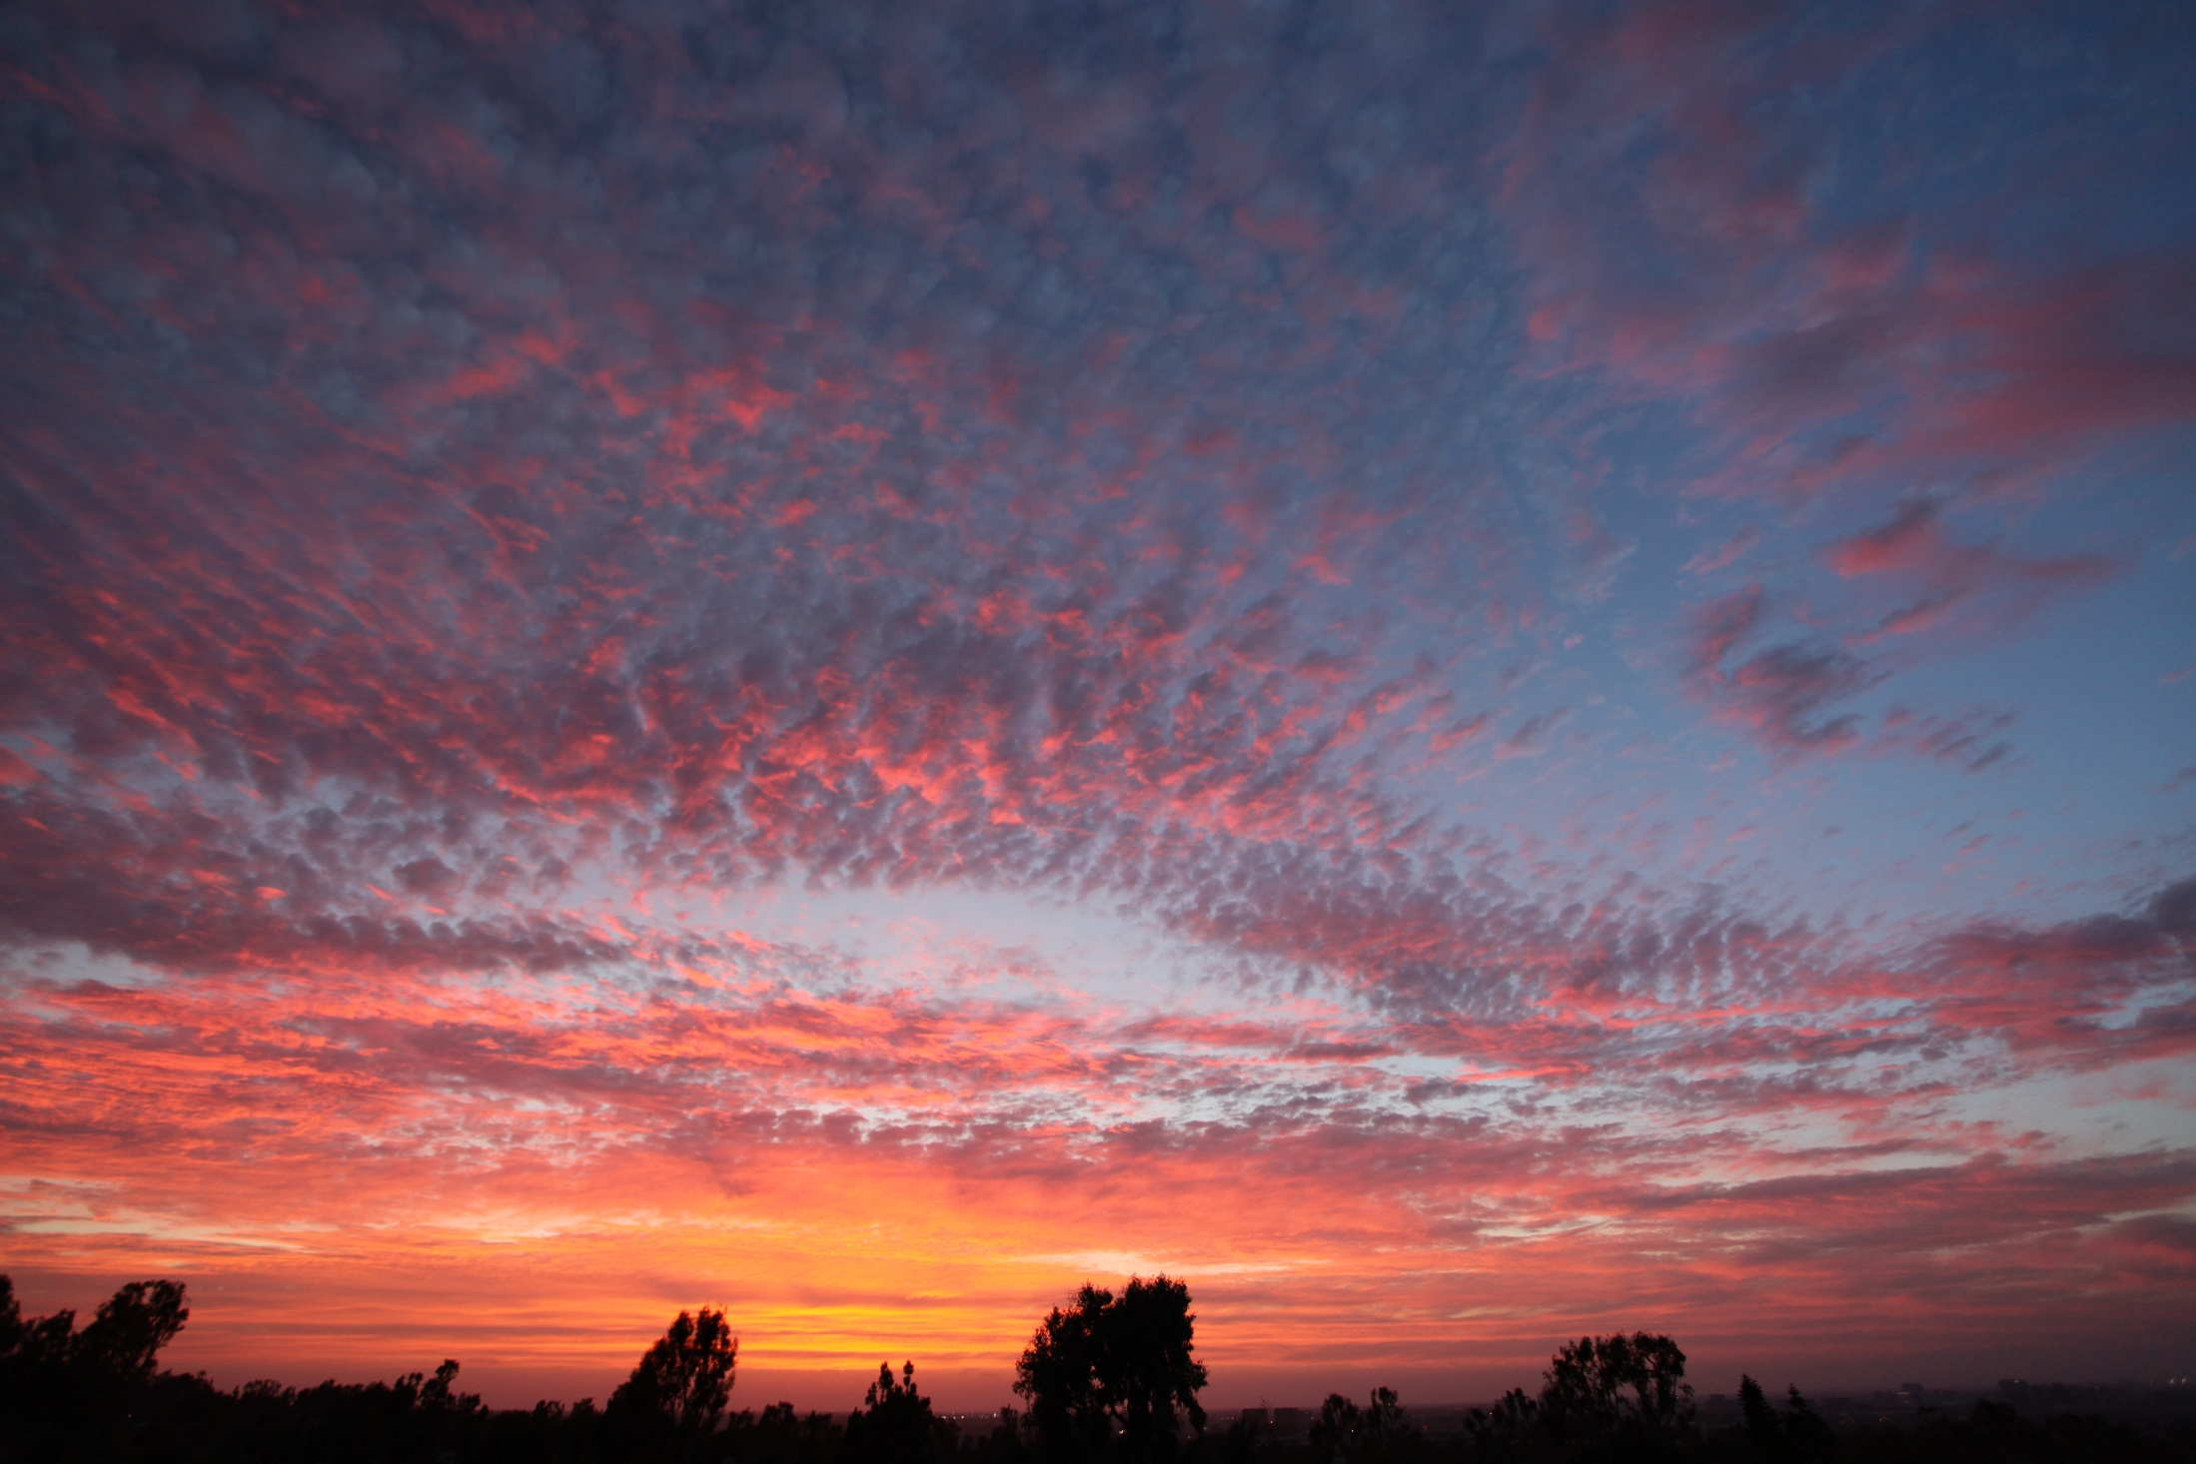
Even Solar-J will have trouble with J’s & H’s
for post-sunset cloud fields like these.

Slide 14
Links across ACME components to proposed Solar-J
System element | Input to Solar-J | Output from Solar-J
Atmospheric dynamics | T, q, clouds | Atmospheric heating rates
Cloud Super-Parameterization | Cloud structures | Internal cloud heating, cloud radiative forcing
Aerosols/Chemistry | Aerosols, ozone | Photolysis rates, aerosol radiative forcing
Land surface | Canopy optics (leaves, etc.) | Direct/diffuse PAR, surface heating
Upper ocean (<100 m) | Surface roughness, sediments, plankton, … | Angle-resolved radiative transfer and diurnal heating in upper ocean.

Slide 15
UNCERTAINTIES
Solar-J is, in many aspects, more accurate (and more costly) than RRTMG-SW. Solar-J has a balanced level of error across sources.
Solar-J RRTMG-SW
Output heating & photolysis rates heating rates
Stratus Cloud
8-stream RT 1-2%* 2-stream RT 4-10%
Clear sky heating (stratosphere)
Fast-J 0-4%* RRTMG ~10%
Clear sky heating (troposphere)
RRTMG adapted 1-4% RRTMG ~0%
High SZA (88-95°)
semi-spherical <5%* flat atmos. ??>5%
Fractional Cloud Cover
Cloud-J quad. 1-2% MC ICA ?? >10%
Reduced Precision
15-bit arithmetic 1-2%** standard R*8 0%
* Estimated values , for Solar-J it is based on previous model-model and model-measurement comparisons, for RRTMG it is relative to Solar-J or based on RRTMG publications.
** Not yet implemented.

Slide 16
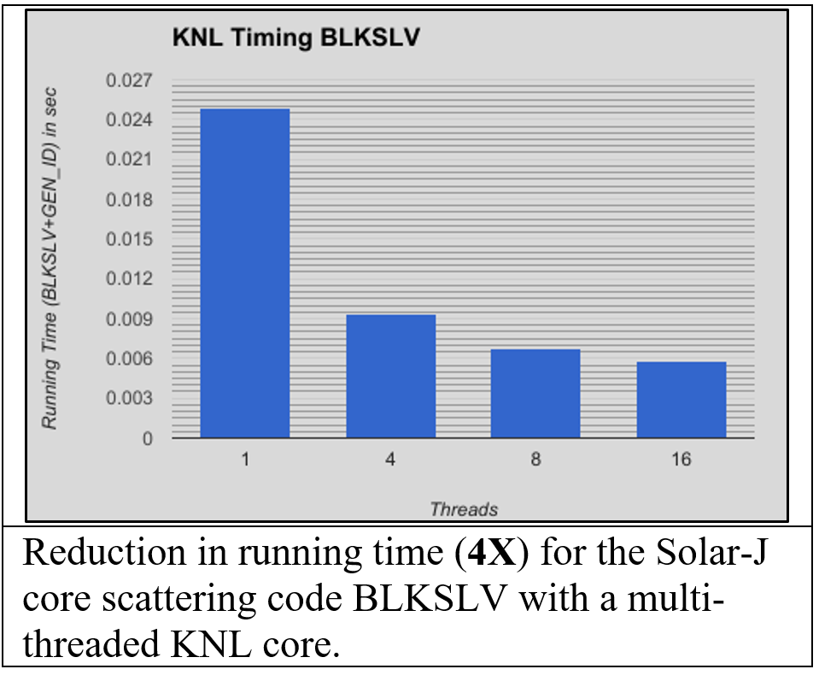
OPTIMIZATION
Computer Science
* GPU recoding of scattering core
* 15-bit arithmetic (?)
Spectral model for near-IR
* RRTM
* Grant & Grossman
* Chu & Suarez
* ….

Slide 17
Alternative near-IR spectral models for H₂O absorption tested in Solar-J.
RRTMG-SW visible-infrared spectral bins (used in Solar-J)* | LLNL (Grant & Grossman, 1998, Table 2) H₂O bands | CLIRAD-SW (Chou and Suarez, 1999, Tables 1&2) H₂O bands**
S19 (0.78-1.24 μm);10 sub-bins | Band 1 (0.69-0.86 μm) 2 k-distributions | Band 9 (0.7-1.22 μm) 10 k-distributions
S20 (1.24-1.30 μm); 2 sub-bins | Band 2 (0.86-2.27 μm) 6 k-distributions | Band 10 (1.22-2.27 μm) 10 k-distributions
S21 (1.30-1.63 μm);10 sub-bins
S22 (1.63-1.94 μm);10 sub-bins
S23 (1.94-2.15 μm); 8 sub-bins
S24 (2.15-2.50 μm); 8 sub-bins
S25 (2.50-3.08 μm);12 sub-bins | Band 3 (2.27-3.85 μm) 7 k-distributions | Band 11 (2.27-10.0 μm) 10 k-distributions
S26 (3.08-3.85 μm); 6 sub-bins
S27 (3.85- 12 μm); 12 sub-bins
Total (0.78-12 μm); cost = 78 sub-bins | Total (0.69- 3.85 μm) 15 sub-bins | Total (0.7 -10.0 μm) 30 sub-bins
Clear-sky trop. heating 2.16 K/day | Clear-sky trop. heating 2.05 K/day | Clear-sky trop. heating 2.03 K/day
* RRTMG includes also CO₂, O₂, and CH₄. ** CLIRAD-SW also has parameterization for O₂ and CO₂.

Slide 18
UNCERTAINTIES
Solar-J is, in many aspects, more accurate (and more costly) than RRTMG-SW. Solar-J has a balanced level of error across sources.
Solar-J RRTMG-SW
Output heating & photolysis rates heating rates
Stratus Cloud
8-stream RT 1-2%* 2-stream RT 4-10%
Clear sky heating (stratosphere)
Fast-J 0-4%* RRTMG ~10%
Clear sky heating (troposphere)
RRTMG adapted 1-4% RRTMG ~0%
High SZA (88-95°)
semi-spherical <5%* flat atmos. ??>5%
Fractional Cloud Cover
Cloud-J quad. 1-2% MC ICA ?? >10%
Reduced Precision
15-bit arithmetic 1-2%** standard R*8 0%
* Estimated values , for Solar-J it is based on previous model-model and model-measurement comparisons, for RRTMG it is relative to Solar-J or based on RRTMG publications.
** Not yet implemented.

