Slide 1
Workflow Group
2016 Overview and Highlights:
Framework and Tools for Supporting Model Integrations and Analysis
Group Leads: Dean N. Williams and Val Anantharaj
Team Leads: Sasha Ames, Bibi Raju, Charles Doutriaux, Aashish Chaudhary, Jim McEnerney, Sam Fries, Matthew Harris, Sterling Baldwin, Lukasz Lacinski, Rachana Ananthakrishnan, Charlie Zender, Jerry Potter

Slide 2
ESGF Highlighted Accomplishments
Objectives
A multi-institutional effort to securely access, monitor, catalog, transfer, and distribute petabytes of data for ACME research experiments and observations
After more than six months of downtime, LLNL and the other ESGF sites required redeployment with the updated v2.X software stack in order to resume its role in serving ACME, CMIP and other various data products
Accomplishments
Iterative effort to update software components in response to CVEs, cut and test ESGF v2.X release candidates
Following the ESGF 2.x release, the software has been deployed and sites configured at LLNL and ORNL for ACME data
ESGF deployment effort coordination among node administrators creates a common user experience delivered by each individual node frontend
Version 3.1.0 of esg-publisher released. This release includes a complete rewrite of the utility to create publisher mapfiles (the driver of the publication process) and QC features in support of upcoming CMIP6 data
We have a working service to publish data stored in HPSS to ESGF and support user downloads. The service has been tested with HPSS at NERSC and a test data node at LLNL
Completed ingestion service to support programmatic publication of data for ACME
Impact
ESGF now uses the CoG frontend and gives users listings of other frontend nodes and respective data projects available for search
Future
Reference: Dean N. Williams, V. Balaji, Luca Cinquini, Sébastien Denvil, Daniel Duffy, Ben Evans, Robert Ferraro, Rose Hansen, Michael Lautenschlager, and Claire Trenham, “A Global Repository for Planet-Sized Experiments and Observations”, Bulletin of the American Meteorological Society, June 2016, doi: http://dx.doi.org/10.1175/BAMS-D-15-00132.1.
Reference: Dean N. Williams, et al., U.S. DOE. 2016. 5th Annual Earth System Grid Federation Face-to-Face Conference Report. DOE/SC-0181. U.S. Department of Energy Office of Science.”, March 2016, DOI: 10.2172/1253685.
Plan to overhaul the ESGF installation process into a Python-based modular system
Support Funding
Team Lead: Sasha Ames
Notes:
Features: climatology, 2d files – ready for V1; deck exp – cmorize tools & publish; cmip5,6 analysis; high impact pubs bams & eos

Slide 3
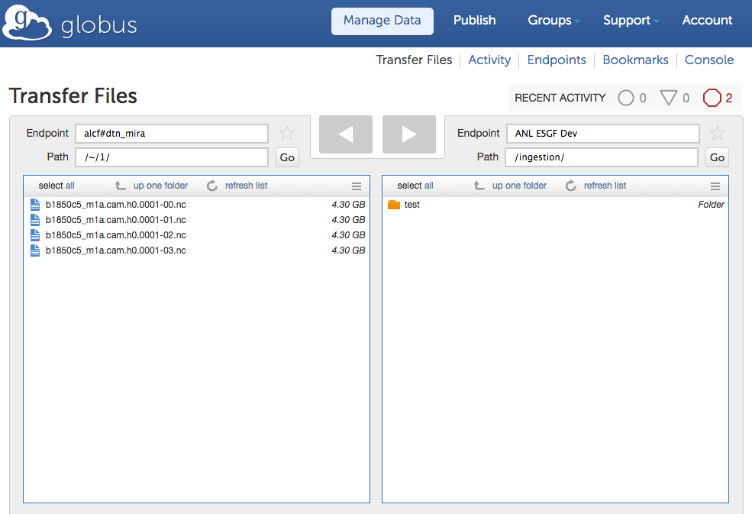
Managed Data Transfer using Globus
Globus Web UI - http://globus.org
Objective
Provide a service that can be used to transfer ACME datasets between all ACME machines
Solution
Leverage Globus Data Transfer to provide managed data transfer and synchronization
All compute resources (ALCF, ORNL, NERSC, LLNL) have Globus endpoints deployed
ALCF Mira/Cetus - alcf#dtn_mira
NERSC Edison - nersc#dtn
OLCF Titan - olcf#dtn
ALCF HPSS – alcf#dtn_hpss
NERSC HPSS – nersc#hpss
Accomplishments
Relevant ESGF data nodes have Globus enabled:
CADES - peby#cades-dtn01.ornl.gov, climate#ornl
ANL ESGF – anlesgf#prod
LLNL ESGF – llnlesg#acme
Impact
Researchers use managed transfer to easily transfer large datasets across resources.
More than 500 TB of data transferred to CADES
Future
Leverage OAuth2 protocol to integrate the Globus Transfer Web UI with the ACME Dashboard
Globus CLI - ssh cli.globusonline.org
Team Lead: Lukasz Lacinski
Notes:
For v1 – able to move across facilities; allow data to move v1 runs; moved 100 year runs;

Slide 4
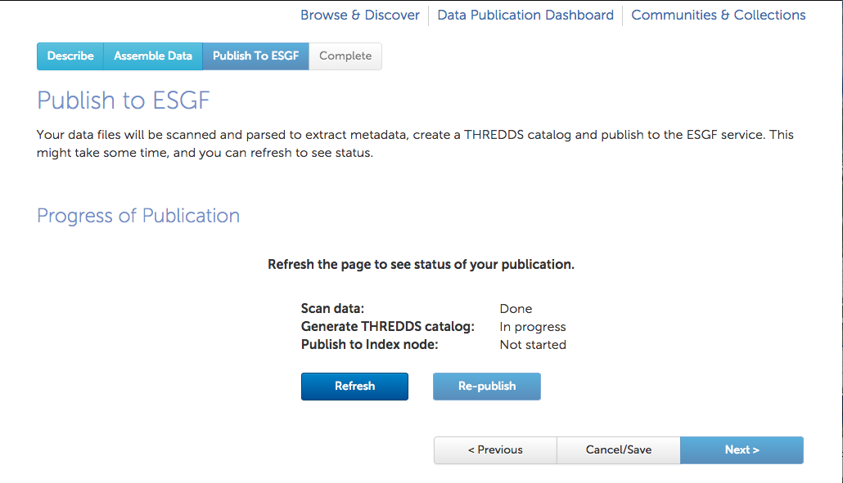
Publication and Ingestion Service
Objective
Develop a web interface for end users to publish datasets remotely
Develop a REST API for programmatic access to the publication capability
Accomplishments
Developed the Publication Service
Deployed the service (https://acme.globuscs.info) and configured it to publish data sets on ORNL CADES data node and ANL data node
Developed the Ingestion REST API
Defined three publication workflow for different locations of datasets that are to be published:
ESGF Data node
Compute resource (Edison, Titan, Cetus)
HPSS
Deployed the Ingestion REST API on ORNL CADES, ANL data
Developed an Ingestion client Python module with sample scripts
Impact
Ingestion API is used to integrate the publication capability to the dashboard
Researchers used the service to transfer and publish about 40 ACME datasets to ORNL CADES
Future
Develop the Ingestion Web UI and integrate it with the ESGF installer
Publication Service/Web UI - http://acme.globuscs.info
Ingestion client Python module
Team Lead: Rachana Ananthakrishnan
Notes:
Tested published via GUI or CLI; test using 100 year run

Slide 5
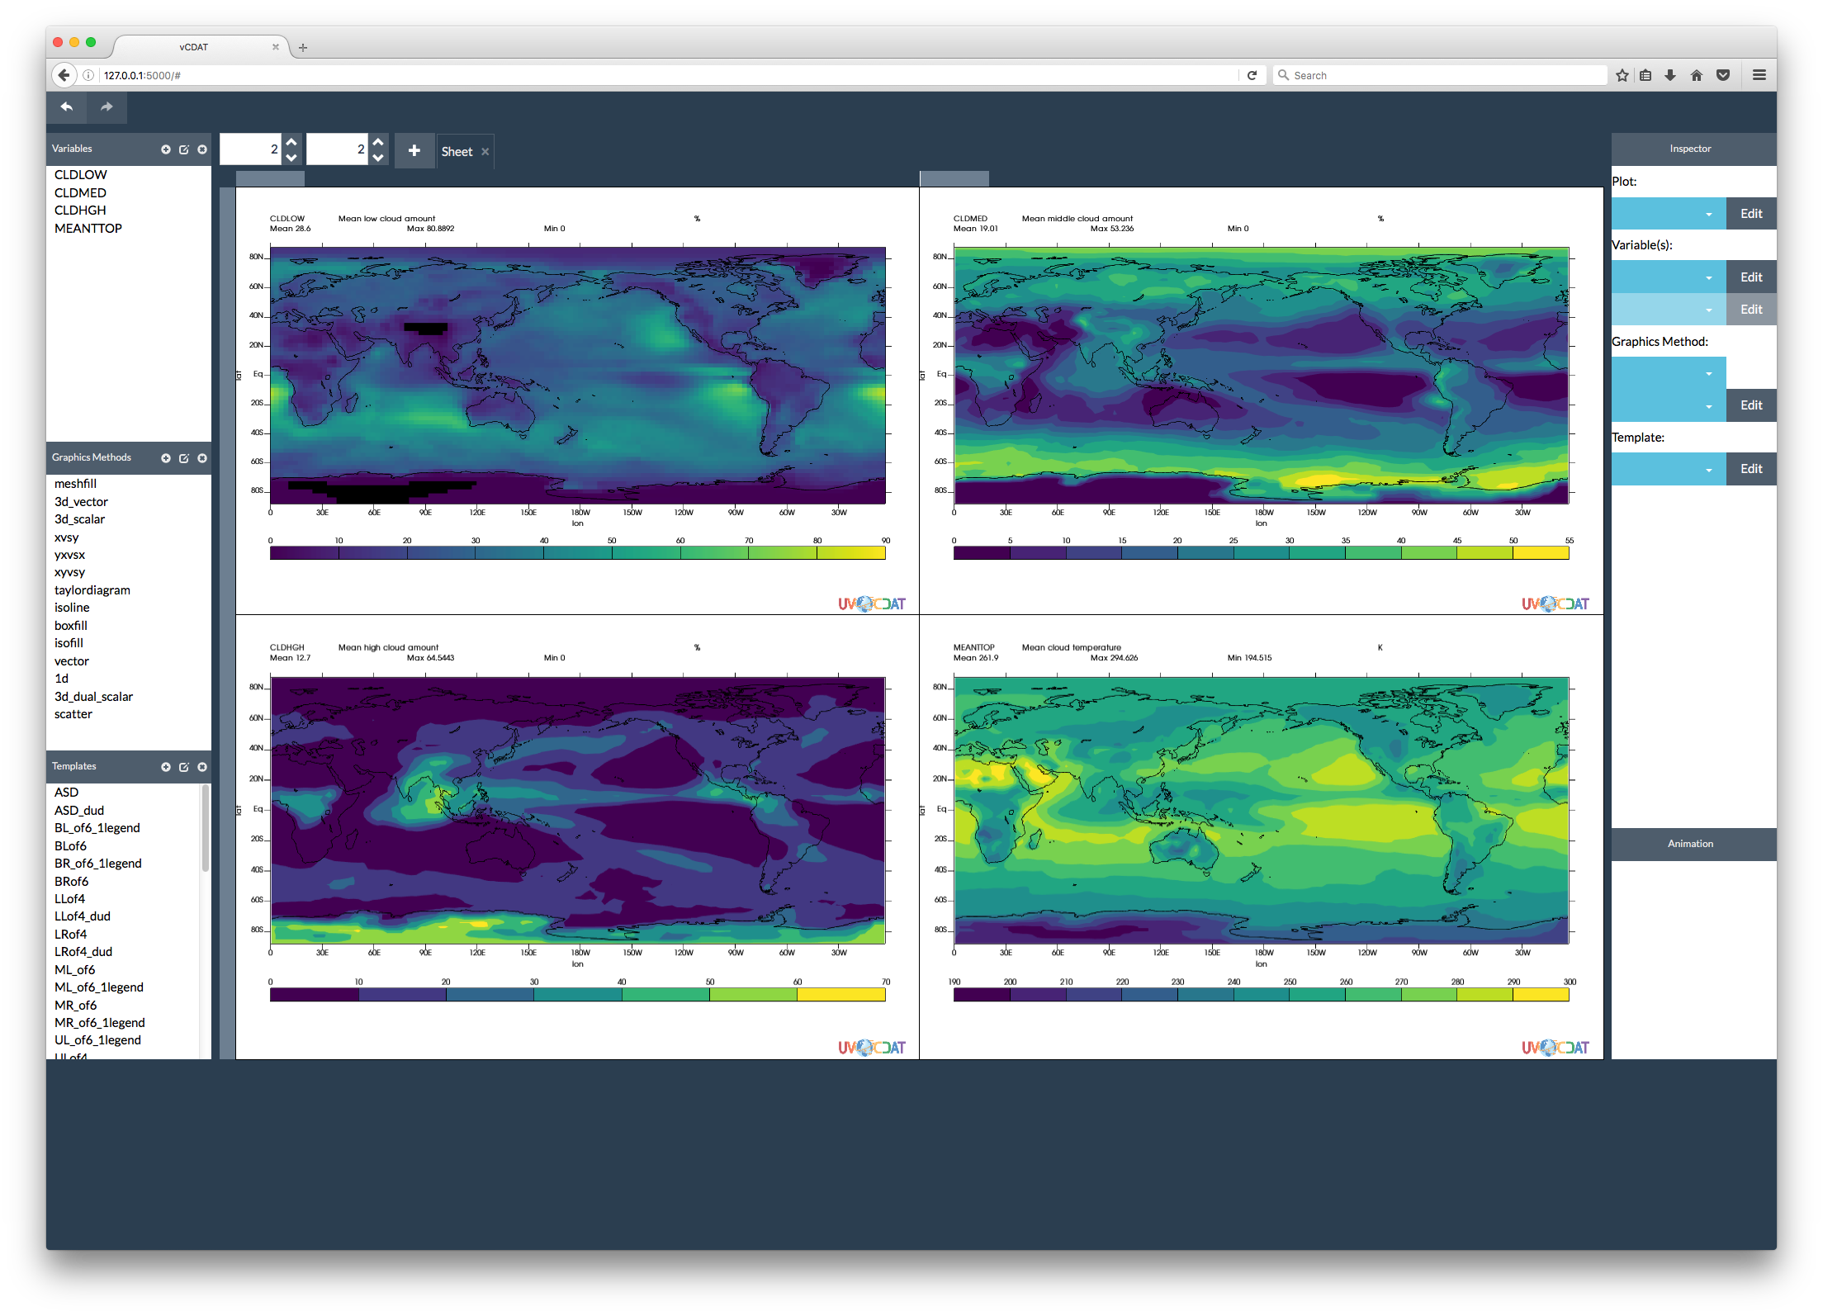
UV-CDAT Highlighted Accomplishments
Objective
Implement a visualization and analysis platform for ACME use
Accomplishments
UV-CDAT 2.4 and 2.6 Anaconda release
Improved and better API for plotting including improvements to the line plotting API
Fixed projections needed for diagnostics output. Added orthographic projection
New colormaps were included for better distinction between contour levels and color blind awareness
Vector plot improved for diagnostic output
VCDAT web interface to CDAT, in prototype phase
Patterns fill was added as a secondary attribute in place of filling in an area with only color
Vector output such as PDF and PS were added as an option for diagnostic output; allows for publication quality output
Documentation
Converted to Sphinx as our documentation builder
Gallery improved to display actual scientific use cases
New graphic methods (add-ons):
Polar plots
Histograms
Impact
The Anaconda port allow users to easily deploy UVCDAT on any Linux or Mac OS based machine; ported to multiple sites (ANL, LLNL, NERSC, ORNL) with various configurations
Impact
Web browser installation
Extensible and customizable for high-performance interactive and batch visualization and analysis for climate science and other disciplines of geosciences. The screen shots shows ACME diagnostics products, all joined seamlessly under the VCDAT web interface framework.
Reference: Williams, D. N. (2016), Better tools to build better climate models, Eos, 97, doi:10.1029/2016EO045055. Published on 9 February 2016
Reference: Gleckler, P. J., C. Doutriaux, P. J. Durack, K. E. Taylor, Y. Zhang, and D. N. Williams, E. Mason, and J. Servonnat (2016), A more powerful reality test for climate models, Eos, 97, DOI: 10.1029/2016EO051663, 3 May 2016.
Support Funding
Team Lead: Charles Doutriaux
Matthew Harris
Notes:
2.6 anaconda release; desktop analysis for v1 – using desktop; cli and web versions

Slide 6
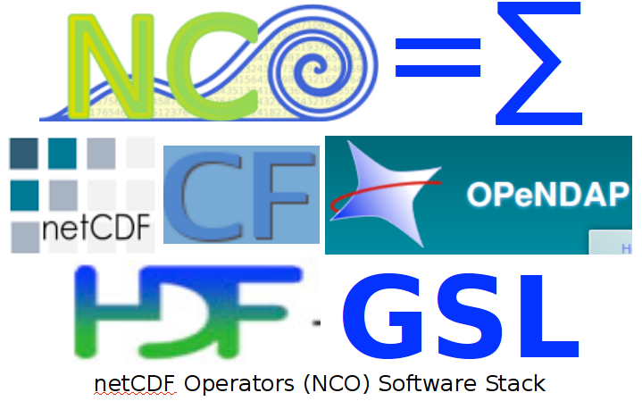
NCO Highlighted Accomplishments
Objective
Improve ACME data pre- and post-processing
Accomplishments
Release new operators ncremap and ncclimo:
These make regriddding and climatology-generation easier for geoscience community.
Improved Python wrappers for NCO (PyNCO):
Replaced system NCO commands with PyNCO in two important scripts in ACME’s Pre and PostProcessing utilities. Resulting scripts are simpler and faster. PyNCO includes three new methods to simplify editing attributes, renaming variables, and specifying hyperslabs.
Impact
Operators meet all applicable ACME specifications, are well-documented, and are used daily to analyze CAM-SE, ALM, and MPAS-O/I simulations in support of v1 model development and analysis. Researcher feedback has been almost all positive. Repeated use at multiple sites (ANL, LANL, LLNL, NERSC, ORNL) with various configurations (serial, intra-node parallel, inter-node parallel, interactive, batch) improved features, robustness, and versatility.
Future
More parallelism, exact regridding from great to small-circle (lat-lon) grids
Reference: Zender, C. S. (2016), Bit Grooming: Statistically accurate precision-preserving quantization with compression, evaluated in the NetCDF Operators (NCO, v4.4.8+), Geosci. Model Dev., 9, 3199-3211, doi:10.5194/gmd-9-3199-2016.
Reference: Silver, J. D. and C. S. Zender (2016), Finding the Goldilocks zone: Compression-error trade-off for large gridded datasets, in revision after review, Geosci. Model Dev., doi:10.5194/gmd-2016-177.
Reference: Wang, W., C. S. Zender, D. van As, P. C. J. P. Smeets, and M. R. van den Broeke (2016), A Retrospective, Iterative, Geometry-Based (RIGB) tilt correction method for radiation observed by automatic weather stations on snow-covered surfaces: application to Greenland, The Cryosphere, 10, 727-741, doi:10.5194/tc-10-727-2016.
Team Lead: Charlie Zender
Notes:
Currently used for V1

Slide 7
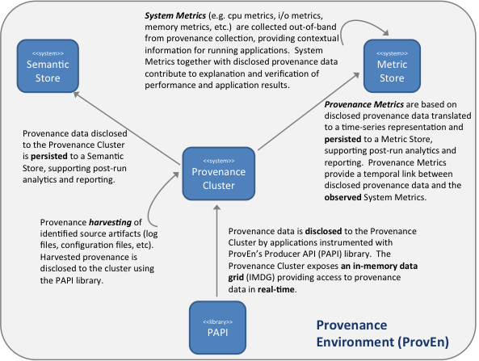
Provenance Highlighted Accomplishments
Objective
Development of provenance solutions in support of reproducibility and performance investigations
Accomplishments
ProvEn Infrastructure buildout:
ProvEn server enhancements to support high demand database access and scalability
ProvEn Client API enhancements:
ProvEn client API supports provenance disclosure in distributed environments
Provenance Metrics Hybridization:
Combine disclosed provenance with the observed system metrics in order to have a complete understanding of a workflow application
ACME provenance requirements gathering:
Gathered provenance specific requirements from climate scientists and created sample provenance messages for disclosure
Impact
A scalable ProvEn infrastructure supports large volume of data and support high demand database access. The hybrid approach supports better reproducibility and performance optimization
Future
Complement the existing local provenance capture methods in ACME with more standardized approach and integrate provenance with performance metrics
Reference: Elsethagen T O,Stephan E G,Raju B ,Schram M ,Macduff M C,Kerbyson D J,Kleese-Van Dam K ,Singh A ,Altintas I 2016. "Data Provenance Hybridization Supporting Extreme-Scale Scientific Workflow Applications" NYSDS 2016 - Data Driven Discovery.
Reference: Raju B ,Elsethagen T O,Stephan E G,Kleese van Dam K 2016. "A Scientific Data Provenance API for Distributed Applications" The 6th International Workshop on Semantic Technologies for Information-Integrated Collaboration .
Reference: Thomas M ,Laskin J ,Raju B ,Stephan E G,Elsethagen T O,Van NYS ,Nguyen S N 2016. "Enabling Re-executable Workflows with Near-real-time Visualization, Provenance Capture and Advanced Querying for Mass Spectrometry Data" NYSDS 2016 - Data-Driven Discovery.
Team Lead: Bibi Raju
Notes:
Not ready for v1; unified collection for model & workflow provenances

Slide 8
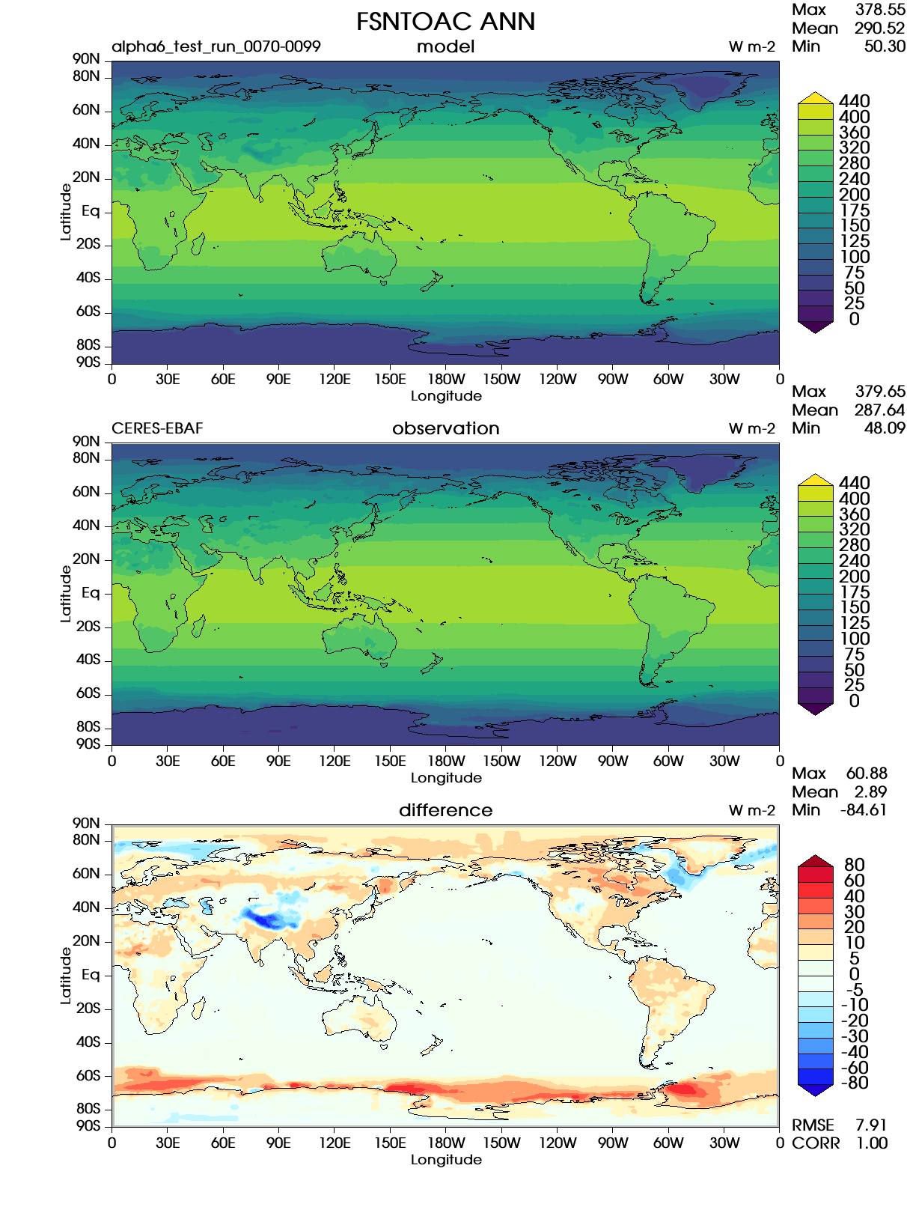
ACME Diagnostics Highlighted Accomplishments
Objective
As part of the underpinning workflow environment, a diagnostics, model metrics, and intercomparison Python framework, called UVCMetrics is needed to aid in testing and production execution of the ACME model.
Accomplishments
Publication quality output
Matched AMWG results with ACME Diagnostics
Customizable inputs: levels, colormaps (more choices, user-settable, better defaults), choice of variables to run, choice of observation, and user-defined variables
Mass weighted averages; system detects where appropriate based on units of the data
Parallelized climatology calculations
Parallelized diagnostic calculations
An online viewer for diagnostics was created for sharing and viewing output with others
Provenance capture described in output, even inside PNG graphics files
Impacts
Critical tool to evaluate ACME models for high resolution simulations
Fast output and customizable workflow diagnostics
Easy access to any of the hundreds of files produced by the Diagnostics Suite.
Future
Maintain agreement with AMWG while upgrading/expanding ACME diagnostics and supporting to multiple users
Diagnostics
Provenance
Reference: McEnerney, J. , Ames, S. , Christensen, C. , Doutriaux, C. , Hoang, T. , Painter, J. , Smith, B. , Shaheen, Z. and Williams, D. (2016) “Parallelization of Diagnostics for Climate Model Development”. Journal of Software Engineering and Applications, 9, 199-207. doi: 10.4236/jsea.2016.95016.. May 2016.
GitHub URL: https://github.com/UV-CDAT/uvcmetrics
Team Lead: Jim McEnerney
Notes:
Working w/ golaz coupled team for V1 – plot set 5 – also contains proveance; being used right now

Slide 9
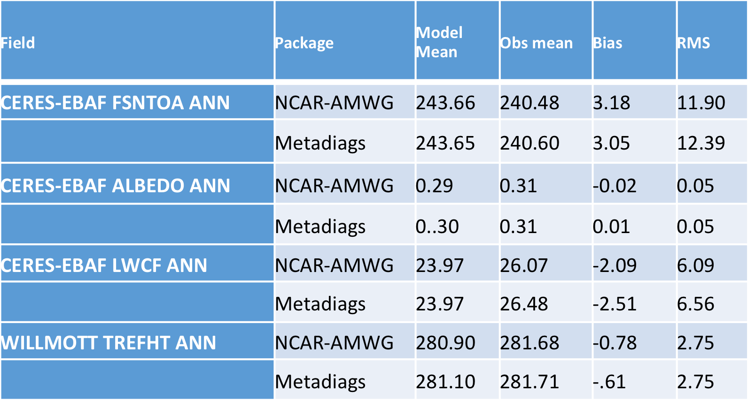
Work with ACME-Coupled model group to enhance metadiags and replace AMWG diagnostics
Objectives
Help with development of a more flexible tool to quickly diagnose latest model runs and produce publication quality plots that track the model progress
Assess needs of coupled group by helping customize metadiags package
Accomplishments
Continued testing of metadiags the ensure it is easy to use and produce the output needed
Some modifications of the observational data set that goes into the metadiags tests. Provided guidance on some proper observation data sets to be used
Impacts
Use of metadiags appears to be more acceptable and readily available to ACME model teams
Critical part of modeling effort to assess the model will now be easier to run and customizable
Comparison of Metadiags global average calculations compared to the NCAR AMWG diagnostic package
Confluence URL: https://acme-climate.atlassian.net/wiki/display/SIM/2016-09-02+Test?focusedCommentId=95518805#comment-95518805
GitHub URL: https://github.com/UV-CDAT/uvcmetrics
Team Lead: Jerry Potter
Jim McEnerney
Notes:
Ensure trust – v&v

Slide 10
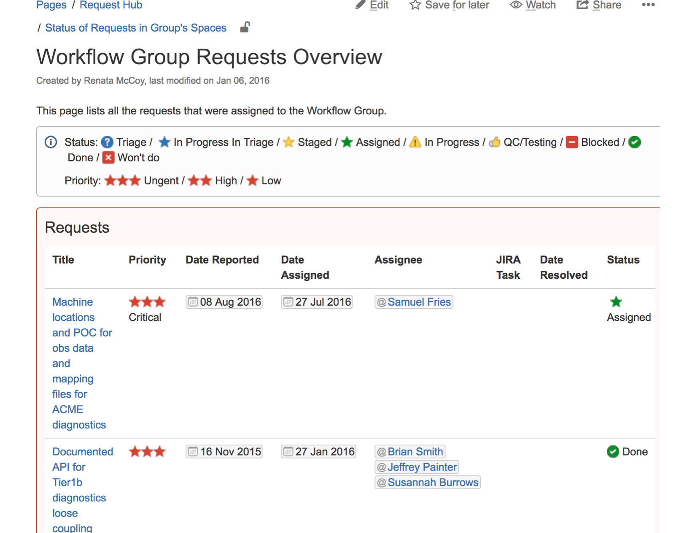
Workflow Request Hub Accomplishments
Objectives
Respond to requests for Workflow – coordinate Workflow activities with leads
Help resolve issues with diagnostics and metadiags
Accomplishments
Maintenance of Request hub requests
Coordinated the Workflow request for improvements of metadiags
Helped evolve Workflow request issues – recast “showstoppers” to realistic requests
Impact
This is a continuing effort to help groups communicate. The success is mixed
Example from Workflow Request Hub in Confluence
Confluence URL: https://acme-climate.atlassian.net/wiki/display/WORKFLOW/Requests+for+Workflow+Group
Team Lead: Jerry Potter
Notes:
Helps identify & prioritize needs; Ready for your requests;

Slide 11
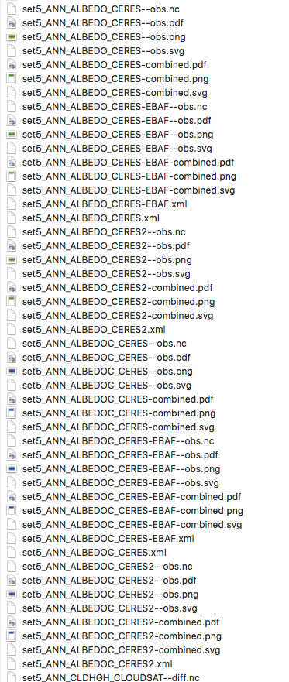
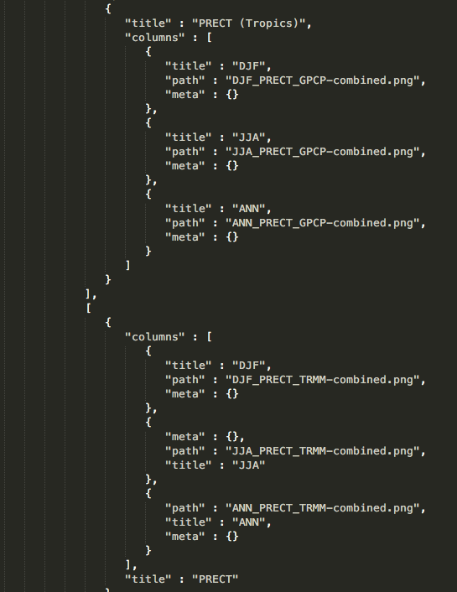
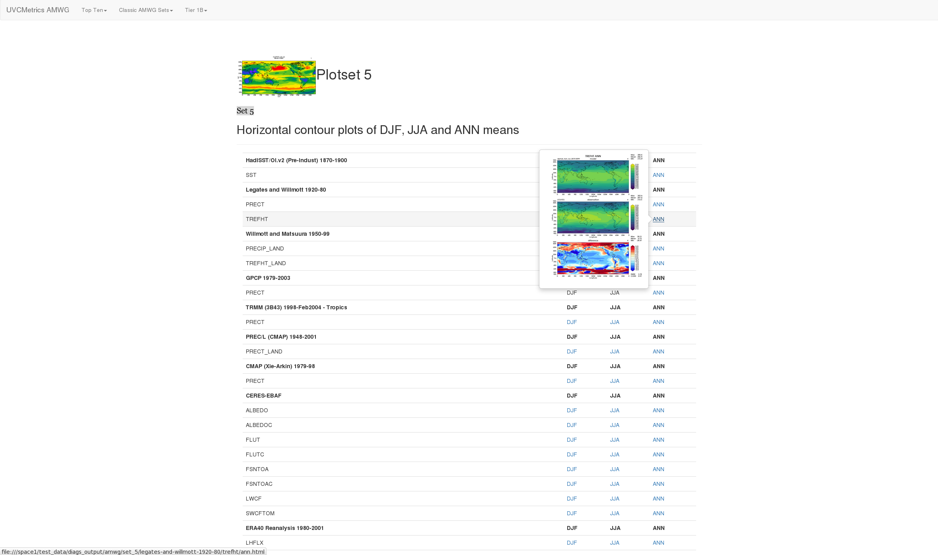
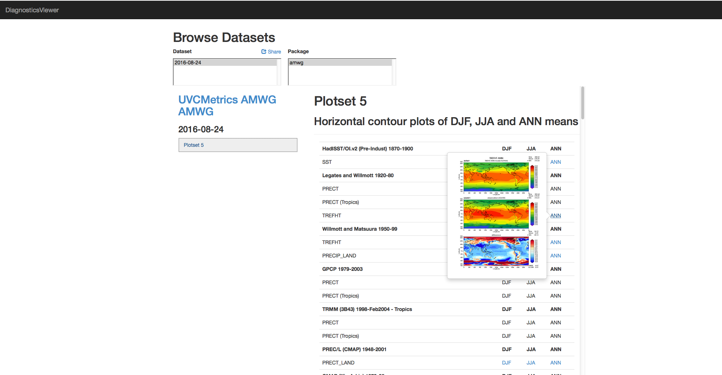
Viewer
Output generated
Objective
Climate model diagnostics suites generate huge amounts of output, making it difficult to find specific metrics
It is difficult to generate a system for viewing the output without relying on filenames and post-hoc analysis of the file system
Accomplishments
Defined a JSON format for describing the results of a diagnostics run
Created library to integrate into diagnostics suite that will automatically create structured JSON file
Created generic “viewer” script to build HTML pages that allow easy browsing of output
Created web application for uploading, viewing, and sharing that output using same JSON format
Impacts
Users greatly appreciate clean user interface and that all of the parts “just work”
Having a quality viewer dramatically improves usability of diagnostics suites
Structured output allows for many opportunities to improve workflow
Future
Ability to compare diagnostics runs against each other and view multiple sets at once
Run Diagnostics
index.json
Output images/data files
Users use local viewer to determine if results are worth sharing.
They then upload to the web diagnostics viewer and share with others
GitHub URLs:
https://github.com/ESGF/output_viewer
https://github.com/ESGF/DiagnosticsViewer
Funded by
Team Lead: Sam Fries
Notes:
Ready for V1 … works w/ diagnostics; on laptop or at compute/analytics platforms; tested w/ golaz

Slide 12
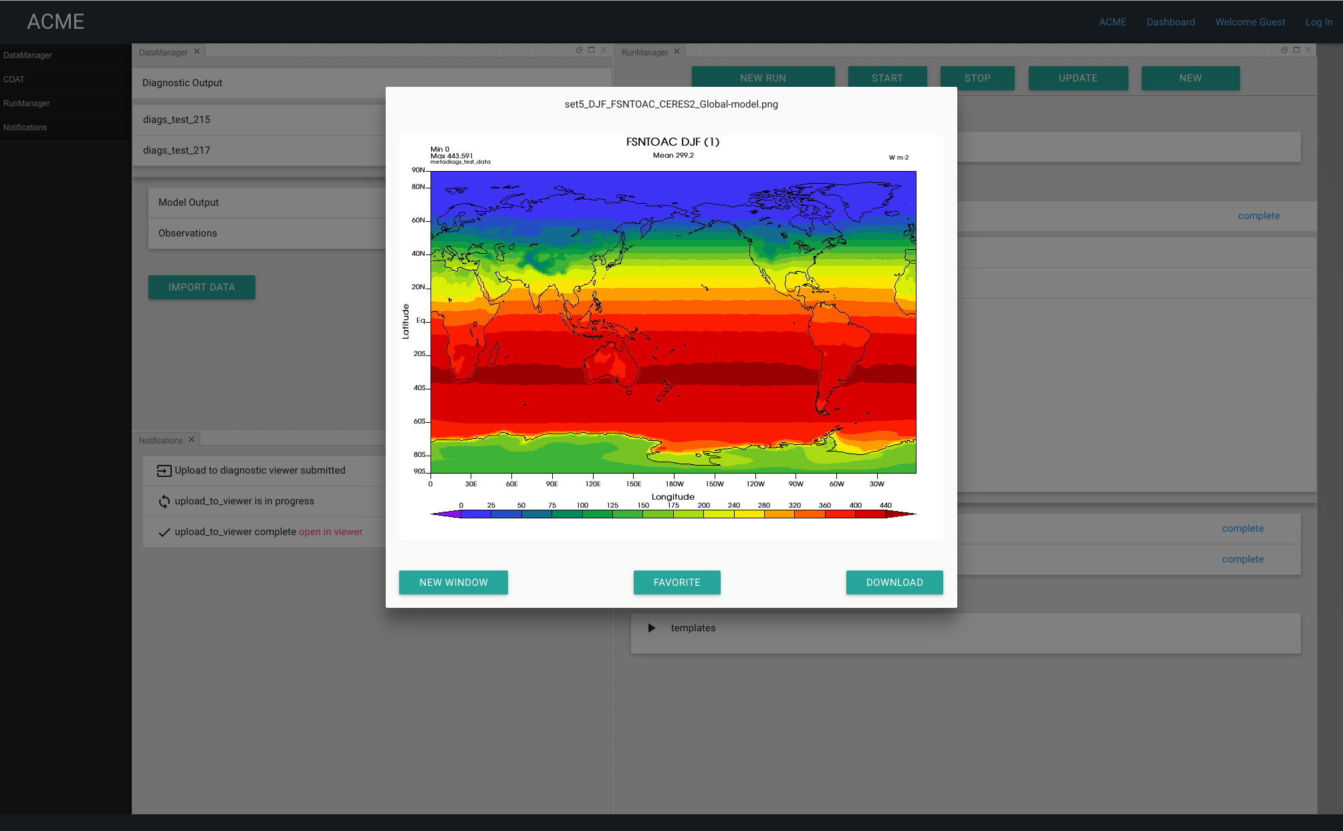
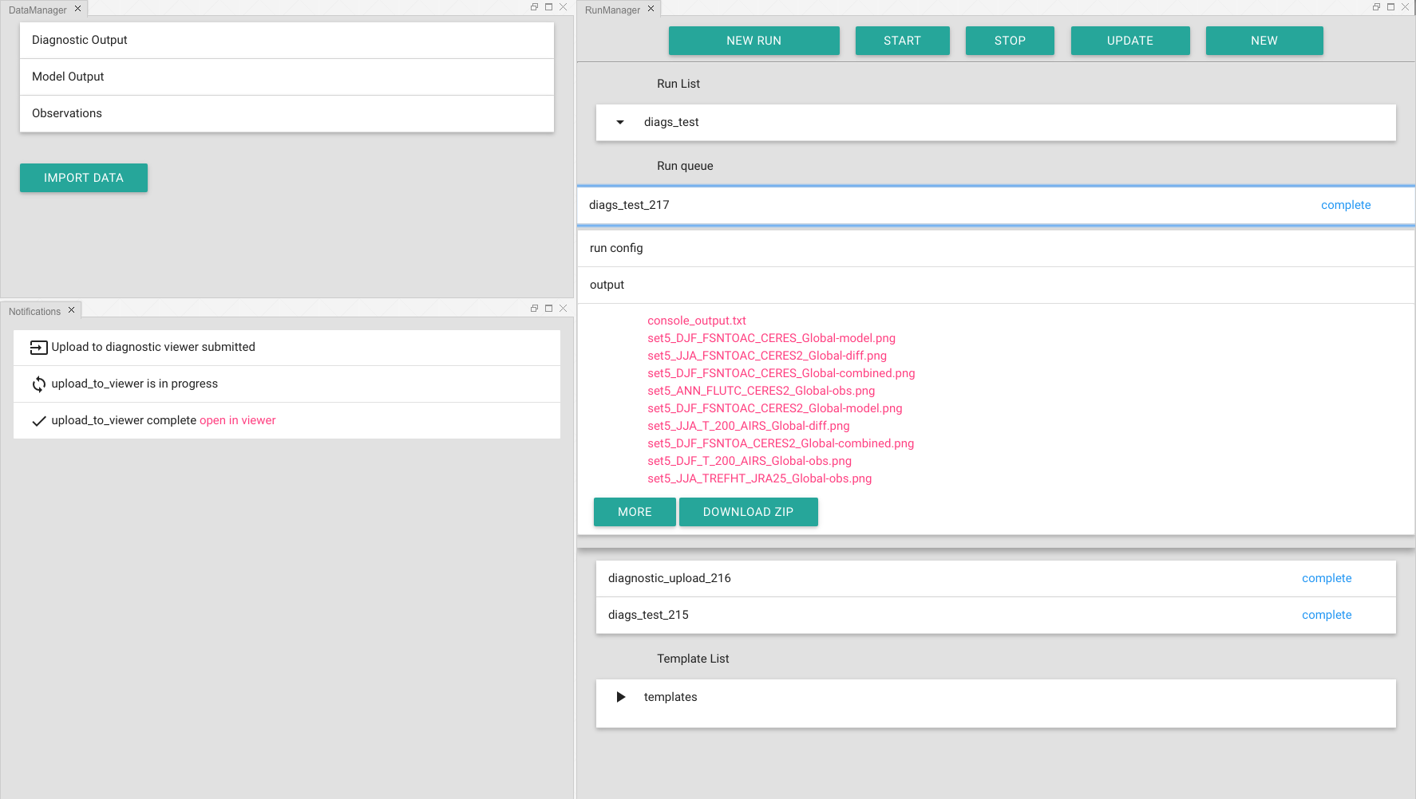
ACME Workbench Highlighted Accomplishments
Objective
Create a unified user interface for running and analyzing the ACME model. Give ACME team members the ability to configure, run, monitor, and analyze the ACME climate model through their browser
Accomplishments
Model diagnostics run at a click of the button
Diagnostics upload to the Diagnostic Viewer
First pass at polling system to move job configuration and data between secure compute enclave and web interface
Real-time updates in the browser as job status changes
Impact
The ACME dashboard will give climate scientists easy to use tools to run complex models, accelerating the rate of model development and analysis
Future work
Integrate model run job creation and execution. Build out UI for existing features, and deploy to beta users.
Diagnostic output in the Dashboard
Sterling A. Baldwin, Matthew B. Harris, Samuel B. Fries Science as a Service, Proceedings of The World Congress on Engineering and Computer Science 2016, Vol. I, WCECS 2016, 21-23 October, 2016, San Francisco, USA, pp123-126, http://www.iaeng.org/publication/WCECS2015/ ISBN: 978-988-19253-6-7
GitHub URL: https://github.com/ACME-OUI/acme-web-fe
Setting up a diagnostic run
Team Lead: Sterling Baldwin
Notes:
Pull individual pieces under one web application

Slide 13
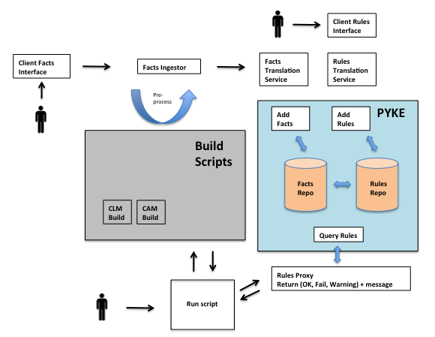
ACME Rule Engine
ACME Rule Engine
Objective
Develop a a rules-based expert system that can eliminate spurious combinations of parameters that are invalid and/or will generate errors Accomplishments
Gather requirements and developed use cases for ALM and coupled model configurations
Evaluated technical and programmatic risks
Surveyed open source rule engines; identified candidate core technologies; and selected Pyke
Developed system architecture
Specified simple rule formats, and derived corresponding rule tables for a simple ALM use case involving “binary rules with tertiary targets”
Tested initial proof-of-concept by prototyping and implementing simple rules and consistency checks
Impact
The ACME Rule Engine will save precious facility cycles and prevent frustrating invalid runs that can’t be detected at compile time and runtime. It will mainly be put to use by the experiment team, as it is rare to have one model developer know all of the information in earth system modeling domains with which they are not familiar.
Future work
Implement the Rule Engine V1 for ACME Land Model.
Valid model configuration
Increased productivity
Rule Engine Architecture
The ACME Rule Engine will alleviate frustrating invalid runs that can not be detected at compile time and runtime, prevent wasted hours tracking down configuration errors, enhance productivity, and conserve precious facility cycles that are used for simulations with unpublishable output.
Team Lead: John Harney
Notes:
requirements driven; risk analysis; end user engagement;

Slide 14
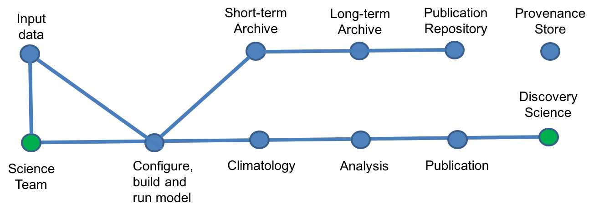
Workflow Integration
Objective
Develop, deploy and integrate software systems and utilities essential for operational ACME activities, across all major computational facilities
Accomplishments
Developed utilities for long-term archive of model simulations
Provide liaison support for the coupled experiment team
Manage the ESGF data archive at ORNL CADES
Data transfer utilities for copying data across production sites and CADES
Deploy and maintain SVN repository for ACME input data
Support and maintain the ACME observation data repository
Prototyped and tested the Pegasus Workflow and management system for use with ACME
ACME development testbed at CADES
Integration of process flow utilities into the ACME CIME infrastructure. (in progress)
Impact
The ACME process flow facilitates the seamless integration of ACME workflow components across multiple production sites, allowing the ACME science teams to be more productive.
Future work
Test and document the processflow for ACME V1 experiments.
Process flow for ACME Experiments
Provenance Capture and Analysis
A simplified Overview of the ACME process flow
The ACME process flow provides the infrastructure utilities necessary for the the seamless integration of ACME workflow components across multiple production sites, facilitating simulation experiments, provisioning the necessary input data, short and long term archive of model output, data transfer and analysis, and data publication, sharing, search and discovery. The simulation output can be incrementally: archived; transferred; regridded; reduced; and analyzed.
Team Lead: Val Anantharaj (acting)
Ben Mayer (emeritus)
Notes:
Working w/ chris & others

