Slide 1

Exploration of Coupled-model Spin-up with Alternating Approach
Shixuan Zhang (PNNL)
Wuyin Lin (BNL)
Carolyn Begeman, Mathew Maltrud, Jon Wolfe, Andrew Roberts, Luke Van Roekel, Xylar Asay-Davis, (LANL)
Xue Zheng, Chris Golaz (LLNL)
E3SM Phase 3 Coupled Model Group
EESM PI Meeting 2024
08/2024

Slide 2
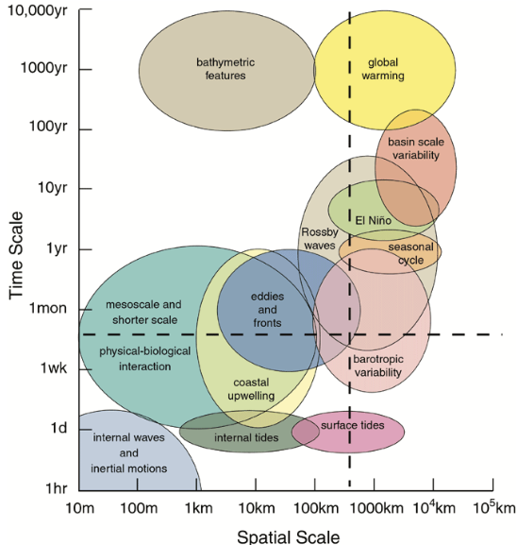
E3SM Coupled Model Spin-up Workflow: Challenge & Motivation
Science Need: Spin-up Earth System Models to a stable equilibrium representative of real-world conditions is critical for simulating response of atmosphere, land and ocean to climate change
Challenge: An extremely slow process primarily due to the deep ocean's long adjustment timescale
  Fully spun-up often requires 1000s years → heavy burden even for LR on powerful computers, formidable for high-resolution
  Limiting factor for timely delivering simulation campaigns and high-res (ultra-high-res) coupled model development in E3SM Phases 3&4
Ocean Physical Processes
From Sommer et. al., 2018
Notes:
Going forward, the coupled model spinup will become a limiting factor for E3SM development

Slide 3
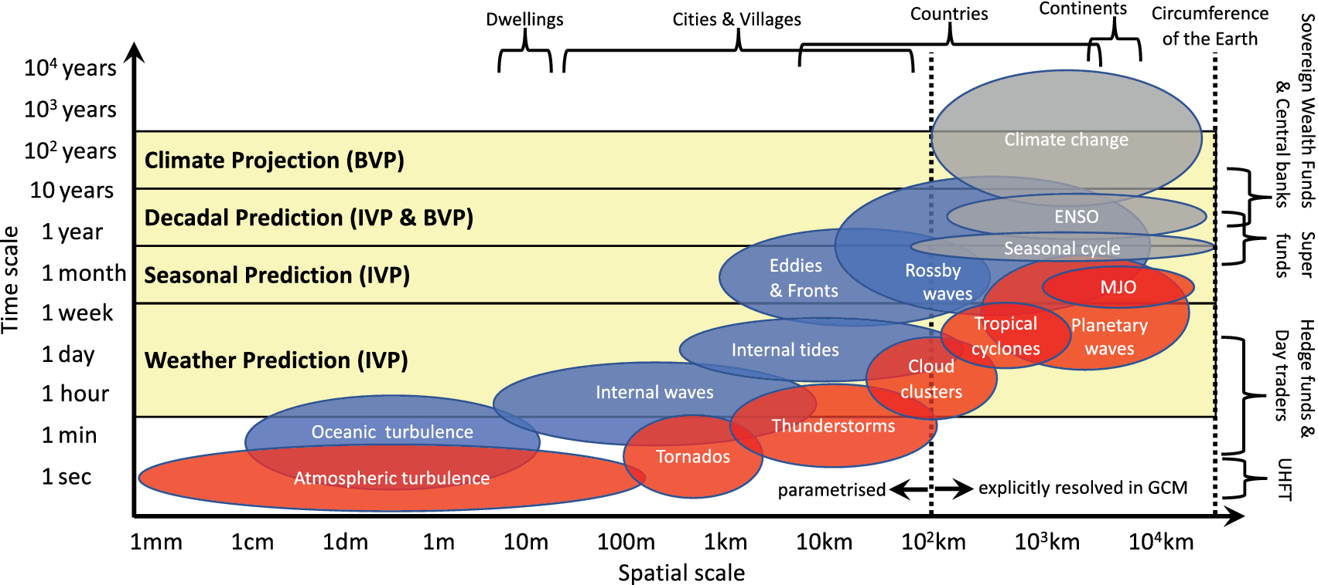
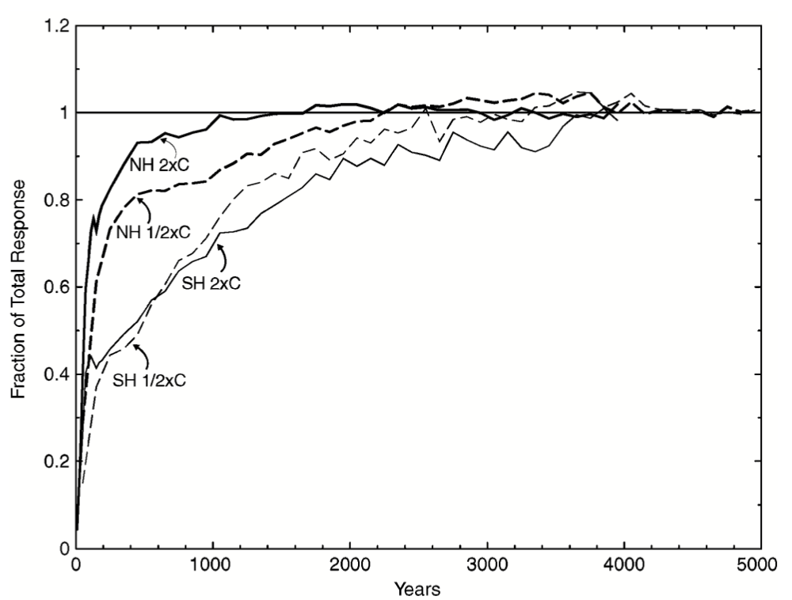
E3SM Coupled Model Spin-up Workflow: Conception & Justification
Science Question: Can we find an alternative approach to address (at least partially) the challenge of model spin-up?
Most coupled earth system (interested to climate prediction) processes operated on time scales that are much faster than slowing deep ocean processes
Focus on spinup of upper/middle ocean (above 2km) to equilibrium
  much shorter conceptual equilibrium time scale → can be well spun-up with hundred instead of thousand years simulations
  trends due to the continuing drift in the deep ocean (below 2km) can be partially removed via linear regression (e.g., Streffing et. al., 2022)
Kitsios et al., 2022
Partial (and simple) solution: explore approach to reduce computational burden from long-term spinup simulation
  Alternating coupled (B-Case) and uncoupled ocean (G-Case) spin-up
70%
NH
<200yr
SH
Stouffer, 2003
<1000yr
Spatiotemporal scales of motion in the coupled Earth system (Top), and time series of the fraction of total equilibrium hemispheric mean surface air temperature response (Bottom)
B-Case: fully coupled
Notes:
For most of decadal to centennial climate change predictions, focus on fully spin-up on upper/middle ocean will be reasonable.

Slide 4

E3SM Coupled Model Spin-up Workflow: Conception & Justification
Science Question: Can we find an alternative approach to address (at least partially) the challenge of model spin-up?
Partial (and simple) solution: explore approach to reduce computational burden from long-term spinup simulation
  Alternating coupled (B-Case) and uncoupled ocean (G-Case) spin-up
  Reducing the computational cost from the atmosphere model integration (occupies ~60-70% of total cost in B-Case) for ocean model spinup
Percentage savings as a
function of alternating design
Continuous B-Case Approach
$$⋯$$
2000yr
1
Coupled (B-Case) simulation length
Alternating B-Case and G-Case Approach
B1
G1
B2
G2
B3
G3
B4
20
80
90
150
160
220
350
$$⋯$$
2000yr
OCN Model Year
Uncoupled (G-Case) simulation length
The key for “success” is to find optimal alternating design with maximum computing savings while still allowing all model components to evolve in a manner that mimics a fully coupled simulation
Notes:
Estimated computational savings for a 2000-year coupled model spin-up using Anvil (100 Nodes, 3600 Tasks): B-Case costs are 6.85 SYPD and G-Case costs are 15.56 SYPD, with initial and final simulations assumed to be 10-year and 30-year B-Cases.

Slide 5
E3SM Coupled Model Spin-up Workflow: Verification & Validation
Alternating B-/G-Cases show the potential to reduce the computational cost, meanwhile maintaining the ocean model state to stay close to those from fully coupled configuration
Continuous B-Case Approach
$$⋯$$
2000yr
1
Alternating B-Case and G-Case Approach
B1
G1
B2
G2
B3
G3
B4
Alternating B/G
Coupled
20
80
90
150
160
220
350
$$⋯$$
2000yr
OCN Model Year
Short-term B-Case: 10-year fully coupled v3 low-res simulations
  Adjust and equilibrate coupled components
  provide data atmosphere/land for G-Case
Long-term G-Case: 60-year ocean model standalone simulations
  Spin up Ocean and Sea Ice models
  Provide initial conditions for B-Case
Cost Reduction: ~40-45% savings if targeted for 2000-year spin-up
Alternating B/G
Coupled
Time evolution of ocean heat content anomaly (∆OHC), AMOC at 26.5N, over 350 years of piControl simulations with cycled 1850 external forcing data.

Slide 6
E3SM Coupled Model Spin-up Workflow: Summary & Future Work
Exploration from our study indicates that a well-designed simulation approach can potentially facilitate efficient coupled model spin-up
  Alternating B-/G-Cases approach effectively reproduces the climate of the atmosphere, land, and ocean (middle and upper layers) obtained from the Continuous B-Case approach
  After three cycles of Alternating B-/G-Cases, coupled E3SMv3 achieved an acceptable equilibrium state in the upper and middle ocean with a reduced simulation time
Optimal simulation approach combined with other existing and emerging technologies could be needed to address challenges facing high-resolution model spinup
  Exploration on methods that can use existing simulations to speed up coupled model spinup
    e.g. starting the model with interpolated state from existing well spunup runs
    Data assimilation maybe helpful for coupled model spin-up and prediction
      create more balanced first guess conditions for coupled model components to initialize the spinup simulation
      reduce drifting errors due to insufficient equilibrium model spin-up with observations during the prediction stage (e.g. decadal predictions)

Slide 7


