Slide 1
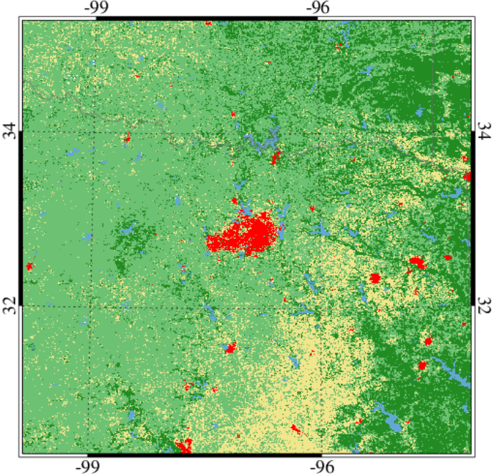
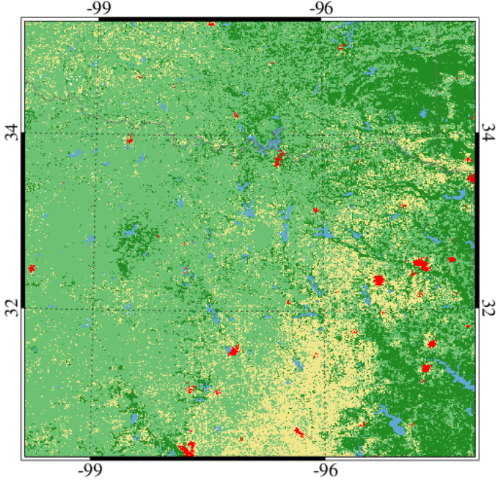
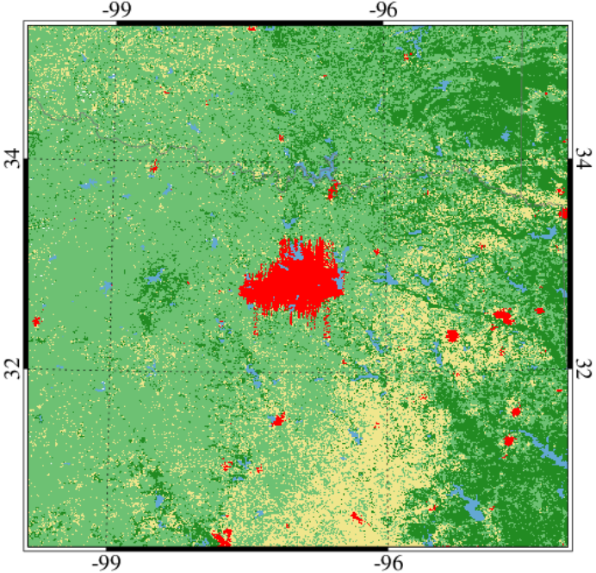
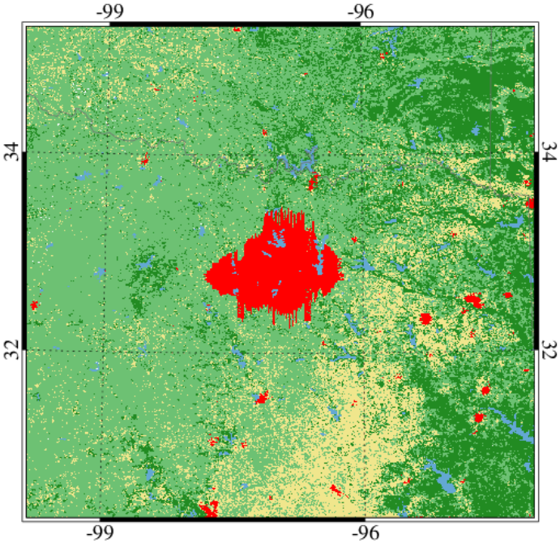
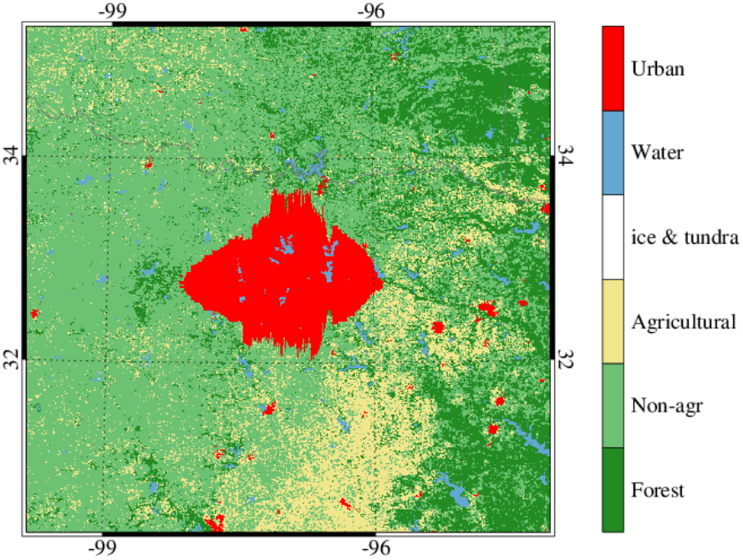
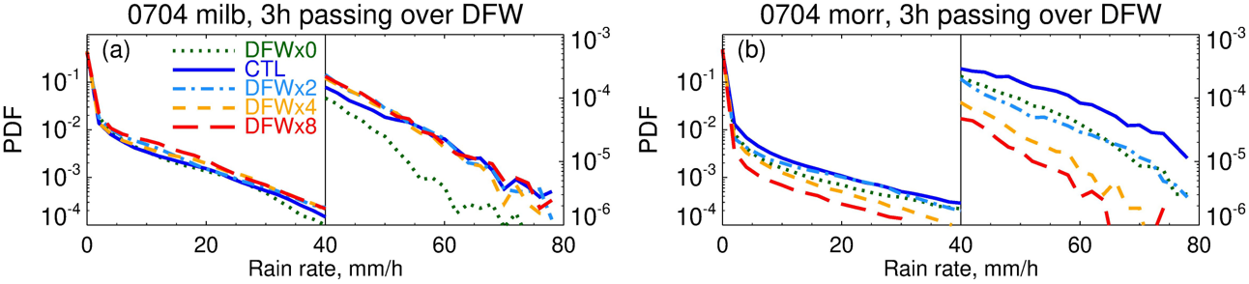
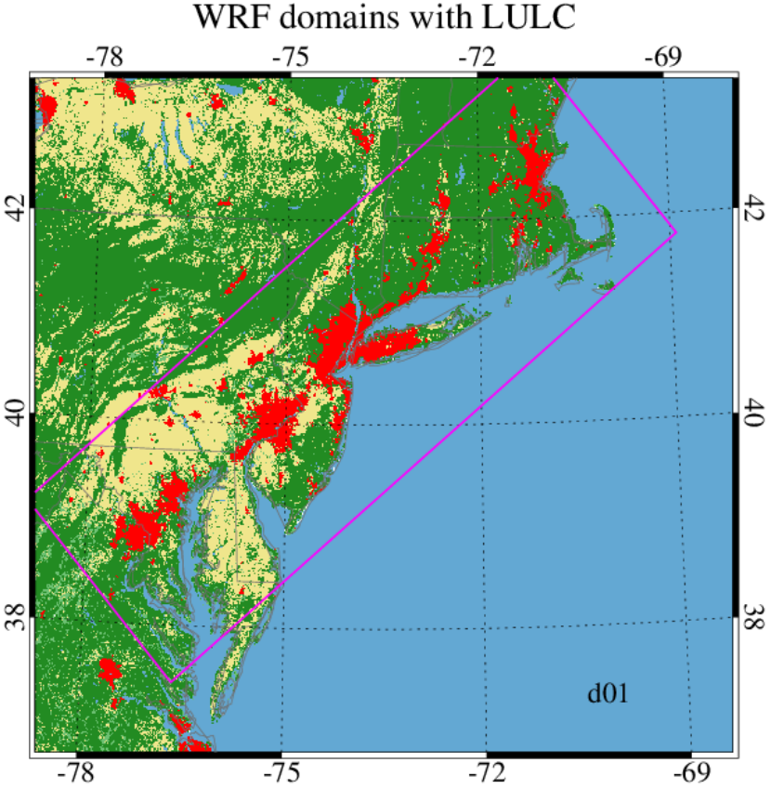
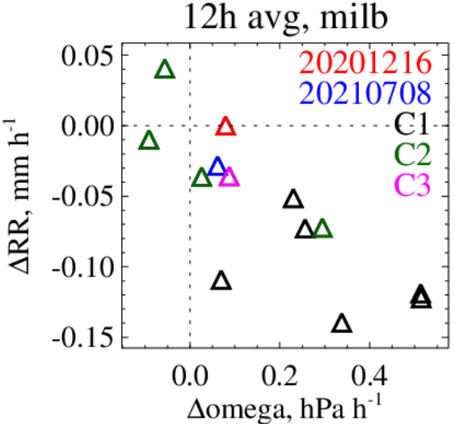
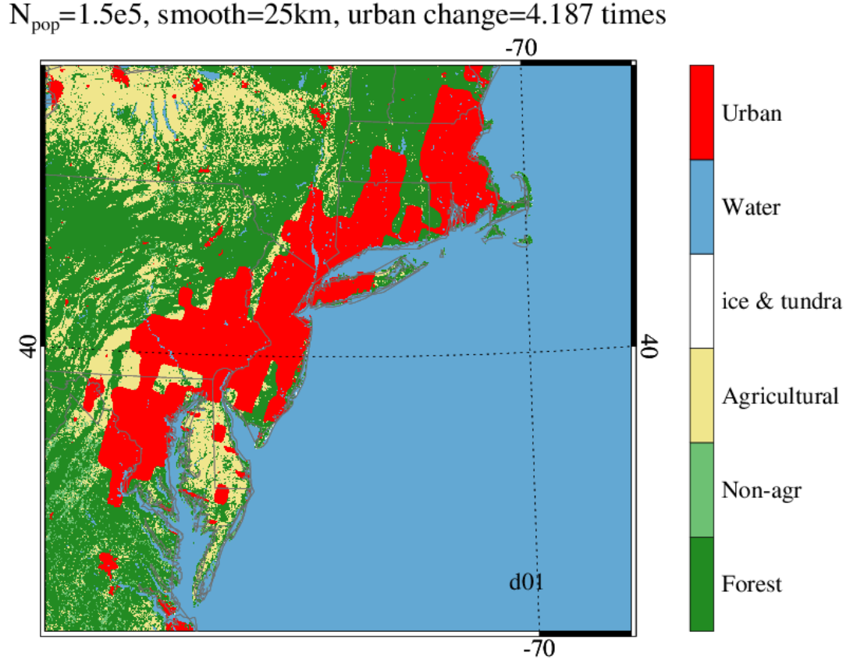
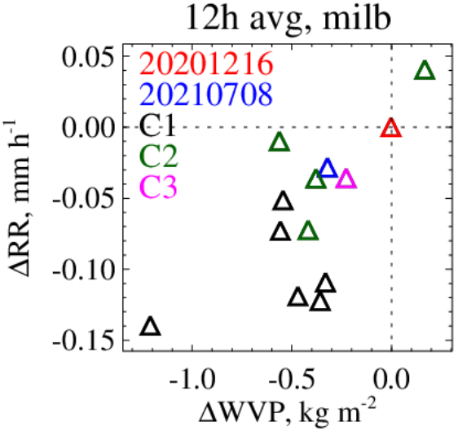
Urban Impacts on Deep Convection
Xin Zhou¹, Fred Letson¹, Paola Crippa², Melissa Bukovsky³, and Sara C. Pryor¹
1. Cornell University, 2. University of Notre Dame, 3. University of Wyoming
CTL (DFWx1)
DFWx0
DFWx2
DFWx4
DFWx8
Deep convection
Major hazard in Southern Great Plains (SGP) + societally important over urban areas (NE US)
Research question
Will urbanization enhance the hazards?
Method: WRF simulations
Build WRF ensemble simulations for storylines over two areas
- Dallas-Fort Worth (DFW): 2 cases
- Northeast urban corridor (NE): 13 cases
Convection permitting + different microphysical schemes
Modified land use land cover (LULC)
- DFW: changes from 0-8 times
- NE: population based SSP5 projection
Combined with thermodynamic-global-warming (TGW)
Results
DFW
CTL
$∆LULC$ all cases
Urban effect is non-linear to the urban cover
Sensitive to MP physics when the urban cover is small
NE
Urbanization reduces the intensity of deep convection in general
Urban effect varies with different cases and climates
LULC
Conclusion: hazards$↓$ + exposed population$↑$

