Slide 1





Extreme Precipitation and Flood Risk for New York City post-Ida
Challenges due to system complexity
EESM PI Meeting
August 06, 2024
Naresh Devineni
Department of Civil Engineering, The City College of New York
Earth and Environmental Sciences, The Graduate Center
City University of New York, New York, NY 10031, USA
Email: ndevineni@ccny.cuny.edu
Students and Postdocs
Dr. Seon-Ho Kim
Fatemeh Yavari and Carolien Mossel
Scientists
Naresh Devineni, Donovan Finn, Kevin Reed,
Melissa Bukovsky, Jiwen Fan, Andrew Jones, Yun Qian
Stakeholders
Nihar Samal (NYCDEP), Hayley Elszasz (NYC Mayors Office of Climate and Environmental Justice), Amanda Stevens (NYSERDA)

Slide 2
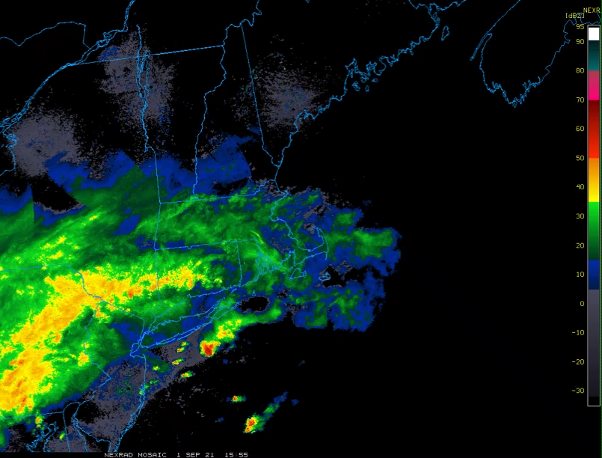
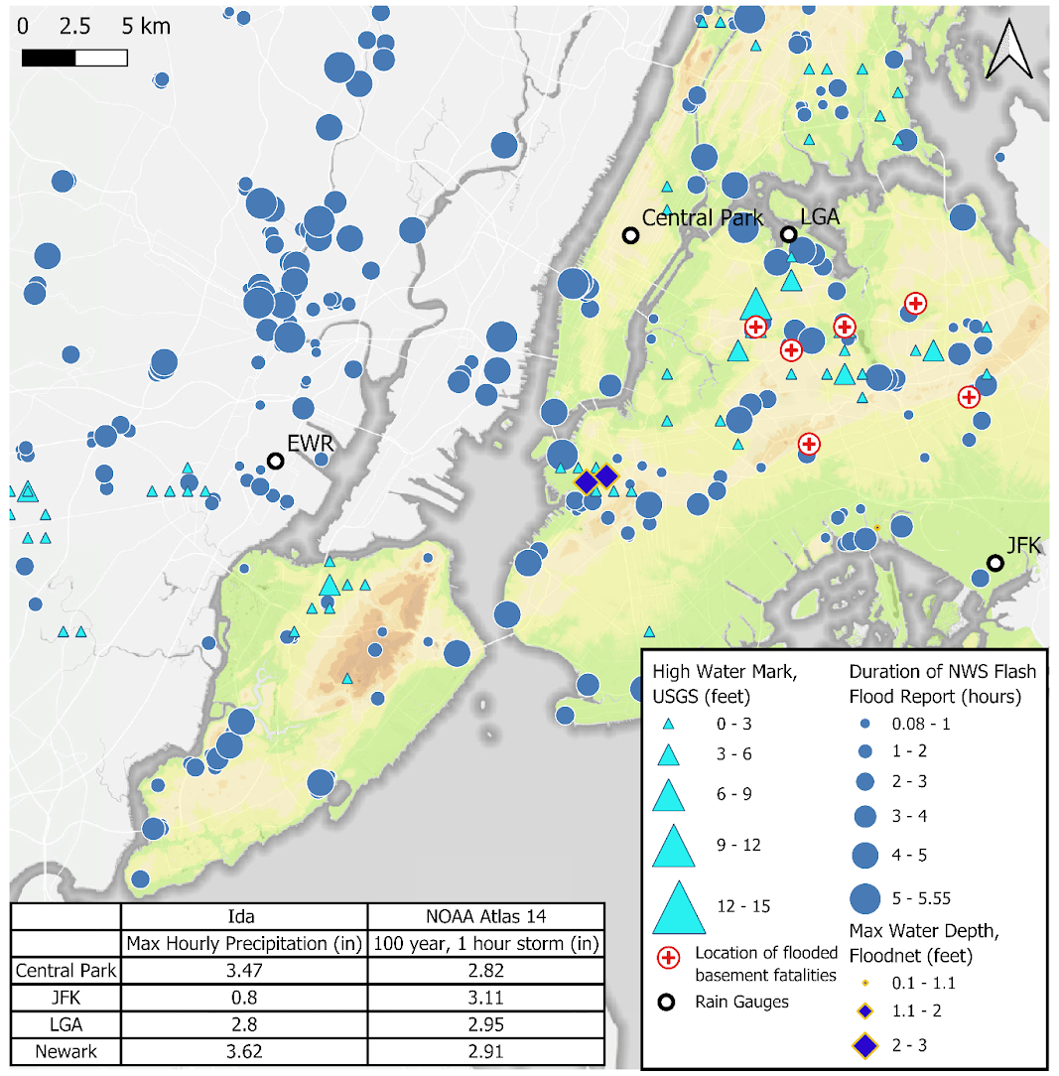
September 1, 2021
Remnants of Ida: New York City was put under a Flash Flood Emergency for the first time
NEXRAD Radar Mosaic as Hurricane Ida crosses New York City Metro
A record 3.5 inches of rainfall in one hour
It is the wettest hour in history
44 deaths from this event in urban New York Area, including 11 deaths from apartment basement flooding

Slide 3
P(Rainfall Attributes | Flash Floods)
NEXRAD Radar Mosaic as Hurricane Ida crosses New York City Metro
Flash Floods happened even for smaller intensity than the design intensity –
duration of the rainfall matters
other sewer infrastructure constraints matter

Slide 4
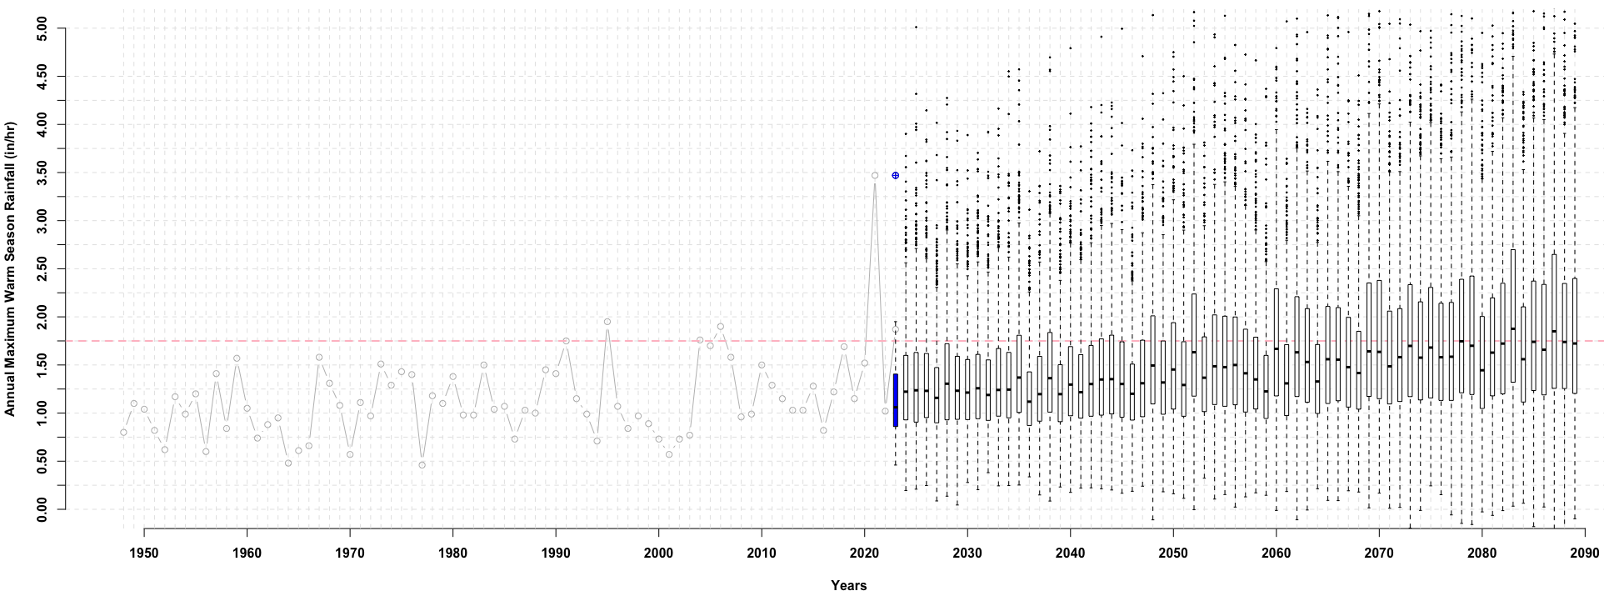


Changing Annual Maximum Hourly Precipitation
$$AMR(t)\sim G\left(𝓊(t),β(t)\right)$$
$$𝓊\left(t\right)=a_{u}+b_{u}∗CDD(t)$$
$$β\left(t\right)=a_{β}+b_{β}∗CDD(t)$$
Ida
$$Design Rainfall Intensity$$
$$=1.75 inches per hour$$
Need for adaptive designs and risk analysis
[exceedances may happen with greater probability]
Mossel et al., 20xx, Extreme hourly precipitation risk for New York City post-Ida, Nature Sci.Reports (under revision)

Slide 5
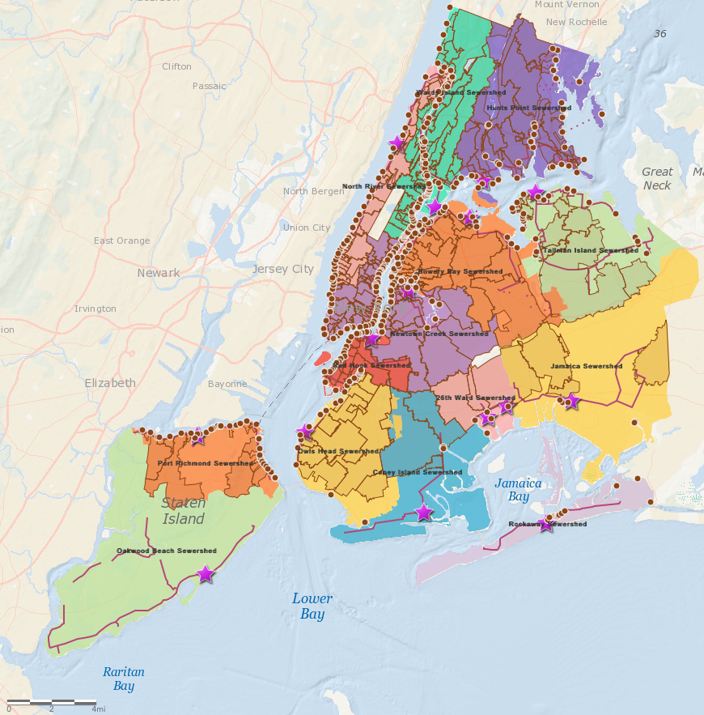
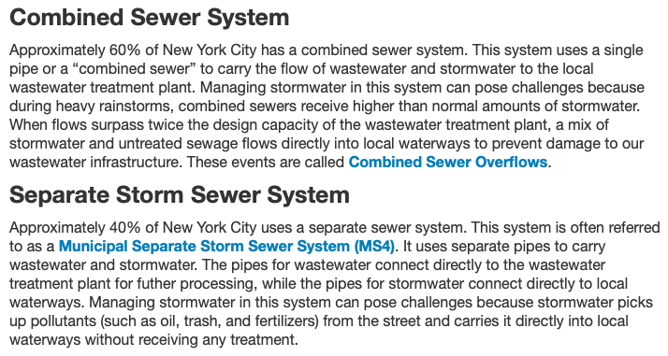

NYC Sewer Systems
This network consists of over 7,400 miles of sewer pipes, 152,000 catch basins, and 95 wastewater pumping stations

Slide 6
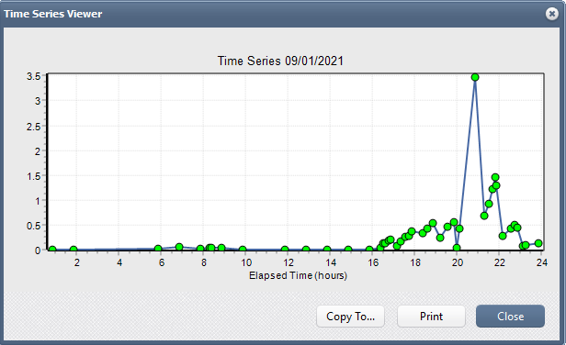
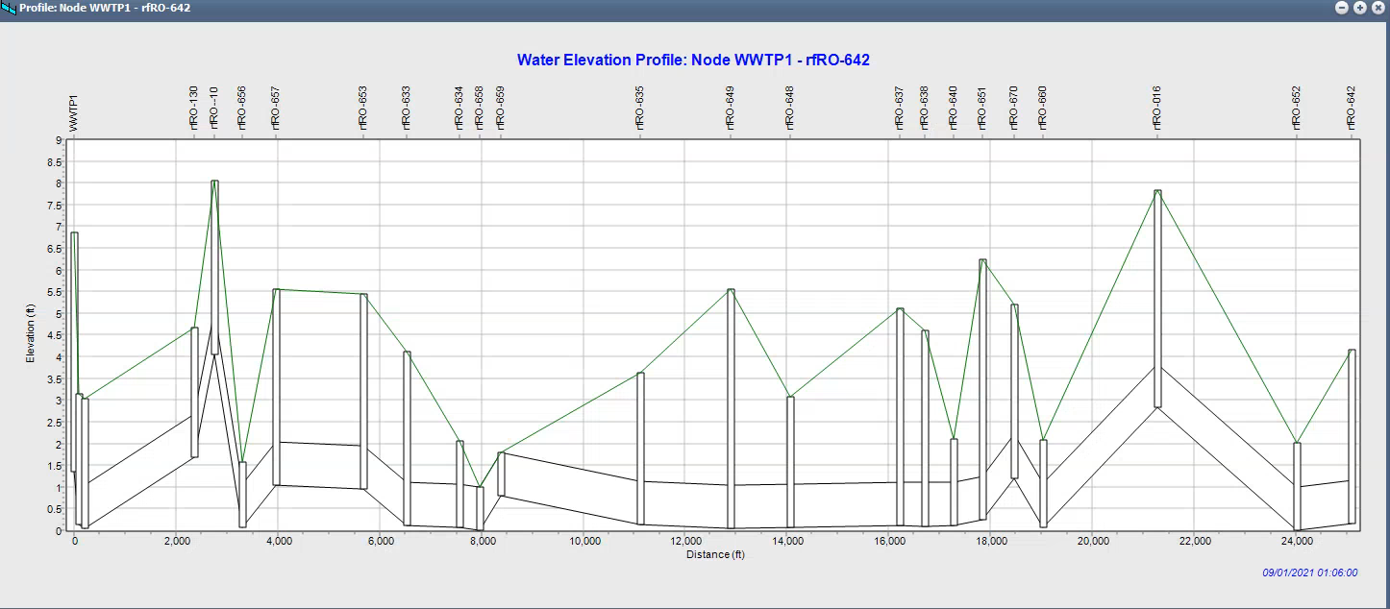
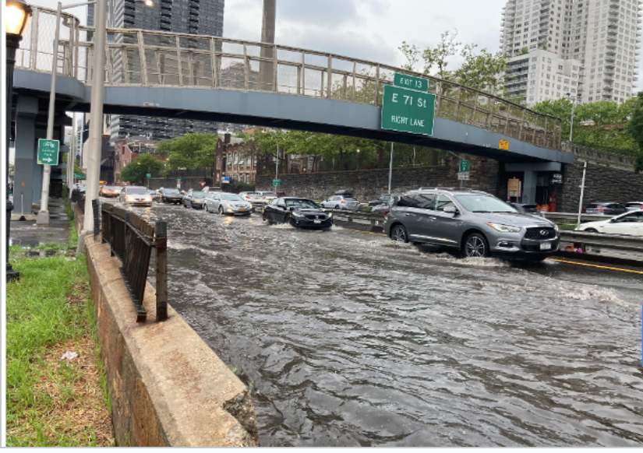
SWMM Test Case – Simplified block in Rockaway
Ida
Utilization of Storm Water Management Model (SWMM) and HEC-RAS 2D model to generate detailed urban flood maps

Slide 7
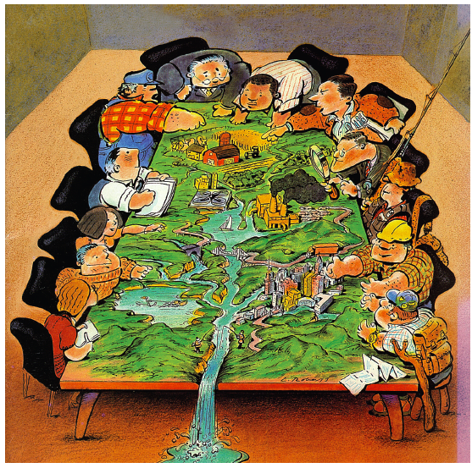
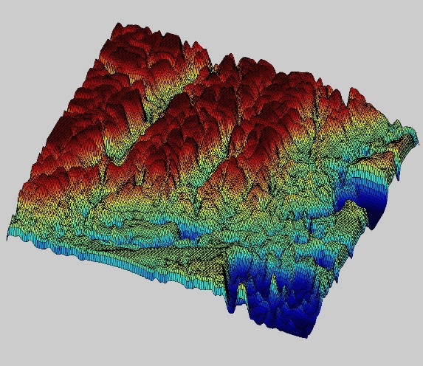
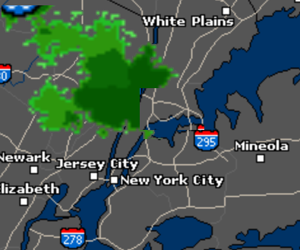
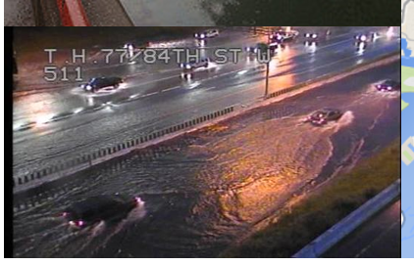
Science → Action
Stakeholders Engagement
&
Co-produced Research
Climate Change and LULC change Data Curation
Extreme Rainfall Modeling
Urban Flood Scenarios
Infrastructure Performance Analysis under Climate Change
Thank you!
Pressing need for improved urban stormwater modeling/management systems to handle higher intensity rainfall as climate change continues to impact the weather and urban cosmos

