Slide 1
Impacts of Anthropogenic Climate Change and Urbanization on Derechos – Contrasting Results between Two Case Studies
Poster # 016 on Thursday
2024 EESM PI Meeting
Yuwei Zhang¹, Jiwen Fan²,
Jianfeng Li¹, Zhe Feng¹ and Paul Ullrich^{3,4}
1. Pacific Northwest National Laboratory
2. Argonne National Laboratory
3. Lawrence Livermore National Laboratory
4. University of California, Davis

Slide 2
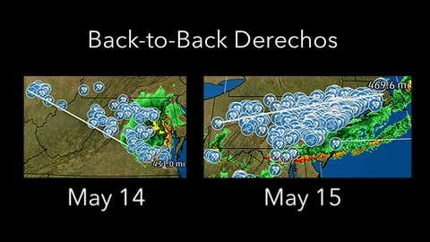
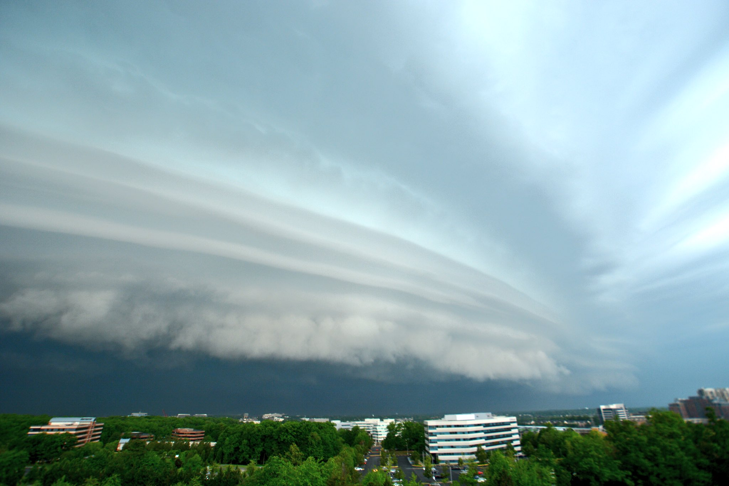
Objective
To improve understanding of how present-day derechos would be changed under future warming and urbanization environments
Methods
Conduct WRF simulations at 1-km grid spacing for two present-day Derecho cases
2018 Northeast Derecho (May 14 and 15, two back-to-back derechos; damaging tornados and large hail). The first to hit the New York metropolitan area in several year.
@DildineWTOP
Carry out sensitivity simulations to investigate climate change effect (PGW approach with ensemble mean difference between 2071-2100 and 1981-2010 from 11 CMIP6 models) and urbanization effect (increase urban areas by 6 times)

Slide 3
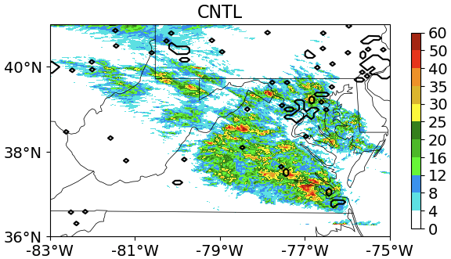
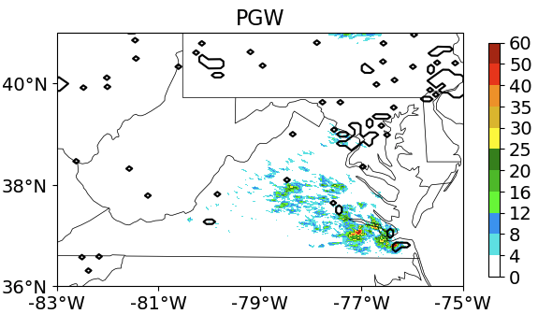
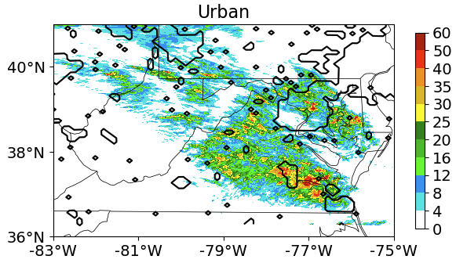
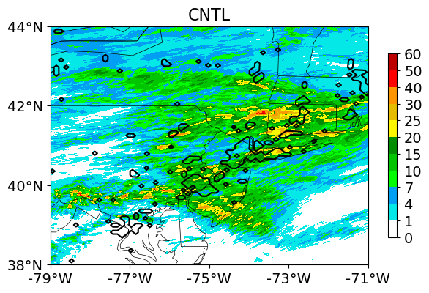
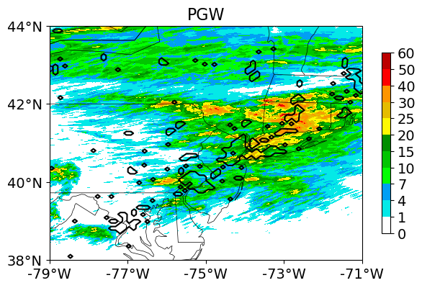
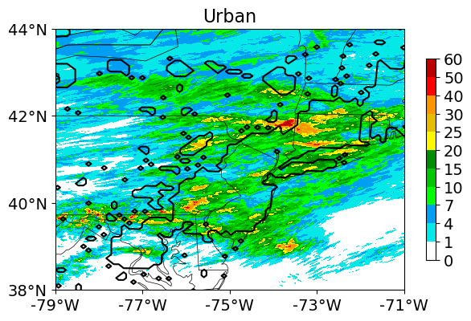
Main results: Maximum precipitation rate
May 14 derecho
CNTL
ACC
Urban
May 15 derecho
CNTL
ACC
Urban

Slide 4
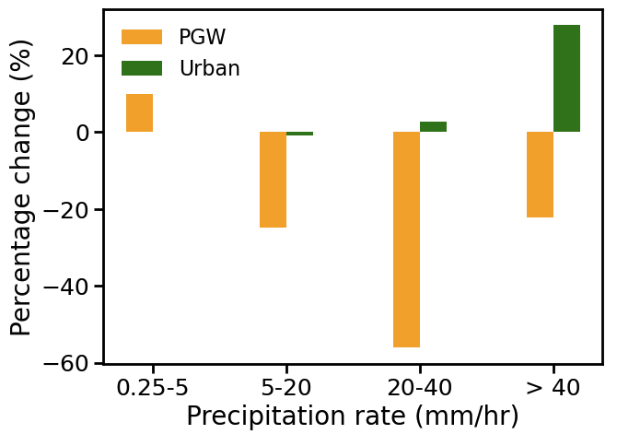
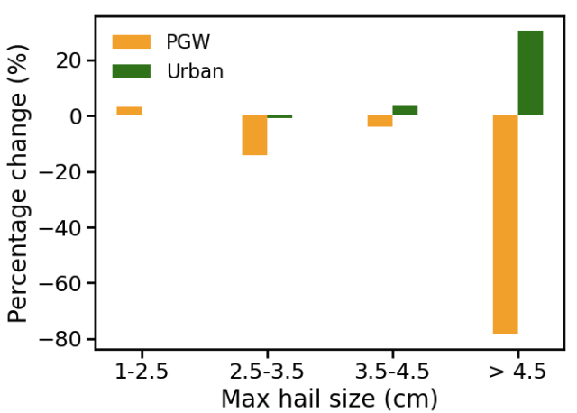
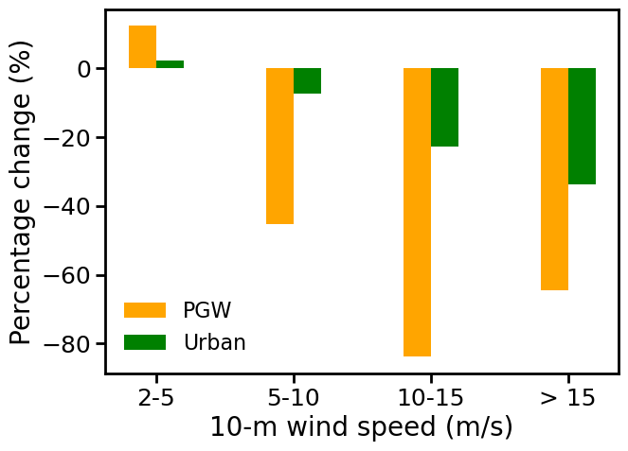
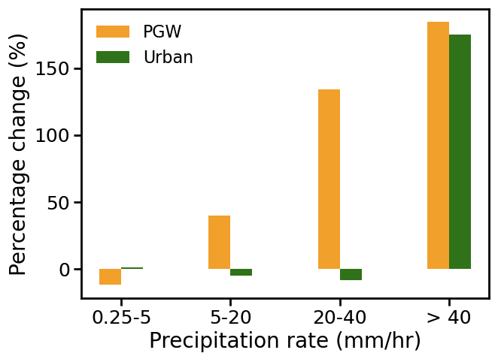
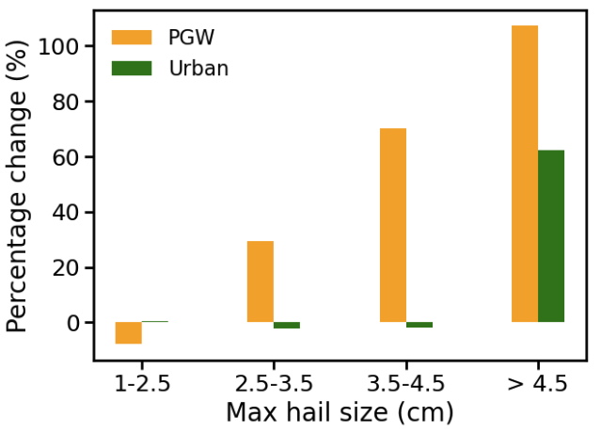
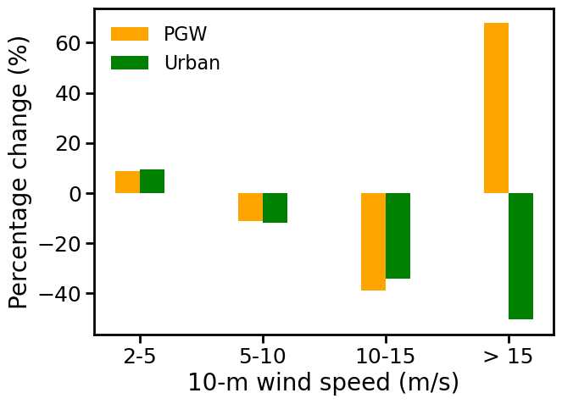
Main results: percentage change of PDFs of precipitation, hail and near surface winds
May 14 derecho
Hourly precipitation rates
Max hail sizes
10-m wind speed
ACC
Urban
ACC
Urban
ACC
Urban
May 15 derecho
Hourly precipitation rates
Max hail sizes
10-m wind speed
ACC
Urban
ACC
Urban
ACC
Urban

Slide 5
Summary
Anthropogenic climate change (ACC) and urbanization effects on severe convective storms are case-dependent – can be in a contrasting effect between different cases
ACC impacts are opposite between May 15 and May 14 derechos: strengthened in the former but drastically weakened in the latter, resulting from drastically different large-scale responses.
Urbanization effects on on wind speeds, heavy precipitation, and significant severe hail (SSH) are consistent for both cases: enhanced heavy precipitation and SSH, but weakened near-surface wind speeds.
Urbanization effects are stronger in May 15 but the effects are much weaker in May 14 case because a smaller part of the storm passes over the urban area.
Welcome to the poster session for more details.
Poster # 016 on Thursday

