Slide 1
Spark: Modeling Battery Storage in MSD Context
Pralit Patel
2024 EESM PI Meeting

Slide 2
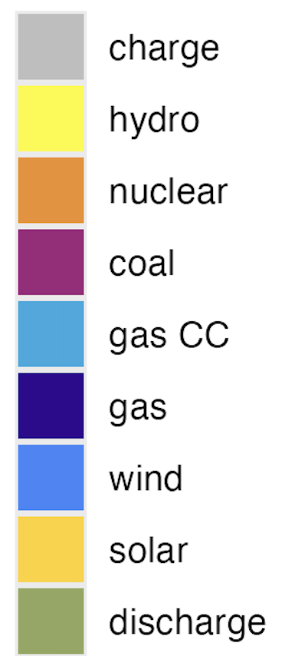
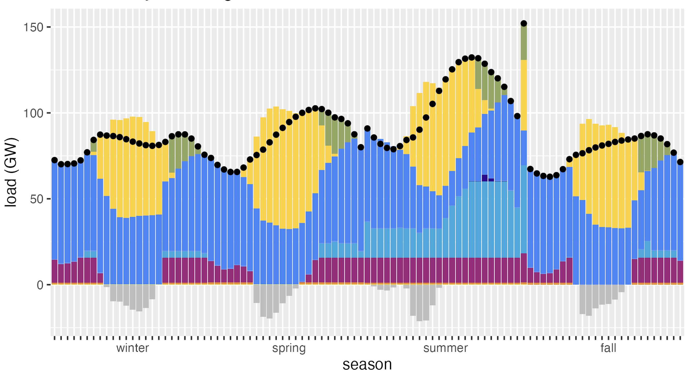
Ostensibly about grid storage
Explicitly model battery grid storage which provides “load shifting”; more effectively utilize electric capacity
Particularly useful in conjunction with Variable Renewable Energy (VRE)
Within a structural model which includes appropriate dynamics to characterize the benefits of storage to the system (not just a statistical relationship)
Still within the full GCAM/GCAM-USA

Slide 3
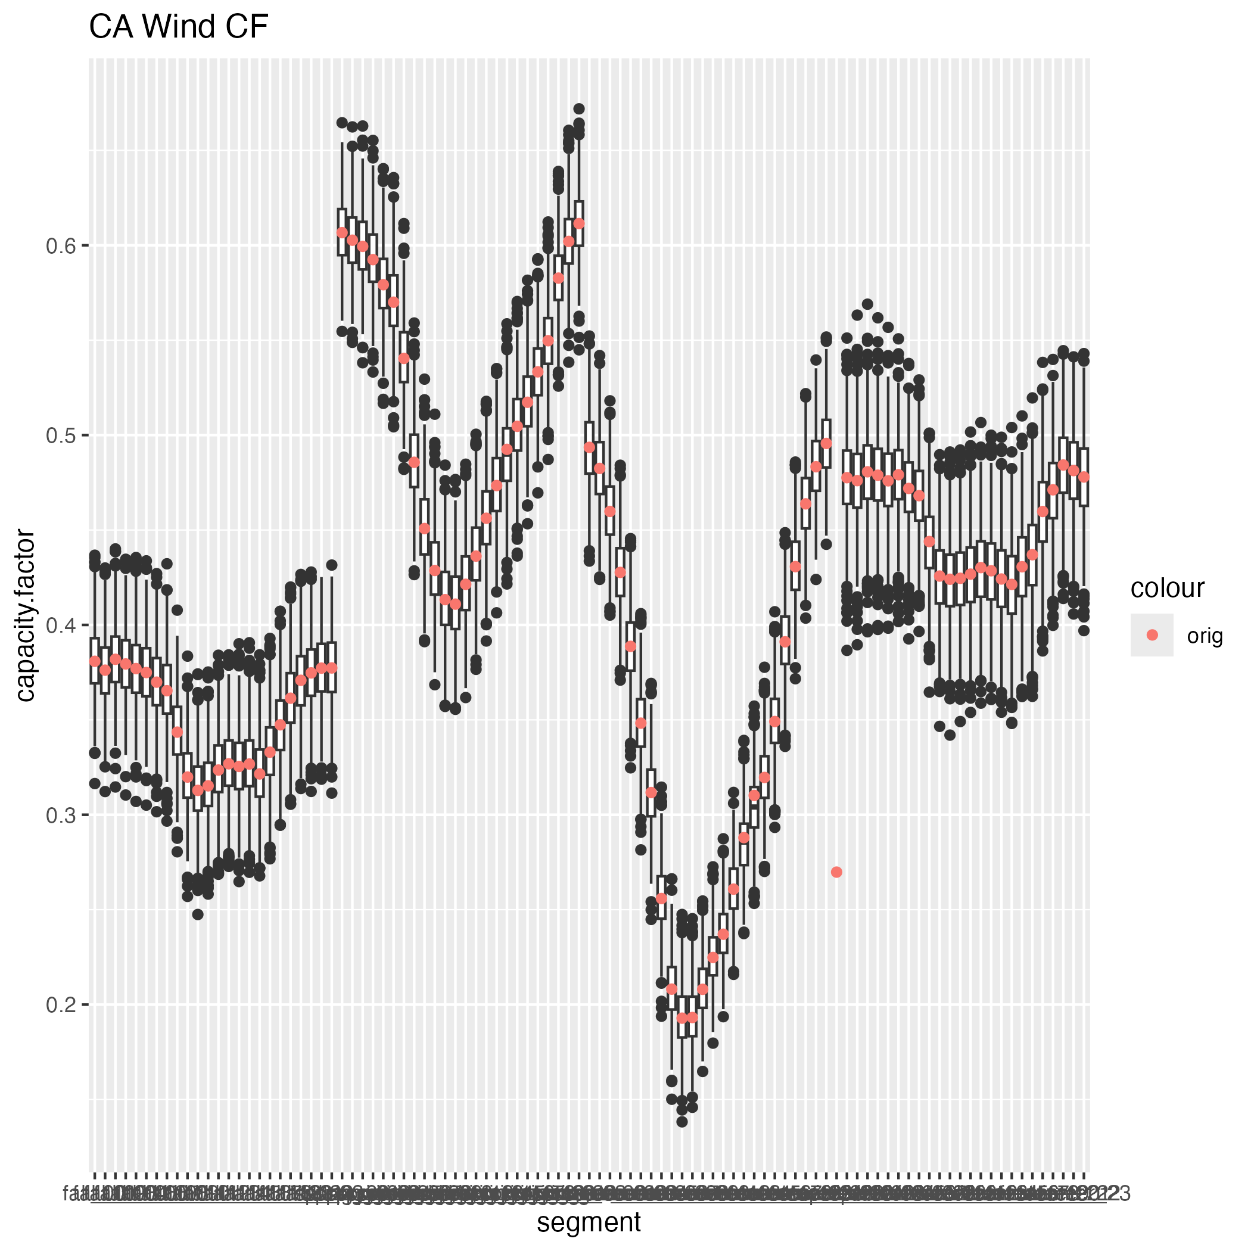
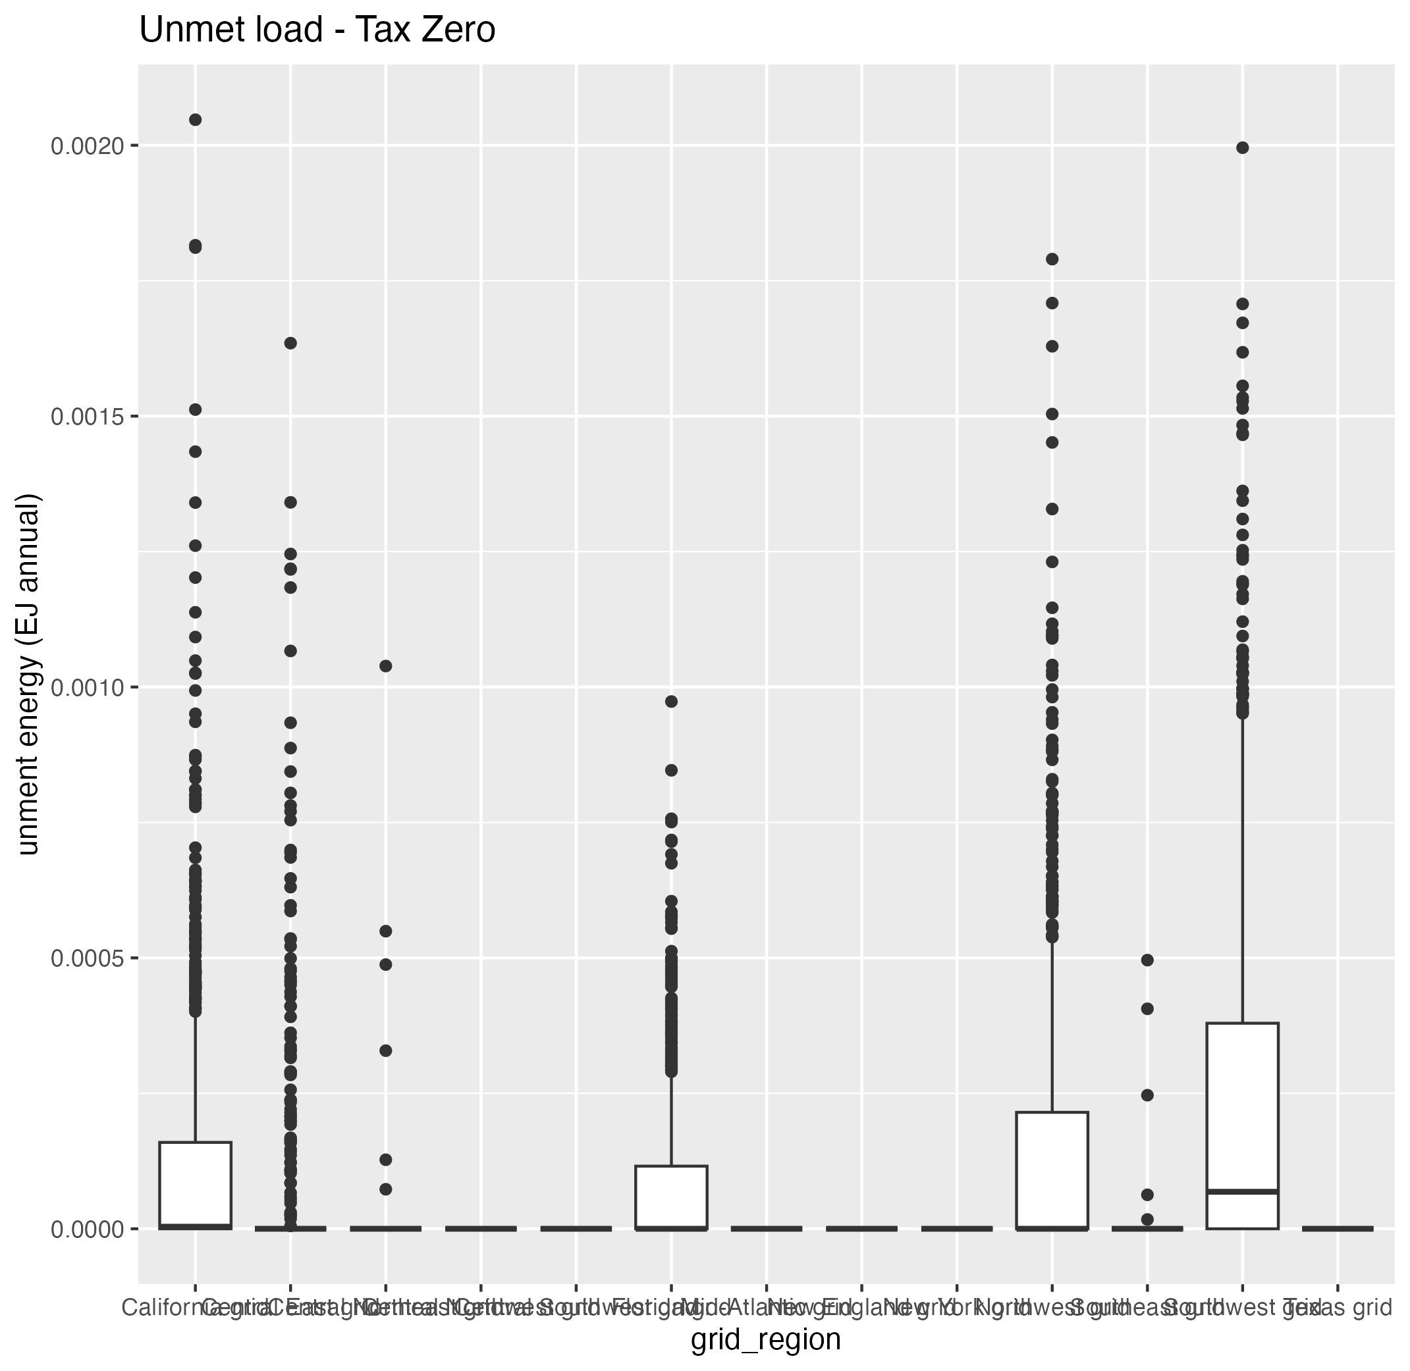
Really driving towards the overarching science goals
“How do short-term influences affect long-term dynamics”?
”How will investments affect the ability to respond to future influences”?
Variability
Extremes
Climate Impacts

Slide 4
Designing a flexible system which has the right levers
GCAM will never have all the details (resolution, climate, stressors)
Collaboration and model coupling are key
Speak the same language to ensure we can faithfully include feedbacks to / from coupled systems
Manage trade off in complexity with science goals
Robust methodologies
Flexible and nimble data processing
We may want to ultimately translate to statistical relationships

Slide 5
Poster 136

