Slide 1
Land use and land cover change for V1 experiments
G. Hurtt, R. Sahajpal, L. Chini, P. Thornton, Xiaoying Shi, Dan Ricciuto
November 10, 2016

Slide 2
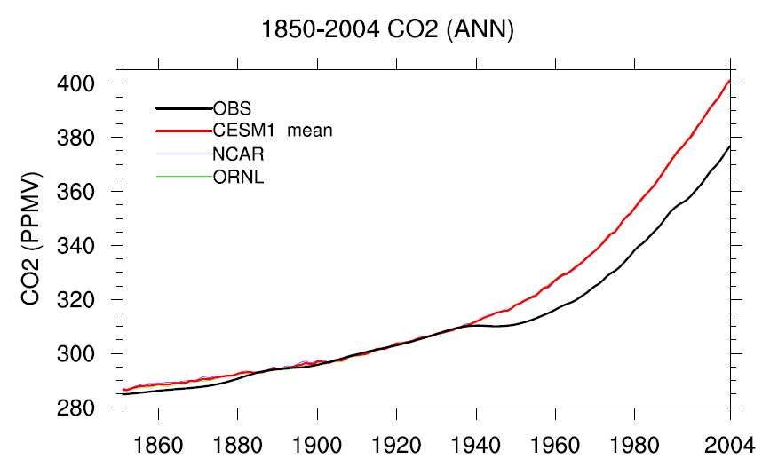
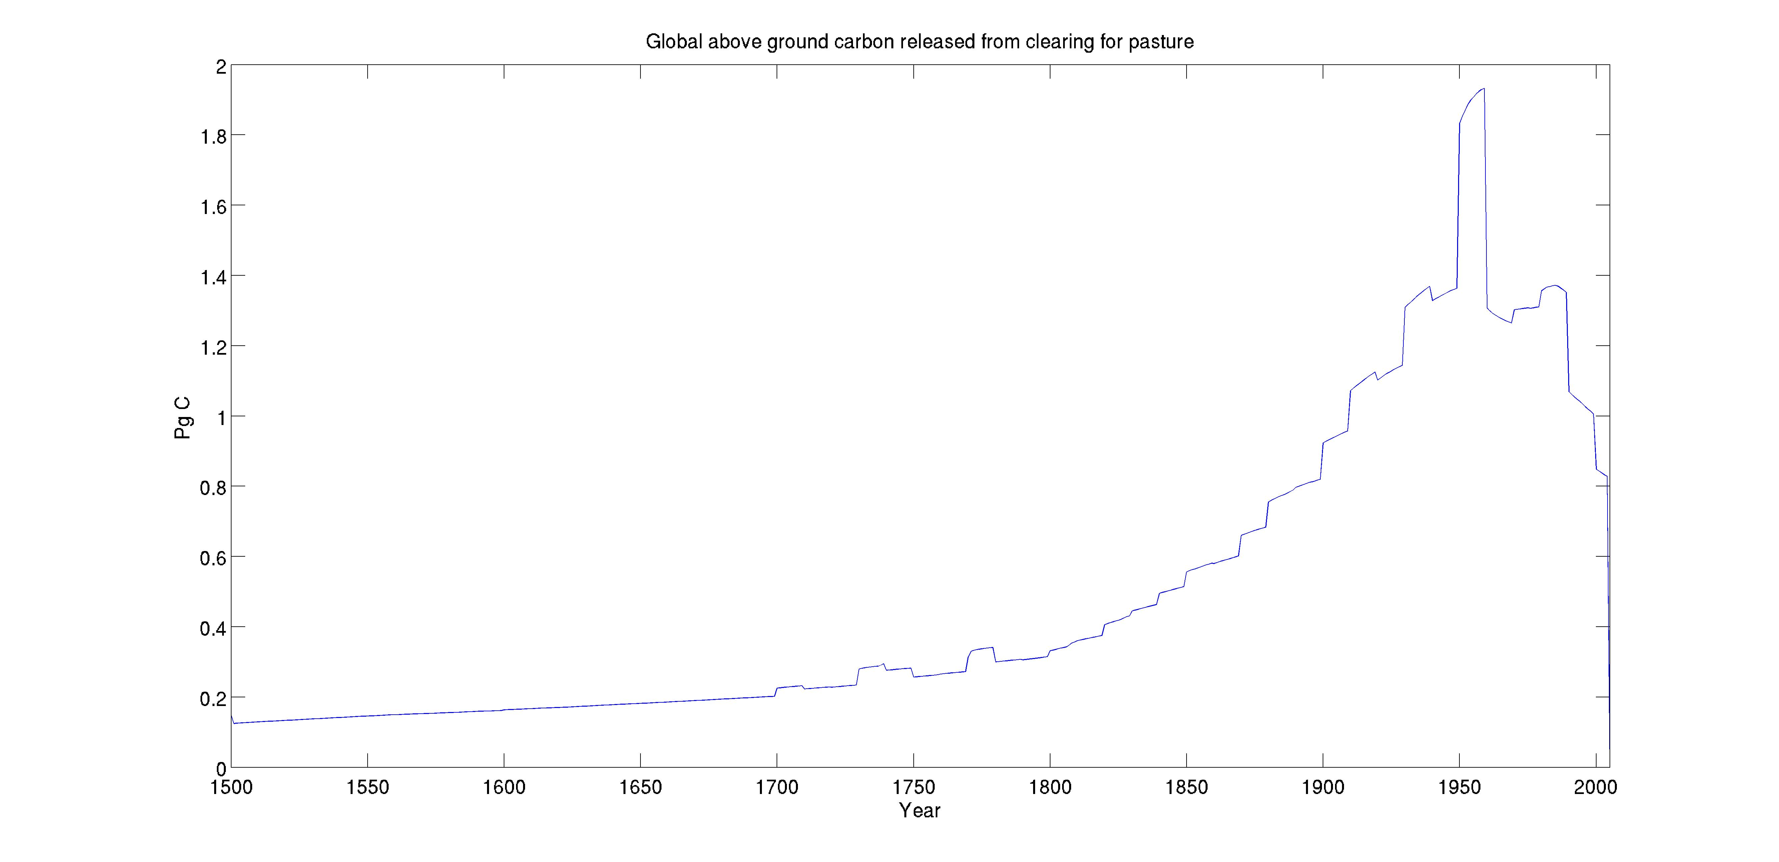
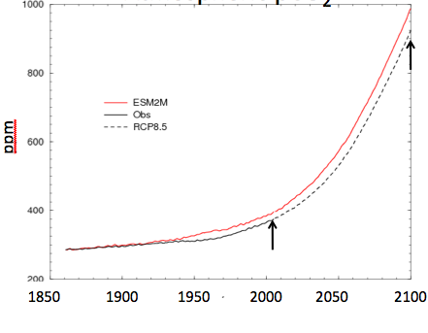
Simulated Atmospheric CO₂
Courtesy P. Thornton
Courtesy R. Stouffer
Courtesy L. Chini

Slide 4
Goals
Enable new land use datasets in ACME v1 (LG-170)
  Convert LUH2 dataset into a format ACME v1 can recognize (LG-171)
  Enable usage of land-use/land cover-change data in ACME v1 (LG-172)
Enable new land use datasets in ACME v2/3 (LG-144)
Develop consistent historical carbon cycle and land-use in ACME v2/3 (LG-145)

Slide 6
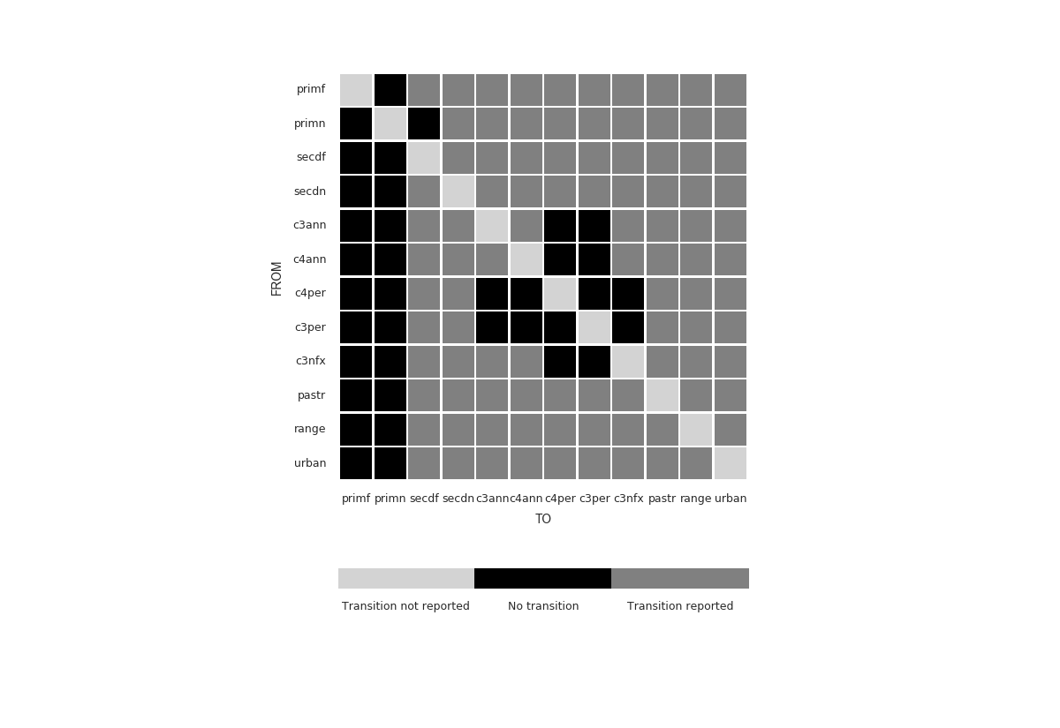
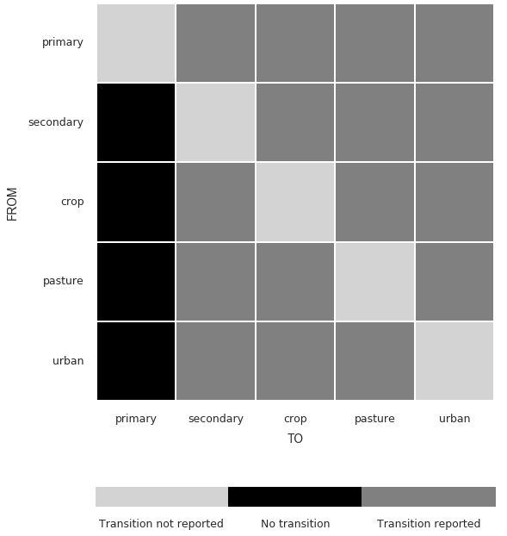
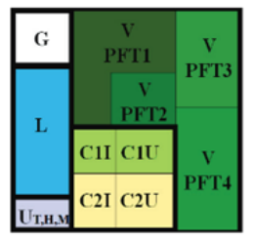
Enabling use of LUH2 in ACME v1
Land use
translator
LUH1 (0.5 ͦ)
ACME v1
LUH2 (0.25 ͦ)

Slide 7
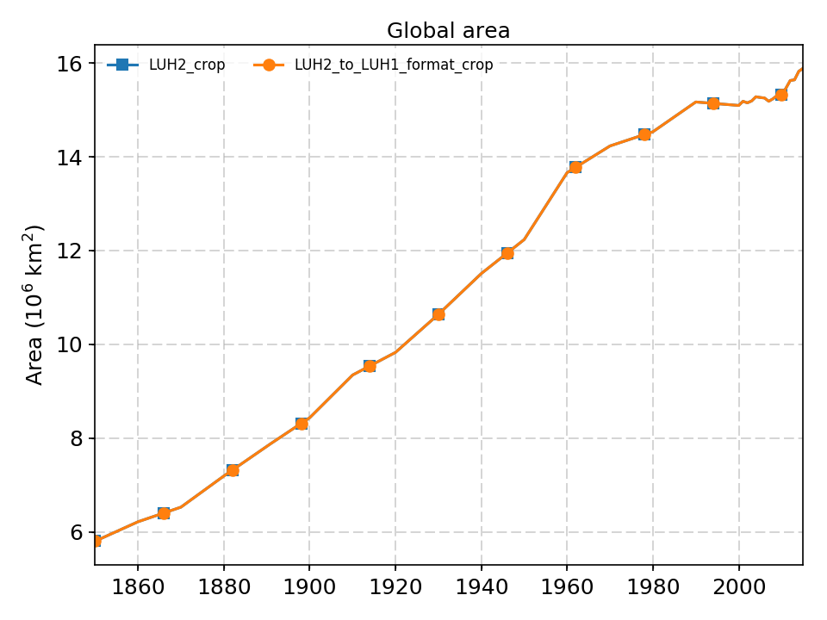
  Convert LUH2 dataset into a format ACME v1 can recognize (LG-171)
Major Steps
DONE
Regridding LUH2 datasets into LUH1’s spatial extent
Producing LUH1 land use classes from constituent LUH2 land use classes using land use state and gross transition information
Converting resulting product into a format compatible with Land use translator code
Validation (offline)
DONE
DONE
DONE
Notes:
Converting luh2 into luh1
Land use translator
diagnostics
Makesurface dat

Slide 8
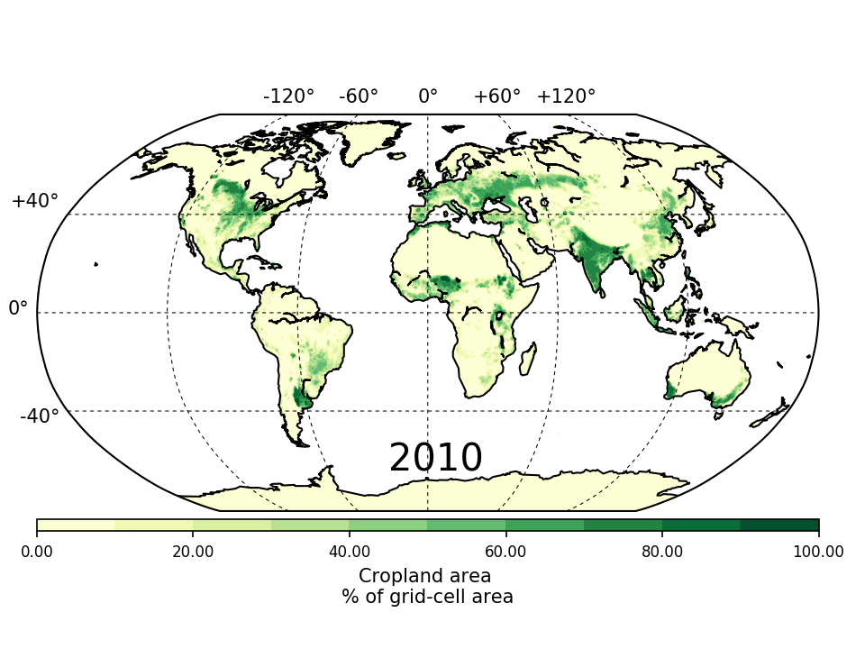
  Enable usage of land-use/land cover-change data in ACME v1 (LG-172)
Major Steps
DONE
Identifying and decoupling Land use translator code from iESM code base
Modifying Land use translator code to ingest latest land use data (in LUH1 format) and output land cover information
Validation (offline)
Creating surface dataset from land cover information
Validation (online)
DONE
DONE
NOW

Slide 9
Enable LUH2 dataset in ACME v2/v3
Vegetation forest (primary)
Vegetation non-forest (primary)
Vegetation forest (secondary): 10 age classes
Vegetation non-forest (secondary)
Cropland (13 crop types) 3 management options: irrigation, fertilization, flooding
Pasture (managed)
Pasture (rangeland)
Urban
LUH2 (12 classes, ~100txns)
ACME v2/v3 (33-59 units )

Slide 10
Enable LUH2 dataset in ACME v2/v3
LUH2 transitions | Land-unit in ACME v2/v3
Not present in LUH2 | Glacier, Lake, Wetland, Barren
primf_to_c3ann, primf_to_c3nfx, primf_to_c3per, primf_to_c4ann, primf_to_c4per, primf_to_pastr, primf_to_range, primf_to_secdn, primf_to_urban, primf_harv | Vegetation forest (primary)
secdf_to_c3ann, secdf_to_c3nfx, secdf_to_c3per, secdf_to_c4ann, secdf_to_c4per, secdf_to_pastr, secdf_to_range, secdf_to_secdn, secdf_to_urban, secmf_harv, secyf_harv | Vegetation forest (secondary): 10 age classes
primn_to_c3ann, primn_to_c3nfx, primn_to_c3per, primn_to_c4ann, primn_to_c4per, primn_to_pastr, primn_to_range, primn_to_secdn, primn_to_urban, primn_harv | Vegetation non-forest (primary)
secdn_to_c3ann, secdn_to_c3nfx, secdn_to_c3per, secdn_to_c4ann, secdn_to_c4per, secdn_to_pastr, secdn_to_range, secdn_to_secdf, secdn_to_urban, secnf_harv | Vegetation non-forest (secondary)
urban_to_c3ann, urban_to_c3nfx, urban_to_c3per, urban_to_c4ann, urban_to_c4per, urban_to_pastr, urban_to_range, urban_to_secdn, urban_to_secdf | Urban
*_to_c3ann, *_to_c3nfx, *_to_c3per, *_to_c4ann, *_to_c4per, *_to_pastr, *_to_range, *_to_secdf, *_to_secdn, *_to_urban * can be one of c3ann, c4ann, c3per, c4per, c3nfx. No self-transitions allowed. | Crop – 13 crop types x 3 management options each
Pasture (managed) pastr_to_c3ann, pastr_to_c3nfx, pastr_to_c3per, pastr_to_c4ann, pastr_to_c4per, pastr_to_range, pastr_to_secdf, pastr_to_secdn, pastr_to_urban Rangeland (unmanaged) range_to_c3ann, range_to_c3nfx, range_to_c3per, range_to_c4ann, range_to_c4per, range_to_pastr, range_to_secdf, range_to_secdn, range_to_urban | Pasture – 2 types (managed/unmanaged)

Slide 12
ACME Opportunity
Use of newest land-use data (DOE-SciDAC), required forcing CMIP6
Advanced model development for fullest and most consistent representation of land-use effects
Opportunity to lead science of land/land-use change on Earth system dynamics/climate/carbon (past-future)

