Slide 1
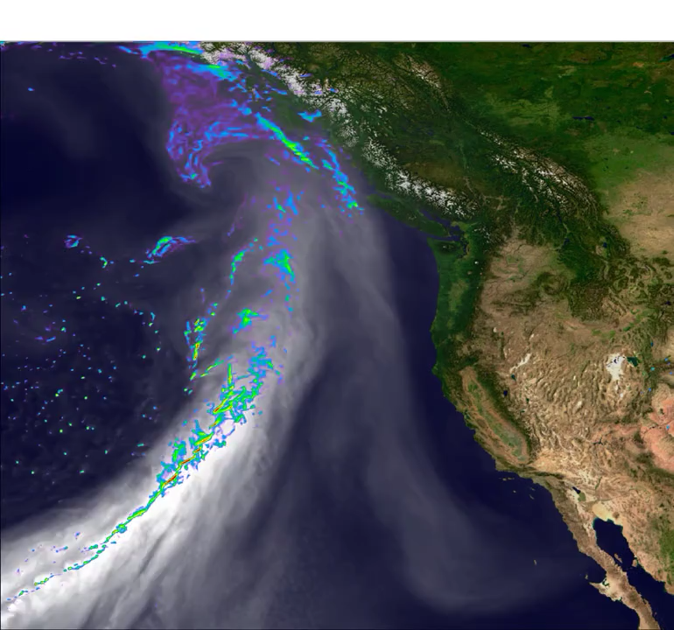
The Simple Cloud-Resolving E3SM Atmosphere Model (SCREAM)
Scientific Challenge
Treatment of sub-grid scale convection in general circulation models (GCMs) is a major source of climate-change uncertainty
Climate impacts are felt on scales too small to resolve in conventional global models
Upcoming exascale computers won’t perform individual calculations faster, they will do more in parallel. This requires more parallel work… which higher resolution provides…
⇒ Now is the time for a convection-resolving global model!
Approach and Results
E3SM is creating a new global atmosphere model (SCREAM) which is:
  targeted for 3 km grid spacing but able to run at any resolution
  written in C++ for fast performance on GPUs
Prototype (F90) runs contributed to the “DYAMOND2” intercomparison look very promising (see movie)
Movie: Precipitation (colors) and integrated water vapor (gray) for an atmospheric river from E3SM’s DYAMOND2 simulation. By Paul Ullrich/UC Davis
Impact
This effort provides E3SM with a GPU-enabled atmosphere model
Explicitly resolving convective events appears to solve many long-standing biases in GCMs
Because it resolves finer scales, SCREAM will be more useful for climate impact studies
Citation: Caldwell, Terai, and 28 coauthors, Convection-Permitting Simulations with the E3SM Global Atmosphere Model, Submitted to J. Adv. Model. Earth Syst. (2021). https://doi.org/10.1002/essoar.10506530.1

