Slide 1
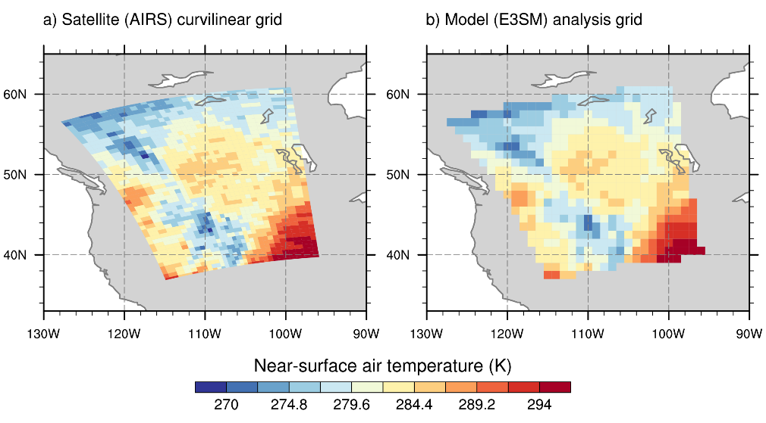
The netCDF Operators (NCO): Automatic Remapping of Gridded Geoscience Data
Science
The netCDF Operators (NCO) provide the first automatic remapping tool that transforms geoscience data between any two map grids. This significantly eases the intercomparison of Earth system model (ESM) simulations and their evaluation against satellite-based observations.
NCO Solution
Using NCO, researchers can readily perform what was formerly a time-consuming and error-prone remapping task without having to manually locate or generate grid information. Instead, they can work with readily available data files.
NCO takes advantage of parallel computer processing to provide the fastest possible regridding. Comparisons show that NCO regrids up to 100 times faster than other similar-purpose tools.
Beyond automatic remapping, NCO performs much of the workflow that converts raw ESM output into the statistical data formats favored by researchers, DOE, NASA and the Intergovernmental Panel on Climate Change (IPCC).
NCO remapping of fine-scale temperature data derived from NASA satellite measurements, in the HDF format (left), onto a coarser DOE E3SM model grid in netCDF format (right).
Science Impact
In addition to facilitating comparison between models and satellite measurements, NCO significantly eases intercomparison of ESM simulations with those of other models.
NCO expedites deeper understanding of geophysical processes and accelerates their improved representation in ESMs.
Get NCO
NCO software is available at: https://github.com/nco/nco
Documentation can be found at: http://nco.sf.net/nco.pdf

