Slide 1
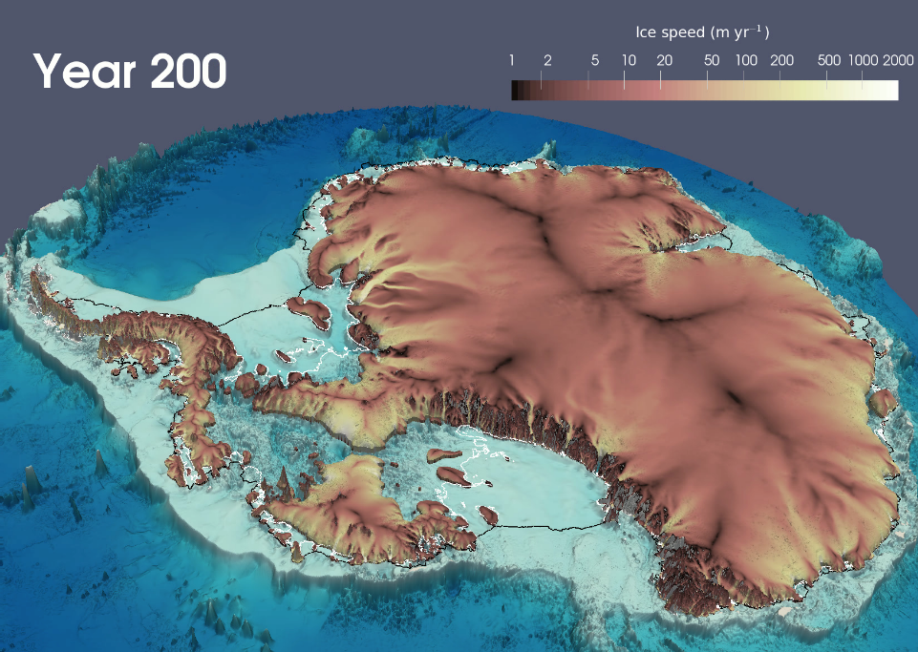
MPAS-Albany Land Ice (MALI): a variable-resolution ice sheet model for Earth System modeling using Voronoi grids
Science
MALI is a new ice sheet model that is built using the Model for Prediction Across Scales (MPAS) framework for developing variable-resolution Earth system model components and the DOE multiphysics software library, Albany. MALI uses variable-resolution, unstructured Voronoi grids to provide high resolution only where needed such as in highly dynamic regions like ice streams and ice shelves, thereby applying computational power more efficiently.
Performance
When employing MALI’s variable resolution capability, the same solution accuracy can be achieved for approximately half the number of unknowns relative to a uniform, high-resolution model.
MALI’s multi-century simulations of Antarctic ice sheet evolution operate at unprecedented spatial resolution and solve for ~32 million unknowns on 6400 processors with average model throughput of ~120 simulated years per wall clock day.
Model fidelity, performance, and reliability under offline, extreme climate forcing experiments lend confidence in MALI’s ability to perform robustly as a coupled component of E3SM (e3sm.org).
Simulated Antarctic ice sheet geometry and speed from MALI 200 years after the instantaneous removal of all floating ice shelves.
Science Impact
By solving a more complete description of ice motion, MALI is more accurate than most existing large-scale, high-resolution, whole-ice-sheet models.
MALI is being coupled to DOE’s E3SM model and will soon be suitable for simulations as a fully-coupled component of E3SM.
Coupled E3SM-MALI simulations will be used to estimate the potential impacts of ice sheets on future sea level and to better understand how ice sheets interact with the global climate system.
Get MALI
MALI is part of MPAS v6.0.
Code: https://github.com/MPAS-Dev/MPAS-Model/releases Documentation and test cases:
http://mpas-dev.github.io/land_ice/download.html

