Slide 1
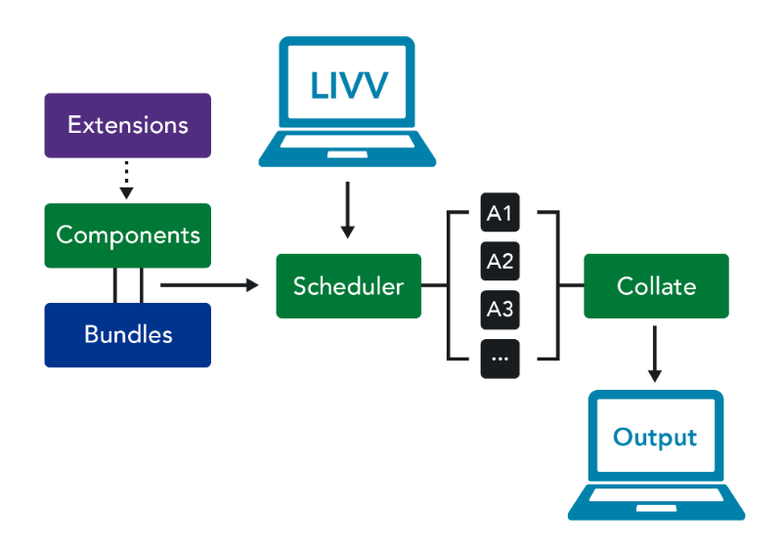
The Land Ice Verification and Validation Toolkit (LIVVkit)
Ice Sheet Modeling
LIVVkit is a python-based ice sheet model validation and verification software that is important for testing ice sheet models as they are developed, and comparing with available observations.
It is a part of the Community Ice Sheet Model (CISM) and the Energy Exascale Earth System Model (E3SM).
Verification and Validation
LIVVkit provides an easily extensible framework to expand its capability, to include new observational data, and to apply to new ice sheet models on new computing platforms.
Data from reanalysis, remotely sensed, and in-situ sources are included within the validation process; they are accessed and processed using a suite of scripts that can be extended to include new data as they become available
This schematic of LIVVkit architecture illustrates how the interface is used to schedule a series of analyses..
Science Impact
Ice sheet changes are expected to accelerate, and new observations will be made available. LIVVkit will be important for modelers to improve simulations and estimate expected ice sheet melting and sea level rise.
LIVVkit will greatly accelerate ice sheet modeling workflow, simplifying and standardizing model testing.
Get LIVVkit 2.1.1
Download the source code and software documentation at: https://github.com/LIVVkit/LIVVkit
J. H. Kennedy et al.: "LIVVkit: An extensible, python‐based, land ice verification and validation toolkit for ice sheet models," Journal of Advances in Modeling Earth Systems, https://doi.org/10.1002/2017MS000916

