Slide 1
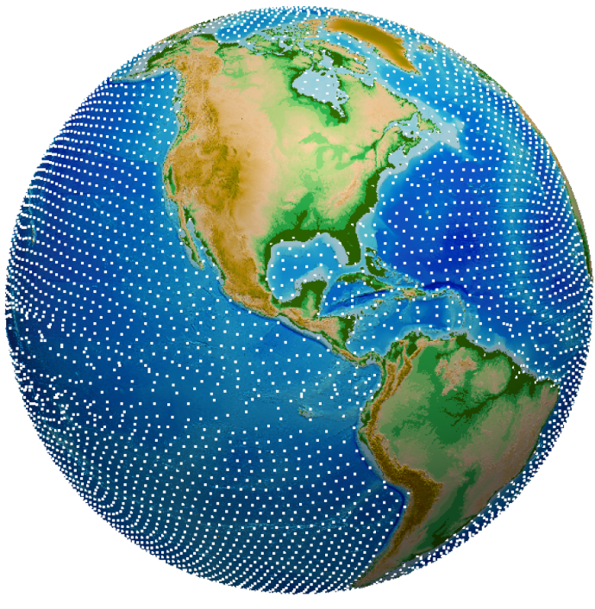
Analyzing Ocean Mixing at Exascale: Lagrangian, in Situ, Global, High-Performance Particle Tracking (LIGHT)
Science
LIGHT provides a new capability to analyze ocean mixing within the Energy Exascale Earth System Model (E3SM, e3sm.org) by using “virtual” particle floats to follow the natural motion of the ocean currents, making it more accurate than other approaches.
LIGHT Solution
Light makes use of a Lagrangian (flow-following) frame of reference compared to other models that use Eulerian (Earth-centric) coordinates.
By calculating particle/float motion in situ with each model time-step, rather than saving flow velocities to disk much less frequently, LIGHT uses computing power more efficiently and economically.
Global Lagrangian floats in E3SM using LIGHT, with 1 out of 5000 floats plotted for clarity.
Science Impact
The gains in accuracy and computational efficiency LIGHT provides, allows it to be incorporated into high-resolution models like E3SM, to more realistically model ocean mixing.
When applied to other E3SM components, LIGHT will foster a better understanding of the global water cycle.
Get LIGHT
LIGHT is part of MPAS-Ocean v6.0. Download MPAS-Ocean at: https://github.com/MPAS-Dev/MPAS-Model

