Slide 1
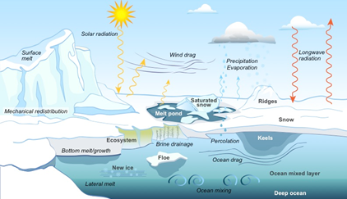
Icepack: Essential Physics for Sea Ice Models
Science
Understanding and predicting the evolution of sea ice–a mutable, moving, semi-solid material composed of ice, water, salt, gases, and other chemical constituents–poses a formidable challenge for scientists.
Sea ice and earth system models must include representations of highly complex physical processes.
Icepack Solution
Icepack is a modular software package that represents critical, vertically active sea-ice processes, including thermodynamics, ridging, biogeochemistry, and associated area and thickness changes.
The software can be ported easily to a wide variety of models for sea ice prediction and earth system simulation.
The sea ice physics in Icepack were developed with the support of the U.S. Department of Energy since the early 1990s as part of the Los Alamos sea ice model, CICE.
Icepack incorporates column-based physical processes that affect the area and thickness of sea ice.
Science Impact
Icepack is incorporated into the Department of Energy’s E3SM, the Exascale Earth System Model, and a new, discrete-element model for sea ice (DEMSI), under development in DOE.
Scientists can adjust Icepack to meet their needs. It can be used for developing and testing sea ice parameterizations.
Icepack enables collaboration for sea ice physics model development.
Get Icepack
The Icepack software and documentation are available at: https://zenodo.org/communities/ciceconsortium

