Slide 1
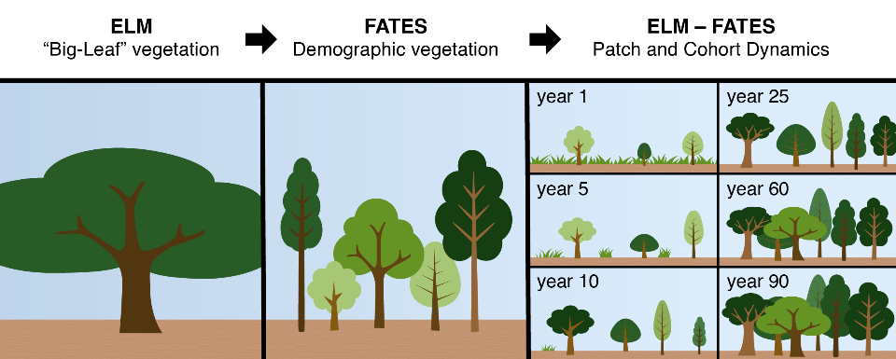
FATES: The E3SM Functionally Assembled Terrestrial Ecosystem
Terrestrial Ecosystem Modeling
FATES is a next-generation numerical terrestrial ecosystem model that simulates and predicts growth, death, and regeneration of plants and subsequent tree size distributions.
It allows representation of potential ecosystem responses to environmental resource availability, climate, and atmospheric compositional changes—and how ecosystem change alters earth system dynamics.
Earth System Model Integration
FATES is currently coupled to DOE’s Energy Exascale Earth System Model (E3SM) and the Community Earth System Model (CESM).
It allows E3SM to simulate earth systems at a high resolution, without substantially reducing computation speed.
A representation of vegetation in a ‘big-leaf’ version of the model, compared to demographic vegetation in FATES with heterogeneity in plant size, canopy, type as represented by ‘cohorts,’ and age since disturbance separated into different ‘patches.’
Science Impact
FATES provides a precise representation of real-world ecologies, such as accurate water, carbon, and energy cycles. This is a critical step in moving ESMs to more realistic representations of a terrestrial ecosystem’s impact on earth systems.
Get FATES
Download FATES code and software at: https://github.com/NGEET/fates-release
Documentation is available at: https://fates-docs.readthedocs.io/en/latest/index.html
Fisher, R. A., et al. (2015). “Taking off the training wheels: the properties of a dynamic vegetation model without climate envelopes, CLM4.5(ED).” Geoscientific Model Development 8, 3593-3619, DOI: 10.5194/gmd-8-3593-2015

