Slide 1
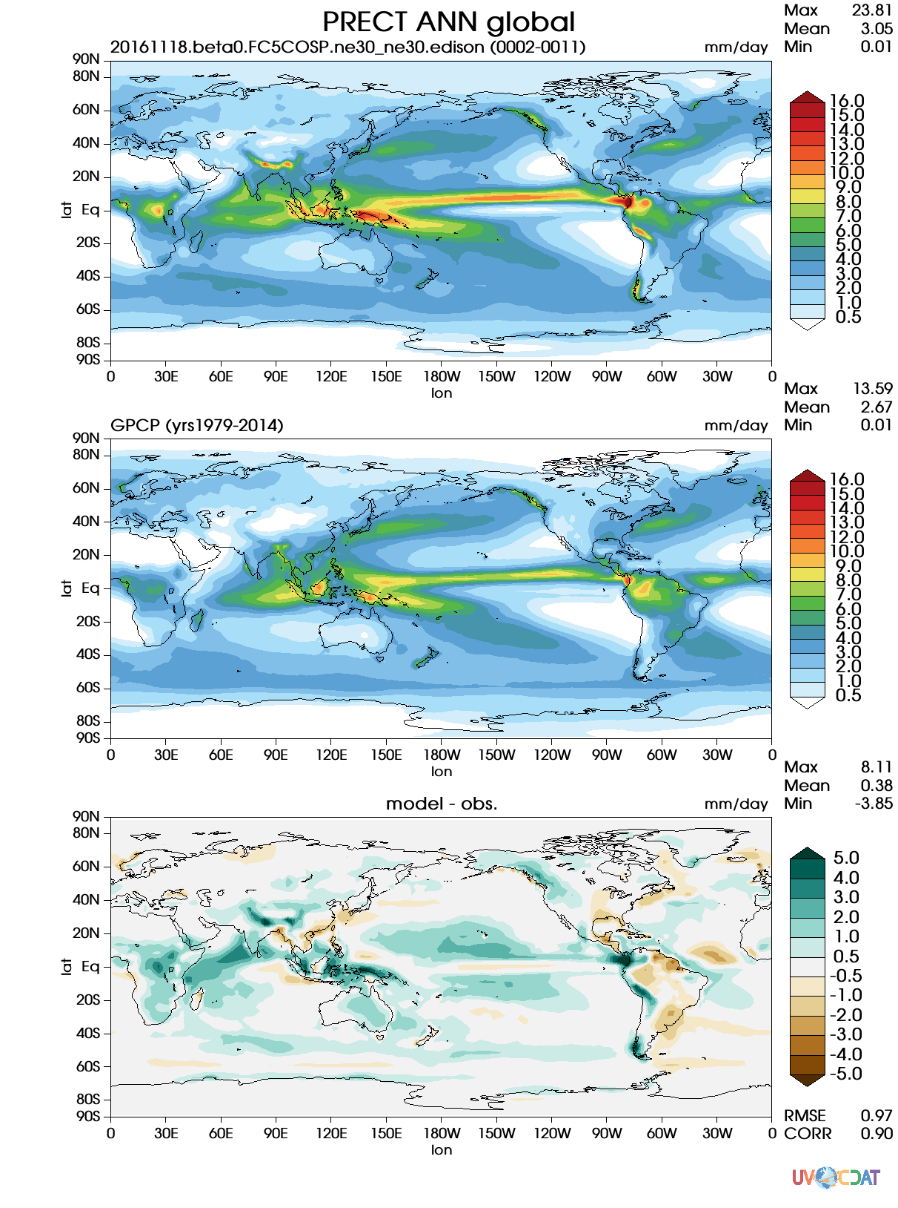
The E3SM Diagnostics Package for Earth System Model Evaluation
Science Impact
An important step in model development is performing diagnostics by comparing the model to observational or reanalysis data or by comparing it to another model. The E3SM Diagnostics Package facilitates the diagnostic process due to its adaptability and the inclusion of the most up-to-date validation datasets.
Flexible Software
E3SM Diagnostics is adjustable and modular, enabling users to customize data processing and metric computation, as well as data visualization.
Written with parallel computing in mind, the package can manage a multiprocessing pool to speed up diagnostics processes.
Though designed for E3SM, the software can be easily expanded to accommodate output from other earth system models.
Get E3SM Diagnostics
Code: https://github.com/E3SM-Project/e3sm_diags
Code DOI: http://doi.org/10.5281/zenodo.1009156
Docs: https://e3sm.org/resources/tools/diagnostic-tools/e3sm-diagnostics/
Example diagnostic latitude-longitude contour plot of global precipitation. Top panel shows E3SM model data, middle shows observational data, and bottom shows the difference.

