Slide 1
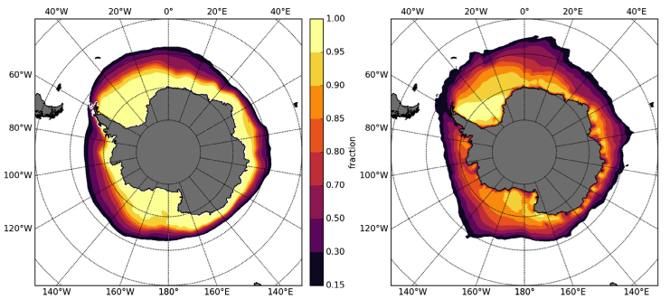
The CICE Consortium: A New Collaborative Paradigm for Sea-Ice Model Development
Sea-Ice Model Science
CICE—a preeminent model simulating the growth, melting, and movement of sea ice—is used by research and operational modeling centers in more than 20 countries.
CICE Consortium develops frameworks for sea ice modeling and model testing.
CICE Software
The sixth version of CICE software is currently being developed (https://doi.org/10.5281/zenodo.1205674).
The Icepack submodule containing CICE single-column physics and biogeochemistry is used in the DOE E3SM as well as other centers.
Climatologies of sea ice concentration simulated by MPAS-sea ice with Icepack in the E3SM (left), compared with observational estimates derived from the Special Sensor Microwave Imager (SSM/I) satellite instrument (right).
Science Impact
By coordinating collaboration on sea-ice model development, CICE Consortium accelerates the science that is critically needed for models to predict the sea-ice changes in both polar regions.
Get CICE
CICE: https://doi.org/10.5281/zenodo.1205674
Icepack: https://doi.org/10.5281/zenodo.1213462
About the CICE Consortium: https://github.com/CICE-Consortium/About-Us
CICE History: https://github.com/CICE-Consortium/About-Us/wiki/History
A. Roberts, et al. Quality Control for Community Based Sea Ice Model Development. Phil. Trans. Royal Soc. A, submitted 2018

