Slide 1
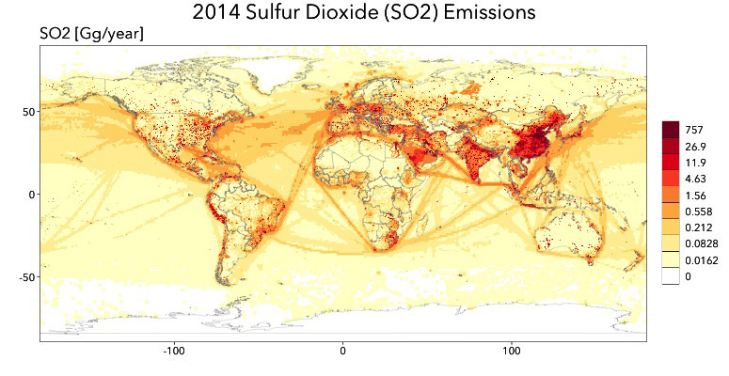
Historical Estimates of Atmospheric
Reactive Gases and Aerosols by the
Community Emissions Data System (CEDS)
Science
The Community Emissions Data System (CEDS) produces gridded estimates of atmospheric emissions by country and sector from 1750 to the present. The emissions lead to increased concentrations of aerosols - small atmospheric particles that have a net cooling effect and influence human health and ecosystems. Emissions data are used by models such as E3SM to examine how atmospheric concentrations of aerosols have changed over time and to evaluate whether models are accurately representing atmospheric chemistry and transport processes.
CEDS Solution
Prior emissions datasets lack reproducibility, high temporal resolution, and uniform methods across emissions species. CEDS meets these needs by bringing together information on energy consumption by sector, default emission factors, population, and country-level emission inventory data to generate annual emissions species estimates over time.
As open-source software, CEDS allows users to modify the system to use different assumptions or obtain different outputs, such as gridded emissions for a specific fuel or sector. New inventories or emission species can be added, or users can supply historical energy data for a specific country, overriding default historical values.
CEDS global sulfur dioxide (SO2) emissions in gigagrams per year (Gg/year) for 2014. Sulfur dioxide is the primary anthropogenic precursor of sulfate aerosol, which cools the Earth by reflecting sunlight into space. Emissions over the oceans are due to sea navigation routes.
Science Impact
CEDS provides a reproducible approach applied to all emissions types, uses updated emissions factors and more recent estimates, and documents data sources.
The CEDS system was used to create the 1750-2014 historical emissions data set used in the Coupled Model Intercomparison Project Phase 6 (CMIP6).
Future work includes regular data updates and calculating uncertainty estimates to aid in uncertainty analyses which ultimately help scientists better understand aerosol sources and effects.
Get CEDS
Code: https://github.com/JGCRI/CEDS/
Documentation: https://github.com/JGCRI/CEDS/wiki
Data: http://www.globalchange.umd.edu/ceds/ceds-cmip6-data/

