Slide 1
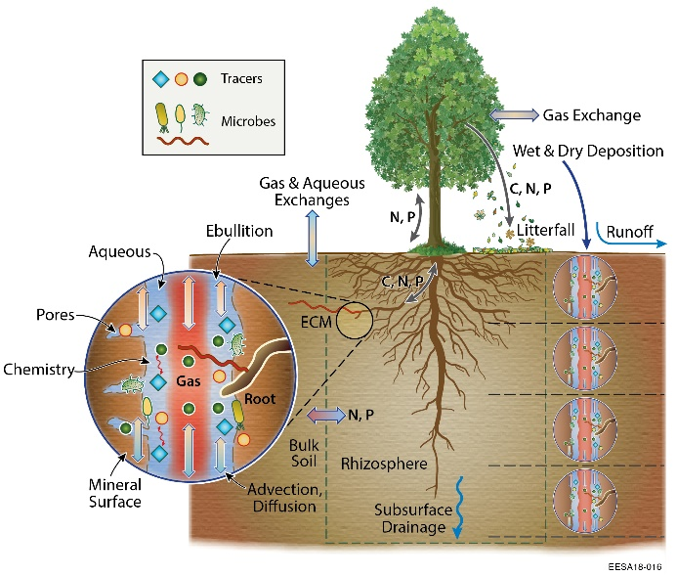
BeTR: Reactive Transport Modeling of Land Biogeochemistry
Science
The Biogeochemical Transport and Reaction module (BeTR) is a modular and robust framework that integrates solutions for many common BGC processes, such as multiphase transport and reaction, tracer labeling, and multiple competitor interactions.
It enables consistent and comprehensive assessment of ecosystem modeling uncertainties resulting from various sources.
Software
The software is built on the concept of modularity and polymorphism, and solves the various sub-processes using well evaluated numerical algorithms.
It allows different biogeochemical processes to be coupled with any given ESM.
BeTR is implemented into E3SM (e3sm.org).
Processes can be resolved in BeTR to enable hierarchical representation of land biogeo-chemistry dynamics.
Science Impact
BeTR code frees scientists from redesigning the transport code and numerical algorithms that are often embedded in BGC model development.
BeTR enables fast model development and comprehensive model evaluation with more diverse measurements.
Get BeTR
Code and documentation: https://github.com/BeTR-biogeochemistry-modeling/sbetr
Tang, JY and WJ Riley. 2018. "Predicted Land Carbon Dynamics Are Strongly Dependent on the Numerical Coupling of Nitrogen Mobilizing and Immobilizing Processes: A Demonstration with the E3SM Land Model," Earth Interact, 10.5194/gmd-6-127-2013.
Tang, JY, WJ Riley, et al. 2013. "CLM4-BeTR, a generic biogeochemical transport and reaction module for CLM4: model development, evaluation, and application," Geoscientific Model Development, 10.5194/gmd-6-127-2013.

