Slide 1
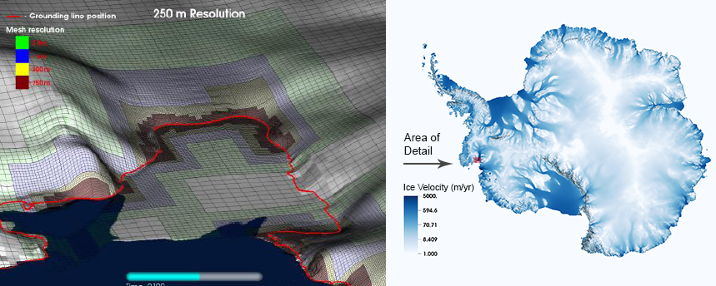
BISICLES: Adaptive Mesh Refinement for Ice Sheets
Science
Understanding how ice sheets respond to changing earth systems is critical for projections of sea level rise.
There is compelling evidence that modeling marine ice sheets, like the Antarctic Ice Sheet, requires very fine spatial resolution near grounding lines to sufficiently resolve the complex dynamics in play.
BISICLES Solution
BISICLES is a scalable adaptive mesh refinement (AMR) ice-sheet modeling code that dynamically deploys fine spatial and temporal resolution only where needed to resolve ice sheet dynamics at a low computational cost.
BISICLES is built on the DOE-funded Chombo framework, which uses block-structured AMR to dynamically refine the computational mesh needed to resolve the wide range of scales found in ice sheets.
BISICLES-computed simulation of present-day Antarctic ice velocities. The image at the left illustrates adaptive placement of fine spatial resolution near grounding lines (red) for the Pine Island Glacier.
Science Impact
The BISICLES code allows scientists to efficiently and accurately model ice sheet response to climate forcing.
BISICLES computations are the first fully-resolved full-continent simulations of decadal-to-millennial scale Antarctic ice sheet dynamics.
Get BISICLES
The BISICLES ice-sheet modeling code and software documentation are available at: http://bisicles.lbl.gov/
S.L. Cornford et al.: “Century-scale simulations of the response of the West Antarctic Ice Sheet to a warming climate,” The Cryosphere, 9, 1579-1600, 10.5194/tc-9-1579-2015
BISICLES was developed by a collaboration of computational scientists at Lawrence Berkeley National Laboratory and the University of Swansea (UK) and climate scientists at Los Alamos National Laboratory and the University of Bristol (UK).

