Slide 1

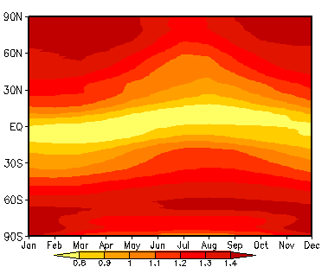
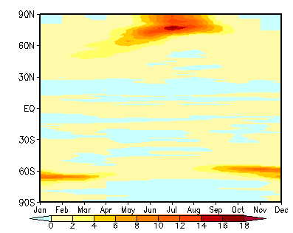
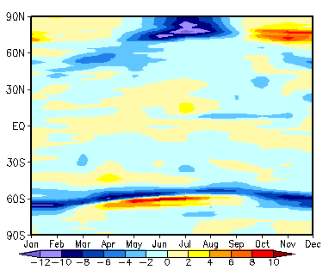
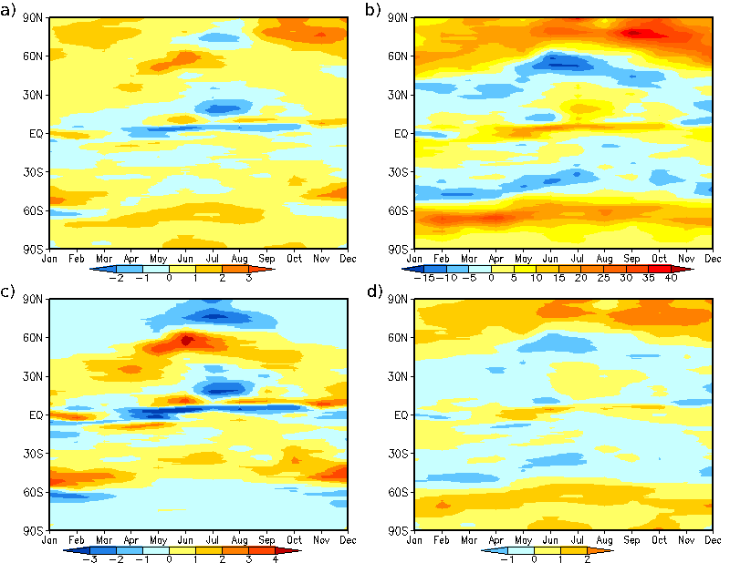
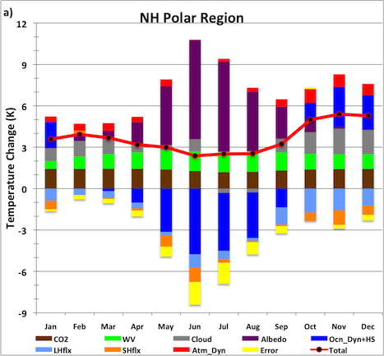
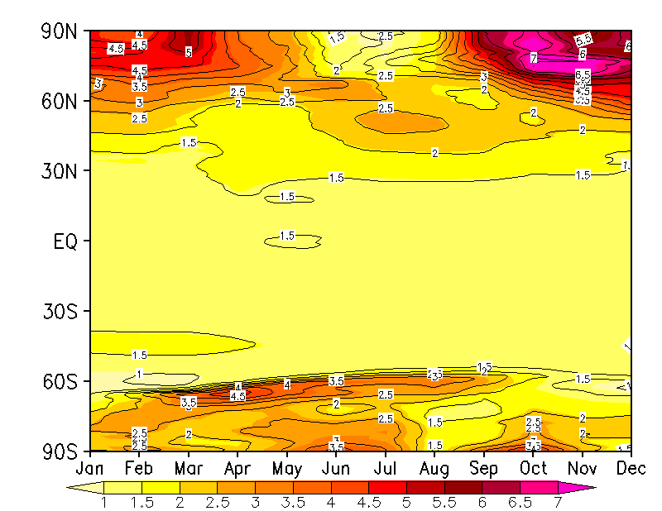
Understanding the Seasonality of Polar Warming
Sergio A. Sejas (sas07t@my.fsu.edu) and Ming Cai (mcai@fsu.edu)
¹Department of Earth, Ocean, and Atmospheric Science , Florida State University, Tallahassee, Florida 32306, USA
Sponsored by DOE RGCM program (DE-SC0004974)
1. Objective: To understand how a spatially uniform increase in CO₂ leads to such a spatially and seasonally varied surface temperature response. We attribute the individual contributions of the CO₂ forcing (without any feedbacks) and feedback processes to the seasonality of the surface temperature response to a 1% per year increase in CO₂ concentration at the time of CO₂ doubling.
5. Temperature Change due to the CO₂ Forcing Alone
Spatial variability is due to spatial variations of temperature, water vapor, and cloud properties in the unperturbed time mean state.
Overall pattern does not account for most of the features observed for the seasonal surface temperature response, indicating feedback processes are largely responsible for surface temperature response.
7. SAF and Ocean Heat Storage Interaction
The large summer warming by the SAF is highly offset by the cooling of the ocean heat storage/dynamics feedback representing the solar energy going into the melting of sea ice and the heat being stored by the ocean due to its large heat capacity. The ocean heat storage causes the warming due to the SAF to be relayed from summer to late fall/early winter warming. The seasonality of this interaction is directly associated with the strong solar annual cycle in polar regions.
Weak PWA
2. Data: 20-year monthly mean data from a transient simulation of the NCAR CCSM4 centered at the time of CO₂ doubling from a pre-industrial concentration of 284.7 ppm.
Weak Seasonality
Everywhere
3. Attribution Method (CFRAM)
Perturbation in response to an external forcing
8. Temperature Change due to the Cloud Feedback
6. Seasonal Polar Warming
Minimum Warming in Summer
Temperature change attributed to process (x).
Maximum Warming in Late Fall/Early Winter
4. Zonal-mean Seasonal Surface Temperature Change
Figure S1. Mean partial surface temperature change contributions due to the forcing alone and each of the feedbacks in the northern hemisphere (NH; from 60⁰N-90⁰N).
The increase in clouds causes a cooling for the shortwave (SW) cloud component due to an increase in cloud albedo and a warming for the longwave (LW) cloud component due to an enhancement of the greenhouse effect during summer, which nearly offset each other. During late fall/early winter there is a lack of insolation, which allows the LW cloud feedback to warm the surface without being offset.
Pronounced Seasonality in Polar Regions
Even though the strongest feedback is the surface albedo feedback (SAF) in summer, it is highly offset by the ocean heat storage/dynamics feedback leading to a minimum warming in summer. In late fall and winter most feedbacks warm the surface with relatively little opposition from other feedbacks, leading to a warming maximum. The surface albedo, ocean heat storage/dynamics, and cloud feedbacks demonstrate the largest seasonal variation, indicating they are primarily responsible for the strong seasonality of the surface temperature response in polar regions.
Conclusions
The seasonality of the polar surface temperature response can be mainly attributed to the SAF and ocean heat storage interaction, and the cloud feedback.
The large seasonal variation of insolation plays a key role in the pronounced seasonal variation of polar warming.
Color shading is surface temperature change given by the CCSM4 simulations.
(ºC)
Contours are total surface temperature change given by the CFRAM analysis.

