Slide 1
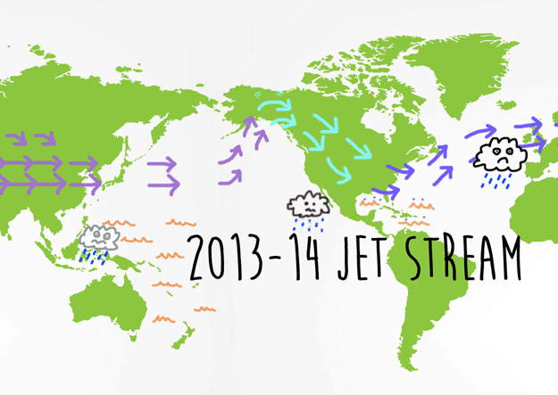


The Weather-Climate Nexus: Large-Scale Organization of Extreme Events
Robert Black, Yi Deng, Katherine Evans*
Yun-Young Lee, Tae-Won Park, Rebecca Westby
School of Earth and Atmospheric Sciences
Georgia Institute of Technology, Atlanta, GA
*CCSI, Oak Ridge National Laboratory, Oak Ridge, TN
Tom Phillips/Buzzfeed
Notes:
The main goal of my talk is to provide ideas for the breakout discussion session related to the topic of large-scale organization of extremes.
It turns out that this past winter has provided us with an excellent example of such organization and I will spend a little time discussing this case.

Slide 2
Recent DOE-funded Research on Extreme Weather Events
(EWEs), Planetary Climate Modes (PCMs) and linkages
♠ Winter cold air outbreaks (CAOs) & warm waves (WWs)
  ➙ No significant long-term trends in either CAOs or WWs
    ➙ Regional modulation by NAO/AO, PNA, ENSO & PDO
    ➙ General CAO/WW behavior well replicated in CMIP5
    ➙ PCM modulation of EWEs underestimated in CMIP5
♥ PCM behavior in CMIP5 models during boreal winter
  ➙ PNA teleconnection pattern generally well represented
    ➙ NAO structure misrepresented in some CMIP5 models
    ➙ PDO poorly represented by majority of CMIP5 models
    ➙ No apparent benefit from well-resolved stratosphere (!)
(Westby et al. 2013, Lee and Black 2013)
Notes:
Regional extreme weather events related to variability in the energy & water cycles (e.g., temperature extremes, flooding events, droughts) have substantial societal impacts.
It is becoming well recognized that planetary-scale climate modes such as ENSO, NAO, PDO etc. significantly modulate the regional frequency of extreme weather events.
Much of our recent DOE-funded research has focused on the behavior of Extreme Weather Events (EWEs), Planetary Climate Modes (PCMs) & their linkages.

Slide 3
Recent DOE-funded Research on Extreme Weather Events
(EWEs), Planetary Climate Modes (PCMs) and linkages
♣ Annular modes in reanalyses and CMIP5 simulations
  ➙ Polar Annular Mode impacts regional surface weather
    ➙ Stratospheric variability too weak in “low-top” models
    ➙ Stratospheric NAM (SNAM) too weak in low-top models
    ➙ Uncertainty in future Arctic SLP change is significantly impacted by uncertainty in stratospheric polar vortex
    (Black et al. 2012, Charlton-Perez et al. 2013,
    Lee and Black 2014, Manzini et al. 2014)
♦ Key general conclusion relevant to Breakout Session:
  ➙ Model deficiencies in representing PCM behavior carry over to deficiencies in representing regional weather conditions including EWEs
Notes:
The Polar Annular Mode, related to N-S movements in the stratospheric polar vortex, provides medium-range impacts upon regional surface weather.

Slide 4
Large-Scale Organization of Extreme Events:
Much More than Planetary Climate Modes at Work!
♠ Although PCMs can modulate EWE behavior, they are insufficient and intermediary large-scale meteorological patterns (LMPs) such as cyclones, blocks or other forms of intraseasonal variability are additionally required
♥ Furthermore, the nature of such LMPs must be unusual or distinct as EWEs are, by definition, infrequent events
♣ LMPs linked to EWEs represent a phenomenological bridge between global climate and regional weather
PCMs LMPs EWEs
Notes:
However. commonly occurring PCMs obviously cannot be the whole story.

Slide 5
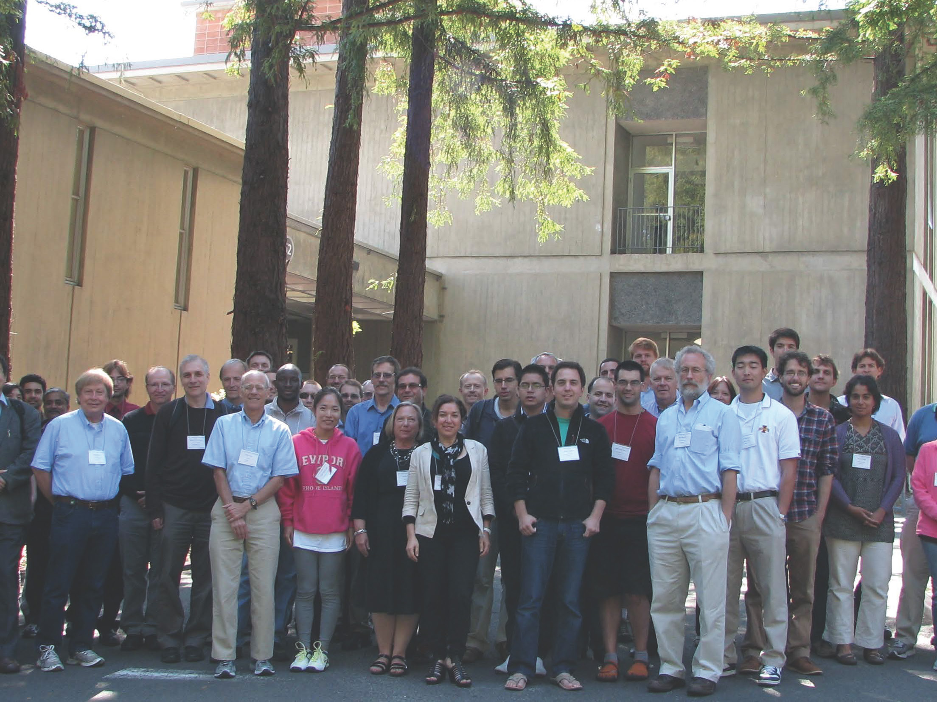
US CLIVAR Workshop on Analyses, Dynamics and Modeling of Large-Scale Meteorological Patterns Associated with
Extreme Temperature and Precipitation Events
August 20-23, 2013
Lawrence Berkeley National Laboratory
Statisticians! Dynamicists! Synopticians! Modelers!
Conclusion: Great scientific need for the coordinated study of the behavior & dynamics of those LMPs related to EWEs, including study of LMPs and EWE linkages in global models
Notes:
Last August a large group of us got together under the auspices of US CLIVAR to exchange research results and general ideas regarding the study of Large-Scale Meteorological Patterns related to short-term extremes in temperature and precipitation.

Slide 6
Large-Scale Organization of Extreme Events:
Practical Motivation and Suggested Scientific Path Forward
  ♠ LMP-EWE linkage provides unique framework to study weather-climate nexus in a climate model setting since, in principle, LMPs can be resolved by modern CGCMs
  ♥ A more complete understanding of such LMPs and their representation in CGCMs is of fundamental importance in any attempt to predict likely future behavior of EWEs
  ♣ Key scientific needs for LMPs & LMP-EWE linkages:
  ➙ Fully characterize LMPs for different classes of EWEs
    ➙ Delineate physical mechanisms for (a) LMP life cycles and (b) linkages among LMPs, EWEs & PCMs
    ➙ Develop simple & robust metrics of LMP behavior
    ➙ Pursue systematic assessment of LMP behavior and physics (& PCM-LMP-EWE links) in global models
Notes:
Building upon the ideas coming out of the workshop here we suggest that:
LMPs need to be characterized using a “bottom-up” procedure that begins with EWE events, themselves. Although linear approaches to this problem (e.g., composites) are appealing, it is important to recognize that the same type of EWE may result from different LMP structures. Thus, a multivariate approach (such as a clustering analysis) to LMP classification is desirable to allow for segregation of LMPs.

Slide 7



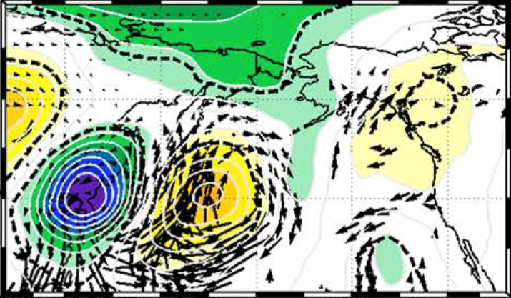
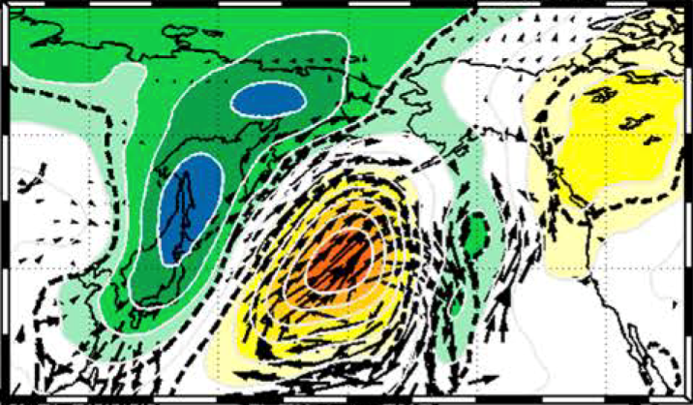


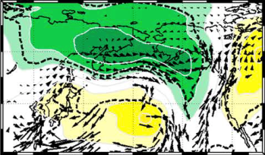
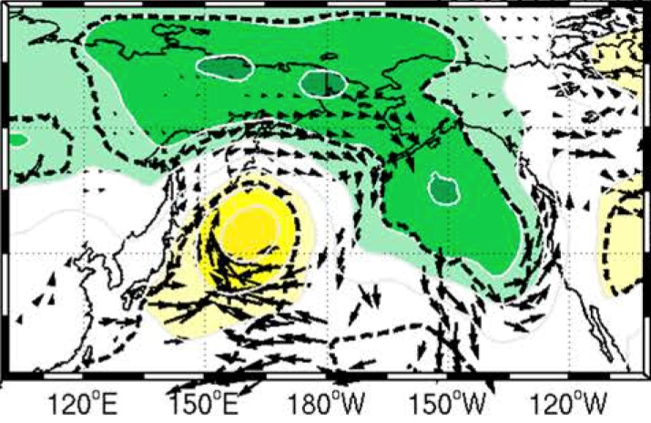


Large-Scale Organization of Extreme Events. Example #1:
LMP bridging East Asian Cold Surge & Western US Precipitation
Anomalies composited with respect to East Asian Cold Surges
500 hPa geopotential height; 850 hPa water vapor transport
  - Coherent large-scale circulation anomaly pattern forms over Pacific
  - Cyclonic anomaly over east Pacific organizes narrow channel of water vapor flux into west coast region
  - Onshore directed atmospheric river provides regional enhancement of precipitation
(Jiang, Evans, Deng & Dong 2014; JGR-Atmospheres)
Notes:
An observed example of such an intermediate meteorological bridge was presented in the recently published study involving Yi Deng’s former student, Tianyu Jiang, Kate Evans and Yi Deng.
The interesting twist here is the the LMP discussed is actually bridging 2 regionally distinct extreme events:
The authors demonstrate that East Asian Cold Surges are connected to subsequent heavy precipitation events over the western US via a Large-Scale Meteorological Pattern forming over the North Pacific. This LMP pattern organizes anomalous moisture transport from the North Pacific into western North America via an atmospheric river structure.

Slide 8
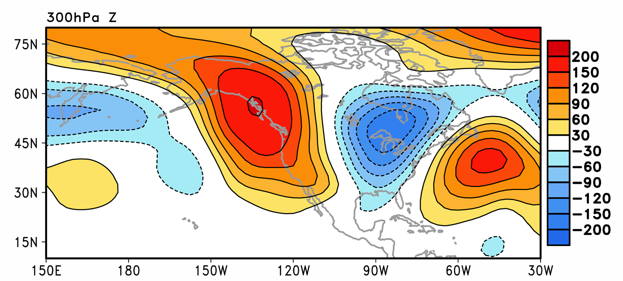
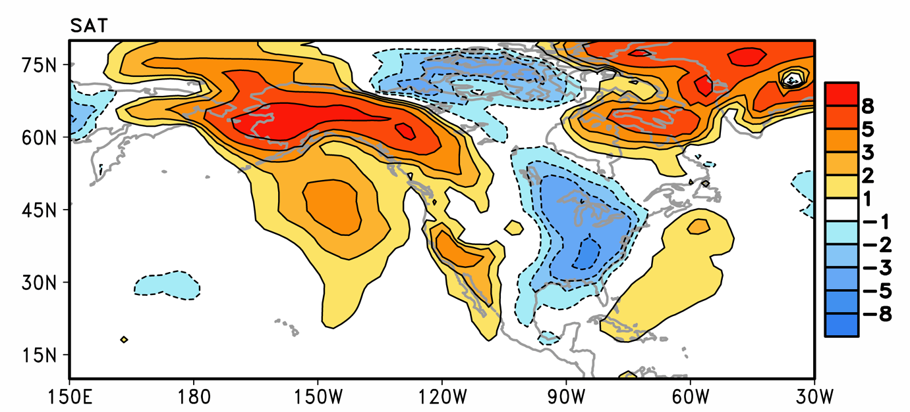
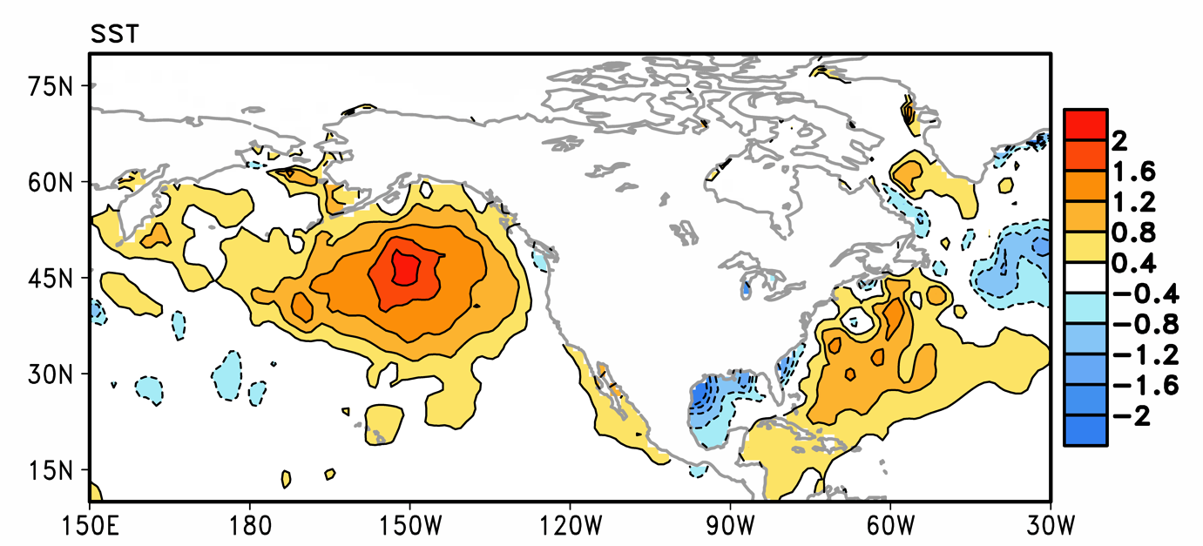
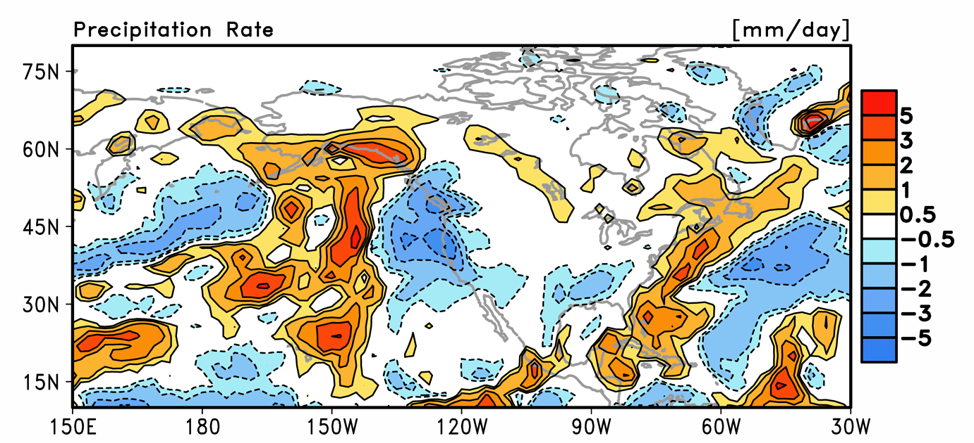
Large-Scale Organization of Extreme Events. Example #2:
Temperature & Precipitation Extremes during January 2014
Observed anomaly fields for January 2014: Alaskan warm wave; Eastern US cold air outbreaks; West coast drought conditions
300 hPa geopotential height (m)
Surface Air Temperature (K)
?
Sea Surface Temperature (K)
Precipitation rate (mm/day)
Key LMP structure: Persistent west coast anomalous ridge
Notes:
The second example I will discuss is the large-scale organization of extreme temperature and precipitation events occurring over North America during this past January. The analyses I will be presenting are based upon monthly-mean anomalies (departures from normal).
During January there was (1) a record-breaking warm wave over Alaska, (2) record-breaking cold air outbreaks over the eastern US and (3) drought conditions over the west coast. These events were all prominent enough that they are reflected in the monthly-mean anomaly fields as shown here.
From a synoptic-dynamic meteorological perspective, all three of these EWEs can be attributed to either the local and downstream influences of a prominent and persistent anomalous ridge anchored over the west coast of North America. The salient outstanding question is where did this ridge come from? One intriguing possibility is that the ridge may have been somehow connected to a broad pre-existing warm SST anomaly south of Alaska.

Slide 9
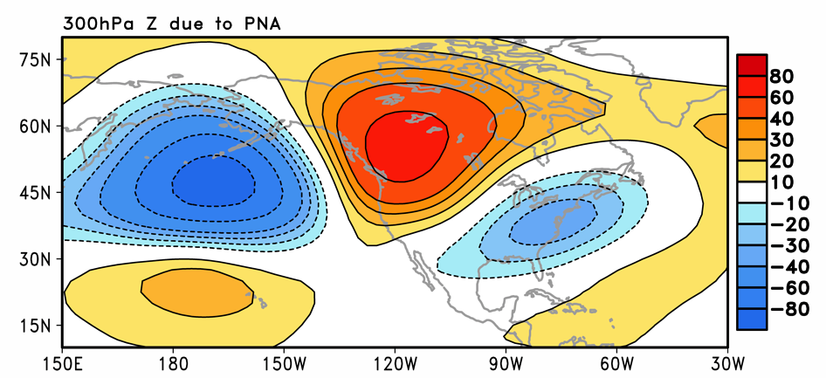
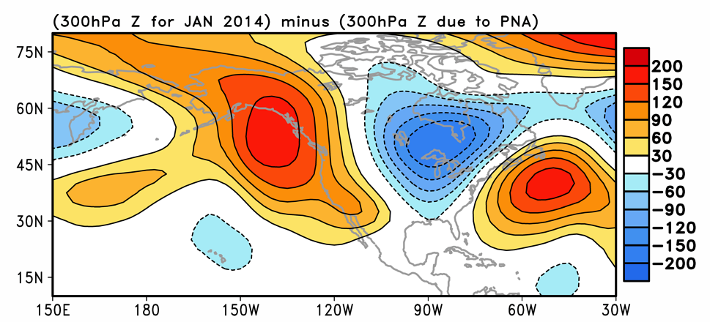
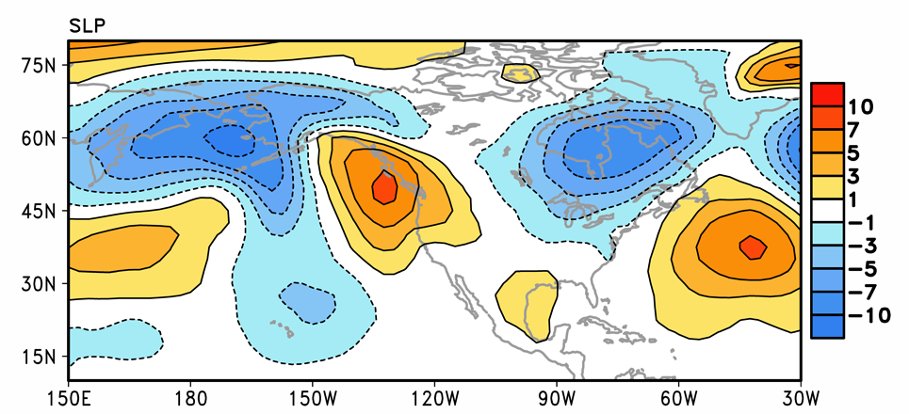
Large-Scale Organization of Extreme Events. Example #2:
Temperature & Precipitation Extremes during January 2014
Geopotential height anomaly fields (Z’; m) for January 2014:
Contribution of PNA (PCM) pattern toward LMP structure
300 hPa Z’ – Total (m)
300 hPa Z’ – PNA Contribution
300 hPa Z’ – Residual (m)
Sea Level Pressure Anomaly (hPa)
Mean PNA index ~ +1σ; Modest contribution to LMP
Notes:
Interestingly, January 2014 was also characterized by the positive phase of the PNA teleconnection pattern with a mean amplitude rather conveniently around +1σ. Given that the PNA, itself, is known to modulate North American extremes, it is also of interest to assess the contribution of the PNA pattern to the total LMP structure. As shown here, although the PNA provides a modest contribution (not quite in phase), there is a large-amplitude residual circulation that is unaccounted for.
Two other notes about the LMP structure: It is roughly equivalent barotropic and exhibits a horizontal structure that is more meridionally elongated than zonally elongated. Taken together, these observations indicate that the LMP does not have a structure that is amenable for large-scale baroclinic or barotropic growth (so, these are not likely energy sources).

Slide 10
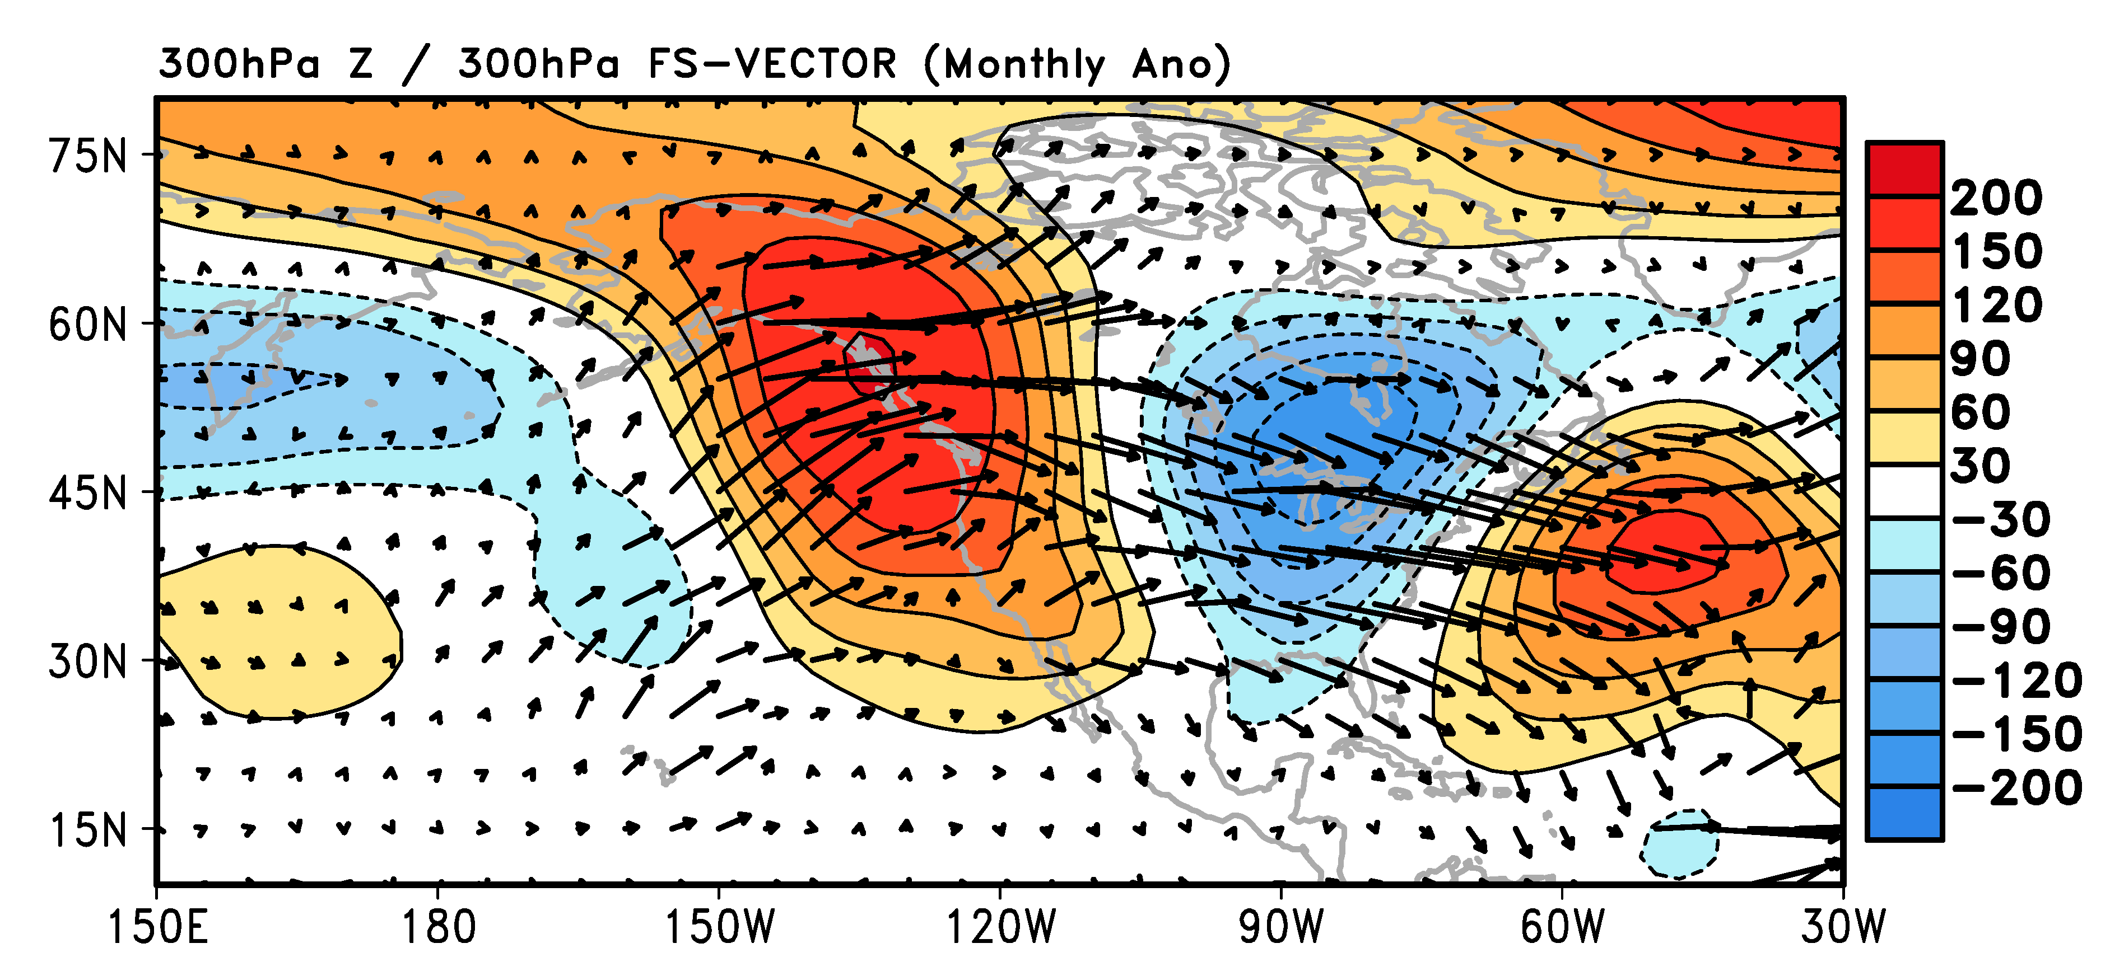
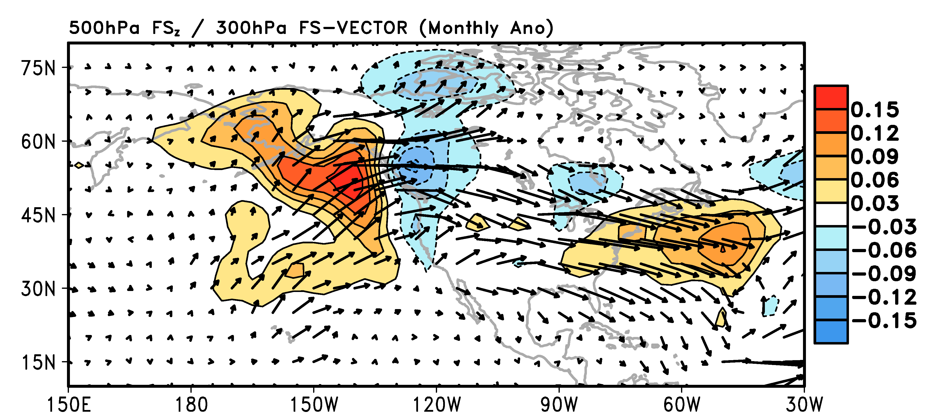

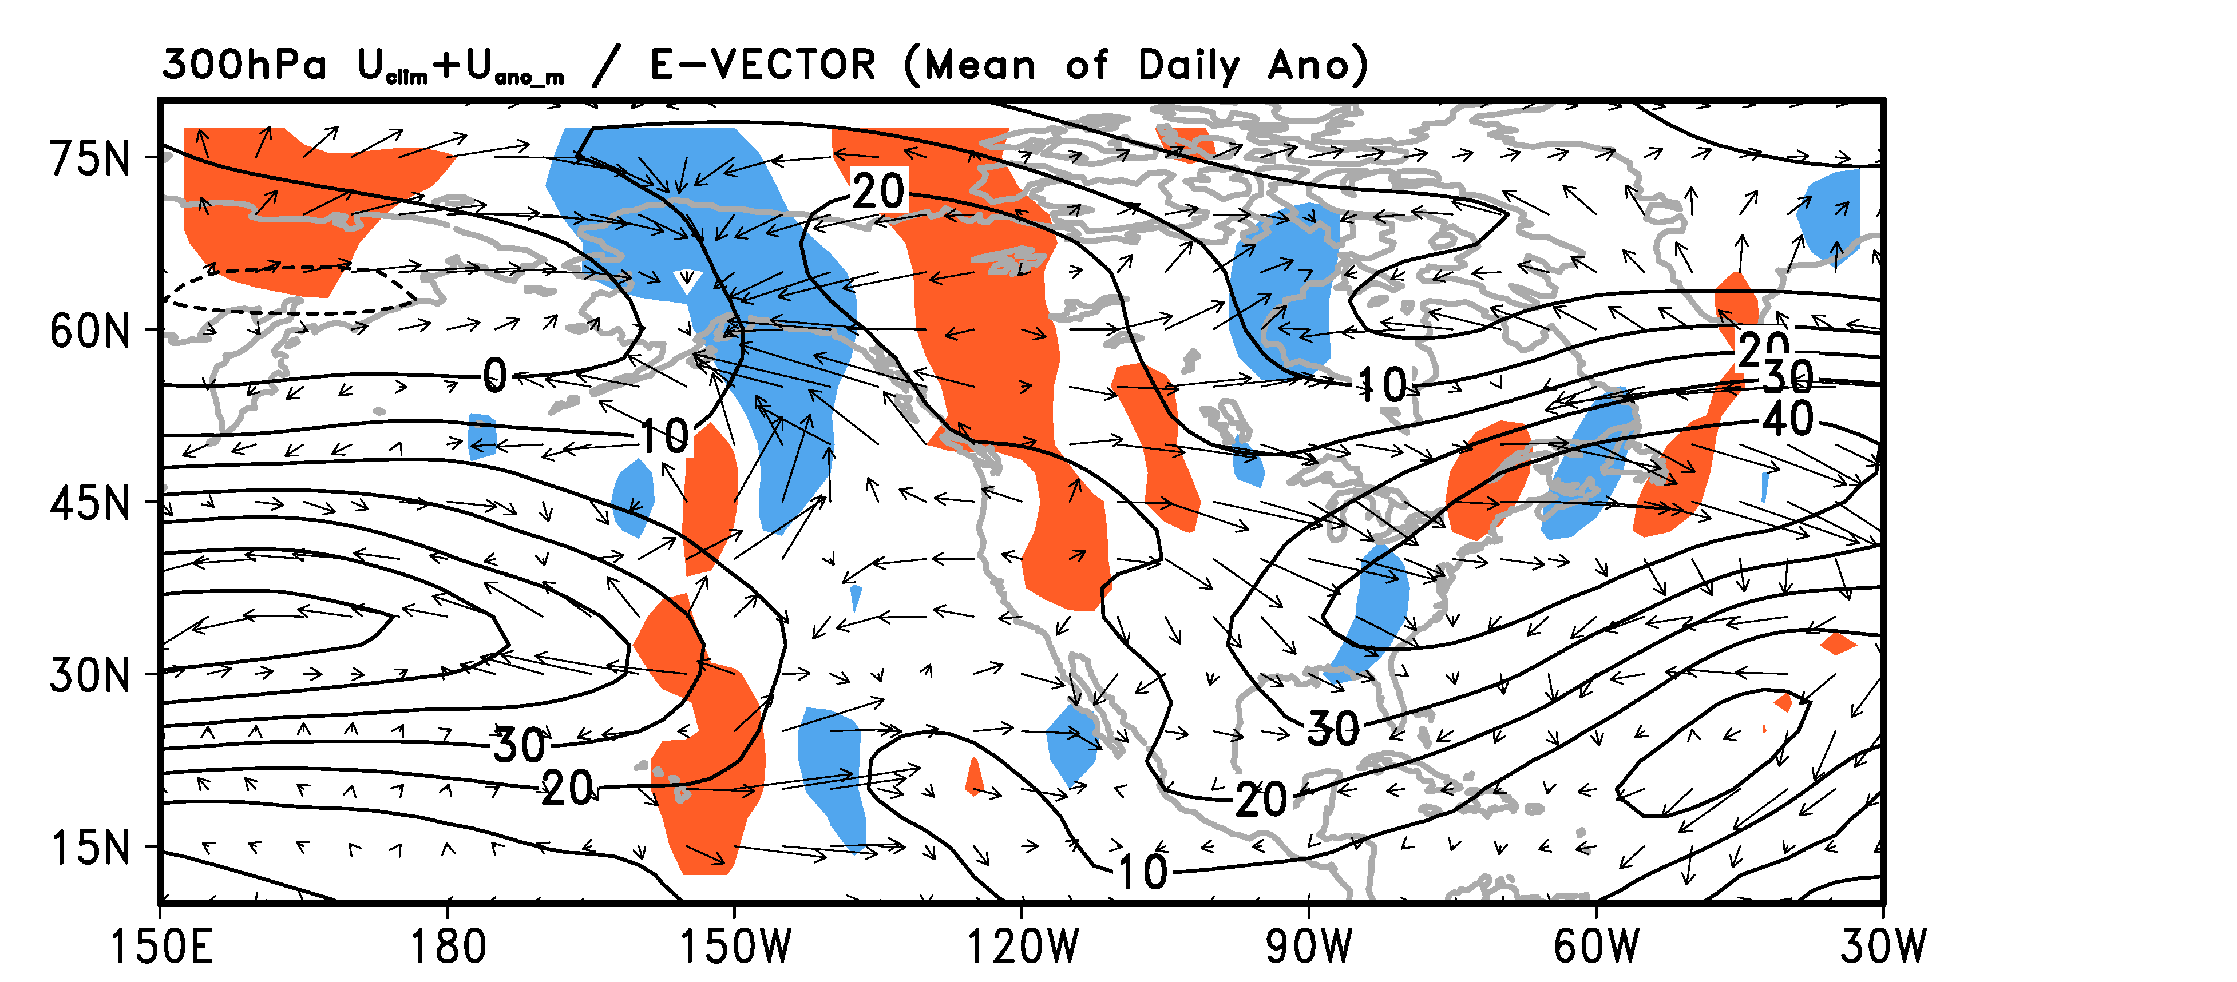


Large-Scale Organization of Extreme Events. Example #2:
Temperature & Precipitation Extremes during January 2014
Time-average dynamical diagnostics for January 2014:
Top ➔ Wave activity flux (FXY; FZ); Low Right ➔ E-vectors
300 hPa Z’ & 300 hPa FXY
500 hPa FZ & 300 hPa FXY
Sea Surface Temperature (K)
Forcing of U by submonthly eddies
2 possible local forcings: warm SST & synoptic eddy feedback
Notes:
Insight into the dynamical forcing of the pattern can be obtained via use of wave activity flux diagnoses, which isolate wave source & sink regions.
Here we note a prominent upward and downstream flux pattern emanating from the Gulf of Alaska. This suggests that there is a lower tropospheric dynamical wave source located in the vicinity of the SST anomaly feature. It also suggests that the downstream wave pattern over North America has its roots in the North Pacific.
A useful diagnostic for studying barotropic wave-mean flow interaction is the E-vector, which is diagnosed here for the submonthly eddies. The analysis indicates that the higher frequency eddies provide a local zonal momentum forcing that is consistent with the eddies providing a positive feedback upon the large-scale background flow.

Slide 11
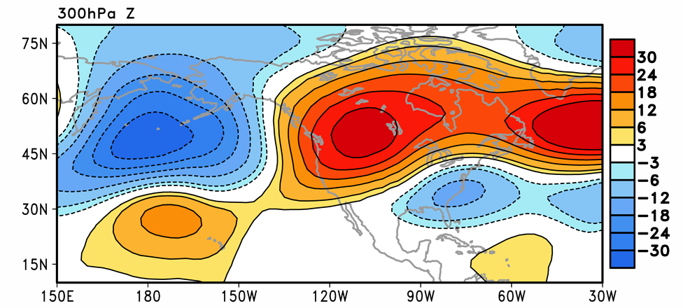
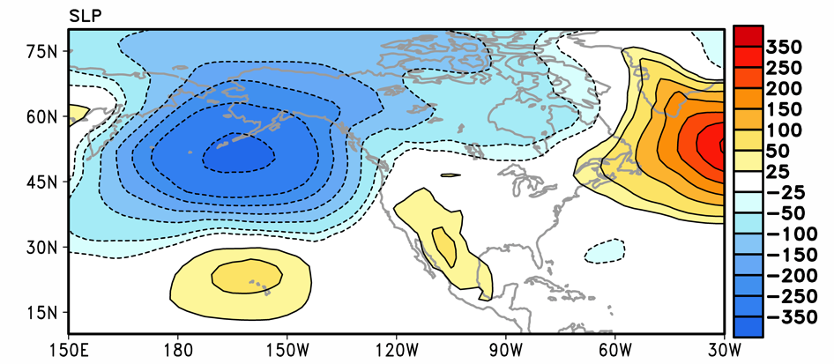
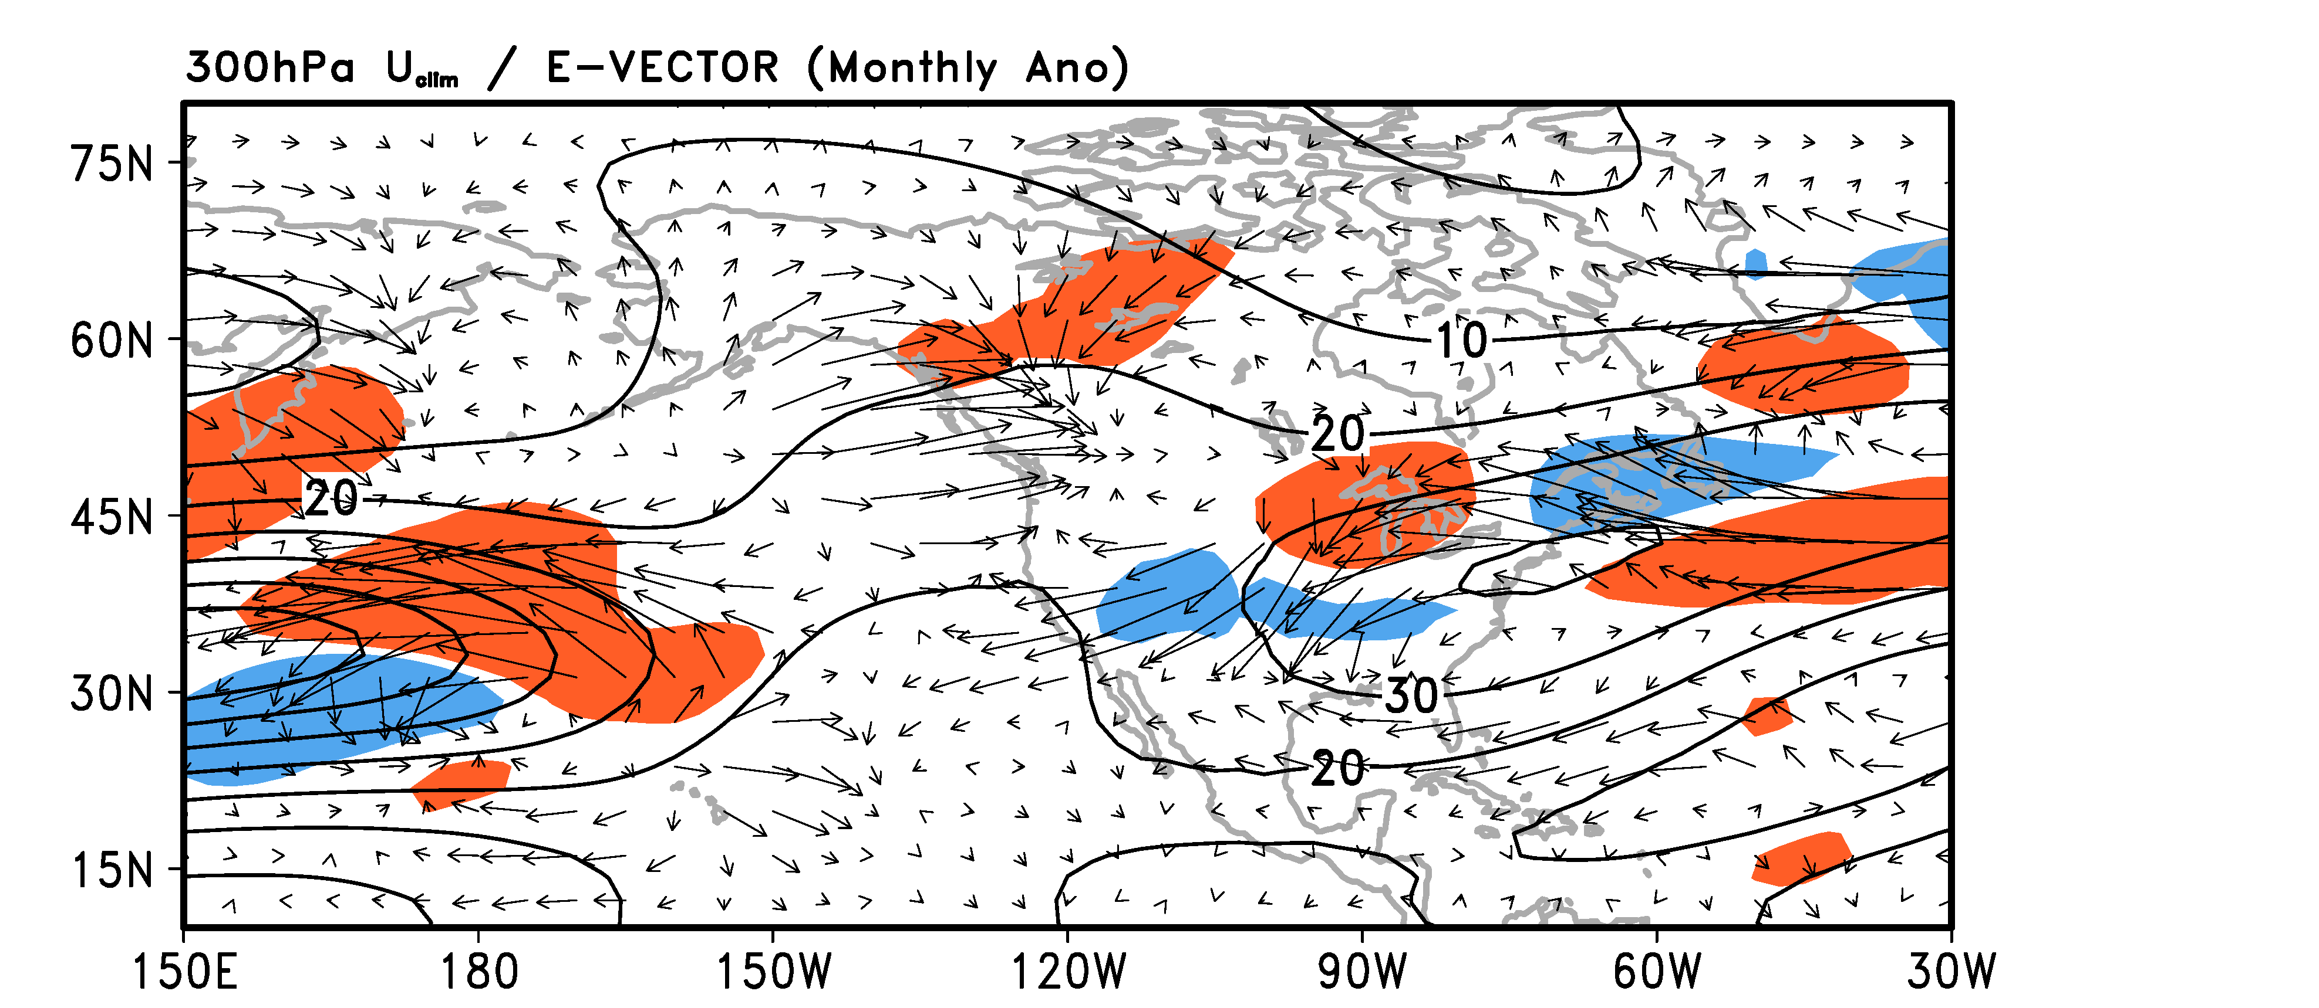
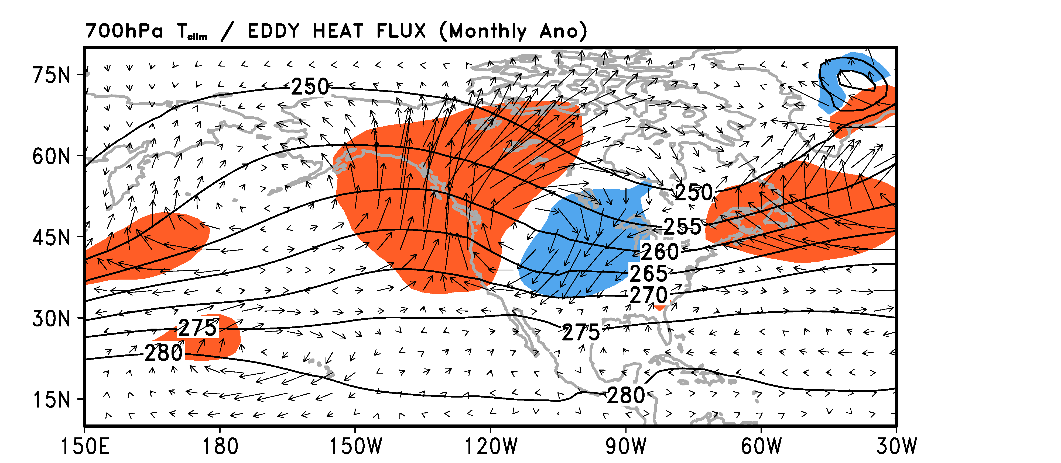
Large-Scale Organization of Extreme Events. Example #2:
Perpetual JAN AGCM study of role of N Pacific SST Anomalies
CESM1.0.2 (2.5 lon/1.9 lat/26 levels; prescribed SST/sea ice) (10 years with Jan 2014 warm SST anomaly) minus (10 years w/climo)
300 hPa geopotential height (m)
Sea Level Pressure (Pa)
300 hPa U (climo)/E-vector (LMP)
700 hPa T (climo)/heat flux (LMP)
Weak response w/Baroclinic & Barotropic feedback (LMP)
Notes:
In the past few weeks Tae-Won Park at Georgia Tech has performed some preliminary low resolution modeling experiments to assess the potential role of the North Pacific SST anomaly pattern in forcing the large-scale meteorological pattern during January 2014. These are perpetual January simulations with prescribed SST forcing. The results shown here are the differences between two simulations.
Although an anomalous ridge is forced, it is much weaker and displaced eastward compared to observations. Furthermore, it is characterized by both zonal elongation and a westward vertical tilt suggesting the possibility that the LMP is also associated with baroclinic & barotropic energy extraction from the background mean flow, which is verified in the diagnostics displayed in the bottom row.
Bottom line: The preliminary modeling results seem inconsistent with the observed structure & dynamics. Working with Kate Evans at ORNL, we are currently pursuing additional simulations of this case using a higher resolution model based upon CESM.

Slide 12
Summary Comments for Breakout Session
  ♠ Physical pathways for LMPs to promote EWEs
  ➙ Direct, linear contributions (e.g., LMP = cyclone)
    ➙ Indirect, nonlinear effect (e.g., LMP = block)
    ➙ Local responses (e.g., to topography or coastal contrasts)
  ♥ Key knowledge gaps/scientific needs (3-year time horizon?)
  ➙ Uniform characterization of LMPs related to EWEs
    ➙ Coordinated research on physical mechanisms for LMPs
    ➙ Develop synoptic & dynamic metrics of LMP behavior
    ➙ Assess LMP behavior & physics in CGCM simulations
    ➙ Target atmospheric blocking as key LMP prototype
  ♣ How can models go wrong, let me count the ways…
  ➙ Tropical heating; convective outflow; subtropical vorticity gradients; barotropic deformation; storm track variability
Notes:
Here I provide some summary comments to help lead into discussion.
First, it is useful to provide some placeholder ideas for how LMPs & EWEs may be connected.
To restate our view on existing knowledge gaps:
One really interesting conundrum is how modern modeling systems continue to have difficulty correctly representing the behavior of atmospheric blocking (even though the processes fundamental to blocking are thought to be handled well by models). To the extent that blocking is also connected to some extremes, this suggests that blocking represents a key LMP prototype deserving special attention.

Slide 13
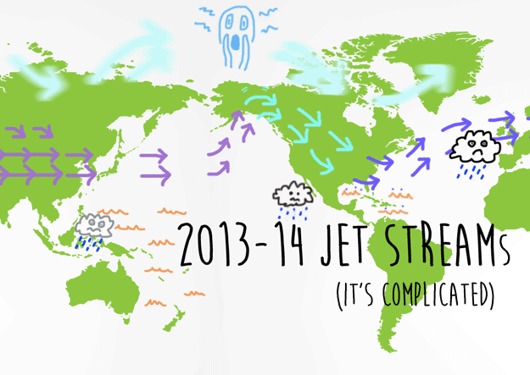
Questions?
  ➙ Tropical heating; convective outflow; subtropical vorticity gradients; barotropic deformation; storm track variability
Tom Phillips/Buzzfeed
Notes:
If one is to consider EWEs linked to an extratropical wavetrain (LMP) that, itself, is forced by anomalous tropical heating (say by the MJO), the success of any model depends upon correctly representing a sequential series of related physical processes.
Bottom line: The problem is difficult & complicated but it is tangible and requires careful mechanistic study.

Slide 14
Used Model Description
CESM1
Version: CESM1.0.2
Stand-alone atmospheric and land model with prescribed ocean and ice: CAM4 physics
→ Components: CAM, CLM, CICE, DOCN, SGLC, CPL
144 x 96 (2.5 longitude degree by 1.9 latitude degree) Finite Volume in horizontal resolution
26 sigma-pressure hybrid levels in vertical resolution

