Slide 1
Huge divergence in land-atmosphere carbon exchange resulting from ambiguous numerical coupling between carbon and nitrogen dynamics
Jinyun Tang and William J. Riley

Slide 2
Take Home Message
Ambiguous numerical coupling between C and N dynamics results in climate prediction uncertainties larger than those associated with cloud processes.
This problem arises because of problems and uncertainties in numerical methods, boundary conditions, initial conditions, parametric uncertainty, etc.
We evaluated these large uncertainties in ALMv1-BeTR and suggest model improvements to mitigate them

Slide 3
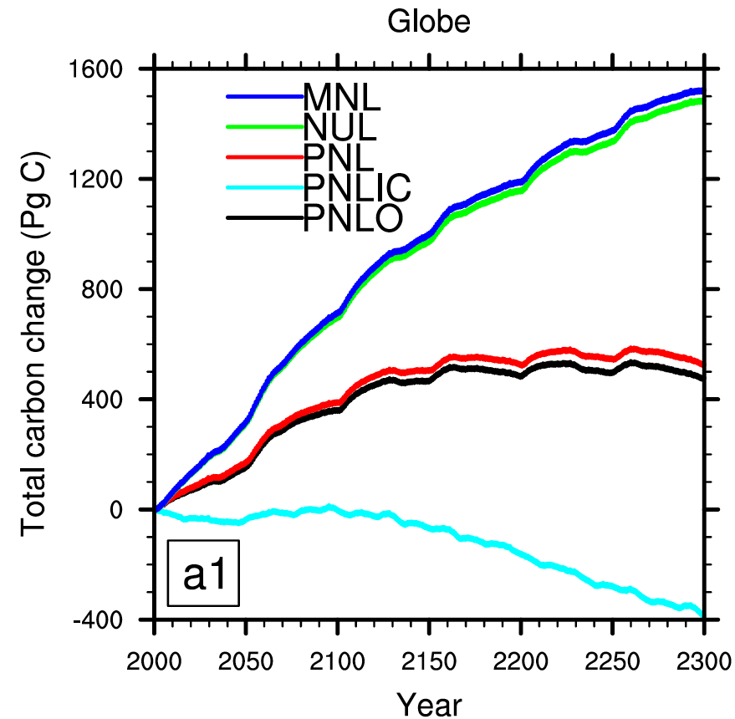
The huge spread of land-atmosphere CO₂ exchange predictions from different C&N coupling approaches
1900 Pg C
~
900 ppmv CO₂

Slide 4
The cause is simple
I.e., a nutrient constrained condition

Slide 5
Land ecosystems are nutrient limited: N and P.
Ecosystem C to N and C to P ratios are typically high.
Plants and microbes compete for N and P
Land biogeochemistry could be limited by different substrates under different conditions.

Slide 6
ALM, BIOM-BGC, CLM, etc.
Modified from MATLAB ode solvers
ECOSYS, ALMv1-BeTR-CN

Slide 7
Strength of N limitation

Slide 8
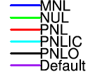
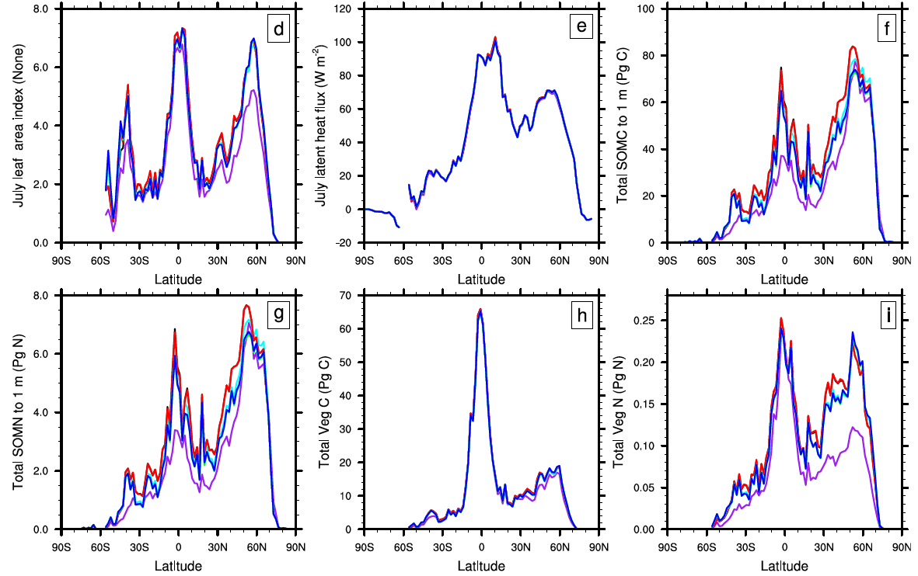
Small differences in 1990s
July LAI
SOC
July LH
VEGC
SON
VEGN

Slide 9
Huge differences for 2001-2300
1900 Pg C
~
900 ppmv CO₂

Slide 10
Two reasons explain the differences
Strong sensitivity to initial conditions.
The three approaches imply different carbon-nitrogen coupling (note C to N ratio is high).

Slide 11
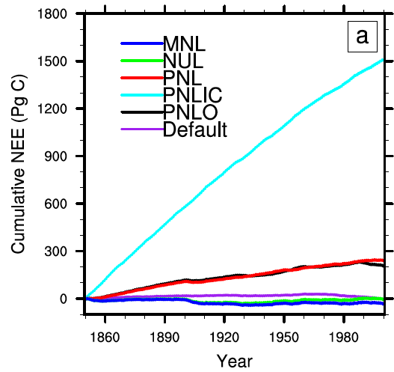
Strong sensitivity to initial conditions
Differed only in IC

Slide 12
Different CN coupling
MNL and NUL decouple nitrogen uptake and nitrogen mineralization (asynchronous CN coupling: helps retain mineral nitrogen).
PNL tightly couples nitrogen uptake and nitrogen mineralization (synchronous CN coupling: favors NH₄ nitrification and NO₃ nitrogen loss).

Slide 13
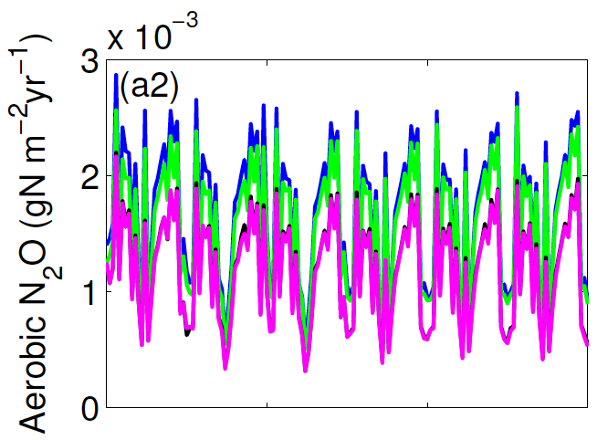
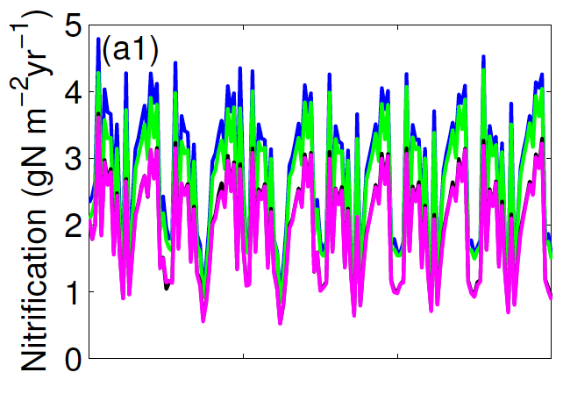
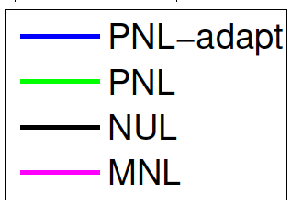
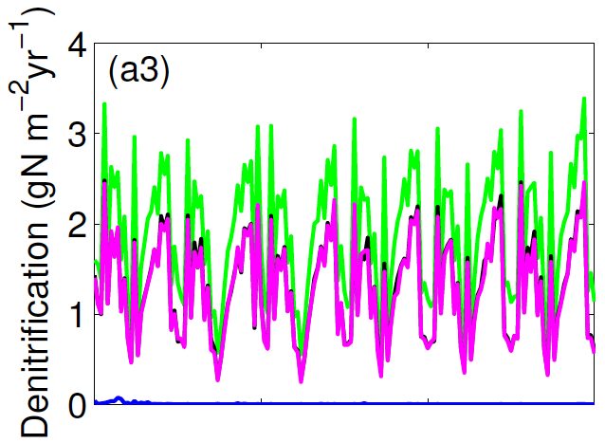
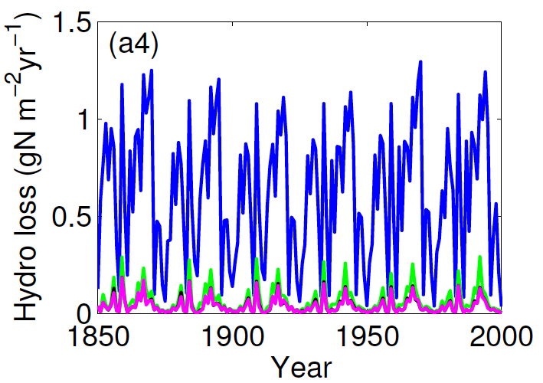
Point simulation example

Slide 14
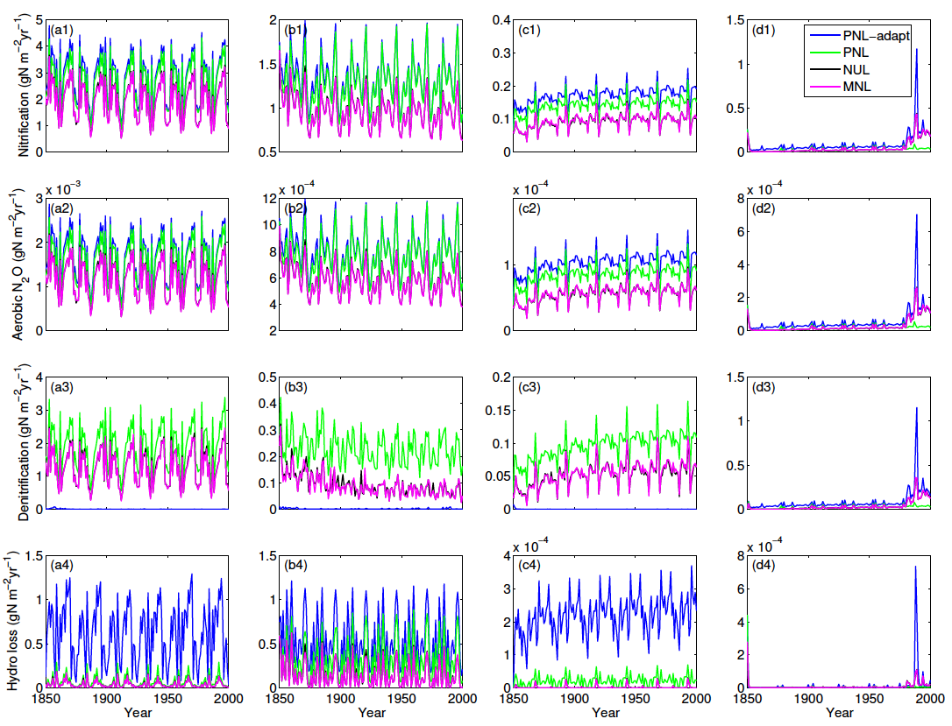
The dependence on different CN coupling is systematic

Slide 15
Summary
Ambiguous numerical carbon-nutrient coupling is a large uncertainty source: different numerical methods imply different ecological coupling.
Synchronizing nutrient uptake and production is critical for consistent carbon-nutrient coupling.
ALM should fix this problem in v2 (or even v1, e.g., by using the method from Tang and Riley (2016; Biogeosciences)).

Slide 16
Implications
Revisit the idea that land is computationally trivial:
Errors in land computation can lead to comparable climate errors as those associated with clouds!
The algorithm is more than applied math.
Many more to reflect on (e.g., data assimilation, parametric optimization, ecological principles of substrate limitation).

