Slide 1
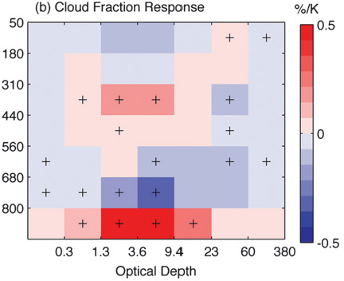
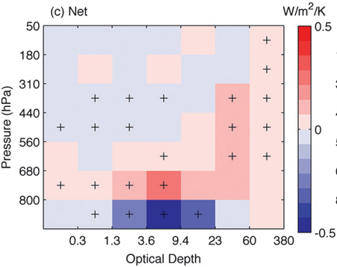
Progress on Understanding Cloud-Radiation Interactions
Mark Zelinka
Lawrence Livermore National Laboratory
1. Introduction: Cloud Radiative Kernels
4. Effective Radiative Forcing from Aerosol-Cloud Interactions
Using a radiative transfer model, we have calculated the sensitivity of top of atmosphere (TOA) radiative fluxes to unit perturbations in cloud fraction segregated by cloud top pressure (CTP) and cloud optical depth (τ)
The largest uncertainties in present-day radiative forcing come from aerosols and their interactions with clouds. Here we use cloud radiative kernels to diagnose the radiative impacts of aerosol-induced changes in cloud properties in the sstClimAerosol runs. Two example models are shown to the right.
Both models have large increases in low cloud optical depth downwind of aerosol sources
But only in MRI are there large radiative impacts from changes in high clouds (both LW and SW).
This is because only MRI allows aerosols to interact with ice clouds
Longwave High Clouds
Multiplying these kernels by the change in cloud fraction as a function of CTP and τ (provided by the ISCCP simulator in models) yields an estimate of the cloud-induced TOA radiation anomalies.
Allows for systematic quantification of contributions from individual cloud types (e.g., high, mid-level, and low clouds) and from changes in gross cloud properties (e.g., altitude, optical depth, and total amount).
Here I will highlight some recent insights we have gained using cloud radiative kernels
Shortwave High Clouds
Shortwave Low Clouds
The net (LW + SW) cloud radiative kernel. From Zelinka et al., J. Climate (2012)
Impact of aerosol-induced changes in high & low cloud properties on LW & SW fluxes. From Zelinka et al., JGR (under revision)
2. Cloud Feedbacks in CMIP5
5. Rapid Cloud Adjustments to 4xCO2 in CMIP5
Using the approach of Gregory et al. (2004), we have estimated the temperature-mediated responses of clouds in abrupt4xCO2 experiments. As the planet warms:
Total cloud fraction decreases, especially over the subtropical oceans and tropical land
Cloud top altitude increases everywhere
Cloud optical depth increases for cold clouds at high latitude and altitudes
Using kernels, we compute the feedbacks due to each of these changes:
Net cloud feedback is positive in all but one model
The amount and altitude components are systematically positive
Optical depth feedback is negative in all but one model
Δ Total Cloud Frac.: -0.10 % K⁻¹
Clouds respond very rapidly to a quadrupling CO₂ (i.e., before the planet warms), which induces radiation anomalies that modify the “pure” 4xCO₂ radiative forcing. We have estimated these rapid cloud adjustments in sstClim4xCO2 experiments. In response to 4xCO2:
Total cloud fraction decreases
Cloud top altitude increases over land
Cloud optical depth decreases
Using kernels, we compute the radiative response due to each of these rapid cloud adjustments:
Net adjustment is systematically positive and comes primarily from the SW
Roughly equal (positive) contributions from rapid reductions in fractional coverage, CTP, and optical depth
Substantial inter-model spread
Δ Total Cloud Frac.: -0.50 %
Δ CTP: -3.76 hPa K⁻¹
← Temperature-mediated change in total cloud fraction, CTP, and τ, averaged over 5 CMIP5 models. Stippling indicates locations where at least four out of five models agree on the sign of the cloud anomalies. Note: Negative values shown in red; positive in blue. From Zelinka et al., J. Climate (2013)
Δ CTP: -8.30 hPa
← Rapid adjustments in total cloud fraction, CTP, and τ, averaged over 5 CMIP5 models. Stippling indicates locations where at least four out of five models agree on the sign of the cloud anomalies. Note: Negative values shown in red; positive in blue. From Zelinka et al., J. Climate (2013)
Δ Optical Depth: 2.0 % K⁻¹
Δ Optical Depth: -4 %
← Global mean LW (red), SW (blue) and net (black) cloud feedbacks, separated into contributions from changes in cloud amount, altitude, and optical depth. Dots represent individual models, bars represent the multi-model mean. From Zelinka et al., J. Climate (2013)
← Global mean LW (red), SW (blue) and net (black) cloud adjustments, separated into contributions from changes in cloud amount, altitude, and optical depth. Dots represent individual models, bars represent the multi-model mean. From Zelinka et al., J. Climate (2013)
Total Amount Altitude Optical Depth
Total Amount Altitude Optical Depth
3. Detailing the Short-Term Cloud Feedback from Satellite Obs
6. The Ozone Hole “Indirect Effect”
Here we estimate the cloud feedback in response to interannual climate fluctuations. We calculate the sensitivity of MODIS-observed clouds to interannual fluctuations in global mean T_{sfc}., then use cloud radiative kernels to quantify the radiative impact.
The small short-term cloud feedback arises from large but offsetting relationships among individual cloud types
Low clouds provide a strong negative cloud feedback
Mid-level clouds provide a positive net cloud feedback.
High clouds make small contribution to net cloud feedback due to close LW-SW cancellation.
The midlatitude jet shifts poleward in CAM3 simulations of the ozone hole. Here we quantify the radiative impact of cloud anomalies accompanying this jet shift (the ozone hole “indirect effect”):
High- and mid-level clouds closely follow the poleward shift in the SH midlatitude jet.
Low clouds decrease across most of the Southern Ocean.
The hemispheric annual mean radiation response to the cloud anomalies is calculated to be approximately +0.25 W m⁻² , arising largely from the reduction of the total cloud fraction at SH midlatitudes during austral summer.
(top) Cloud fraction anomalies per unit increase in global mean T_{sfc}, segregated by CTP and τ. (bottom) Contributors to the net short-term cloud feedback. Plus signs indicate statistical significance
From Zhou et al., J. Climate (2013)
Cloud-induced radiation anomalies due to the poleward jet shift in ozone hole simulations. (left) SW radiation anomalies and (right) zonal mean LW, SW, and net radiation anomalies. Modified from Grise et al., GRL (2013)
This work is supported by the Regional and Global Climate Modeling program of the Office of Science of the United States Department of Energy. This work was performed under the auspices of the U. S. Department of Energy by Lawrence Livermore National Laboratory under contract DE-AC52-07NA27344. LLNL-POST-653977. All publications are available on my website: Google “Mark Zelinka”

