Slide 1
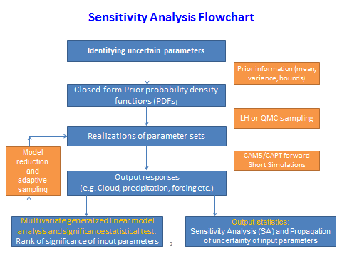
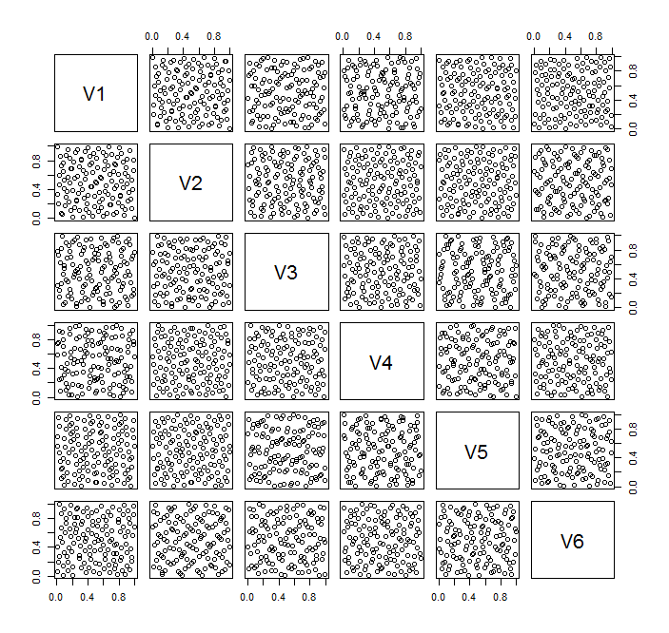
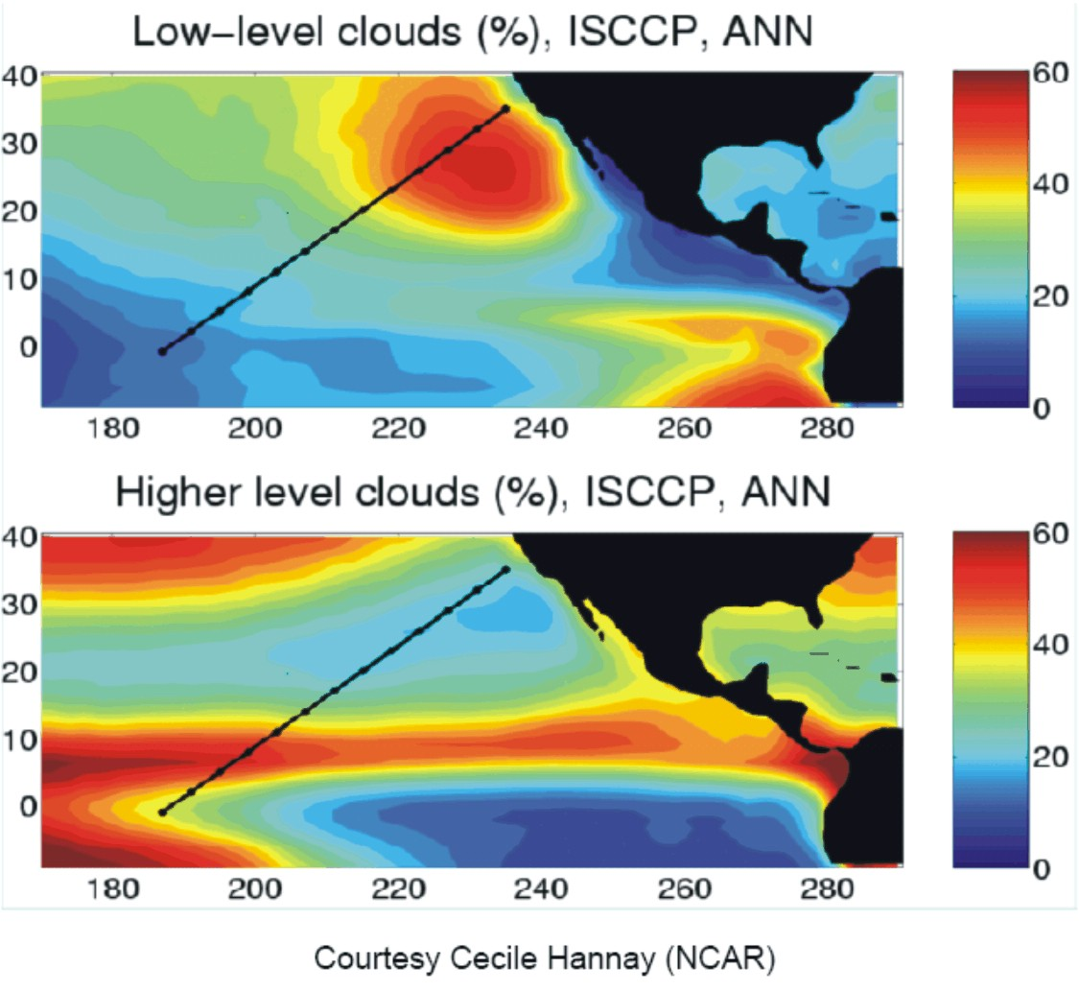
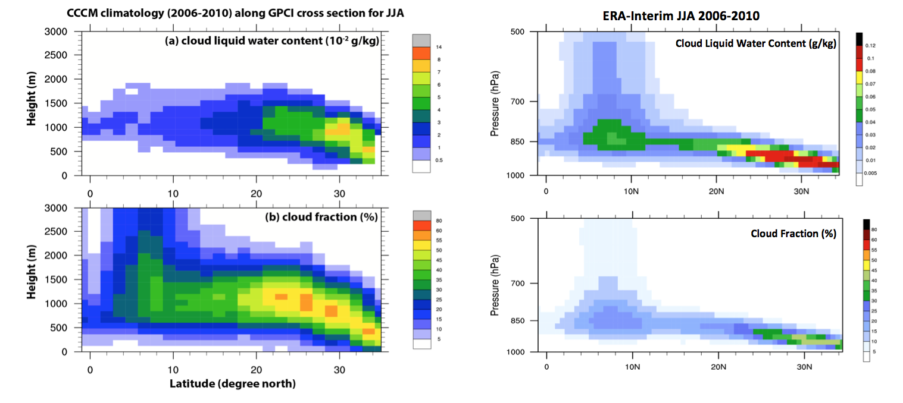

Short Simulations
for Efficient Model Evaluation, Tuning and Calibration: Strategy and Framework
Yun Qian¹, Hui Wan¹, Phil Rasch¹, Wuyin Lin², and Shaocheng Xie³
¹ PNNL, ² BNL, ³ LLNL
Overview
Framework
Objective
  Explore the feasibility and usefulness of short (2-10 days) simulations for the purpose of efficient evaluation and tuning of high-resolution models
Strategy
  Two-phases exploration: parametric sensitivity analysis followed by automatic model tuning.
  Parametric sensitivity analysis provides a testbed to identify the strengths and limitations of short simulations and to fine-tune the experimental design. Later it will also be used to down-select uncertain parameters thus further speed up the auto-tuning.
  Progress
  In the past quarters we have identified a test problem, and established a complete framework that efficiently conducts simulations and analyzes results for the parametric sensitivity study. (More details in Part II: Early Results)
Flowchart of Sensitivity Analysis (SA) using CAPT-based short simulations
Quasi Monte Carlo sampling of the 6D parameter space. 128 sampling points are shown in the figure
Focus Region
Impacts
Initial results indicate that short simulations are effective for the detection of various important model sensitivities. This provides a good basis for further exploration on optimal experimental design for sensitivity quantification and parameter tuning.
The use of short simulations can be a useful testing strategy for many ACME tasks, e.g., quantification of resolution sensitivity and evaluation of candidate convection schemes.
The focus on short time scales and fast processes can provide useful insights into the model’s behavior at process level.
Location of the GPCI cross-section (black lines) and the climatological low- and high-level cloud cover in the surrounding regions (Cecile Hannay)
Cloud liquid water mixing ratio (upper row) and cloud fraction (lower row) averaged over JJA 2006-2010. Left row shows the CERES2-MODIS-CALIPSO-CloudSat (CCCM) dataset and right row shows the ERA-Interim reanalysis
For additional information, contact:
Yun Qian
Scientist
Pacific Northwest National Laboratory
509 372-6404
yun.qian@pnnl.gov

