Slide 1
Scale-aware, Improved Hydrological and Biogeochemical Simulations of the Amazon Under a Changing Climate
Chaopeng Shen, Pennsylvania State University
William Riley, Earth Sciences Division, LBL
John Melack, University of California, Santa Barbara
Jie Niu, LBL and UCSB

Slide 2
This project is an opportunity to provide ideas, tests and overall boosts in the hydrologic component (and possibly general infrastructure) of the earth system models.
Our work is a blend of modeling exercise and data-based synthesis
Infrastructural enhancement
Multi-scale methods
Channel-land interactions
Amazon hydrology
Verification datasets

Slide 3
Infrastructural improvement
I
I.1. PAWS+CLM4.5
I.2. A Fortran-native reflection package
I.3. A global hydrologic input data package
→ prepares hydrologic inputs and forcing for world catchments
→ utilizes latest soils thickness [Pelletier et al. 2016] and geologic inputs [Gleeson et al. 2014]

Slide 4
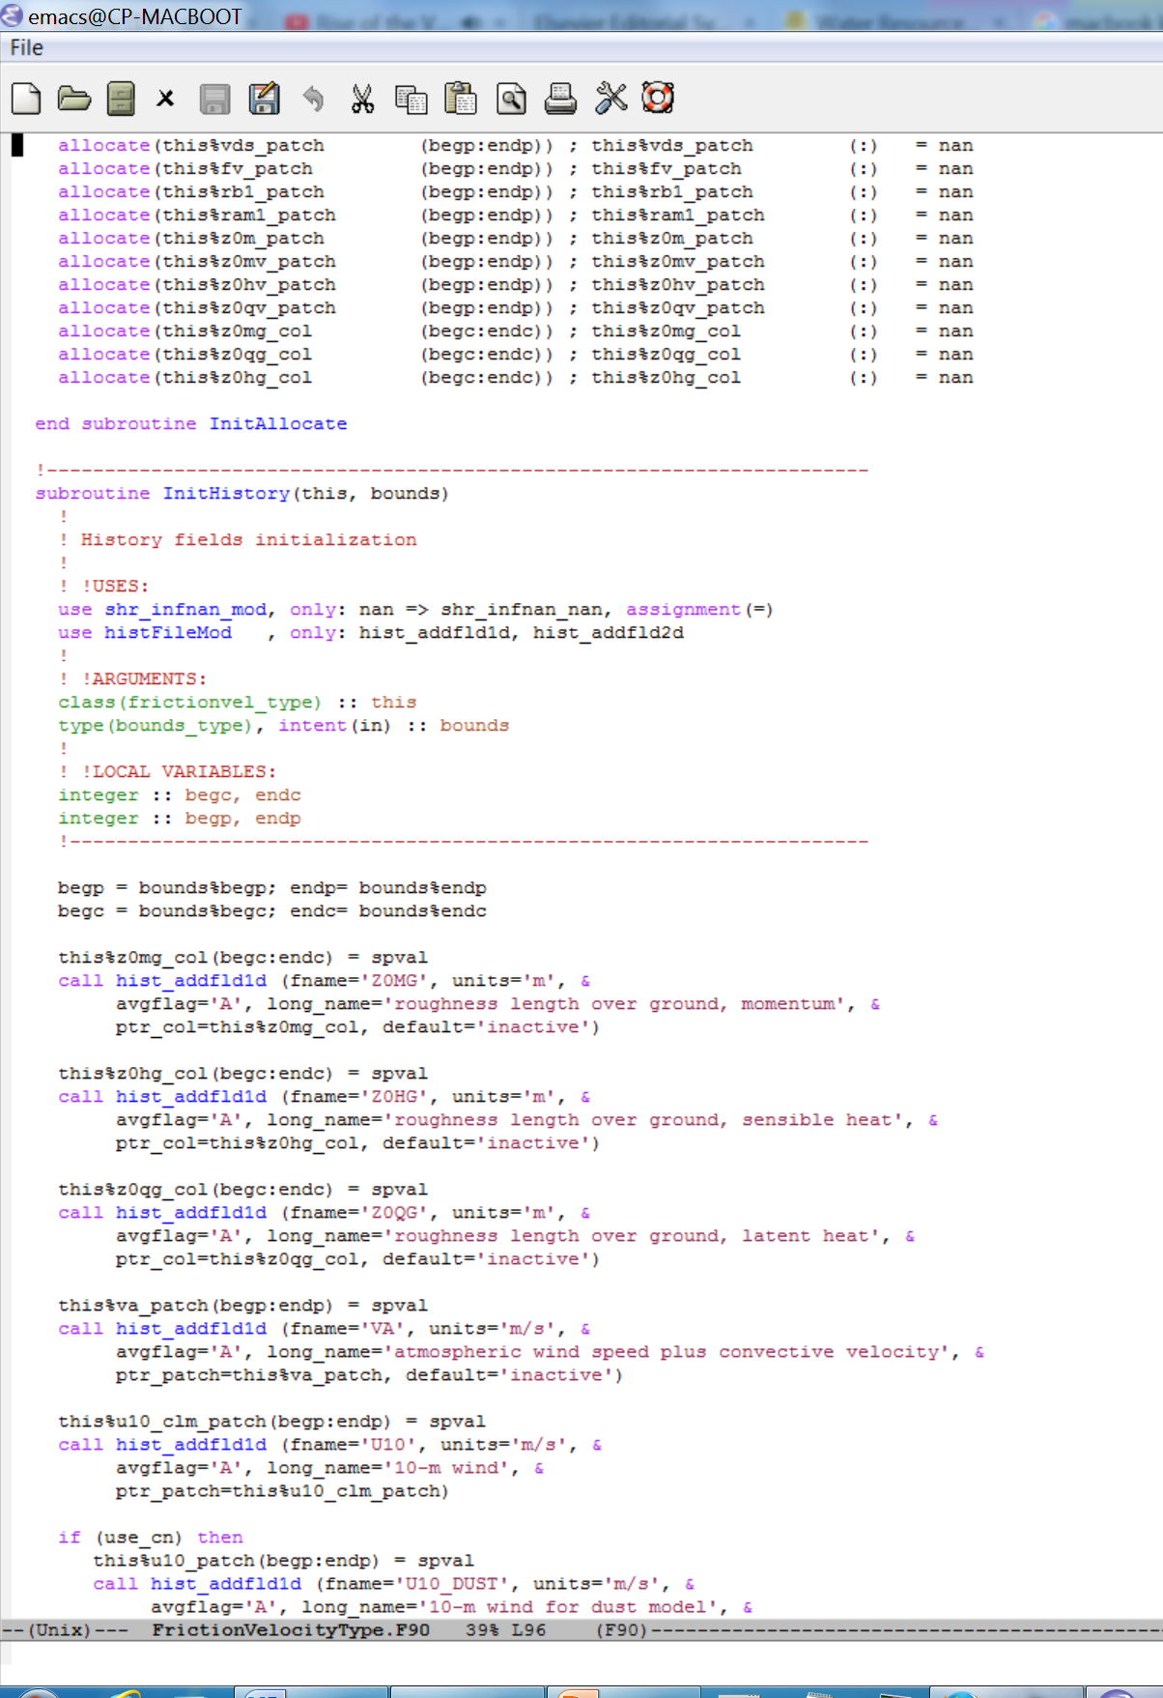
A generic data structure and a Fortran-native reflection package
I

Slide 5
A generic data structure and a Fortran-native reflection package
I
Reflective statements are much more generic
Task described in normal language | Non-reflective | Reflective
Set values to all subfields | ! Hard-code everything A%f1=0 A%f2=0 ….. | ! For every Real field of mine, set the value to 0 (do this for the children of my children and so on …)
Need to be updated when
there are changes!
Requires no maintenance
during updates!

Slide 6
Why is reflection so good?
Dramatic reduction in effort if the program has a little intelligence. For example, compare:
Task described in normal language | Non-reflective | Reflective
Set field values | ! Hard-code everything A%f1=0 A%f2=0 ….. | ! For every Real field of mine, set the value to 0 (do this for the children of my children and so on …)
b. Copy values between variables | ! Hard-code everything A%f1=B%f1 A%f2=B%f2 ….. | ! For every Real field of mine, if source has the same field which is of the same type, copy its value (do this for the children of my children, and so on …)
Notes:
Margin of return.
A bit of semantics
A bit of intelligence with your orbot can be the turning point of the universe.

Slide 7
Why is reflection so good?
Dramatic reduction in effort if the program has a little intelligence. For example, compare:
Task described in normal language | Non-reflective | Reflective
c. Read self-descriptive data files and reproduce the structure | ! Hard-code everything A%f1=read(file, ‘f1’) A%f2%f3=read(file,’f2/f3’) ….. | ! Read variables in the file, establish exactly the same data structure as specified
Notes:
Margin of return.
A bit of semantics
A bit of intelligence with your orbot can be the turning point of the universe.

Slide 8
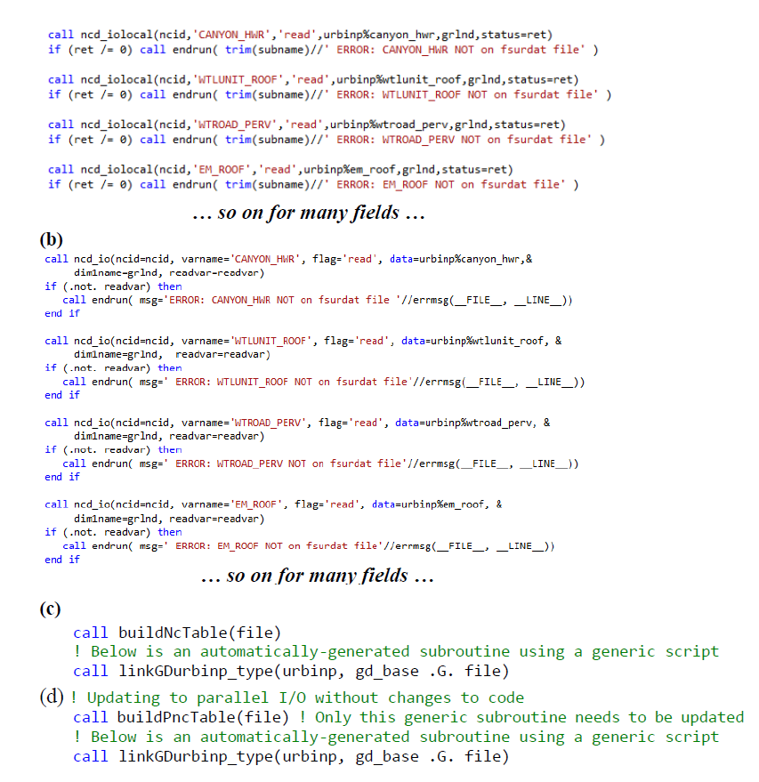
We have implemented a generic Fortran-native data structure that enables reflection

Slide 9
Multi-scale methods
II
II.1 Fractal-based method
II.2 Reduced-order models
II.3 Physically-based subgrid-scale parameterization and perturbed prototypes

Slide 10
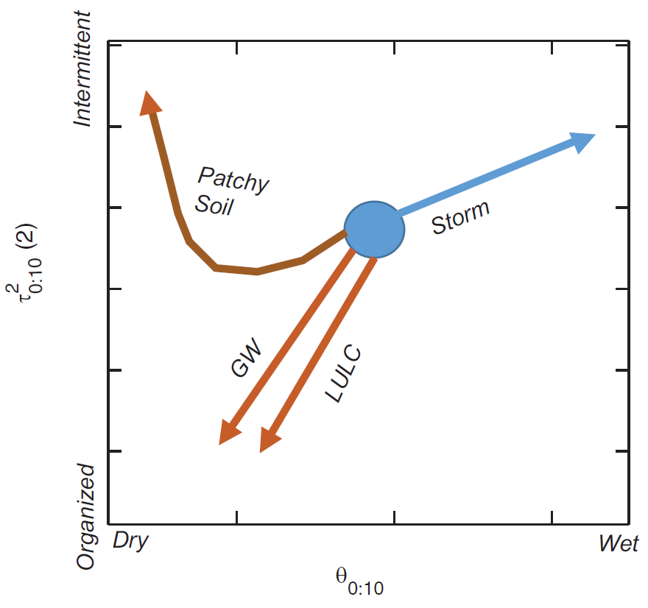
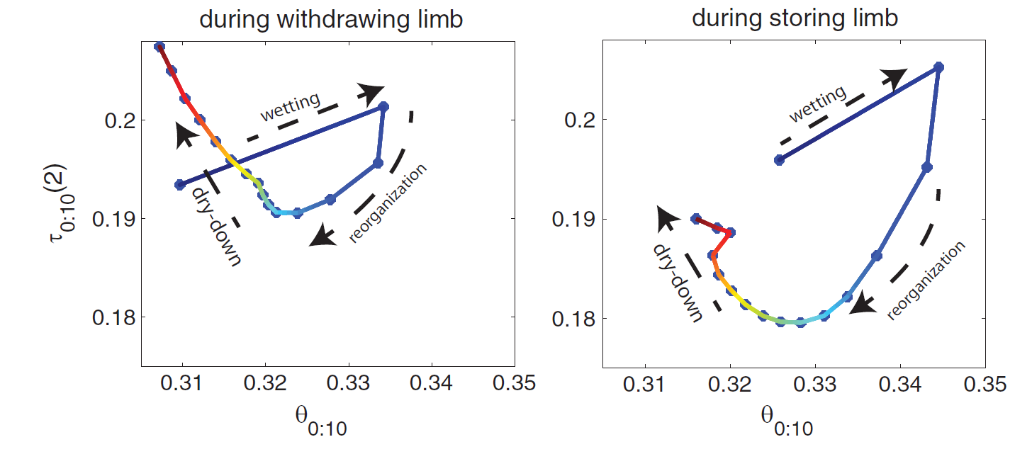
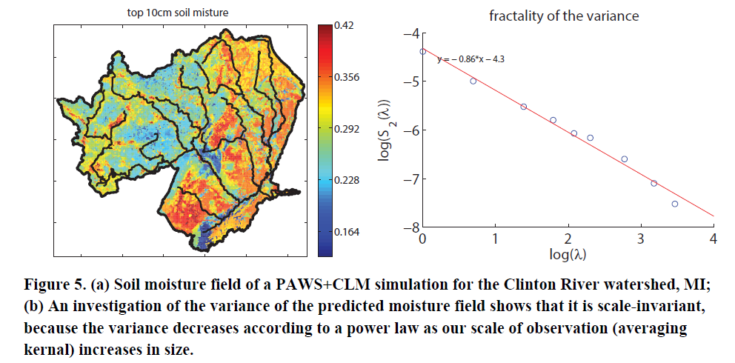
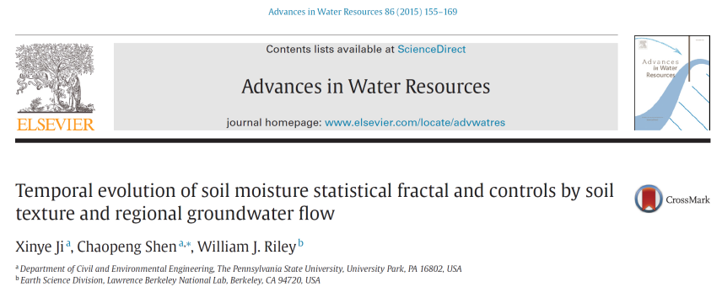
Fractal-based multi-scale methods?
II
Hysteresis in temporal evolution and influence by groundwater flow and soil patchiness
PAWS+CLM

Slide 11
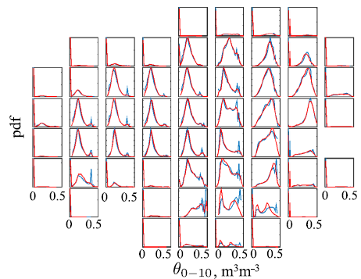
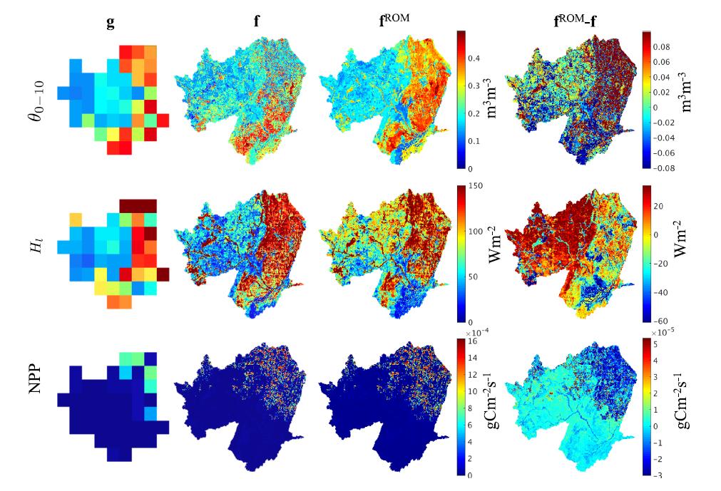
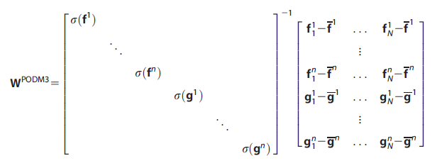
Reduced-order modeling (collaborative)
II
ROM-approximated distribution is indistinguishable from fine grid solution (PAWS+CLM)
We still need to study how ROM change as functions of parameters
Pau, Shen, Riley and Liu, WRR, 2016
Riley and Shen, HESS, 2014

Slide 12
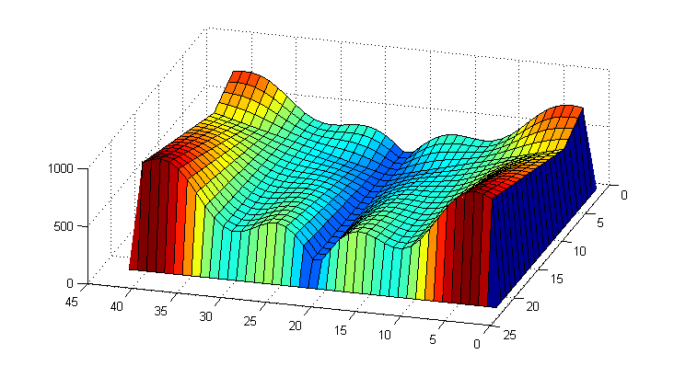
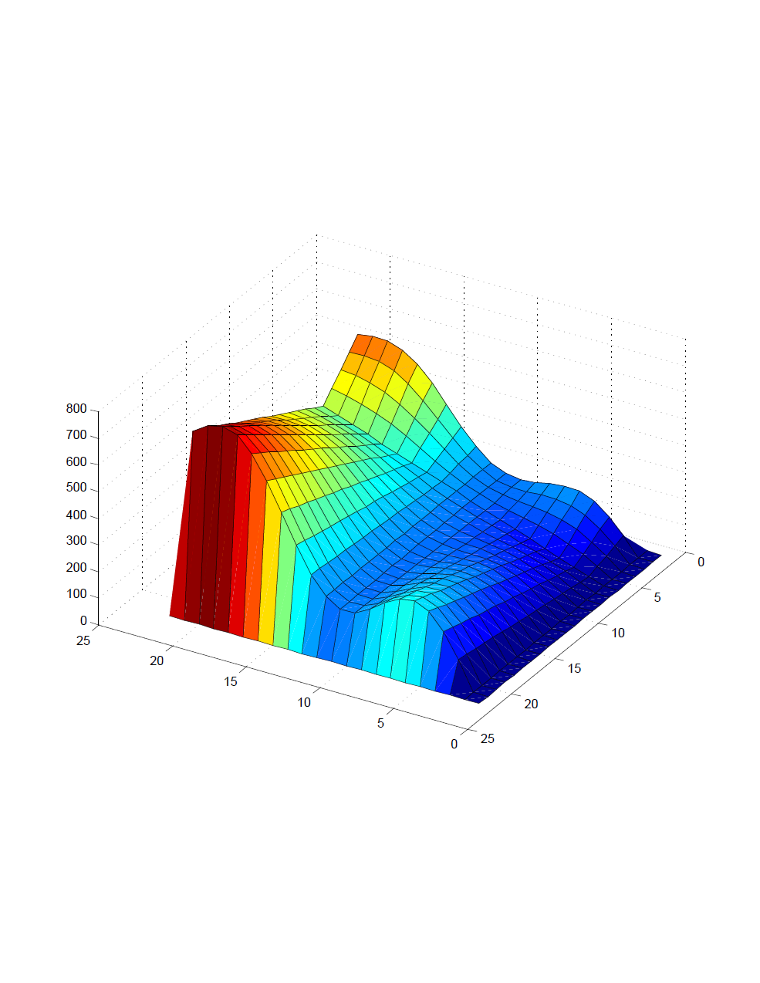
Subgrid parameterization+
Perturbed prototypes
II
We created prototypical, parameter-tunable landscapes
We are trying to find the functional form of local groundwater exfiltration as a function of control parameters
This work is useful for constructing a multi-scale model for small-scale groundwater exfiltration

Slide 13
Perturbed prototypes
II
PAWS+CLM model
Notes:
“slope” means

Slide 14
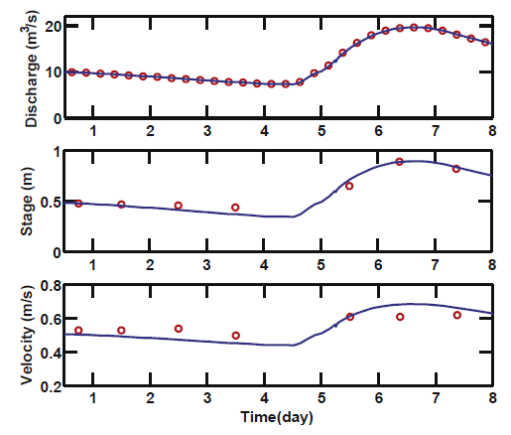
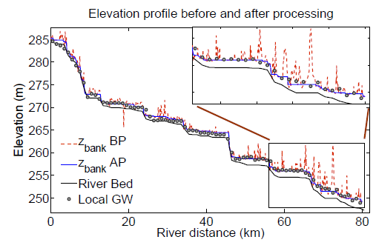
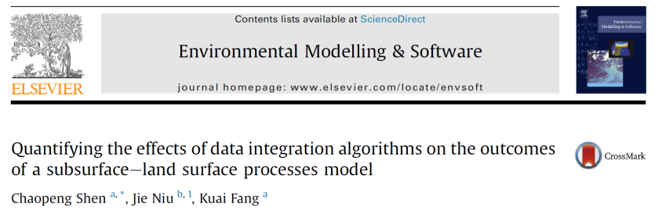
Channel-land interactions
III
Channels are an important hydrologic component assumed to have no impact on land surface
We extract channel bank elevation from high resolution DEM
Different soil PTFs were tested
PAWS+CLM explicitly simulates overland-flow-channel exchange, groundwater-channel exchange using physically-based formulations.

Slide 15
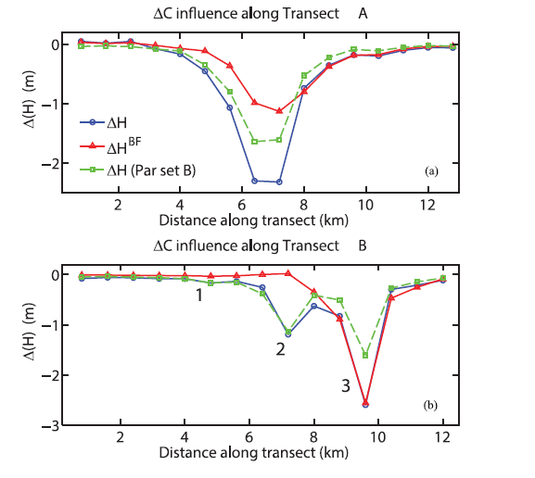
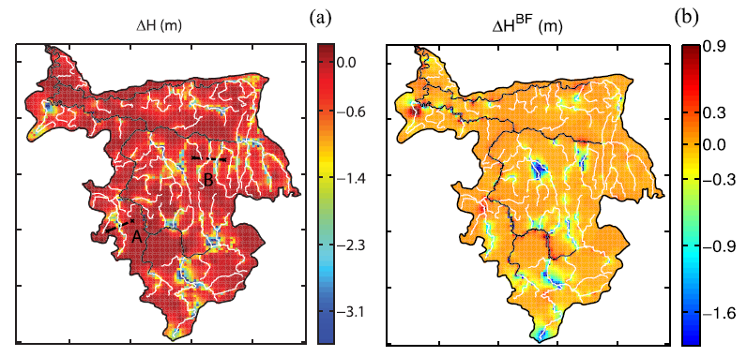
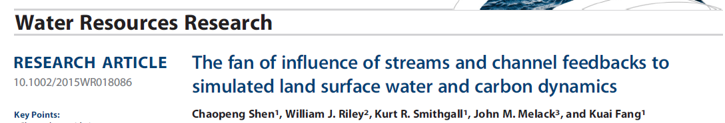
Channel-land interactions
III
A “fan of influence” was identified where river representation has noticeable (10%) influence on land surface fluxes
The mechanisms are channel incision/groundwater exchange and efficient conveyance capacity of streams

Slide 16
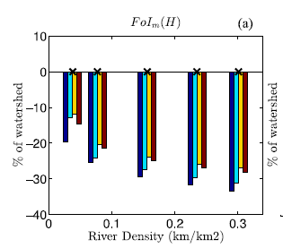
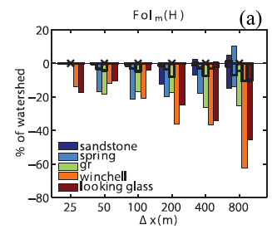
Channel-land interactions
III
A “fan of influence” was identified where river representation has noticeable (10%) influence on land surface fluxes
The mechanisms are channel incision/groundwater exchange and efficient conveyance capacity of streams
The effects of channels are noticeable even at 25m resolution (too expensive!)
→ Channels need to considered rather than ignored
→ Channels should not be treated identically as overland flow. They need to be parameterized and properly represented.

Slide 17
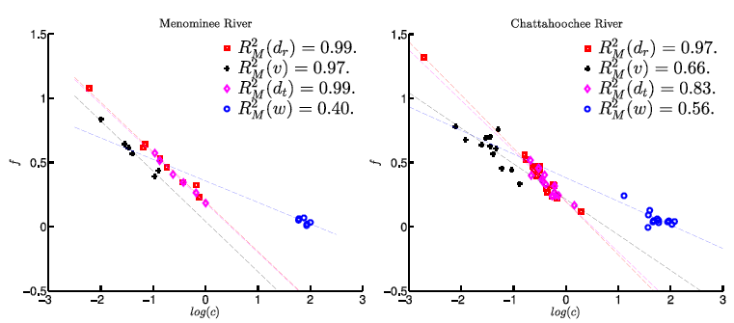
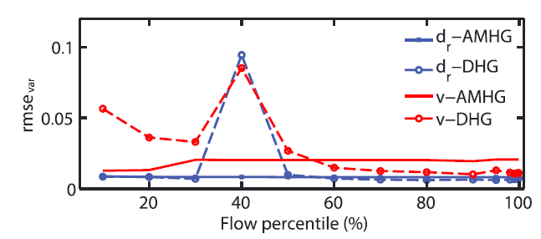
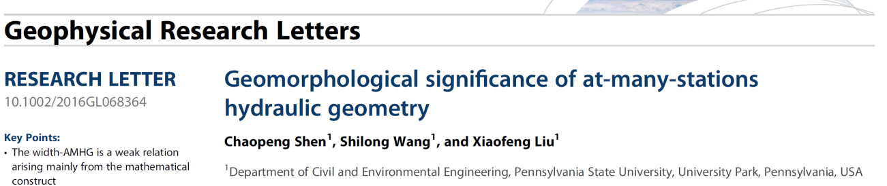
Channel-land interactions
III
To further provide large-scale channel characterization datasets, we explored At-many-stations hydraulic geometry (AMHG), a new concept proposed in a Gleason & Smith 2014, PNAS.
AMHG reduces the number of parameters in hydraulic geometry (HG), which relates width/depth to discharge.
This data synthesis work explored expanding limited observations of channel hydraulic geometries (width, depth as a function of discharge) to large-river scales using AMHG and percentile-based Downstream HG.

Slide 18
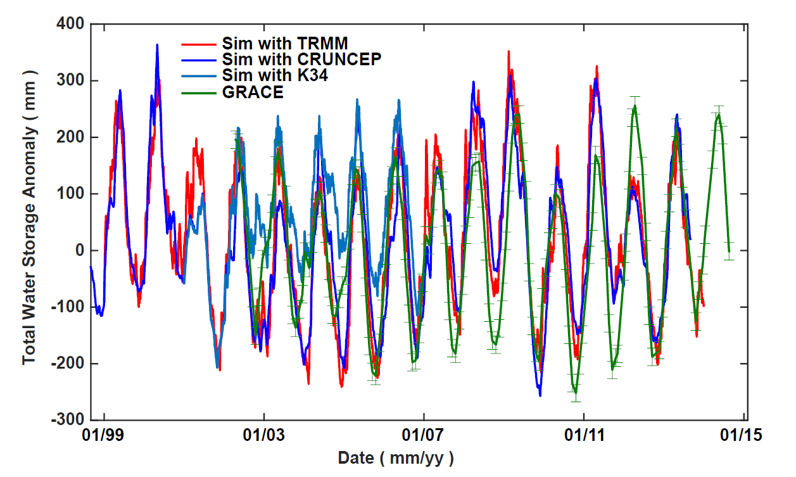
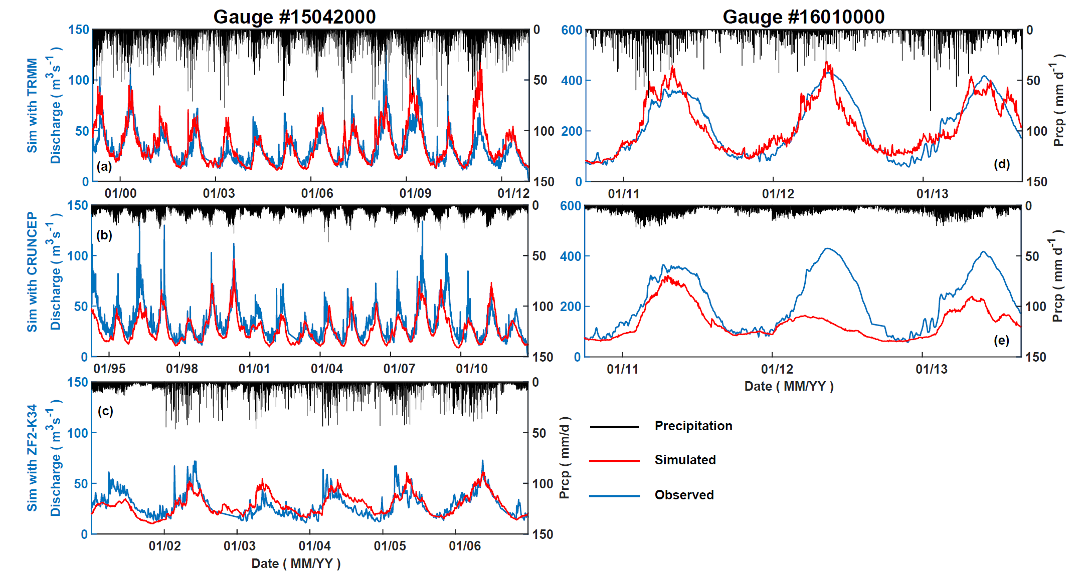
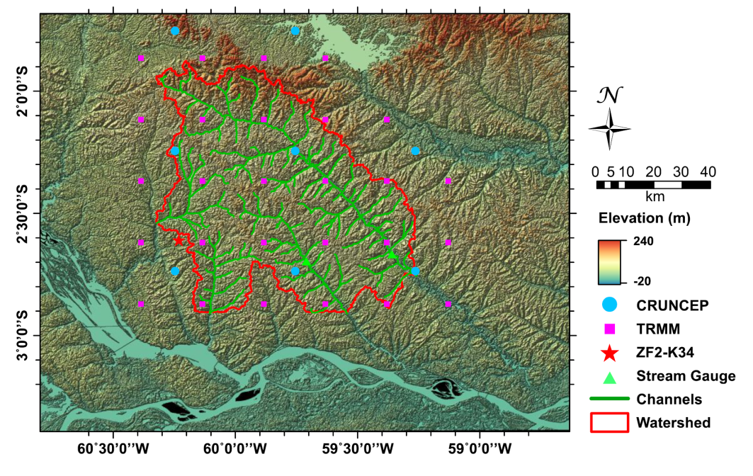
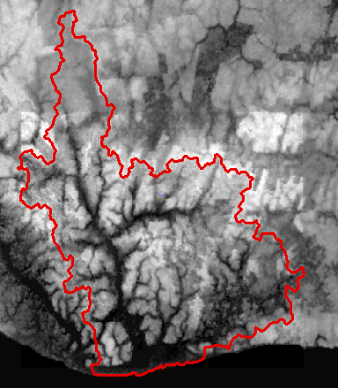
Amazon hydrologic budgets
IV
Niu, J., CP. Shen, JQ. Chambers, JM. Melack and WJ. Riley, under revision

Slide 19
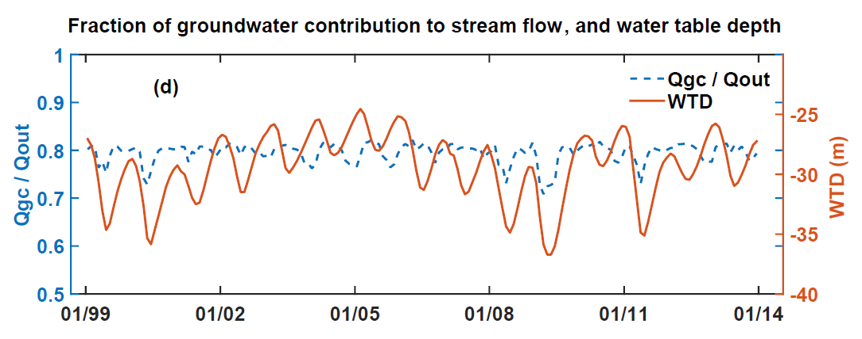
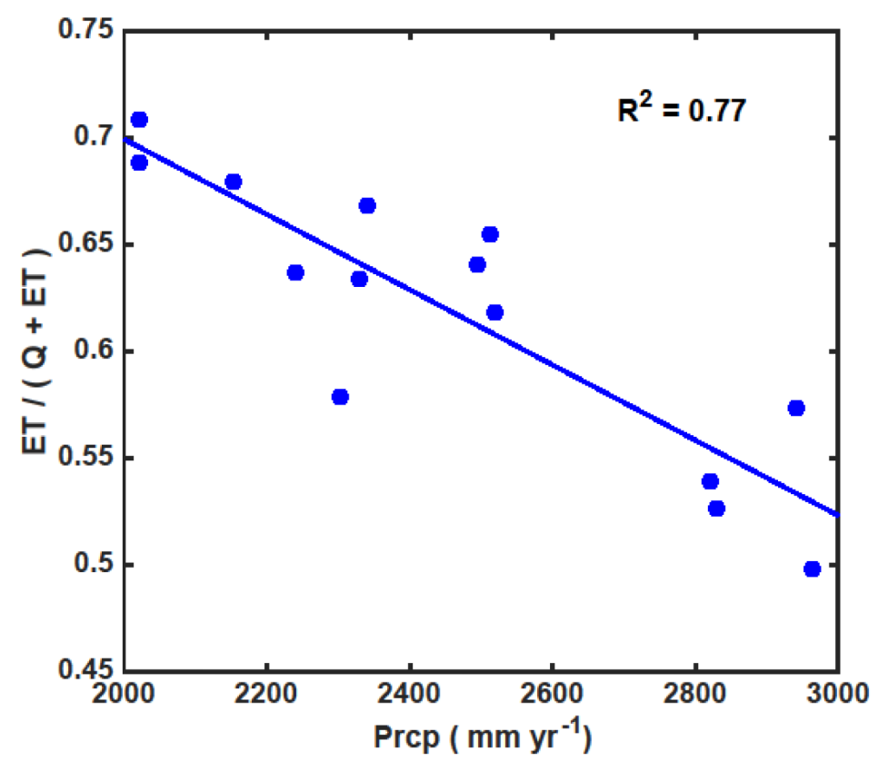
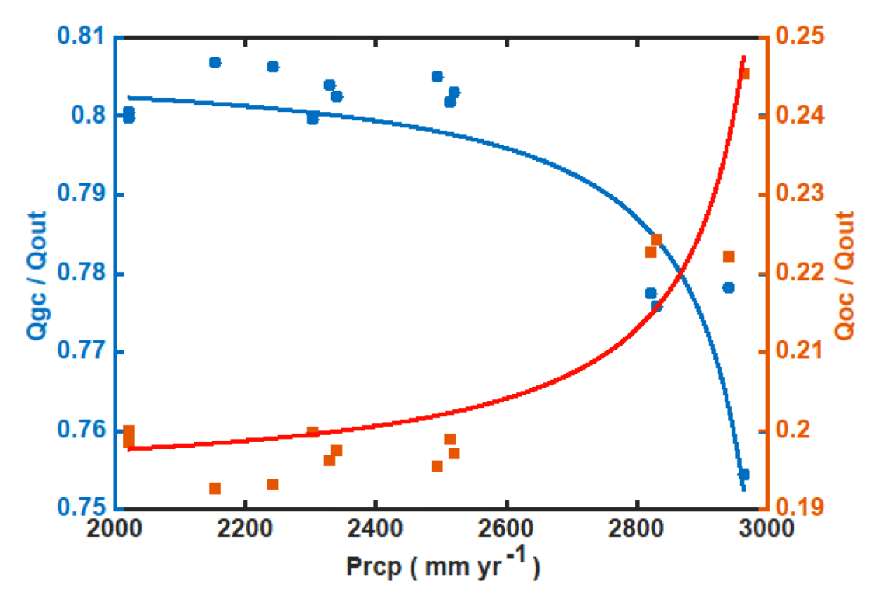
Controls for Amazon ET fluxes
IV

Slide 20
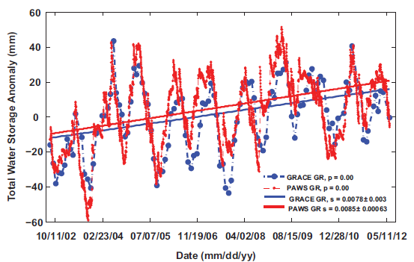
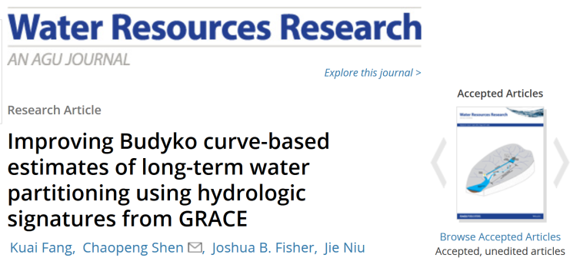
Verification datasets for ungauged basins
IV
GRACE-Budyko-curve based ET estimates

Slide 21
GRACE-based streamflow estimates?
(in coordination with PSU internal grant)

Slide 22
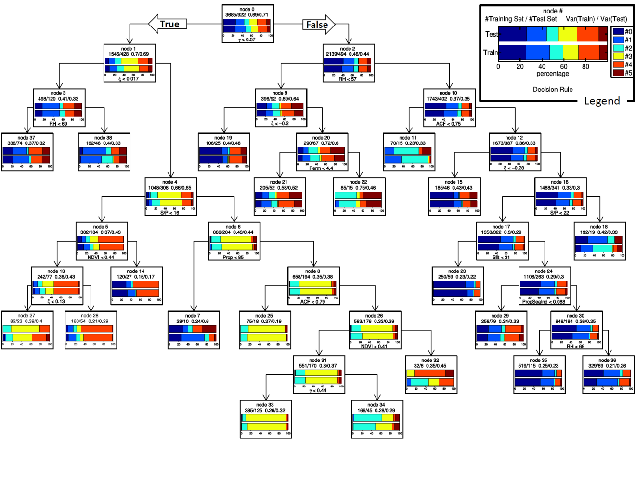

Using machine learning techniques to learn TWS-streamflow relationships
K-means clustering to identify main patterns
Support Vector Machine and regression tree
Fang and Shen, to be submitted soon

Slide 23
References
Published
Fang, K.*, CP. Shen, JB. Fisher and J. Niu. Improving Budyko curve-based estimates of long-term water partitioning using hydrologic signatures from GRACE, Water Resources Research, doi: 10.1002/2016WR018748 (2016, In press)
Shen, CP., SL. Wang* and X. Liu, Geomorphological significance of at-many-stations hydraulic geometry, Geophysical Research Letters, Vol. 43, No. 8, doi: 10.1002/2016GL068364 (2016)
Shen, CP., WJ. Riley, KR. Smithgall*, JM. Melack and K. Fang*, The fan of influence of streams and channel feedbacks to simulated land surface water and carbon dynamics, Water Resources Research, doi: 10.1002/2015WR018086 (2016)
Pau, GHS, CP. Shen, WJ. Riley and Y. Liu, Accurate and efficient prediction of fine-resolution hydrologic and carbon dynamic simulations from coarse-resolution models, Water Resources Research, doi: 10.1002/2015WR017782 (2016)
Ji, XY*, CP. Shen and WJ. Riley, Temporal evolution of soil moisture statistical fractal and controls by soil texture and regional groundwater flow. Advances in Water Resources, 86, 155–169. doi:10.1016/j.advwatres.2015.09.027 (2015)
Riley, WJ. and CP. Shen: Characterizing coarse-resolution watershed soil moisture heterogeneity using fine-scale simulations, Hydrol. Earth Syst. Sci., 18(7), 2463–2483, doi:10.5194/hess-18-2463-2014 (2014).
Shen, CP., J. Niu and K. Fang*, Quantifying the Effects of Data Integration Algorithms on the Outcomes of a Subsurface - Land Surface Processes Model, Environmental Modelling & Software., doi: 10.1016/j.envsoft.2014.05.006 (2014)
Under review/revision
Ji, XY. and CP. Shen, The introspective may achieve more: enhancing existing Geoscientific models with native-language structural reflection.
Niu, J., CP. Shen, JQ. Chambers, JM. Melack and WJ. Riley, Inter-annual variation in water budgets in an Amazonian Watershed Using a Coupled Subsurface – Land Surface Process Model

