Slide 1
Dynamical Contribution to the Extratropical Precipitation Extremes
JIAN LU, L. RUBY LEUNG, QING YANG
G. Chen, W. COLLINS, FUYU LI, J. HOU AND X. FENG
Atmospheric Science and Global Change Division
Pacific Northwest National Laboratory, US Department of Energy

Slide 2
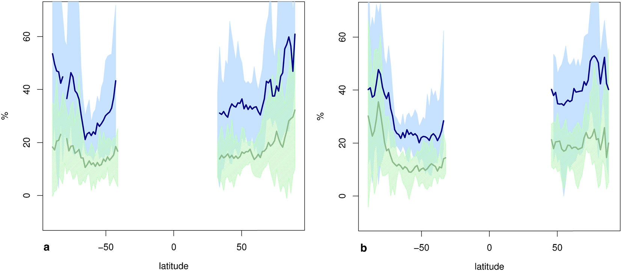
Background and Motivation
Circulation shifts/expands under global warming
Dynamical impacts on extratropical hydrological cycle
Possible convergence on the extratropical climate and extremes
Increase of of 50-yr return level under scenario RCP8.5
DJF
JJA
2060-2099
2020-2059
Toreti et al. (2013)
Notes:
Note that 30 yr of length is not adequate to resolve locally even 95% intensity of precip. Kendon et al (2008, Met Office)

Slide 3
The state of the science about precipitation extremes
Emori and Brown (2005): thermodynamic mechanism dominates over the dynamical mechanism nearly everywhere.
Gastineau and Soden (2009): The strongest precipitation bins (>90th %tile) are associated with weaker ascending velocity and surface cyclonic vorticity. This suggests that the increase of the heavy precipitation events in the models results from the increased water wapor and not an increase in the strongest circulation events.
Sugiyama et al (2010): Combining vertical motion and precipitable water overestimates precipitation extremes; only when the vertical profile of moisture convergence is considered is it possible to account for the extreme changes.
Lenderink and Van Meijgaard (2008): Hourly extreme precip increases at twice the CC rate, suggesting thermodynamic and dynamical effects can interact jointly.
Notes:
Sugiyama’s work is tantamount to full moisture budget for precip extremes. Their conclusion is more sensible.
The IPCC report also dismissive about the importance of the dyn effect in the extratropical extremes.

Slide 4
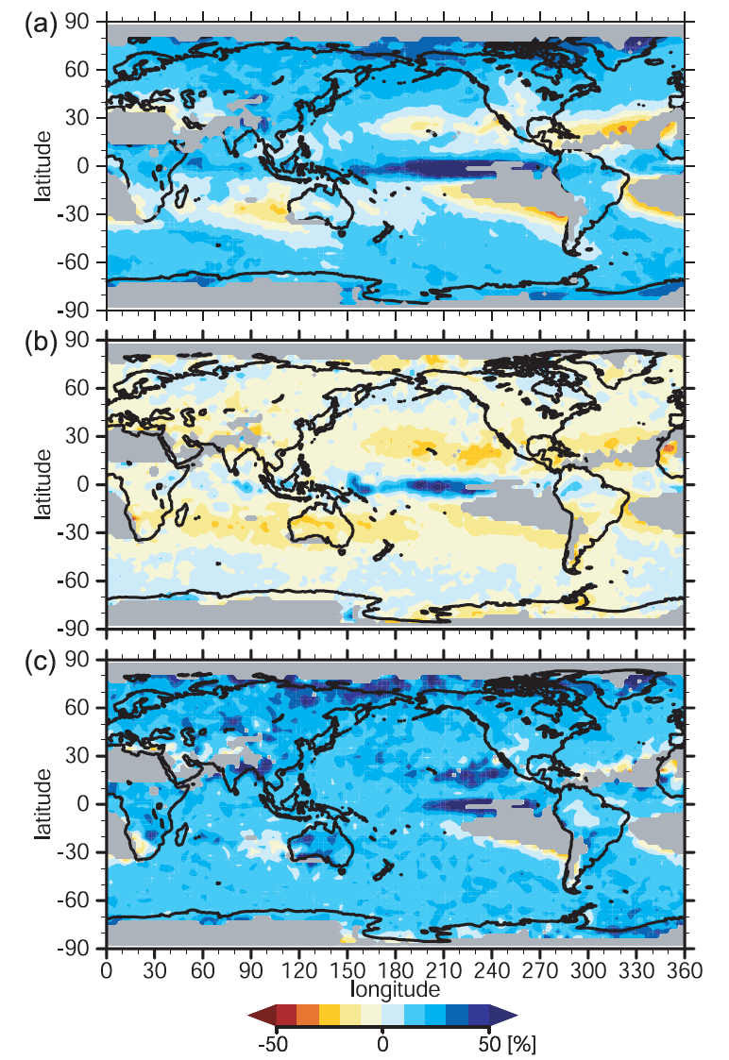
Emori and Brown (2005) fractional increase of p^{99th}
Total:
Dynamics:
Thermodyn:
Notes:
Emori and Brown’s works suggested minimal role of dynamics in extremes, the increased of extreme are dominated by thermodyn effect.

Slide 5
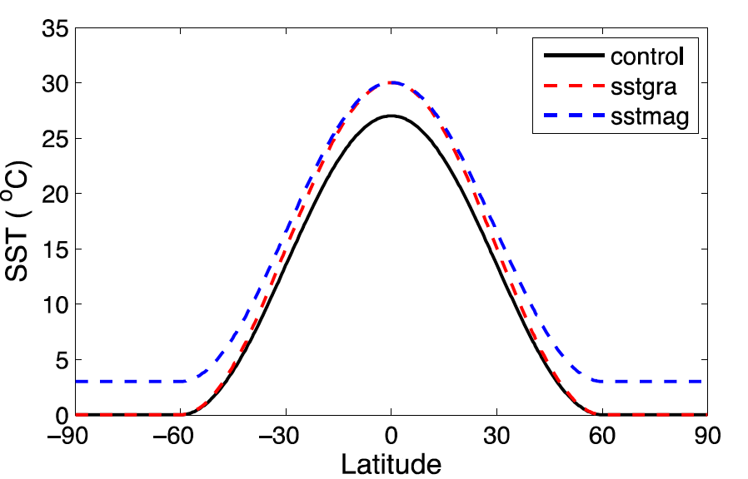
Model and data
Model: NCAR CAM3, Spectral dycore, Aquaplanet configuration.
Simulations:
T42, T85, T170, T340; 5 min time step, 26 levels
for each resolution: control, 3K, sstgra
(only daily data at selected levels are available)
Li et al. (2011)
Notes:
A unique advantage of uniform SST warming is that the associated water vapor, if totally dictated by the thermodyn (C-C) relation, shouldn’t have much meridional structure; any meridional structure should be attributed to dynamics.
Indeed we see a hint of it.

Slide 6
Convergence of Precip PDF
log10(PDF_{3K}/PDF_{cntr}), T42
log10(PDF_{3K}/PDF_{cntr}), T85
1/1000 events
log10(PDF_{3K}/PDF_{cntr}), T170
log10(PDF_{3K}/PDF_{cntr}), T340
Notes:
Compelling evidence of shift of circulation: zonal wind, omega, and instantaneous wind speed.
As far the convergence is concern, the T85 gives a at least qualitative prediction about how the fractoinal change of the freq of occurrence of 99.9th percentile events.

Slide 7
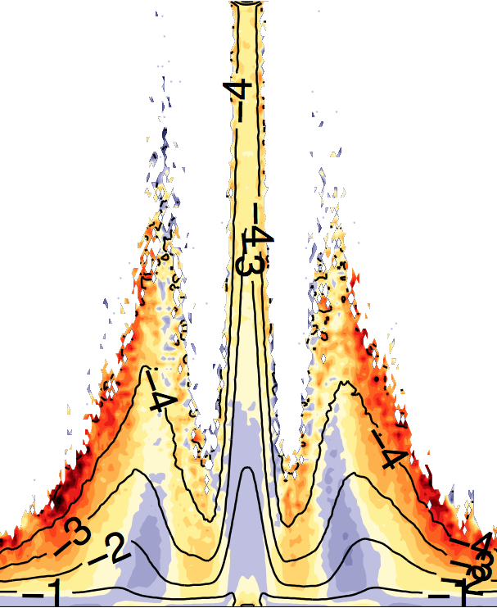
Interpretation of PDF change
=
+
Shift in p direction
Shift in y direction
7
Notes:
To minimize the variance of the residual fractional precip.
Note there is no poleward shift in the pdf of q.

Slide 8
Minimization of frac variance
CC rate
(α)
(in units of jet shift)
Notes:
The parameters of deltap and deltay give the minimum error for the fitting correspond to the same amount of shift as the zonal wind and sub-CC rate of increase in thermodynamics.
Fitting the change of the pdf of omega to a shift gives rise to the same amount of shift as the zonal wind as well. So, as far as shift is concerned, pdf(p), pdf(w) and Um all show the same poleward shfit (if we assume dyn and thermodyn are separable).
Increase of moisture is 8%/K in extratropics. So 0.7 implies 5.6%/K.

Slide 9
Decomposition of precip pdf into dyn and thermodyn shifts
(PDF_{3K}-PDF_{cntr})/PDF_{cntr}
(PDF_{shift}-PDF_{cntr})/PDF_{cntr}
[A]
pdf diff due to 3K, normalized by clim pdf
[C]
pdf diff due to the plwrd shift (45%)
C+D
(PDF_{th}-PDF_{cntr})/PDF_{cntr}
[B]
(90%)
[D]
Pdf diff due
to thermodyn
(80%)
Notes:
B/c the pattern of thermodyn is not orthogonal to the pattern of the dyn, we should be very careful about the result of the fitting.
To cross validate this result, I took a different approach.

Slide 10
Alternative: scaling of the percentiles
dynamical
column moisture
“precip efficiency”
10
Notes:
T42 coarse resolution is deficient in capturing the effect of the dynamical contribution. Coarse resolutions tend to underestimate the dyn contribution to the precip extremes.
Inter-hemi asymmetry gives a sense of how adequate the extreme is sampled.
T170 and T340 can capture two peaks in the extratrop increase of p99.9.

Slide 11
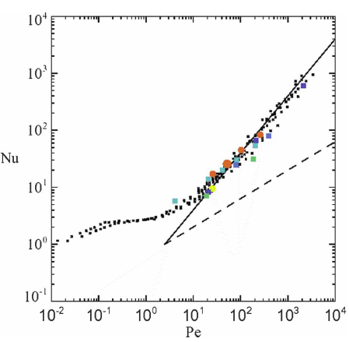
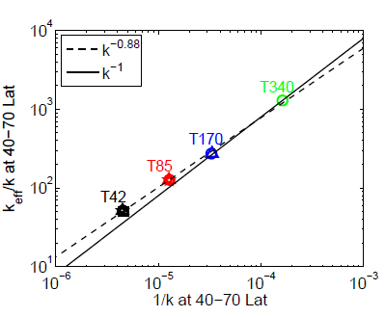
Convergence of effective diffusivity
Sign of dynamical convergence
Keff/k
k⁻¹
At large Pe (>200),
K_{eff}/k → k⁻¹
K_{eff} → const.
(Marshall et al. 2006)
Notes:
VL is quantified by Lyaponov exponent.

Slide 12
Conclusions
Sign of convergence emerges for certain range of extremes, at least within the modeling framework.
Circulation change exerts profound influence on the change of precip extremes by shifting the pdf poleward.
The poleward shift of the precip pdf can be accounted for by the poleward shift of the zonal mean zonal wind and the associated transients.
The sub-CC contribution from the thermodynamics hints at a reduction of “precipitation efficiency”.
Sign of dynamical convergence at resolutions > T170: effective diffusivity becomes independent of numerical diffusion coefficient.

