Slide 1



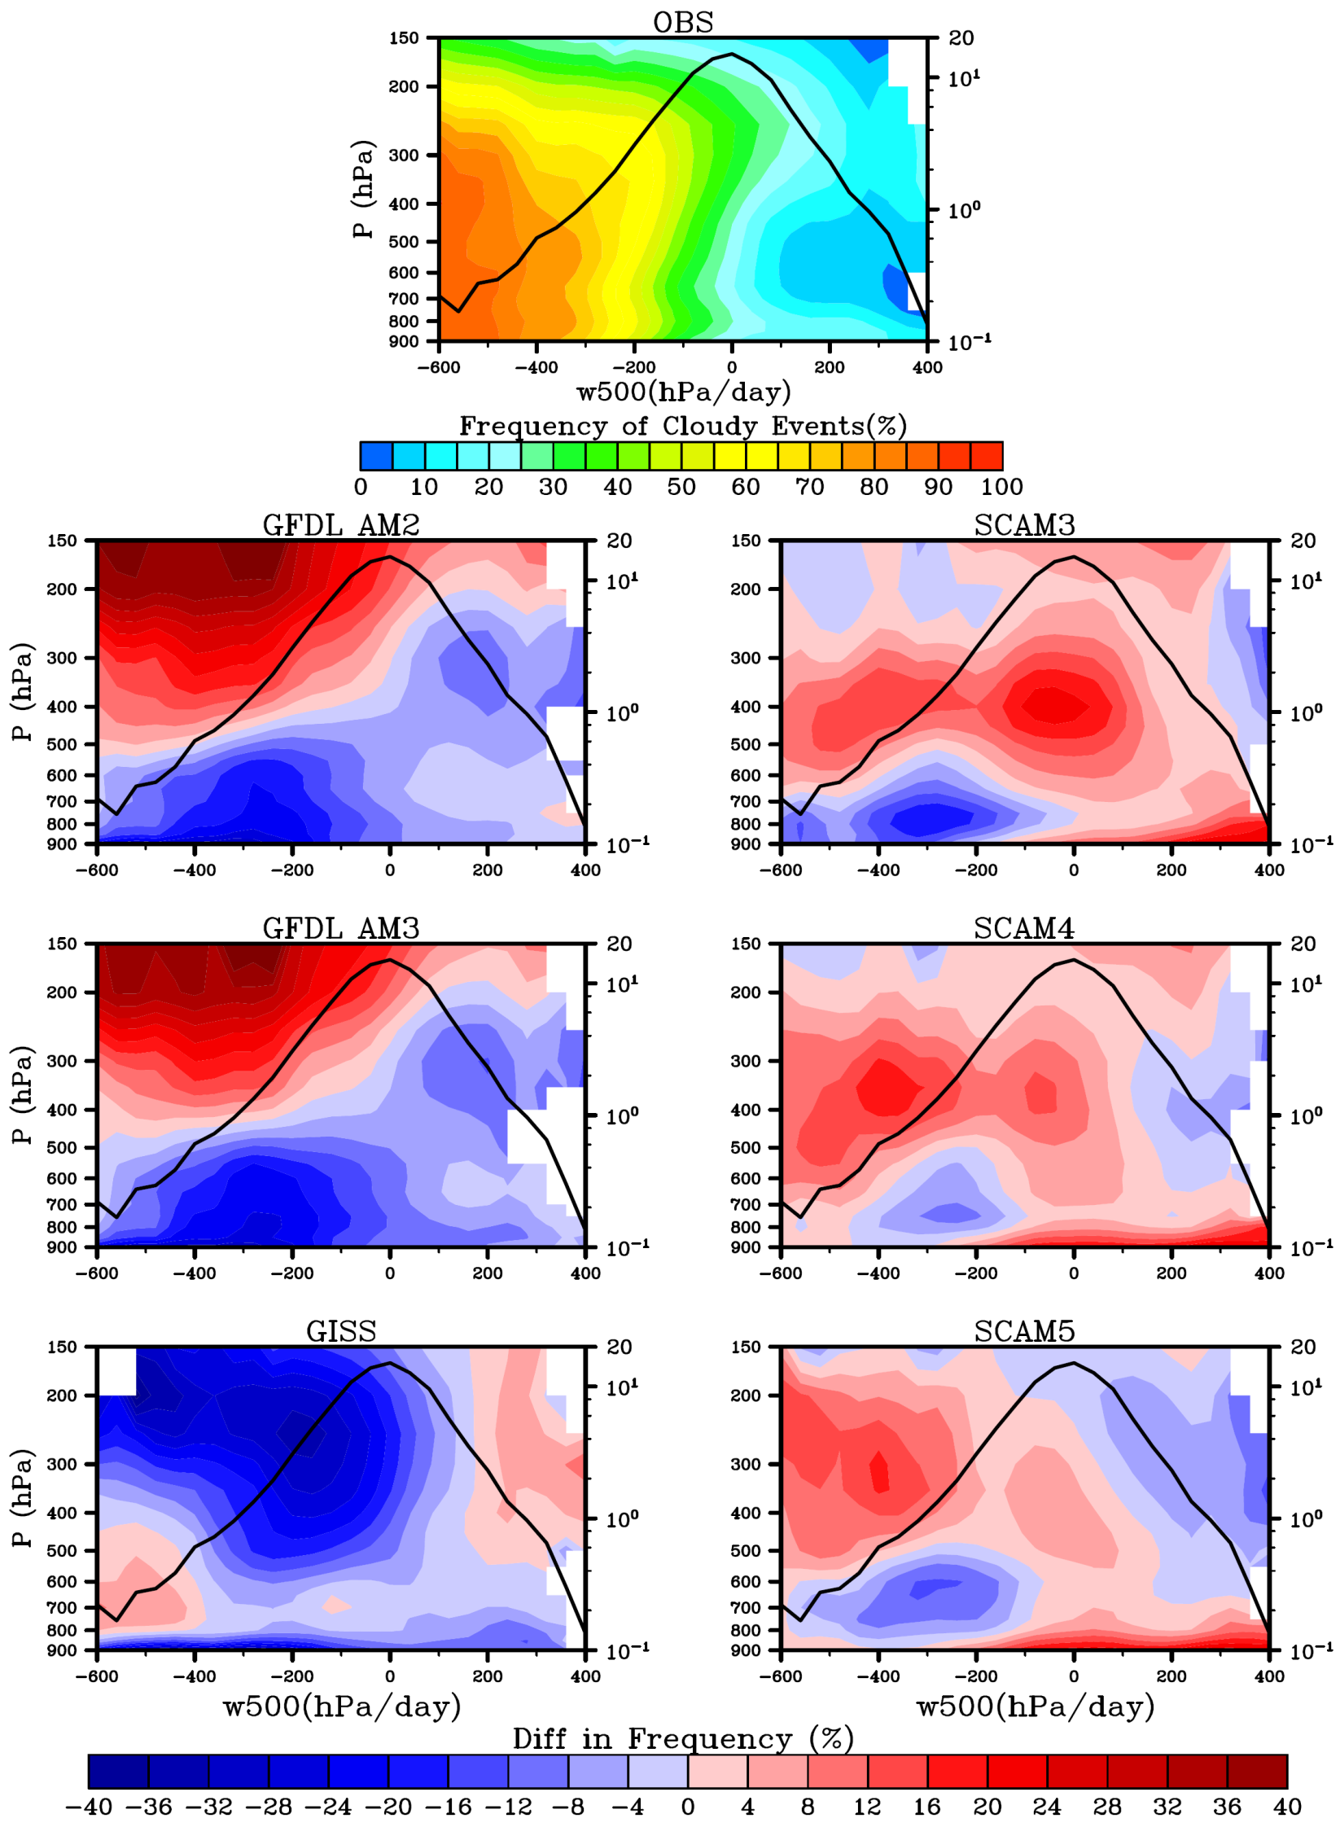
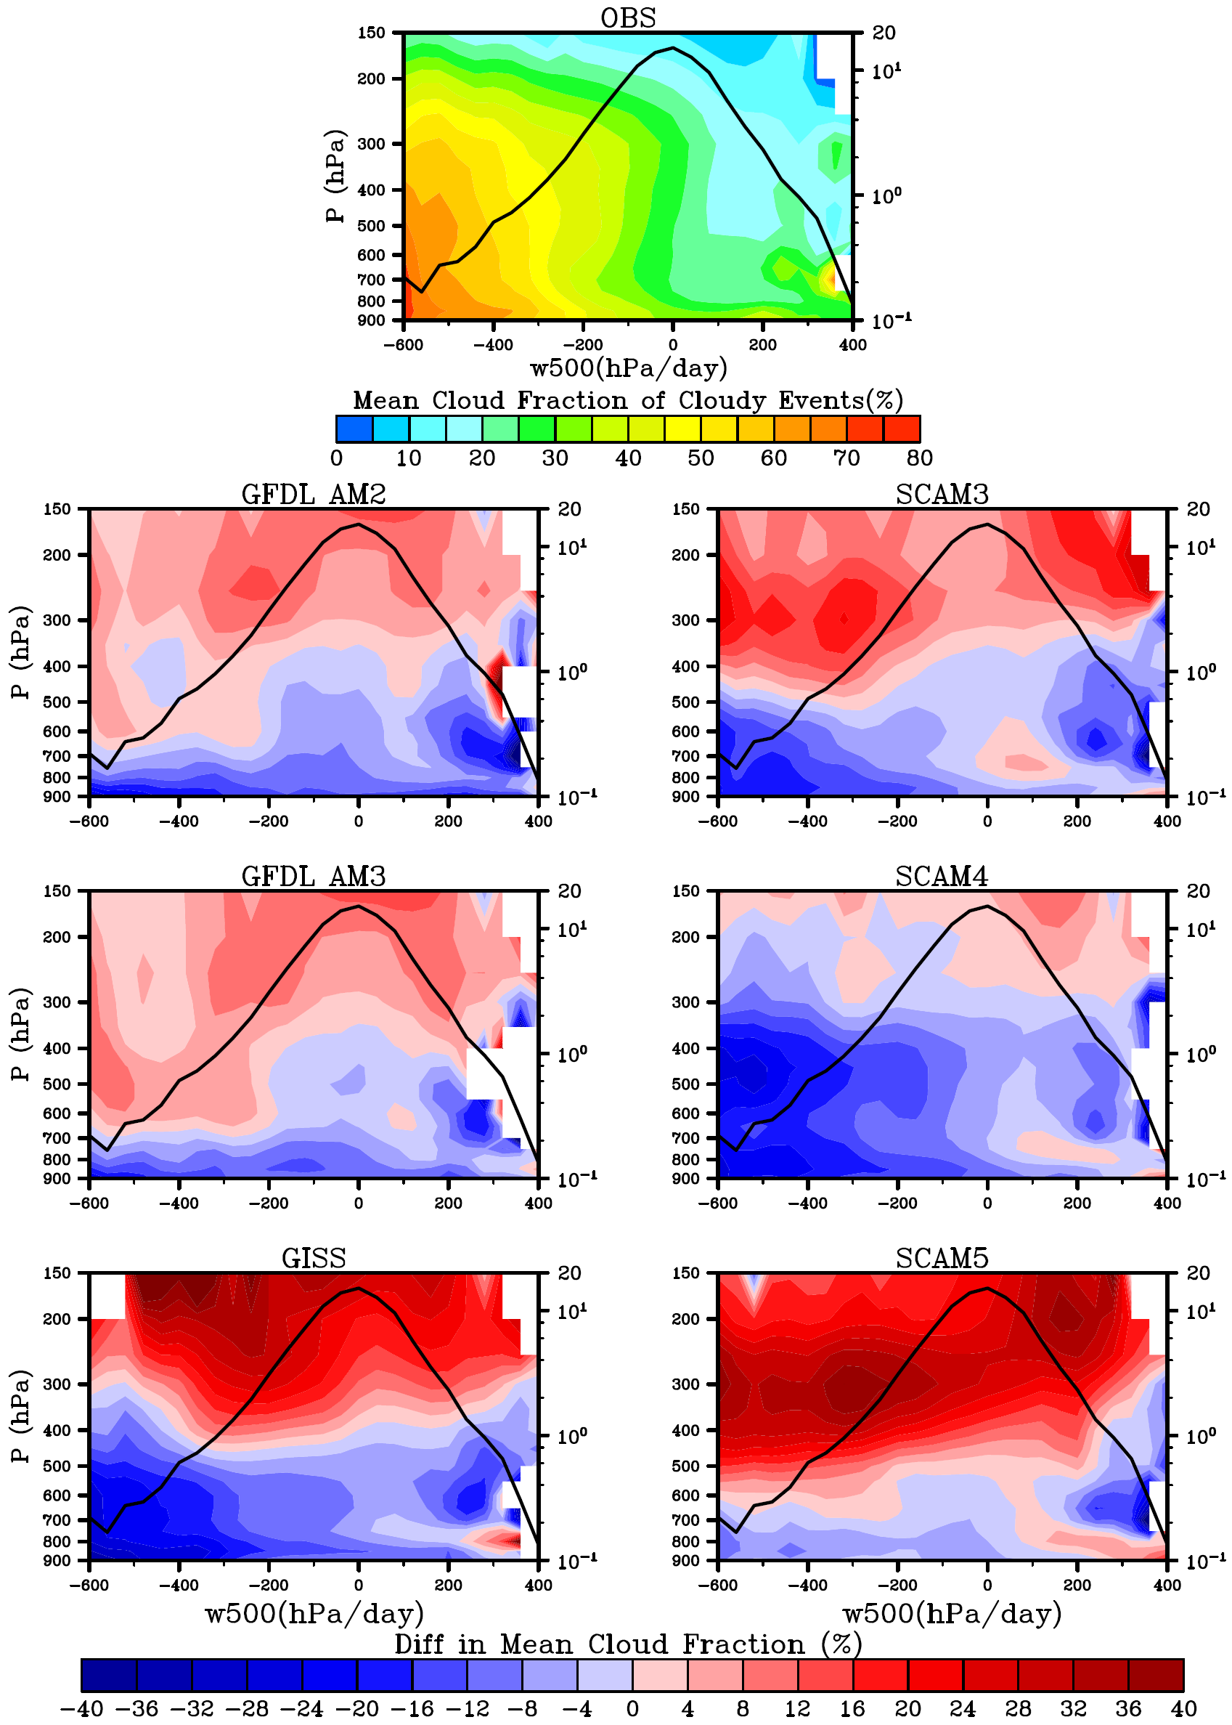
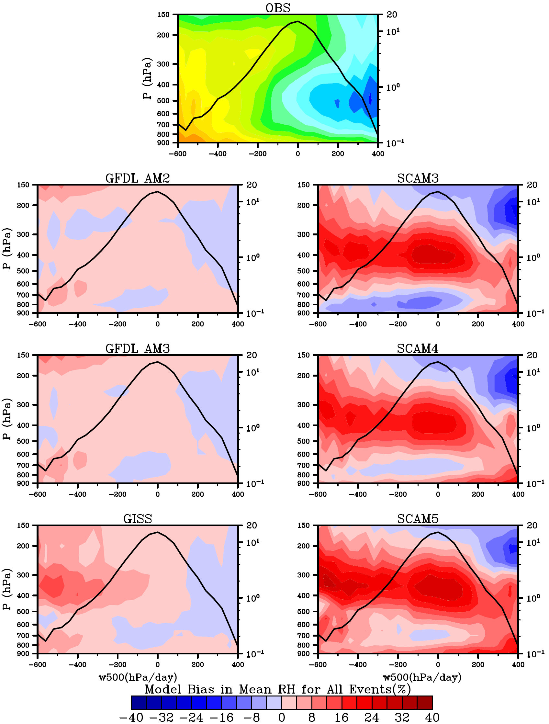
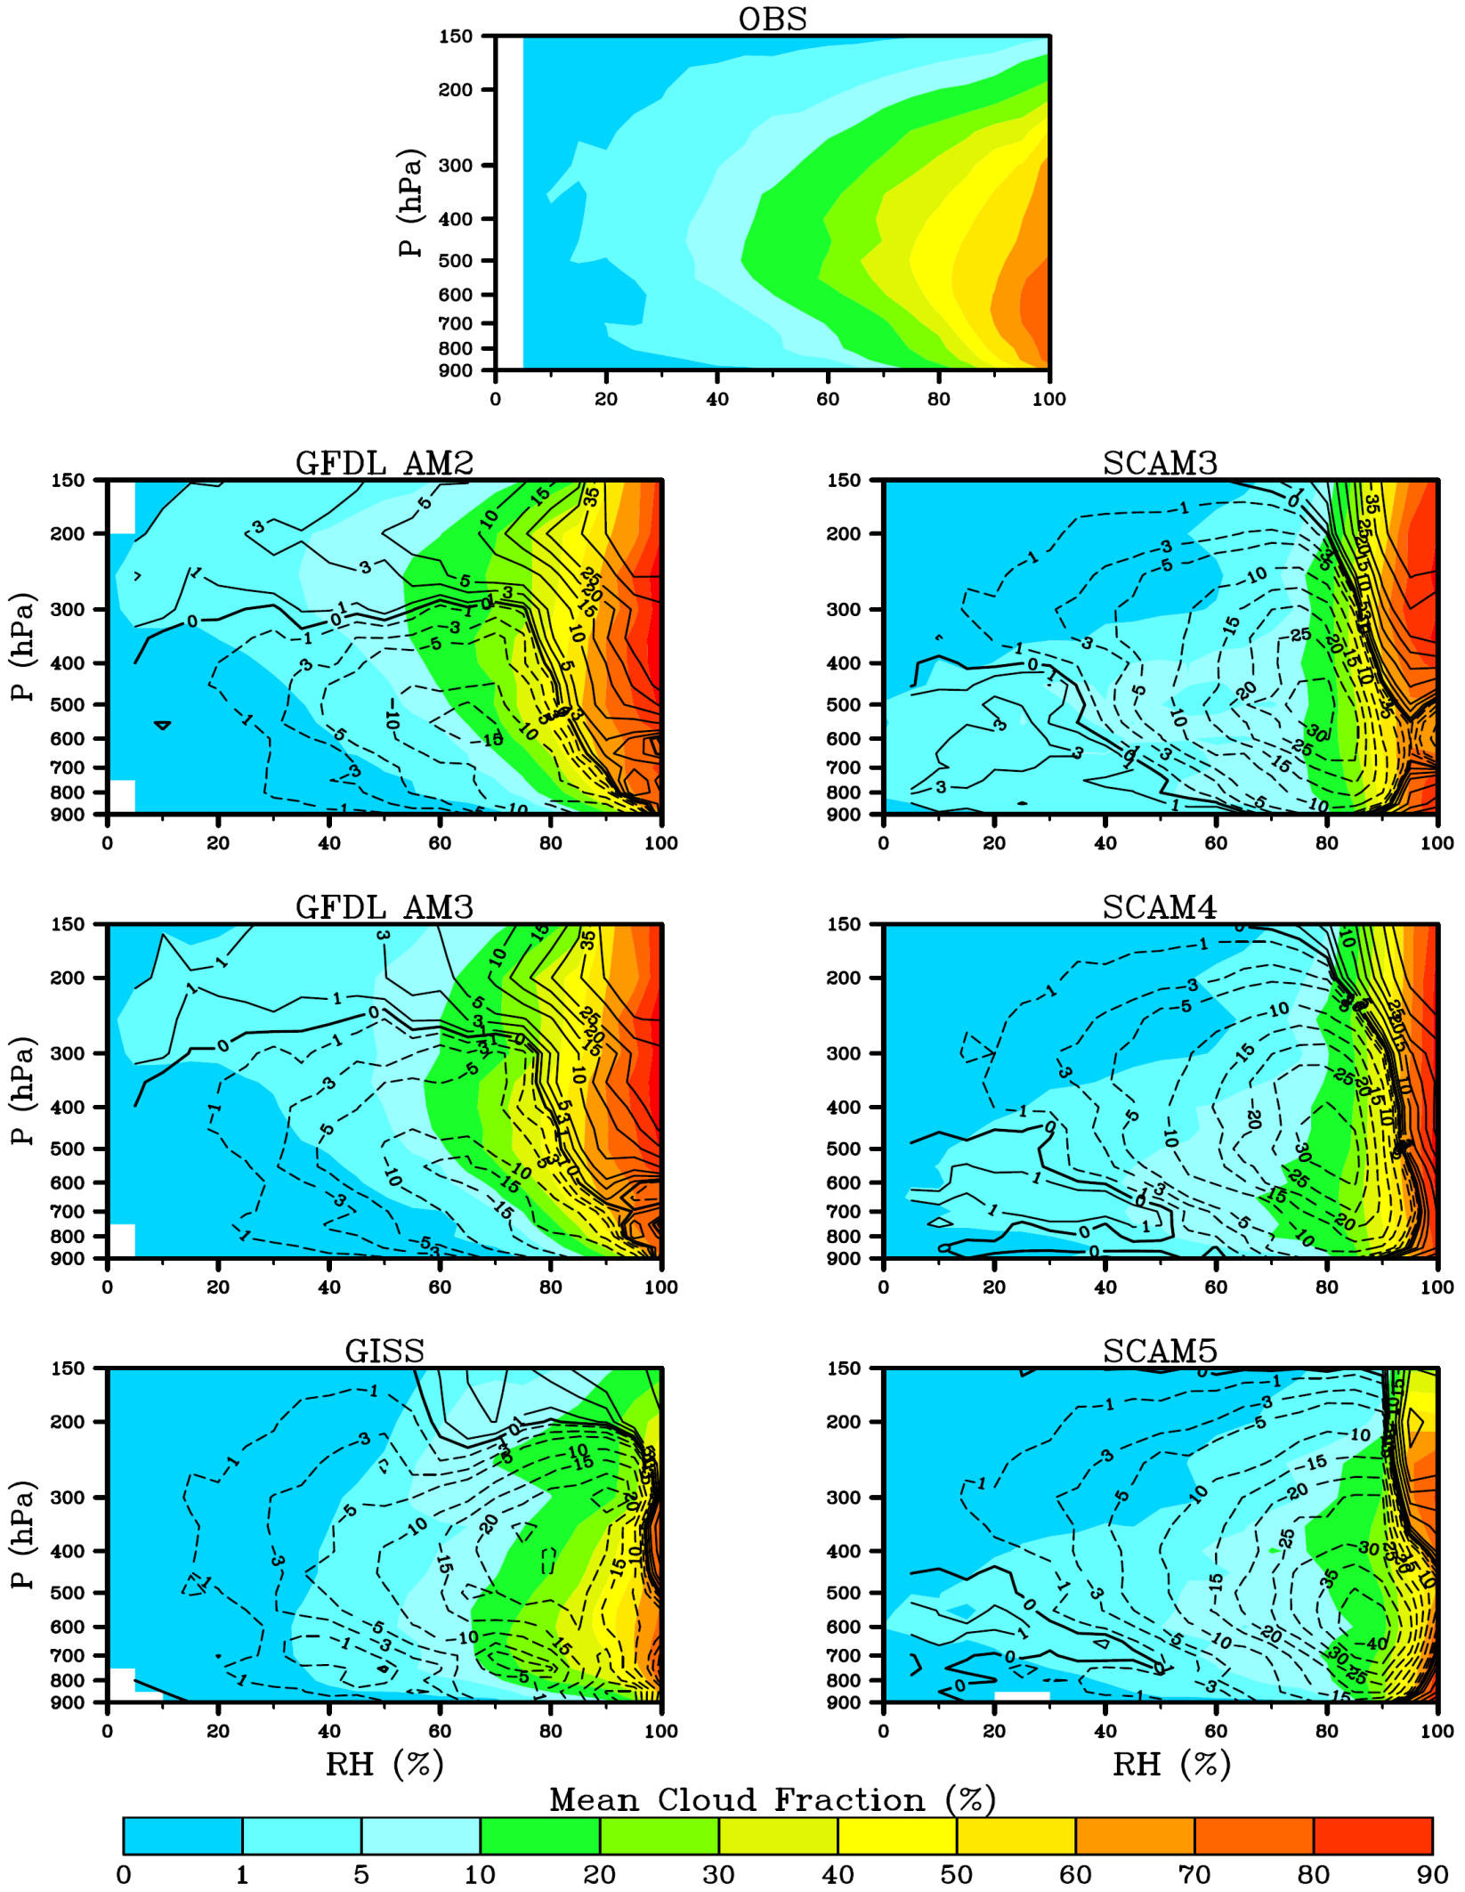
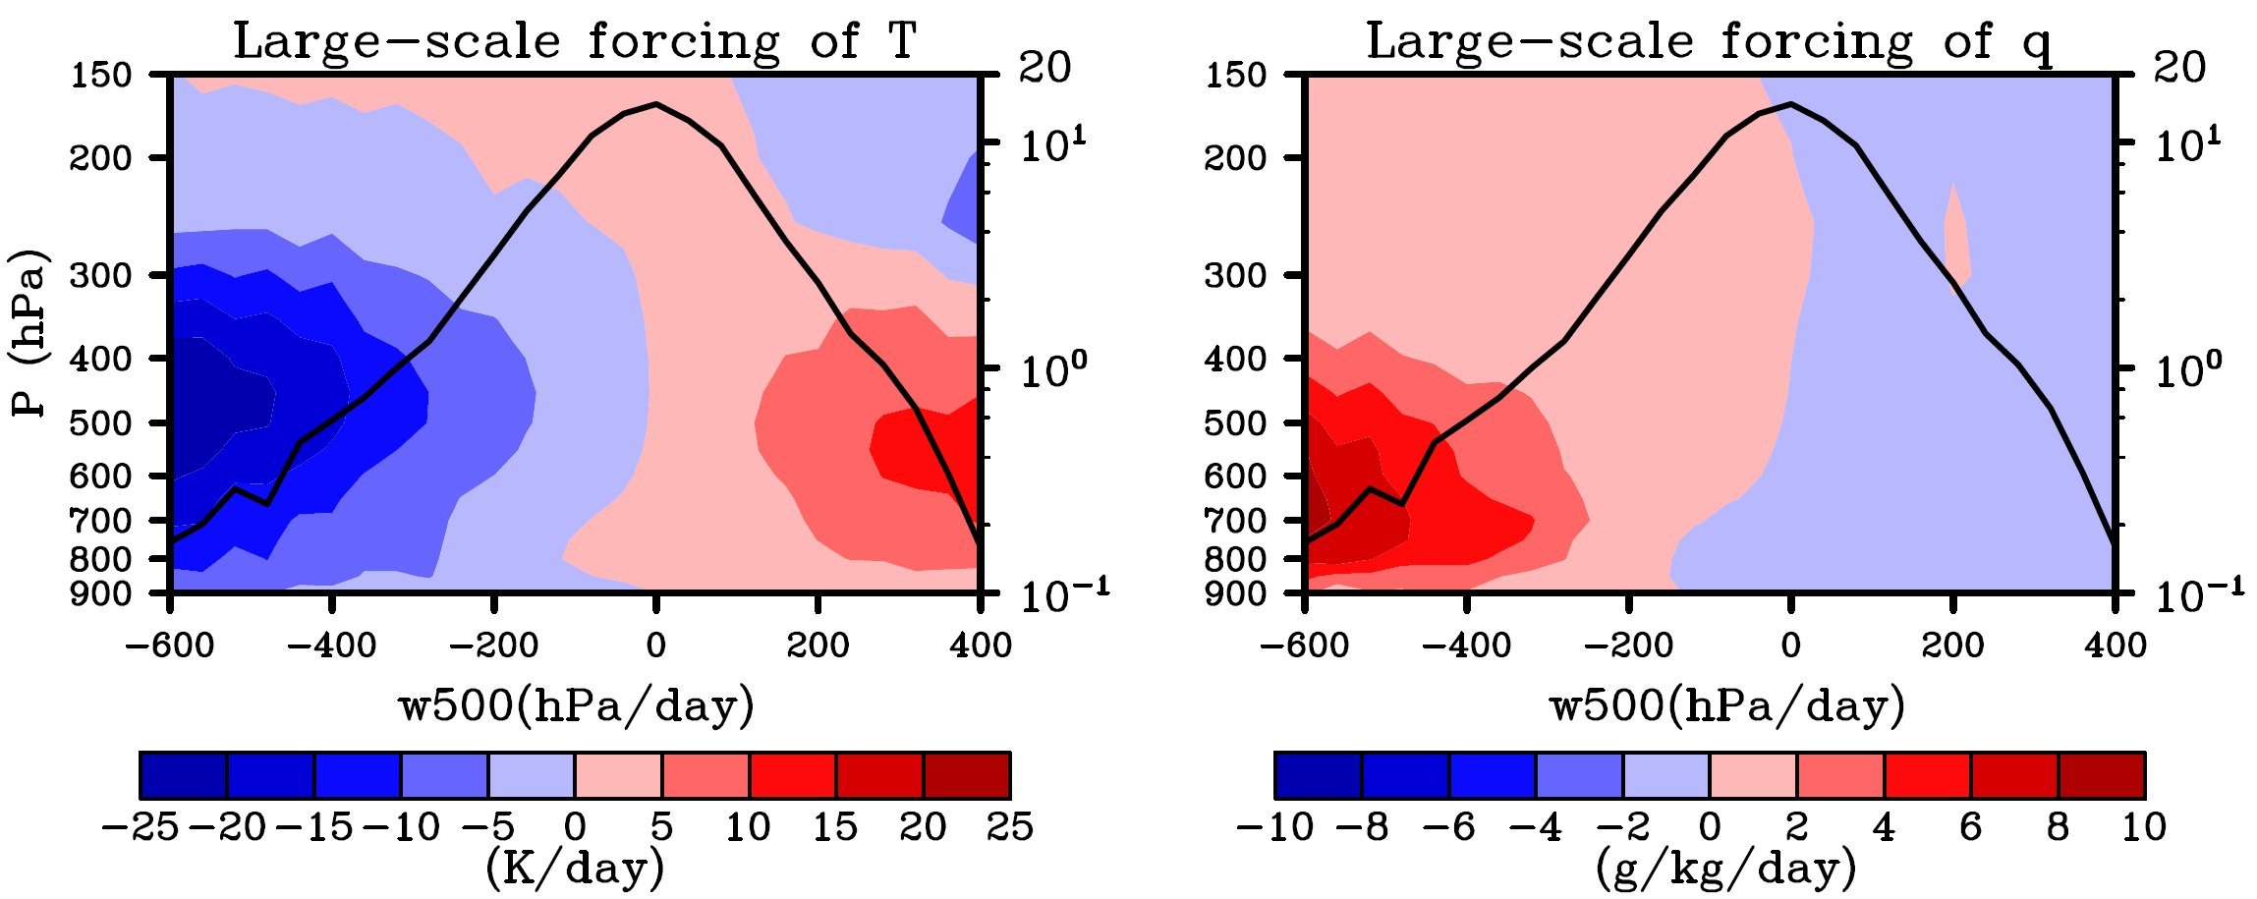
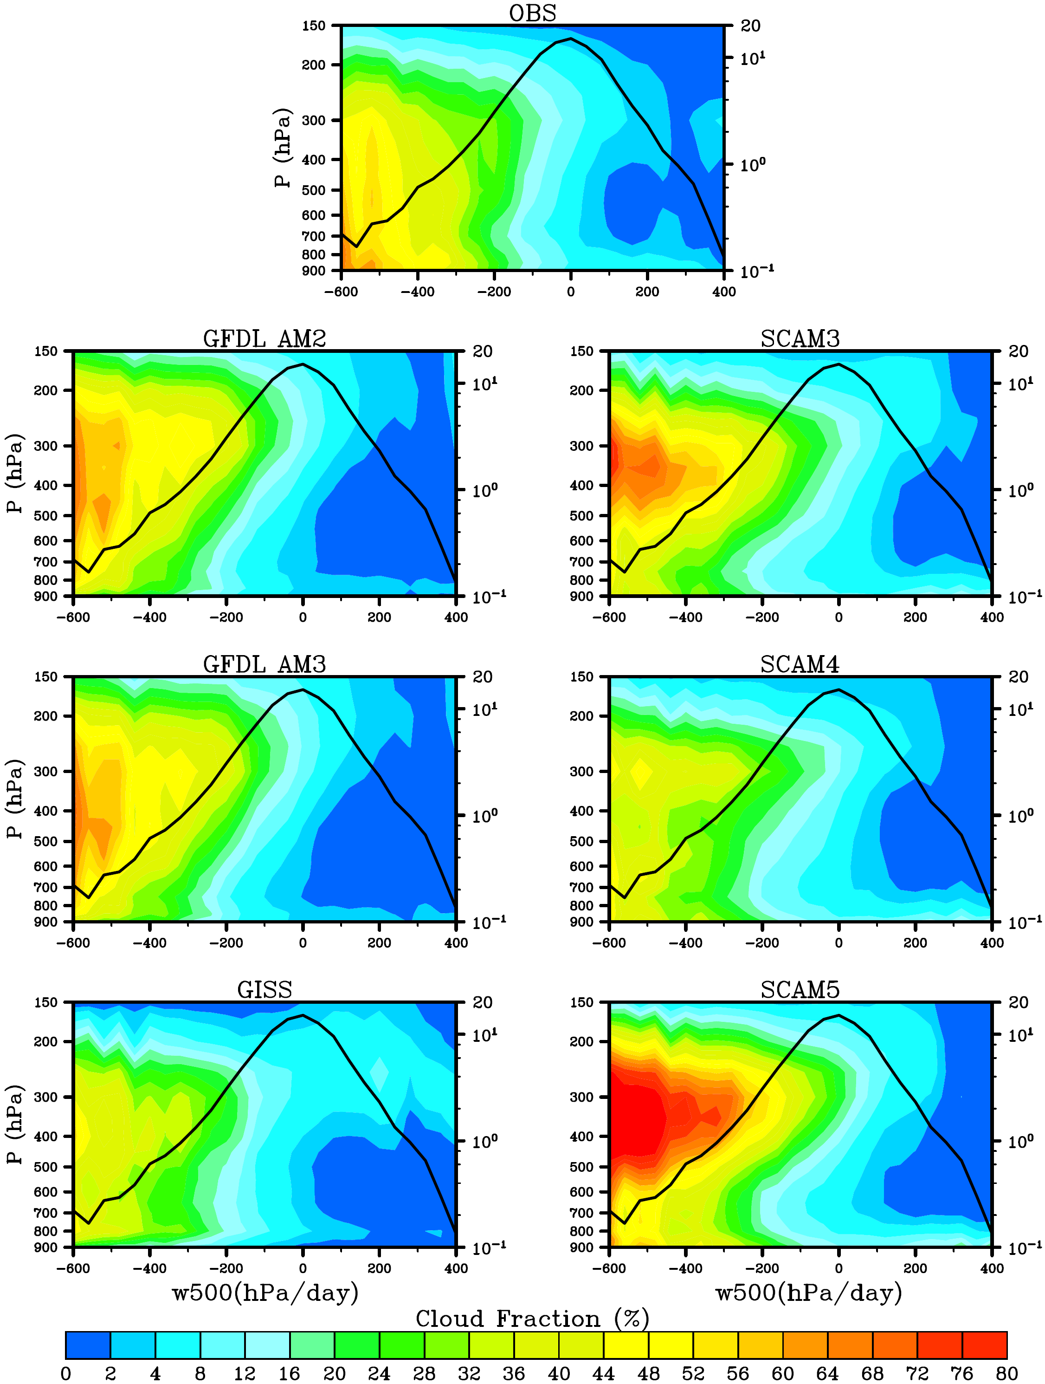
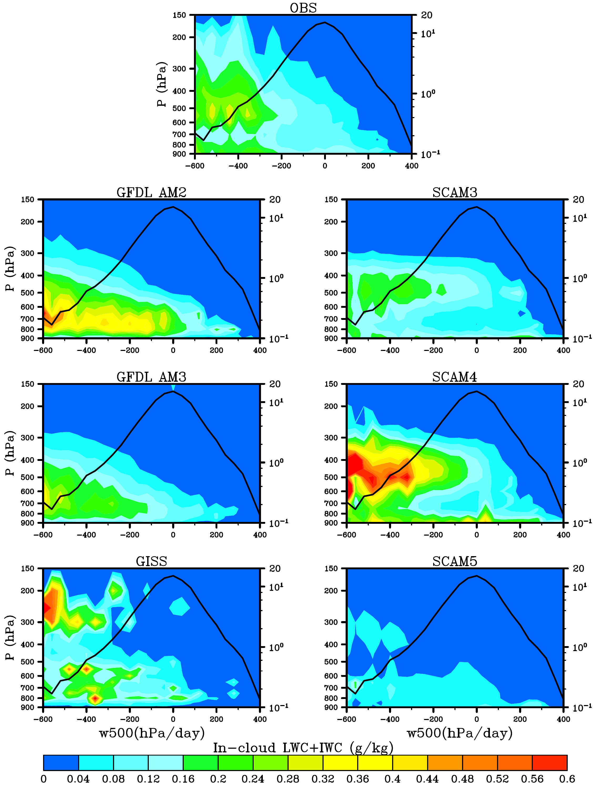
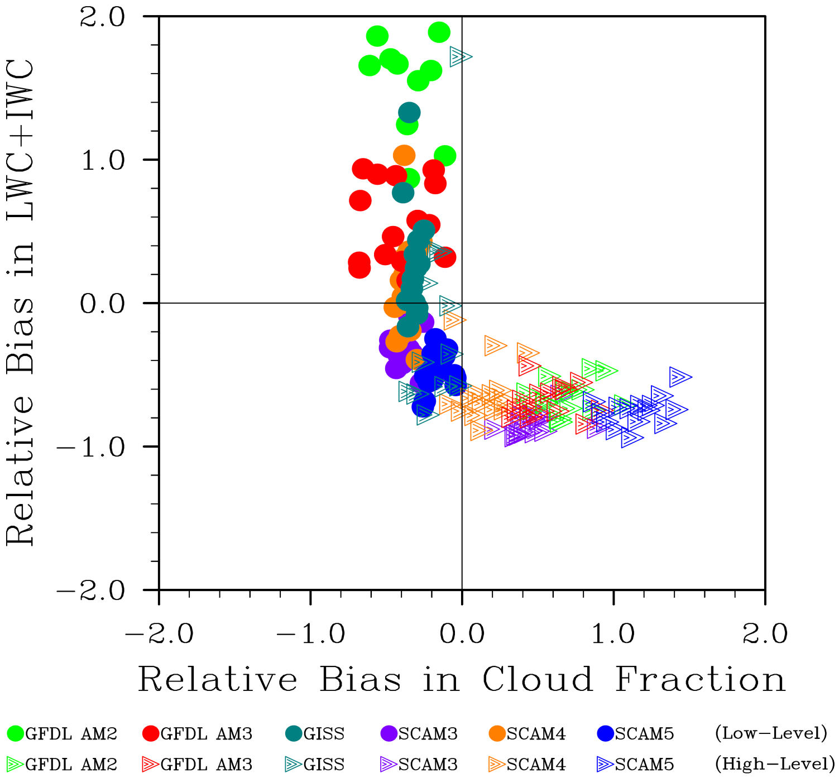
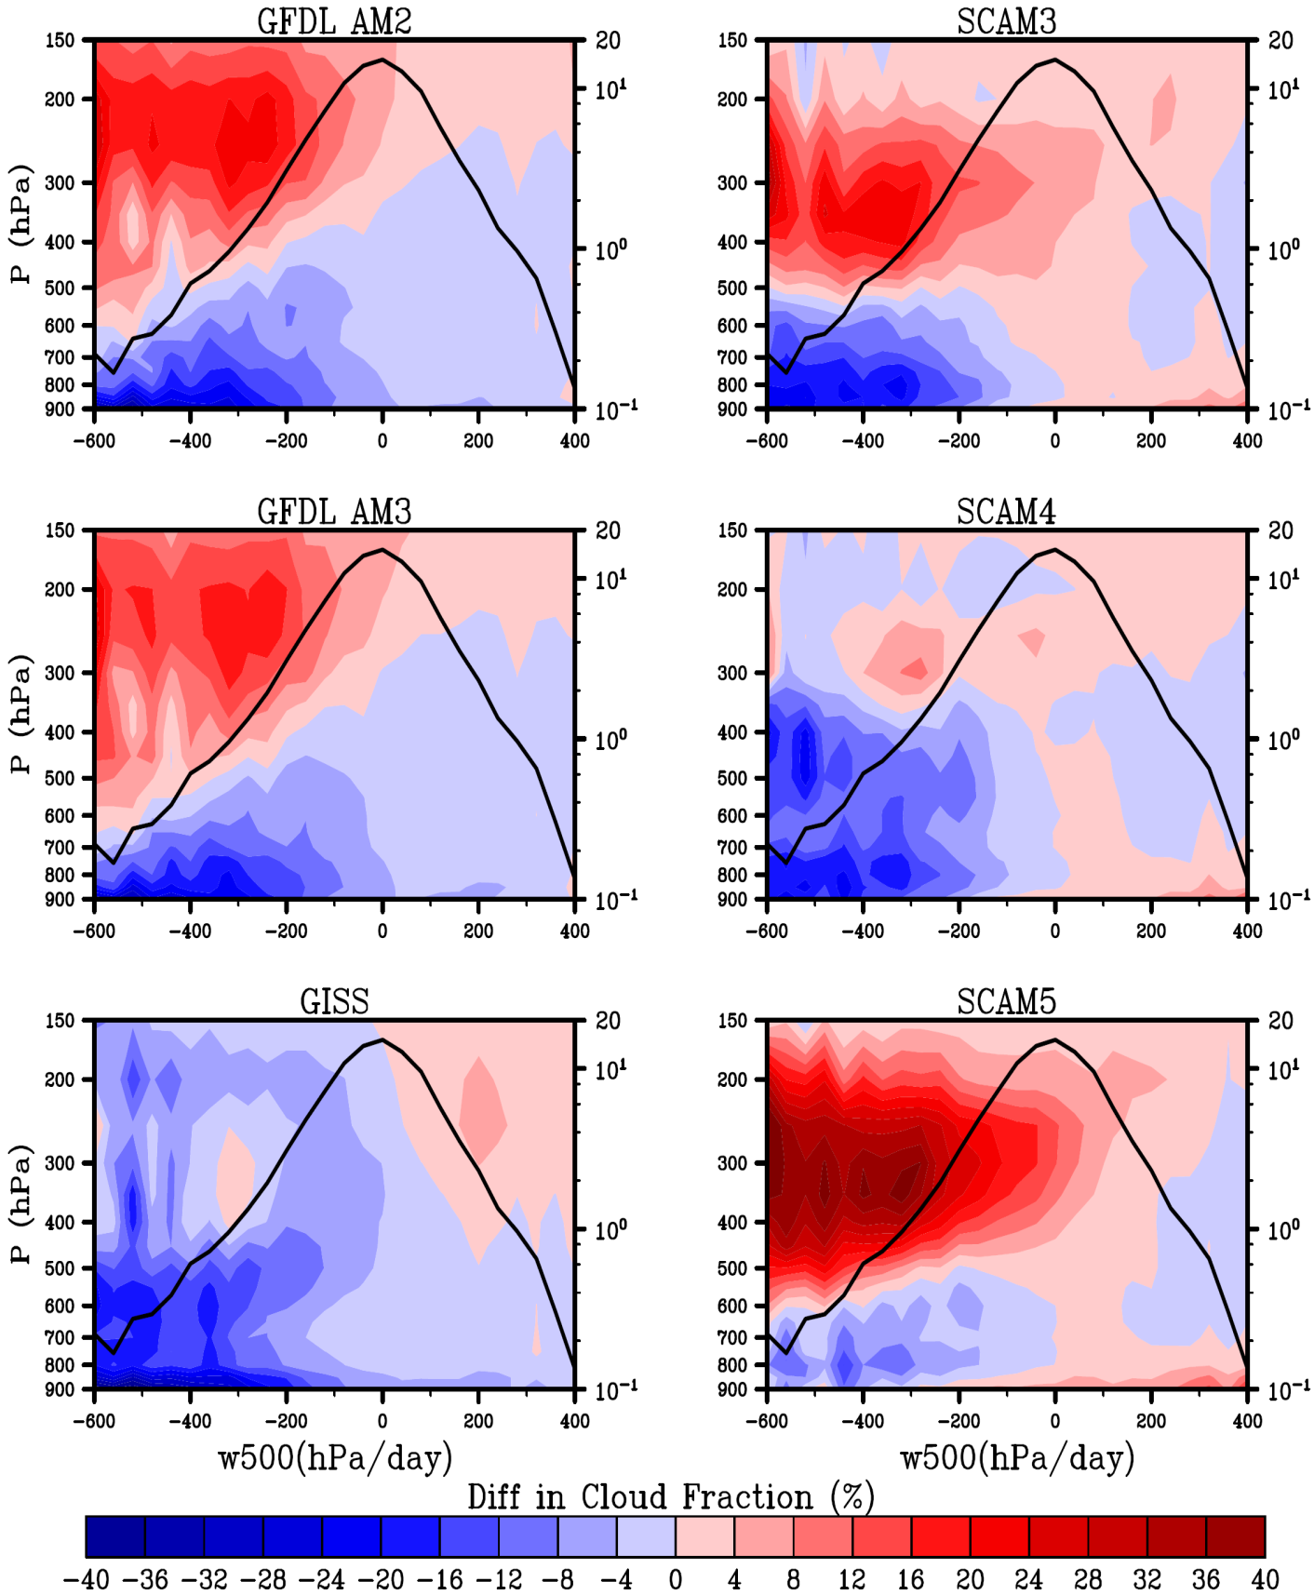
Evaluation of Cloud Properties in Six SCMs
the ARM SGP Site under Different Dynamical Regimes
Hua Song¹(hsong@bnl.gov), Yangang Liu¹ , Wuyin Lin¹, Yanluan Lin²,
Leo Donner² , Audrey Wolf³, Anthony Del Genio⁴ and Satoshi Endo¹
1 Atmospheric Science Division/BNL 2 NOAA/GFDL 3 Columbia University 4 NASA GISS
1. Introduction
Evaluation of cloud fraction, cloud water content and RH in 6 SCMs by
comparison with the ARM observations at the SGP site (97.5˚W, 36.6˚N)
Observations: ARSCL cloud fraction, MICROBASE LWC/IWC
Models: GFDL AM2 and AM3, GISS ModelE2, CAM3, CAM4 and CAM5
6-SCM simulations are driven by same surface and large-scale forcing plus
a relaxation term, and run in the Fast Physics Testbed.
All the results are sorted by 500-hPa vertical pressure velocity (omega)
with 3-year hourly data (Jan1999-Dec2001).
2.3 Frequency and Mean Cloud fraction of Cloudy Events
2.5 Relative Humidity binned by 500-hPa Omega
2. Results
2.1 Large-scale Forcing and 500-hPa Omega
Fig.3: Frequency and mean cloud fraction of cloudy events binned by 500-hPa omega in the ARM observations (upper two panels). Model-Observation differences in frequency and mean cloud fraction (lower panels).
Fig.6: Mean RH binned by 500hPa omega in the observations (RUC-based RH) and model-observation differences in mean RH for all events (left panels). Mean cloud fraction binned by RH in the observations and models (shaded, right panels), and contours are the model-observations differences in mean cloud fraction.
Models’ biases in cloud fraction (Fig.2) are related to different combinations of their biases
in frequency and mean cloud fraction of cloudy events (mainly by frequency in GFDL AMs,
by mean cloud fraction in SCAMs, by frequency at high levels and mean cloud fraction at
low levels in GISS ModelE2).
Overestimation of high-level cloud fraction are mainly due to the larger mean cloud amount
for the GFDL AMs and the strong overestimation of RH for the SCAM3 and SCAM5.
Underestimation of low-level cloud fraction in most SCMs are most likely due to their
larger RH threshold for cloud production than the observations.
Fig.1: The large-scale forcing of T and q binned by 500-hPa omega (shaded, left Y-axis), and PDF of 500-hpa omega (black line, right Y-axis) in years 1999-2001.
2.2 Cloud Fraction binned by 500-hPa Omega
2.4 Cloud Water Content binned by 500-hPa Omega
3. Summary
Statistical analyses sorted by 500-hPa omega show:
Larger model biases under strong updraft regimes;
Overestimation (underestimation) of high (low) clouds in
most SCMs, yet with quite different biases in frequency
and mean cloud fraction of cloudy events;
Compensation between models’ biases in cloud fraction
and cloud water content, implying some deficiencies in
cloud parameterizations;
Strong overestimation of RH at high levels in the SCAMs.
Overestimation of high-level cloud fraction &
underestimation of low-level cloud fraction
in most SCMs under the updraft regimes
(Low-level clouds)
(High-level clouds)
Fig.5: Scatter-plot of the models’ relative biases in cloud fraction and cloud water content under updraft regimes (negative omega bins).
Compensating errors between cloud
fraction and cloud condensates
More (fewer) condensates in low (high)
clouds may indicate the lack of low-level
entrainment but excessive cumulative
entrainment at high levels for convective
clouds, or RH threshold too large (small)
for stratiform low (high) clouds in models
Note large uncertainties in MICROBASE
Acknowledgement:
This work is supported by the DOE ESM Program via FASTER project (http://www.bnl.gov/faster/), and the ASR program.
Fig.2: Cloud fraction binned by 500-hPa omega in the ARM observations and SCMs (left panels). Differences in cloud fraction binned by 500-hPa omega between SCMs and observations (right panels).
Fig.4: Cloud water content binned by 500-hPa omega in the ARM observations (MICROBASE) and SCMs.

