Slide 1



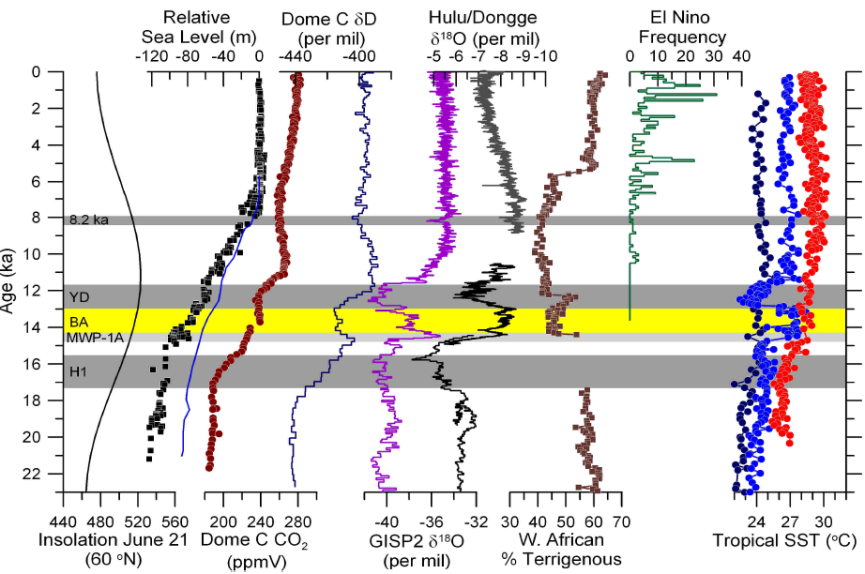

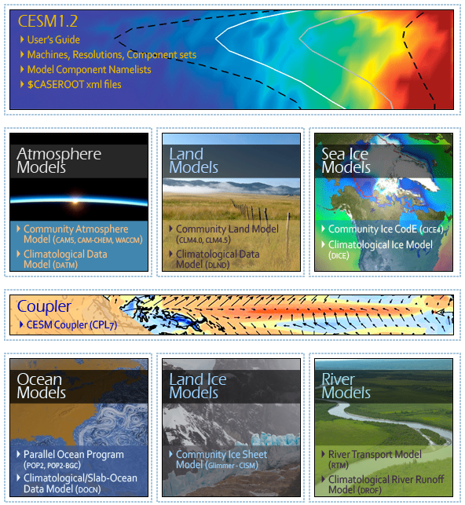

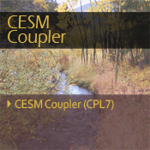
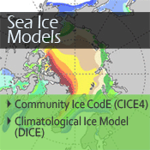
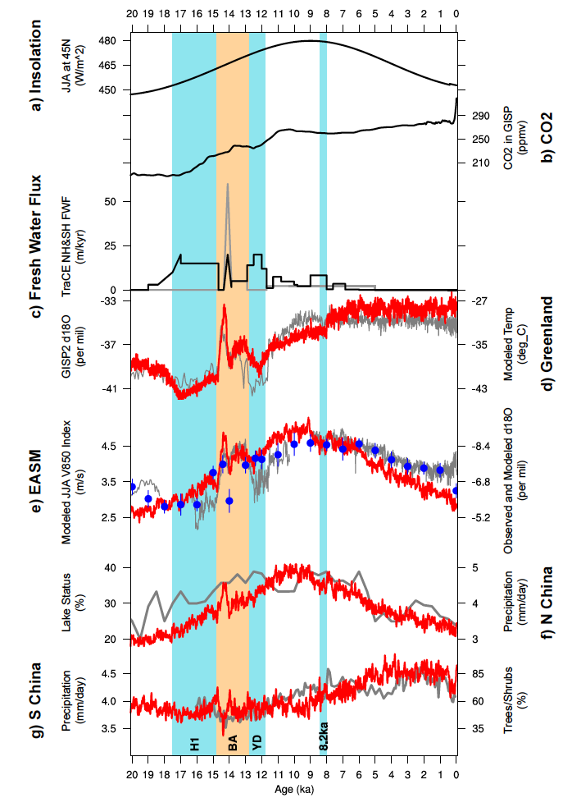

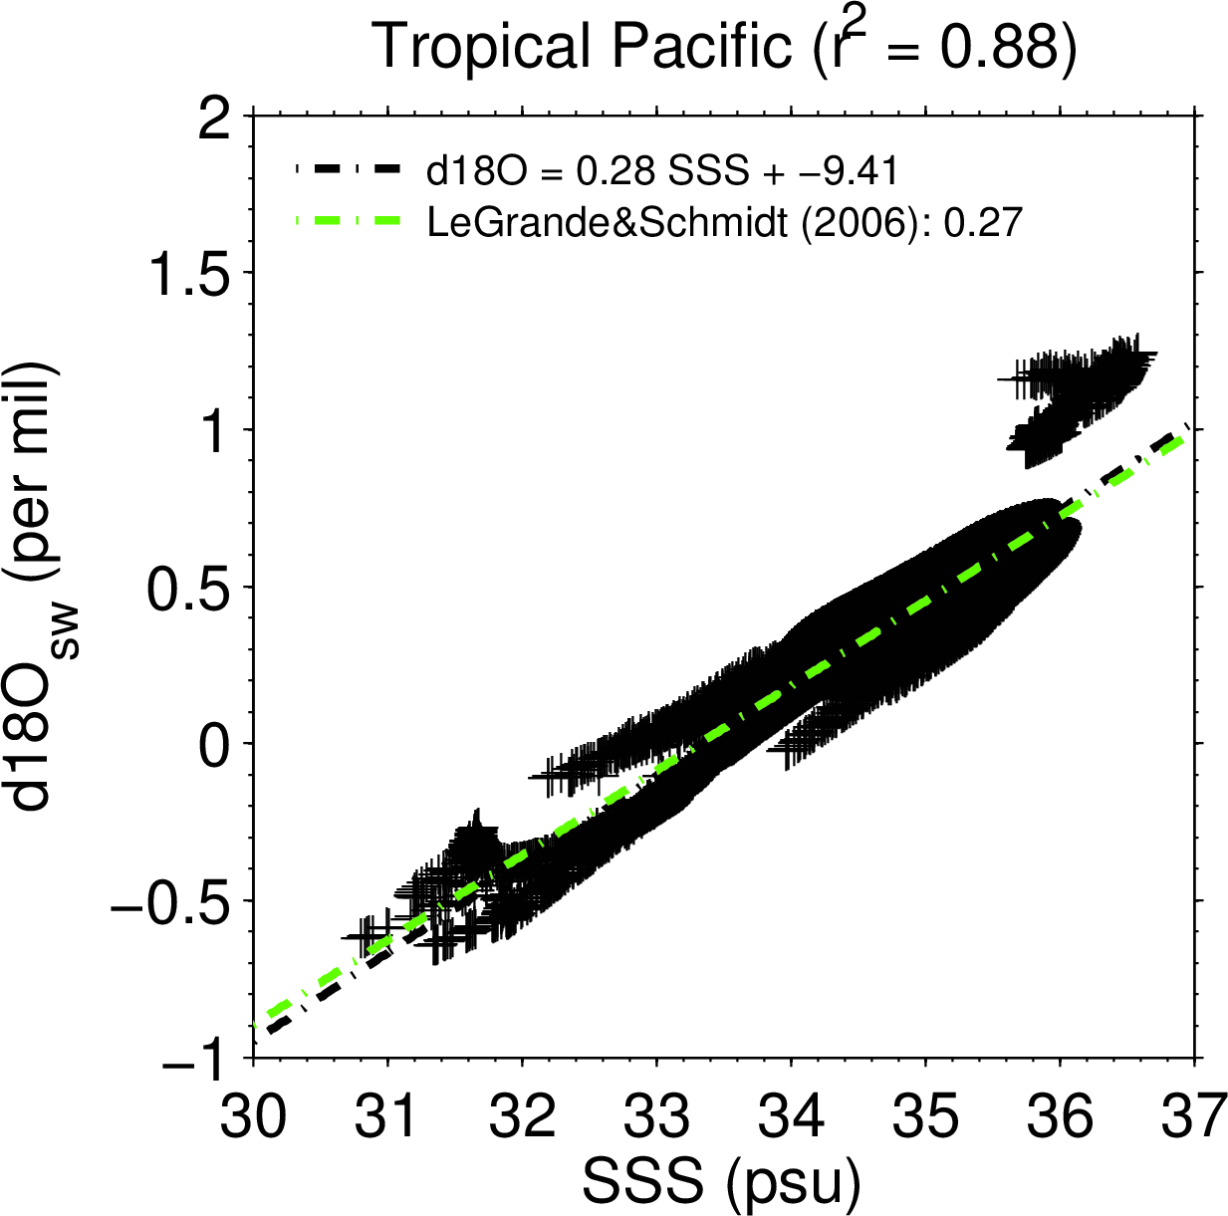
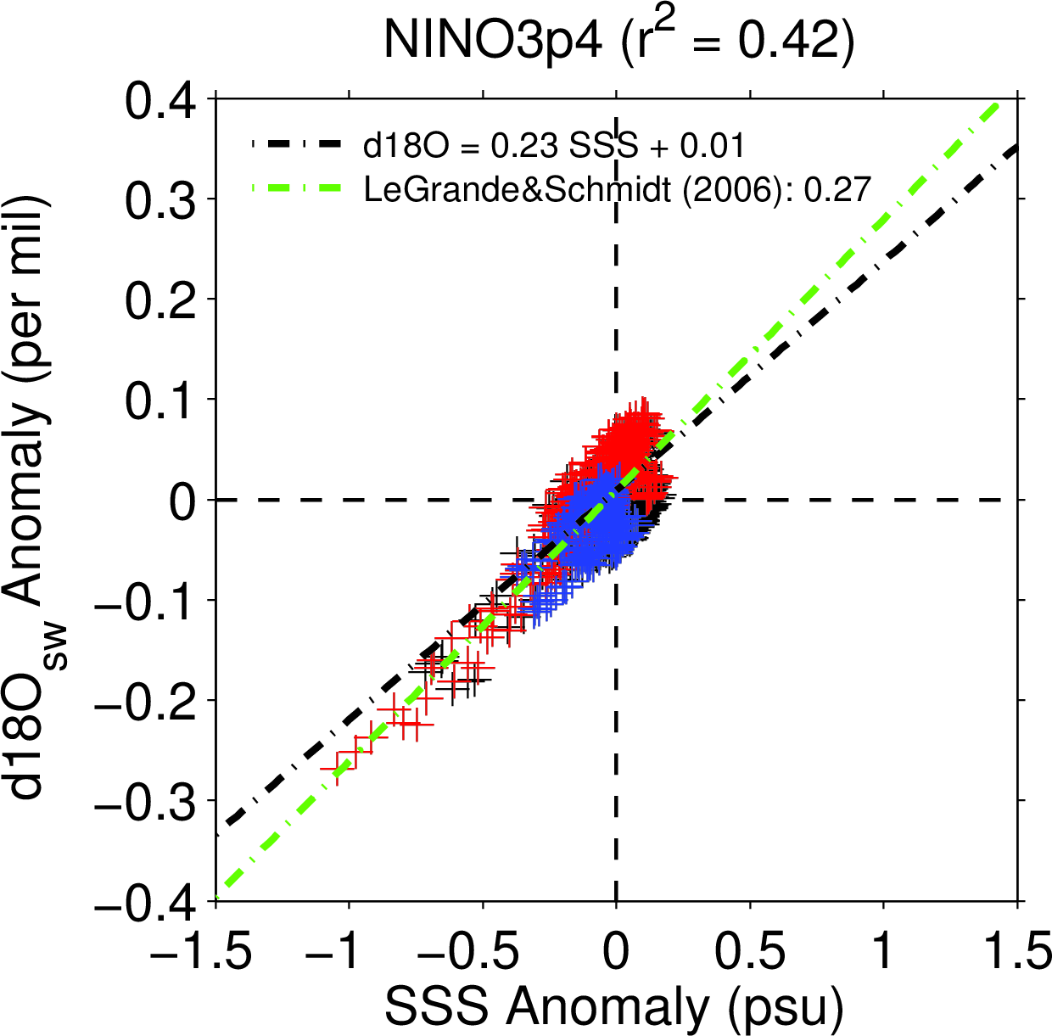
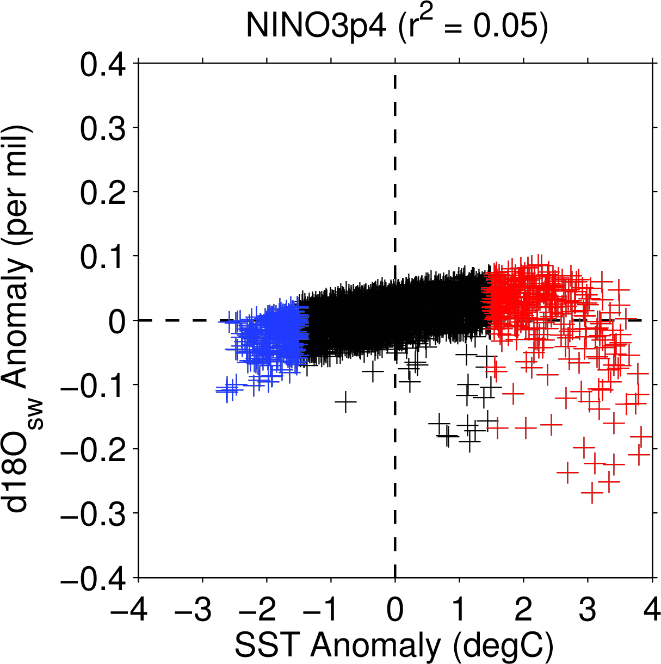
An Isotope-Enabled CESM
Bette Otto-Bliesner¹, Zhengyu Liu², Esther Brady¹, Alexandra Jahn¹, Fortunat Joos³, Keith Lindsay¹, David Noone⁴, Bill Riley⁵, Mariana Vertenstein¹,
David Bailey¹, Anil Bozbiyik³, Andrew Gettelman¹, Charles Koven⁵, Jesse Nusbaumer⁴, Jinyun Tang⁵, Xinyu Wen², Tony Wong⁴, Jiaxu Zhang², Jiang Zhu²
1. National Center for Atmospheric Research, Boulder, 2. University of Wisconsin, Madison, 3. University of Bern, Switzerland, 4. University of Colorado, Boulder, 5. Lawrence Berkeley Laboratory
Project Overview
Simulations
Water Isotopes
Carbon Isotopes
~ Past climates display numerous examples of thresholds and abrupt changes.
~ Validation against past proxy records requires geochemical tracers to be directly simulated.
~ An isotope-enabled CESM (iCESM) is a new tool for validation and development.
Experiment | Grid | # yrs | Status
Water Isotopes
1850 iCAM5 (SST & ice) | FV45 | 30 | Complete
1850 iCAM5 (SST & ice) | FV2 | 30 | Complete
1990 iPOP2 (CORE2 & GNIP) | 3º grid | 500 | Complete
1850 iCAM5+iPOP2 Coupled | FV2_gx1 | 360 | Complete
1850 iCAM5+iPOP2 Coupled | FV45_gx3 | 397 | Complete
1990 iCAM5+iCLM4 | FV45 | 30 | In Progress
1850 iCAM5+iCLM4+iRTM | FV2_gx1 | 30 | Planned
AMIP iCAM5+iCLM4 resolution sensitivity studies | FV2, FV1, FV.5, FV.25 | 4x50 | Planned
Carbon Isotopes
1765 abiotic ¹⁴C iPOP2 spin-up | 3º grid | 6000 | Complete
1765-1950 abiotic ¹⁴C iPOP2 | 3º grid | 185 | Complete
1950-2007 abiotic ¹⁴C iPOP2 bomb-spike sensitiv. | 3º grid | 4x60 | Complete
1765 Biotic ¹³C and ¹⁴C iPOP2 spin-up in cesm1.0.5 | 3º grid | 2400 | Complete
1765-2007 Biotic ¹³C and ¹⁴C iPOP2 in cesm1.0.5 | 3º grid | 242 | Complete
1765 Biotic ¹³C and ¹⁴C iPOP2 spin-up in cesm1.2.1 | 3º grid | 2100 | In progress
1765-2007 Biotic ¹³C and ¹⁴C iPOP2 in cesm1.2.1 | 3º grid | 242 | Planned
Hosing experiments with C-isotopes | 3º grid | 500 | In progress
Last Millennium transient with abiotic ¹⁴C | FV2_gx1 | 1000 | Planned
LGM snapshot with biotic & abiotic C-isotopes | 1º grid | 1000 | Planned
All isotopes
LGM spin-up simulation with isotopes | FV2_gx1 | 1000 | Planned
iTRACE simulation (24 ky to 11ky) | FV2_gx1 | 13000 | Planned
Development of Water isotope Tracers in CESM
Development of Carbon isotopes in the ocean model
Water isotope tracers for H₂¹⁸O and ¹H²HO (HDO) have been added to the CAM5 (Nusbaumer et al. 2013), POP2, CLM4, and the coupler, CPL7. Testing is underway in the CICE model, and isotopic river transport in RTM is in development. Initial results are shown for the iCAM5 coupled to iPOP2 in a preindustrial climate simulation at the FV2_gx1 resolution.
Two kinds of carbon isotopes have been added to the ocean model (POP2) of the CESM (Jahn et al., 2014):
Abiotic radiocarbon (¹⁴C)
Biotic ¹³C and ¹⁴C
The biotic implementation calculates the fractionation during gas exchange and photosynthesis, using the ocean ecosystem model. The abiotic implementation does not require the ocean ecosystem model, making it much cheaper to run.
Preliminary Coupled iCESM Results
Simulated abiotic ¹⁴C ages
Atlantic section along 30.5 W
Pacific section along 179.5 W
Atlantic
Shown are radiocarbon ages (see below for the equation) from the model and from the GLODAP data set (Key et al., 2004).
¹⁴C age =(-1) * 8033 years * log(1 + Δ¹⁴C /1000)
Project Goals:
~ To enhance the CESM with the capability of simulating key isotopes and geotracers, notably δ¹⁸O, δD, Pa/Th, δ¹⁴C, and δ¹³C.
~ To perform transient simulations to test the iCESM directly against proxy records of the last 21,000 years, especially on major abrupt events and onset/collapse of monsoon-ecosystem systems.
~ To understand the mechanisms for the abrupt changes in the CESM.
Simulated δ¹³C
The iCESM
Simulated annual mean δ¹⁸O distribution in the surface ocean (top panels) and the Atlantic Ocean at 30W (bottom panels) is in good agreement with LeGrande and Schmidt (2006) data shown in left panels.
Water isotopes implemented (in progress/planned) in:
POP2, CAM5, CLM4,
(CICE4), (RTM), CPL7
Carbon isotopes implemented (in progress/planned) in:
POP2, CLM4.5, (CAM5)
Pa/Th and Neodymium geotracers in POP2
The CESM* model
δ¹⁸Op
The latitudinal distribution of the isotopic composition of iCAM5 precipitation in the coupled simulation compares well to the GNIP and ITASE observations in tropics and mid-latitudes. The high latitude regions show a positive bias.
δ13C
δ13C
Motivation: Asian Monsoon
Figure shows the evolution of climate and δ¹⁸O.
(a) Summer insolation (b) CO₂, (c) Meltwater fluxes (d) Hulu δ¹⁸O (grey), northerly wind (red) and snapshot model δ¹⁸O (blue) in E. China, (e) lake status (grey) and model rainfall in northern China, (f) pollen records (grey) and model rainfall (red) in Southeast China. (Liu et al., 2014)
δDp
δ13C
δ13C
Shown are δ¹³C model results for the 1990s (shaded), compared to observational δ¹³C data for the 1990s (dots; Schmittner et al., 2013)
*CESM is a fully-coupled, community, global climate model that provides state-of-the-art computer simulations of the Earth's past, present, and future climate states.
Globally averaged depth profiles
Isotope Definitions
Application of Water Isotopes in the iCESM
DIC
δ¹³C
Δ¹⁴C
Notation:
Measured isotope ratios are expressed as delta (δ) values, calculated relative to a known standard:
δ(‰) = (R_{sample}/R_{standard} – 1) x 1000
where R is he measured isotopic ratio relative to the most abundant isotope (e.g., R=¹³C/¹²C or R=¹⁸O/¹⁶O).
Negative δ → depleted relative to the standard
Postive δ → enriched relative to the standard
Fractionation:
Fractionation refers to the small differences in isotopic ratio that arise as a result of different behavior during a chemical or physical (thermodynamic) process.
Examples of processes that lead to fractionation include photosynthesis, evaporation/condensation, melting/crystallization, adsorption/desorption.
Investigating isotope-climate relationships assumed in proxy reconstructions may help improve the interpretation of isotopic signals measured in paleoclimate records.
A study using isotope-enabled CAM3 snapshot simulations driven by TraCE21 provides an interpretation of the Chinese cave speleothem δ¹⁸O record that reconciles its representativeness of EASM and its driving mechanism of upstream depletion.
The δ¹⁸O records do represent the intensity of the EASM system.
Enhanced southerly monsoon winds correlate strongly with negative δ¹⁸O over China and enhanced monsoon rainfall in northern China, as well as continental scale Asian monsoon rainfall response in upstream regions.
Projects using carbon isotopes in the ocean
Using abiotic Δ¹⁴C to separate the influence of wind and atmospheric Δ¹⁴C on southern ocean carbon uptake during recent decades
Improvements of physical parameterizations, using abiotic Δ¹⁴C as diagnostic tool
Freshwater hosing experiments to evaluate the relationship between δ¹³C and the physical circulation
Spatial regression of Sea Surface Salinity (SSS) to δ¹⁸O_{sw} (left) compares well to data in the tropical Pacific. [This relationship is often used to estimate δ¹⁸O_{sw} in forward coral proxy models if salinity is known.]
Temporal regression of SSS to δ¹⁸O_{sw} in the Nino3.4 region is close to the observed spatial slope (center).
Large Warm events can show large negative δ¹⁸O_{sw} anomalies.
Carbon isotopes in the land model
Carbon isotopes have been added to the land model of the CESM (CLM4.5) by A. Bozbiyik and F. Joos and are ready for coupling to the ocean model.
Acknowledgements and References
Next steps
This research is sponsored by DOE-BER grant DE-SC0006744.
The National Center of Atmospheric Research (NCAR) is sponsored by the National Science Foundation (NSF).
CESM is supported by NSF and the U.S. DOE Office of Science (BER), and maintained by the Climate and Global Dynamics Division of NCAR.
Computing resources were provided by the Climate Simulation Laboratory at NCAR's Computational and Information Systems Laboratory (CISL), sponsored by the NSF and other agencies.
Add carbon isotopes to the atmospheric model (CAM5) and couple to the ocean and land carbon models
Finish the implementation of water isotopes in the river transport model and the sea ice model and couple these modules to the others for a fully-coupled water isotope simulation
Complete development of Pa/Th and Neodymium tracers in the ocean model as additional paleo ocean circulation tracers
Incorporate the isotope modules into the trunk of the CESM, to ensure that these developments are maintained as CESM evolves
Release model output and isotope modules to the community of CESM users
Jahn, A., K. Lindsay, B. L. Otto-Bliesner, E. C. Brady, X. Giraud, N. Gruber, Z. Liu (2014), Carbon isotopes in the ocean model of the Community Climate System Model, in prep. for Geophysical Model Development.
Key, R. M., A. Kozyr, C. L. Sibine, K Lee, R. Wanninkhof, J. L. Bullister, R. A. Feely, F. J. Millero, C. Mordy, and T. –H. Peng, 2004: A global ocean carbon climatology: Results from Global Data Analysis Project (GLODAP) Glob. Biogeochem. Cycles, 18, GB4031,doi:10.1029/2004GB002247, 2004.
LeGrande, A. N., and G.A. Schmidt, 2006: Global gridded data set of the oxygen isotopic composition in seawater. Geophys. Res. Lett., 33, L12604, doi:10.1029/2006GL026011.
Liu, Z., X. Wen, E. Brady, B. Otto-Bliesner, G. Yu, H. Lu, H. Cheng, Y. Wang, W. Zheng, Y. Ding, L. Edwards, J. Cheng, W. Liu and H. Yang, 2014: Chinese cave records and East Asian Summer Monsoon. Quat. Sci. Rev., 83, 115–128.
Nusbaumer , J. et al. 2013: The impact of differing physical assumptions on a water isotope climatology simulated by an isotope-enabled version of the NCAR Community Atmosphere Model Version 5 (CAM5). PP23C-1991, AGU Fall Meeting 2013.
Schmittner, A., N. Gruber, A. C. Mix, R. M. Key, A. Tagliabue,T. K. Westberry (2013), Biology and air- exchange controls on the distribution of carbon isotopes, Biogeosciences, 10, 5793–5816.

