Slide 1
Science Perspective and Status
William D. Collins
Lawrence Berkeley Laboratory
ACME Chief Scientist
And the ACME Project Team

Slide 2
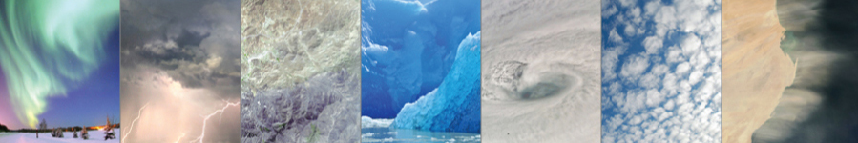
Science Questions
Water cycle:
  What are the processes and factors governing precipitation and the water cycle today and how will precipitation evolve over the next 40 years?
Biogeochemistry:
  What are the contributions and feedbacks from natural and managed systems to current greenhouse gas fluxes, and how will those factors and associated fluxes evolve in the future?
Cryosphere:
  What will be the long-term, committed Antarctic Ice Sheet contribution to sea level rise (SLR) from climate change during1970–2050?

Slide 3
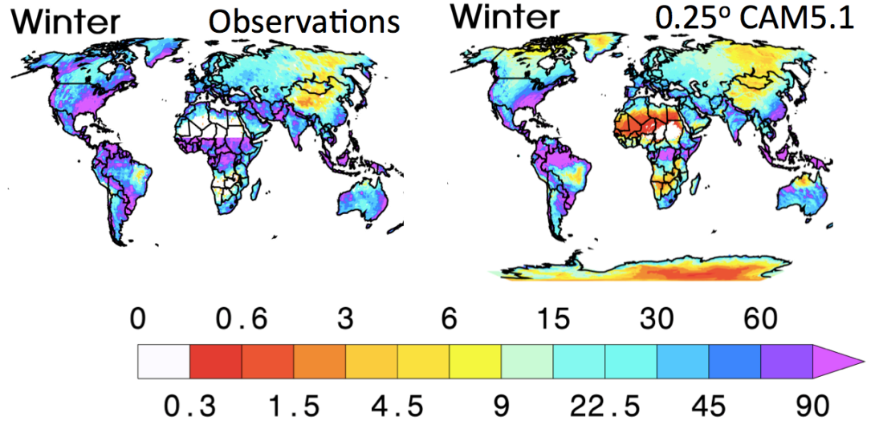
Water Cycle Experiments
20-year Return Daily Rainfall
Near-term: How will more realistic portrayals of features in the water cycle (resolution, clouds, aerosols, snowpack, river routing, land use)
affect river flow and associated freshwater supplies at the watershed scale?
Simulations: Preliminary simulation plan includes:
    Prescribed SST experiments to quantify resolution effects.
    Fully coupled experiments to examine feedbacks = f(resolution)
    Conduct simulations under RCP hypothesis to test hypothesis.

Slide 4
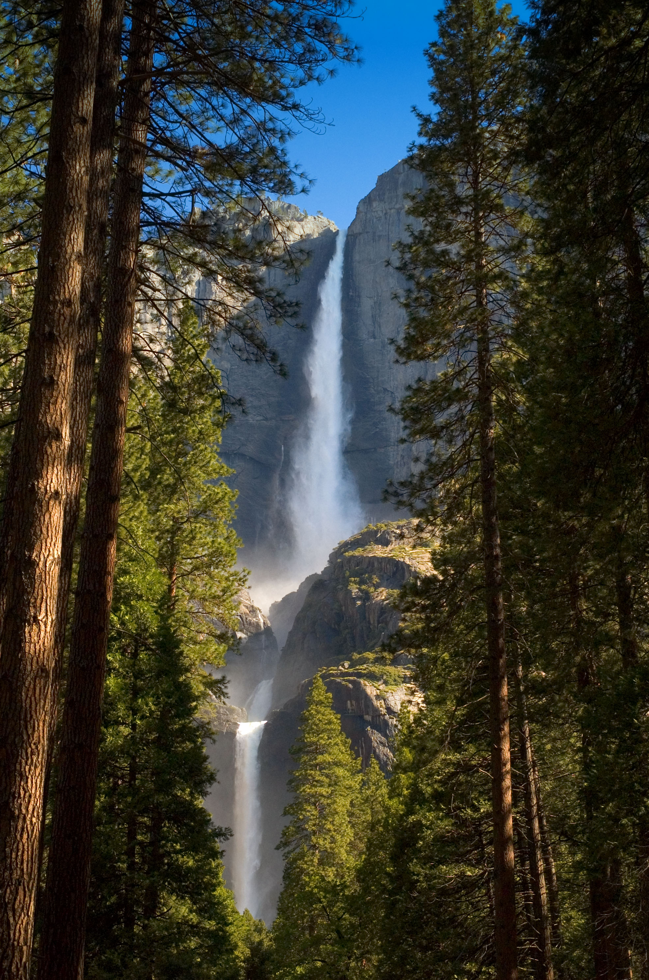
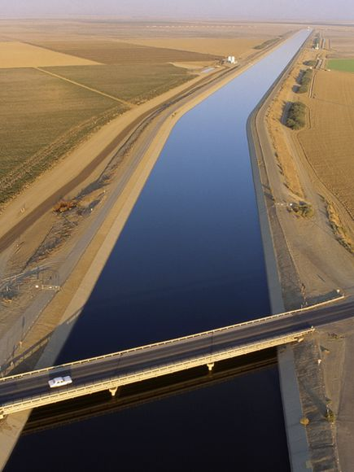
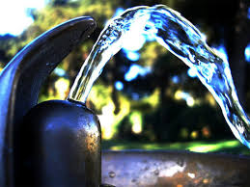
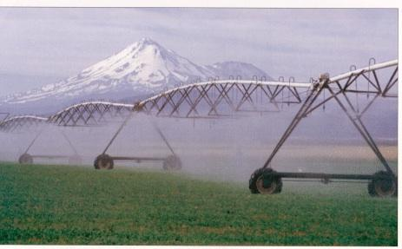
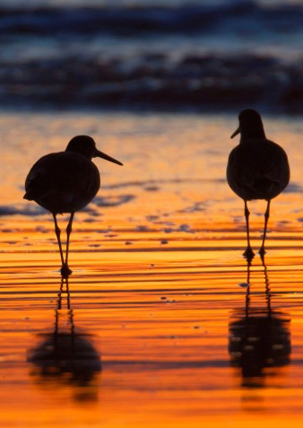
Water Cycle Core Hypothesis
Question: How will improved portrayals of earth system features affect the simulation of Earth’s water cycle, including river flow and freshwater supplies at the watershed scale?
Hypothesis:
  Changes in river flow over the last 40 years have been dominated primarily by land and water use and climate change associated with aerosol forcing.
  During the next 40 years, GHG will produce changes to river flow with signatures that dominate those of other forcing agents in at least one of our domains.
Notes:
From https://acme-climate.atlassian.net/wiki/display/SIM/Slide+1%3A+Description

Slide 5
V1 Atmospheric Capabilities
New Capability | Epic Lead
Update convective parameterization | Shaocheng Xie
Improve Numerics | Mark Taylor
Implement RRM for model evaluation | Steve Klein
Higher vertical resolution | Po-Lun Ma
Surface Model Interactions | Susannah Burrows
Polar Project Updates | Peter Caldwell
Implement short simulations for evaluation | Yun Qian
Update SCAM for evaluation | Jeffrey Johnson
Tuning and evaluation | Phil Rasch
New aerosol and cloud updates | Hailong Wang
Satellite simulator improvements | Yuying Zhang
Addition of elevation class decomposition | Ruby Leung / Steve Ghan
Maintain chemistry capability | Philip Cameron-Smith

Slide 6
V1 Major Milestone
Quarter | Milestone
Q3,Q4 | Exercise testing and evaluation procedure
 | Make most Tier 1b diagnostics fully functional
 | Assessment of convection schemes
 | Elevation class decomposition
 | Finalization of aerosol and cloud improvements
 | Numerics improvements
 | Tests of enhanced vertical resolution
Q5 | Choose convection
 | Assessment of candidate collection of parameterizations
 | Downselect to decide on viable evaluation and tuning methods
 | Attempt a credible simulation at higher vertical resolution
Q6 | Final push to V1

Slide 7
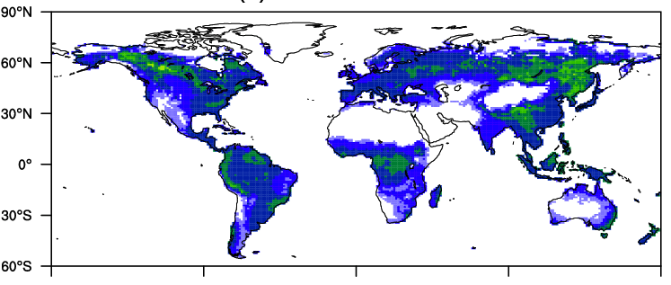
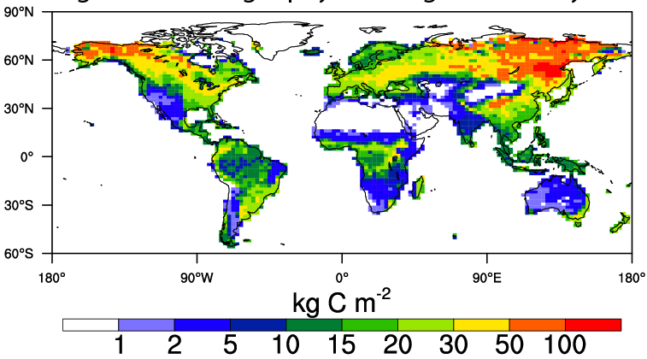
Biogeochemical Experiments
Improvement in total soil organic C
Near-term: How do carbon, nitrogen, and phosphorus cycles regulate
climate system feedbacks, and how sensitive are these feedbacks to
model structural uncertainty?
Simulations: Simulation plan includes
  Fixed-forcing control simulations, using pre-industrial (circa 1850 AD) boundary conditions
  Transient-forcing control simulations, using historical forcings
  Fixed-forcing C-N-P simulations
  Transient-forcing C-N-P simulations

Slide 8
V1 Land Capabilities
New Capability | Epic Lead
Orographic downscaling | Ruby Leung
Head-based soil hydrology | Gautam Bisht
Coupled C-N-P cycles | Xiaojuan Yang
Alternative plant-microbe competition (ECA) | Bill Riley
Initial crop model improvements | Beth Drewniak
New (uncoupled) river routing | Ruby Leung
V1 land model UQ framework | Khachik Sargsyan
V1 land benchmarking framework | Forrest Hoffman

Slide 9
V2 Land Capabilities
New Capability | Epic Lead
VIC-based runoff partitioning | Maoyi Huang
New coupled river routing | Ruby Leung
Initial merged hydrology | Ruby Leung
PFLOTRAN thermal hydrology model | Jitu Kumar
Improved root hydrology | Gautam Bisht
Riverine biogeochemistry | Hong-Yi Li
Explicit microbes and dissolved organic matter | Gangsheng Wang
Improved N cycle | Bill RIley
Improved methane model | Gangsheng Wang
Ecosystem demography | Charlie Koven
V2 land model UQ | Khachik Sargsyan
V2 land model benchmarking framework | Forrest Hoffman

Slide 10
Cryospheric Experiments
Near-term: Could a dynamical instability in the Antarctic Ice Sheet
be triggered within the next 40 years?
Simulations: Simulation plan focuses on
  Rigorous testing of the ice sheet and its interactions with the atmosphere, underlying continent, ocean, and sea ice
  Transient fully coupled simulation from 1970 to 2050.

Slide 11
V1 Land Ice Capabilities
New Capability | Epic Lead
Stand-alone Antarctica simulations with MPAS | Steve Price
Stand-alone Antarctica mass-balance simulations | Steve Price
Ocean/sea-ice runs with data atmos./ice sheet | Steve Price
Coupled ocean/sea-ice/land-ice runs w/data atm. | Steve Price
Fully coupled simulations | Steve Price
Gravitationally self-consistent SLR model | Steve Price

Slide 12
V1 Sea Ice Capabilities
New Capability | Epic Lead
MPAS-CICE model | Adrian Turner
Improved snow model | Elizabeth Hunke
Biogeochemistry | Elizabeth Hunke

Slide 13
V1 Ocean Capabilities
New Capability | Epic Lead
Stand-alone ocean validation | Todd Ringler
Ocean analysis core | Todd Ringler
Biogeochemistry | Todd Ringler
Hybrid vertical coordinate | Todd Ringler

Slide 14
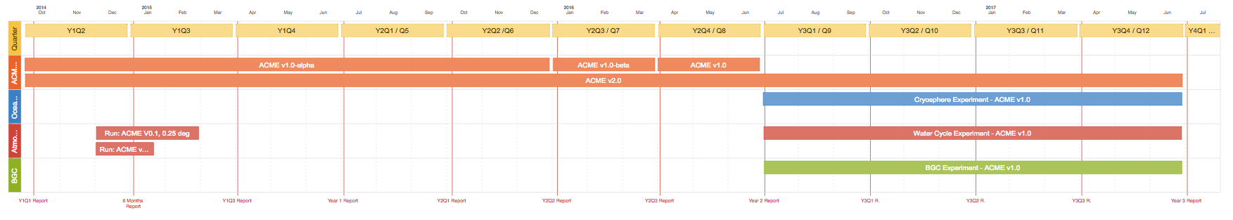
3-year Roadmap Main Points
Complete construction of v1-alpha EOY 2015
  1 configuration, 2 resolutions, 2 levels of BGC activation
Coupled system tuning Jun 2016
Start major experiments with ACME v1.0 code base Jul 2016
  The 3 experiments need not activate same functionality
  But they should all share the same code base,
  with active functionality controlled by run-time switches
All major 3 year experiments completed Jul 2017
Notes:
https://acme-climate.atlassian.net/wiki/display/CNCL/3+Year+Roadmap

Slide 15
QUESTIONS?

