Slide 1
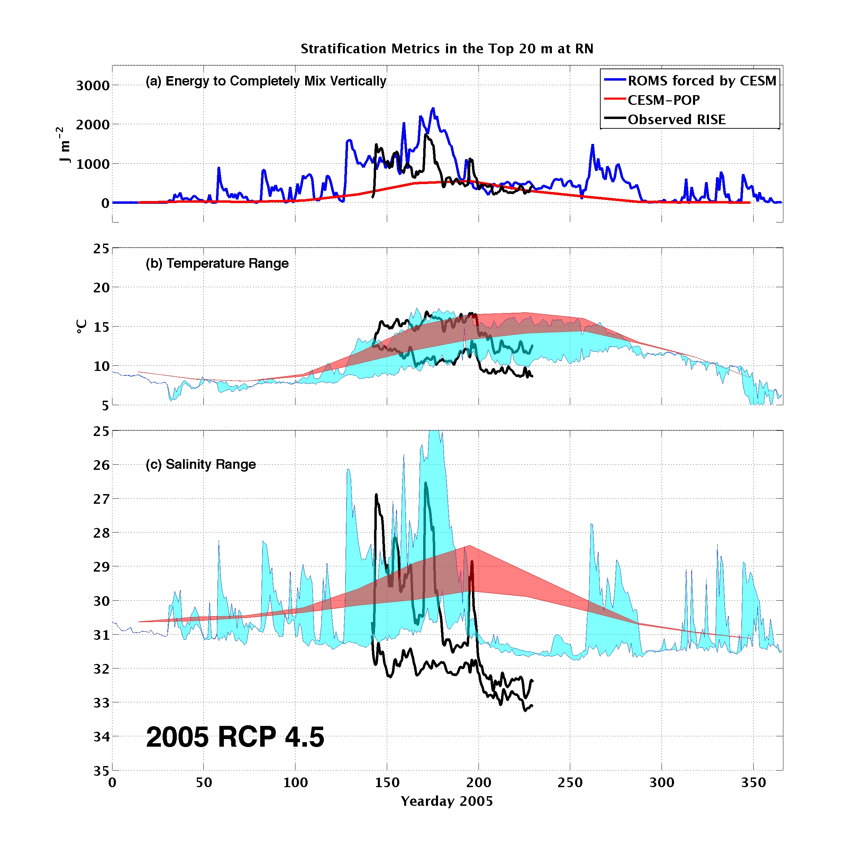
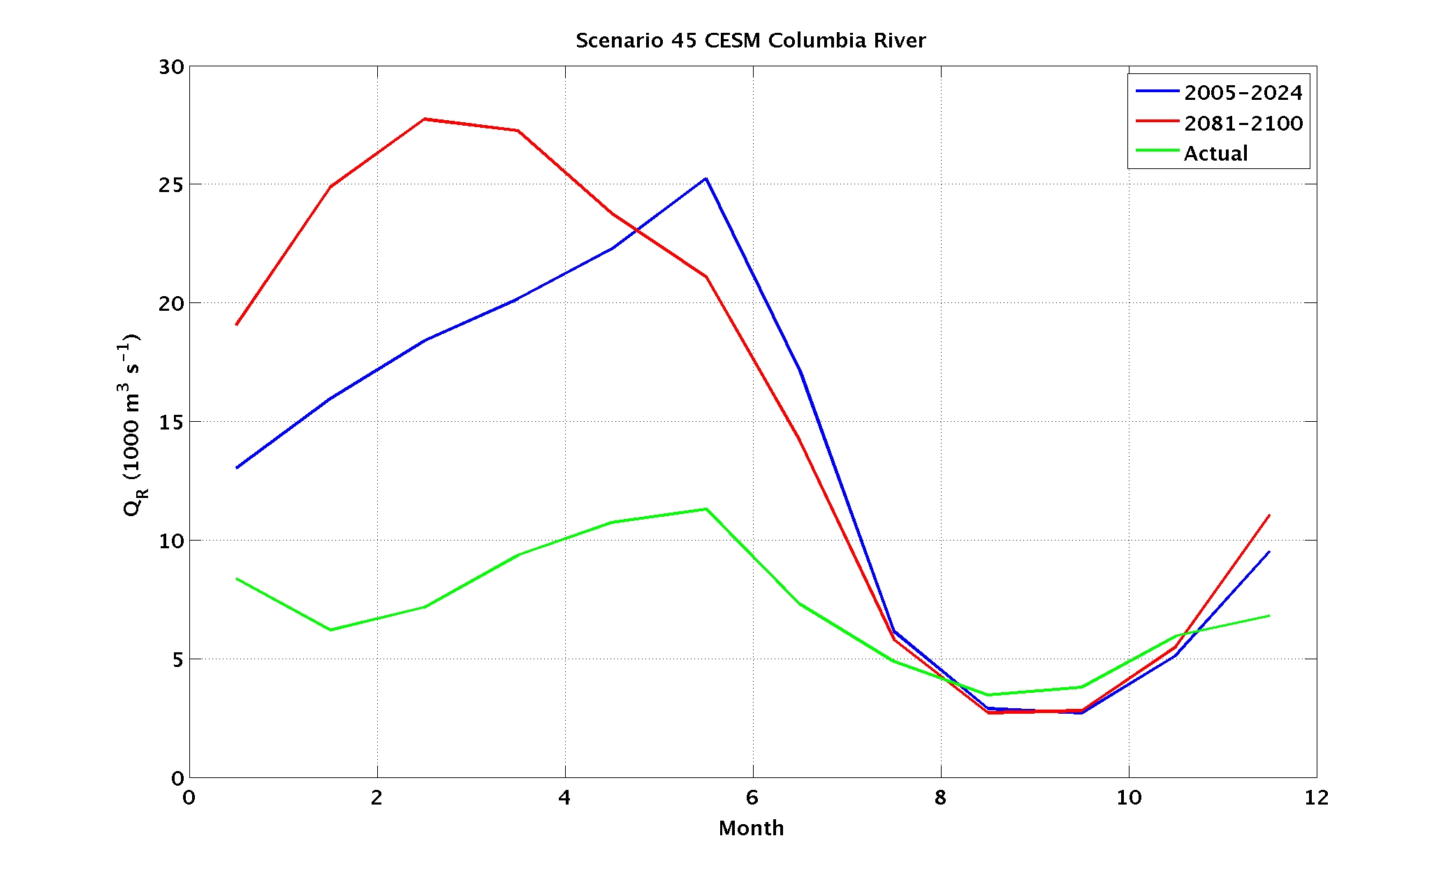
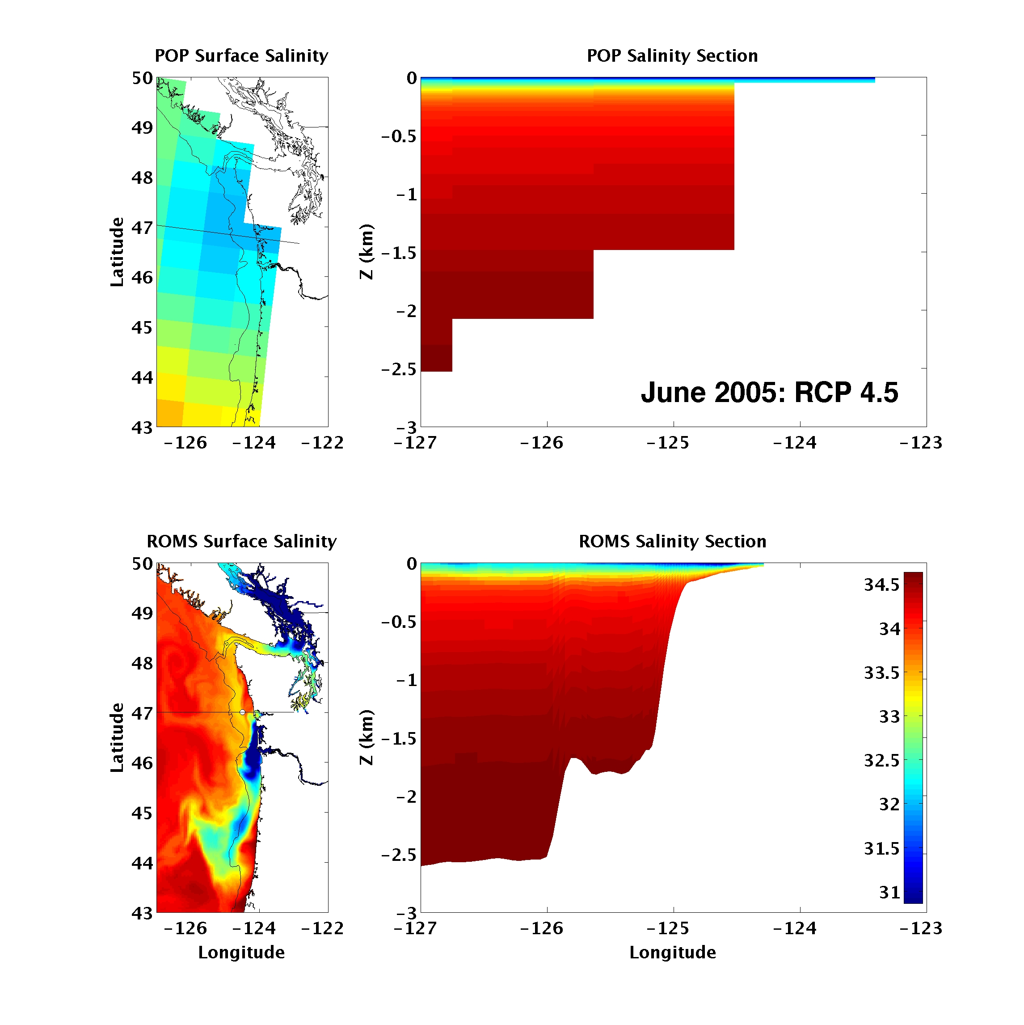
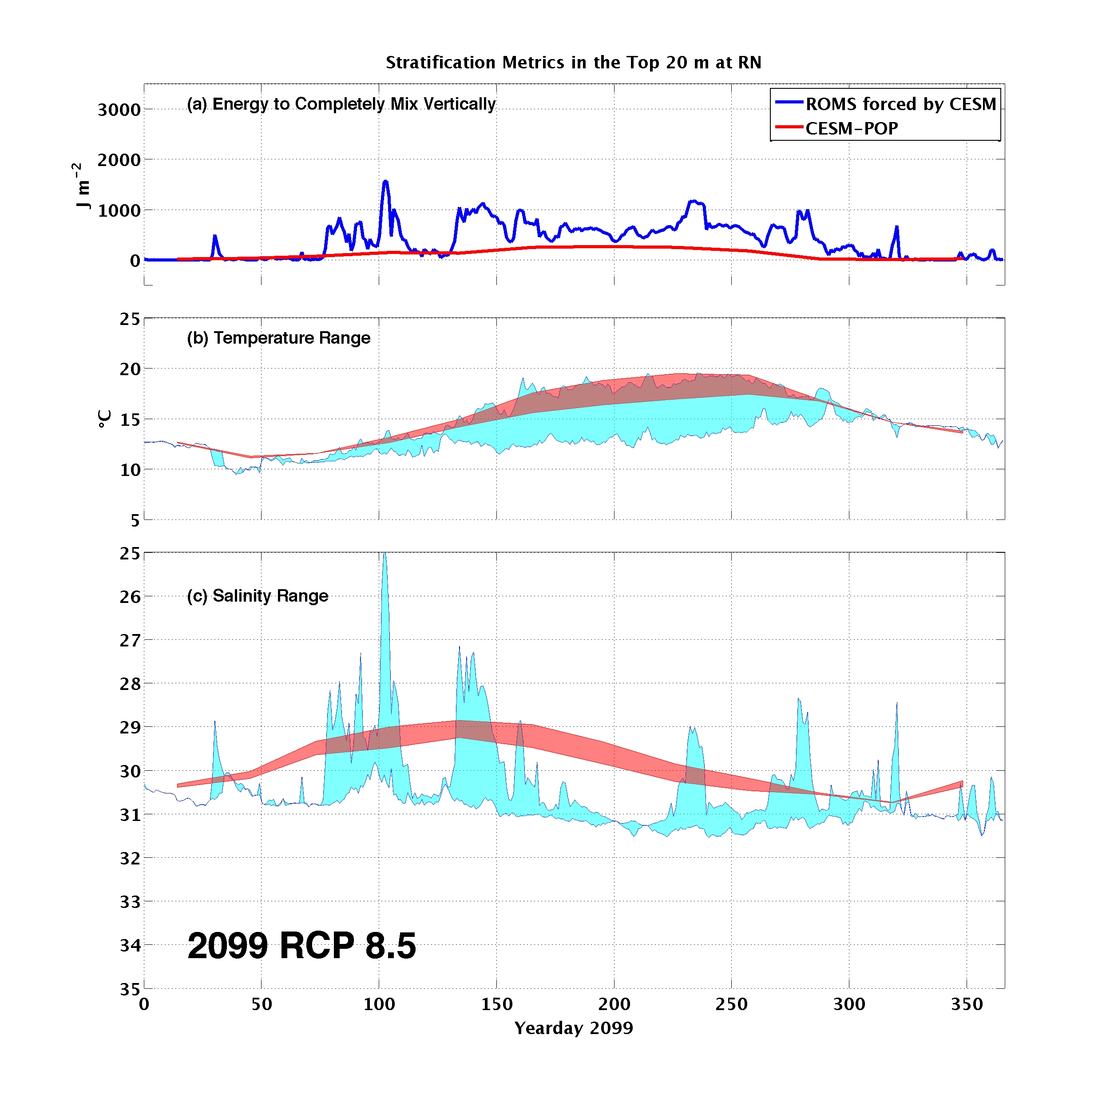
Coastal Downscaling: Can CESM fields successfully force regional coastal ocean simulations with strong freshwater forcing? (YES)
Parker MacCready (U. of Washington), Yu-Heng Tseng & Frank Bryan (NCAR), Mike Whitney (U. of Connecticut)
The coastal ocean accounts for roughly half of the world’s fish harvest, so future projections there are of great importance.
Problems:
Global climate models do not resolve the continental shelf, meaning that they do not have wind-driven upwelling to drive coastal biological productivity.
River input is added as enhanced precipitation over a pre-specified area of the ocean, leading to errors in coastal stratification.
To evaluate model performance we look at water properties and stratification over the top 20 m in the middle of the WA shelf.
This plot shows (a) stratification: the energy required to completely mix the top 20 m, (b) temperature range, and (c) salinity range, all over the year 2005.
The observations (BLACK) show the influence of the Columbia River plume, especially before day 200, in creating stratification. Major wind-driven upwelling, days 200-300, blows the plume offshore and brings in colder, saltier, less stratified Pacific water.
The ROMS model (BLUE) downscaled in CESM retains many of the features of the observations, meaning that this approach has value for future predictions.
Note, however that the model salinity is biased low by 1 psu. This bias is inherited from the CESM-POP model (RED), which is too fresh by about 3 psu.
Solutions:
Improve parameterizations of coastal and estuarine processes (UPSCALING) => See breakout talk (Tseng) & posters 188-189 (Tseng, Whitney) Day 3.
Nest high-resolution models within CESM (DOWNSCALING) => This Poster
The reason for the fresh bias in CESM-POP may be that the model atmosphere has too much precipitation in this region, leading it to have 2-3 times too much Columbia River flow
Here is the CESM POP grid for the NE Pacific (WA, OR, BC), overlain with the real coastline and 200 m depth contour. There is never more than one grid cell on the shelf.
Looking to the future, the downscaling results for 2099, RCP 8.5 (strong warming) have shelf waters warming and remaining stratified throughout the summer upwelling months.
This suggests that coastal upwelling may be substantially weakened in this region in the future.
The model we use for downscaling is a ROMS system, with 1.5 km resolution, and realistic tides, rivers, ocean boundary condition (NCOM), and atmosphere (MM5, high res). The model has been extensively validated against observations, and has excellent skill (Giddings et al. 2014).
For the downscaling experiments we swap out the ocean and atmospheric forcing, instead using fields from CESM simulations for 2005-2099, with different RCP scenarios.
References:
S. N. Giddings, P. MacCready, B. M. Hickey, N. S. Banas, K. A. Davis, S. A. Siedlecki, V. L. Trainer, R. M. Kudela, N. A. Pelland, and T. P. Connolly (2014), Hindcasts of potential harmful algal bloom transport pathways on the Pacific Northwest coast. J. Geophys. Res. Oceans, 119, doi:10.1002/2013JC009622.

