Slide 1
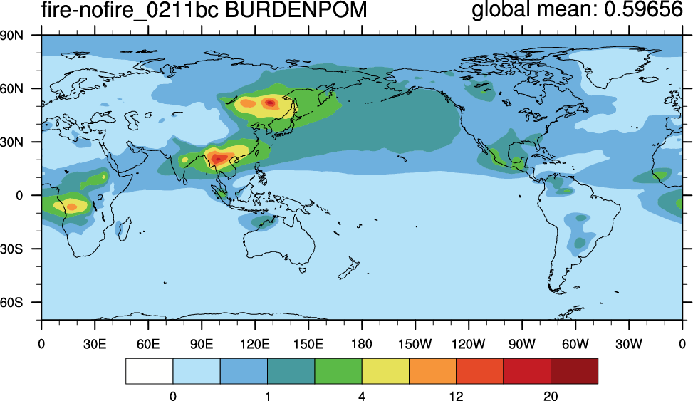
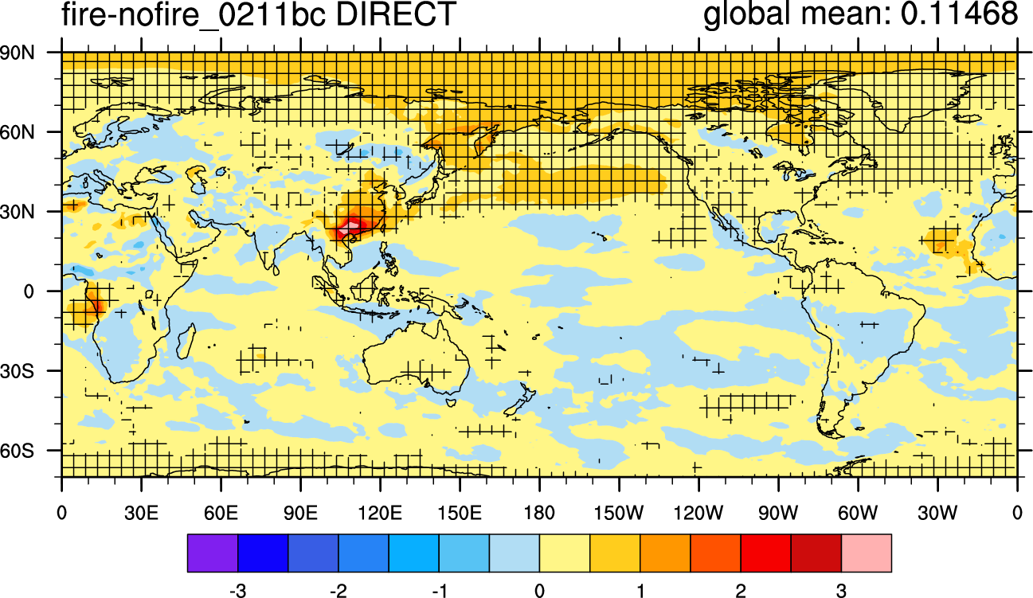
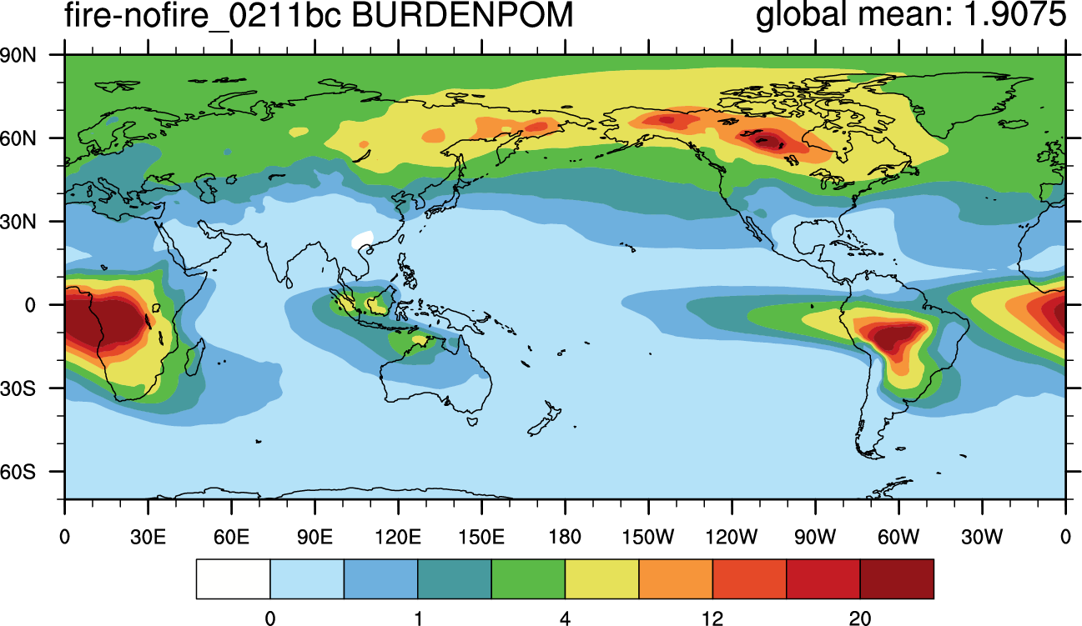
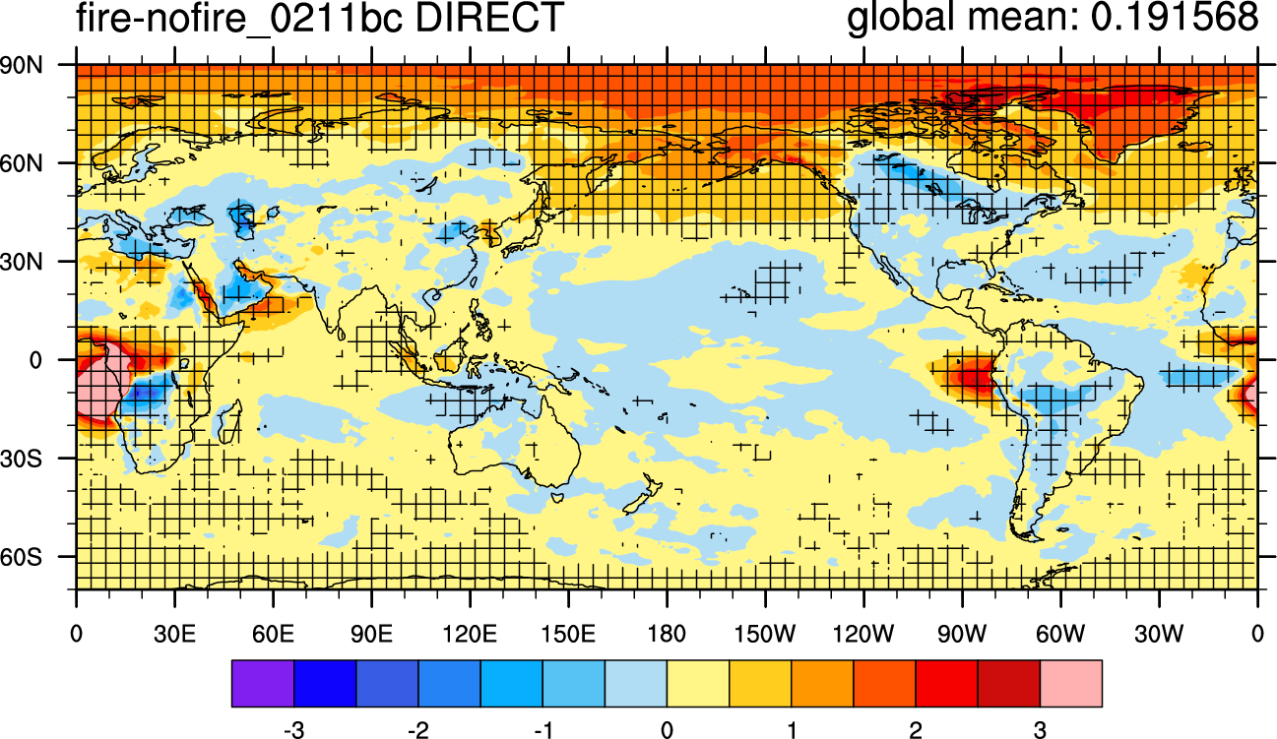
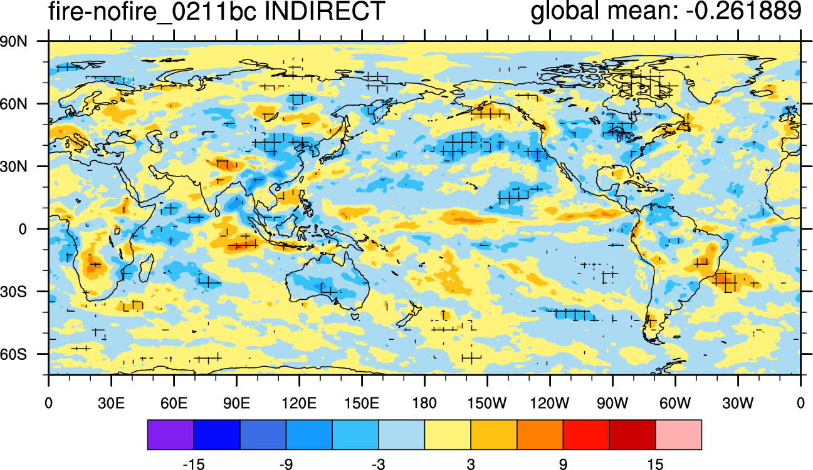
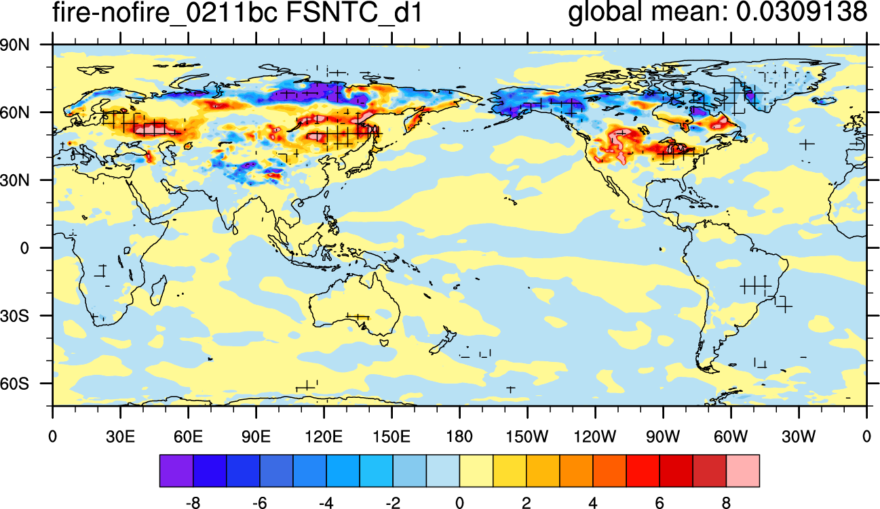
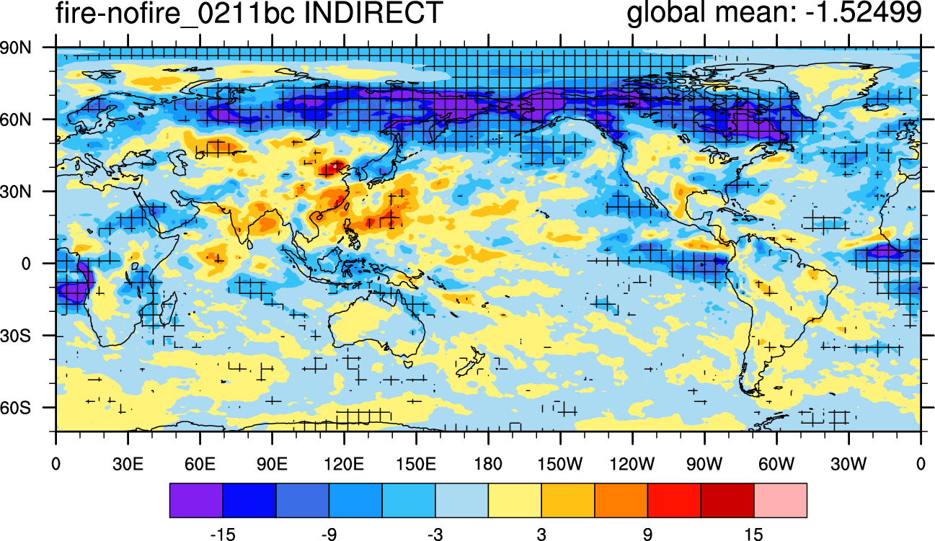
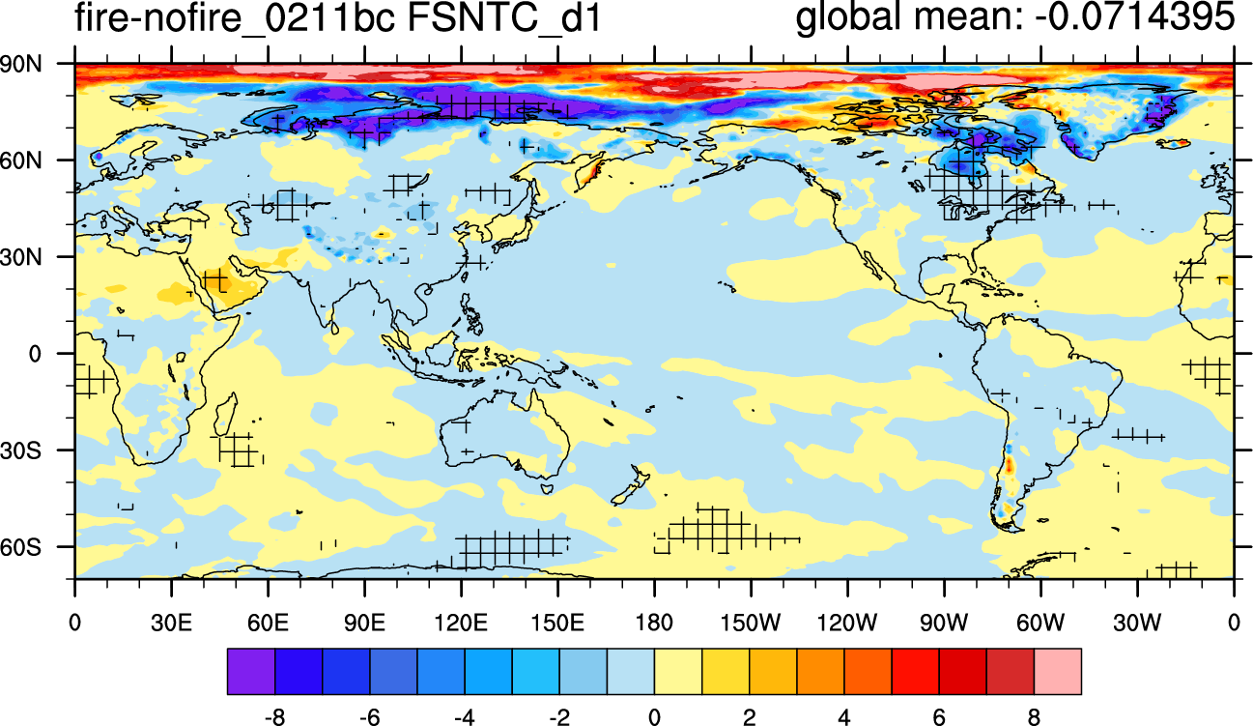
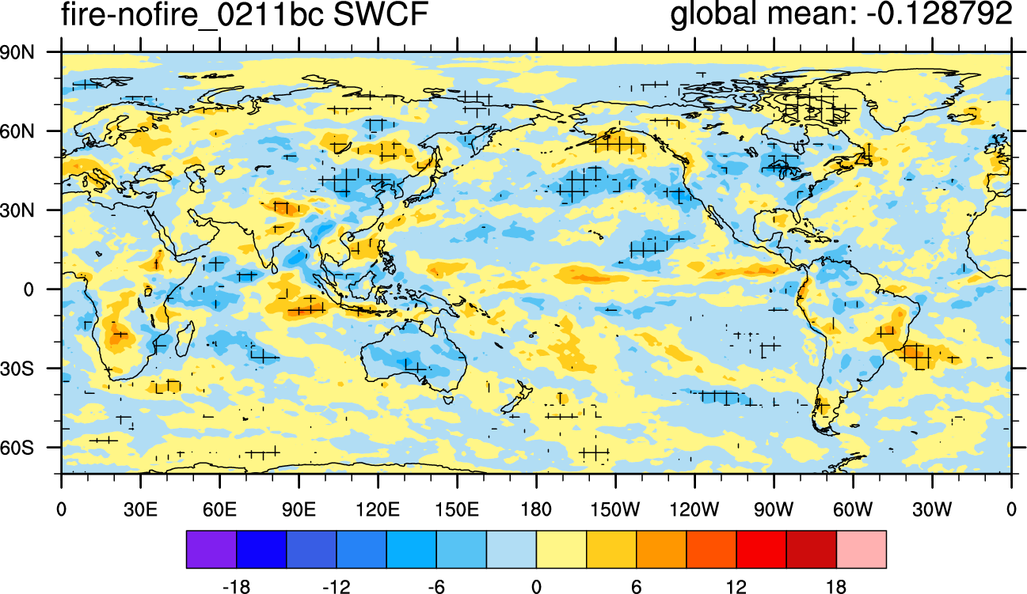
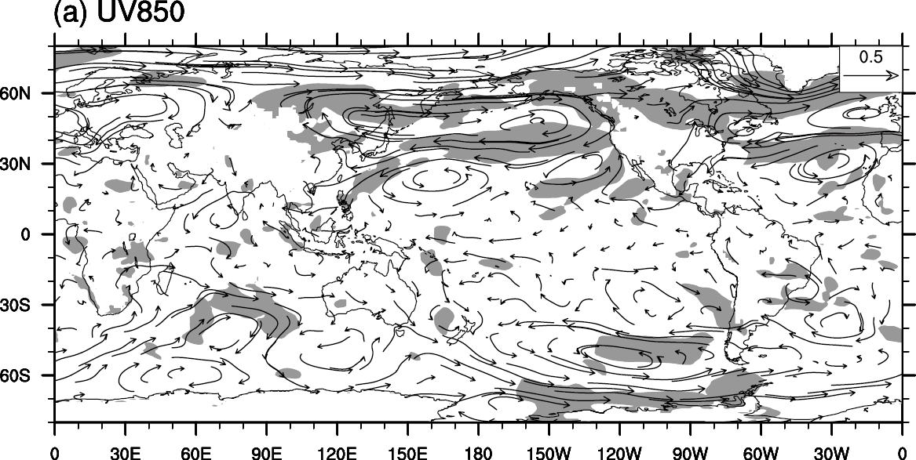
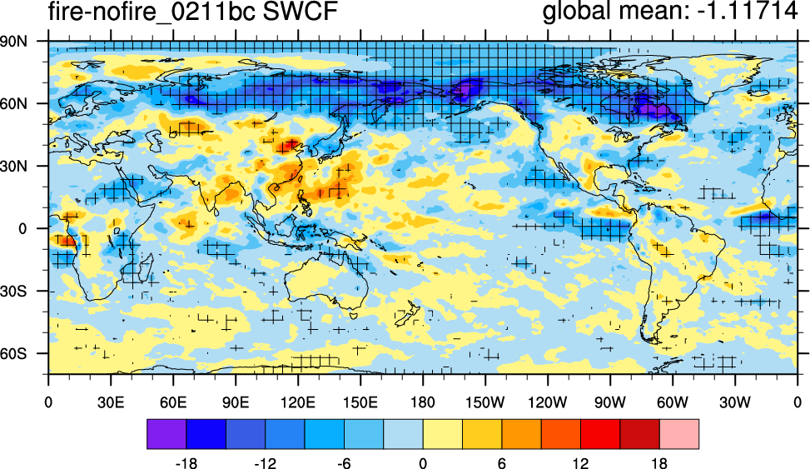
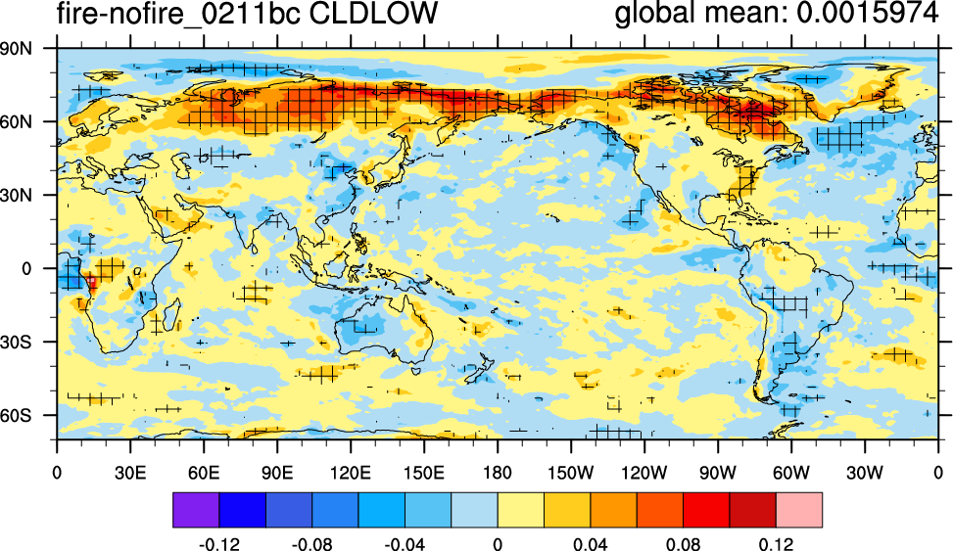
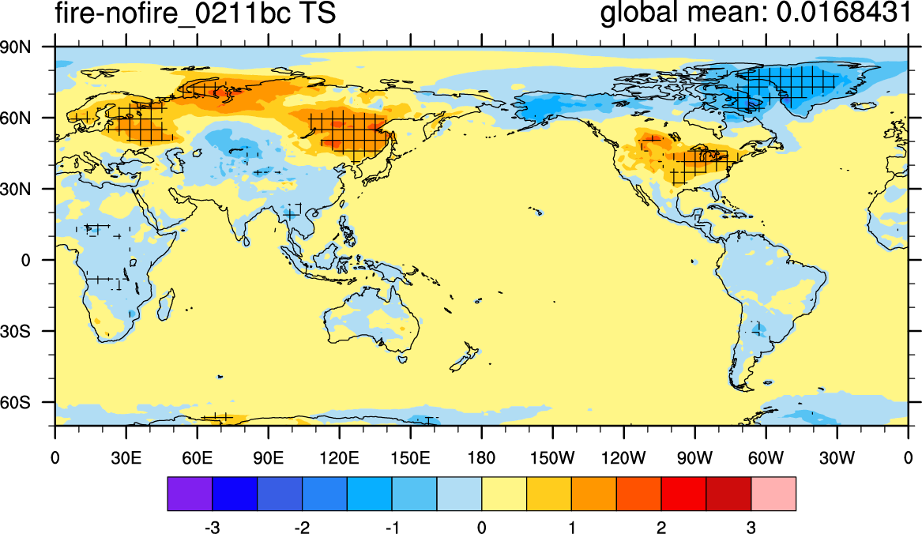
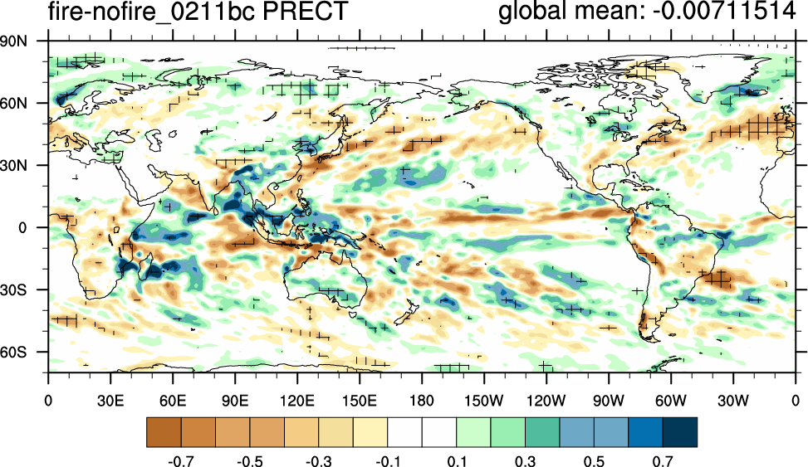
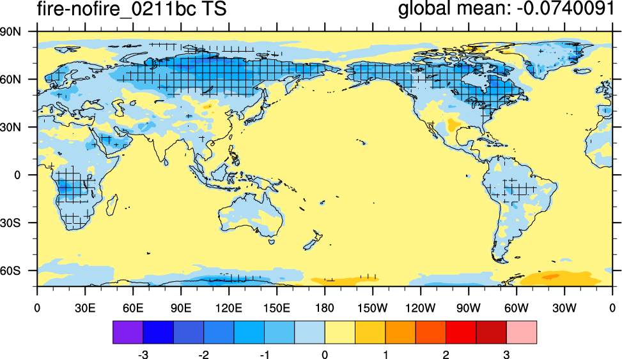
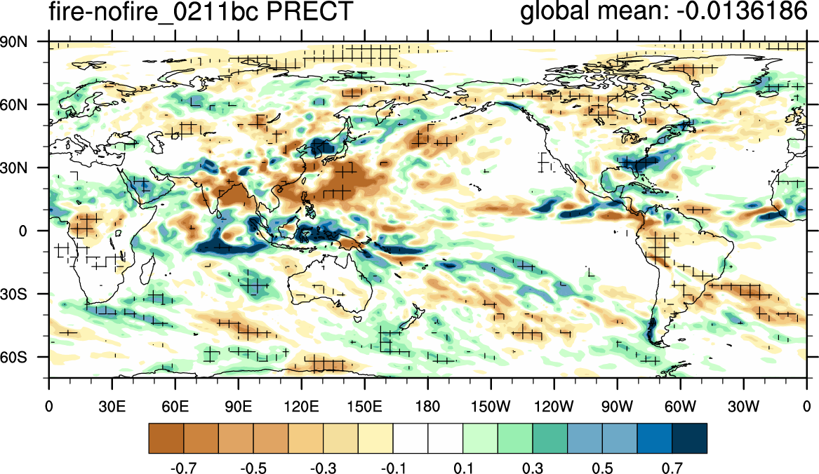
Radiative Forcings of Wild Fire Aerosols and Impacts on Regional Climate
Xiaohong Liu^{1,*}, Yiquan Jiang¹, Kai Zhang², Yun Qian², and Yuhang Wang³
¹Department of Atmospheric Science, University of Wyoming, Laramie, WY 82071
²Pacific Northwest National Laboratory, Richland, WA 99352 ³Georgia Institute of Technology, Atlanta, GA 30332
*xliu6@uwyo.edu
Goal of the Project: Wildfire is a key component of the climate system and plays an important role in regulating regional climate variability. The overarching goal of this project is to elucidate the role of wildfire in decadal climate variation and prediction. The research objectives are to: (1) improve the modeling capability of wildfires and their climate forcing; (2) quantify regional climate forcing by wildfires; (3) understand fire feedbacks to regional climate variability; (4) investigate fully interactive regional fire-climate variability feedbacks; and (5) predict decadal regional climate variability.
Main Results: Wildfire produces different effects in summer versus spring : (1) fire aerosol indirect effect dominates in summer, increase cloud cover and shortwave cloud forcing, and reduce surface air temperature; (2) fire aerosol indirect effect is much weaker in spring. The fire BC-induced snow forcing is most significant during the springtime in Northeast Asia and Northern United States. Surface warming by 1.0-2.0 K is found over these areas in spring due to the increased absorption of solar radiation at surface, while a cooling by about 1.5 K is observed in Canada. The fire BC-induced surface albedo effect generates a PNA (Pacific/North American) like teleconnection pattern during the spring with two anti-cyclones over the North Pacific and North Atlantic oceans.
CESM-CAM5 Model
Spring
Fire Aerosol and Aerosol Radiative Forcings
Summer
Fire Aerosol and Aerosol Radiative Forcings
CESM1.2
4-mode Modal Aerosol Module (MAM4)
CLM4.0 with Snow, Ice and Aerosol Radiation (SNICAR) model
Horizontal resolution at 1° × 1°
Emissions:
GFED 3.1 daily fire emissions (BC, POM, SO2), vertical profile are getting from CAM5 fire emissions.
Surface anthropogenic aerosol emissions are from IPCC RCP4.5 scenario.
Model Experiments
Fire BC-induced snow forcing is most significant during the springtime in Northeast Asia and Northern United States.
Fire OC produces strong indirect forcing (~10 W/m²) in Northeast Asia, Russia and Canada.
Running time: 2003 to 2011 with observed SST
Three experiments:
Fire Aerosol-Induced Changes in SWCF, Circulation, Surface Ts, Precip
Fire Aerosol-Induced Changes in SWCF, Cloud Cover, Surface Ts, Precip
Spring
Summer
- Control run
- Nofire run: remove fire BC, POM, SO2 emissions
- Nofire_bc run: remove fire BC emission
Diagnosing Fire Aerosol Radiative Forcings (Ghan 2013)
ΔF = Δ(F - F_noaer) (direct forcing)
+ Δ(F_noaer - F_noaer,clear) (indirect forcing)
+ ΔF_noaer,clear (albedo forcing)
Δ = Control – Nofire (all fire effects)
Δ = Control – Nofire_bc (fire BC effects)
Surface warming by 1.0-2.0 K is found over these areas in spring due to the increased absorption of solar radiation at surface, while a cooling by about 1.5 K is observed in Canada, which generates a PNA (Pacific/North American) like teleconnection patterns.
Fire OC enhances shortwave cloud forcing, increases low-level clouds, and reduces surface temperatures.

