Slide 1

Accelerated Climate Model for Energy
Principal Investigator “All-Hands”
May 5-7, 2015
Tyson’s Corner, VA
Dorothy Koch
Earth System Modeling
Climate and Environmental Sciences Division
May 5, 2015

Slide 2

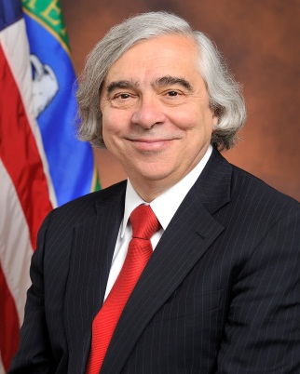
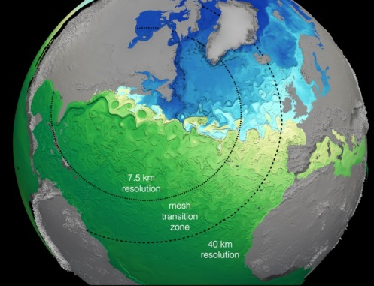
ACME News
Accelerated Climate Model for Energy
  Accelerated: Computational performance, workflow, software
  Climate Model: Science drivers (Water cycle, workflow, ocean-cryosphere)
  Energy: water management, carbon cycle, biofuels, (coastal)
  High-resolution, variable-mesh, (projection UQ)
ACME project “on the map”, part of USGCRP IGIM US “Climate Modeling Summit”; CLIVAR CPT workshop
Secretary’s Honor Award:
to ACME Executive Committee (5-7-14)
AGU ACME Town Hall (December 2014)
BERAC presentation (January 2015)
Outstanding Contributions awards (tomorrow)
Computing awards:
INCITE (2015) 190M hours
ALCC (2014) 137M hours
NESAP – Cory – NERSC early access
CAAR – Summit – OLCF early access
(TBD: ESP – Aurora – ALCF)

Slide 3
ACME Reviews
First Quarter Report (to BER) in October 2014
Six month review in January 2015, face-to-face, 6 reviewers
  High-level comments:
  Need to keep pace with significant challenges posed by addressing both performance and portability on the complex and diverse LCF’s
  Three main science goals are good, “intermediate” goals are important too (e.g. cloud and atmospheric changes)
  Flexibility, contingencies in the course of coupling
  Consider new and creative diagnostics given the new capabilities, get out ahead of “the MIPS”
  Time commitment still a concern
Proposal on energy component (Bader and Calvin) due May 22, 2015
  Update and exercise integrated ACME-GCAM carbon cycle
  Water management (explore coupling with GCAM)
  Biofuels

Slide 4
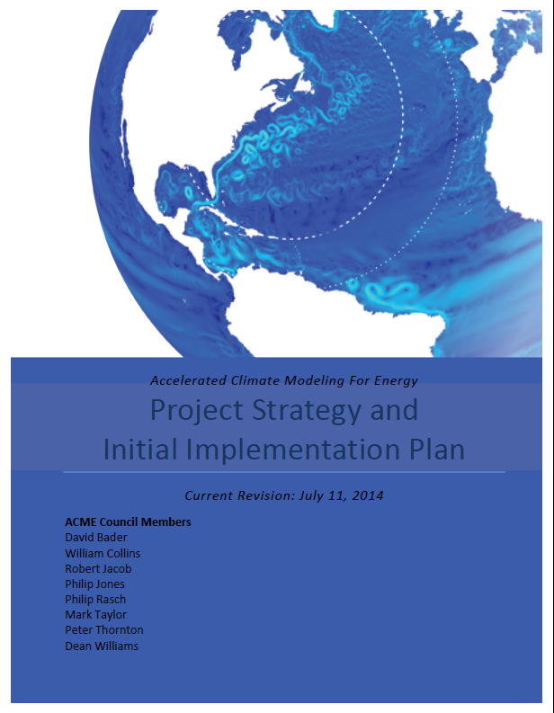
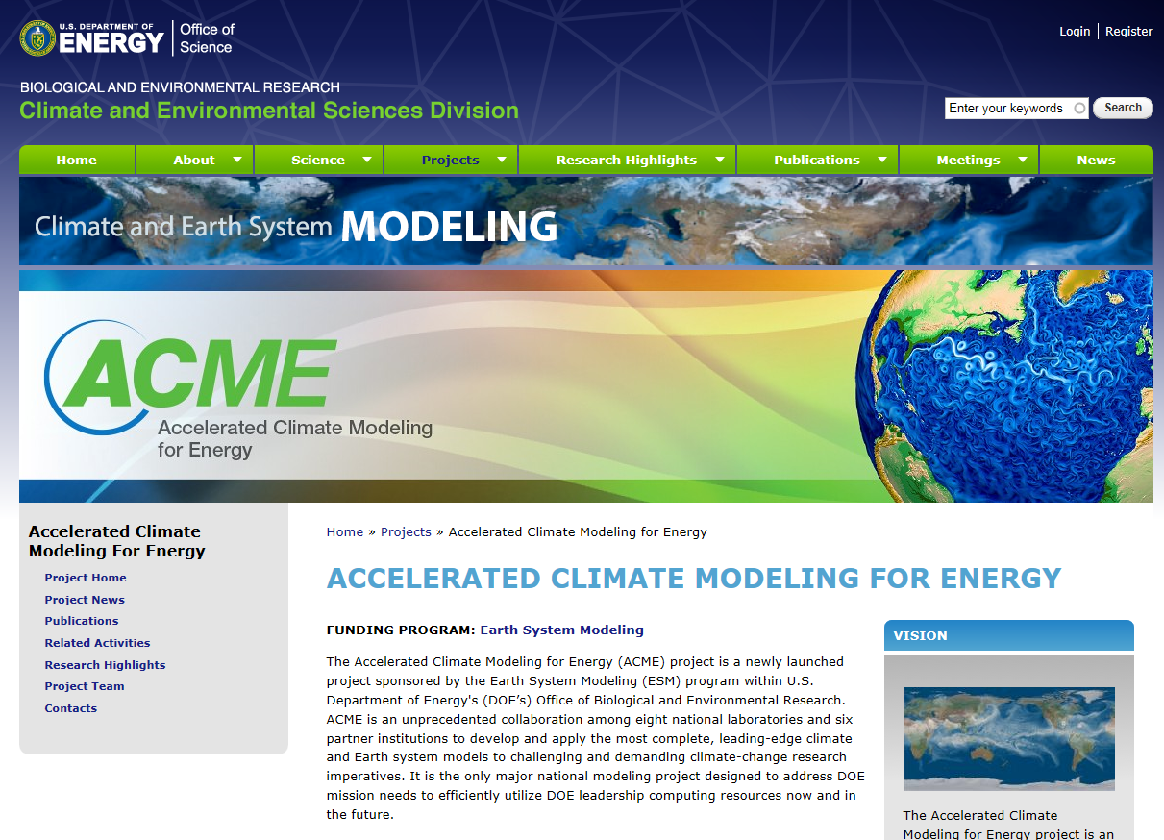
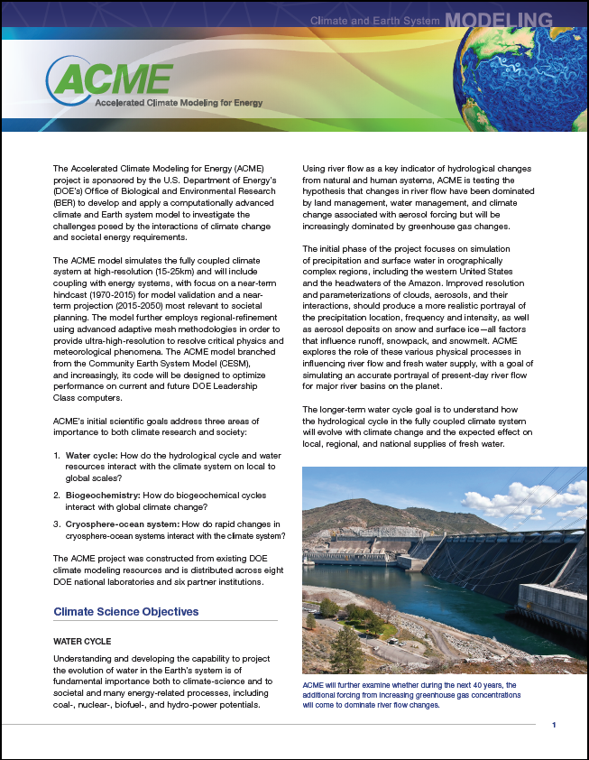
ACME public website, fact-sheet
http://climatemodeling.science.energy.gov/projects/accelerated-climate-modeling-energy

Slide 5
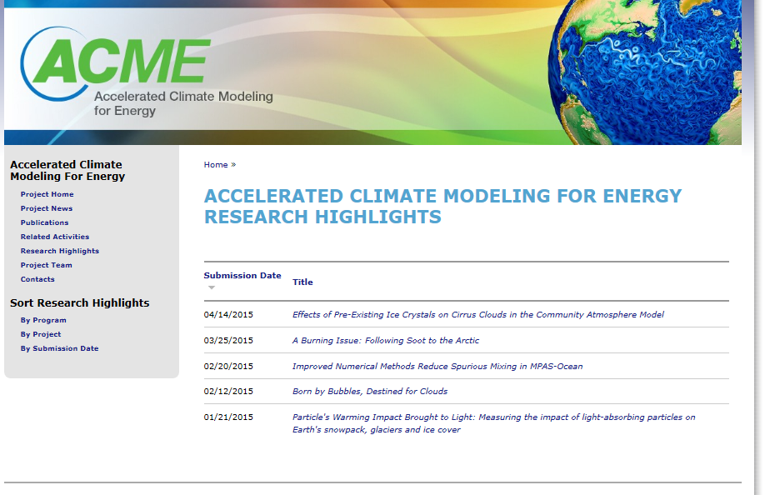
ACME highlights
Liu, Zhang
Wang et al.
Petersen et al.
Burrows et al.
Qian et al.

Slide 6
Highlights
Basic elements of highlights
Paragraph summary for broad-science-educated
a) 1-2 introductory sentences to set context
b) summarize result, method
c) Finish with impact/implications
Single ppt slide with “Objective”, “Approach”, “Impact”, Figure
Upload manuscript
What should be highlighted?
  1. Publications (at time of acceptance)
  2. Component release
  3. New computational capability
Inform us of awards, press-releases
Also useful: movies, images
**Every ACME team member should be engaged in the project, planning publications, new capabilities**

Slide 7
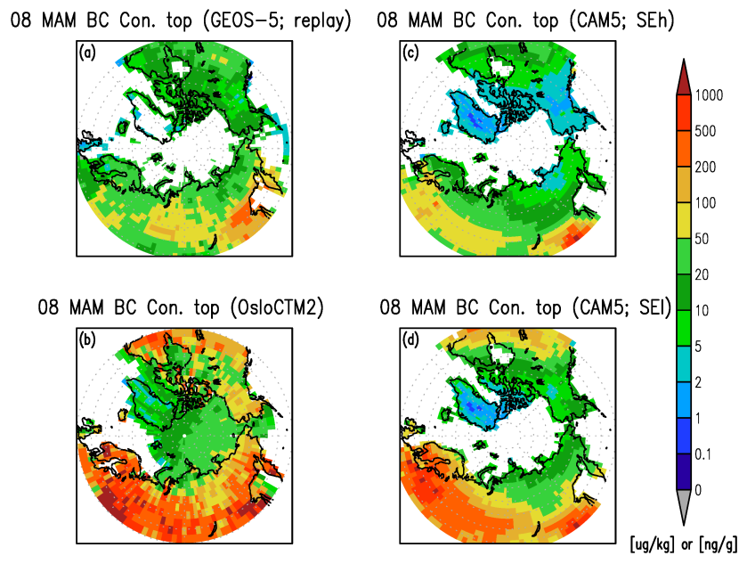
Light-Absorbing Particles in Snow and Ice: Radiative, Climatic and Hydrological Impact
Objective
To review the status of scientific understanding and known uncertainties in how light absorbing particles (LAPs) in snow/ice affect the cryosphere, climate and hydrological cycle
Approach
Review various technical methods of measuring LAPs in snow and ice
Summarize the progress made in measuring LAPs in snow/ice in the Arctic, Tibetan Plateau, and other mid-latitude regions
Report progress in modeling mass concentrations, albedo reduction, radiative forcing, and climatic and hydrological impact of LAPs in snow and ice at global and regional scales
Spatial distributions of black carbon concentrations in top-snow layers (March-April-May mean in 2008) are sensitive to representations in different models.
Impact
LAPs in snow and ice have been identified as one of major anthropogenic forcing agents that can cause surface darkening and accelerate the snow aging and melting processes
More systematic field measurements and coordinated modeling efforts will help advance our understanding of LAPs effects in snow/ice and quantify their impact on the cryosphere and global climate
Qian Y, T Yasunari, S Doherty, M Flanner, WKM Lau, J Ming, H Wang, M Wang, and S Warren. 2015. “Light-Absorbing Particles in Snow and Ice: Measurement and Modeling of Climatic and Hydrological Impact.” Advances in Atmospheric Sciences: 32(1):, 64–91. DOI: 10.1007/s00376-014-0010-0
Notes:
http://www.pnnl.gov/science/highlights/highlights.asp?division=749

Slide 8
Reduced spurious vertical mixing in MPAS-Ocean
Objective
Vertical diffusion in the ocean is very low. Ocean models overestimate mixing and entrainment, causing artificially high diffusion, due to resolution and numerics. This leads to incorrect water properties and currents.
spurious mixing, due to numerics
Approach
Validate the new Model for Prediction Across Scales (MPAS-Ocean) against three long-standing ocean models using five standard test cases.
The MPAS-Ocean design uses:
  Arbitrary Lagrangian-Eulerian vertical coordinate
  hexagon horizontal grid
  advanced advection scheme.
Spurious mixing is quantified using the resting potential energy (RPE).
varying viscosity
Impact
Thanks to improved algorithms, MPAS-Ocean will better represent physical mixing processes in climate simulations, leading to more realistic climate predictions.
Petersen, M.R., D. W. Jacobsen, T. D. Ringler, M. W. Hecht, M. E. Maltrud (2015): Evaluation of the arbitrary Lagrangian–Eulerian vertical coordinate method in the MPAS-Ocean model. Ocean Modelling, Volume 86, Pages 93-113, ISSN 1463-5003
Notes:
Wanda says that this is a general slide with no specific reference

Slide 9
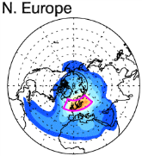
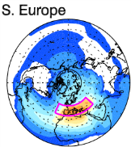
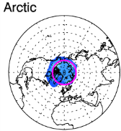
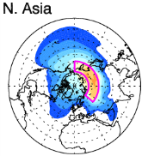
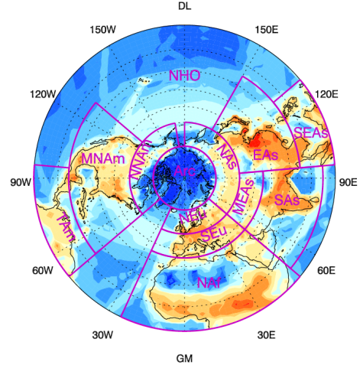
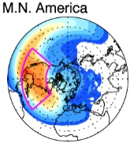
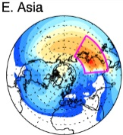
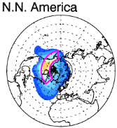
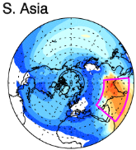
Tracking Emissions to Identify Sources and Transport Pathways of Arctic Black Carbon
Objective
Better understand sources of black carbon (BC) reaching the Arctic and the response of Arctic BC loading and radiative forcing to uncertainty and changes in emissions
Approach
Develop a new tagging technique in the Community Atmosphere Model (CAM5) to explicitly track BC emissions originating from major source regions
Conduct 10-year CAM5 simulations to establish global source-receptor relationships and transport pathways of BC, and characterize interannual variability
Quantitatively attribute Arctic BC loading, deposition and radiative forcing to regional sources
Small circles: contributions to Arctic BC from top 8 source regions, which are outlined in red. Large circle: annual BC emissions. [Warmer colors indicate larger contributions and emissions.]
Impact
The new tagging technique is much more computationally efficient than conventional emission perturbation approaches, making it affordable for studying interannual variability and using numerous source regions
Arctic BC and source attributions have strong seasonal variations; The interannual variability of annual mean Arctic BC burden and radiative forcing due to meteorology is small, but seasonal means have significant variability
Wang H, PJ Rasch, RC Easter, B Singh, R Zhang, P-L Ma, Y Qian, S Ghan, and N Beagley. 2014. “Using an Explicit Emission Tagging Method in Global Modeling of Source-receptor Relationships for Black Carbon in the Arctic: Variations, Sources, and Transport Pathways.” Journal of Geophysical Research: Atmospheres 119:12,888-12,909. DOI:10.1002/2014JD022297.
Notes:
http://www.pnnl.gov/science/highlights/highlights.asp?division=749

Slide 10
ESM synergies
PISCEES: ice sheet development, coupling to MPAS for ACME
Asay-Davis: MPAS ocean-ice interface, experimentation
Otto-Bliesner: Paleo-climate Greenland ice sheet changes and SLR
Large: vertical mixing, mixed-layer depth in southern ocean, MPAS
Long: Ocean BGC modularization, extensibility, into MPAS
Primeau: BGC (offline tracer) rapid spin-up for POP/MPAS
Multiscale: “scale-aware” convection and ocean-eddies
Convective evaluation using tropical data and statistics
Pritchard: Ultra-P-CAM – very high-resolution CRM, GPUs
Teixeira: EDMF into CAM (boundary layer turbulence, clouds)
Prather: SW cloud overlap, diffuse radiation, alternative to RRTMG
Huang: Improving LW treatment of RRTMG (important in Arctic)
Reich: trait-based methods for land
Hurtt: historical land-use, land-cover
Shen: tropical land hydrology-BGC treatment
Miller: tropical evapotranspiration treatment for CLM

Slide 11
BER synergy planning
RGCM:
iLAMB land validation shared with ACME
Other SFA’s proposing to use ACME: LBNL CASCADE, LANL/PNNL HiLAT
IAR:
Energy-component of ACME to complement PNNL-IAR-SFA (both under development); GCAM might use ACME-LM
TES:
NGEE-Arctic co-development of ACME-LM
Coordination of NGEE’s around ED and trait-based modeling
ASR/ARM:
Coordination of RR-CAM and LES around ARM

Slide 12
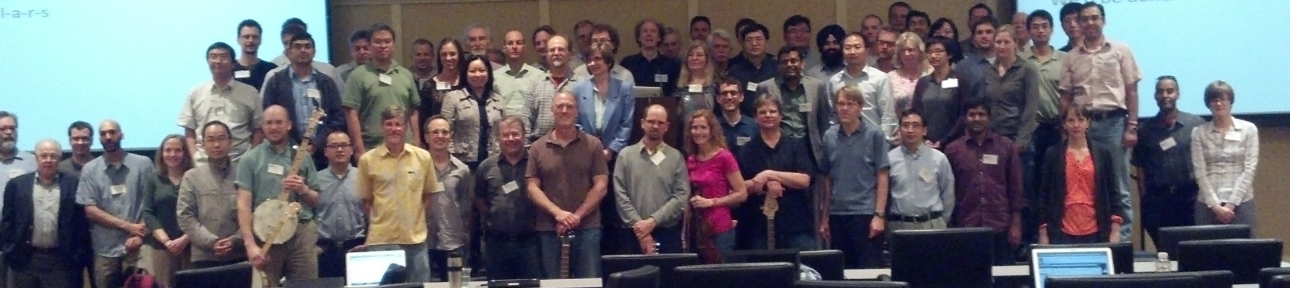
Meeting goals
Gain coherence around coupled system experiments and science
Early science results, challenges and brainstorming (v3-v4)
Technical training: SE, workflow, Jira
Group planning and problem solving (v1-v2)
Cross-group coordination:
Which kind of Spoke are you?

Slide 13
Thank you!
Dorothy.Koch@science.doe.gov
ACME: http://climatemodeling.science.energy.gov/projects/accelerated-climate-modeling-energy
Earth System Modeling:
http://science.energy.gov/ber/research/cesd/earth-system-modeling-program/

Slide 14
ACME management structure
ACME Council
Dave Bader, Chair
Executive Committee: W. Collins, M. Taylor
R. Jacob, P. Jones, P. Rasch, P. Thornton, D. Williams
Ex Officio: J. Edmonds, J. Hack, W. Large, E. Ng
Executive Committee
Chair: D. Bader
Chief Scientist: William Collins
Chief Computational Scientist: Mark Taylor
Project Engineer
Renata McCoy
Land
Group
Peter Thornton
William Riley
Atmosphere Group
Phil Rasch
Shaocheng Xie
Software Eng./Coupler Group
Rob Jacob
Andy Salinger
Workflow
Group
Dean Williams
Kate Evans
Land Task
Leaders
Atmosphere Task Leaders
SE/Coupler Task Leaders
Workflow Task Leaders
Ocean/Ice
Group
Todd Ringler
Steve Price
Coupled Simulation Group
Performance/ Algorithms Group
Phil Jones
Pat Worley
Ocean/Ice Task Leaders
Coupled Sim. Task Leaders
Perf. / Alg. Task Leaders

