Slide 1

Accelerated Climate Model for Energy
Principal Investigator “All-Hands”
June 7-9, 2016
Rockville, MD
Dorothy Koch
Earth System Modeling
Climate and Environmental Sciences Division
June 8, 2016

Slide 2
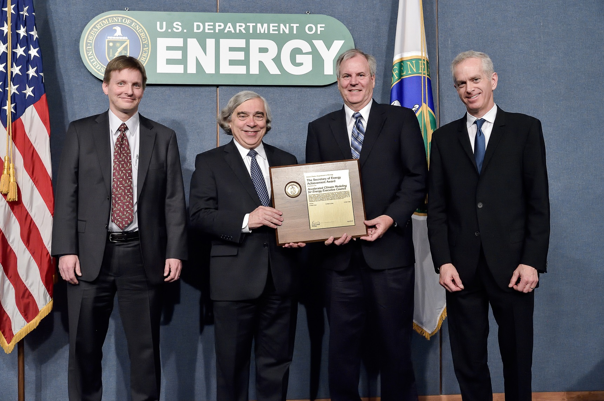
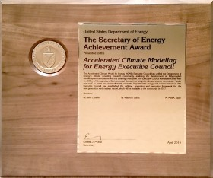
ACME Executive Committee:
Secretary of Energy Achievement Award, 2014

Slide 3
ACME management updates
ACME Council
Dave Bader, Chair
Executive Committee: R. Leung, M. Taylor
R. Jacob, P. Jones, P. Rasch, P. Thornton, D. Williams, T. Ringler, W. Riley
Ex Officio: J. Edmonds, J. Hack, W. Large, E. Ng
Executive Committee
Chair: D. Bader
Chief Scientist: Ruby Leung
Chief Computational Scientist: Mark Taylor
Project Engineer
Renata McCoy
Land
Group
Peter Thornton
William Riley
Atmosphere Group
Phil Rasch
Shaocheng Xie
Software Eng./Coupler Group
Rob Jacob
Andy Salinger
Workflow
Group
Dean Williams
Val Anantharaj
Land Task
Leaders
Atmosphere Task Leaders
SE/Coupler Task Leaders
Workflow Task Leaders
Ocean/Ice
Group
Todd Ringler
Steve Price
Coupled Simulation Group
Performance/ Algorithms Group
Phil Jones
Pat Worley
Ocean/Ice Task Leaders
Coupled Sim. Task Leaders
Perf. / Alg. Task Leaders

Slide 4
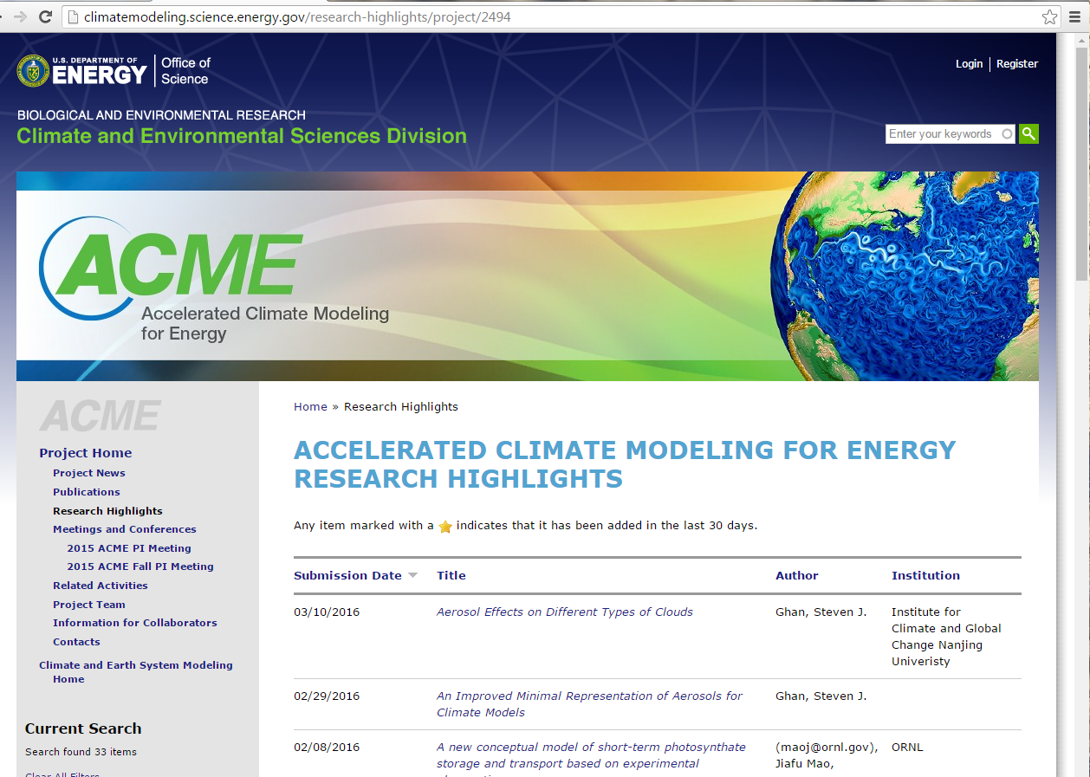


Slide 5
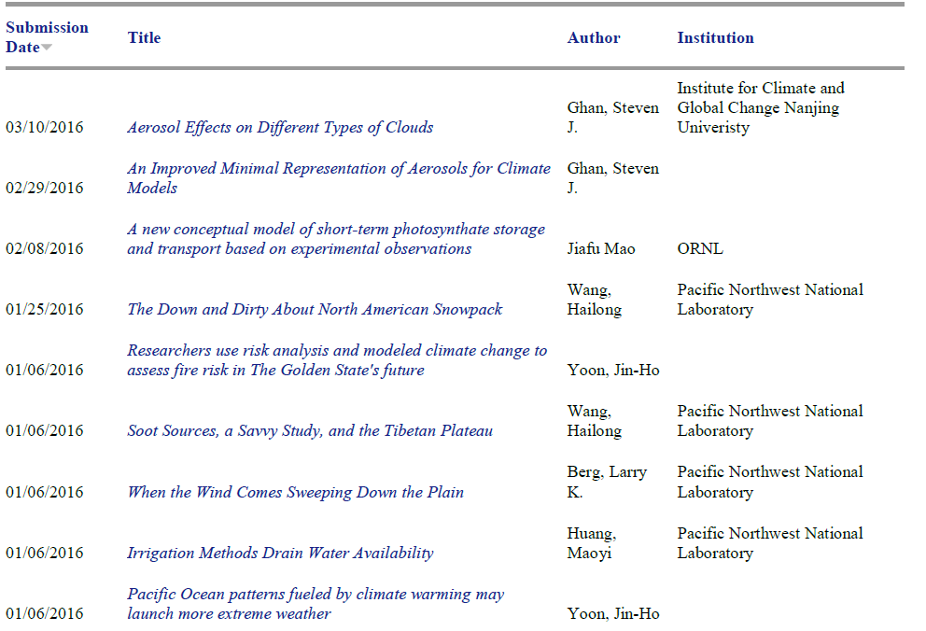
16 ACME publication highlights since Nov 2015

Slide 6
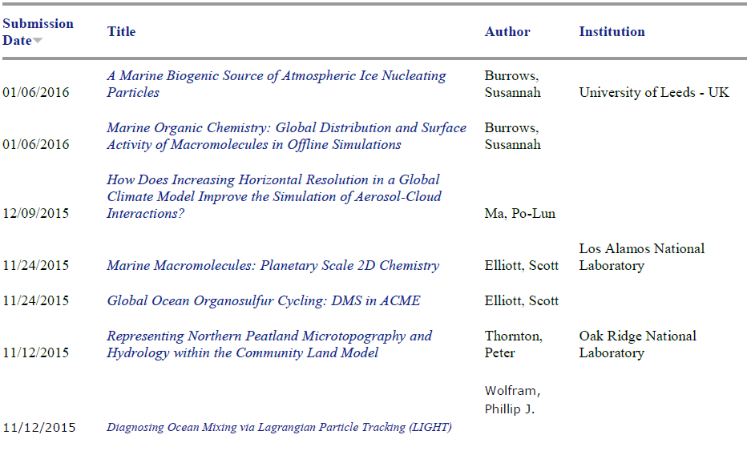
16 ACME publication highlights since Nov 2015

Slide 7

ACME - computation
Solid computational achievements:
ALCC 211M (158M ALCF, 53M OLCF) 2016
INCITE 140M hours ALCF 2015
NESAP – NERSC-Cori early access
CAAR – OLCF-Summit early access
ECP “Exascale Computing Program” (ASCR-facilities program) proposal invitation [SNL-Taylor is PI]
NESAP and CAAR projects both need postdocs – people with computational-climate expertise
DOE-SC Graduate Student Research Program
Topic on computational climate modeling, supports graduate student time at DOE Laboratory
We are evaluating options for purchase of hardware for ACME to use for debugging and post-processing

Slide 8
DOE workshops involving
ACME community
October 21-22 2015 ARM-ASR-ACME workshop
http://science.energy.gov/~/media/ber/pdf/workshop%20reports/CESD_ACME_ARM_ASR_workshopreport_web.pdf
November 19 2015 (ESM-TES)
Traits methods for land-vegetation modeling
November 20 ACME-NGEE coordination meeting http://science.energy.gov/~/media/ber/pdf/workshop%20reports/Trait_workshop_report_05_31_2016.pdf
March 2016 ASCR Facilities BER Exascale Requirements workshop
May 16-18 2016 ILAMB International Land Modeling Benchmarking
(RGCM-ESM)
May 19 Integrated Land modeling meeting (ACME-IAR)
May 20 DOE-Science-Scenarios ACME-GCAM
July 25-29 2016 ESM-IA-IAV frameworks at EMF meeting, Snowmass
September 2016 AXICCS – Computational Climate modeling (ASCR-ESM)

Slide 9
ESM FOA 2016
New University projects (about 10) to collaborate with ACME in the following areas:
Atmospheric chemistry: especially gas-phase species to complement a robust aerosol capability; e.g. methane, ozone, nitrate, SOA precursors
Atmospheric Convection: ACME has started working with CLUBB but could change course; microphysics, high and variable resolution
Ocean BGC: carbon cycle, for variable-resolution MPAS ocean model
Tidal and Estuary systems: New MOSART river with chemistry, temperature; basin gridding for land; variable-resolution ocean
Land disturbance: How have human disruptions to land systems disrupted the carbon cycle
Component coupling: Advanced methods to represent coupling of ACME systems, e.g. ocean-ice, ocean-land (surge, SLR); sub-grid orographic representations
Relevant existing Lab-led projects
Non-hydrostatic CAM-SE SciDAC project (Taylor, Hall and Ullrich)
LEAP project – tracer advection in ocean and atmosphere, exploration of performance portability methods (Jones et al)
Multiscale (Collins et al) – “scale-independent” convection and eddies
PISCEES (Price, Ng et al) – dynamic ice sheet developments

Slide 10
ESM guests this week
Mike Pritchard (UC-Irvine): Towards low cloud-permitting cloud superparameterization
Michael Prather (UC-Irvine): An examination of systematic biases in ACME solar heating rates - comparison with multi-stream Solar-J
Xianglei Huang (U-Michigan): Incorporate realistic spectral emissivity of surfaces into the CESM and the influence on simulated radiation budget, mean climate, and climate changes
Chaopeng Shen (Penn State): Scale-aware hydrologic and biogeochemical modeling for the Amazon and the world: model enhancement, multi-scale strategies and dataset generation
Ethan Butler (U-MN): Estimating Global Maps of Trait Distributions
Michal Kopera (UCSC; Giraldo, NPS): A new ice sheet / ocean interaction model for Greenland Fjords using discontinuous Galerkin method
Matthew Long (NCAR): Ocean biogeochemistry in the Earth system modeling framework: applications and approach (MARBL)
François Primeau, Keith Moore (UC-Irvine): Developing fast implicit spin-­‐up capabilities for CESM to study the dynamics o the ocean’s nitrogen and carbon cycles

Slide 11
CESD-ACME-connected projects
Climate Model Development and Validation (CMDV) is a new DOE-BER activity to improve climate model architecture, software, and computational design to prepare for exascale computing (CMDV-Software; 5M), to develop scale-aware physics for climate systems and to enhance methods for model validation (CMDV-Atmosphere; CMDV-Land-Liaisons; 5M).
Pending projects:
CMDV-Software: Next-generation software developments for ACME
CMDV-Atmosphere: Projects to understand and improve atmospheric processes and develop parameterizations, from ARM/LES to ACME
CMDV-Land: Liaisons to align and coordinate ACME and NGEEs
Modeling Programs
RGCM SFA’s will be using ACME v1
CASCADE, HILAT, WACCEM, BGC-ILAMB
IAR: Alignment of GCAM-land and ACME-LM
ACME-GCAM-scenario and science insights for Energy

Slide 12
Collaboration Title | Collaboration Document | Approval Date
Interpretation of collaboration policy as it applies to CESM | Collaboration_interpretation_CESM_ACME.pdf | 25 Sep 2014
Paul Coffman for I/O performance | 2014-12-04 Council Telecon Notes | 11 Dec 2014
Tang, Zhu and Ghimire (LBNL) | ACME request for scientists.pdf
Sungsu Park | ACME Collaboration with Sungsu Park | 15 Jan 2015
Reich collaboration requested by Peter Thornton | Collaboration_Reich_project.docx | 19 Feb 2015
Larson and Gettleman PDF document | Convection Scheme Testing - Vince Larson and Andrew Gettleman | 05 Mar 2015
David Hall collaboration | Hall_CU.pdf | 12 Mar 2015
Dave Randall subcontract and collaboration to work on CAAR | 2015-04-02 Council Telecon Meeting notes | 02 Apr 2015
Tony Craig subcontract to implement MOSART in CLM (requested by Ruby Leung | MOSART.pdf | 02 Apr 2015
Southern Ocean SciDAC collaboration | Southern Ocean SciDAC collaboration | 16 Apr 2015
Multiscale Collaboration Proposal | Multiscale Collaboration Proposal | 06 Aug 2015
Proposed ACME Ocean Physics Collaboration.pdf | Proposed ACME Ocean Physics Collaboration.pdf | 11 Jun 2015
proposed_ACME_collaboration_MS_precon.docx | proposed_ACME_collaboration_MS_precon.docx | 11 Jun 2015
ACME Collaboration Agreement for Abramoff.docx | ACME Collaboration Agreement for Abramoff.docx | 11 Jun 2015
HiLAT collaboration (requested by Phil Jones) | HiLAT_Jones_Jul2015Final.pdf | 23 Jul 2015
Bouskill collaboration (requested by Bill Riley) | ACME Collaboration Agreement for Bouskill.pdf | 23 Jul 2015
collaboration agreement with Rosie Fisher, the NGEE people and ACME |  | 06 Aug 2015
CICE Collaboration Agreement | ICE_Hunke_Jul2015.pdf | 30 Jul 2015
PISCEES Collaboration Request | PICEES_PriceNg_July2015.pdf | 11 Aug 2015
HiLAT additional collaboration | Additional collaboration info HILAT-ACME.pdf | 07 Apr 2016
Polynya Data Collaboration | Polynya_LANL_Aug2015.pdf | 18 Aug 2015
Transport schemes collaboration | Transport schemes | 02 Sep 2015
Non-hydrostatic dynamical core collaboration | Non-hydrostatic dynamical core | 02 Sep 2015
Extremes_consortium_RGCM_ACME.pdf | Extremes_consortium_RGCM_ACME.pdf | 07 Apr 2016
NGEE-Tropics Collaboration | collab_agreement_NGEE_Tropics_ACME_Oct_20_2015.pdf | 10 Nov 2015
Collaboration_Reich_project_update_1.docx | Collaboration_Reich_project_update_1.docx | 07 Apr 2016
NGEE-Arctic Phase 2 | Collaboration NGEE-Arctic Phase 2.docx, Collaboration NGEE-Arctic Phase 2_update_1.docx | 09 Feb 2016
Collaboration agreement Zeng - University of Arizona | Xubin Zeng collaboration | 10 Dec 2015
LLNL ALM Collaboration Agreement | LLNL ACME ALM Collaboration Request | 09 Feb 2016
MARBL Collaboration Agreement | MARBL Collaboration Agreement | 09 Feb 2016
Manish Shrivastava collaboration agreement |  | 01 Mar 2016
McClean request for postoc Dr. He Wang | McClean request | 17 Mar 2016
UC Irvine Ocean SciDAC project | ACME_Collaborative_Agreement_Primeau.pdf | 24 Mar 2016
LLNL Climate Research SFA supported by RGCM and ASR | ACMELLNLClimateSFACollaborationProposal (1).pdf | 24 Mar 2016
Collaboration with Kate Smits (Colorado School of Mines) | ACME Collaboration agreement Kate Smits.pdf | 19 Apr 2016
Unity Project Collaboration request | ACME Collaboration Agreement with UNITY.docx | 03 May 2016
36
Collaboration Agreements

Slide 13
ESM and ACME community activities
ACME:
CIME Software infrastructure, scripts, mapping capabilities, so far CSEG and ACME-software groups
CICE Consortium for column sea-ice physics
ESM:
CEDS (Smith et al): Emissions Data System
MARBL (Long et al): Modular Ocean BGC
LULC history (Hurtt et al): new land-use dataset for CMIP6

Slide 14
Plans for coming year
June 10: ACME mid-term review
September AXICCS meeting
  (computational climate –
  Kate Evans & Esmond Ng)
SciDAC4 program solicitation (fall 2016)
Fall (Nov 2016) ACME “most-hands” meeting
Proposal for ACME renewal (summer 2017)
DOE modeling meeting – v1 release (fall 2017)
ACME renewal proposal review (fall 2017)
ESM – IPA PM search

Slide 15
Meeting goals
Science results
V1 tuning and debugging challenges
V1 science products
publications
capabilities
softwares
V2 science and simulation planning
Human component
Water management
Crops
Land-use, land-cover change
“iESM” experiments to work with existing code
Next steps for FY2017
Move iESM code into ACME?
Scenarios or science coordination with GCAM
ACME Laboratory Manager’s Meeting
ACME 2016 PI Meeting Proceedings
Include presentations, posters and break-out session notes

Slide 16
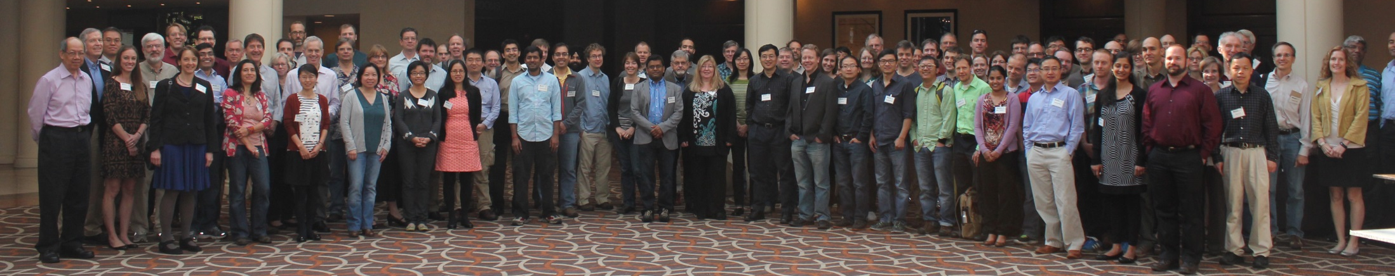
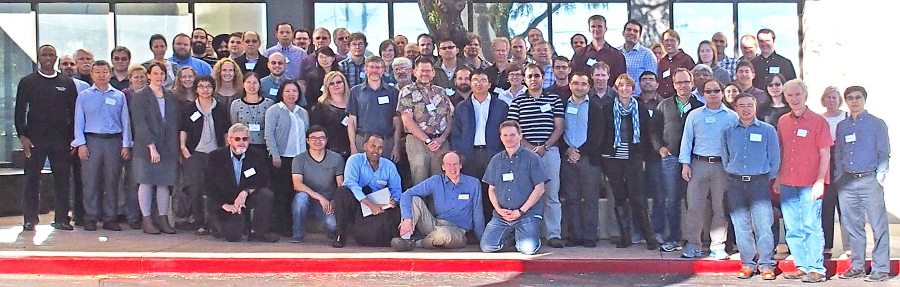
Thanks!
Renata McCoy
Andrew Flatness, DOE
Marie Asher, ORAU

Slide 17
Dorothy.Koch@science.doe.gov
ACME: http://climatemodeling.science.energy.gov/projects/accelerated-climate-modeling-energy
Earth System Modeling:
http://science.energy.gov/ber/research/cesd/earth-system-modeling-program/

