Slide 1

Representing Effects of Complex Terrain on Mountain Meteorology and Hydrology
Steve Ghan, Ruby Leung, Teklu Tesfa, PNNL
Steve Goldhaber, NCAR

Slide 2
Motivation
March snow water equivalent (m)
Most global simulations poorly resolve mountain ranges and watersheds in regions with complex terrain
Simulations at sufficiently fine resolution are too expensive for multi-century simulations
Simulations are highly dependent on horizontal resolution in such regions
River routing is ambiguous for regular grids

Slide 3
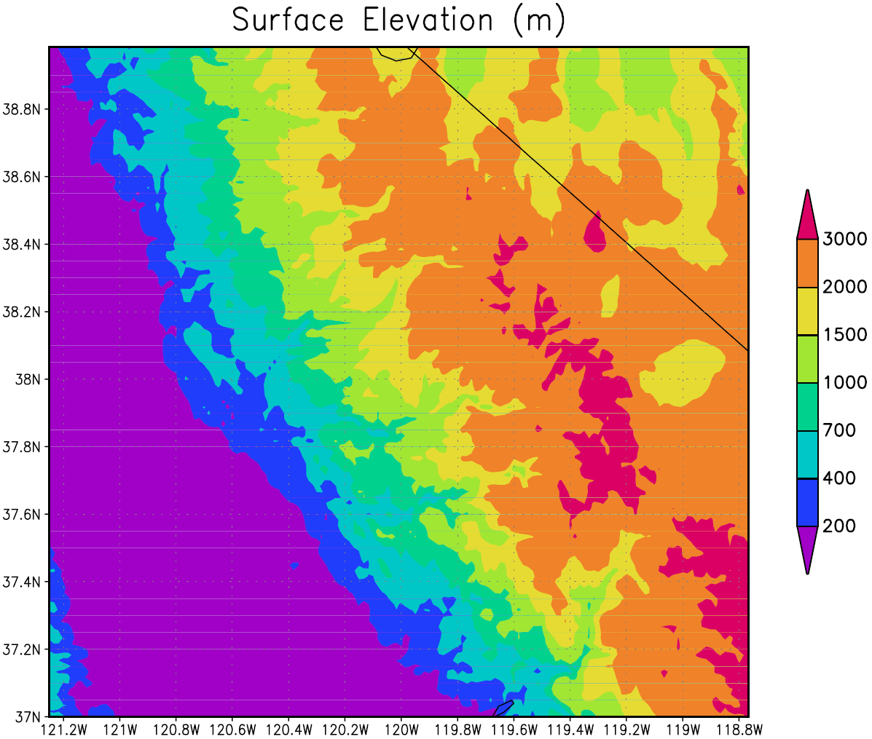
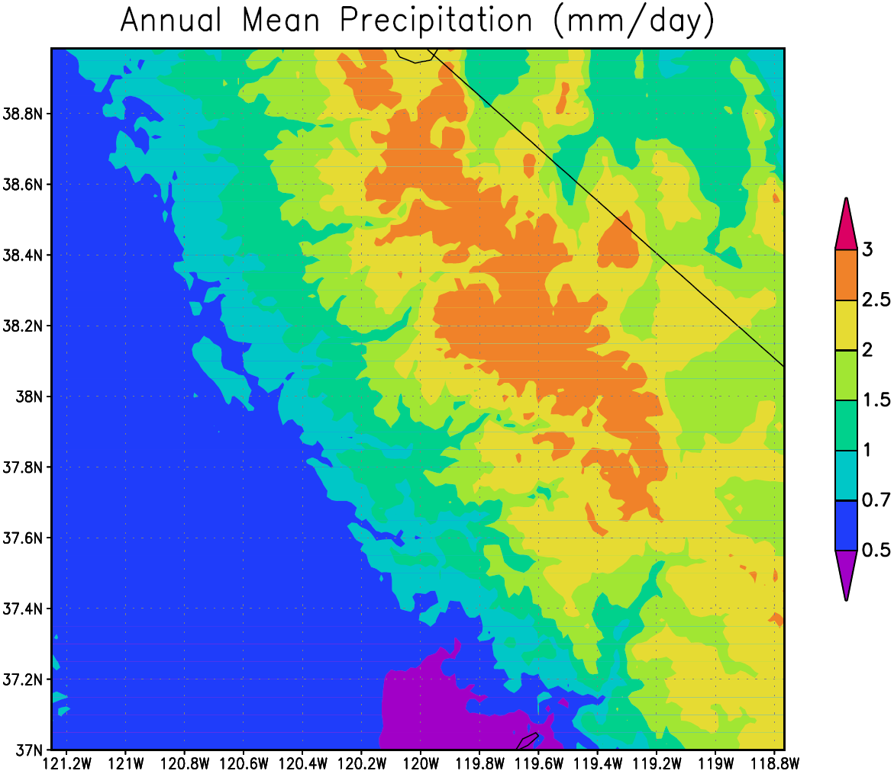
A subgrid orography scheme
Pre
process
online physics
Post process
Leung and Ghan, Mon. Wea. Rev. (1998), Ghan et al. Clim. Dyn. (2002)

Slide 4
A sub-basin representation can improve model scalability
(Tesfa et al. 2014 JGR)
(Tesfa et al. 2014 GMD)
Simulations are less sensitive to model resolution in the sub-basin representation than the grid representation
Spatial structure that takes advantage of the emergent patterns and scaling properties of atmospheric, hydrologic, and vegetation processes may improve model scalability

Slide 5
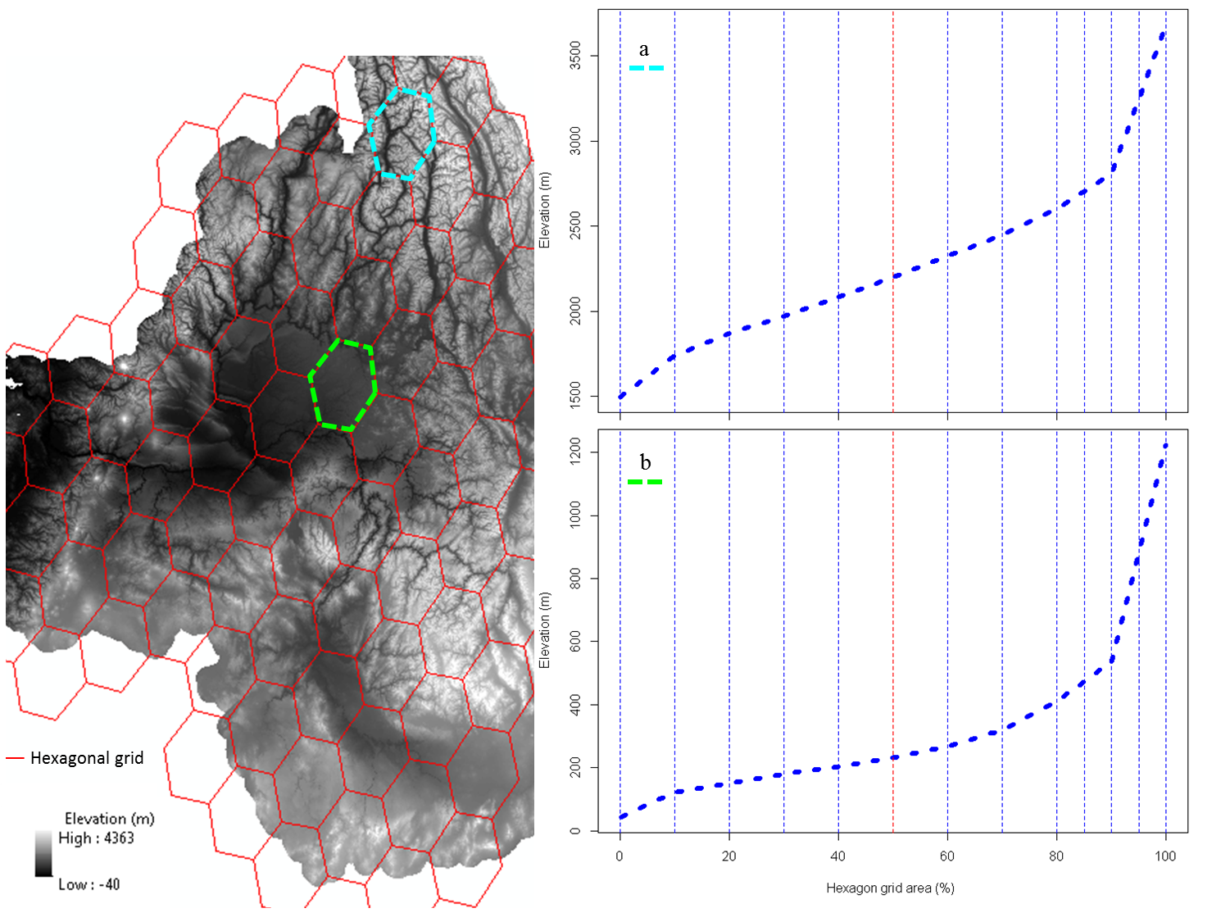
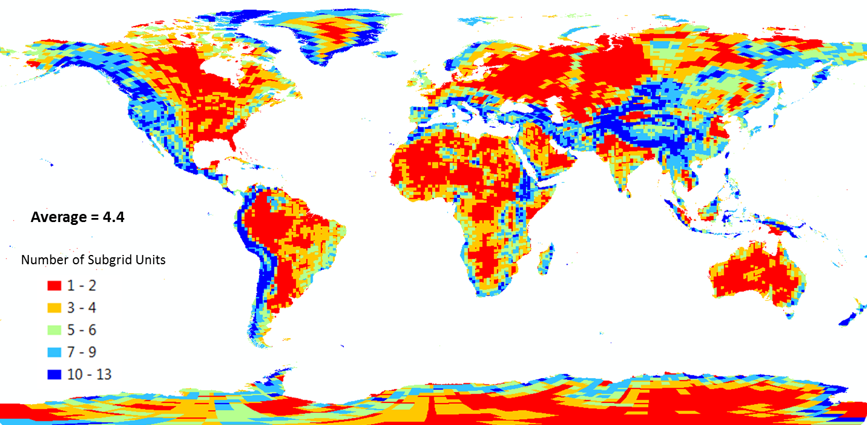
Subgrid topographic landunits
An example of elevation-area profile for a cubed sphere grid
A local elevation classification scheme that discretizes the elevation-area profile into 12 elevation classes using the 10th, 20th, …, 70th, 80th, 85th, 90th, and 95th percentiles
Each grid is discretized into multiple non geo-located subgrid units represented as fractional areas.
Average number of subgrid topographic units for a global 1° grid

Slide 6
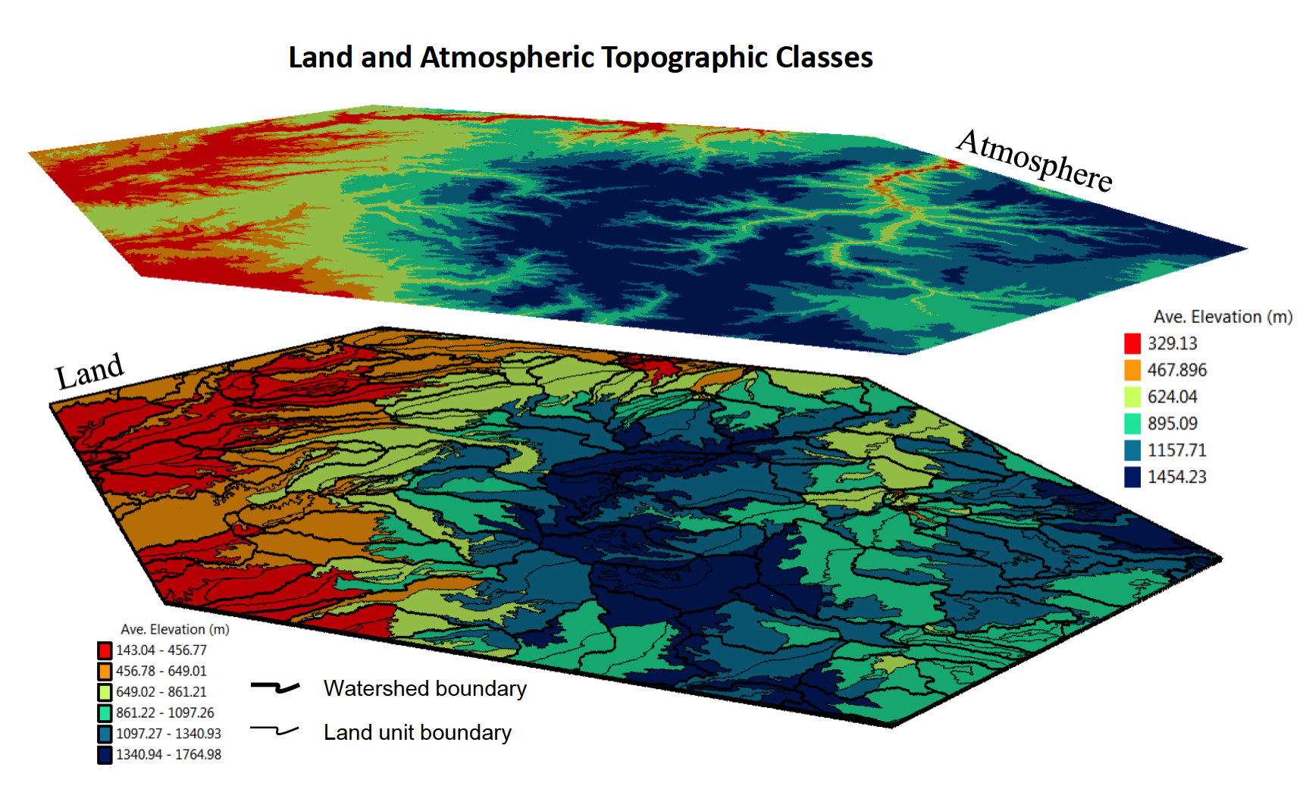




Coupling of atmosphere and land models
Coupling with static topography
Conservative remapping of fluxes
Vertical interpolation and normalization
Coupling with dynamic ice sheet topography
Incorporate glacier columns
Technical challenges: require new coupler functionality for regridding and normalization
Accurate, conservative remapping of fluxes:
For optimal accuracy, fluxes are remapped from the atmosphere to the land in two steps. (Mapping from the land to the atmosphere is similar.)
Vertical interpolation. For each elevation class in a land grid cell, estimate the flux by interpolating between fluxes in neighboring atmosphere elevation classes. For example, consider elevation class 1 (h = 600 m) in land cell L1 of Figure 2 below. The overlying atmosphere grid cell has fluxes F = 300 at 300 m and F = 200 at 800 m. By linear interpolation, we obtain F = 240 at h = 600 m. The resulting land fluxes are show in red. Note: The computation is more complex when a land cell (e.g. L2) overlaps more than one atmosphere cell. In this case the interpolated fluxes must be remapped horizontally.
Normalization. Energy is conserved if the mean flux in a given atmosphere cell is equal to the integrated flux in the land cells with which it overlaps. This is not true of the red fluxes. For each atmosphere cell we can compute an additive normalization factor and map this factor back to the land model, resulting in the maroon fluxes that conserve energy exactly.

Slide 7
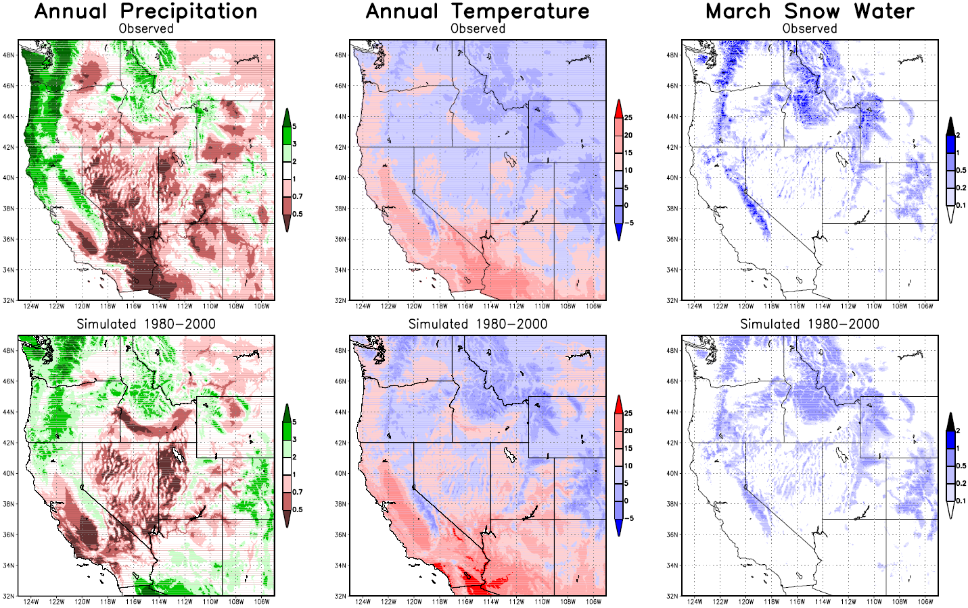
Evaluation for Western U.S.

Slide 8
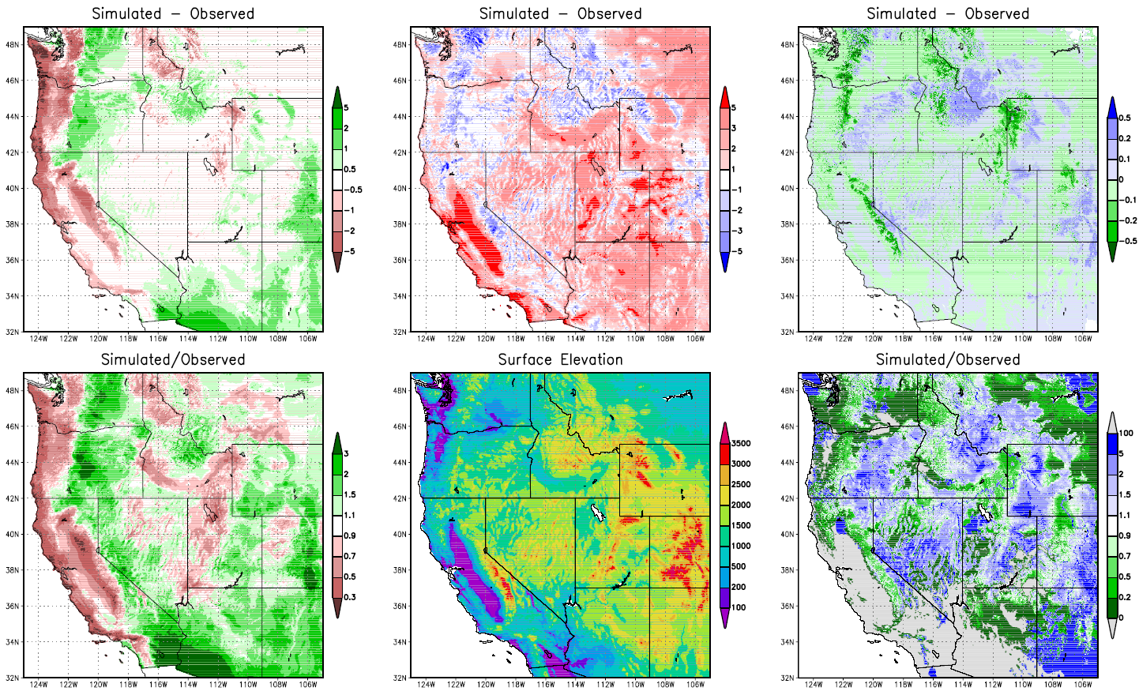
Western U.S. biases

Slide 9
Application to ACME climate model
Start with simple case without watersheds and common grid and elevation classes for land and atmosphere
  One-to-one mapping of land and atmosphere columns
  No need to interpolate when coupling land and atmosphere
  Use Tempest to map fields in post-processing
Introduce watersheds using same elevation classes
  Requires vertical interpolation to mean surface elevation of target elevation class for surrounding columns
  Requires generality in passing information through coupler
  Conservation of mass and energy requires care
For millennial simulations changes in land ice surface elevation must be accounted for

Slide 10
Limitations
Drainage flow is not resolved
The scheme neglects rainshadows
Rainshadows must be either parameterized or resolved explicitly
Parameterizing rainshadows is complicated
Experience suggests a grid size less than 30 km is necessary
Other benefits of high resolution suggest explicit resolution of rainshadows is preferred
Sweet spot of subgrid scheme is grid sizes of 10-30 km

Slide 11
Benefits
Reduced dependence of climate simulation on grid size in regions with complex terrain
Represents important effects of complex terrain at a small fraction of the computational cost and memory of explicitly resolving complex terrain

