Slide 1
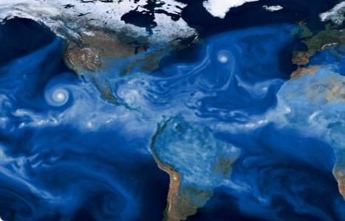

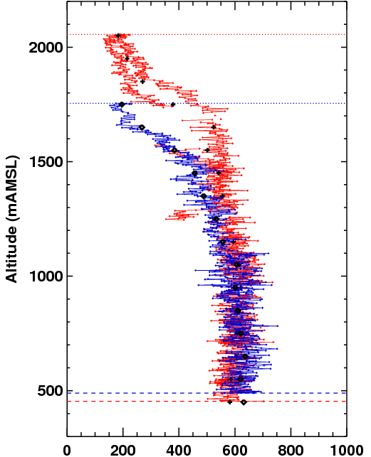
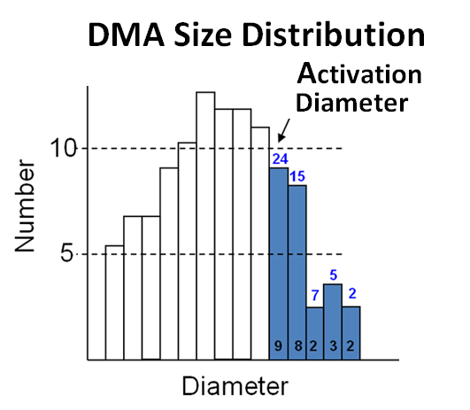
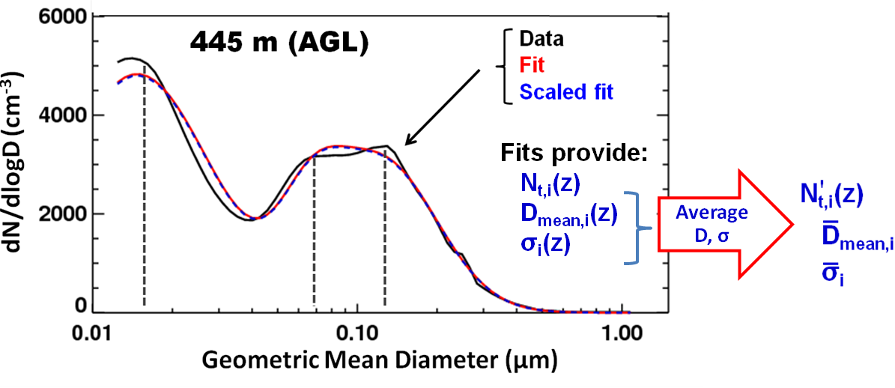
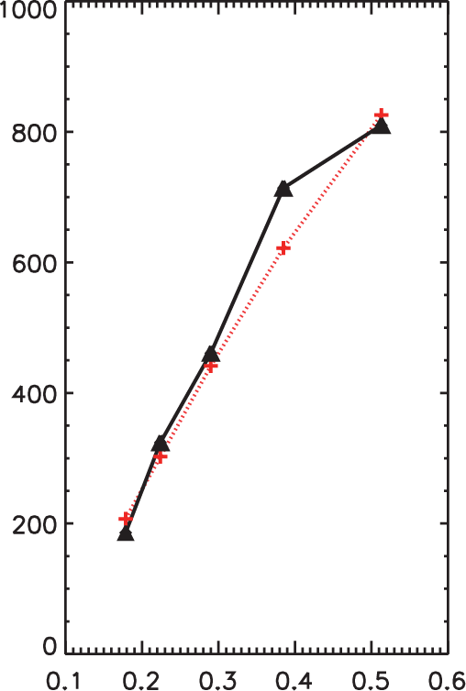
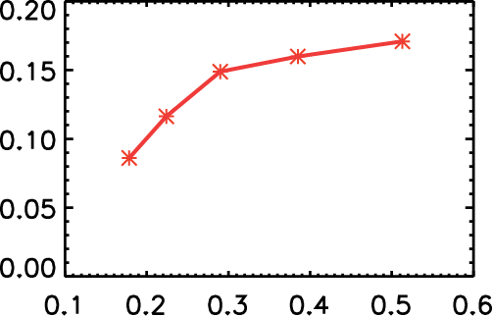
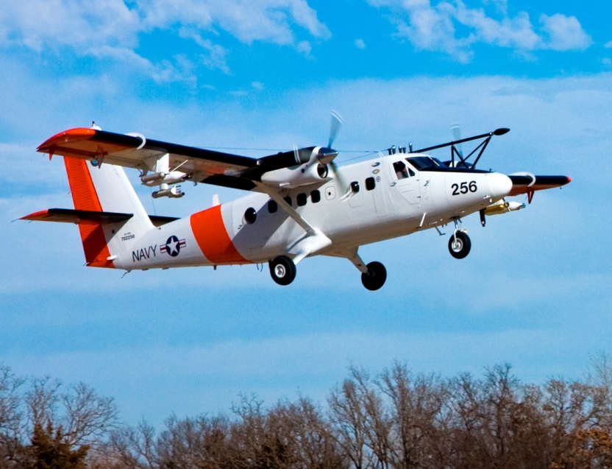
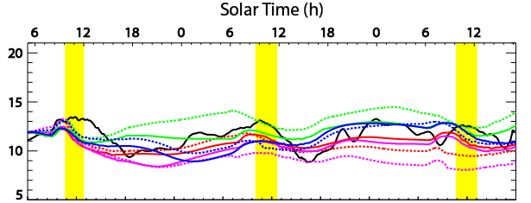
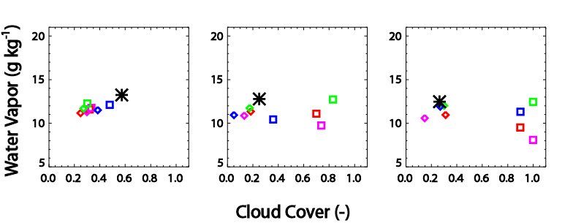
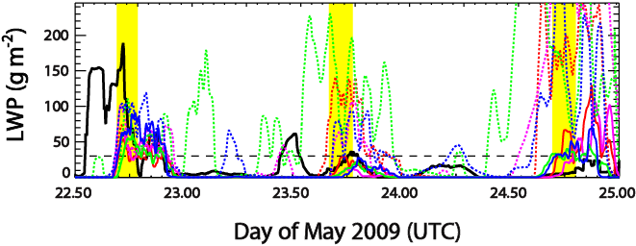
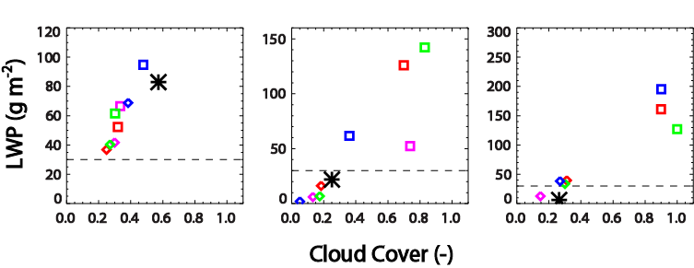
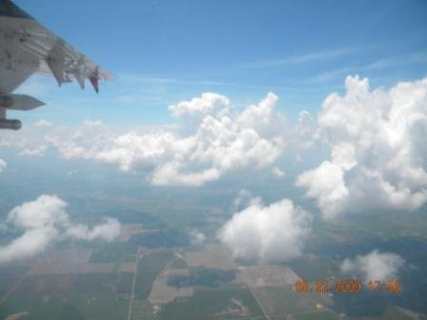
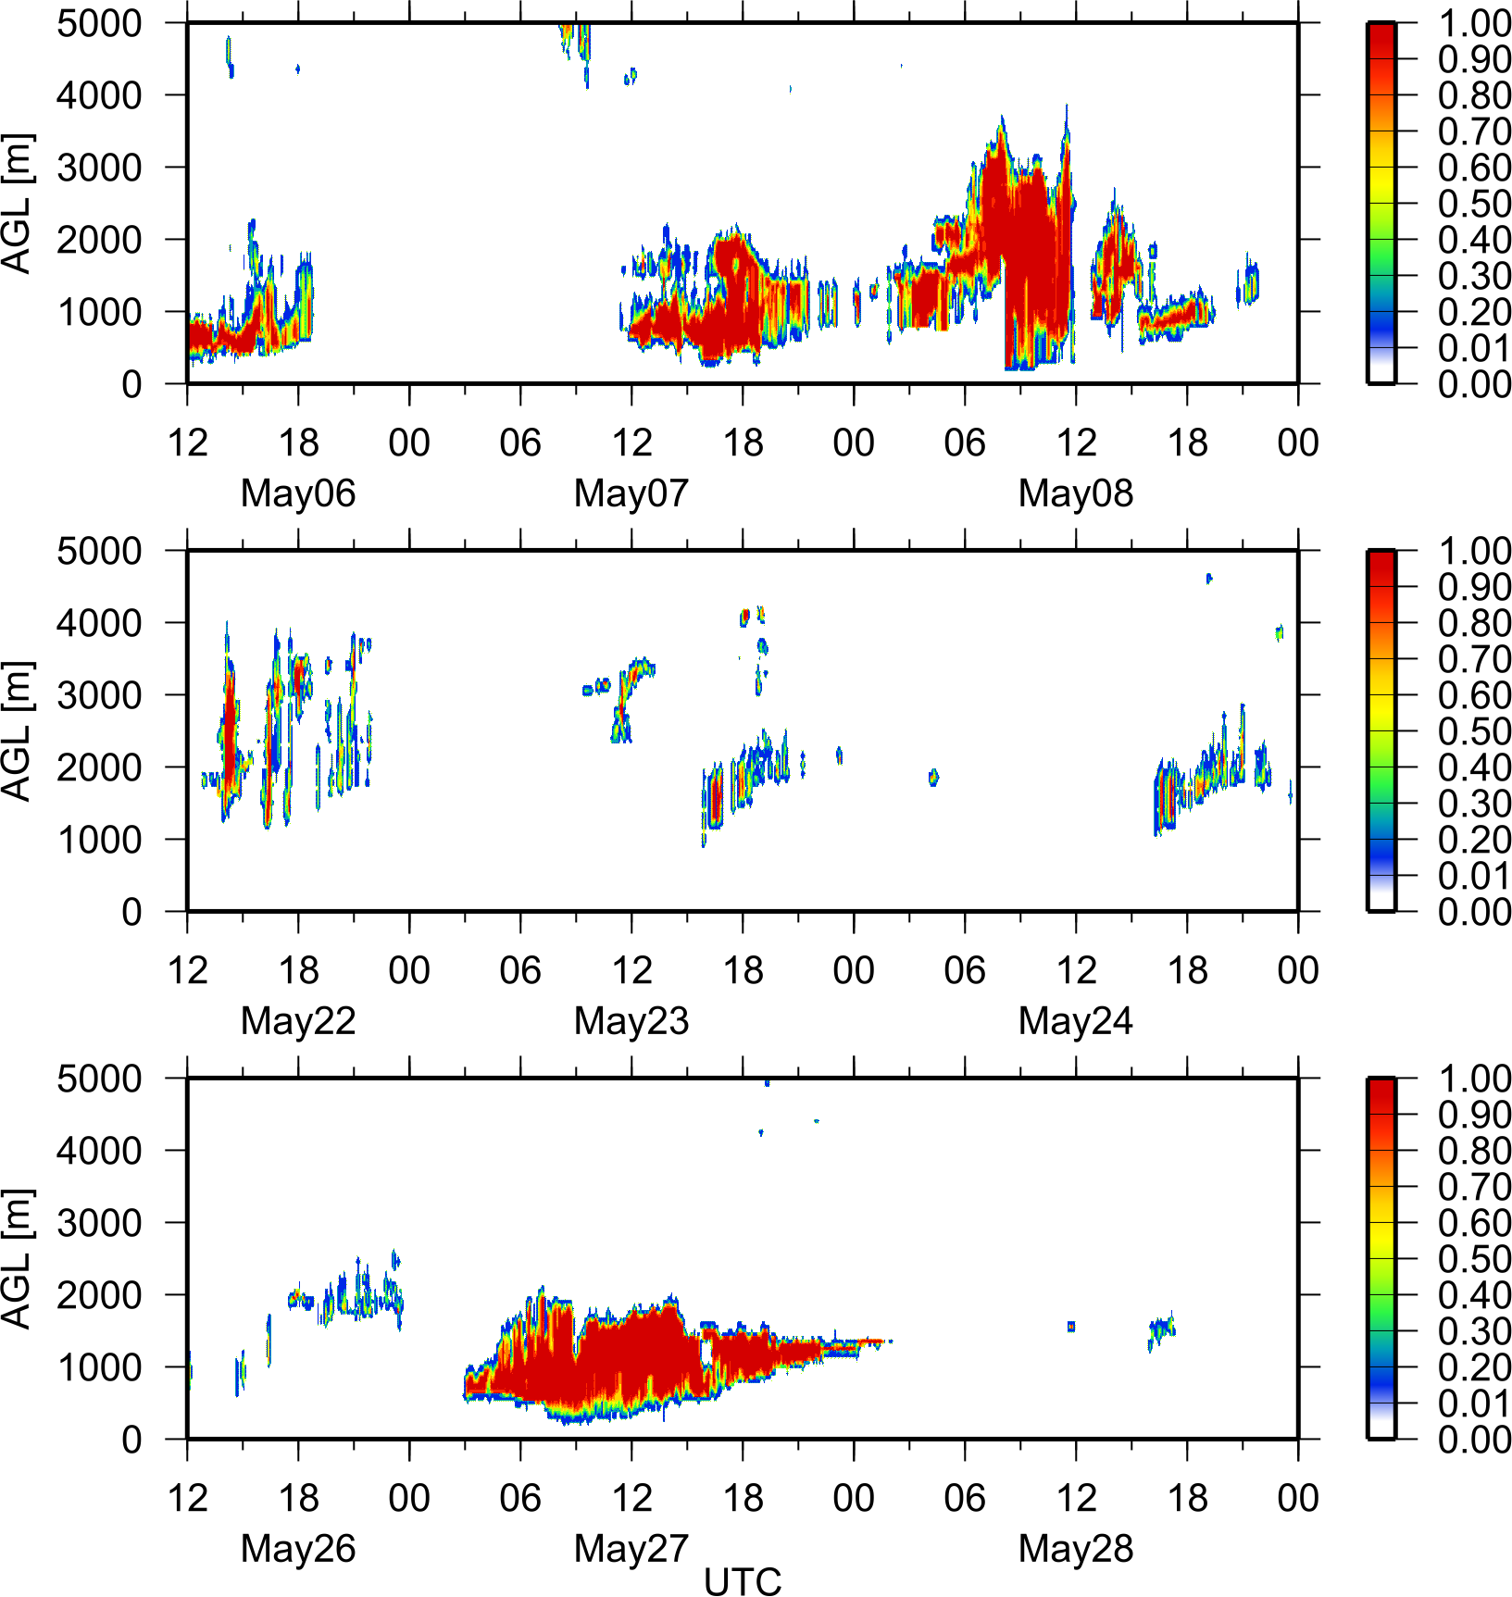
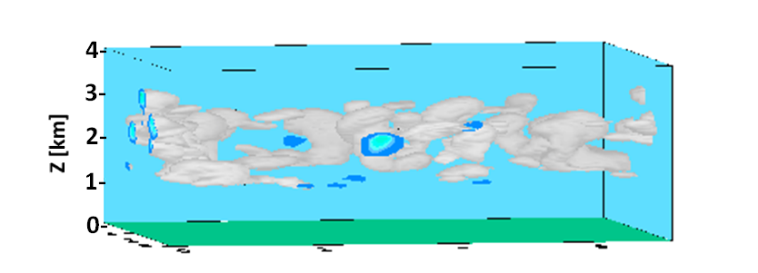
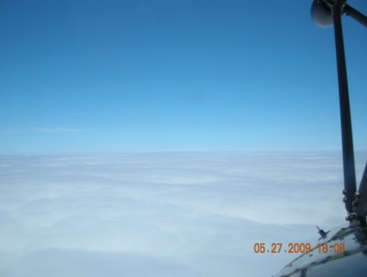
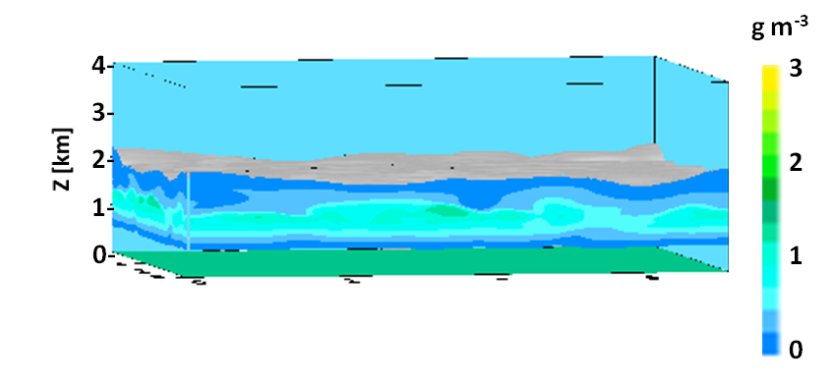
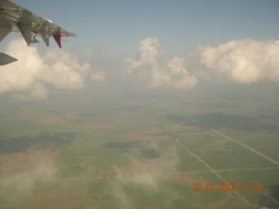
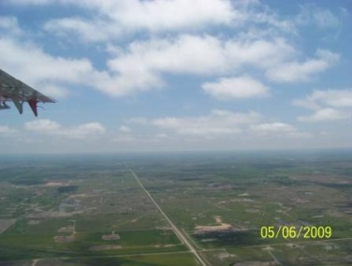
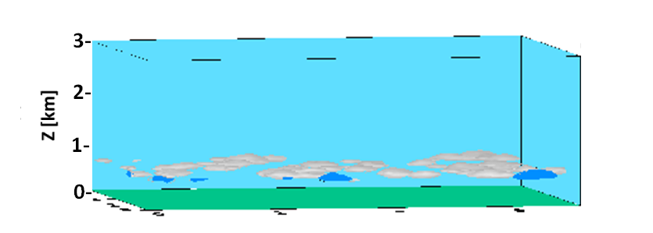
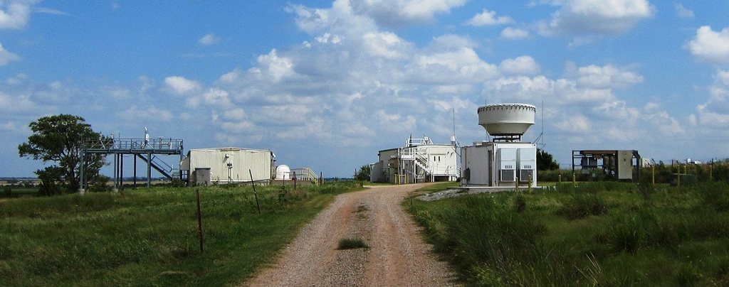
1. RACORO*: Case Study Generation for Continental Boundary Layer Clouds
Andy Vogelmann¹, Ann Fridlind², Tami Toto¹, Satoshi Endo¹, Wuyin Lin¹, Yangang Liu¹, Jian Wang¹, Greg McFarquhar³,
Robert Jackson³, Zhijin Li⁴, Sha Feng⁵, Andrew Ackerman², Minghua Zhang⁶, Shaocheng Xie⁷, and Yunyan Zhang⁷
¹Brookhaven National Laboratory, ²NASA Goddard Institute for Space Studies, ³University of Illinois, Urbana,
⁴Jet Propulsion Laboratory, ⁵UCLA-JIFRESSE, ⁶Stony Brook University, ⁷Lawrence Livermore National Laboratory
*RACORO=Routine Atmospheric Radiation Measurement (ARM) Aerial Facility (AAF) Clouds with Low Optical Water Depths (CLOWD) Optical Radiative Observations
Summary
                Case studies are constructed to assess and improve models of continental boundary layer clouds and their fast-physics processes, as part of the FAst-physics System TEstbed and Research (FASTER) project.
                Cases are a synthesis of data from the RACORO aircraft campaign (Vogelmann et al., 2012) and the ARM SGP site, which were selected to capture diverse physical states:
      Boundary layer cloud types (Cu, St, drizzling St)
      Time variation/transitions (multiple days/timing)
                These cases are a physical contrast to the Global Atmospheric System Studies (GASS, previously GCSS) that primarily focus on steady-state, marine boundary layer clouds.
                We use the FASTER integrated observation-LES-SCM evaluation framework to address the inherent multi-scale nature of the problem.
3. Aerosol Size Distributions and Hygroscopicity
  RACORO aerosol profile observations of CCN (multiple supersaturations) and size distributions
The low kappa values observed (0.05-0.20) suggest a large organic aerosol fraction
Aerosol Hygroscopicity
(Kappa)
Lognormal Size Distribution Fits
Aerosol size distribution profiles available in 3 formats:
  Raw data: Single size distribution from combined SMPS
    and PCASP data per 100-m altitude interval;
  Intermediate format: 3 lognormal modal fits of #1; and
  Simplified profile: Fixed D, σ, variable N_{t}(z)
Modal Kappa Fit
CCN (0.2% SS)
Data
Fit
κ=0.11
CCN
Kappa
Day 26, Spiral 1
Day 26, Spiral 1
1. FASTER Case Study Selection/Development
      Data-model integration takes a team
          1. Observations and initial conditions (This poster)
            Selects multi-day periods with aircraft flights that sampled different cloud types
            Generates aerosol size distributions and hygroscopicity data
            Assesses large-scale forcing datasets
          2. High-resolution modeling (Lead: Ann Fridlind and Satoshi Endo)
            Examines simulated cloud properties for study periods
            See Satoshi Endo’s poster →
          3. Single-Column Model (SCM) diagnostics (Lead: Wuyin Lin)
            Examines SCM biases for low-level clouds
            Examines reason for over triggering in the CAM5 SCM
            See Wuyin Lin’s poster →
CCN (cm⁻³)
Supersaturation
Supersaturation
4. Large-Scale Forcing Datasets
    Large-scale forcings are obtained:
  From the ARM variational analysis (ARM VA) for a standard domain (300 km, 25 mb) & reduced domain (150 km, 10 mb)
  Derived from ECMWF for a standard domain (300 km) and a reduced domain (150 km), both with 3-25 mb vertical resolution
  Derived from a Multi-Scale Data Assimilation (MS-DA) System (300 km, 25 mb)
    Forcings assessed using “Toy” LES runs and bulk observations (in progress)
Observation-LES-SCM Approach
Time Series Over Domain
Flight period
Averages Over Flight Periods
May 22 May 23 May 24
NASA GISS DHARMA Toy Simulations
3.6 km Domain
70-75 m Resolution
~1/7 Time of full run
Relaxation times
3 h winds
12 h thermodynamics
­ ­ Without relaxation
— With relaxation
Observations
Raman lidar WV
MWRRet LWP
TSI cloud cover
Forcings
ECMWF
MS-DA
ARM VA standard
ARM VA reduced
□ W/out relaxation
◊ With relaxation
  2. Three 3-day Case Study Periods Selected
  Case 1: Cumulus with Variable Aerosol (May 22-24)
  Case 2: Cumulus and Drizzling Stratus (May 26-28)
  Case 3: Variable Cloud Types (May 6-8)
The Plan:
  Generate integrated, realistic cases for FASTER, ASR and broader communities
  Later, simplify to observationally constrained “idealized/hybrid” cases (for ease of use)
LWP (g m⁻²) Water Vapor (g kg⁻¹)
Boxes indicate flight times
Liquid water content field in DHARMA
Acknowledgements & References
Contact: Andy Vogelmann, vogelmann@bnl.gov, 631-344-4421
We acknowledge the constructive and engaging discussions with FASTER Team Members, particularly Leo Donner,
  Marat Khairoutdinov, and Wei Zhang. We thank the RACORO team for their diligent work on the campaign.
This research was supported by the U.S. DOE's Earth System Modeling Program via the FASTER Project and
by the Atmospheric Science Program Atmospheric System Research Program.
For more information on RACORO:
  RACORO ACRF Website: http://acrf-campaign.arm.gov/racoro/
  Vogelmann, A. M., 2012: RACORO Data Guide Version 2: http://www.arm.gov/publications/programdocs/doe-sc-arm-10-031.pdf?id=13
  Vogelmann, A. M., G. M. McFarquhar, J. A. Ogren, D. D. Turner, J. M. Comstock, G. Feingold, C. N. Long, and 19 co-authors, 2012: RACORO Extended-Term, Aircraft Observations of Boundary Layer Clouds, BAMS, 93, 861–878.
Papers in preparation/submitted:
    Endo, S. et al., RACORO-FASTER Large Eddy Simulations of Continental Boundary Layer Cumulus Clouds (JGR, in prep)
    Lin, W. et al., RACORO-FASTER Single-column model simulations and parameterization improvement in the SCAM5 (JGR, in prep)
    Vogelmann, A. M. et al., RACORO-FASTER Case Studies of Continental Boundary Layer Clouds (JGR, in prep)
    Development and Analysis of Large-Scale Forcing Using a Multi-Scale Data Assimilation System.
      Part I: Methodology and Evaluations (Li, Z. et al., JGR, submitted)
      Part II: Scale-Aware Forcing and Single-Column Model Experiments (Feng, S. et al., JGR, in prep)
      Part III: Hydrometeor Forcing and Single-Column Model Experiments (Feng, S. et al., JGR, in prep)
ARSCL Cloud Field
UTC

