Slide 1
Evapotranspiration and Drought Changes: Some Key Issues
Aiguo Dai
Dept. of Atmospheric & Environ. Sci., SUNY, Albany, NY, USA
AGU Fall Meeting, Session H34D: Evapotranspiration, Evaporative Demand and Droughts
San Francisco, 12/16, 2015
Acknowledgements:
Collaborator: T. Zaho of Institute of Atmospheric Physics, Chinese Academy of Sciences
Zhao, T., and A. Dai, 2015: The magnitude and causes of global drought changes in the 21st century under a low-moderate emissions scenario. J. Climate, 28: 4490–4512.
The author acknowledges the funding support from NSF, DOE and NOAA.

Slide 2
Some Key Issues
1. What is the expected response for ET and drought to GHG forcing?
2. What has happened during the recent decades for ET and drought?
3. What caused the historical ET and drought changes? (skipped)
4. What are the model projected changes for the ET and drought in the 21st century?
ET here refers to both the actual and potential evapotranspiration
Notes:
ET here is for both actual ET and potential ET. 1 and 4 are related.

Slide 3
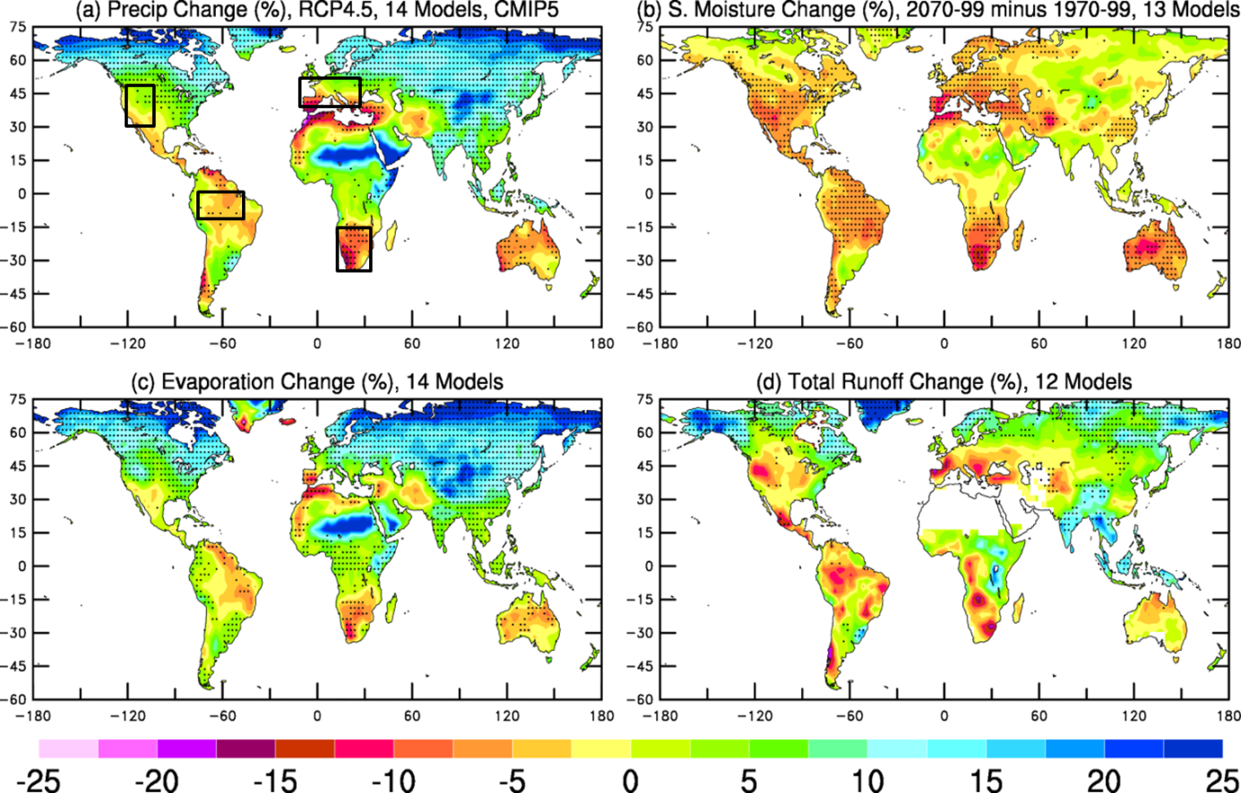
1. Expected Response to GHG Forcing
Actual ET follows precipitation change:
ΔP represents
meteorological drought
change pattern!
ΔP
2070-2099 minus 1970-1999
RCP4.5, 14 CMIP5 models
Stippling: >80% of the models
agree on the sign of change
ΔET
Zhao & Dai (2015)

Slide 4
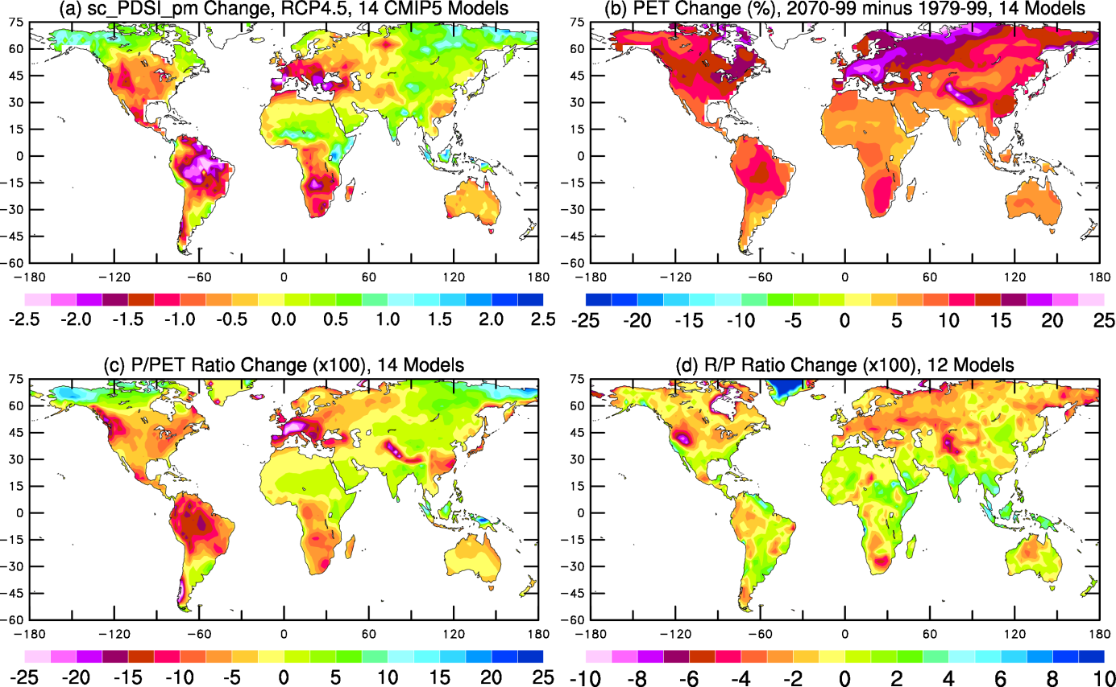
1. Expected Response to GHG Forcing
Potential ET increases everywhere:
2070-2099 minus 1970-1999
RCP4.5, 14 CMIP5 models
PET using Penman-Monteith Eq.
ΔPET
Zhao & Dai (2015)

Slide 5
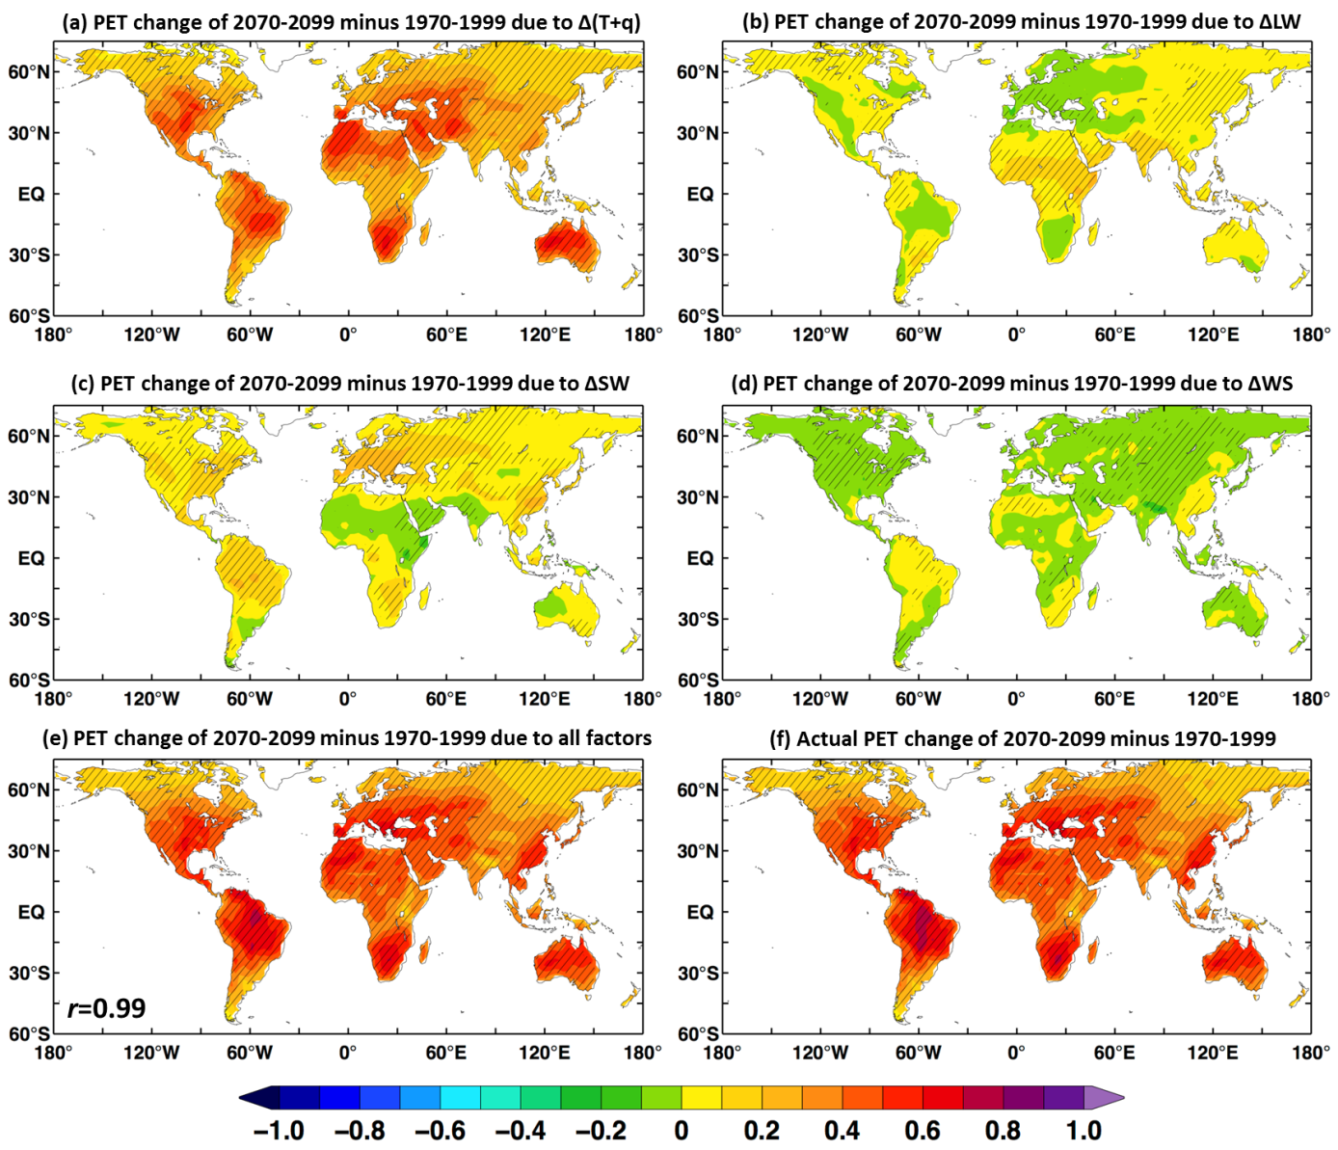
1. Expected Response to GHG Forcing
PET increases because of increased vapor deficits
Due to
Δ(T+q)
Due to
ΔLW
2070-2099 minus 1970-1999
RCP4.5, 14 CMIP5 models
PET using Penman-Monteith Eq.
Due to
ΔSW
Due to
ΔV
Hatching: >80% of the models
agree on the sign of change
Sum of
All factors
ΔPET
mm/day
Zhao & Dai (2015)

Slide 6
1. Expected Response to GHG Forcing
Agricultural & hydrological droughts:
Different from ΔP
Soil
Moisture
2070-2099 minus 1970-1999
RCP4.5, 13 CMIP5 models
Stippling: >80% of the models
agree on the sign of change
Runoff
Follows ΔP
Zhao & Dai (2015)

Slide 7
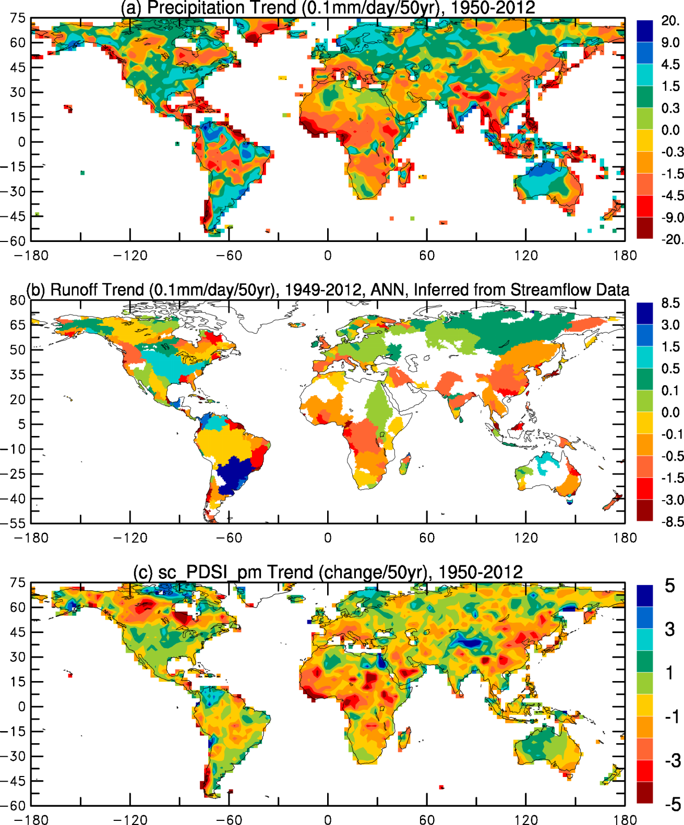
2. Historical Changes
P, R and PDSI show consistent drying patterns during 1950-2012
ΔP
Independent Obs.
ΔR
ΔPDSI
Dai & Zhao (2015)

Slide 8
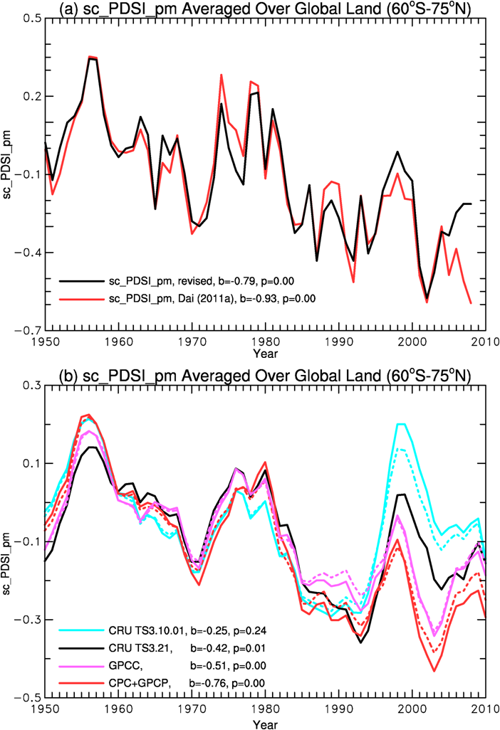
2. Historical Changes
Global drought trend is weaker when CRU precipitation is used:
Dai & Zhao (2015)

Slide 9
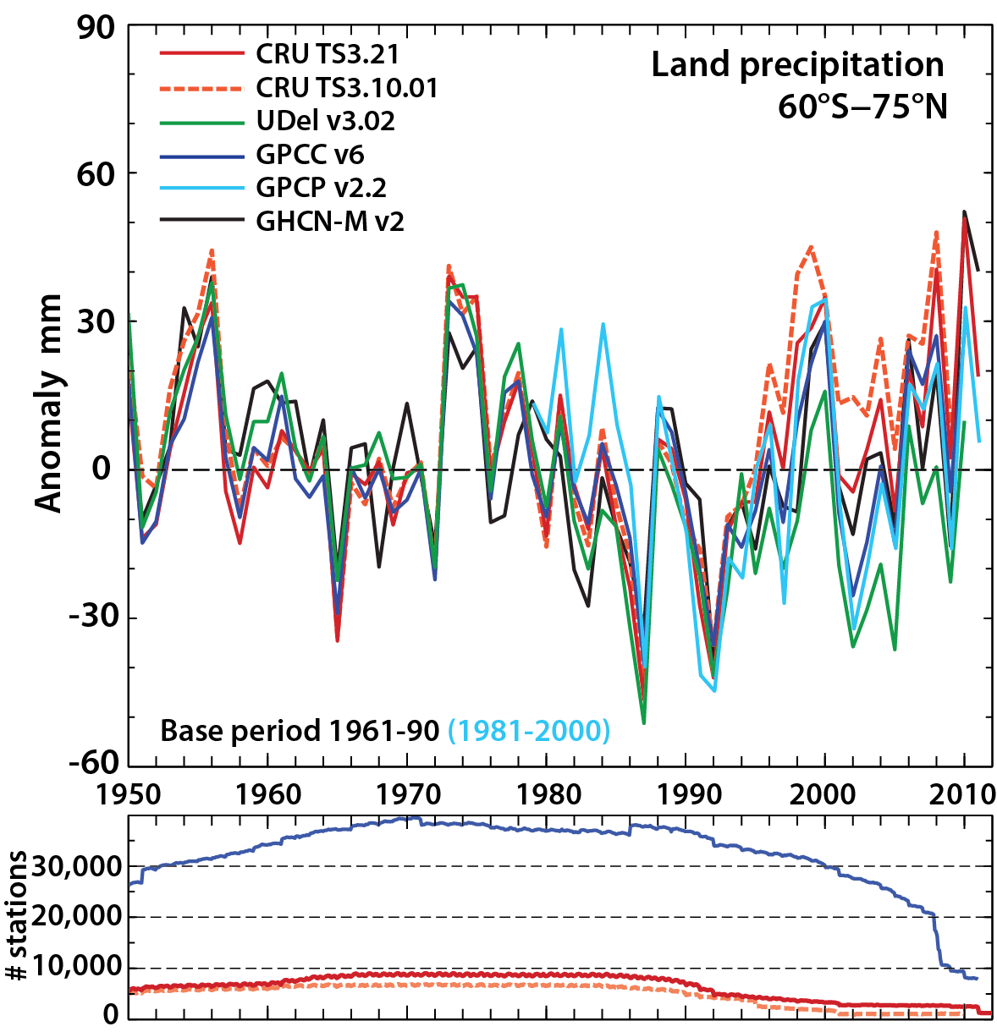
2. Historical Changes
CRU precipitation data have a wet bias since the1990s:
GPCC
The bias is due
to too few stations
CRU TS3.21
Trenberth et al. (2014)
CRU TS3.10.01

Slide 10
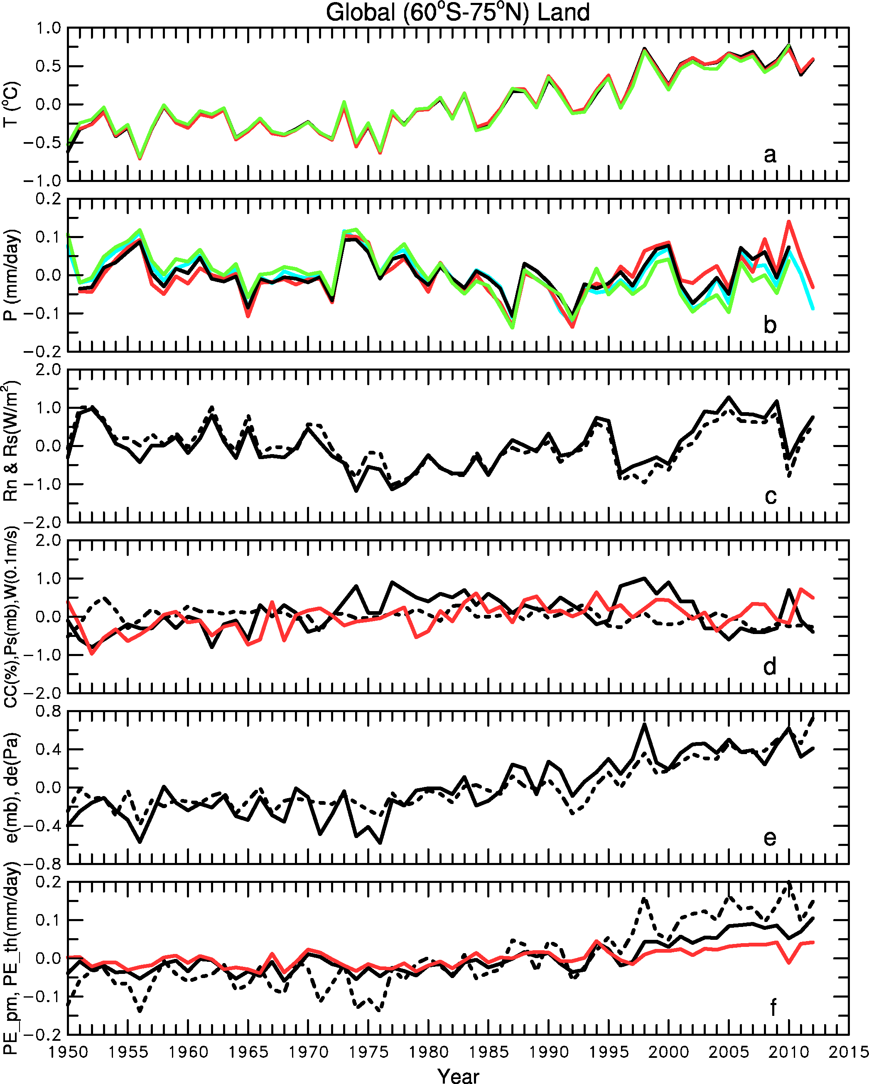
2. Historical Changes
PET increases because of rising vapor deficit:
Based on CRU TS3.21
Surface vapor pressure
Surface vapor deficit
PET_th
PET_pm
with fixed T & e
PET_pm
Dai & Zhao (2015)
Notes:
Figure S3. Globally (60ºS-75ºN) averaged annual time series of the meteorological forcing data over land used in this study: (a) surface air temperature (three lines overlap each other: black=CRUTEM4, red=CRU TS3.21, green=Univ. of Delaware T), (b) precipitation (black=GPCC V6, red=CRU TS3.21, green=WilP, blue=DaiP), (c) surface net radiation (solid) and surface net solar radiation (dashed, based on CRU cloudiness and CLM albedo), both positive downward, (d) cloud cover (black solid, from CRU TS3.21), surface air pressure (black dashed, from 20CR) and wind speed (red, from 20CR), (e) surface air vapor pressure (solid, from CRU TS3.31) and vapor pressure deficit (dashed), and (f) calculated PET_pm (black solid), PET_th (black dashed, i.e., PET from the Thornthwaite eq. see Dai 2011a), and the PET_pm with constant T and vapor pressure.

Slide 11
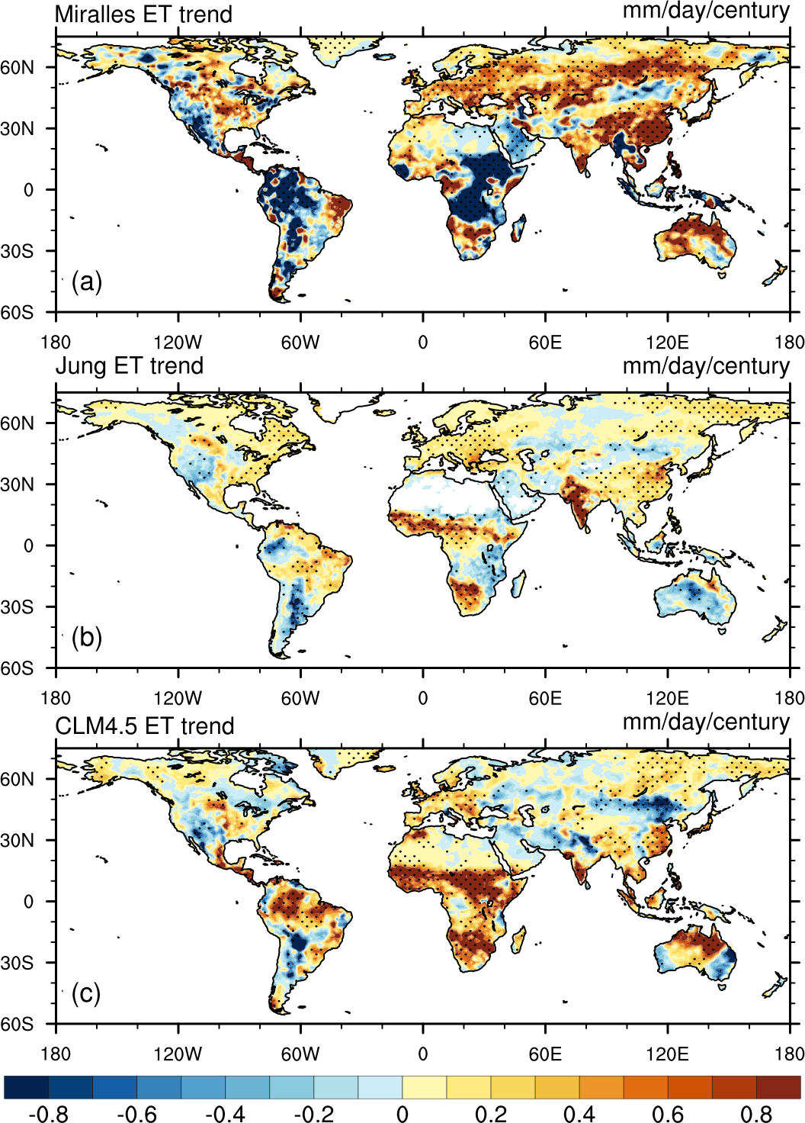
2. Historical Changes
Actual ET trends are uncertain during 1982-2010:
1982-2010
Dong & Dai (2015)
Notes:
Figure S3. Globally (60ºS-75ºN) averaged annual time series of the meteorological forcing data over land used in this study: (a) surface air temperature (three lines overlap each other: black=CRUTEM4, red=CRU TS3.21, green=Univ. of Delaware T), (b) precipitation (black=GPCC V6, red=CRU TS3.21, green=WilP, blue=DaiP), (c) surface net radiation (solid) and surface net solar radiation (dashed, based on CRU cloudiness and CLM albedo), both positive downward, (d) cloud cover (black solid, from CRU TS3.21), surface air pressure (black dashed, from 20CR) and wind speed (red, from 20CR), (e) surface air vapor pressure (solid, from CRU TS3.31) and vapor pressure deficit (dashed), and (f) calculated PET_pm (black solid), PET_th (black dashed, i.e., PET from the Thornthwaite eq. see Dai 2011a), and the PET_pm with constant T and vapor pressure.

Slide 12
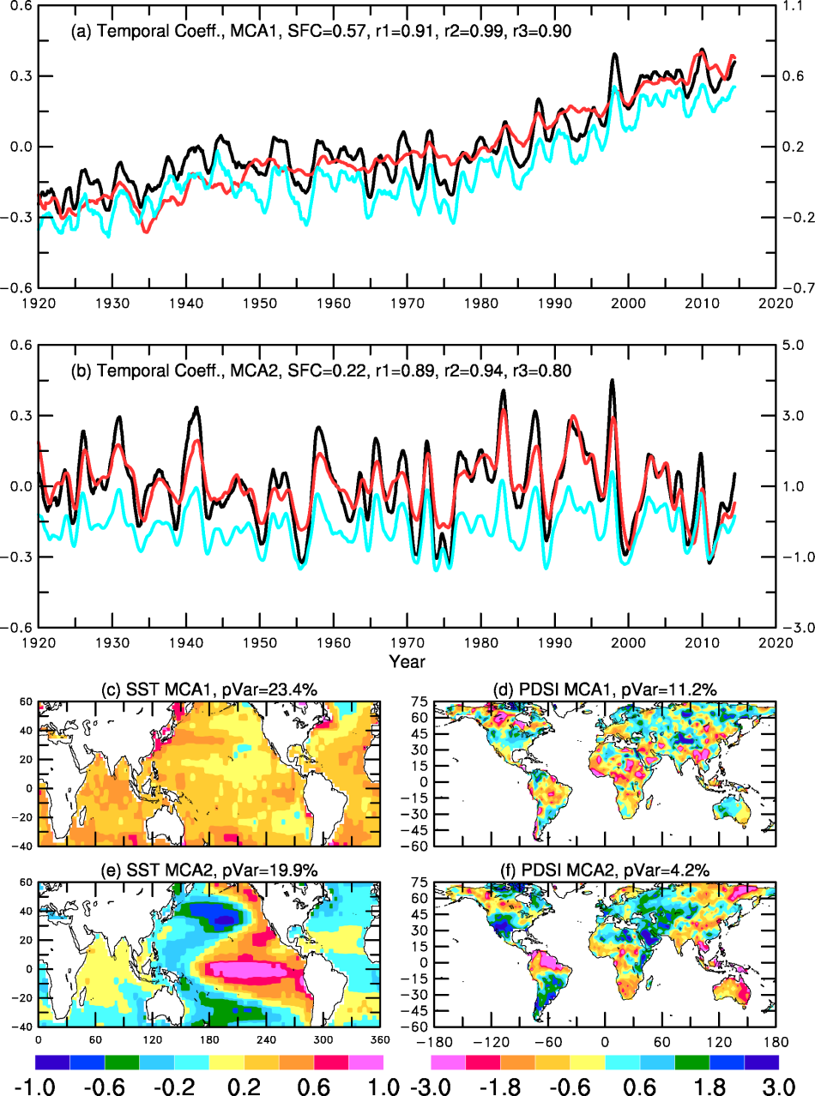
3. Causes of Historical Changes
Maximum Covariance Analysis
of SST and PDSI:
SST PC1
PDSI PC1
Global warming signal is evident in global PDSI
global T
PDSI PC2
SST PC2
But ENSO and PDO/IPO
are also a major factor
Nino3.4
This also applies to ET
Spatial patterns of
Leading modes
Dai & Zhao (2015)
Notes:
Figure 4. Temporal (a-b, black for SST, red for sc_PDSI_pm) and spatial (c-f) patterns of the two leading modes from a maximum covariance analysis (MCA, Bretherton et al. 1992) of the observed SST (from HadSST3, Rayner et al. 2006) and the DaiP-based sc_PDSI_pm. Panels (a), (c) and (d) are for the first MCA mode (MCA1); and panels (b), (e) and (f) are for the second MCA mode (MCA2). Thirteen-point moving-averaged monthly data were used in the analysis. The blue line in (a) is the global-mean surface temperature obtained from the Climate Research Unit (CRU, http://www.cru.uea.ac.uk/cru/data/temperature/HadCRUT4-gl.dat), and the blue line in (b) is the observed Niño3.4 SST index (right-side ordinate) obtained from http://www.esrl.noaa.gov/psd/forecasts/sstlim/Globalsst.html (for 1950–2010) and from http://www.cgd.ucar.edu/ cas/catalog/climind/TNI_N34/index.html#Sec5 (for pre-1950 years, rescaled to match the NOAA index over the 1950–2007 period). In (a-b), SFC is the squared fractional covariance explained by the MCA mode and the r1, r2, and r3 are the correlation coefficients between, respectively, the black and red, black and blue, red and blue lines. pVar is the percentage variance explained by the MCA mode in (c–f). The corresponding MCA modes depict the statistically associated temporal and spatial patterns in the SST and sc_PDSI_pm fields. The product of the temporal and spatial coefficients at a given location is the SST or sc_PDSI_pm anomaly represented by the MCA mode.

Slide 13
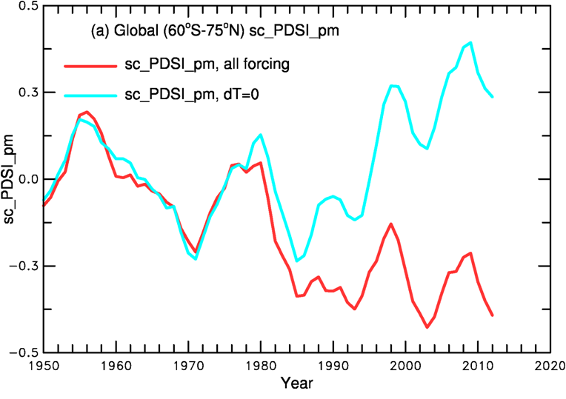
3. Causes of Historical Changes
Recent warming has enhanced the drying
PDSI without warming
PDSI with warming

Slide 14
4. Future Projections
Large drying in Americas, Europe, most Africa and Australia
ΔPDSI
ΔPET
Δ(P/PET)
Δ(R/P)
2070-2099 minus 1970-1999
RCP4.5, 14 CMIP5 models
Zhao & Dai (2015)
Notes:
Figure 4. Temporal (a-b, black for SST, red for sc_PDSI_pm) and spatial (c-f) patterns of the two leading modes from a maximum covariance analysis (MCA, Bretherton et al. 1992) of the observed SST (from HadSST3, Rayner et al. 2006) and the DaiP-based sc_PDSI_pm. Panels (a), (c) and (d) are for the first MCA mode (MCA1); and panels (b), (e) and (f) are for the second MCA mode (MCA2). Thirteen-point moving-averaged monthly data were used in the analysis. The blue line in (a) is the global-mean surface temperature obtained from the Climate Research Unit (CRU, http://www.cru.uea.ac.uk/cru/data/temperature/HadCRUT4-gl.dat), and the blue line in (b) is the observed Niño3.4 SST index (right-side ordinate) obtained from http://www.esrl.noaa.gov/psd/forecasts/sstlim/Globalsst.html (for 1950–2010) and from http://www.cgd.ucar.edu/ cas/catalog/climind/TNI_N34/index.html#Sec5 (for pre-1950 years, rescaled to match the NOAA index over the 1950–2007 period). In (a-b), SFC is the squared fractional covariance explained by the MCA mode and the r1, r2, and r3 are the correlation coefficients between, respectively, the black and red, black and blue, red and blue lines. pVar is the percentage variance explained by the MCA mode in (c–f). The corresponding MCA modes depict the statistically associated temporal and spatial patterns in the SST and sc_PDSI_pm fields. The product of the temporal and spatial coefficients at a given location is the SST or sc_PDSI_pm anomaly represented by the MCA mode.

Slide 15
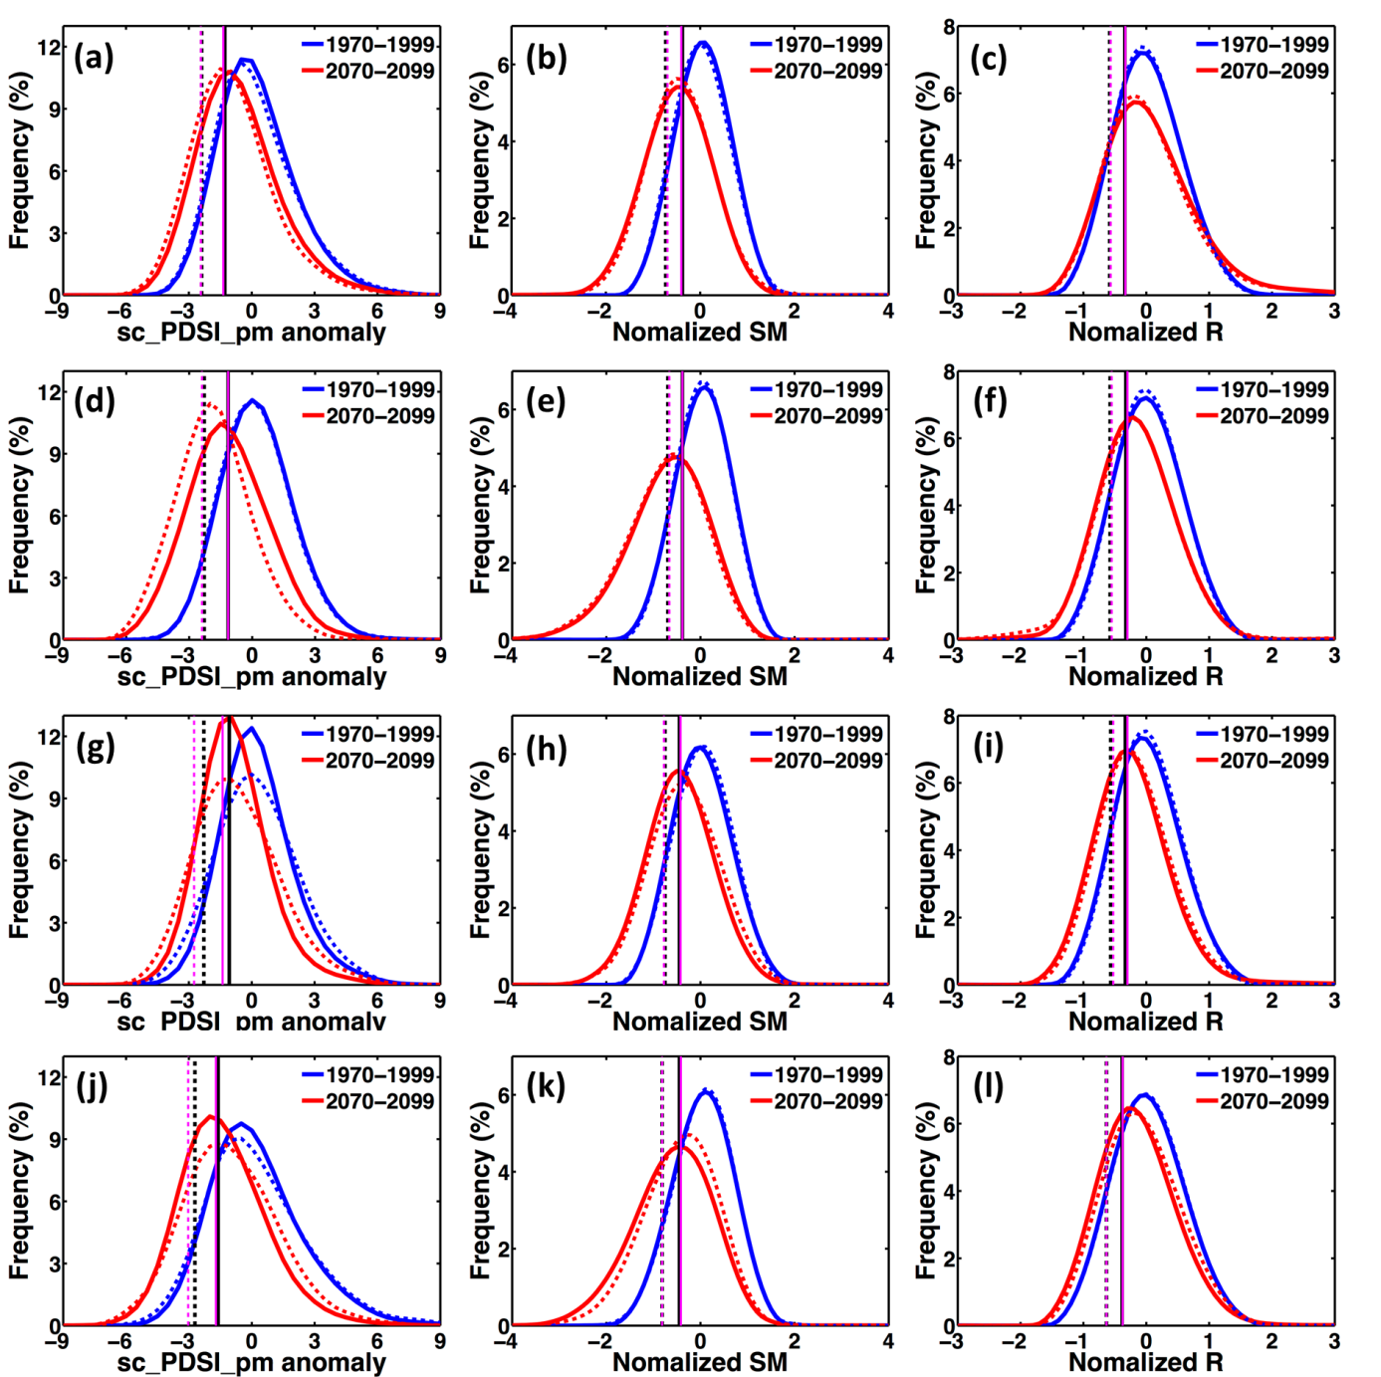
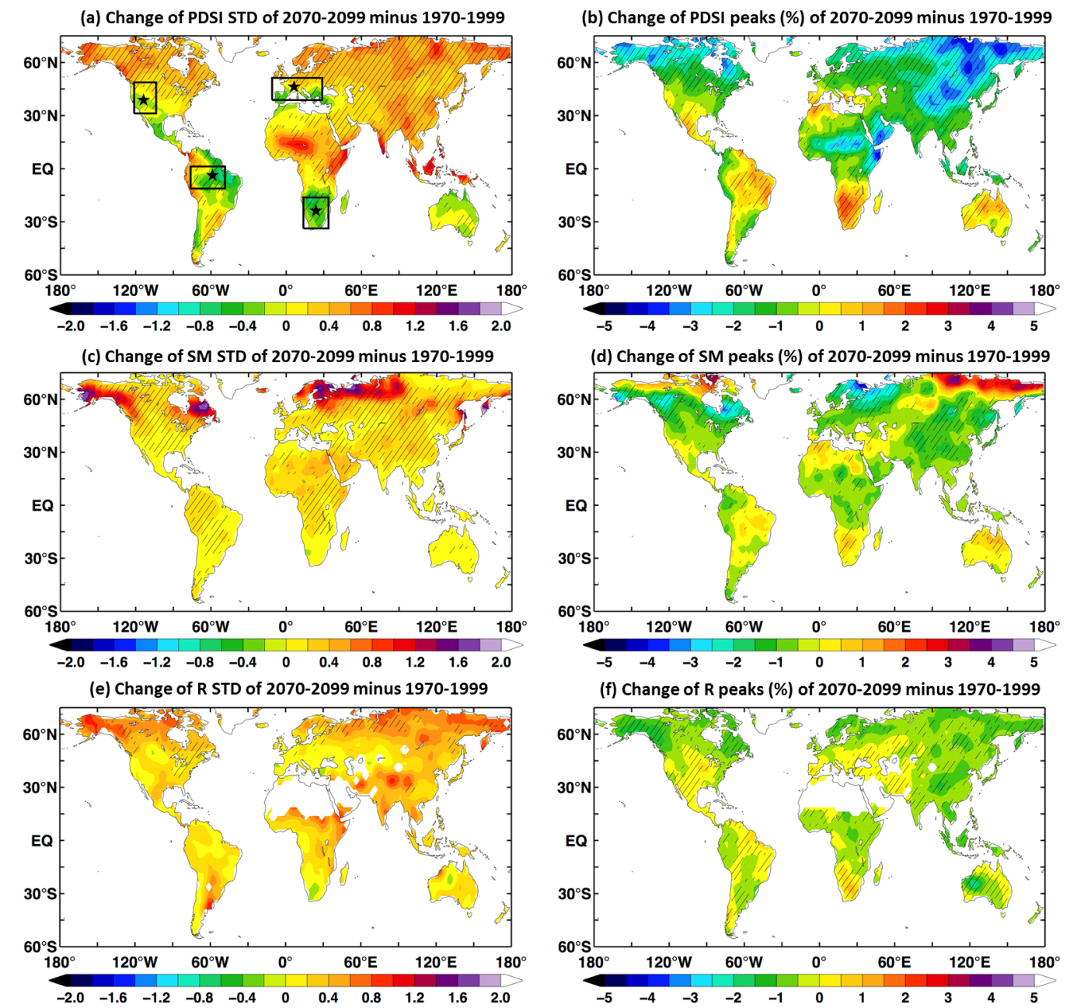
4. Future Projections
The drying results from 1) shift in the mean and 2) PDF flattening
PDFs for the West U.S.
Soil
Moisture
PDSI
Runoff
ΔSD
ΔPeak
Soil Moisture
Soil Moisture
2070-2099 minus 1970-1999
RCP4.5, 14 CMIP5 models
Zhao & Dai (2015)
Notes:
The vertical blue dashed and solid lines are, respectively, the 10th and 20th percentiles of the blue solid curve (i.e., for current all months), while the vertical red dashed and solid lines are the 10th and 20th percentiles of the blue dashed curve (i.e., for current warm season).

Slide 16
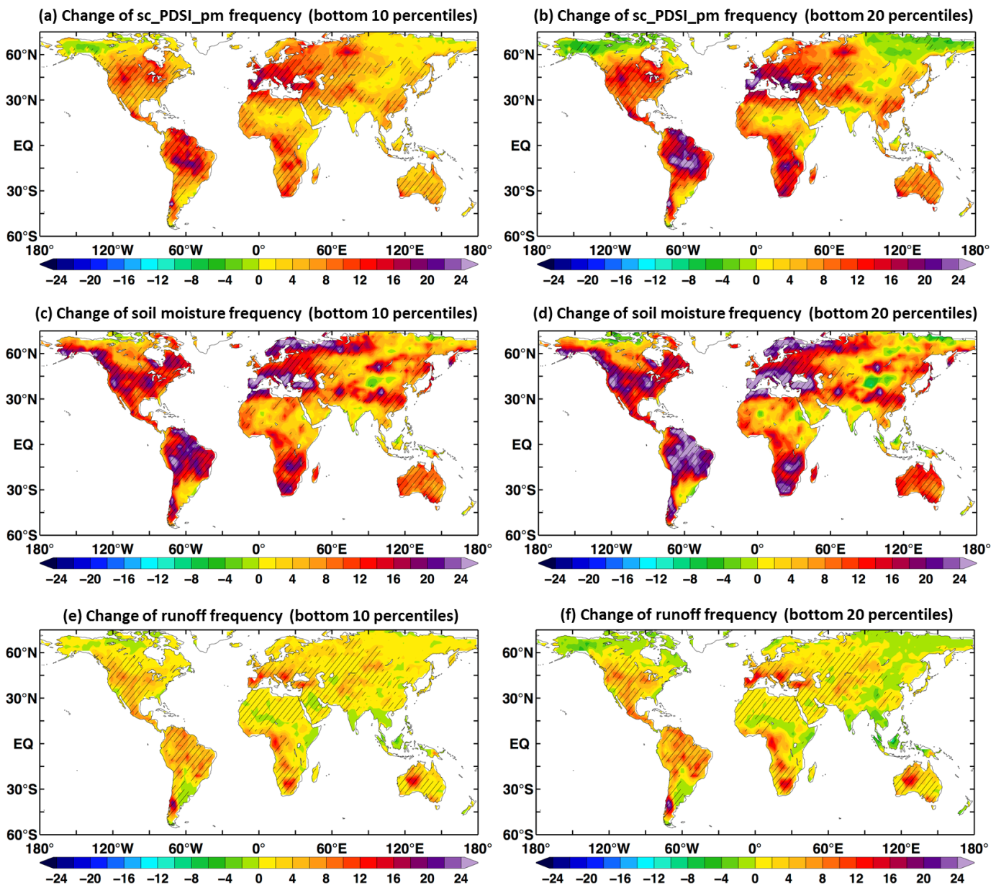
4. Future Projections
Severe-drought frequency could double by the end of 21st century
Based on
PDSI
2070-2099 minus 1970-1999
RCP4.5, 14 CMIP5 models
Based on
S. Moisture
Based on
Runoff
Zhao & Dai (2015)

Slide 17
Summary
Response to GHG forcing:
- ET follows P change (increases over most land except subtropical areas)
- PET increases everywhere due to increased vapor deficit
- S. moisture decreases over most land
- Runoff largely follows P change
- Aridity increases over most land (as measured by P/PET)
Historical changes since 1950:
- P, R and PDSI show consistent drying trends over Africa, East and South
Asia, southern Europe and eastern Australia
- Drying trends based on CRU precipitation data are weaker due to its wet
biases since the 1990s
- Recent warming has enhanced the drying, but Pacific SSTs have large
influences on land precipitaiton and drought on interannual to multi-decadal
time scales
Future Projections:
- Frequency of severe drought may double by the 2090s
- Both mean changes and PDF flattening lead to more drought

Slide 19
