Slide 1
DOE/UCAR Cooperative Agreement
Regional and Global Climate Modeling Program
Effects of the Bering Strait closure on AMOC and global climate under different background climates
Aixue Hu, Gerald A. Meehl, Weiqing Han, Bette Otto-Bliestner, Ayako Abe-Ouchi, Nan Rosenbloom
Published online by Progress in Oceanography, doi:10.1016/j.pocean.2014.02.004
NCAR is sponsored by the National Science Foundation

Slide 2
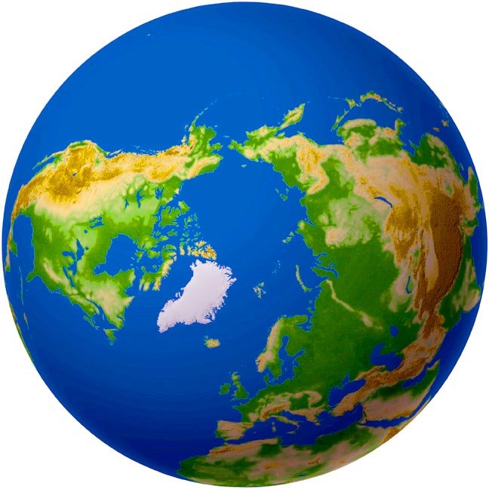
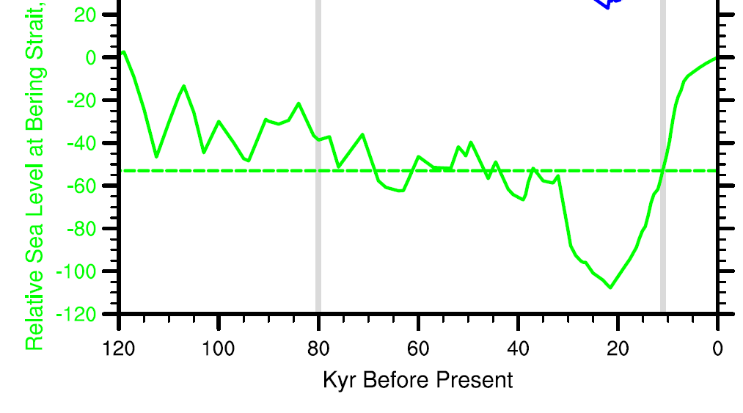
The response of the AMOC to freshwater forcing in the North Atlantic (Shaffter and Bendtsen, 1994; De Boer and Nof, 2004a,b; Hu and Meehl, 2005; Hu et al., 2007, 2008).
The response of the AMOC to future warming (Hu et al, 2009, 2011, 2013).
The hysteresis of the AMOC and the abrupt climate change events (Hu et al. 2012a).
Stability of the ice sheet and changes of global mean sea level during glacial time (Hu et al., 2010)
Seesaw climate change during H1 between North Pacific and North Atlantic (Hu et al., 2012b).
The formation of Quaternary style of climate (Sarnthein et al., 2009).
Present: Bering Strait is a narrow (~150 km) and shallow
(~50 m) pathway connecting the Pacific and the Arctic between Alaska and Siberia.
On average, about 0.8 Sv fresher North Pacific water flows through this strait into the Arctic, subsequently into the North Atlantic. This freshwater makes up about 1/3 freshwater gain in the Arctic.
Sverdrup (Sv) ≡ 10⁶ m³s⁻¹ or 1 million cubic meters per second

Slide 3
DOE/UCAR Cooperative Agreement
Regional and Global Climate Modeling Program
Model and Experiments
Community Climate System Model version 2 and 3:
CAM2 with T42 horizontally and 26 levels vertically
POP with 1 degree horizontally and 40 levels vertically
CSIM4
CLM2
Present day (PD)
CAM3 with T42 horizontally and 26 levels vertically
POP with 1 degree horizontally and 40 levels vertically
CSIM5
CLM3
PD, 112 kyr BP, 15 kyr BP
Experiments: 5 sets experiments – CCSM2 PD, CCSM3 PD, CCSM3 112 kyr BP with or without North American Ice Sheets and CCSM3 15 kyr BP with North American Ice Sheets. In each set, there are two experiments with everything identical except one with an open Bering Strait and the other with a closed Bering Strait. Each simulation runs for 350 years and the last 300 years are presented here.

Slide 4
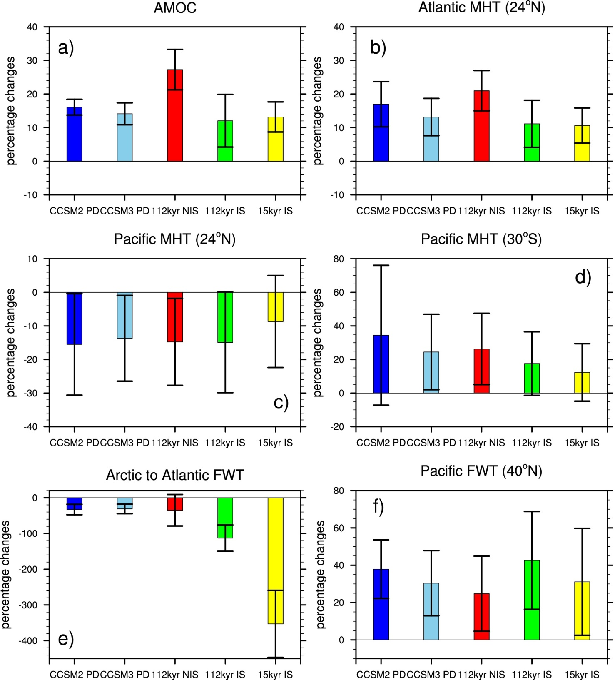
DOE/UCAR Cooperative Agreement
Regional and Global Climate Modeling Program
What are some of the exciting new results on this topic?

Slide 5
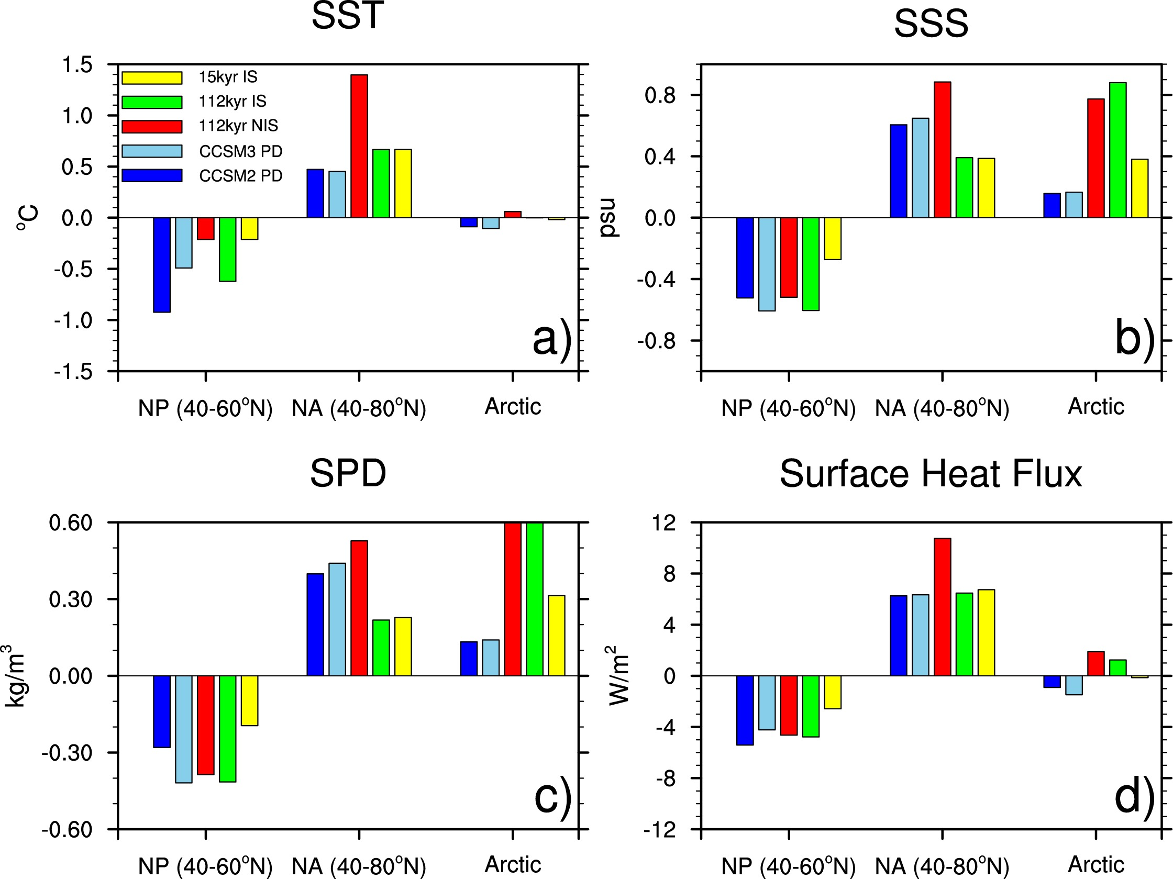
DOE/UCAR Cooperative Agreement
Regional and Global Climate Modeling Program

Slide 6
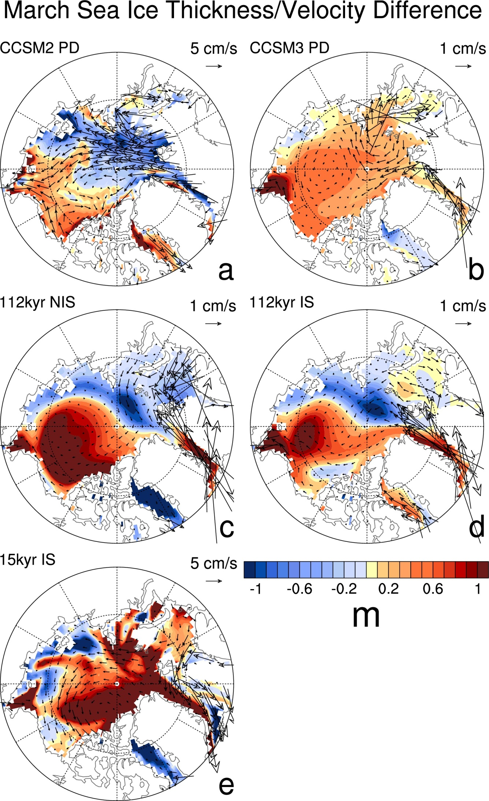
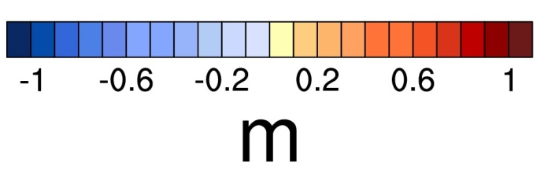
DOE/UCAR Cooperative Agreement
Regional and Global Climate Modeling Program
CBS - OBS

Slide 7
DOE/UCAR Cooperative Agreement
Regional and Global Climate Modeling Program
Summary
Regardless of the version of the model used or the widely different background climates, the Bering Strait’s closure produces a robust result of a strengthening of the AMOC, and an increase in the northward meridional heat transport in the Atlantic.
As a consequence, the climate becomes warmer in the North Atlantic and the surrounding regions, but cooler in the North Pacific, leading to a seesaw-like climate change between these two basins.
For the first time it is noted that the absence of the Bering Strait throughflow causes a slower motion of Arctic sea ice, a reduced upper ocean water exchange between the Arctic and North Atlantic, reduced sea ice export and less fresh water in the North Atlantic.

Slide 8
DOE/UCAR Cooperative Agreement
Regional and Global Climate Modeling Program
What are the frontiers for this topic, including both short-term (3-year) and long-term (10-year)
Properly resolve the Bering Strait in all model simulations with time scale on multi-centuries.
Recognize the status of the Bering Strait in paleo simulations
What are the recognized gaps in research in this area?
1. The importance of the Bering Strait has not fully recognized.
2. Paleo simulations has not fully incorporated the changes of the Bering Strait.
How are/could connections be leveraged?
For modern climate simulations, as model resolution increases, the Bering Strait will be properly treated.
For coarser resolution models, a closed Bering Strait will affect the simulated response of the AMOC to green house gas forcings.

