Slide 1
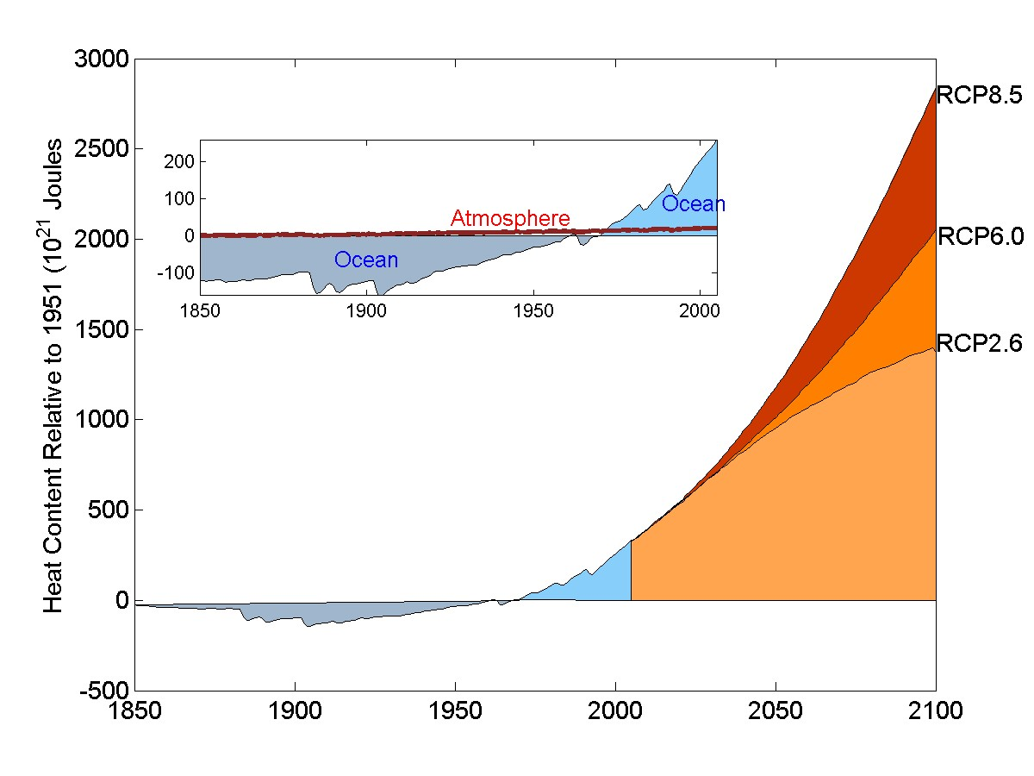
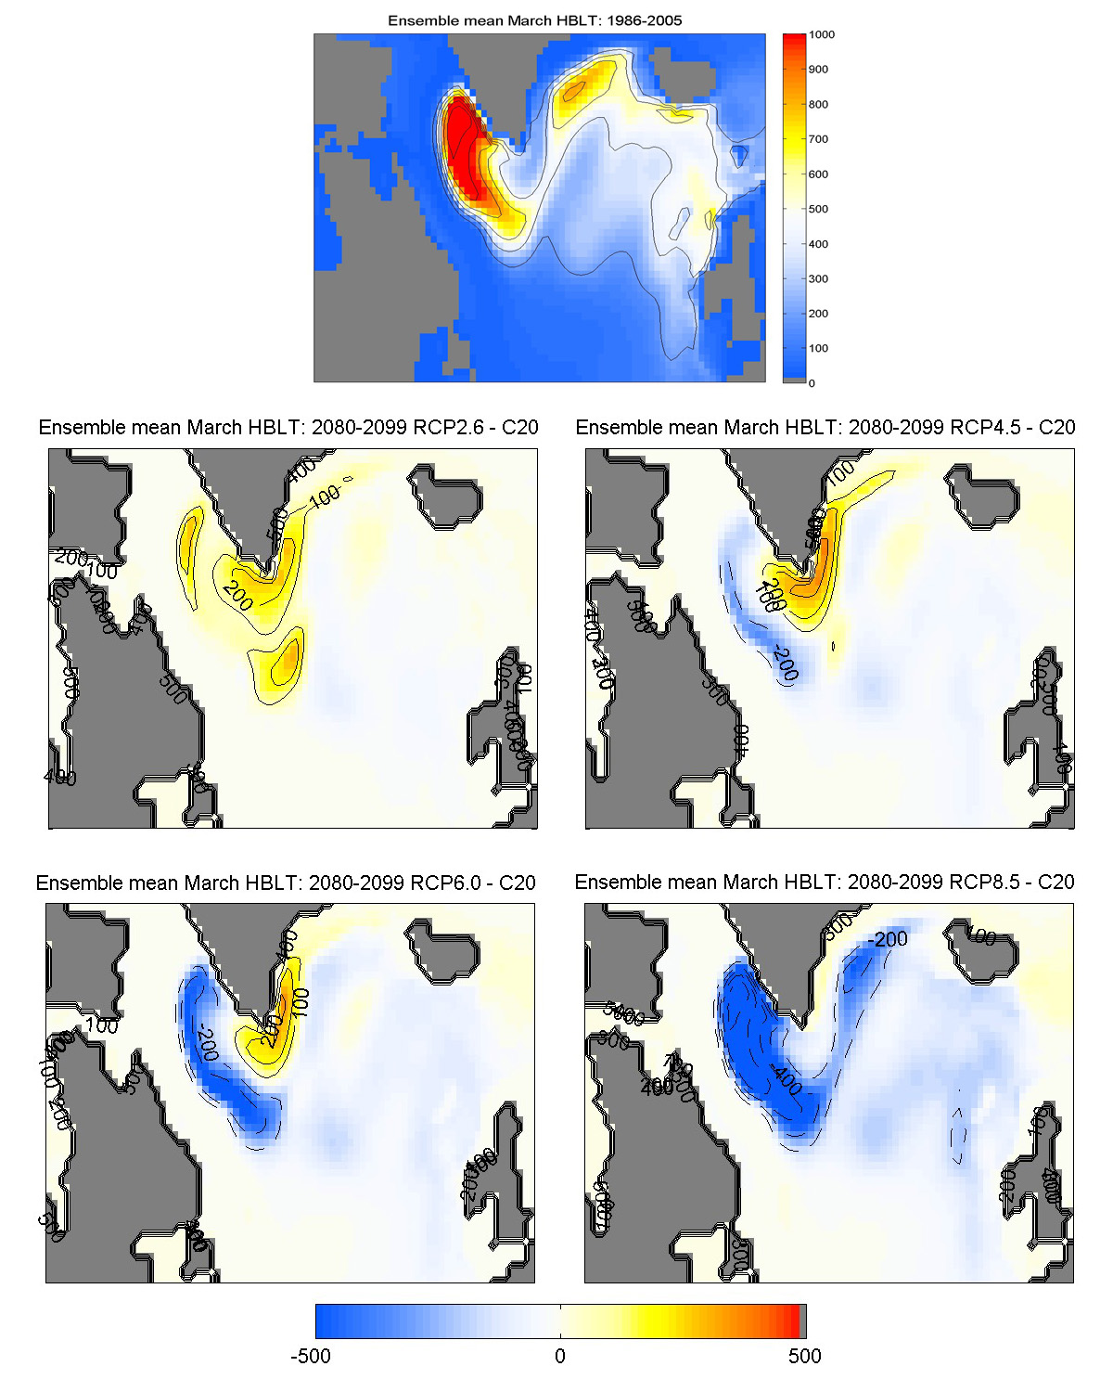
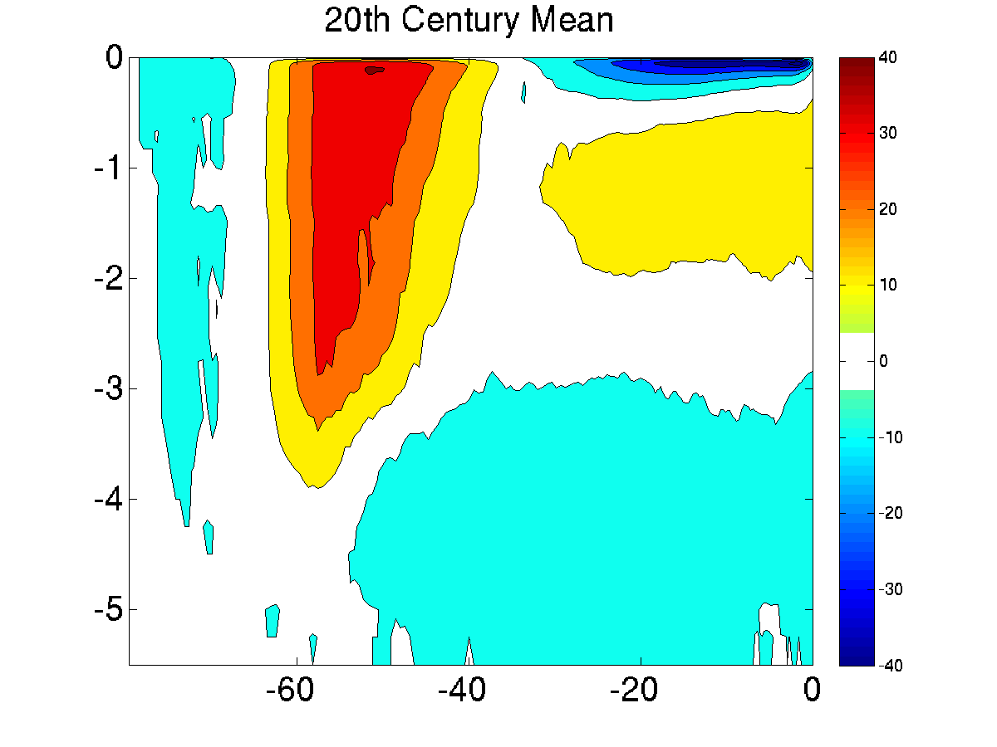
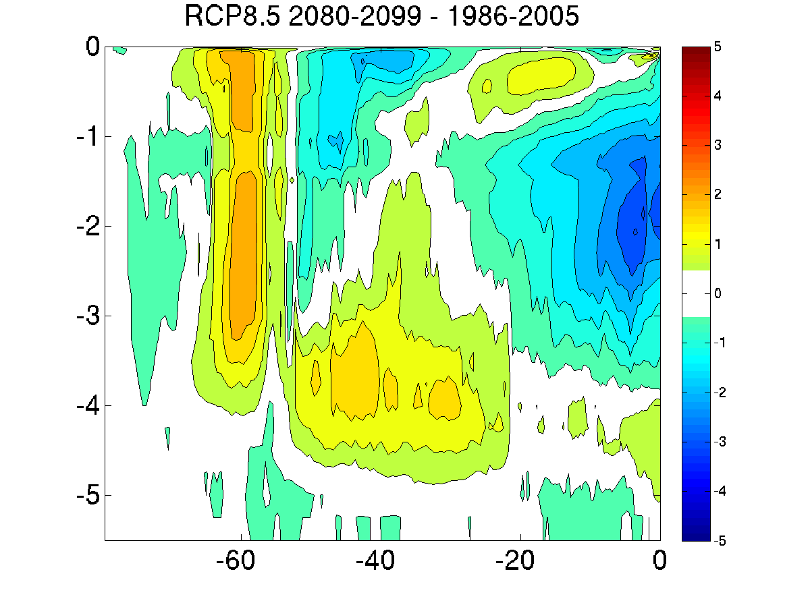
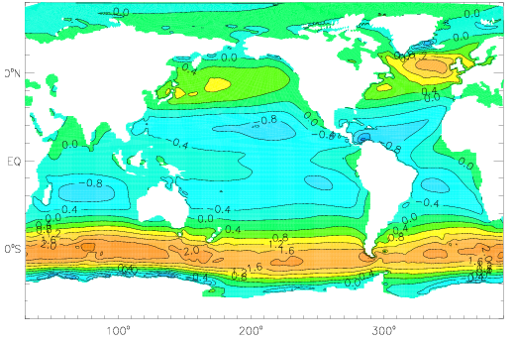
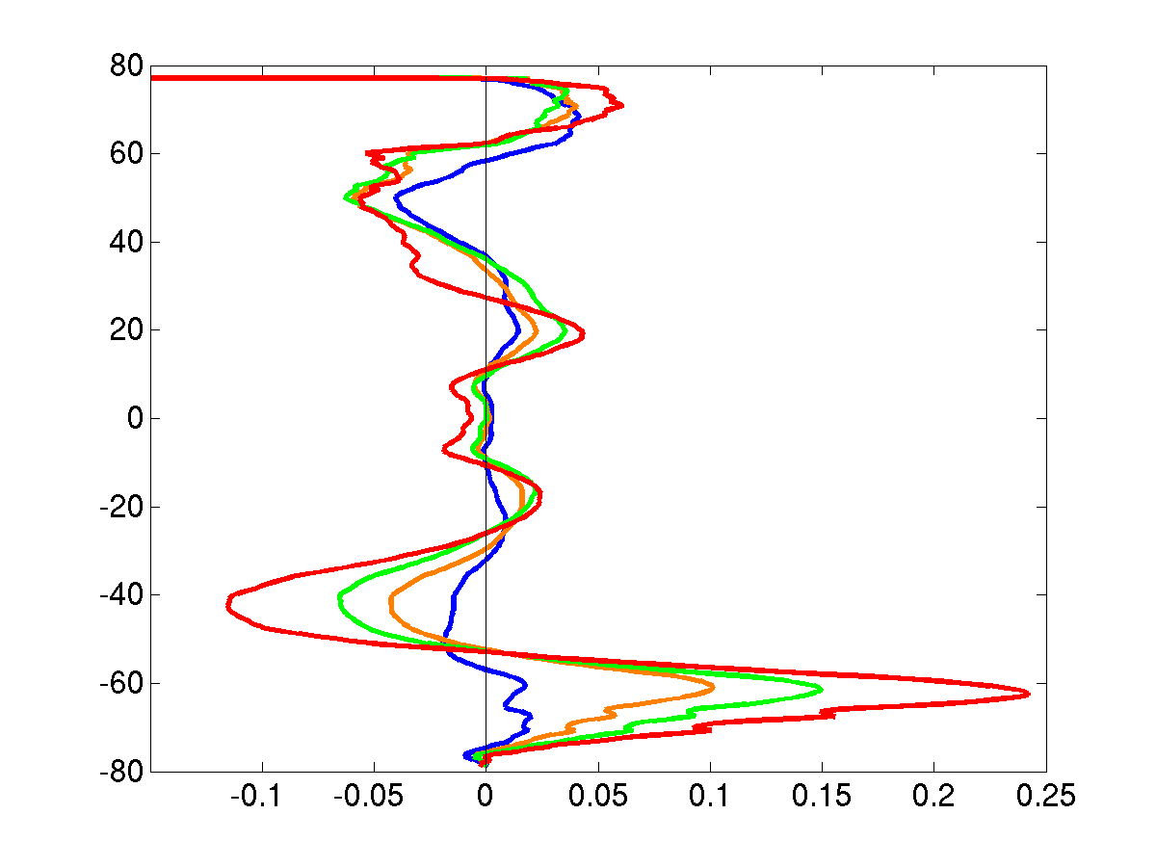
DOE/UCAR Cooperative Agreement
Regional and Global Climate Modeling Program
Changes in Ocean Heat Content from the 20th to 21st Centuries
Susan C. Bates, Synte Peacock, Gokhan Danabasoglu
National Center for Atmospheric Research, Boulder, CO
Conclusions
Over the 20th Century, the ocean has taken up the majority of excess heat due to global warming, twenty times as much as the atmosphere, and is projected to continue to do so in the 21st Century.
The patterns of heat content change in both deep and shallow layers are monotonic with increasing emission scenario, with a large portion of heat content change located in the North Atlantic and Southern Oceans.
These changes are attributed to a longterm reduction in the strength of the Atlantic Meridional Overturning Circulation (AMOC) and strengthening of zonal wind in the Southern Ocean.
Global Heat Content Change
Heat Content Change by Layer (°C)
RCP8.5 – 20th Century
(2080-2099) – (2086-2005)
RCP8.5
A large portion of ocean heat uptake is in the North Atlantic and Southern Oceans in shallow and deep layers.
The pattern is similar for all RCP scenarios increasing in magnitude with increasing emissions scenario (not shown).
(2001-2005) – (1967-1971)
RCP6.0
(0 – 700m)
Heat Content Relative to 1951
(10²¹ Joules)
RCP2.6
The ocean takes up the majority of excess heat entering the Earth System.
(700m – bottom)
Deep Convection Change in the North Atlantic
Southern Ocean Circulation Change (Sv)
20th Century Mean
(1986-2005)
RCP8.5 – 20th Century
(2080-2099) – (1986-2005)
Positive = clockwise Negative = counterclockwise
20th Century Mean
(1986-2005)
°C
m
m
A shallowing of deep convection, related to the reduction in the strength of the AMOC, mixes less cold water to the deep North Atlantic, thus warming the deep ocean.
RCP8.5 – 20th Century
(2080-2099) – (1986-2005)
Wind Stress Change in the Southern Ocean
20th Century mean
Magnitude of Wind Stress (dy/cm²)
Deep and intermediate water formation shifts poleward and strengthens.
A band of strong wind drives circulation in the Southern Ocean.
Future Plans
Changes shown here are due to longterm changes in the Earth System, such as ice melt affecting the AMOC and longterm shifts in atmospheric circulation; however, the ocean regulates global temperature on decadal timescales also.
We are currently investigating the pathways that heat enters shallow and deep layers on decadal timescales to better understand the driving mechanisms behind hiatus and accelerated warming periods. The pathways to mix heat into the ocean (tropical overturning cells and deep water formation regions) are likely the same; however, the forcing behind changes in those circulation patterns are likely different.
Recent publications point to atmospheric variability in the Pacific Basin as driving hiatus periods, but how that relates to heat content changes in other ocean basins is still an open question.
Zonal Mean Wind Stress
Difference (dy/cm²)
(2080-2099) – (1986-2005)
RCP2.6-20th
RCP4.5-20th
RCP6.0-20th
RCP8.5-20th
The above band of strong wind stress shifts poleward and strengthens in future scenarios, which causes the ocean circulation change (above right).
More heat enters the Southern Ocean through this increased circulation.

