Slide 1
Understanding Climate Model Biases in Tropical Atlantic
P. Chang, Z. Xu, R. Montuoro, C. M. Patricola, R. Saravanan & J. Kurian
Texas A&M University
L.-Y. Leung
Pacific Northwest National Laboratory
Tony Craig
National Center for Atmospheric Research
Supported by DOE Grant # DE-SC0006824
Patricola, C. M., M. Li, Z. Xu, P. Chang, R. Saravanan, J.-S. Hsieh, 2012: An Investigation of Tropical Atlantic Bias in a High-Resolution Coupled Regional Climate Model, Clim. Dyn., 39, 2443-2463, DOI 10.1007/s00382-012-1320-5.
Xu, Z., M. Li, C. M. Patricola, and P. Chang: 2013: Oceanic Origin of Southeast Tropical Atlantic Biases, Clim. Dyn., DOI 10.1007/s00382-013-1901-y.
Xu, Z., P. Chang, I. Richter and W.-M. Kim, 2014: Diagnosing Southeast Tropical Atlantic SST and Ocean Circulation Biases in the CMIP5 Ensemble, Clim. Dyn., Accepted.
Richter, I., P. Chang, Z. Xu, T. Doi, T. Kataoka, M. Nagura, P. Oettli, S. de Szoeke, and T. Tozuka, 2014: An overview of coupled GCM biases in the tropics, Chapter 8 in The Indo-Pacific Climate Variability and Predictability ed. by T. Yamagata and S. Behera, World Scientific Publisher on Asia-Pacific Weather and Climate book series, Accepted.
DOE Integrated Climate Modeling PI Meeting, Bolger Center, MD, May 12th-14th, 2014

Slide 2
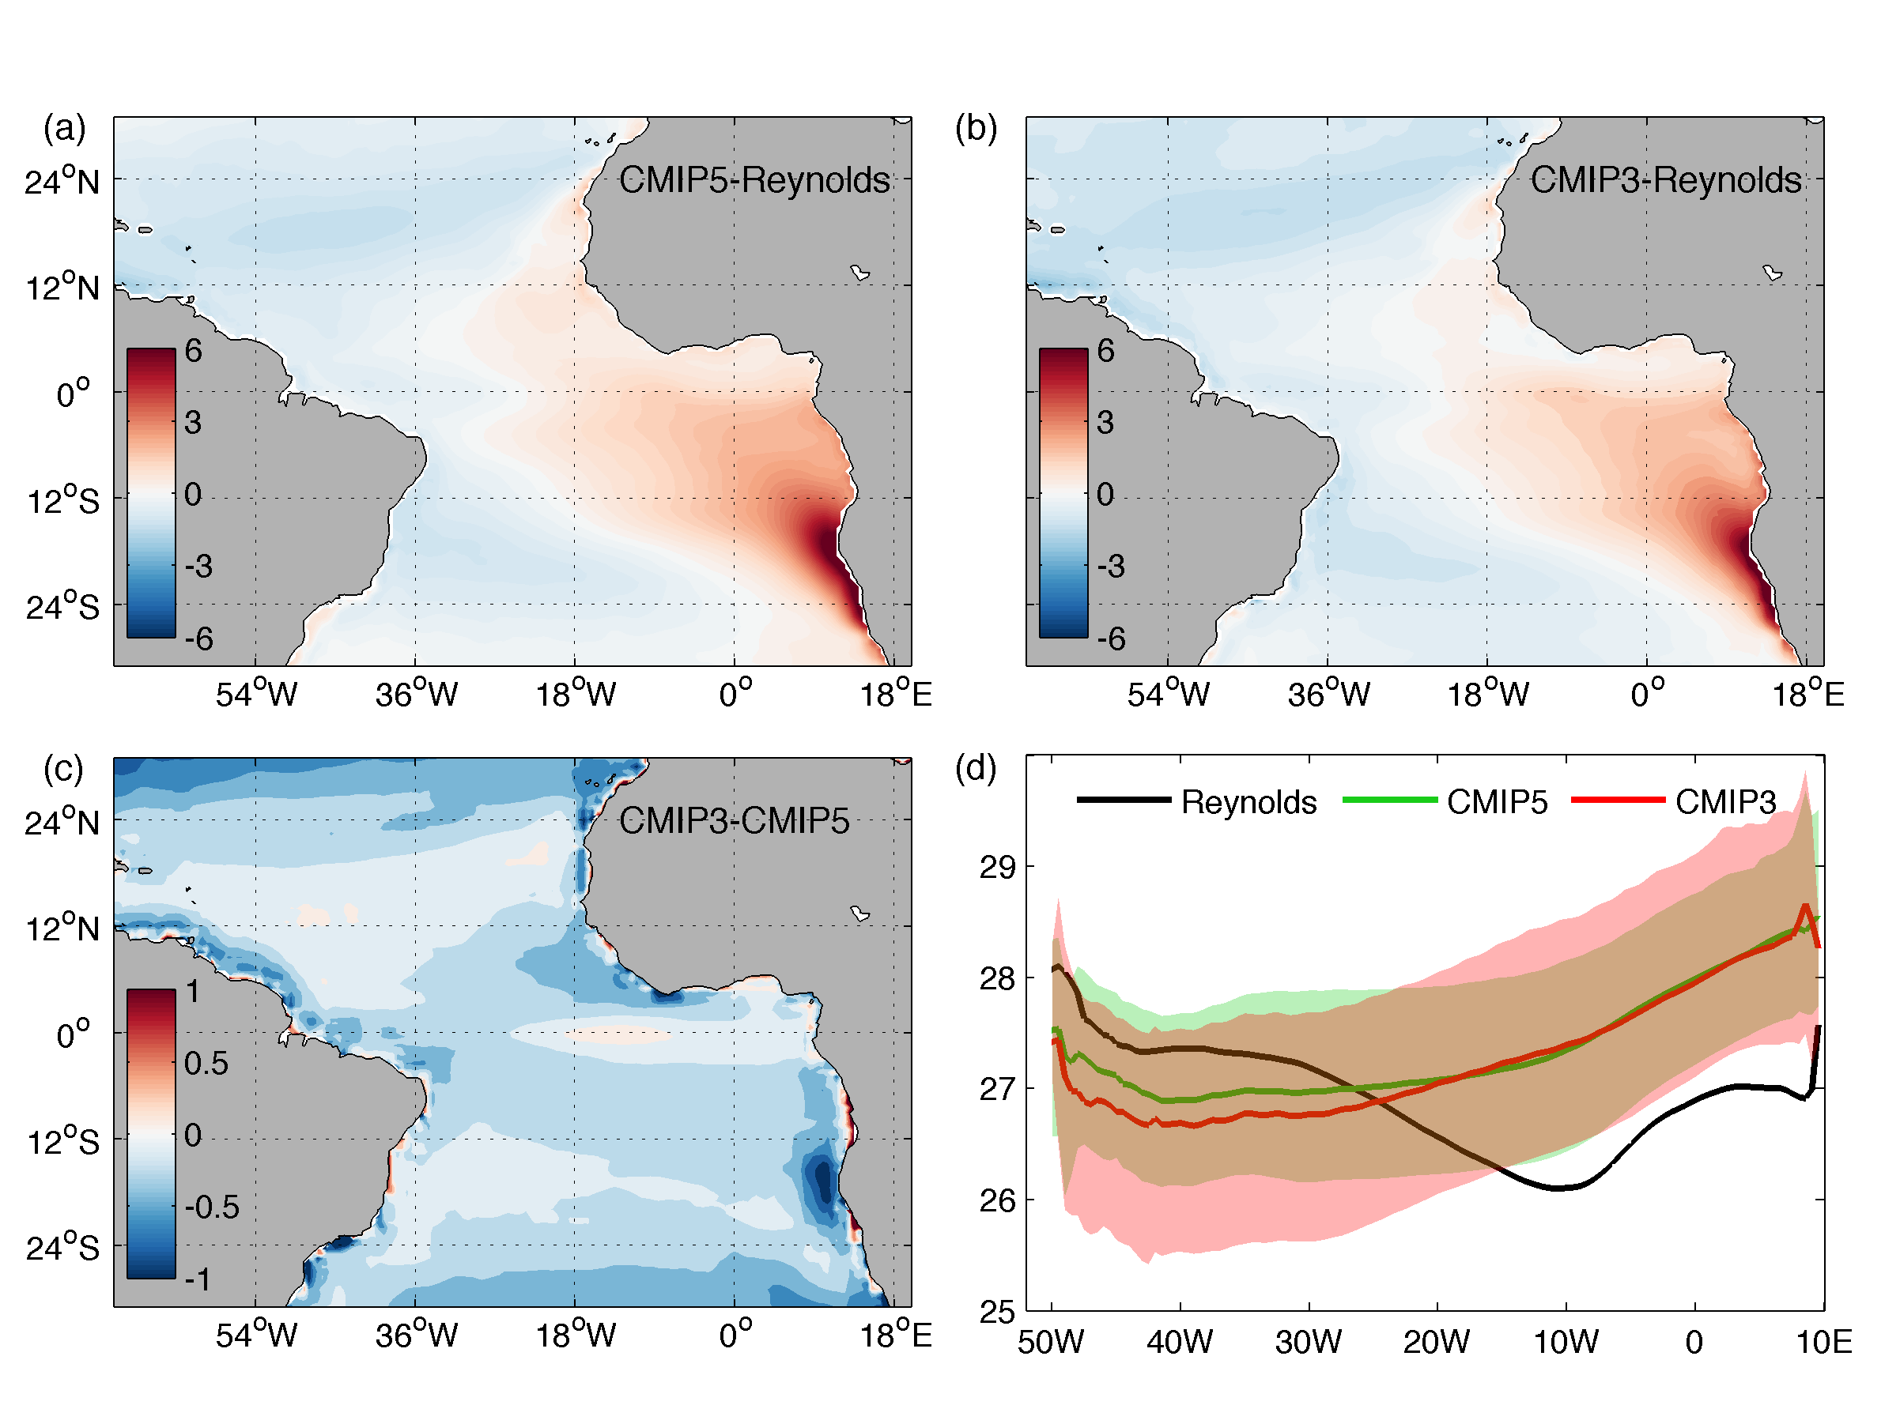
Biases in CMIP5 and CMIp3 ensemble
Equatorial SST bias
Benguela Coastal SST bias
CMIP3 & CMIP5 share remarkably similar SST biases in the tropical Atlantic with the largest bias near the Angola-Benguela Front (ABF).
Notes:
1. The cold SST bias in the northwestern tropical Atlantic is slightly improved in CMIP5, but the warm SST along southern African coast is worsened by ~1C in CMIP5. 2. The zonal SST gradient, albeit improved slightly in CMIP5, is still in the opposite direction compared to observation.

Slide 3
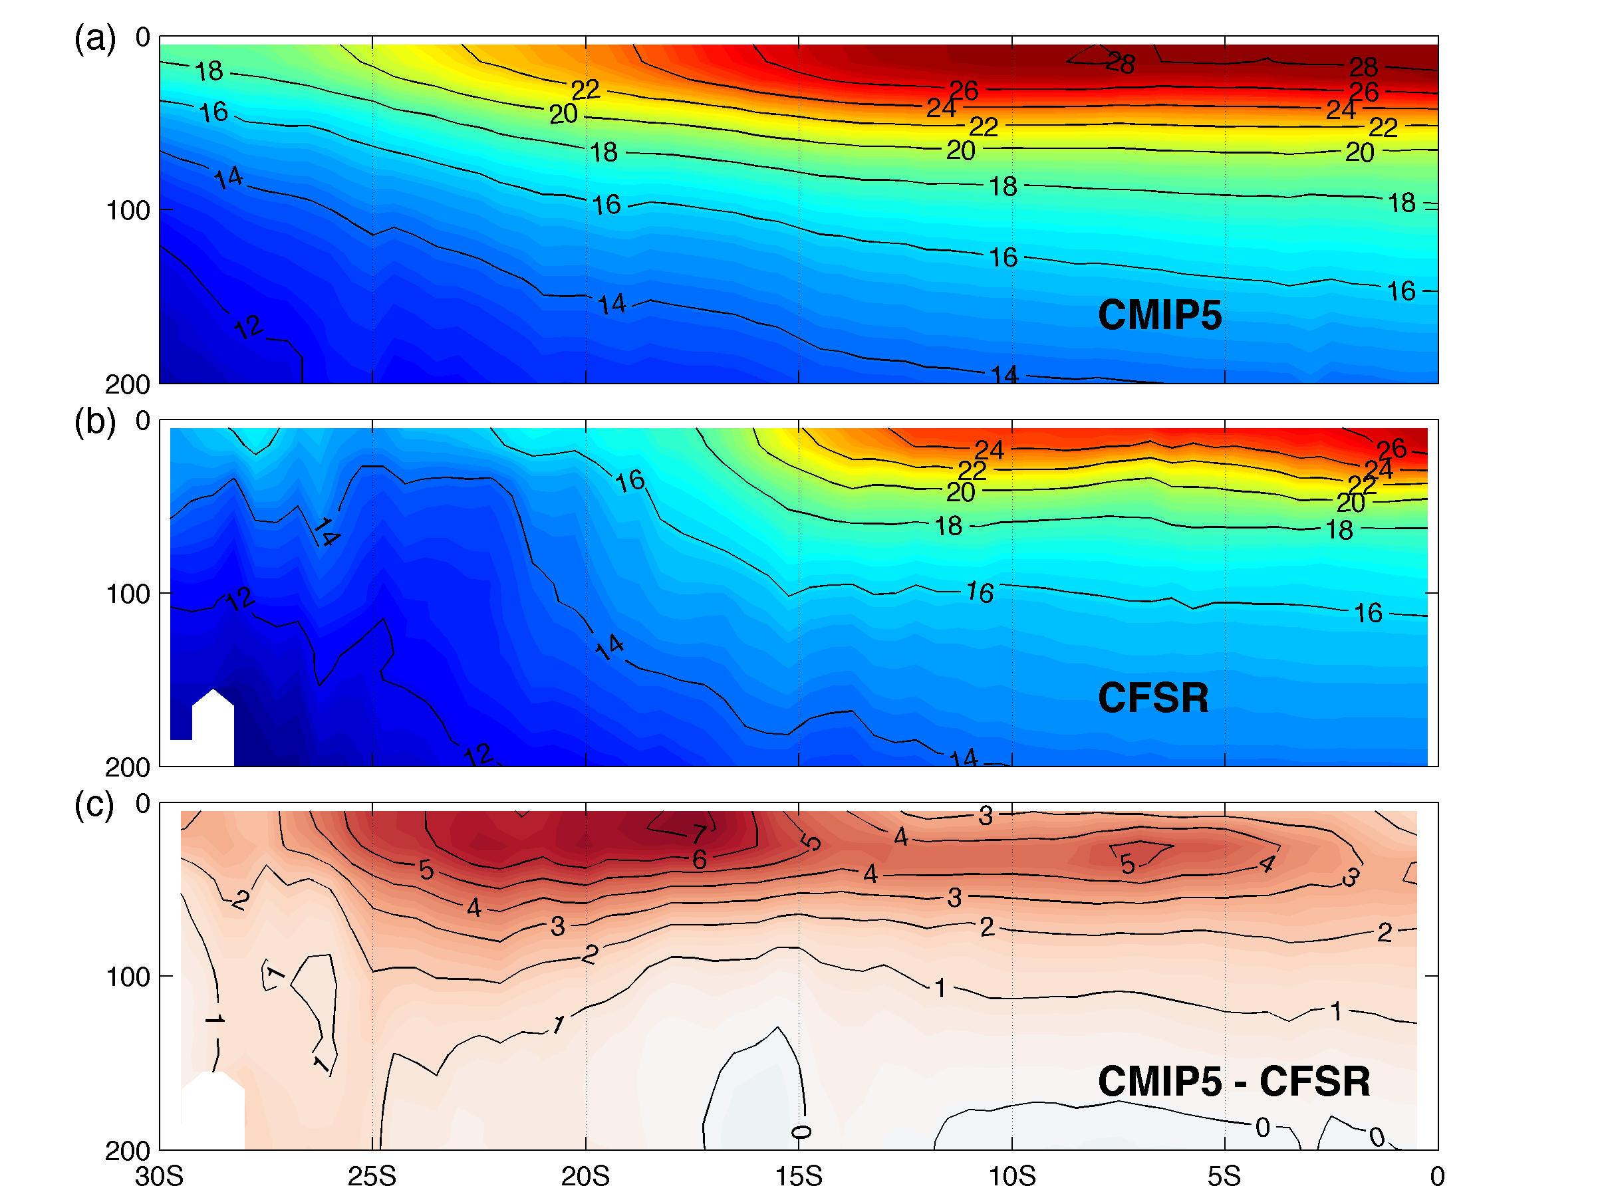
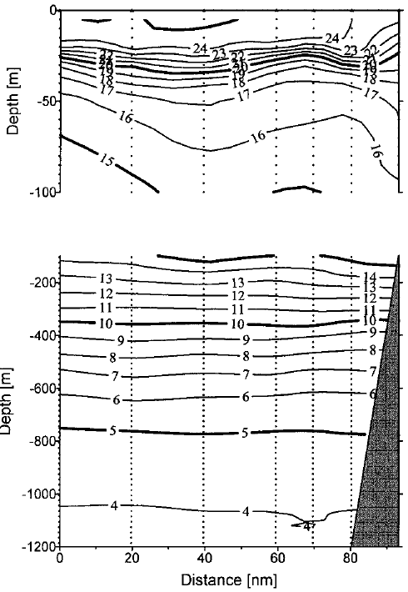
Biases Along Angola-Benguela Coast
Lass et al. (2010)
CMIP5 models show a strong warm bias (~5°C) near the thermocline of the Angola current and an even stronger warm bias (~7°C) in the Benguela upwelling region in reference to CFSR.
Notes:
1. The thermocline is too diffused in CMIP5, 2. stratification is too strong in CMIP5, indicating a weak upwelling in the Benguela region.

Slide 4
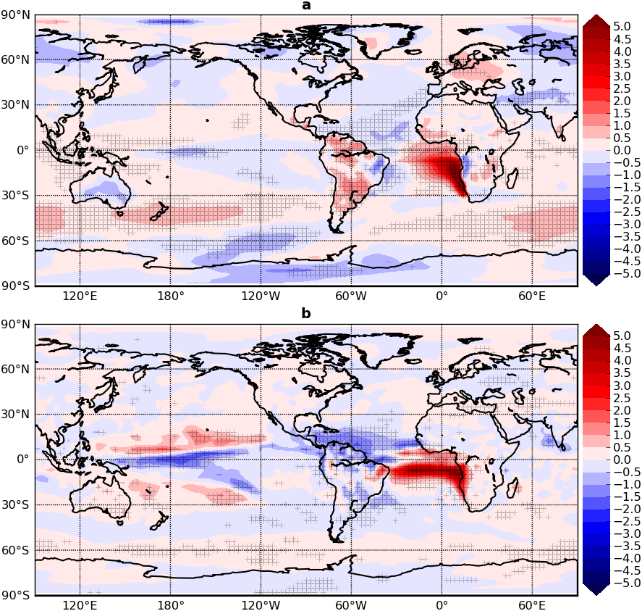
Impact of Atlantic SST Bias
CAM-SOM Experiments
CTRL run: 50-year run with Q-flux computed using observed annual cycle of SST
BIAS run: 50-year run with Q-flux=0 in the south tropical Atlantic (30°S-5°S) (see the box)
Removing Q-flux in the south tropical Atlantic results in a warm SST bias that bears close resemblance to the bias in the CMIP5 ensemble
The warm SST bias has a strong remote influence
SST bias
Precipitation bias
Notes:
CAM slab-ocean experiments: in CTRL, Q-flux is computed based on observed SST climatology and the model reproduce realistic SST. In the perturbed run, Q-flux is removed in the southeastern tropical Atlantic indicated by the green box. The top panel shows CTRL-BIAS annual mean SST and the bottom shows the precipitation bias. Note that how the Atlantic bias affects the precipitation and surface temperature not only in the Atlantic, but in the other basins.

Slide 5
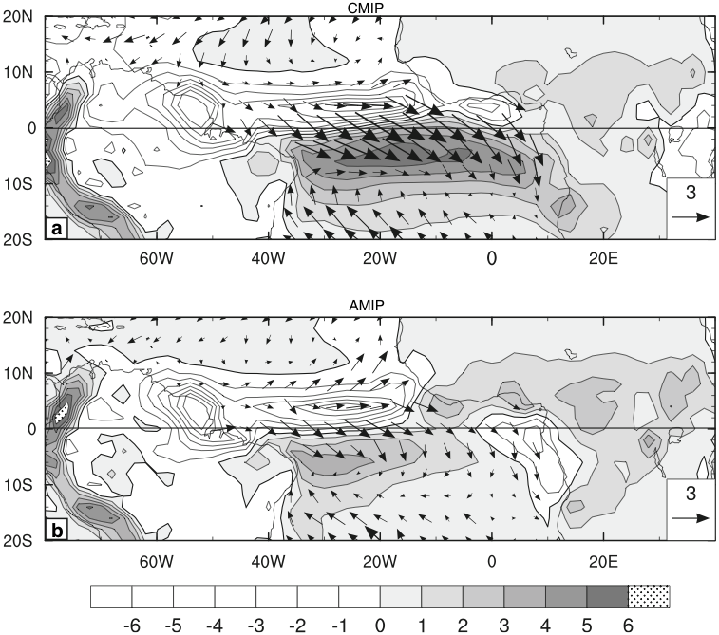
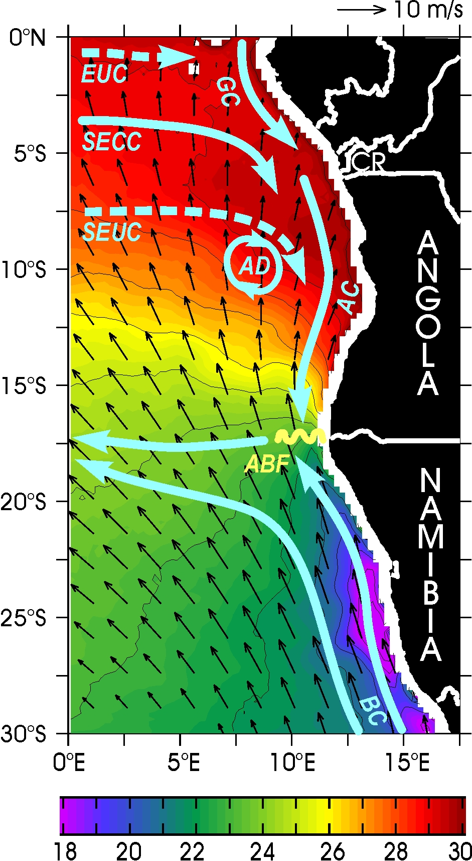
Equatorial Bias Vs. Benguela coastal Bias
Equatorial Atlantic SST bias has an atmospheric origin: AGCMs have systematic errors in simulating Amazonian deep convection, resulting in a dry bias over the Amazon and weak equatorial trade (Chang et al. 2007; Richter and Xie 2012)
Benguela Coastal SST bias has an oceanic origin: OGCMs have difficulties in resolving the sharp SST gradient associated with the Angola-Benguela Front (ABF)(Zhao et al. 2013) and upwelling dynamics off the Benguela coast (Large and Danabasoglu 2006)
Amazonian Convection Bias (Richter and Xie)
Angola-Benguela Front (From Rouault)
Notes:
The current understanding of the Atlantic bias is divided along the line of equatorial bias vs. Benguela coastal bias. The equatorial bias is thought to be connected with biases in AGCM simulation of Amazonian deep convection. The panel on the left shows MAM precip and surface wind biases in AMIP and CMIP ensembles. Note that similar biases appear both AMIP and CMIP, including dry bias over the Amazon and weak trade wind bias along the equator, except that the bias in the CMIP ensemble is stronger than that in the AMIP, leading the hypothesis that the bias in CMIP is originated from the AGCM in simulating Amazonian deep convection. The Benguela coastal bias is closely related to the ocean model errors in representing the Angola-Benguela front. Almost all the ocean models have difficulties in representing ABF correctly.

Slide 6
Amazonian Convection bias in 27-km WRF Simulations
“Dry case” (KF convection and CAM radiation)
A large number of sensitivity runs revealed that even with the same prescribed lateral boundary conditions WRF simulation can be highly sensitive to physics parameterizations, including radiation physics, cumulus parameterizations, PBL schemes, land surface models and etc.
The radiation physics in WRF has the most significant impact on Amazonian convection: Switching from CAM to RRTM radiation scheme changed a dry to a wet Amazon bias
Coupled WRF-ROMS simulations are conducted to examine the effect on the Amazon bias on SST
strong westerly bias
(m/s)
(mm/day)
“Wet case” (BM convection and RRTM/Goddard radiation)
moderate northwesterly bias
(m/s)
(From Patricola et al. 2012)
(mm/day)
Notes:
To test the Amazon deep convection bias, we ran a large set of WRF sensitivity experiments where we change physics parameterizations extensively. We found that the Amazon convection is highly sensitive to physics parameterizations. For example, we can change Amazon precipitation bias from a dry to a web bias by switching radiation scheme from CAM to RRTM. The upper panel shows the precip and surface wind bias using KF convection and CAM radiation and bottom shows the same bias using BM convection and RRTM radiation. Note that the trade wind bias in the “wet case” is weaker in the equatorial zone. Question is: will this reduce the equatorial SST bias.

Slide 7
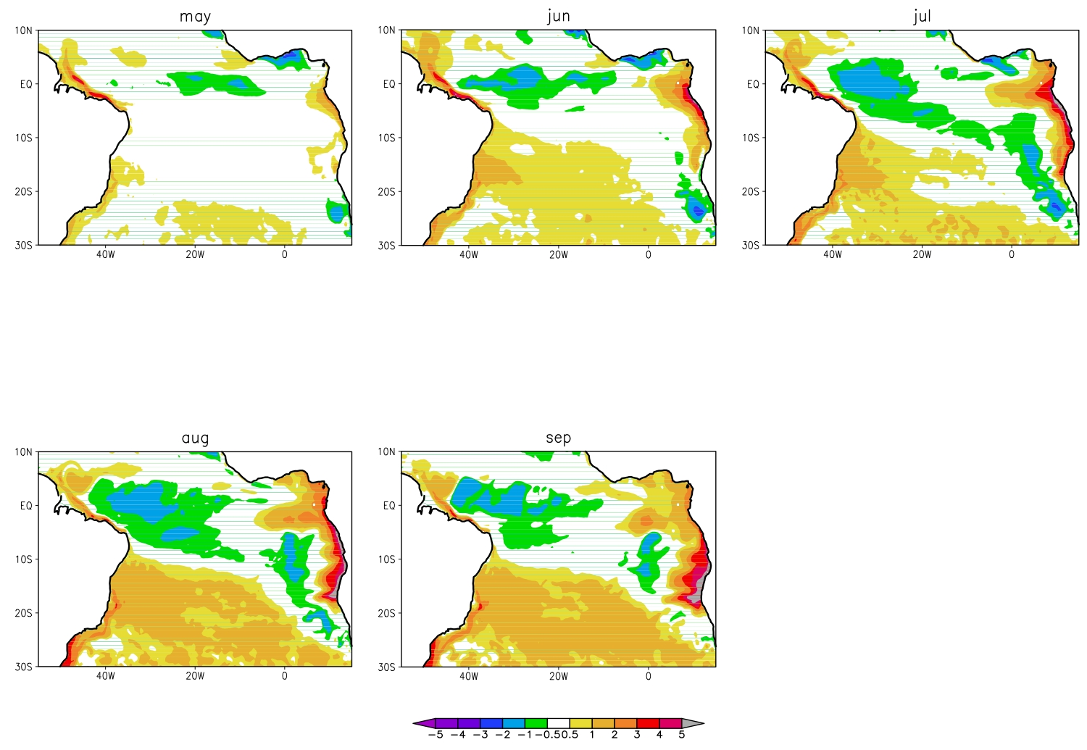
SST bias from coupled WRF-Roms Simulations: “wet case”
stronger SST bias
WRF-ROMS coupled simulations suggest that the warm SST bias along the eastern equatorial region and off the coast of southern Africa depend more strongly on local biases than biases over the Amazon.
In spite of the weaker precipitation and wind biases over the Amazon, the coupled model produces a strong equatorial SST bias (~1°C), suggesting a vital role of local feedbacks
Strong warm SST bias develops at the ABF region, which seemingly originated from the equatorial region. Why?
?
(From Patricola et al. 2012)
(K)
Notes:
The coupled WRF-ROMS simulation suggests that even if the Amazon bias is reduced, this are still significant warm SST biases developed in the eastern Atlantic. We analyzed the results further. It turns out that WRF model bias in eastern Atlantic can trigger local air-sea feedbacks that amplify the initial bias quickly. The warm bias can be developed with a season or two.

Slide 8
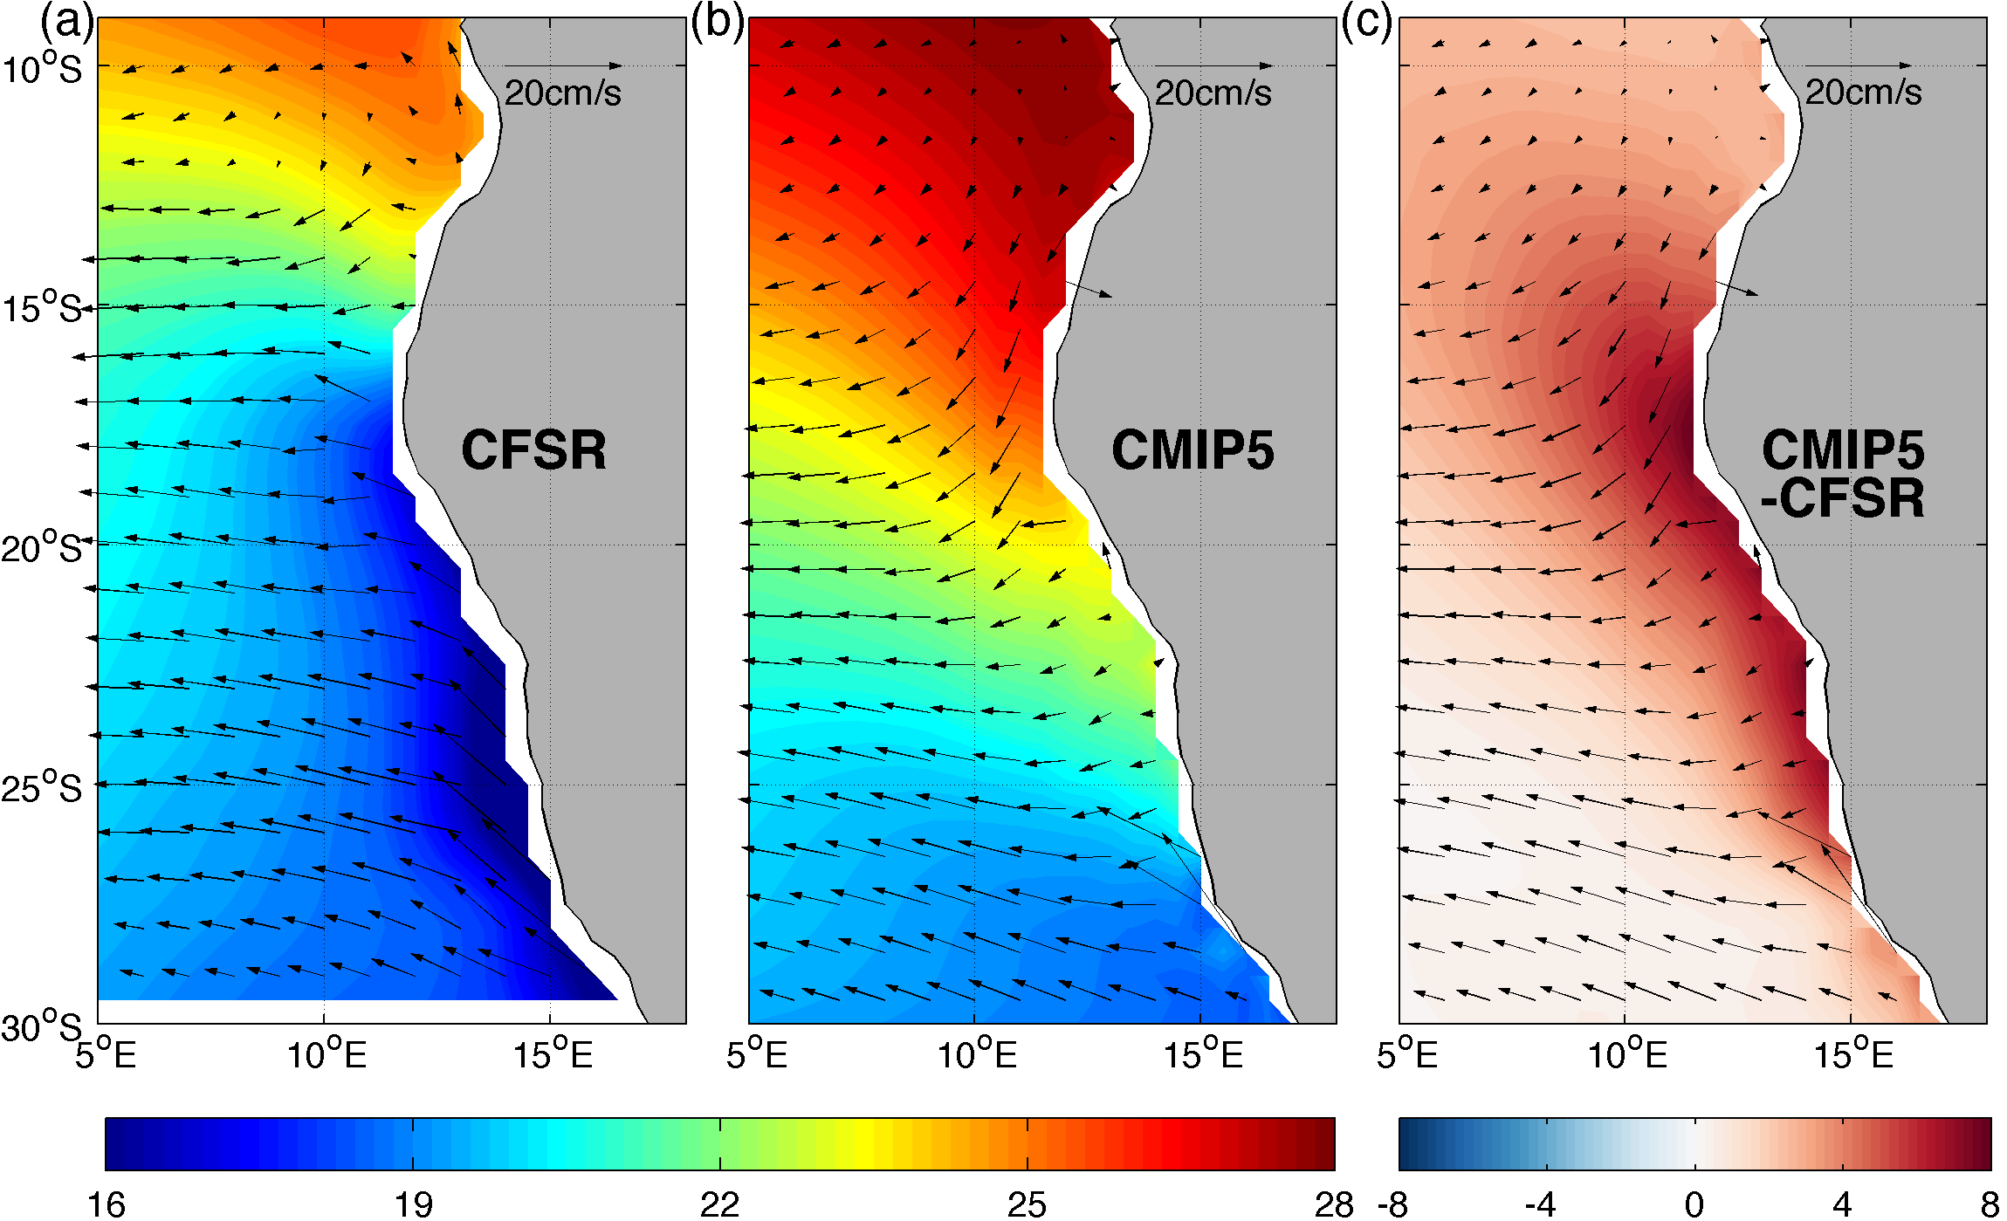
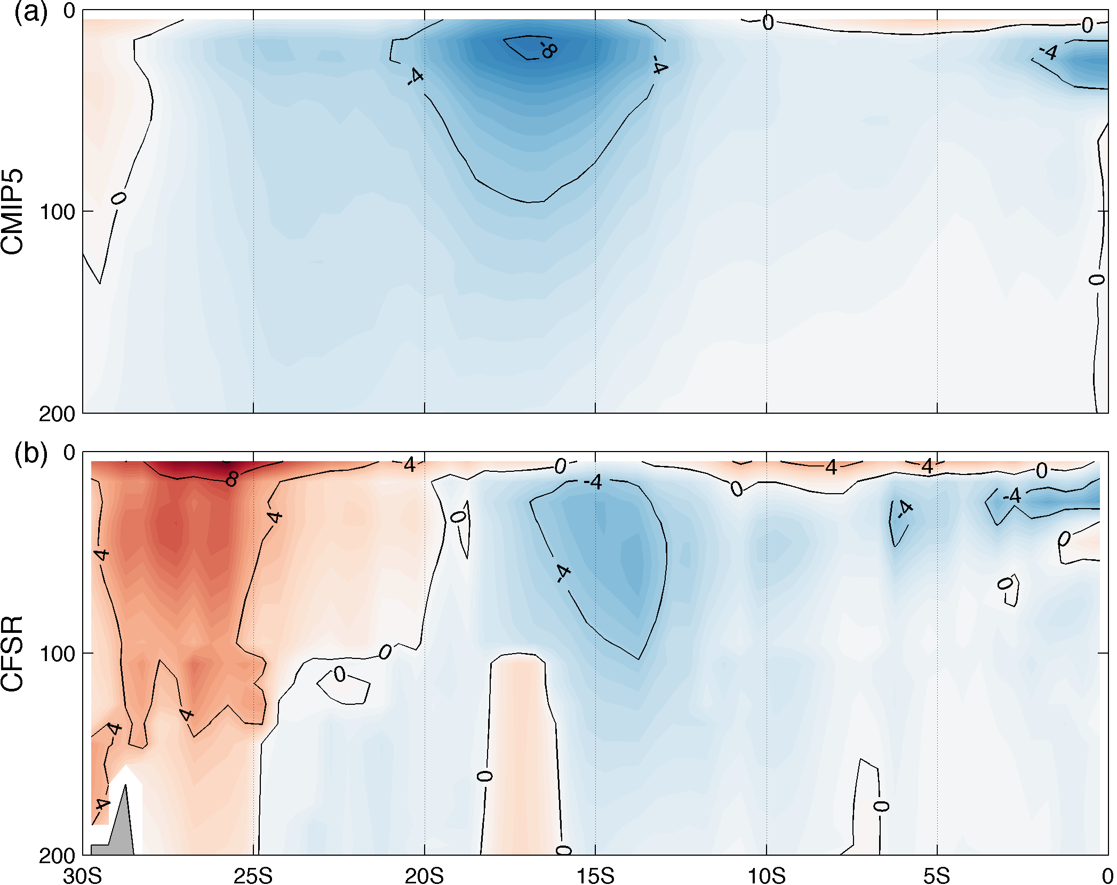
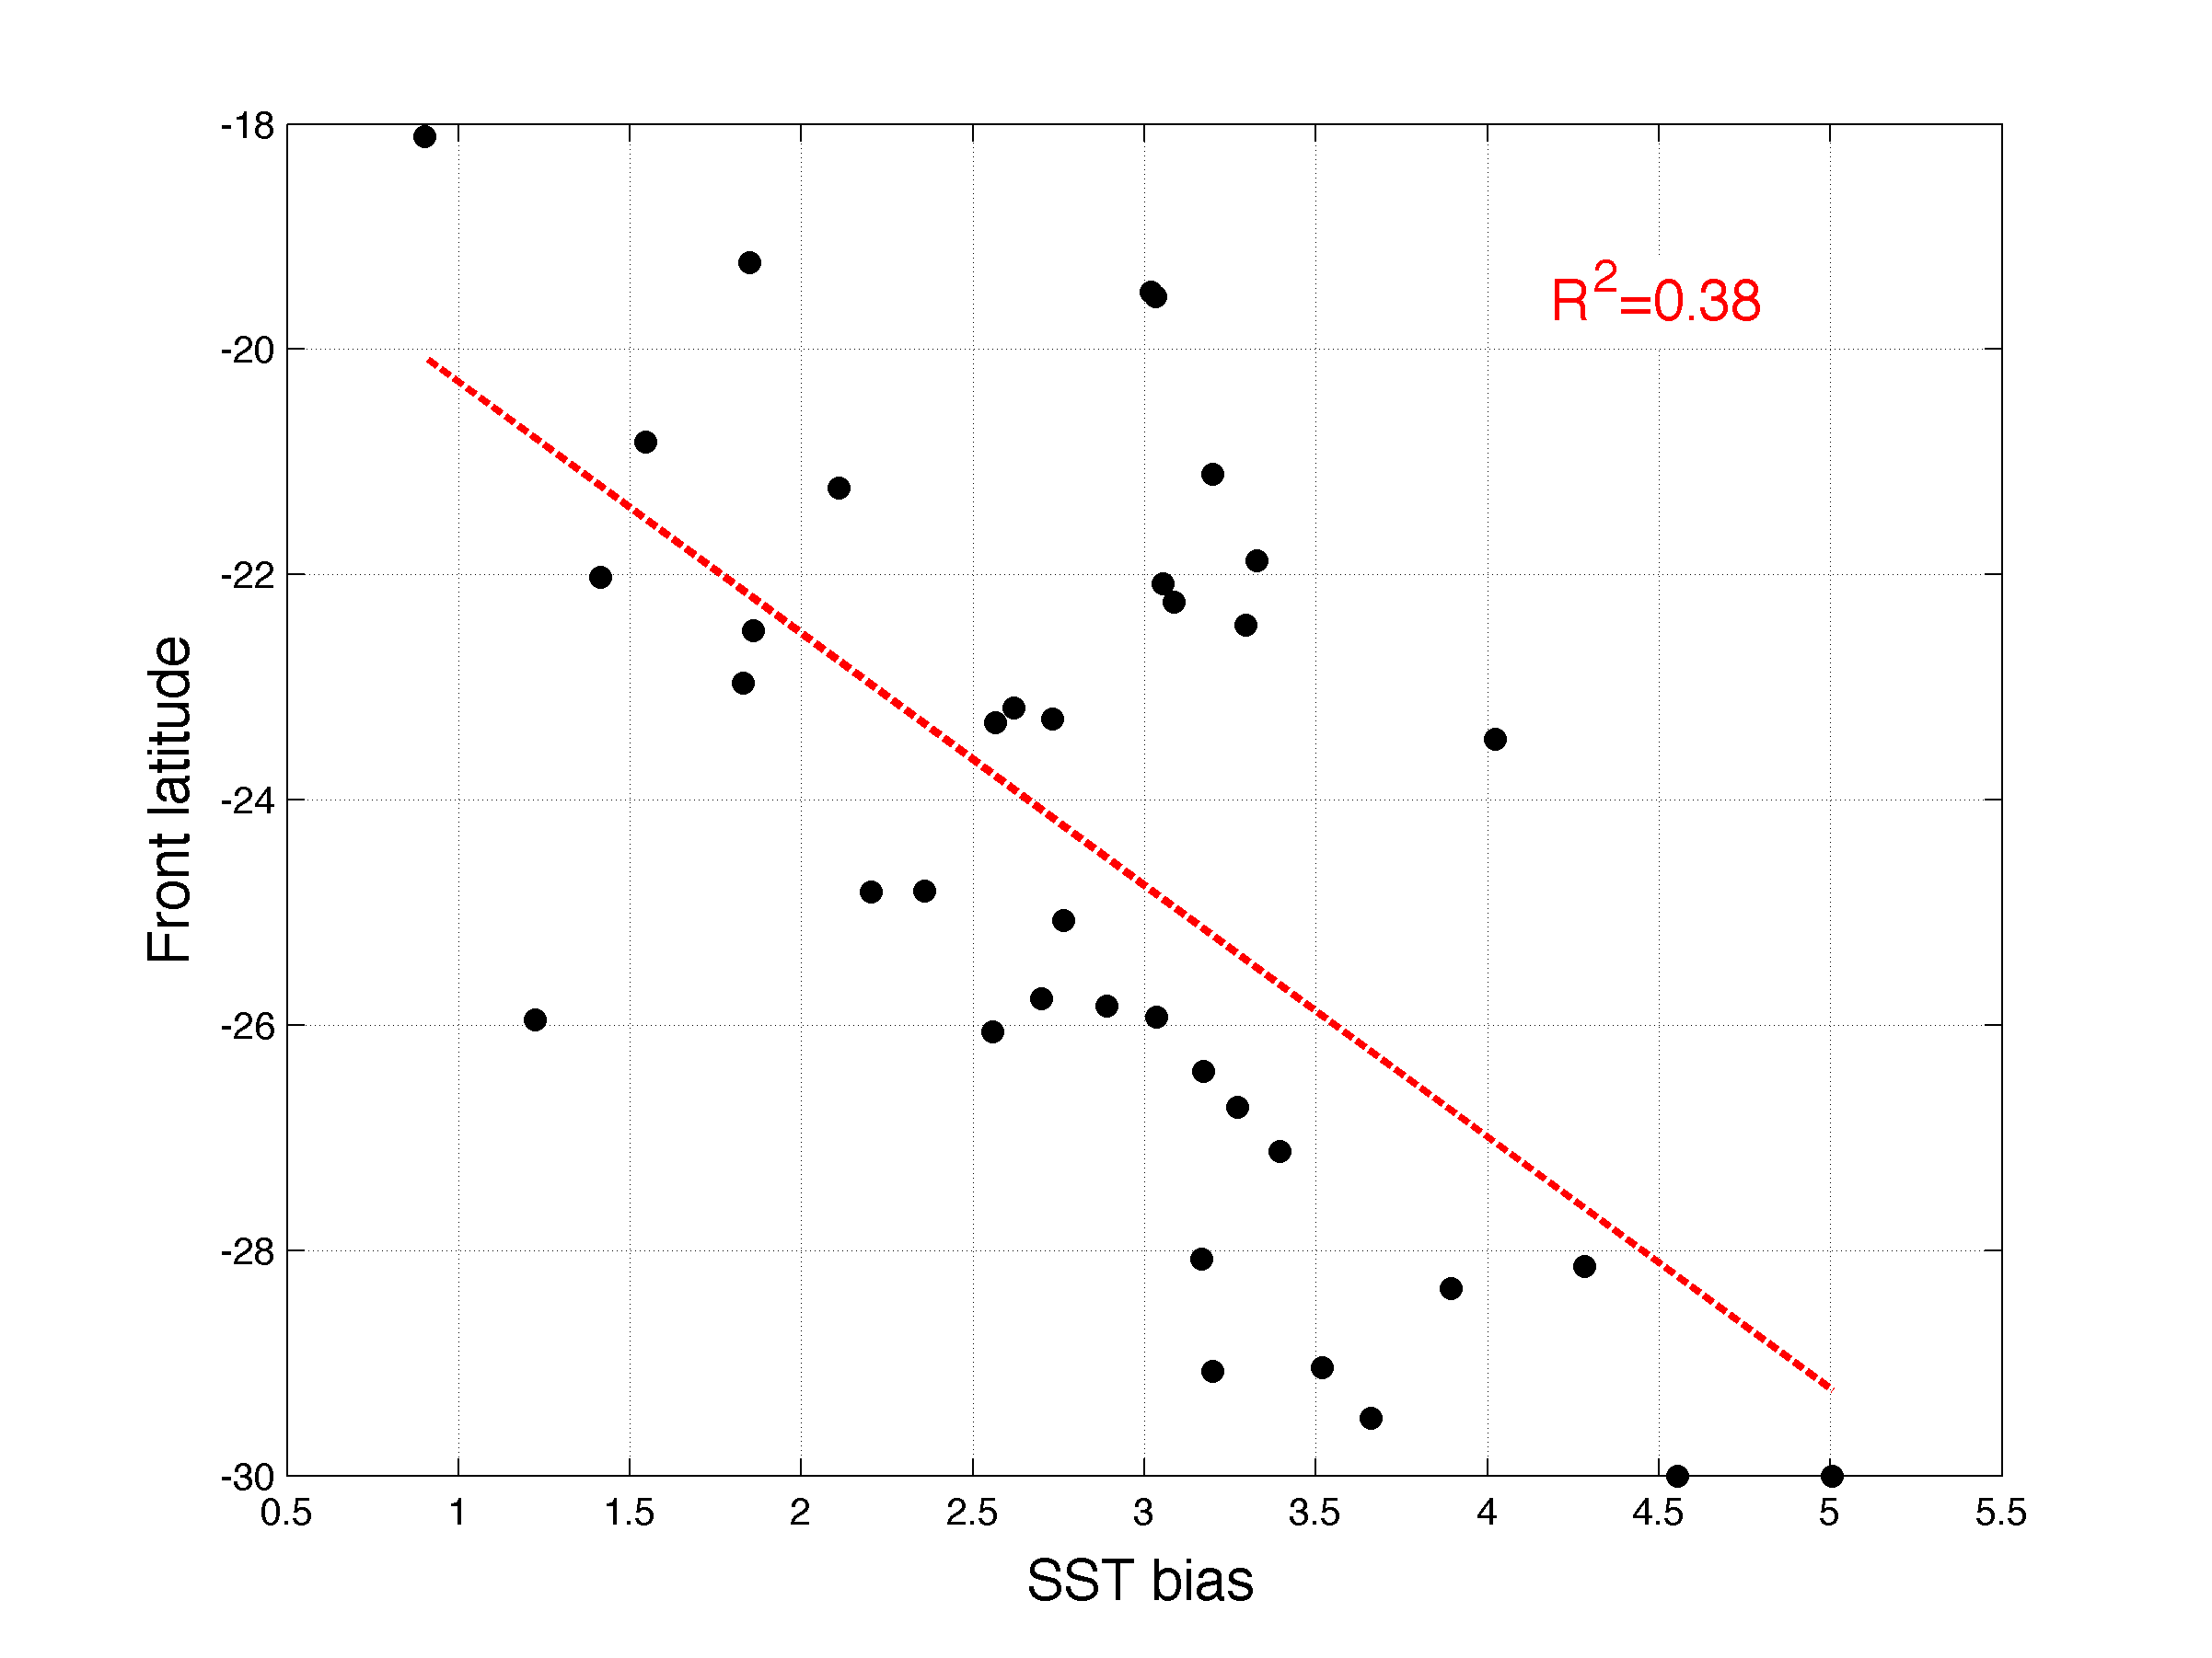
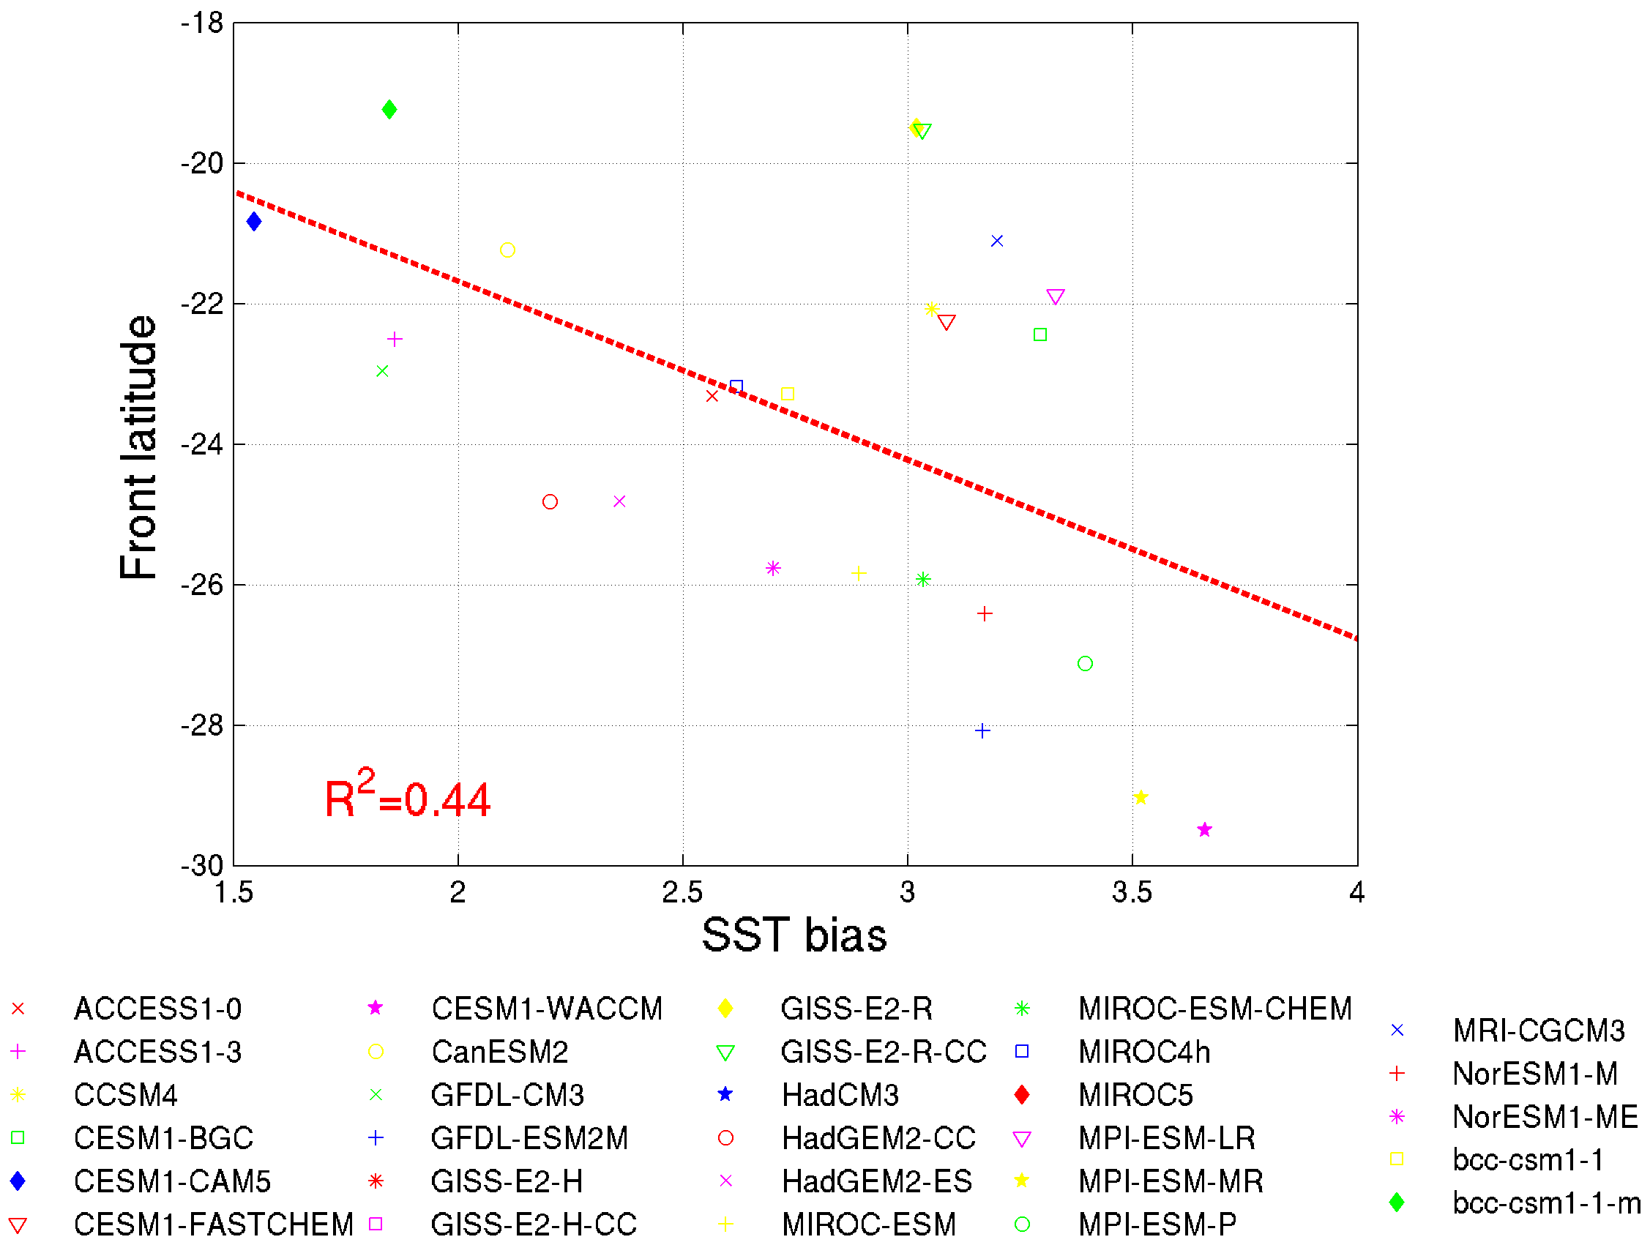
Benguela Coastal SST Bias in Cmip5 ensemble
BC
AC
ABF
ABF
V along the coast in CMIP5
ABF
BC
ABF
AC
V along the coast in CFSR
CMIP5 models show an overshoot Angola current and severely southward displaced ABF (~10°)
Simulated ABF locations are highly correlated with SETA SST biases; models with a more southward displaced ABF have a larger SST bias
Horizontal heat advection associated with poorly simulated ABF may contribute significantly to the SETA SST bias
(Xu et al. 2014)
Notes:
Turing to Benguela coastal bias problem, we did an analysis on the CMIP5 ensemble. The panels on the left show comparison of SST in CFSR and ensemble mean of CMIP5. Note that the ABF is being displaced further south than its observed location by ~10 deg. The southward shift of the ABF is also seen in the alongshore velocity field shown in upper right panel. Note that the Angola current in CMIP5 is too strong and extending too far south. Bottom right panel shows a correlation between CMIP5 model simulated ABF locations and the Benguela SST bias strength. The two are correlated at r=0.66.

Slide 9
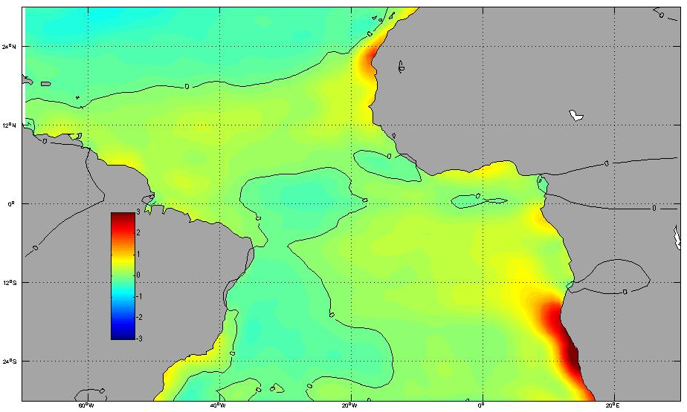
SST bias in OGCM Simulations
SST bias from an ensemble of 17 OGCM simulations forced by observationally derived CORE-II forcing shows strong warm SST bias along the Benguela coast, suggesting that the bias has an oceanic origin.
Notes:
The question is: whether this overshoot of the ABF problem is caused by ocean model physics and resolution or errorenous surface forcing fields in the coupled model, such as winds and surface heat fluxes. So we examine that SST bias in an ensemble of OGCM simulations forced by a common forcing set derived from the observations, i.e., COREII. As shown this slide, a strong warm SST is again seen along the Benguela coast, although the amplitude is reduced somewhat.

Slide 10
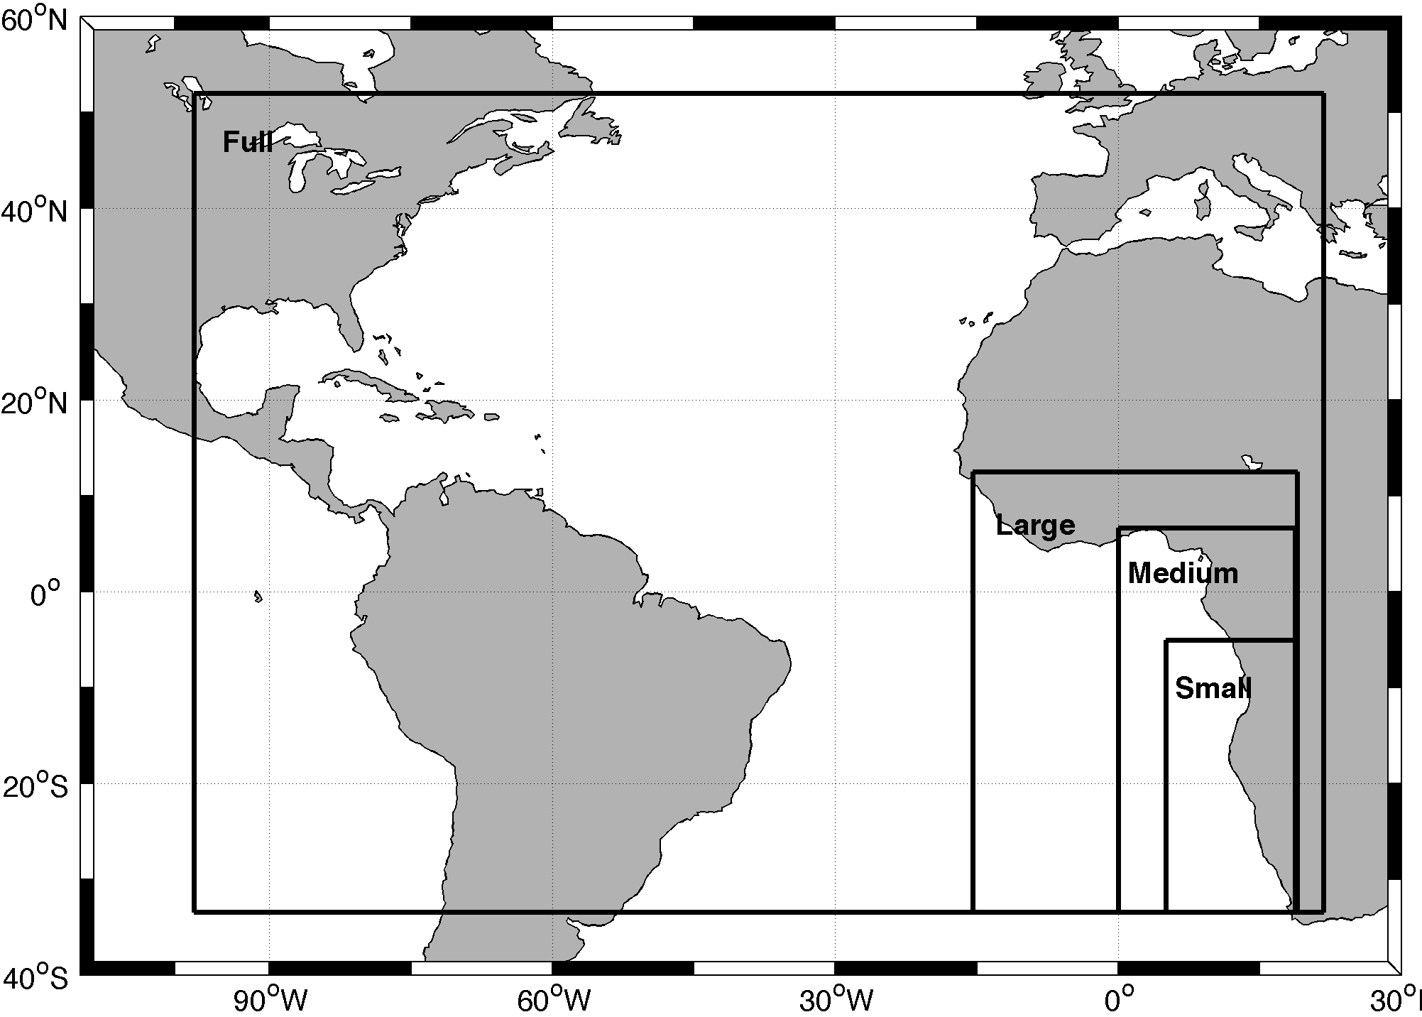
ROMS Simulations
ROMS: 9km horizontal resolution and 30 vertical layers, KPP mixing in both surface and bottom boundary layer, Laplacian horizontal mixing, 10 min time step.
Four Experiments:
Basin Simulation: Atlantic Ocean from 33°S to 53°N
Large Domain Regional Simulation
Medium Domain Regional Simulation
Small Domain Regional Simulation
11-year simulation from Jan. 1997 to Dec. 2007
Surface forcing: NCEP/CFSR short and long wave radiation and COREII wind stresses, latent and sensible heat fluxes
Lateral boundary conditions: 6-hourly NCEP/CFSR data set
ROMS Domain
BC from NCEP/CFSR
Surface Forcing:
NCEP/CFSR short and long wave radiation and COREII wind stresses, latent and sensible fluxes
BC from NCEP/CFSR
From Xu et al. (2013)
Notes:
Are the Benguela SST bias caused by remote or local processes? So we designed a set of experiments progressively reducing the simulation domains from a basin domain to regional domain in the southeastern tropical Atlantic. All the simulations are forced by COREII from 1997-2007 and CFSR boundary conditions.

Slide 11
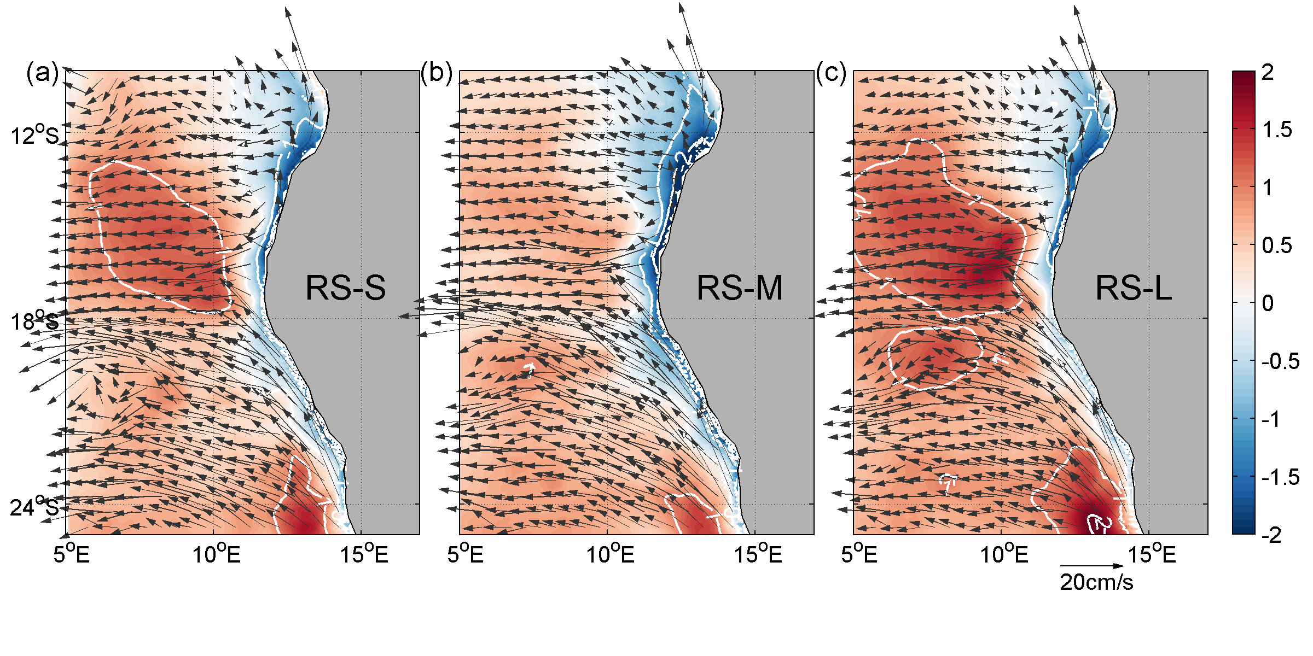
SST Bias in Regional Simulations
Large warm SST bias along the Benguela coast in the basin simulation is replaced by a modest cold SST bias in the regional simulation!
From Xu et al. (2013)
Notes:
The basin shows a similar warm Benguela SST bias to OMIP models. However, the warm bias is much reduced in the regional simulation. In fact, the warm bias is even replaced by a cold bias along the Angola coast.

Slide 12
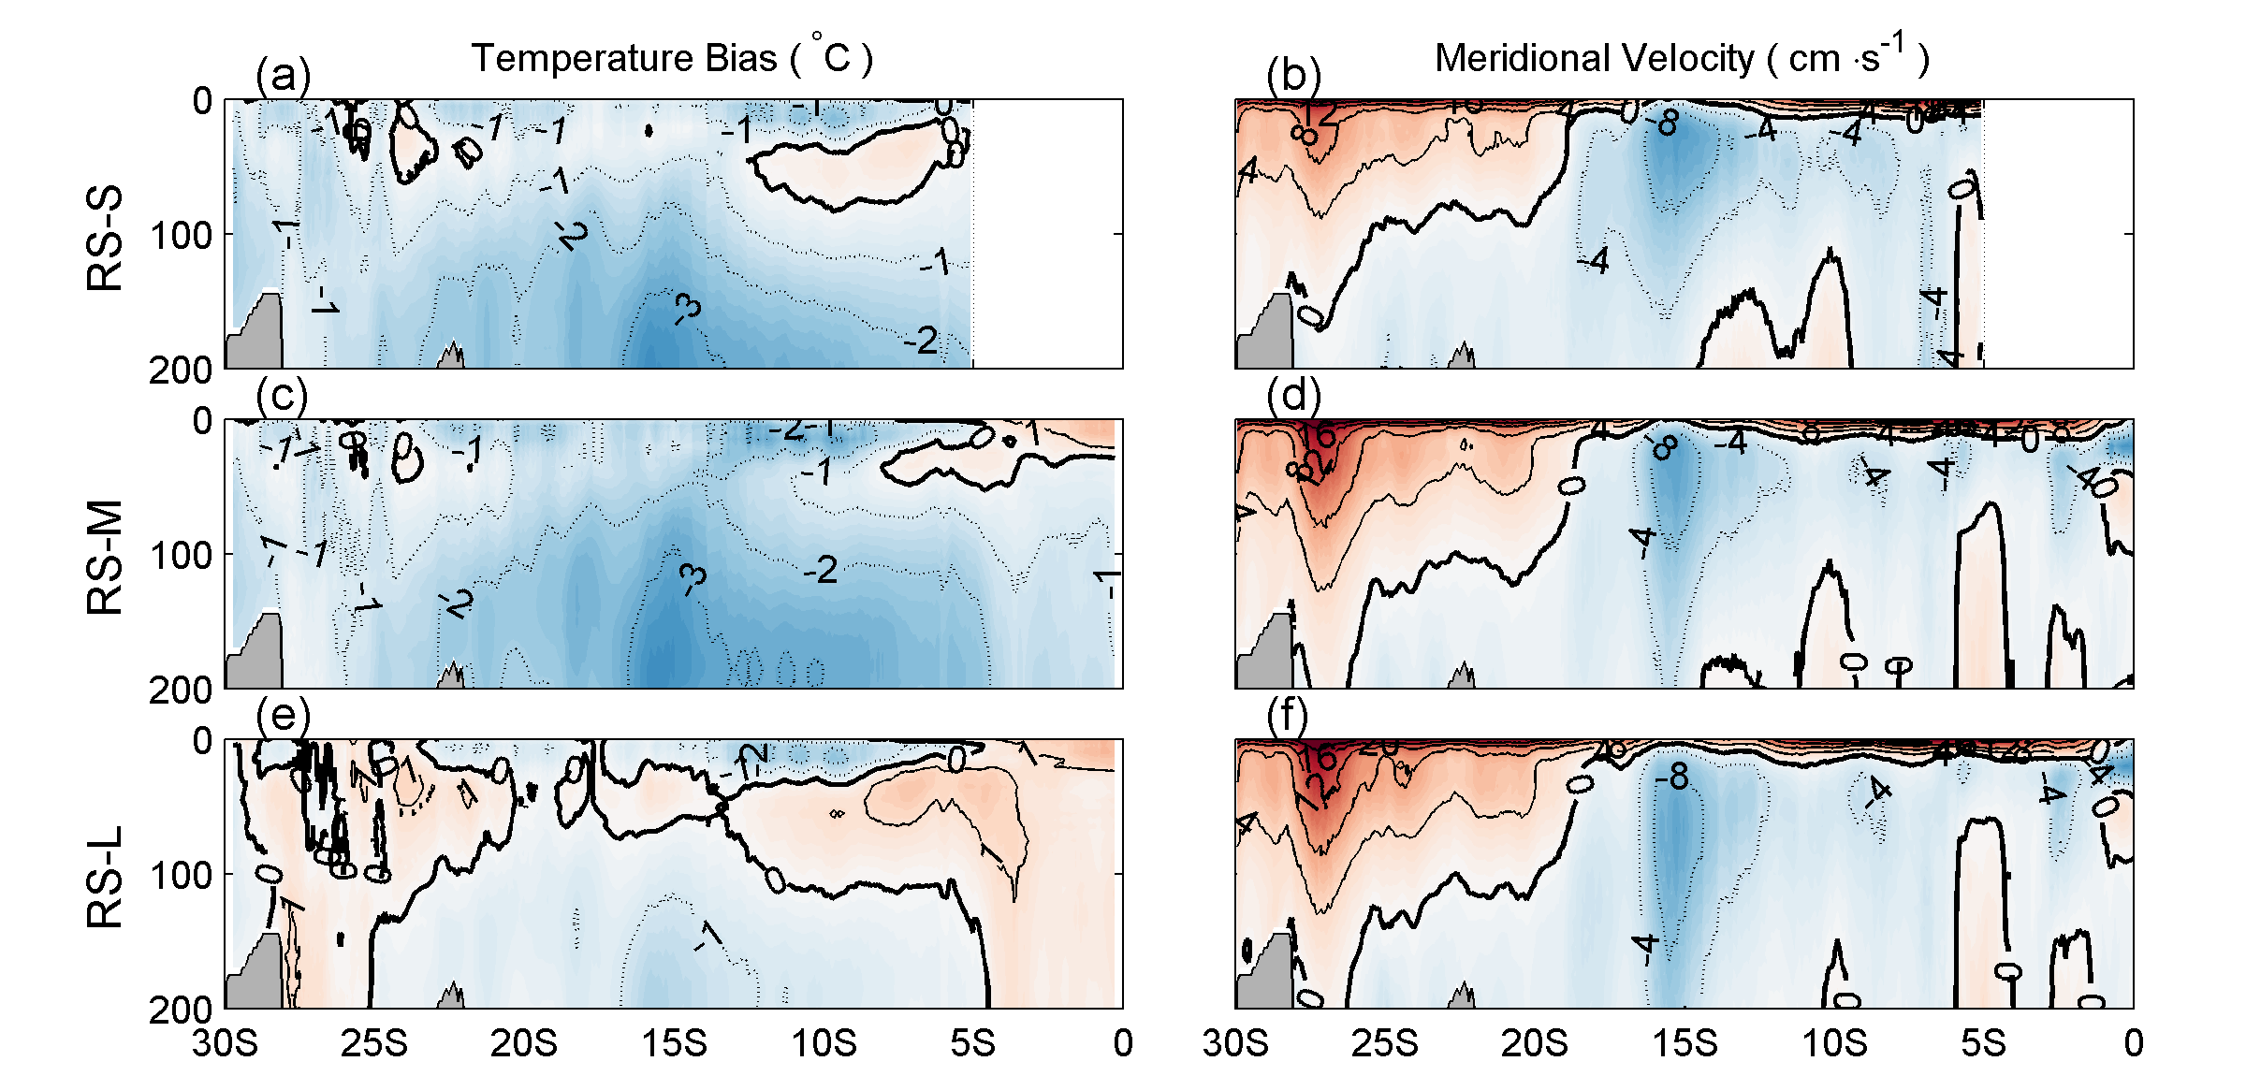
Alongshore Temp Bias and Velocity
Upwelling
Subsurface Warm Bias
The large subsurface warm bias in the basin simulation comes from remote sources and the alongshore flow is determined locally.
Notes:
The reason is that in the regional simulations the strong warm bias in the thermocline off the Angola coast is much reduced. Therefore, we propose the thermocline warm bias off the Angola comes from remote sources. Once formed, it is being advected by the Angola undercurrent to the Benguela upwelling zone, where the subsurface warm bias is being brought up to the surface.

Slide 13
Summary
The Tropical Atlantic bias problem remains very severe in the CMIP5 ensemble, comparable to or even worse than that in the CMIP3 ensemble. The warm SST bias in the southeastern tropical Atlantic can have an impact on not only the Atlantic ITCZ bias, but also the ITCZ bias in the other basin.
The equatorial Atlantic SST bias is not only attributed to the atmospheric deep convection bias over the Amazon, which is sensitive to model physics parameterizations, but also to local feedbacks in the eastern basin.
The Benguela coastal SST bias appears to have an oceanic origin, as suggested by ocean-only model simulations forced by observationally-derived atmospheric forcing field. One systematic error common to all CMIP5 models is the overshoot of the Angola Current. Simulated latitudes of the ABF are strongly correlated (~0.66) with magnitudes of the SETA SST bias. The other is the overly diffused thermocline along the Angola coast, which generates a severe subsurface warm bias, contributing to the warm SST bias off the Benguela coast via upwelling dynamics.
High-resolution regional modeling approach offers some promising perspectives on reducing the Atlantic SST bias. It is shown that a high-resolution regional ocean model can remove the Benguela coast SST bias by 1) resolving the ABF and 2) reducing subsurface warm bias along the Angola coast.
A high-resolution coupled regional climate model, consisting of WRF, ROMS and CLM, has been developed in the framework of CESM coupling software (CPL7). Initial tests show that the model simulates more realistic tropical Atlantic climate with reduced SST and ITCZ biases.

