Slide 1
Including albedo affects in IAM scenarios
KATE Calvin, ANDY Jones, Jae Edmonds, William Collins
14 May 2014
PNNL-SA-97327

Slide 2
MOTIVATION

Slide 3
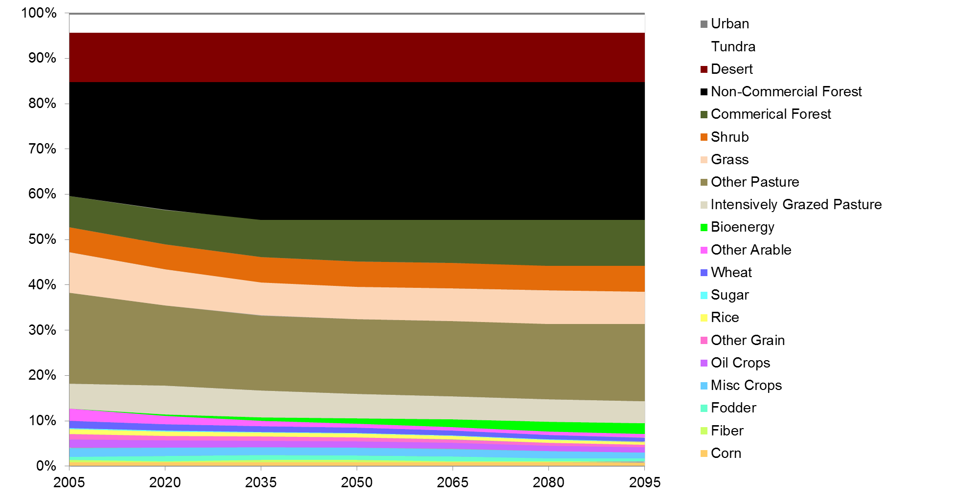
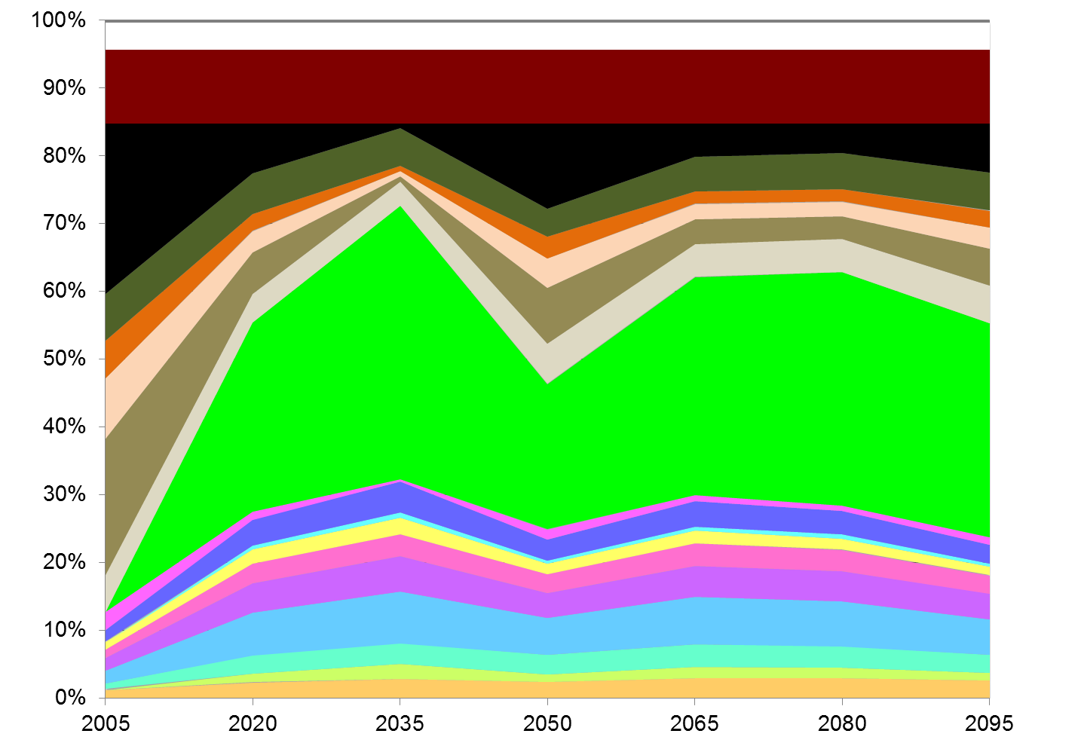
Quantifying the effect of land cover on climate: Results using GCAM & CESM
We run two scenarios: RCP 4.5 (UCT) and Rep 4.5 (FFICT)
We hold total CO₂ and non-CO₂ GHG emissions fixed and run the two scenarios that limit year 2095 radiative forcing to 4.5 Wm⁻².
In RCP 4.5 (UCT) we use the original RCP 4.5 land use.
In Rep 4.5 (FFICT) we use the alternative land use—the ONLY thing that is different between the two.
RCP 4.5 (UCT)
Rep 4.5 (FFICT)
Calvin et al. (2014). Near-term limits to mitigation: challenges arising from contrary mitigation effects from indirect land-use change and sulfur emissions. Energy Economics.

Slide 4
Quantifying the effect of land cover on climate: Results using GCAM & CESM
RCP 4.5 (UCT)
Large change—0.6Wm⁻² change in climate forcing from the alternative (Rep 4.5, FFICT) land-use policy assumption.
Change is almost immediate
Time scale of the change from direct physical effects is a decade—in addition to changes in the atmospheric composition of GHGs.
Well within a decadal (up to 40-year) time horizon.
Rep 4.5 (FFICT)
Rapid Change in PHYSICAL Forcing
Comparison between Rep 4.5 and RCP 4.5
Rep 4.5 is shown to be cooler, with rapid transition under Rep 4.5
Jones A et al. (2013) Greenhouse gas policy influences climate via direct effects of land-use change. Journal of Climate 26:3657-3670.

Slide 5
COMPUTING ALBEDO

Slide 6
Forcing is determined by both surface and atmosphere
Steps to calculate forcing in CESM:
First we compare surface properties of woody vegetation (forests and/or shrublands) to non-woody vegetation (grassland and/or cropland) in each zone while holding atmospheric forcing constant
Next, we use an offline radiative transfer model (PORT) to compute top-of-atmosphere flux associated with conversion from woody to non-woody vegetation

Slide 7
Incorporating albedo into GCAM
Land conversion:
At each timestep, for each region, we compute the amount of land that is converted from woody vegetation to non-woody vegetation in GCAM.
Albedo:
The change in albedo is computed by multiplying the albedo factors and the amount of land converted for each region, and then summing over the regions.
This change in albedo is passed into MAGICC.

Slide 8
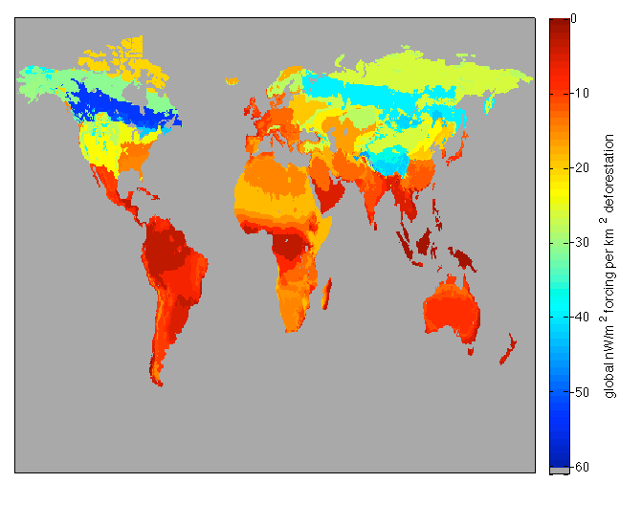
Albedo Factors by GCAM Region
global nW/m² per km² conversion
Greatest forcing in Boreal forest zones and Tibetan plateau
Results are function of vegetation, insolation, and clouds

Slide 9
RESULTS

Slide 10
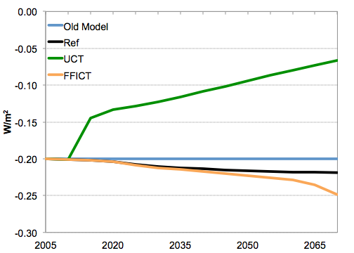
Forcing from Land-Use Change: Revisiting our Original Scenarios

Slide 11
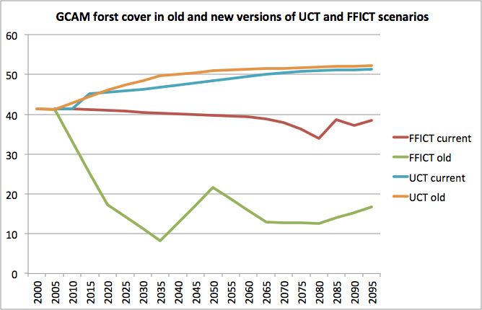
Why is the forcing smaller than the original experiment?
Forest Cover (M km^2)

Slide 12
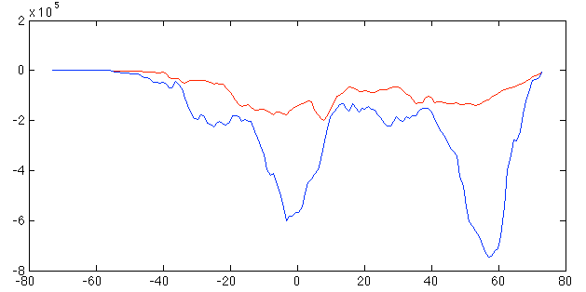
Why is the forcing smaller than the original experiment?
land converted (km^2)
latitude

Slide 13
Effect of including albedo in policy targets

Slide 14
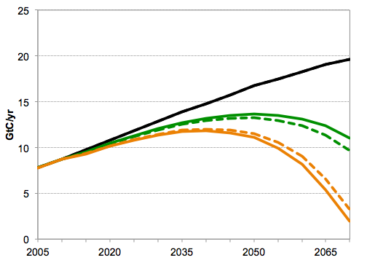
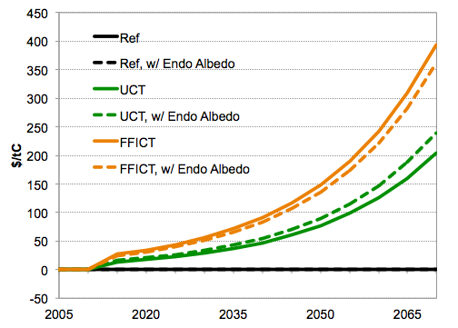
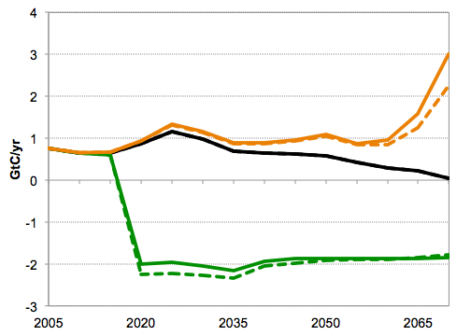
Fossil Fuel Emissions
Carbon Price
Land-Use Change Emissions

Slide 15
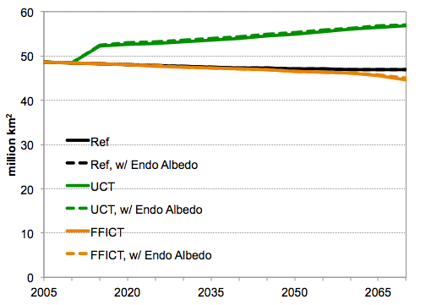
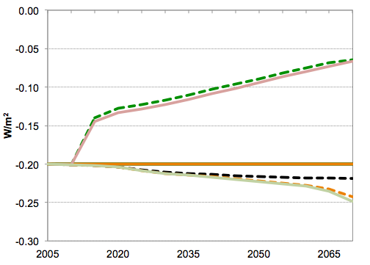
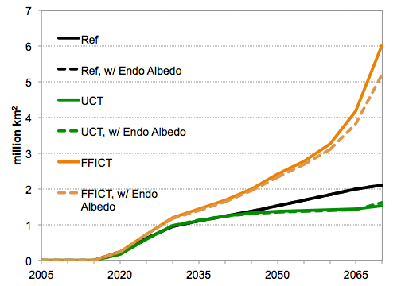
Forest and Shrub Cover
Albedo Forcing
Bioenergy Crop Area

Slide 16
Some Conclusions
Albedo forcing (and climate effect) of land-use change can be quite significant
Newer GCAM estimates lower rates of deforestation
We can now diagnose albedo change within GCAM
Including albedo in forcing targets feeds back onto energy and land-use systems
Less deforestation in FFICT despite forcing “bonus”

Slide 17
Remaining questions
Given the regional nature of land-use forcing, how do we understand climate implications of equivalent forcing in different locations? Perhaps with pattern scaling?
For impacts research, regional climate is what is critical not global mean temperature rise.
See Jones et al. (2013) GRL paper on differences between albedo and GHG forcing
How different do land cover patterns have to be to induce a significant difference in climate?
We have conducted some scenarios that have differences, but we haven’t systematically tested this.

Slide 18
discussion

