Slide 1
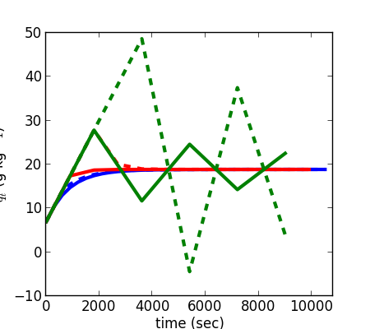
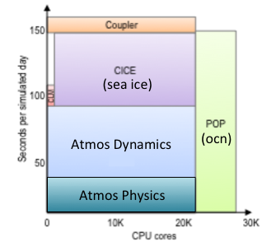
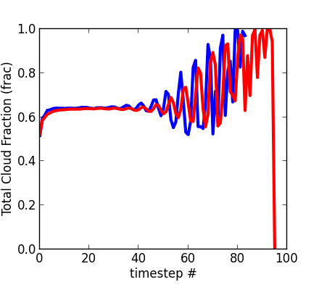
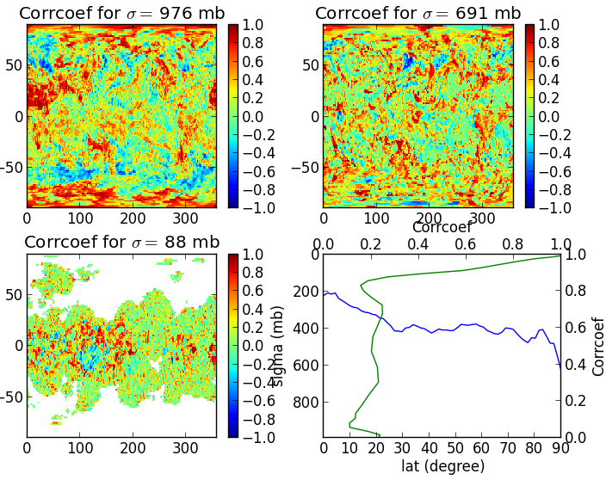

Improving Throughput of the ACME Climate Model by Parallel Splitting Atmospheric Physics and Dynamics
Peter Caldwell (LLNL)
Mark Taylor (SNL)
1. Introduction
3. New Approach: Lagged Physics
For intellectual and numerical tractability, climate models are broken into components (Fig. 1) and sub-components which are connected by coupling assumptions. Some popular coupling approaches are shown in Fig. 2.
Since dynamics returns a state rather than a tendency, the typical parallel splitting in Fig. 1A will not work. The easiest approach is to lag the physics tendency passed to dynamics by one step, which enables us to rewrite Fig. 1C as:
A. Parallel Split: All processes are computed from the same state
Lagged-Parallel Split: Proc1 can run at the same time as Proc2 if its output isn’t needed until a timestep later
state^{n}
Proc1
tend1^{n}
state^{n+1}
tend1^{n-1}
Proc1
tend1^{n}
Proc1
tend1^{n+1}
q_{t} (g kg⁻¹)
Fig. 5: Behavior of simple box model for water inflow/rain-out with lagged (dashed) and unlagged (solid) rain rate. Forward Euler timestepping is used for each simulation.
Proc2
tend2^{n}
state^{n}
Proc2
state^{n+1}
Proc2
state^{n+2}
dt = 300 s
dt = 900 s
dt = 1800 s
B. Sequential-Update Split: The state is updated after each process
Fig. 4: Our approach for parallelizing physics and dynamics in the ACME model.
state^{n}
Proc1
tend1^{n}
state^{n*}
Proc2
tend2^{n}
state^{n+1}
We get a sense of the impact of this change by applying lagging to a very simple system where water q_{t} flows into a cell at a constant rate C and falls out according to the Kessler (1969, Meteorol. Monogr.) precipitation equation
K(q_{t})=max(0, k*(q_{t} – q_{s} – a))
where k=0.001, a=0.0003, and q_{s}=0.7 g kg⁻¹ is an assumed saturation mixing ratio. Lagging K(q_{t}) is shown in Fig. 5 to have little impact at small dt but causes the model to go unstable at smaller dt than the unlagged version. This is perhaps unsurprising because lagging one process prevents the other process from acting to remove instabilities immediately as they occur.
C. Sequential-Tendency Split: The tendency from Proc1 is used by Proc2
state^{n}
Proc1
tend1^{n}
Proc2
state^{n+1}
Fig 1:Optimal performance layout for high-res CESM1 run on Titan (achieves 1.5 SYPD). Adapted from ACME proposal.
Fig 2: Three popular ways of coupling processes in climate models.
Sequential splitting is generally thought to be better (Beljaars et al 1991, Lederink and Holtslag 2000) though Bates (1998) and Williamson (2002) found less difference between methods. Lack of differentiation between sequential-update versus sequential-tendency splitting in previous studies may have contributed to this inconsistency.
While sequential splitting may yield a better climate, running processes in parallel on separate processors could have huge benefits in terms of throughput on huge supercomputers:
Run time is significantly reduced by doing multiple process computations at once
Scalability on massively parallel systems is improved
Parallel splitting of atmospheric physics and dynamics (defined below) is particularly appealing because physics is embarrassingly parallel across atmospheric columns, so more sophisticated physics can be used without time penalty by increasing the physics processor count.
The goal of this study is to explore the feasibility of parallel splitting for physics and dynamics in the ACME v0 climate model.
Unfortunately, lagging also causes instability in the ACME model (Fig. 6). Strangely, the ACME model goes unstable at the same step count regardless of dt. This suggests there is a bug in the parallel implementation. This could occur, for example, if somewhere in the code a tendency is computed using the difference between the current state and a state saved from the last step. We have fixed these sorts of issues where we know of them (e.g. in macrophysics) but finding all instances is like looking for a needle in a haystack.
dt = 30 min
dt = 1 min
Fig. 6: Global-Average vertically-integrated cloud fraction as a function of timestep.
One obvious way to improve upon on the lagged approach is to estimate physics tendencies at the current step using older information. Unfortunately, the predictive power from previous timesteps is spotty and relatively weak (Fig. 7) because of the long (30 min) timesteps used in the model.
2. Current Approach
Physics and dynamics in the ACME model are currently sequential-tendency split (see Fig. 2C). Because dynamics uses several levels of substepping (see Fig. 3), it returns a state rather than a tendency. This precludes the typical parallel-split implementation shown in Fig. 2A.
Fig. 7: Correlation between water vapor predicted by extrapolating from previous two steps versus actual modeled values. Panels show lat/lon cross sections at various model levelsn except for bottom right, which shows the vertically-averaged longitudinal distribution (blue) and the horizontally-averaged vertical distribution (green)
“Dynamics”:
Physics tendency is passed to dynamics
6. Conclusions
There are nsplit vertical remap steps per physics step
“Physics”:
Convection
Macrophysics
Microphysics
Radiation
Surface fluxes
Turbulence
Applying physics and dynamics in parallel has huge potential for improving climate model scalability and simulation throughput on massively parallel computers.
The complexity of modern climate models makes implementing coupling changes difficult
  Substepping ⇒ dynamics returns a state, precludes traditional parallel splitting. Can we turn that state back into a tendency?
  The immensity and complexity of the ACME code base makes Identifying locations where proposed changes violate assumptions in the code extremely difficult.
There are qsplit dynamics steps per tracer step
There are rsplit tracer steps per remap step
sequential-tendency
split
State after dynamics returned to physics
Fig. 3: Schematic of processes in ACME atmosphere model.
This work is supported by the Regional and Global Climate and Earth System Modeling programs for the Office of Science of the United States Department of Energy. This work was performed under the auspices of the U. S. Department of Energy by Lawrence Livermore National Laboratory under contract DE-AC52-07NA27344. LLNL-POST-680050

