Slide 1
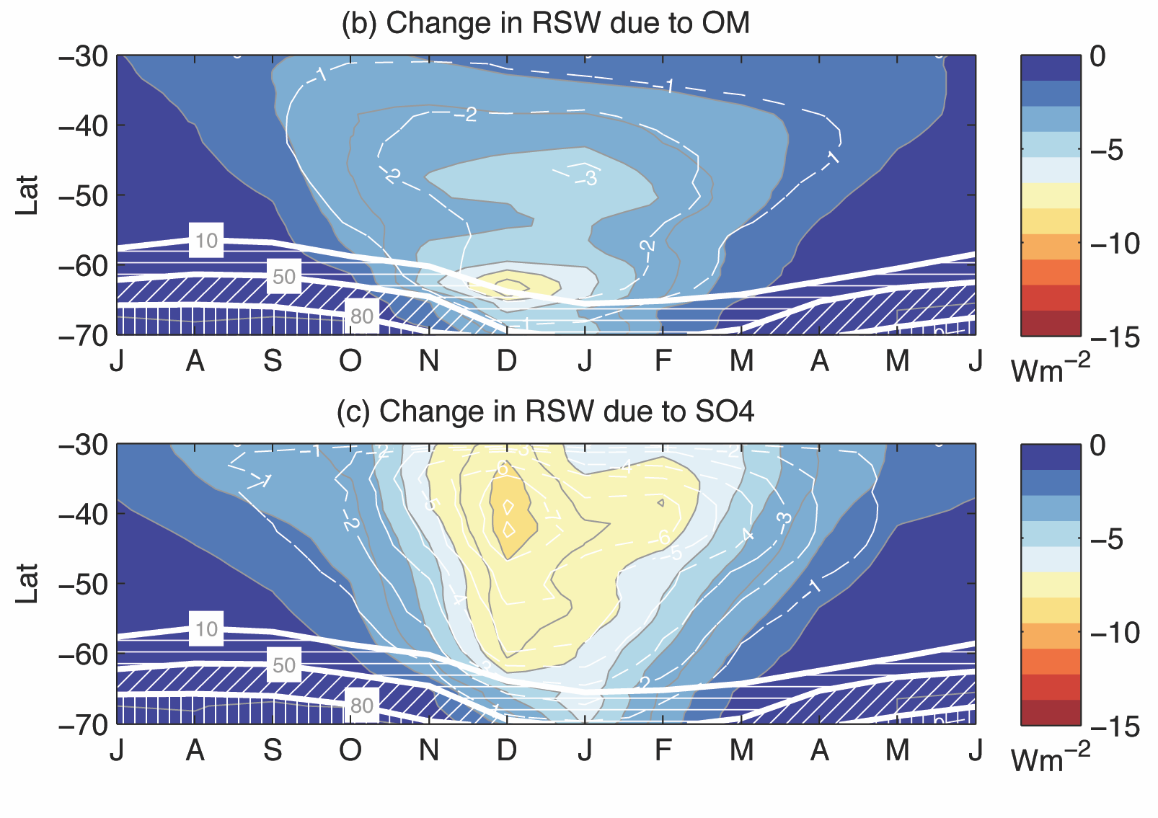
Marine organic matter in sea spray
Susannah Burrows, Phil Rasch, Scott Elliott, Richard Easter, Balwinder Singh
Adding marine organic matter as a source into ACME
In Y1, implementation into CESM has been completed, and is being evaluated
Implementation with offline ocean BGC fields planned for ACME v1
Analysis of satellite-observed CDNC shows that marine organic matter statistically predicts a portion of geographic and seasonal variability over the Southern Ocean, with statistically significant effects on radiation (McCoy, Burrows et al., under review).
Nd vs. SO4, binned into low-OM, intermediate OM, and high-OM groups

Slide 2
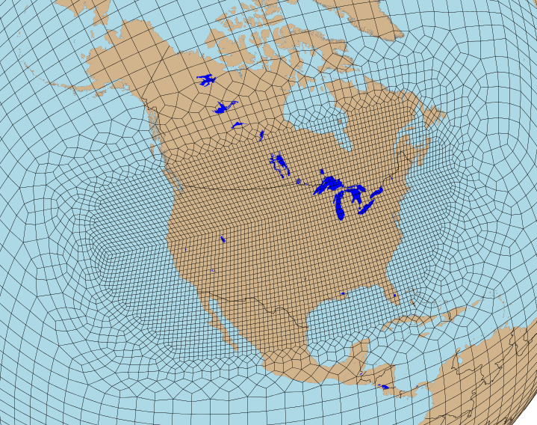
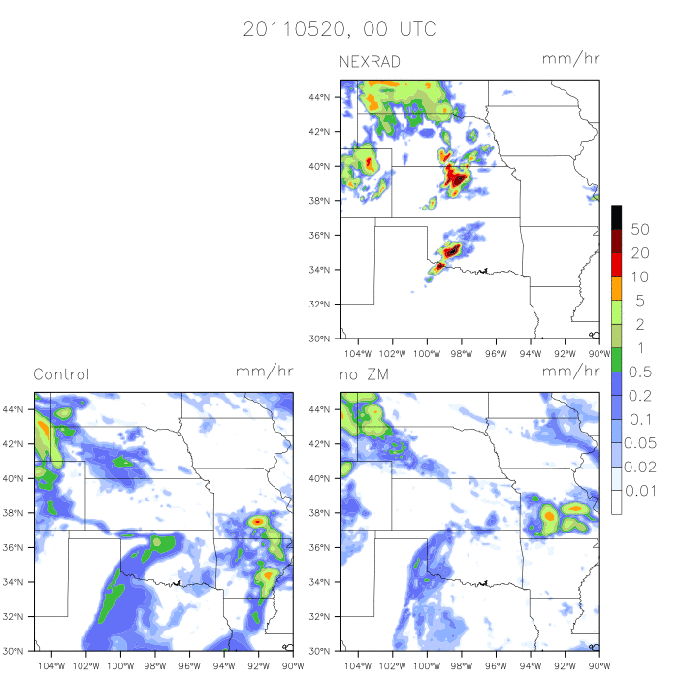
ACME Regionally-Refined Model (RRM) Status
Erika Roesler, Qi Tang, Wuyin Lin, Mark Taylor, Steve Klein
CONUS RRM is Nearly Ready for New Users!
  Prototype of regional refined model (RRM) free-running and nudging is ready for rest of Atmosphere team
    Code merged to ACME master
  How to build and run case CONUS from ACME master:
    Free-run:https://acme-climate.atlassian.net/wiki/pages/viewpage.action?pageId=20807739
    Nudging: https://acme-climate.atlassian.net/wiki/pages/viewpage.action?pageId=20153276
Major Q4/Q5 activities
  Scientific analysis to determine suitability of North-American RRM to study local characteristics of high-resolution climate.
  Testing alternative model formulations (vertical resolution and physics for V1) with CONUS RRM
Major Issue
  Creation of new RRM for Asia and Amazon for Water Cycle Experiments require more resources than available in Q4/Q5
  How much scientific analysis is needed to be sure of the RRM’s utility?
  Should we reduce our effort in our planned activities to give us time to create the new RRM for other regions?
  What area coverage and time-periods would be of most interest?
NEXRAD Obs.
Precipitation
May 20, 2011
RRM simulations
Default No Deep Conv.
Notes:
Figure shows the NEXRAD observations and 2 Regionally – Refined Model (RRM) simulations nudged to analysis data to simulate the meteorology of the day. The two RRM simulations include the standard CAM/ACME model and the model after shutting off the Zhang-McFarlane Deep Convection Scheme. Note however that the RRM used in the figures is not from the CONUS configuration which has 0.25 degree resolution, but is from the earlier CSSEF RRM which had 0.125 degree resolution.

Slide 3
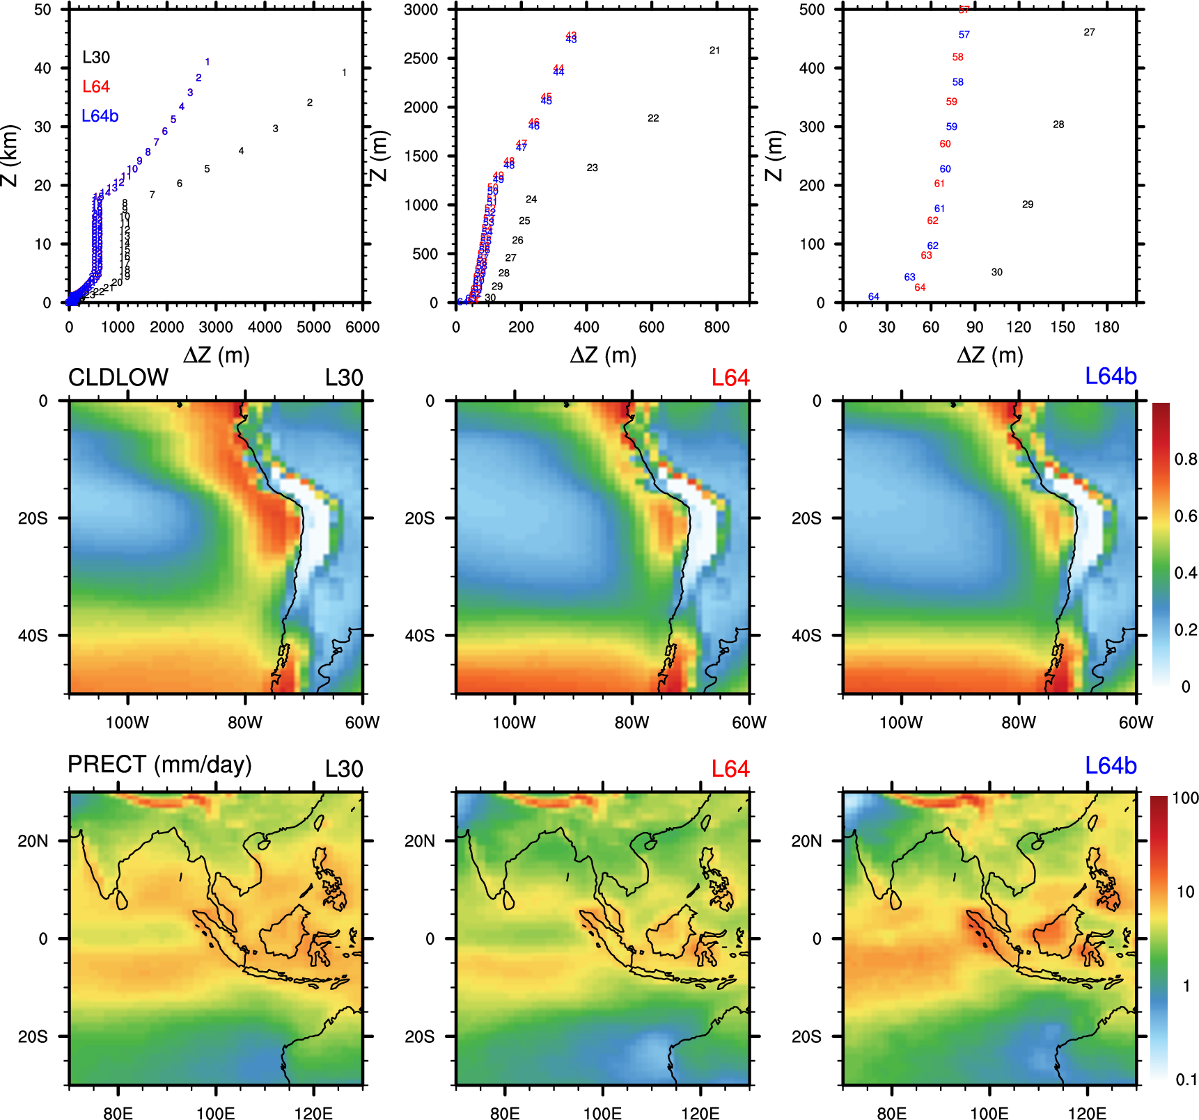
Vertical resolution sensitivity
Top row:
Configurations for the standard 30-level and two new 64-level models, for the atmosphere (left), lower troposphere (middle), and near the surface (right).
Middle row:
Reduction of stratocumulus clouds with increasing vertical resolution
Bottom row:
Vertical resolution sensitivity of tropical and monsoonal precipitation
Next steps:
Systematically test the vertical resolution sensitivity (L47, L50, L72)
Test the sensitivity with new model physics (e.g., aerosol, cloud, convection)
Some other vertical grids developed:
L47: doubling resolution above 5km
L50: doubling resolution below 5km
L72: based on L64b, but add 8 more layers above current
model top (raise model top to 0.1 hPa)

Slide 4
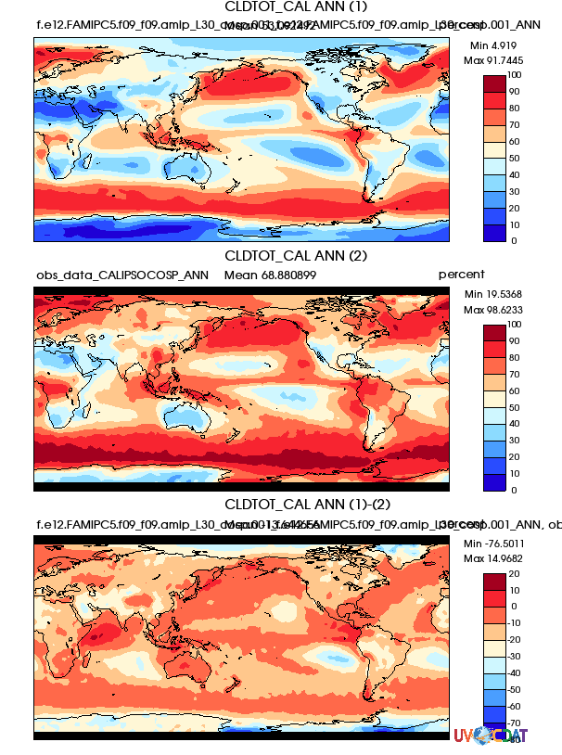
Applications of Simulators in ACME
Approach:
Satellite simulators (COSP) facilitate a meaningful comparison of models with observations
Tier 1b cloud collection of COSP diagnostics has been implemented in UVCDAT
Make progress on aerosol in lidar simulator
Problem:
COSP + OpenMP works fine on Titan and LC, but specifically has problems on Miran.
The memory requirements in COSP are too large for ne120 resolution.
CALIPSO Total Cloud Fraction
CAM5.3
OBS
CAM5.3 - OBS
Plan for Q4 and Q5:
Upgrade COSP and implement aerosol lidar simulator in ACME model
Make cloud collection of COSP diagnostics functioning and perform the testing for the AMIP ensemble runs of ACME model v0.1
As part of Convection task, examine the cloud simulations from the candidate convection schemes through simulator diagnostics
Notes:
Figure:
ANN CALIPSO total cloud fraction
Approach:
The simulators facilitate a meaningful comparison of models with observations by accounting for limitations or features of the observing process.
The cloud collection includes cloud diagnostics from multiple satellite simulators (ISCCP, MODIS, MISR, and CALIPSO).
Problem:
1. Without OpenMP slows the model down by a factor of 2-5.
2. For the memory issue, sub-column number has been reduced to the minimum at 10.

Slide 5
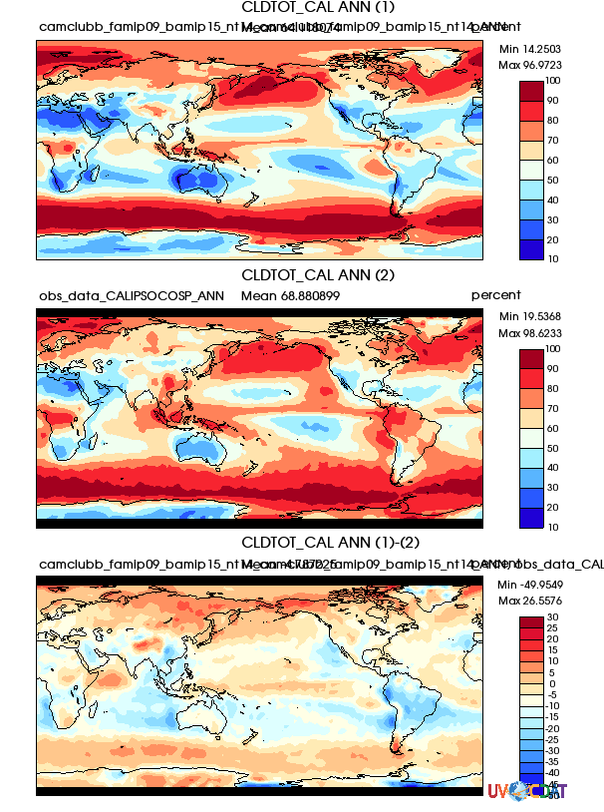
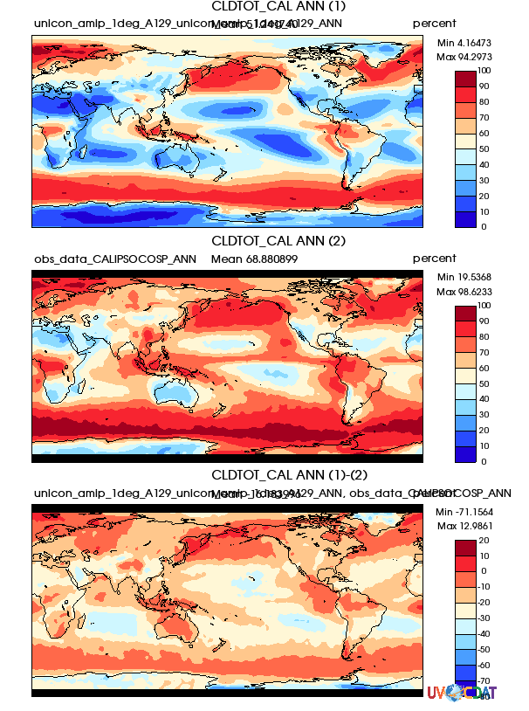
Applications of Simulators in ACME
CALIPSO Total Cloud Fraction
CAM5.3 CLUBB UNICON
OBS OBS OBS
CAM5.3 – OBS CLUBB – OBS UNICON – OBS
CALIPSO total cloud fraction increases with CLUBB whereas it decreases with UNICON
Comparisons with passive satellites (ISCCP, MODIS, MISR) show a similar results for total cloud fraction

Slide 6
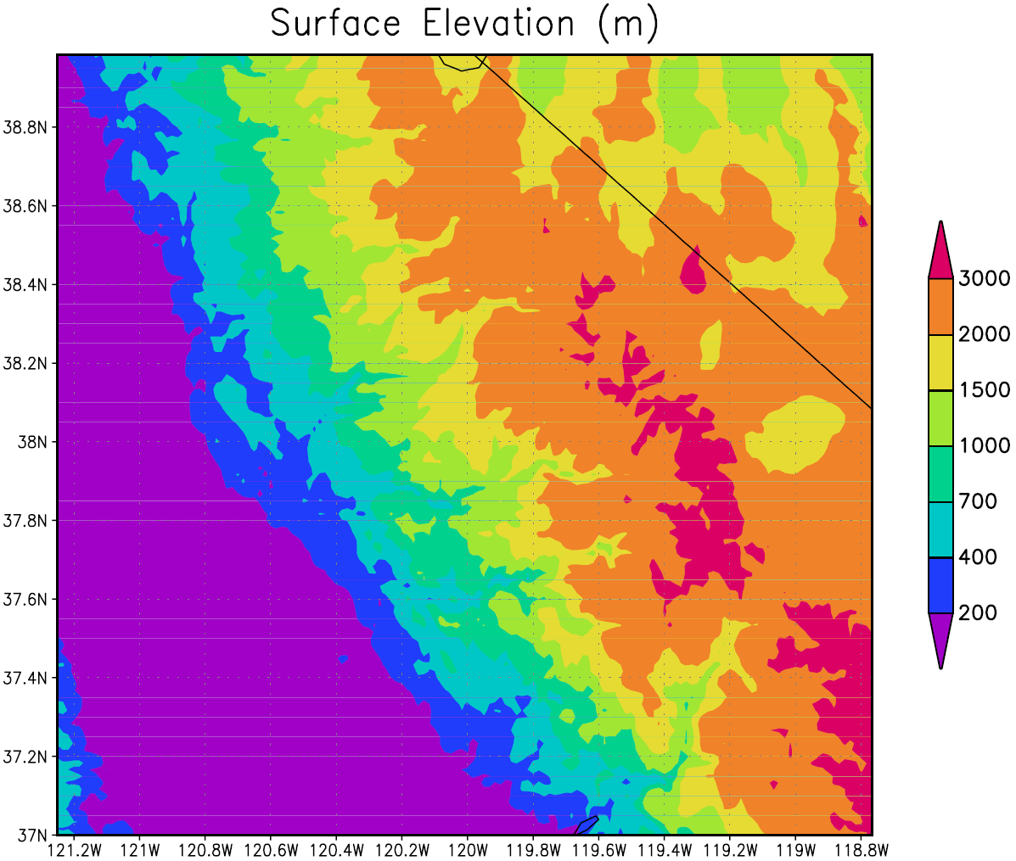
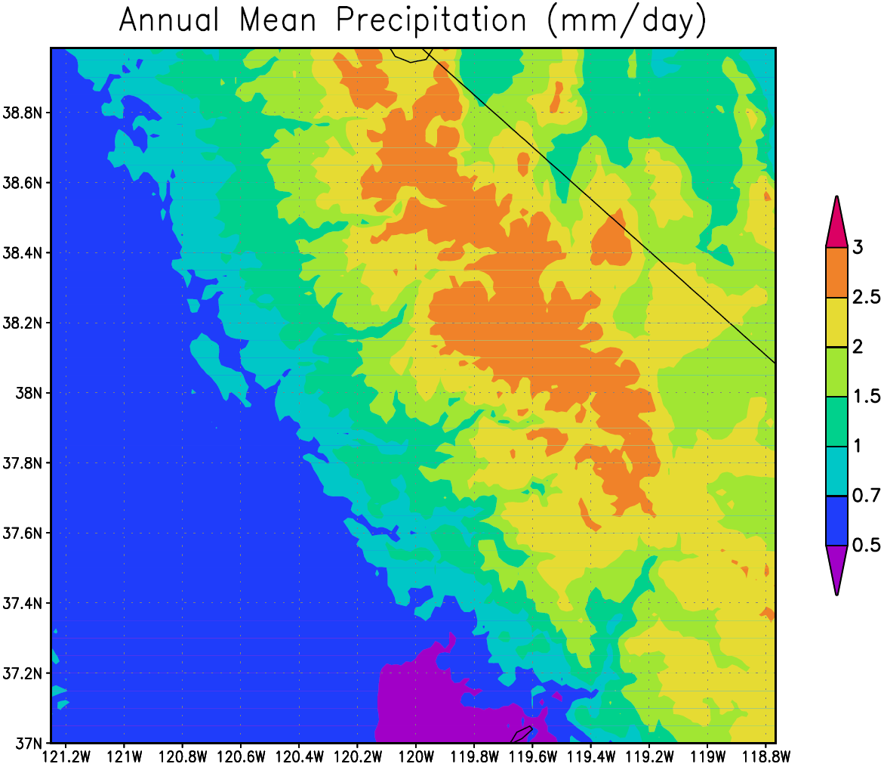
Subgrid Orography Scheme
input dataset
Pre
process
CAM simulation
online physics
CAM history
Post process
Notes:
The scheme begins with a global high resolution surface elevation dataset. Surface elevation for a grid cell over central California is shown in upper left. From the data the mean elevation and fractional area of each of a modest set of elevation classes is determined (upper right). That information is fed into the atmosphere and land models. All atmosphere and land physics is applied to each elevation class, and a simple model of airfow over topography is combined with conservation of energy and water to drive the different thermodynamics of the atmosphere for each elevation class. The physics consequently produces different results for each elevation class (lower right), which can be mapped in postprocessing according to the high-resolution distribution of topography (lower left).

Slide 7
Code Changes
Unlike any other parameterization
  All column physics applied to each elevation class
Mostly manifest at higher levels
  phys_grid
  phys_types
  dp_coupling
  history

Slide 8
Challenges
Breaking the assumption that physics and dynamics apply to the same columns
Distributing the heterogeneous number of physics columns across nodes
Mapping between atmosphere and land on different grids
Passing information through the coupler
Accommodating a variable ice sheet surface elevation

