Slide 1
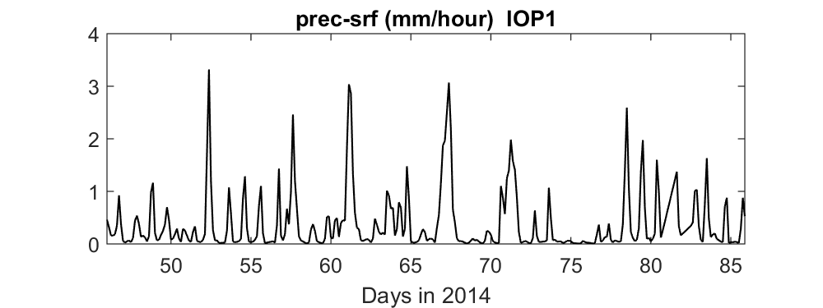
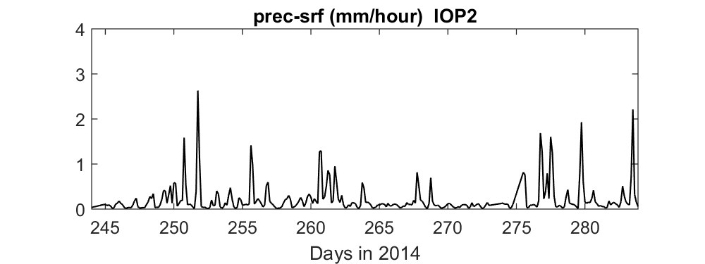
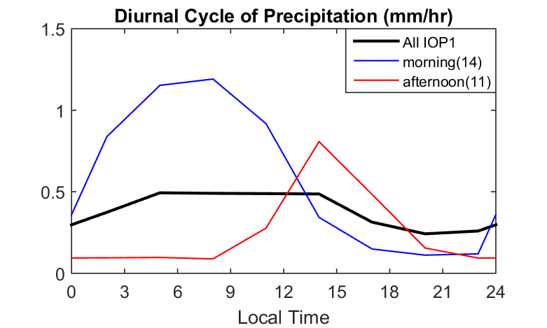
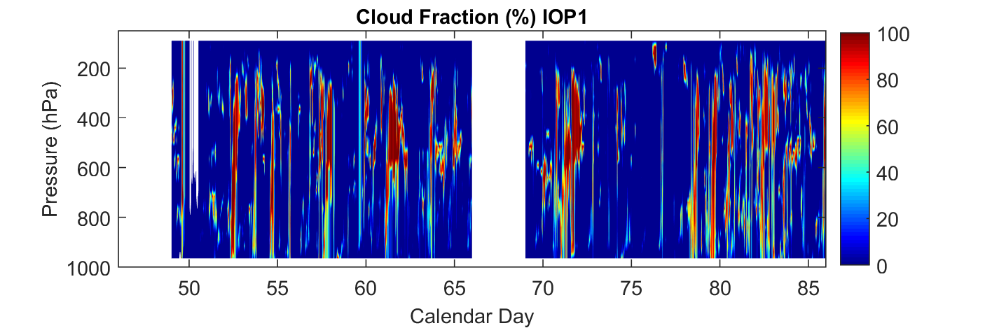
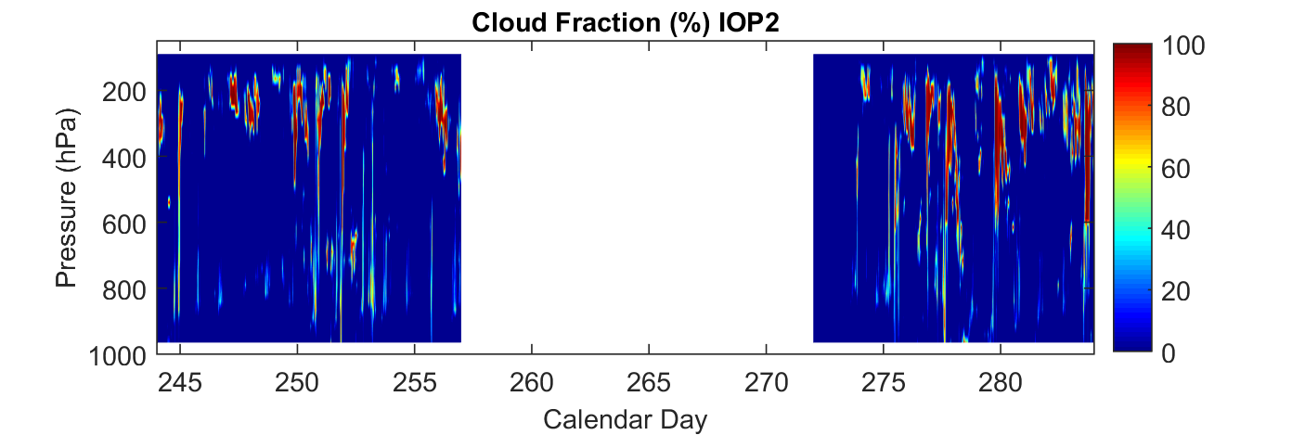
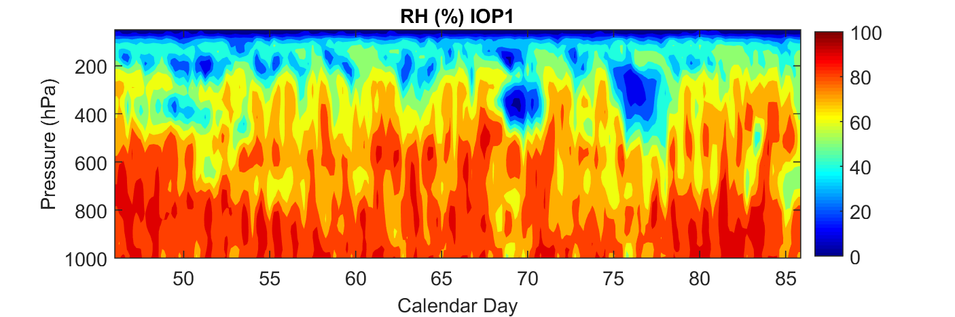
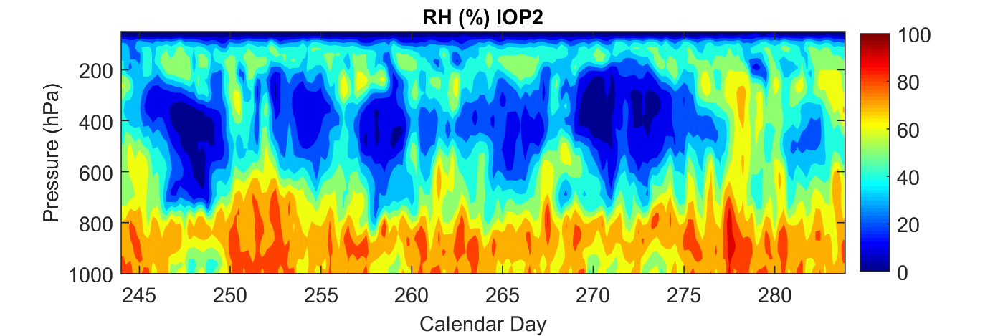
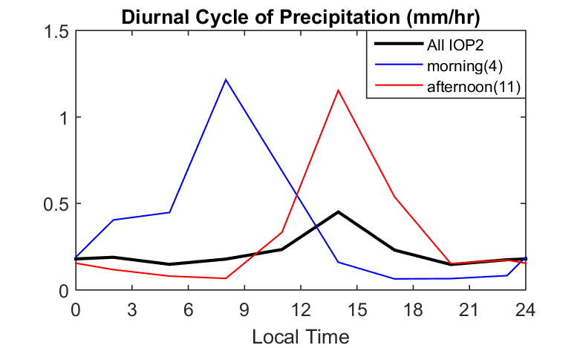
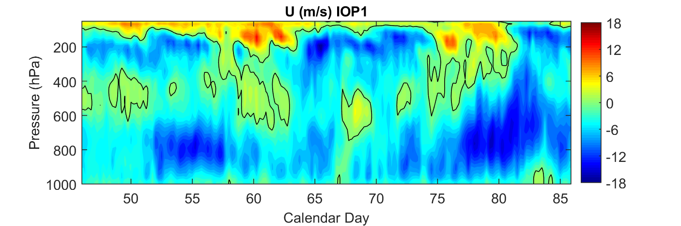
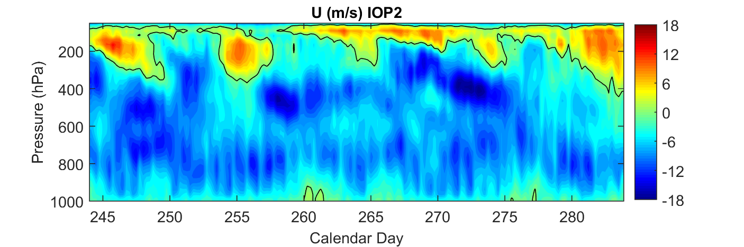
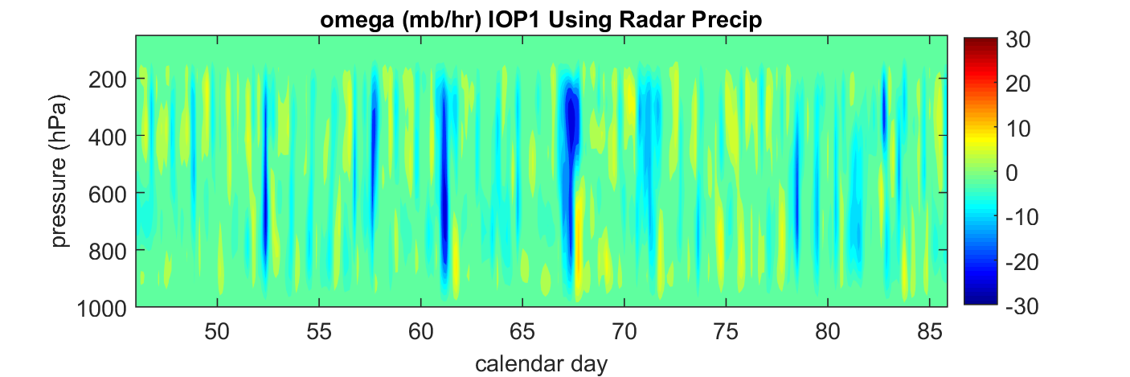
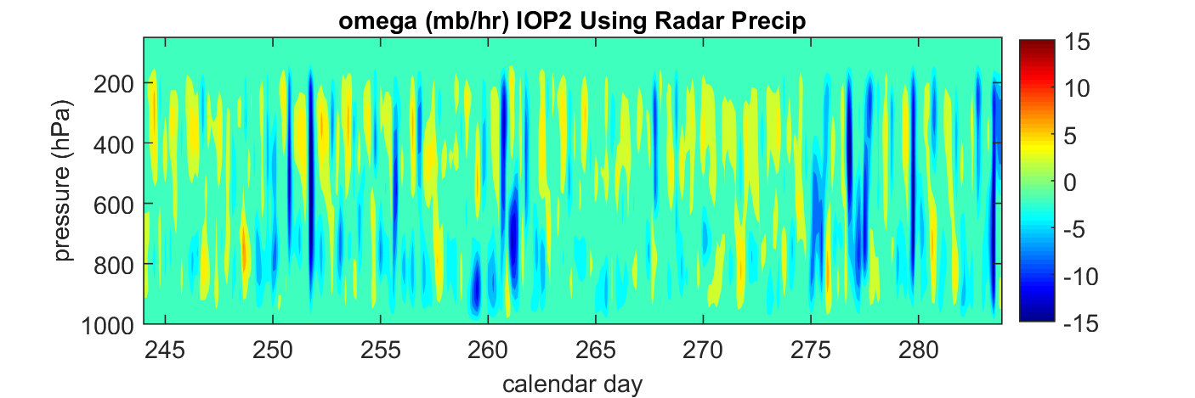
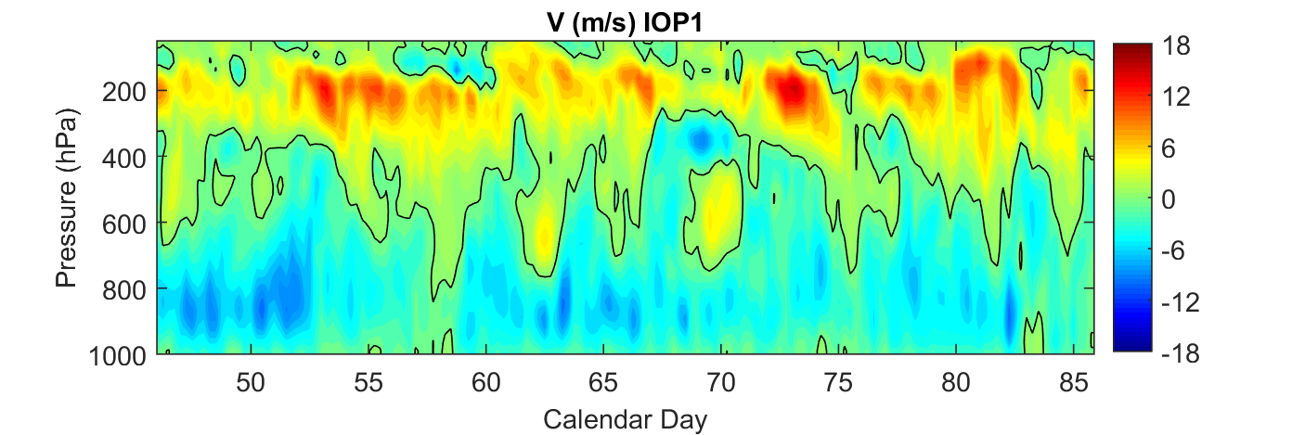
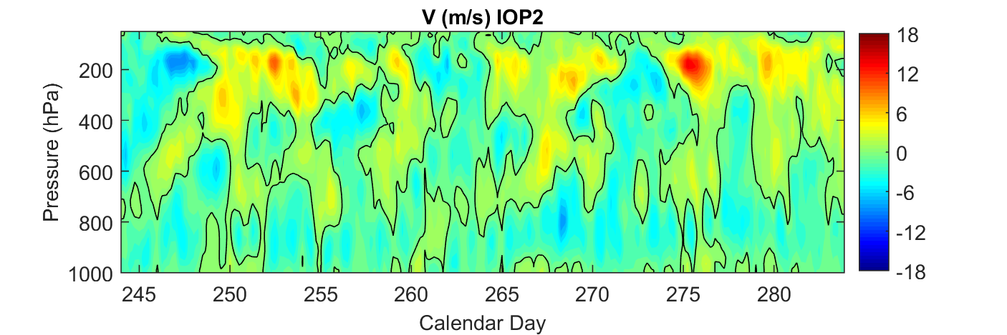
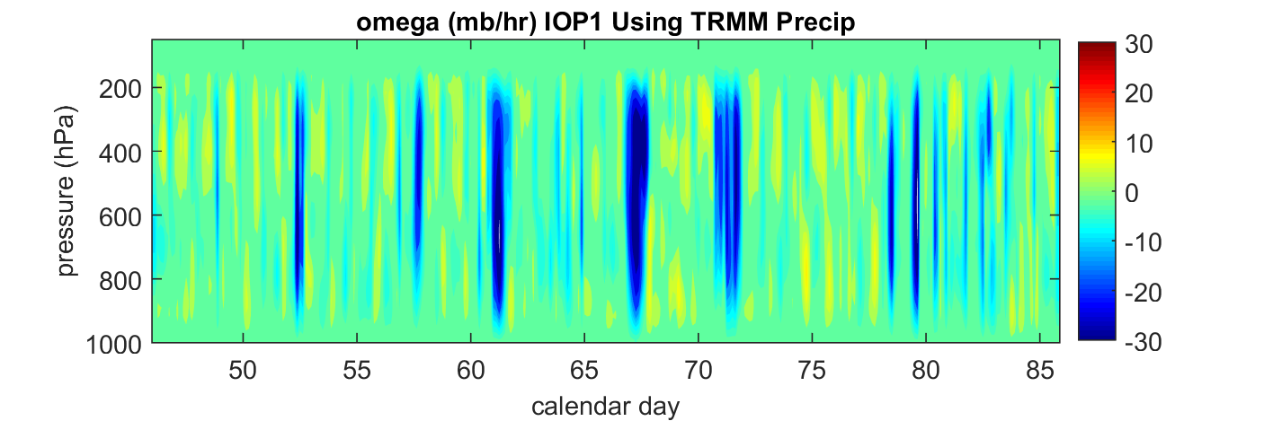
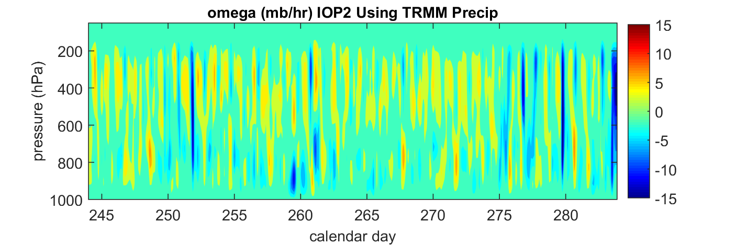
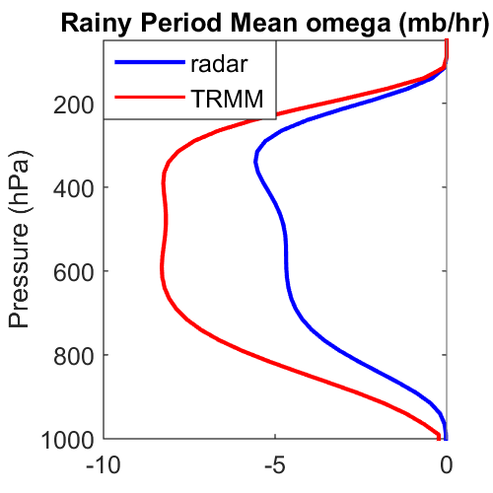
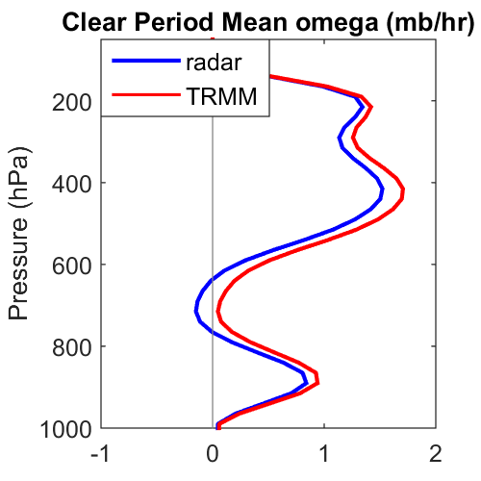
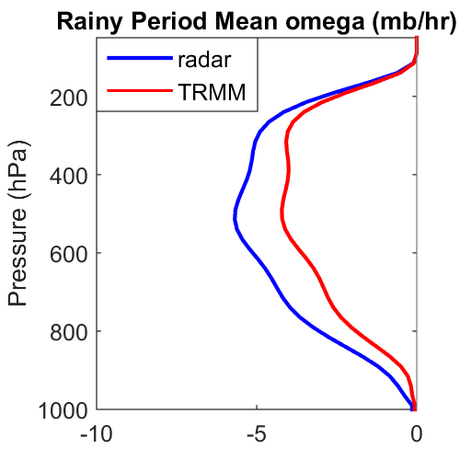
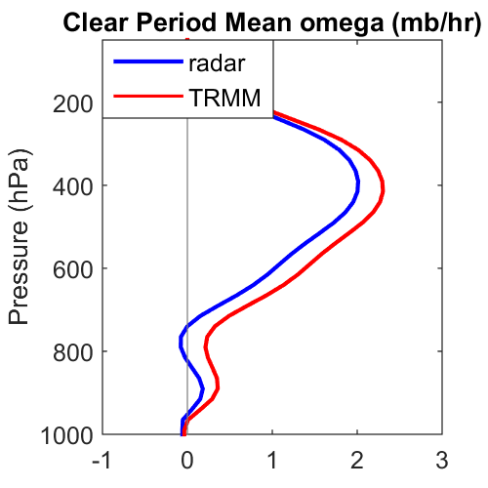
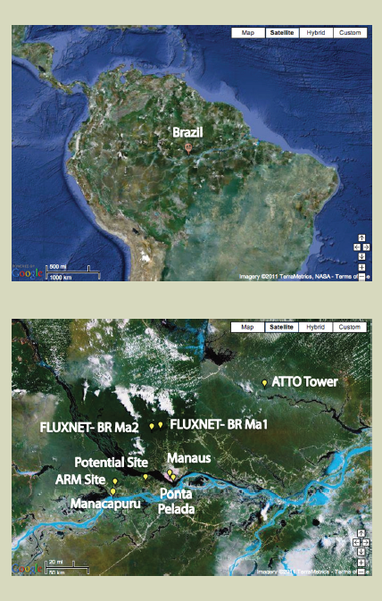
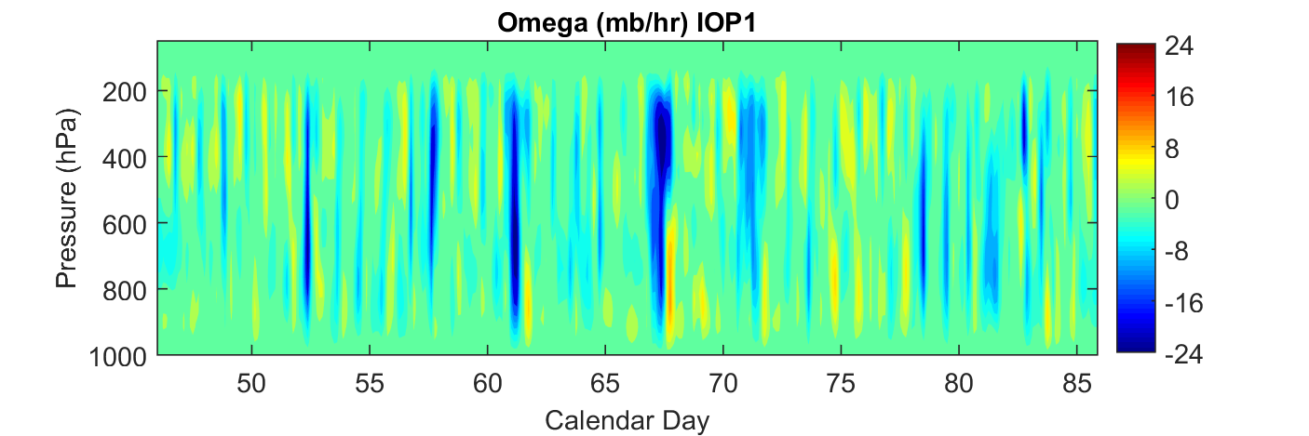
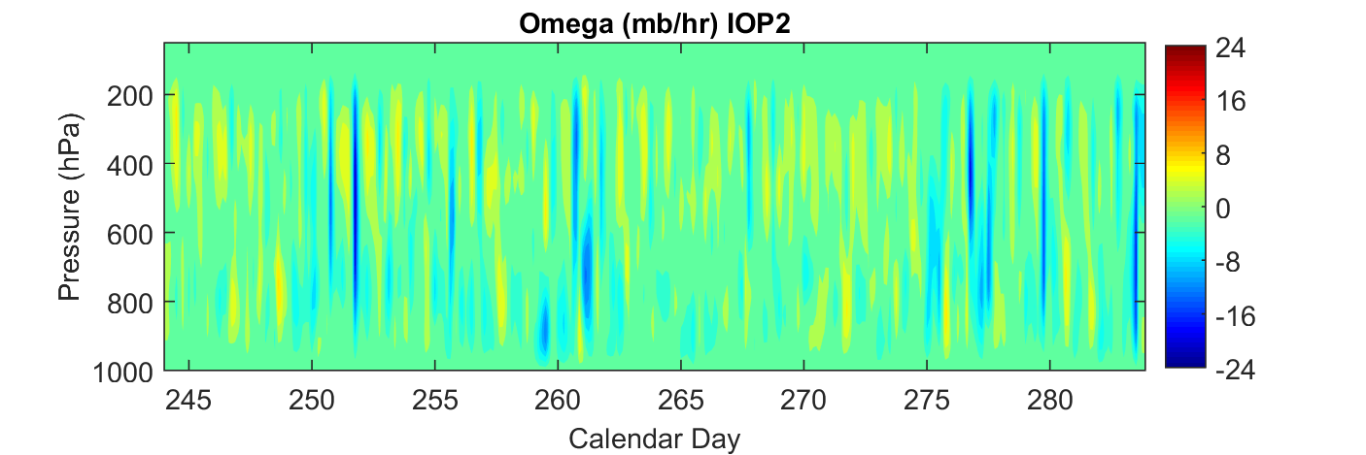
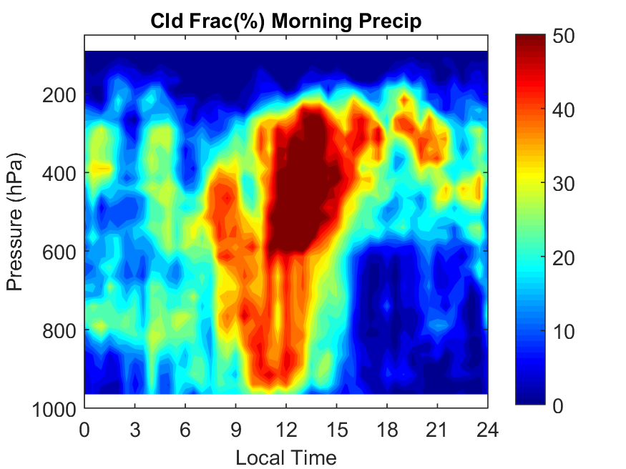
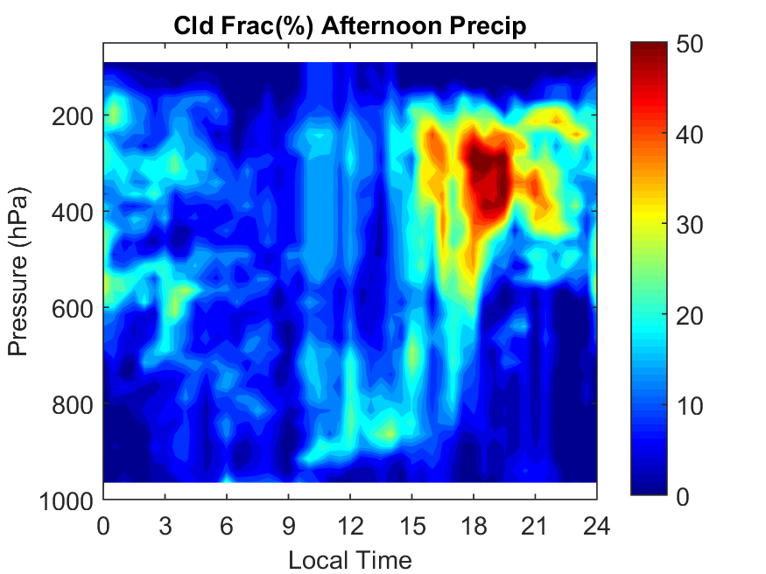
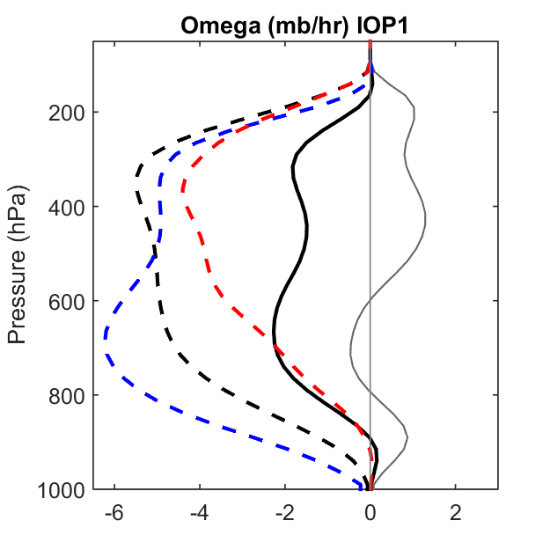
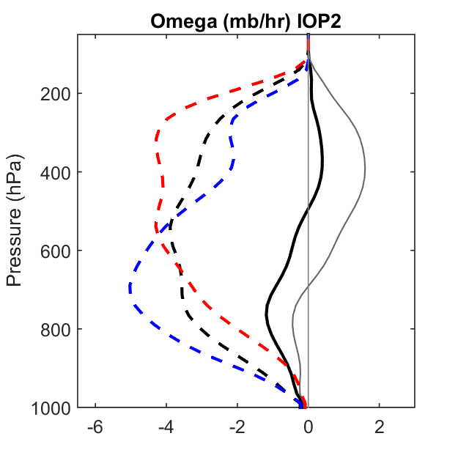
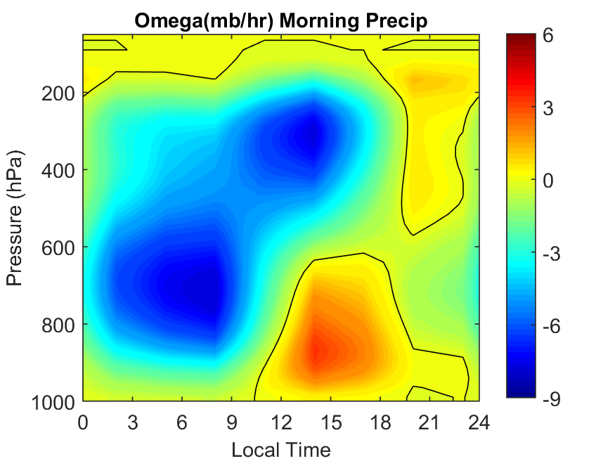
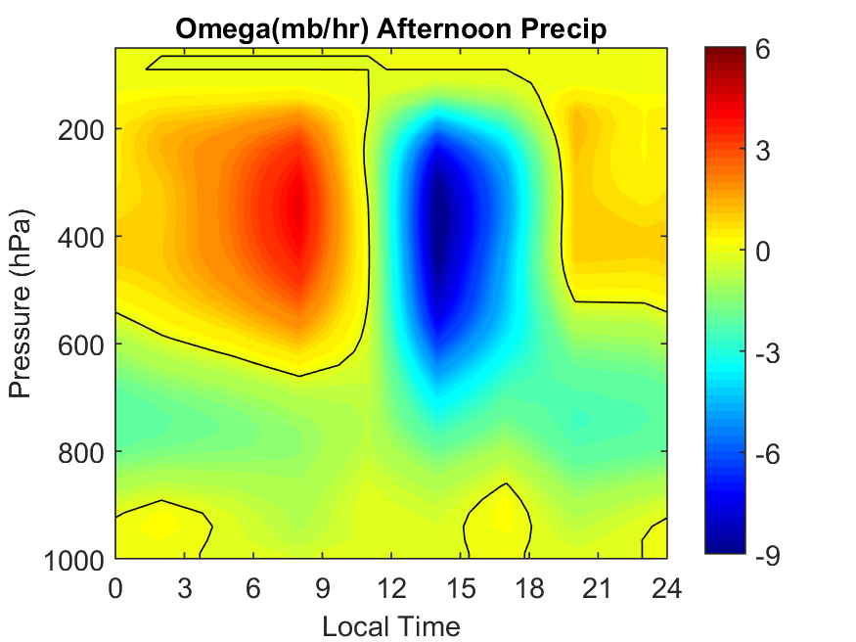
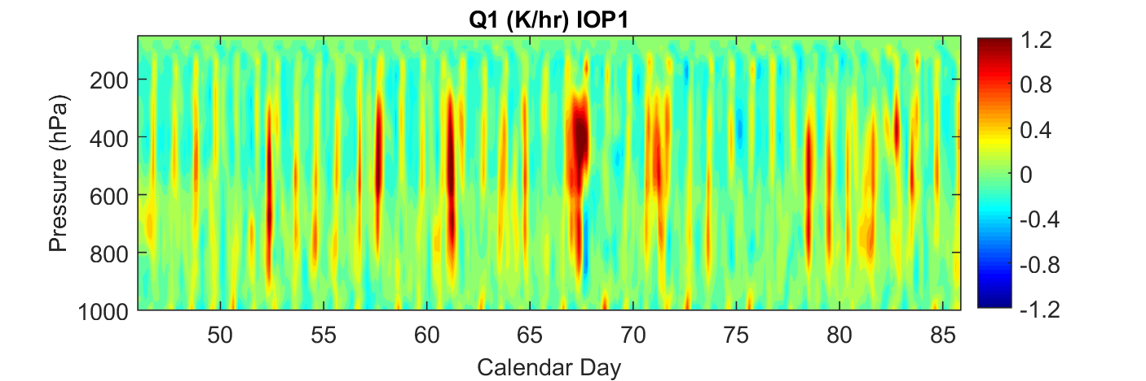
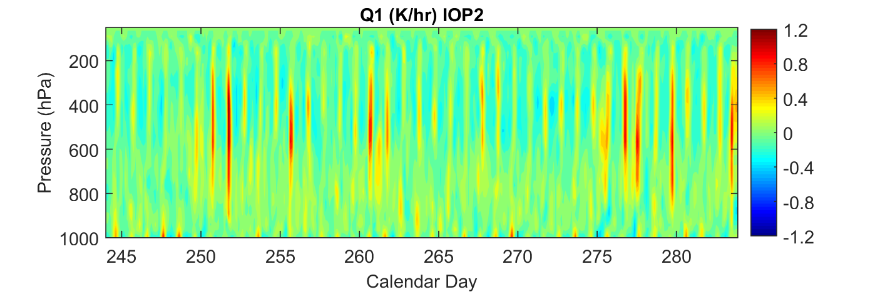
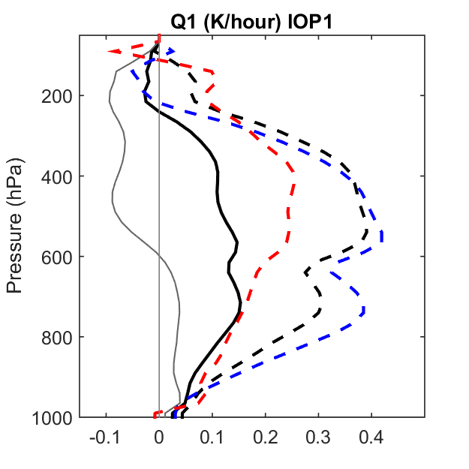
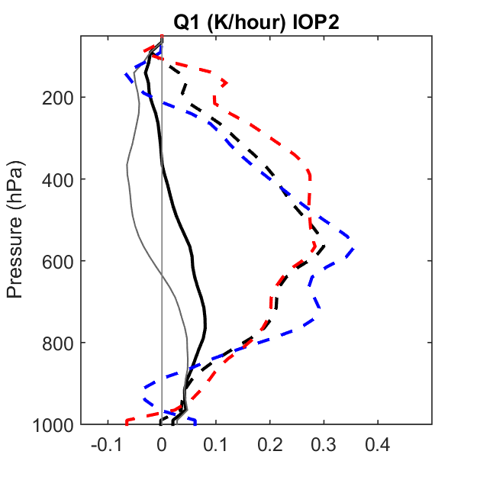
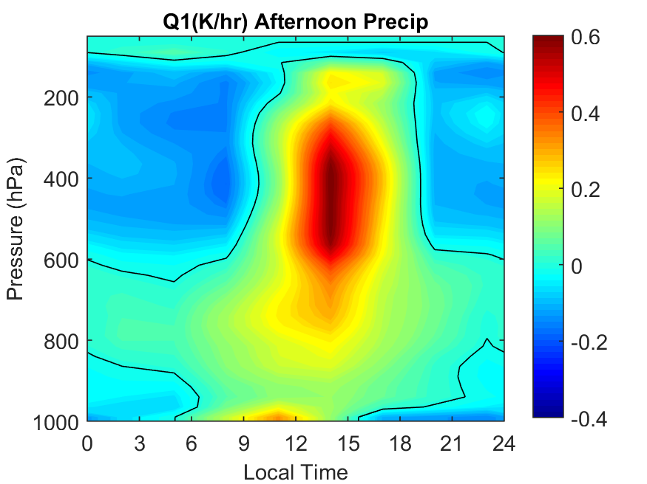
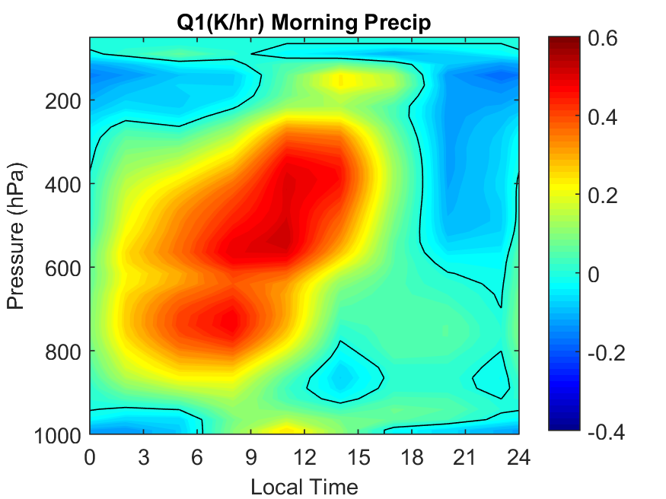
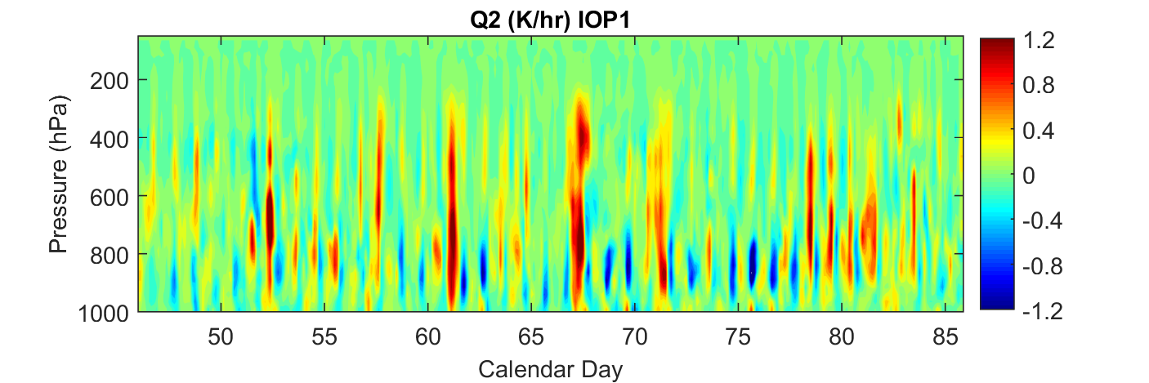
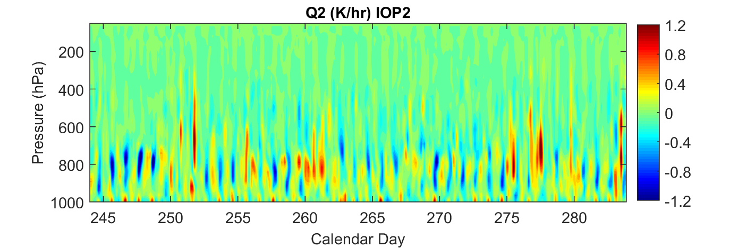
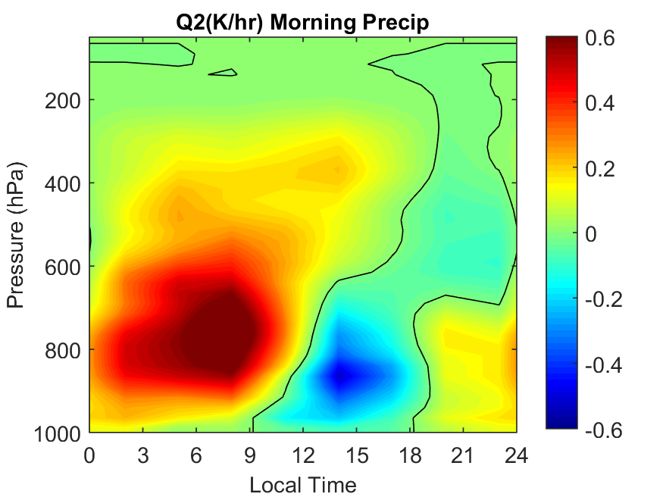
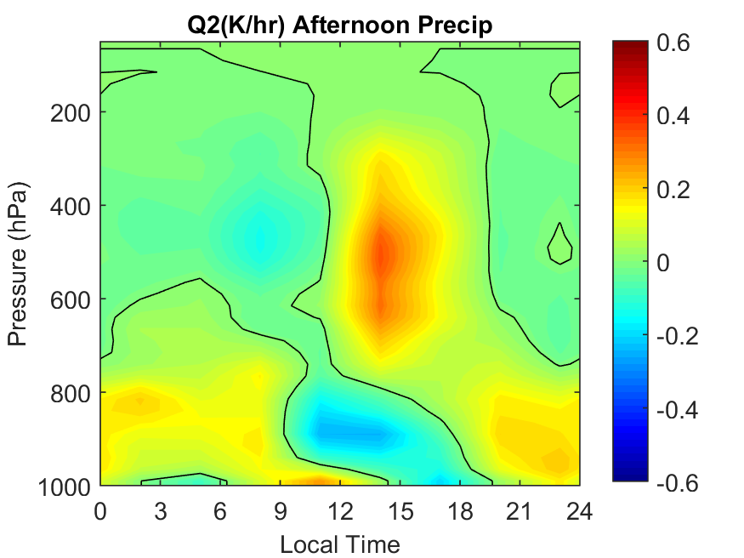
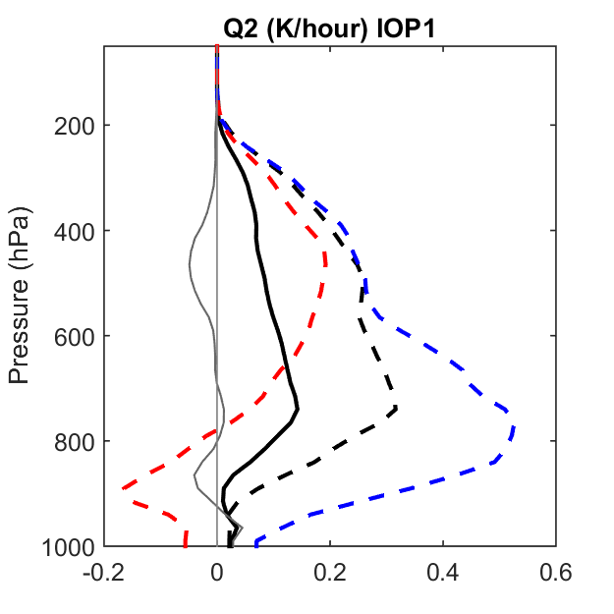
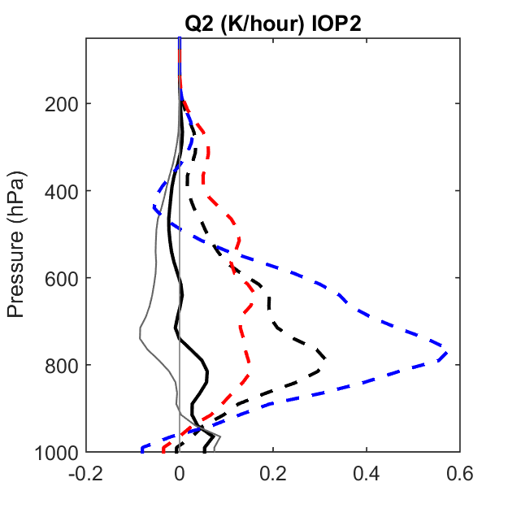


Large-Scale Structure Derived from GoAmazon2014/5 Experiment
Shuaiqi Tang¹, Shaocheng Xie¹, Yunyan Zhang¹, Minghua Zhang², Courtney Schumacher³, Hannah Upton³, Michael Jensen⁴, Karen Johnson⁴, Meng Wang⁴, Maike Ahlgrimm⁵ and Zhe Feng⁶
¹Lawrence Livermore National Laboratory; ²Stony Brook University; ³Texas A&M University; ⁴Brookhaven National Laboratory; ⁵European Centre for Medium-Range Weather Forecasts; ⁶Pacific Northwest National Laboratory
Introduction
Synoptic Conditions
Diurnal Cycle
Sensitivity to Precipitation
The GoAmazon 2014/5 experiment is conducted to understand the aerosol and cloud life cycles and aerosol-cloud-precipitation interactions in tropical rainforests.
To support simulations on cloud and precipitation processes for GoAmazon, large-scale forcing data are derived using constrained variational analysis approach.
The seasonal variation and diurnal cycle of large-scale structure are analyzed.
IOP1: Wet season
IOP2: Dry season
Days of sample
Radar .vs. TRMM 3B42
Morning Peak
Afternoon Peak
Precip
IOP1
(wet season)
Precipitation (mm/hr)
Cloud
IOP1: Wet season
IOP2: Dry season
IOPmean: 0.39 0.56
IOPmean: 0.22 0.08
RH
IOP2
(dry season)
Omega (hPa/hr)
U
Radar precip
V
Morning Precip:
rain peak between 2-11 local time
maximum rain rate > 0.4mm/hr
maximum rain rate > 1.5 × maximum rain rate out of 2-11 local time.
Afternoon Precip:
rain peak between 14-20 local time
maximum rain rate > 0.4mm/hr
maximum rain rate > 2 × maximum rain rate out of 14-20 local time.
This Criteria excludes the days with weak precipitation and days with continuous rainfall from morning to afternoon.
TRMM precip
GoAmazon Sites and Data
Deep cloud
Moist middle level
Weak mid-level zonal wind
Low-level northeasterly
High and low cloud
Dry middle level
mid-level easterly
Weak low-level meridional wind
Rainy period
No-rain period
Rainy period
No-rain period
      Intensive Operational Periods
        (wet season) 1st IOP: 15 Feb. – 26 Mar. 2014
        (dry season) 2nd IOP: 1 Sep. – 10 Oct. 2014
        Analysis domain is in 110km radius centered at Ponta Pelada airport (location of SIPAM radar).
Mean Large Scale Structure
Precip period: >0.2mm/hr
Fraction of precip time: IOP1: 42.8% IOP2: 25.6%
The large-scale forcing data is robust to uncertainty of precipitation
IOP1: Wet season
IOP2: Dry season
Summary
Omega
Morning Precip
(18 days)
Afternoon Precip
(22 days)
The large-scale forcing data are derived for the wet and dry seasons of GoAmazon 2014 experiment to support cloud and precipitation simulations.
The wet season precipitation is more extended to upper level and the dry season is more suppressed and limited at lower to middle level, except afternoon deep convections.
The morning precipitation has double peaks evolving from low-level to upper-level, indicating propagating systems. The afternoon precipitation has higher heating and drying peaks, indicating locally developed deep convections.
Although the precipitation has large uncertainties, the large-scale forcing data are robust.
GoAmazon site
Cloud
[Images © 2011 Google and TerraMetrics]
Analysis Domain
Q1
omega
Q1
        Method
        Constrained variational analysis (Zhang and Lin 1997).
        3 hours, 25mb time and vertical resolution.
        Data Used
        Precipitation from SIPAM radar
        ECMWF analysis as background and other required surface and TOA constraints.
Q2
Q2
Acknowledgement
This work is supported by the DOE Atmospheric Radiation Measurement Program. We thank ECMWF for providing the background field for this analysis. The large-scale forcing data are available at ARM Archive.
Dry season is more suppressed and limited at low-mid levels except afternoon deep convections.
The morning precip is more dominated by propagating systems. The afternoon precip is more locally developed.
This work was performed under the auspices of the U. S. Department of Energy by Lawrence Livermore National Laboratory under contract DE-AC52-07NA27344. LLNL-POST-680052

