Slide 1

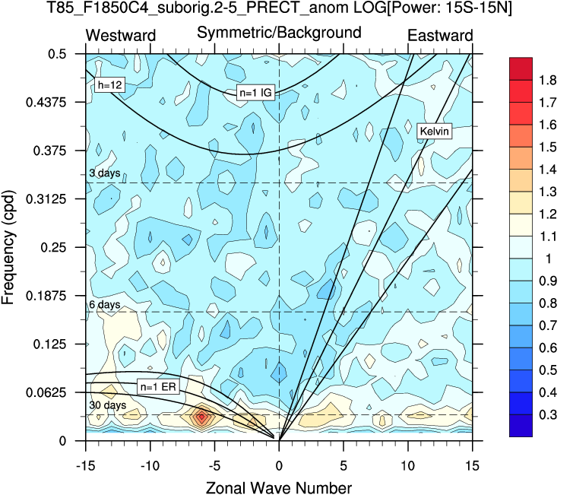
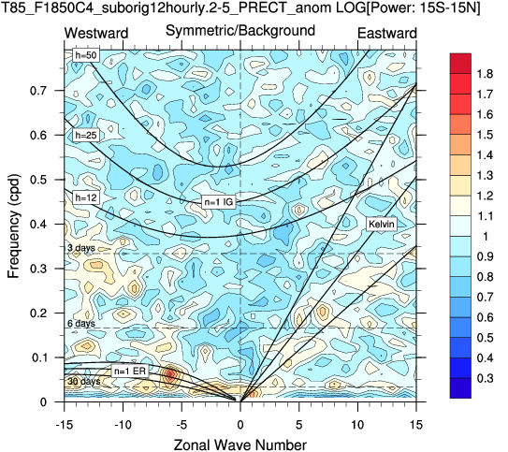
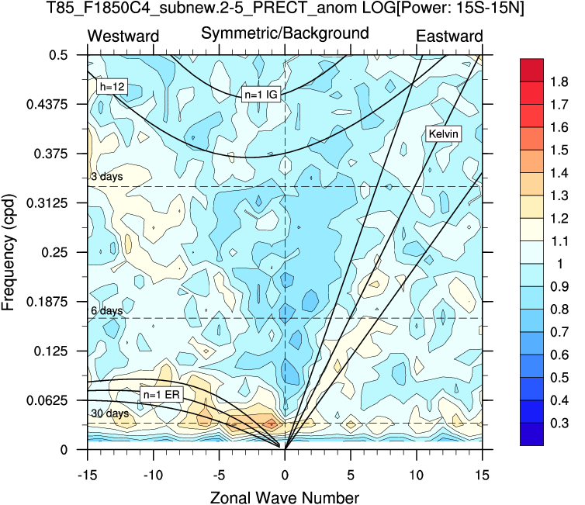
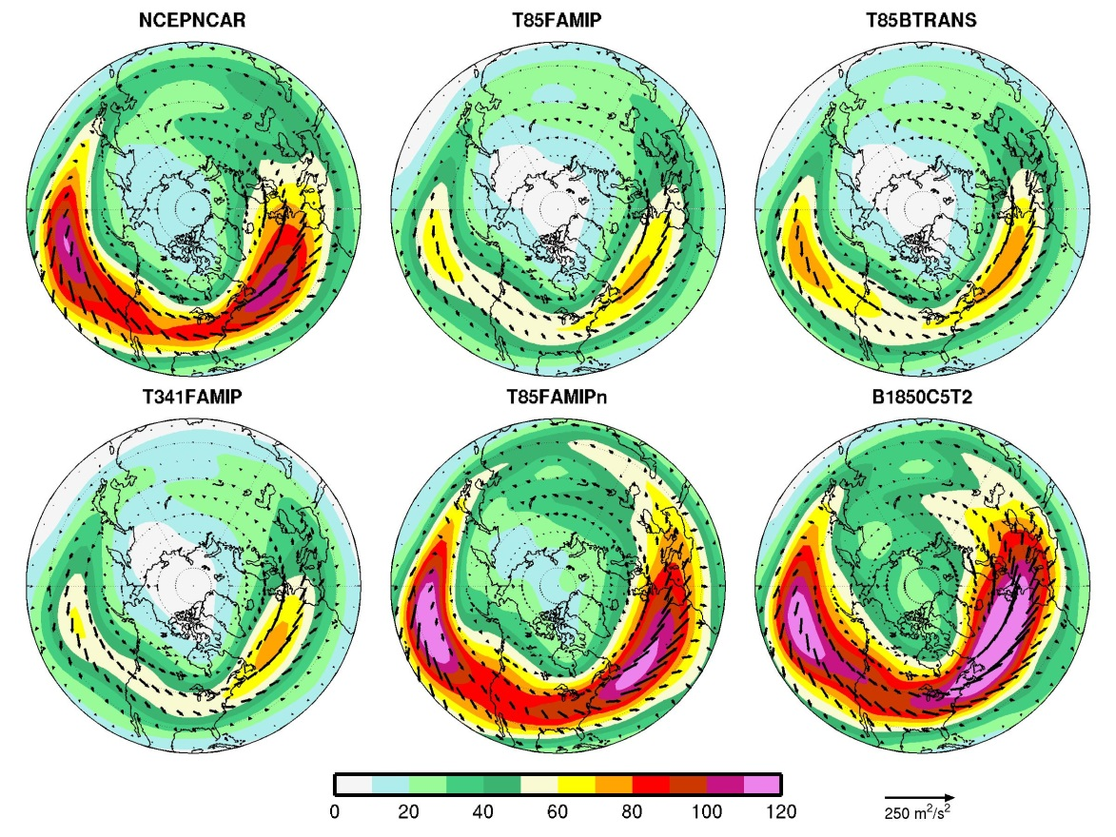
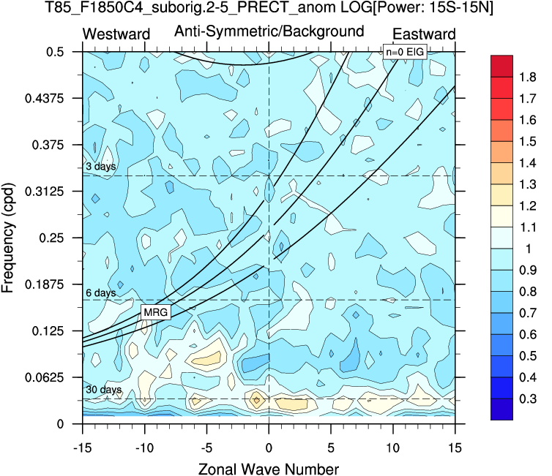
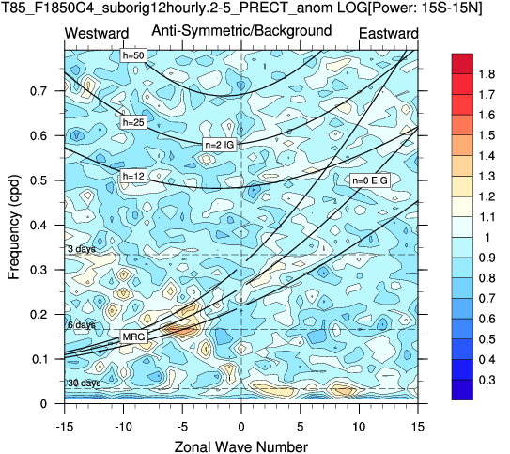
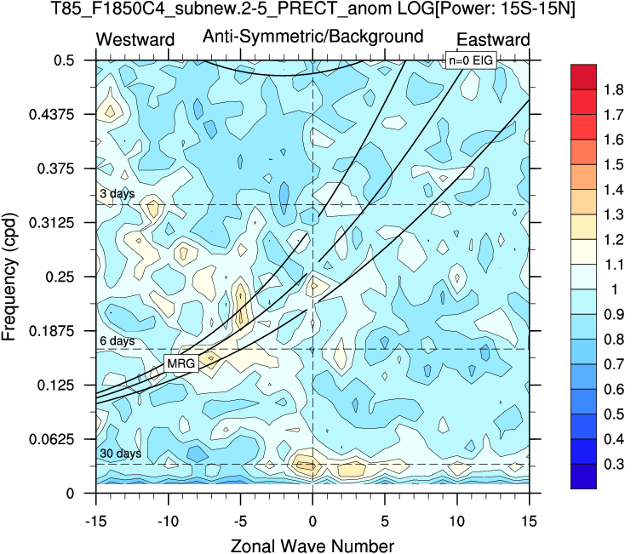
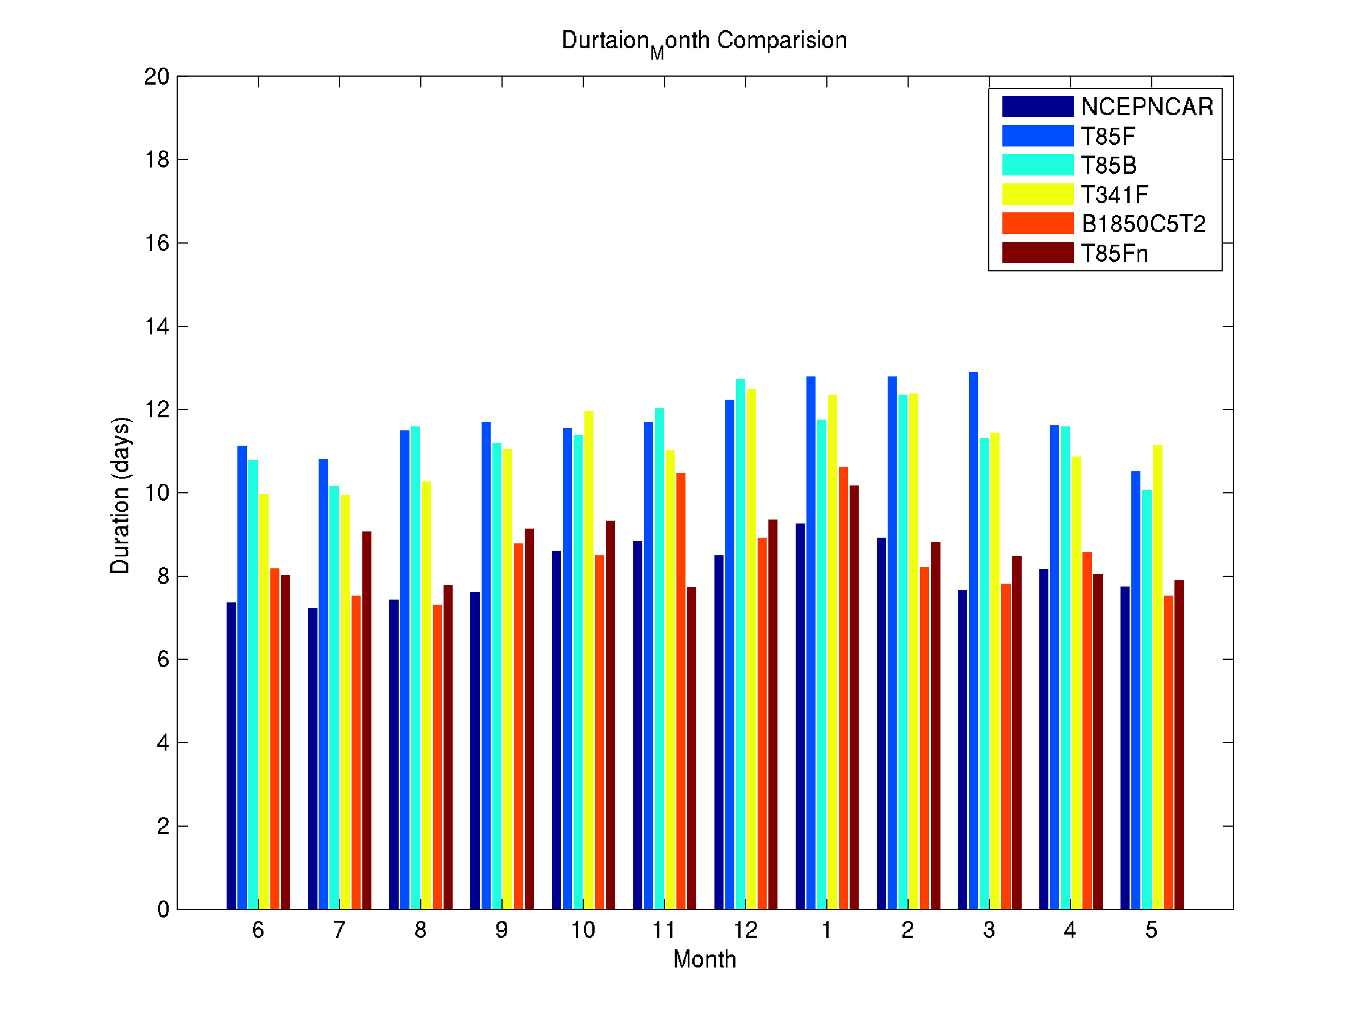
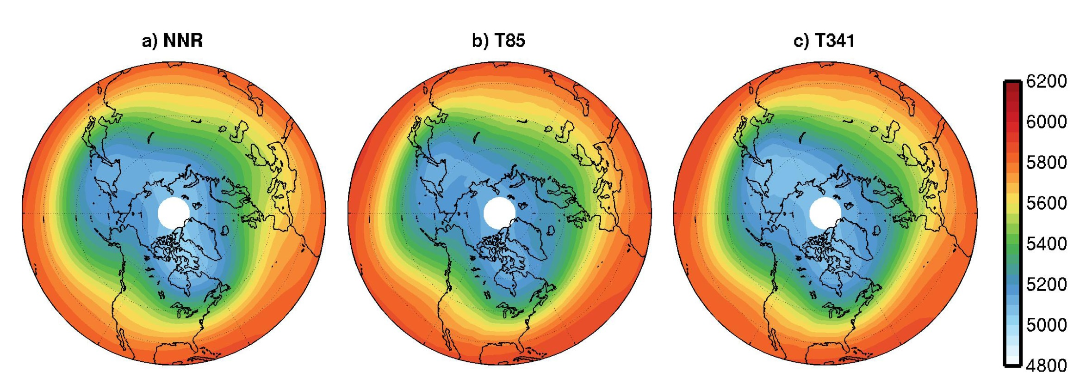
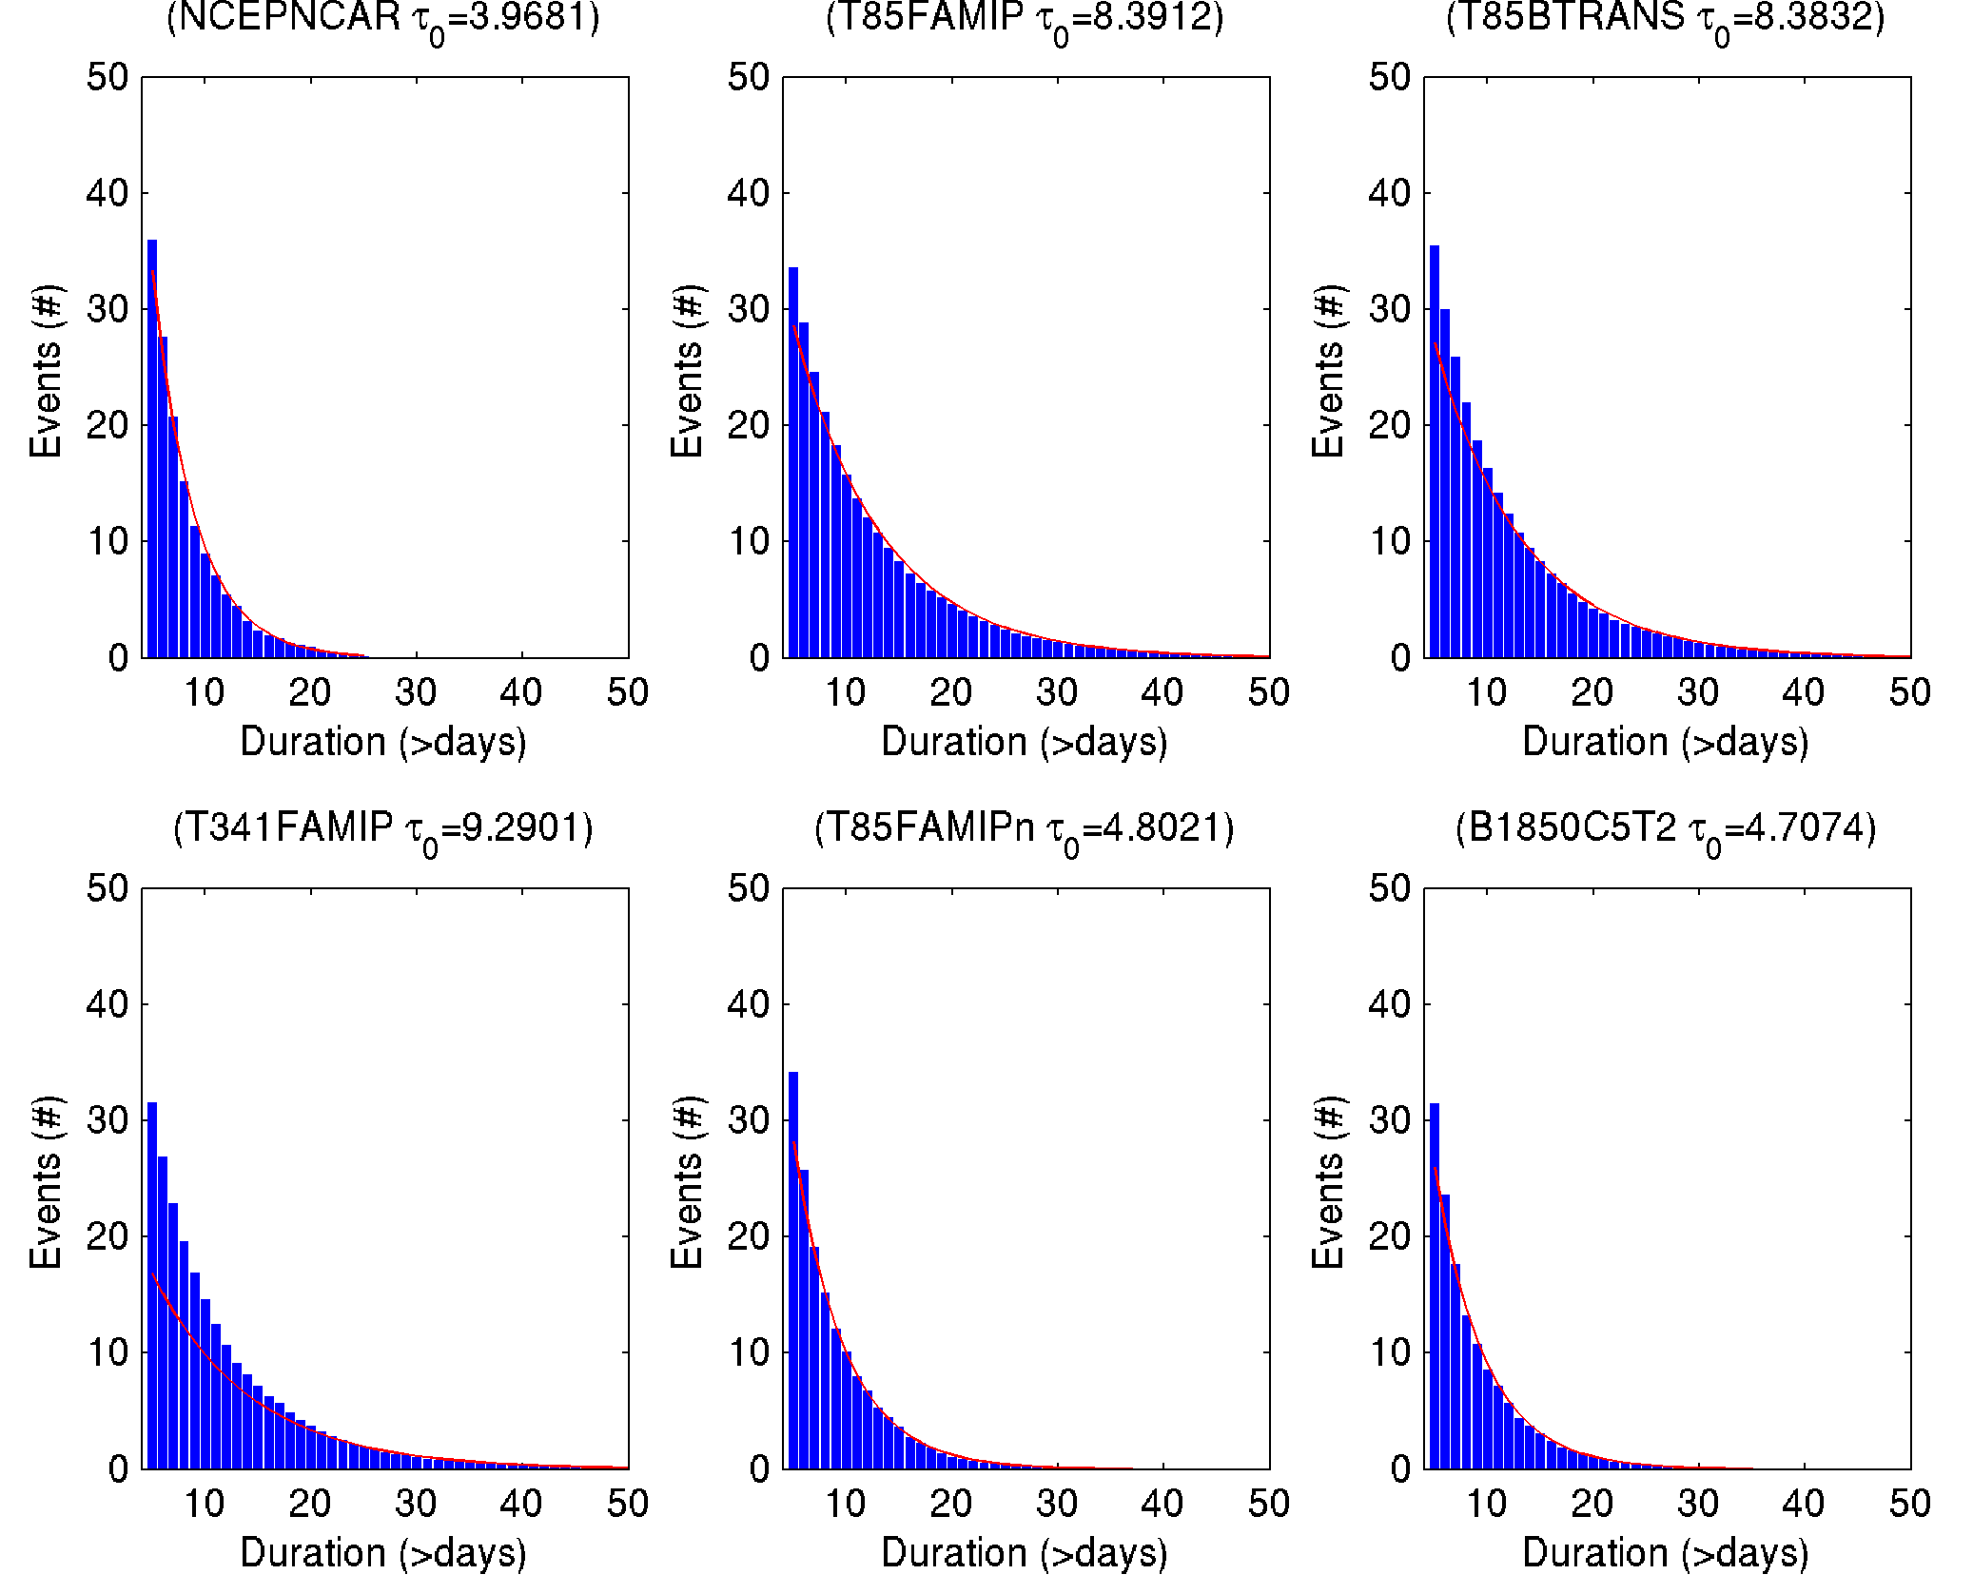
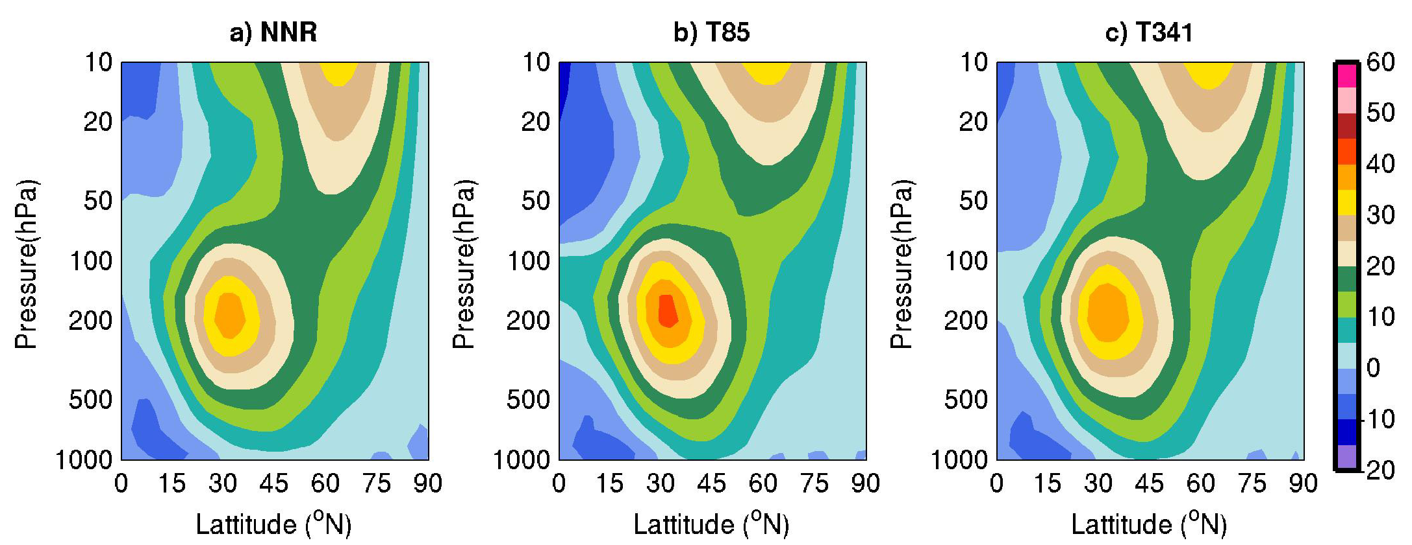

Lessons learned from the “high-res” project:
the importance of atmospheric variability and suggested improved testing
Tianyu Jiang*, Kate J. Evans, Mark Taylor, Jim Hack and Peter Caldwell
jiangt@ornl.gov
Abstract
Large multi-lab projects on climate model development involves a collaboration of technical staff with very different backgrounds and expertise. For climate science, we are interested in the accuracy of dynamics and physics in the atmosphere; however, most of the automated model validation used during model development only covers the averaged climate behavior presented in diagnostic packages.
During the post-analysis of a version of CESM output from “high-res” project, we found that the energetics and the atmospheric variability, including wave activity and some key atmospheric phenomena, did not match observations well. After an in depth examination, we found the problems to be affiliated with incorrect subcycling (time-stepping bug) of the dynamics in the atmosphere. It indicates a serious issue in the atmosphere coupler, which is responsible for the energy conversion between dynamical and physical processes. This issue, due to its nonlinearities, contaminated most of the dynamical processes in the model’s atmosphere.
We highlight this case here to emphasize that the atmospheric dynamics, and thus the associated shorter timescale variability, are the most fundamental process to the climate model. However, because these simulations are expensive, these aspects are often not not be analyzed until most of the allocation is spent for a given run. Therefore, establishing more significant and quantitative early testing of the high frequency atmospheric variability is important, especially during the developing stage of the model.
Equatorial Waves
The synoptic scale atmospheric variability
Fig. 4 Winter storm track climatology. The storm track is represented by upper troposphere EKE, computed based on 200 hPa high-pass (< 5 day) filtered u, v. unit: m²/s^{2.}
The overlaid vectors indicate the propagation of synoptic wave packet (E-vector, unit: m²/s²).
The midlatitude stormtracks in high-res runs (b, c and d) is about 2/3 of the amplitude as in the NCEPNCAR reanalysis (a).
The stormtrack is more comparable if the subcycling issue is corrected (e).
The spectral element is able to capture the mean synoptic scale variability in the B1850C5T2 version (f).
The much weaker weather scale variability is because the atmosphere flow is perturbed by the baroclinic potential energy generated through subcycling process.
Fig. 1 Wheeler-Kiladis diagram for tropical precipitation. (left) based on wrong time-stepping data; (middle) based on the wrong time-stepping data, but assume the daily output were 12 hourly; (right) based on the corrected time-stepping version.
Atmospheric blocking: the impact to an atmospheric phenomenon
The tropical dynamics don’t match the theoretical curves with the wrong subcycling (left column).
A simple temporal spectra assumption (2Δt ➔Δt, middle column) of the output data largely corrected the problem (compare to right column)
Demonstrated that the tropical dynamics is largely determined by the subcycling due to the heavily parameterized processes in this region (more linear response).
Atmospheric blocking is a large-scale quasi-stationary extratropical flow regime. It is commonly referred to as the situation when the midlatitude westerly jet and synoptic systems are interrupted by strong and persistent (lasting more than 5 days) meridional flow.
Fig. 5 Mean blocking duration for each month (unit: days). The T85F, T85B and T341F are those with subcycling issue. The T85Fn is the corrected version. The B1850c5t2 is a version of SE model.
The subcycling issue
The time integral in the climate model is computed through the leapfrog scheme as
U(t+1)=U(t-1)+2Δt F(t)
this process of stepping forward from moment to moment to mimick the dynamics and physics in the atmosphere; however, in the the spectral transformed dycore developed in HOMME, the time step 2Δt is mistakenly replaced by Δt for the physical process, therefore all the associated subcycling (include various diabatic processes and energy conversion) in the atmosphere is inaccurate in the model.
Because the coupling between the atmosphere flow and the subcycling is the most fundamental mechanism for the dynamical process and atmospheric phenomena, the time stepping issue has a serious impact on the atmospheric variability.
Extratropical mean circulation
The blocking duration is much higher under the inaccurate subcycling.
The characteristic timescale τ₀ is about doubled in T85F, T85B and T341F runs.
The characteristic timescale indicates the typical spindown timescale of the blocking through diabatic decay.
Because the wrong time-stepping in the model, the diabatic cooling rate is only about half of it should be. So the lifespan of blocking phenomenon is unrealistically long.
Fig. 2 Winter climatology of Northern Hemisphere 500 hPa height (The difference among the three plot is less than 3%). Unit: meter
Data and model
The model output used here to illustrate the issue is from the “high-res project”.
The model employs a spectral transformed dycore, and completed 3 types of experiment: T85FAMIP, T85BTRANS and T341FAMIP.
The reference data used here is from NCEP-NCAR reanalysis.
All the following analysis are performed on daily or sub-daily (6-hourly) time spectra.
Fig. 6 Histogram of mean total number of blocking events in the Northern Hemisphere lasting at least a given number of days (blue bins). The red curves indicate the exponential fit of the distribution. τ₀ is the characteristic timescale.
Summary
The subcycling issue contaminates the dynamical processes in most of the high-res runs, but this influence is difficult to be detected in the mean circulation.
The ACME model is free from this problem, at least in B1850C5T2 version.
It is suggested that the testing of high-frequency atmosphere variability and transient eddies need to included in model validation, especially because we are plugging in more and more component and schemes into the model.
General features of NH blocking:
Fig. 3 Vertical structure of Northern Hemisphere zonal wind (The difference is less than 10%). Unit: m/s
This work is funded through the U.S. Dept. of Energy Office of Biological and Environmental Research (BER) projects “Ultra High Resolution Global Climate Simulation to Explore and Quantify Predictive Skill for Climate Means, Variability and Extremes” and “Accelerated Climate Modeling for Energy”

