Slide 1
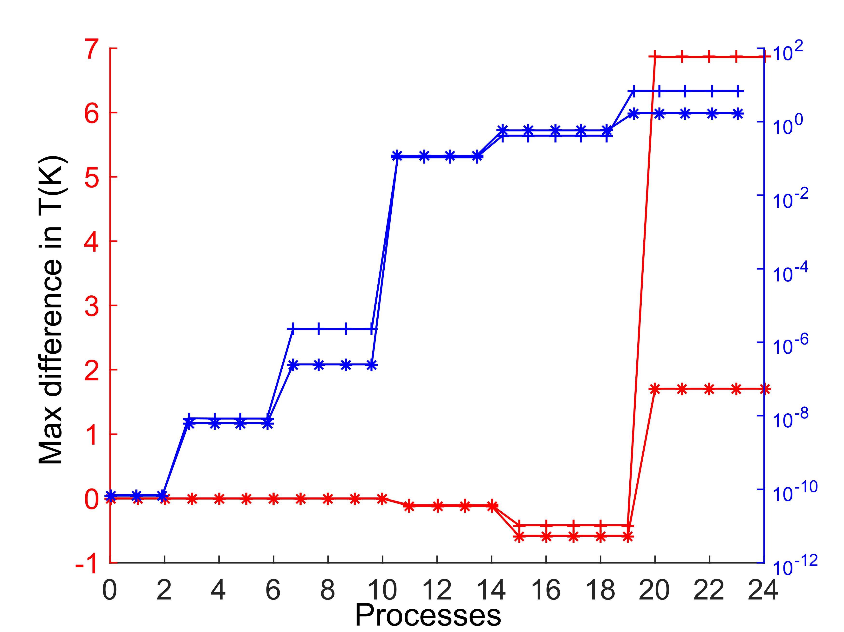
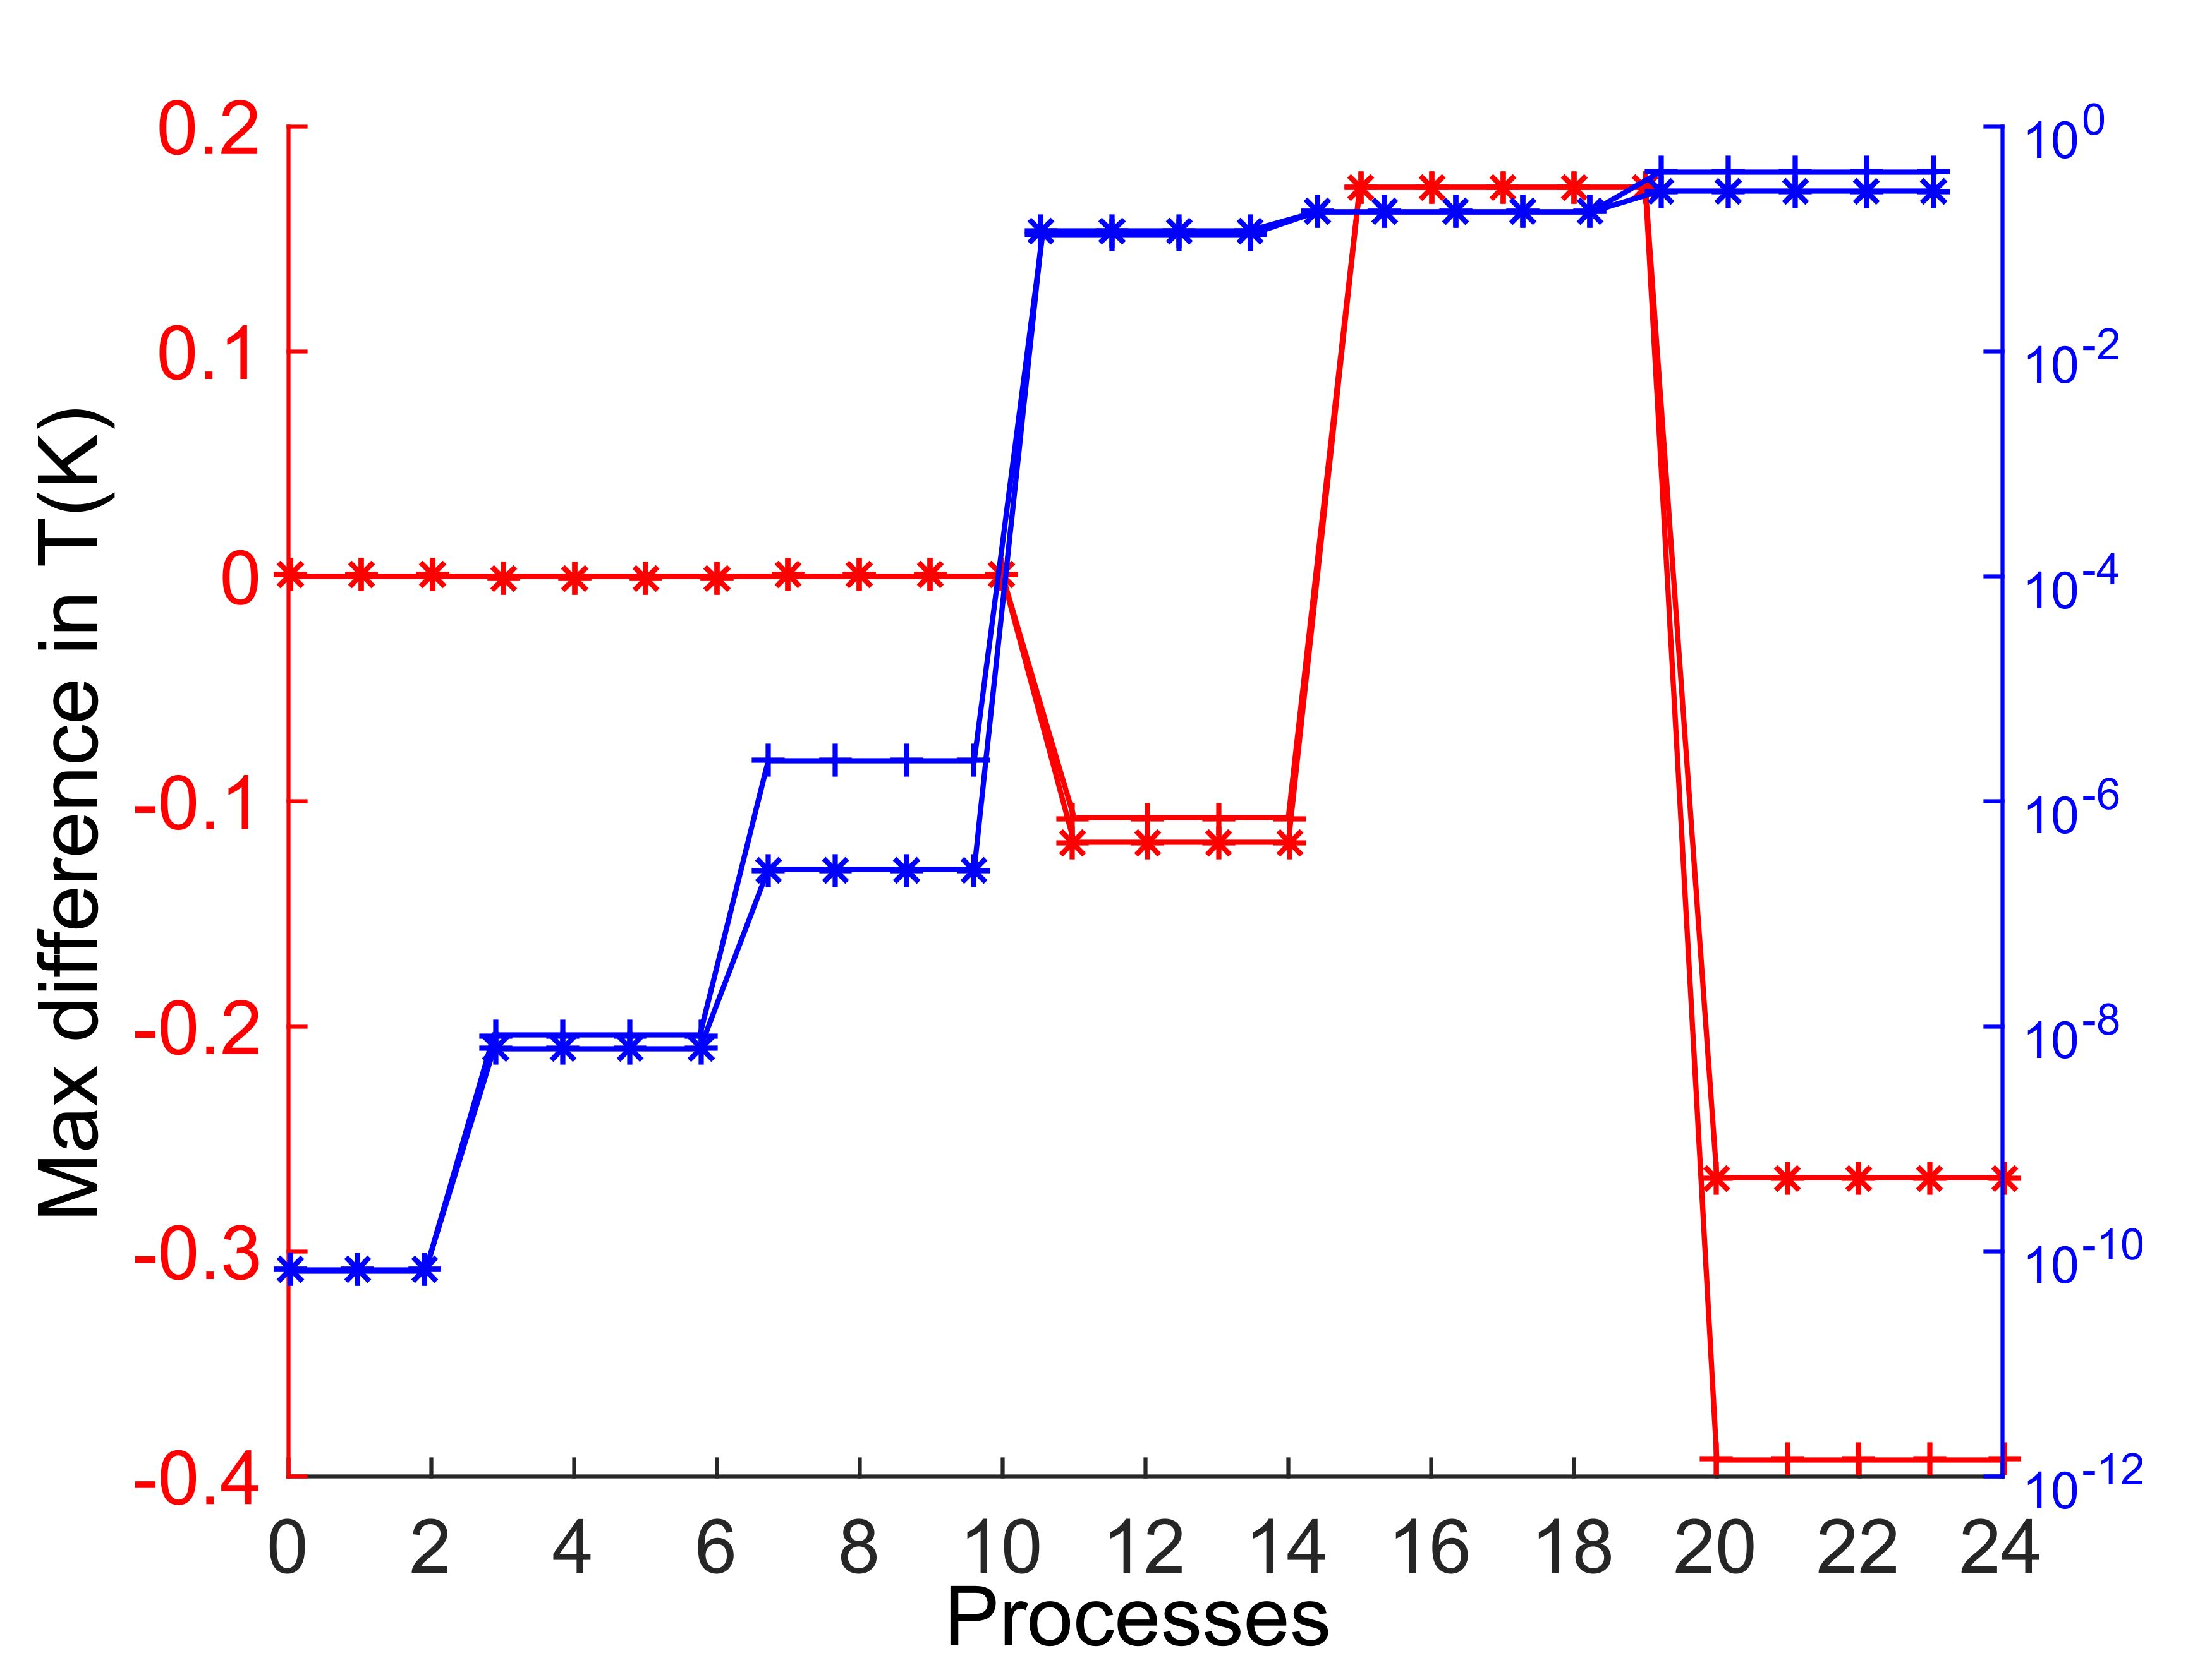
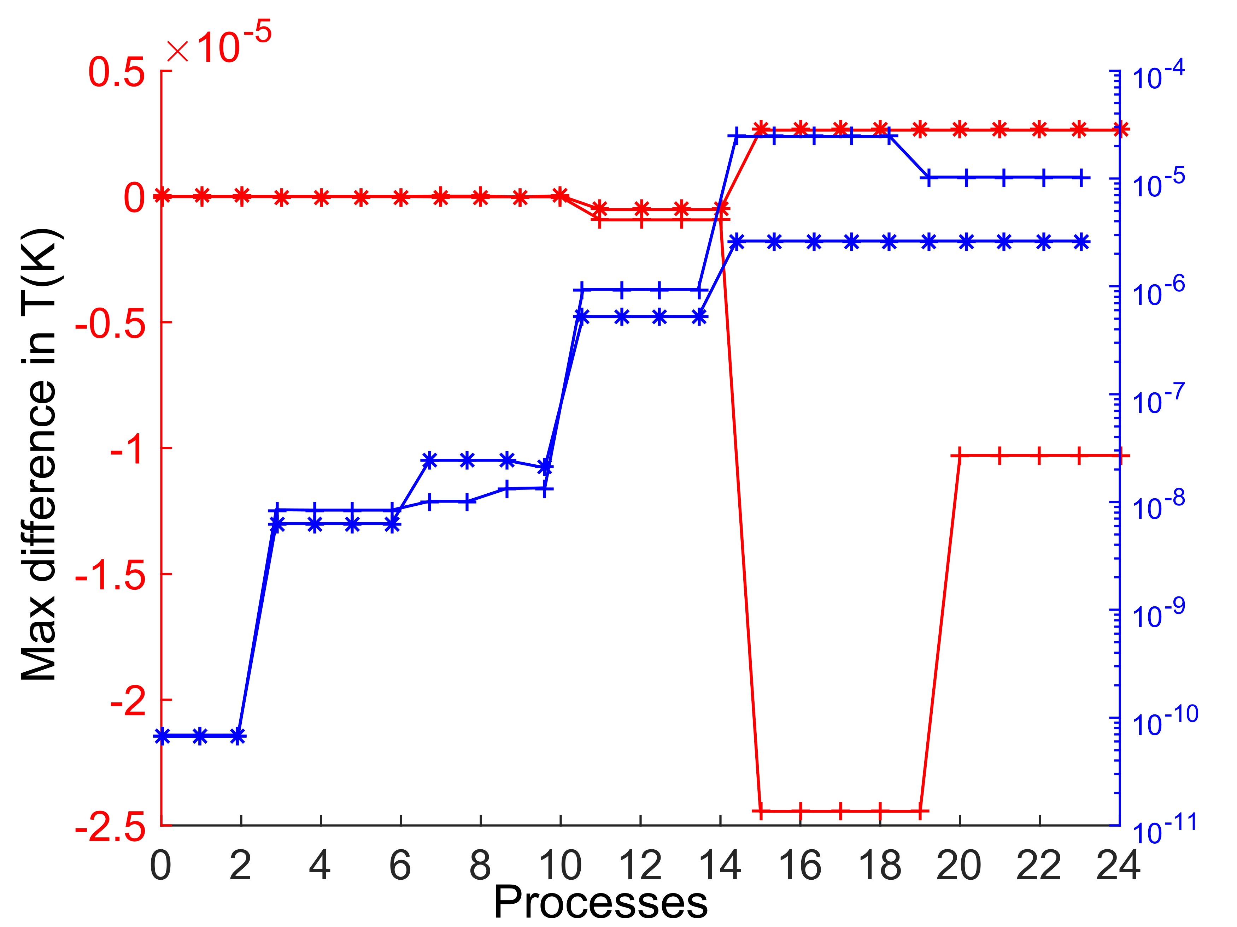
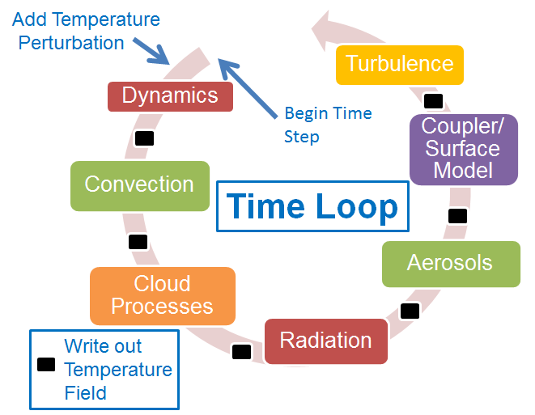
A First look at a new method to detect
problems in ACME atmosphere code
Balwinder Singh, Phil Rasch, Hui Wan, Jin-Ho Yoon, Po-Lun Ma
Exploring a new paradigm for model testing
Default simulation
Radiation discontinuity removed
Introduction:
It can be difficult to detect problems in a source code which does not exhibit any runtime (or
compile time) failure and its log files do not contain a discernable error message. Often times,
a thorough analysis is required to detect such problems. In the past, problems were encountered
where a new compiler or a particular version of an existing compiler caused the model to
produce erroneous results. In all such instances, the model
exhibited no compile time or runtime errors. Our objective is
to formulate a methodology to quickly detect such problems
in complex source codes like ACME.
Proposed solution:
Currently there is no testing infrastructure in place to quickly
detect problems in the model behavior when the model is
exposed to a new environment (new hardware, operating system, compilers and libraries). The
worked presented in this poster explores a new paradigm (based on the works of Rosinski and
Williamson (1997)) for examining the model solutions that Exposes potential problems in the
code by searching for solution “discontinuities” when they are not necessarily expected.
Microphysics
Radiation
Benchmark Simulation
Turbulence
Error in max temperature is reduced from ~7K to ~5x10⁻⁶ K after removing solution discontinuities
Approach: Detecting solution discontinuities
Key Benefits
Run 3 single time step simulations: default model, model with a small positive perturbation
to the temperature field and model with a small negative perturbation to the temperature field
Write out the temperature field after every process (e.g. microphysics, convection,
turbulence etc.) which updates the temperature field
Plot the maximum temperature after each process to see where the temperature field
started to diverge. This indicates a discontinuity in solution
Repeat these single time step experiments with a
number of different initial conditions such that the
codes are run under millions of different, but
physically possible, conditions
Remove the solution discontinuities by revising the
codes, if possible.
This process will lead us to a benchmark simulation
by removing all possible solution discontinuities.
Testing: run the model in a new environment and
compare the solution divergence against the
benchmark simulation
Capable to revealing solution discontinuities in a complex and non-linear model
An efficient and inexpensive way to identify problems in the model even in the
absence of any runtime or compile time error
Capable of detecting issues with the model when exposed to a new environment (hardware,
compilers, operating systems, libraries)
Ensemble runs facilitates testing of a large fraction of code under physically possible test
conditions
Limitations and Next steps:
Not able to detect numerical instabilities beyond first time step
Currently only monitoring divergence in temperature field. Other state fields will be
monitored in the future versions
Currently only sampling for 12 initial condition files (for each month of a year). Ensemble space
will be augmented to include each day of a year
References:
Rosinski, J. M., and D. L. Williamson, The accumulation of rounding errors and port validation for
global atmospheric models, SIAM J. SCI. COMPUT. 18(2), pp. 552-564, 1997.
climatemodeling.science.energy.gov/acme
For additional information, contact:
Balwinder Singh
Scientist
Pacific Northwest National Laboratory
(509) 375-6595
Balwinder.Singh@pnnl.gov

